Slide 1
GIS
B Holland 2016
GIS Data representation

Slide 2
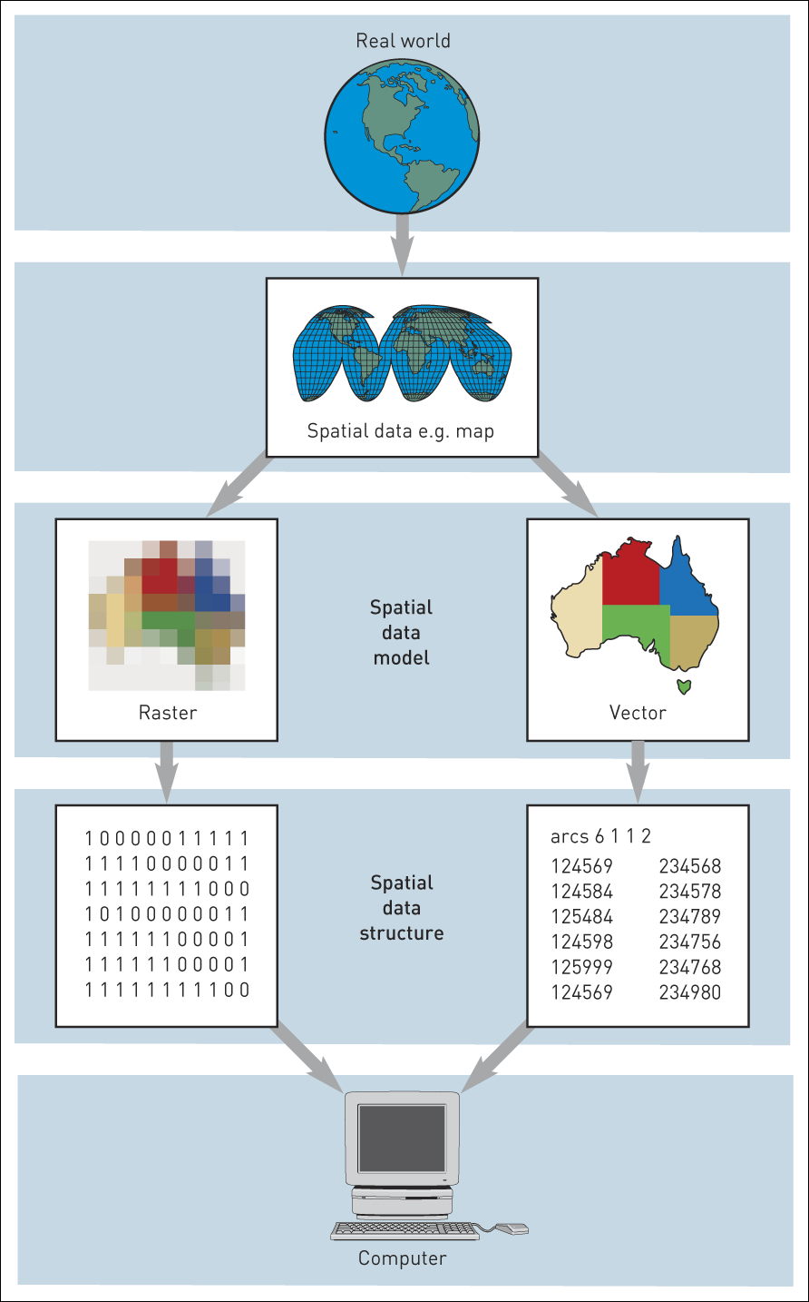
Stages involved in constructing a GIS data model
At each stage of the model building process the physical element represented on the map become more of an abstract of reality

Slide 3
Modes or dimensions
Temporal – dates Jan 15 2021
Thematic – Flood damage
Spatial - near Craig Y Nos visitor car park
Thus temporal dimensions indicate time, thematic indicates the characteristics of the real world feature and spatial gives it a location.

Slide 4
Classifying Spatial Data – Entity Definition
Geographic theory employs the subdivision of spatial data into one of four object classes
  Points, Lines, Areas, Surfaces
  Vector Data structures - Use is made of the two-dimentional Cartesian (x,y) co-ordinate system to store shapes as spatial entities.
  The following Diagram gives examples

Slide 5
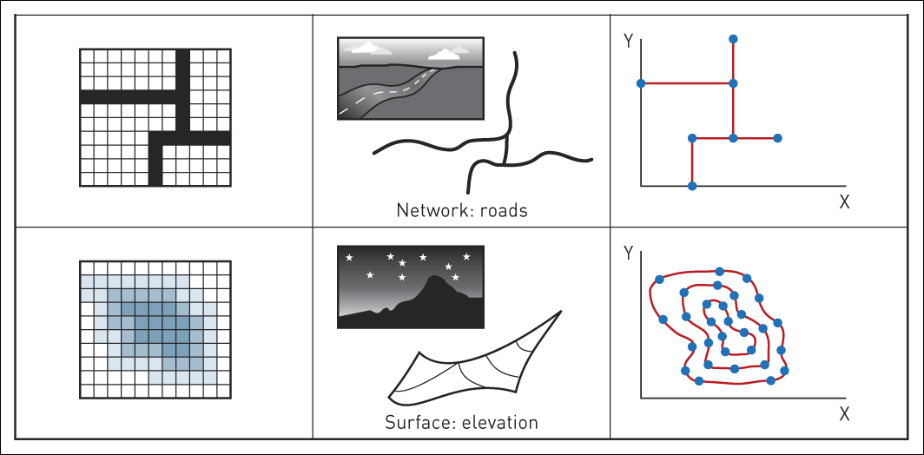
Raster and vector spatial data (Continued)

Slide 6
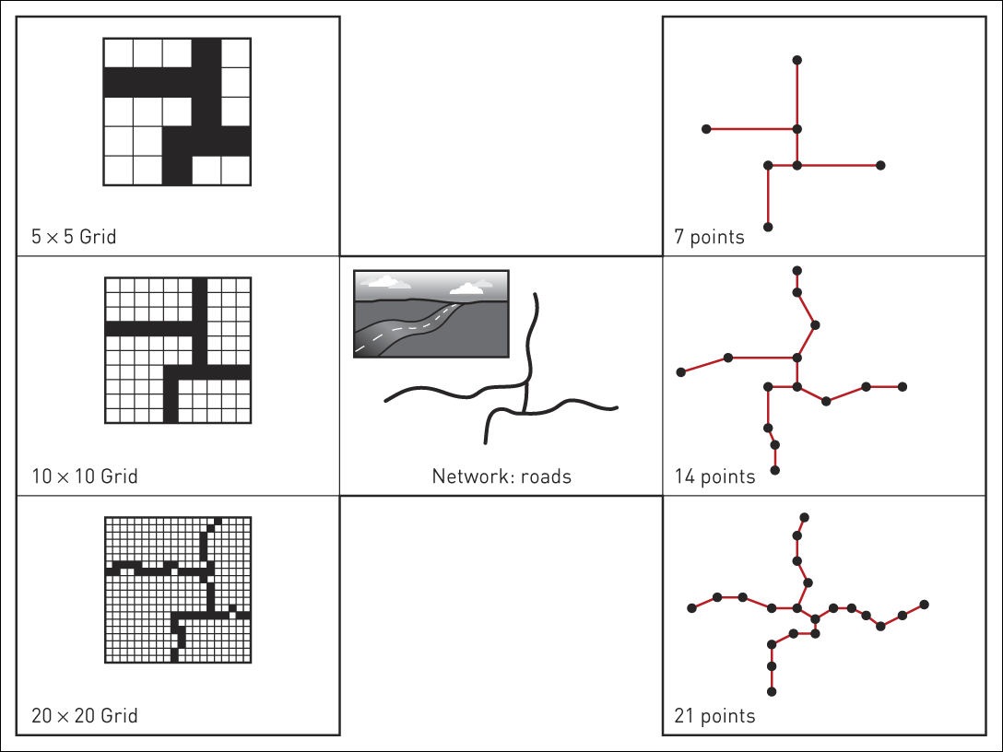
Effect of changing resolution in the raster (left) and vector worlds (right)

Slide 7
Raster data structures
The following slide provides an example of a raster data representation
Basically we us the principle of pixels on a computer screen – each pixel will have a grid reference. Each reference will have one or more values attached to it.
In a simple raster structure different spatial features must be stored as separate data layers.
To store images in raster format sometimes causes impact on the storage and retrieval of eth GIS map information.
Because vector storage only need to retain the point values and then use is made of various algorithms the memory requirement are less.

Slide 8
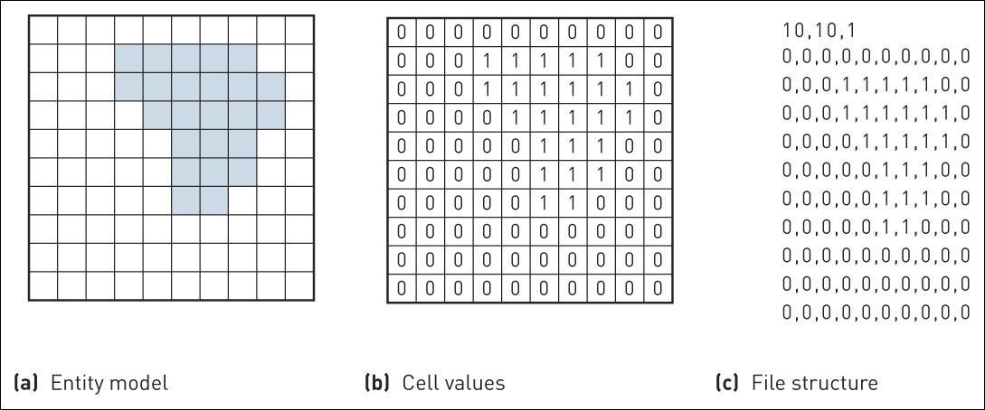
A simple raster data structure

Slide 9
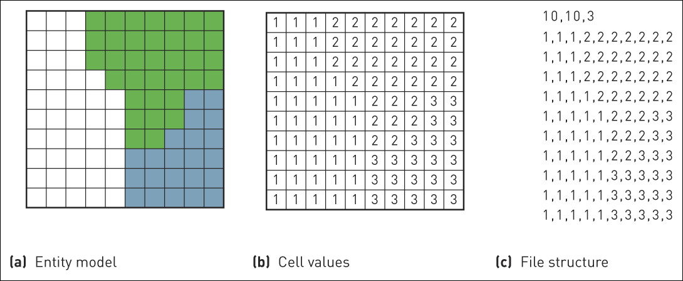
Feature coding of cells in the raster world

Slide 10
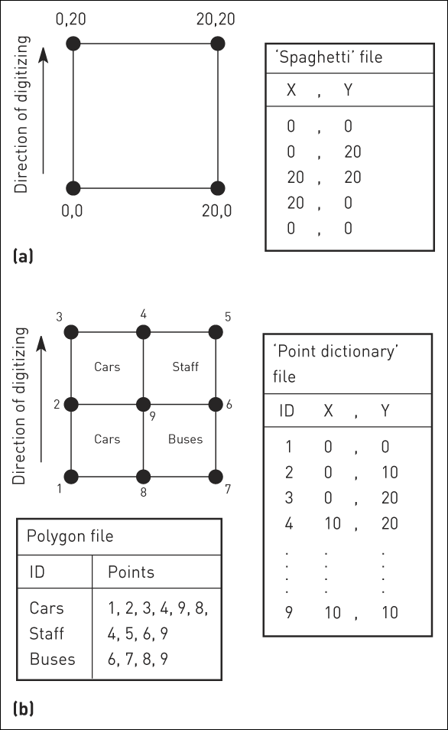
Data structures in the vector world: (a) simple data structure;
(b) point dictionary

Slide 11
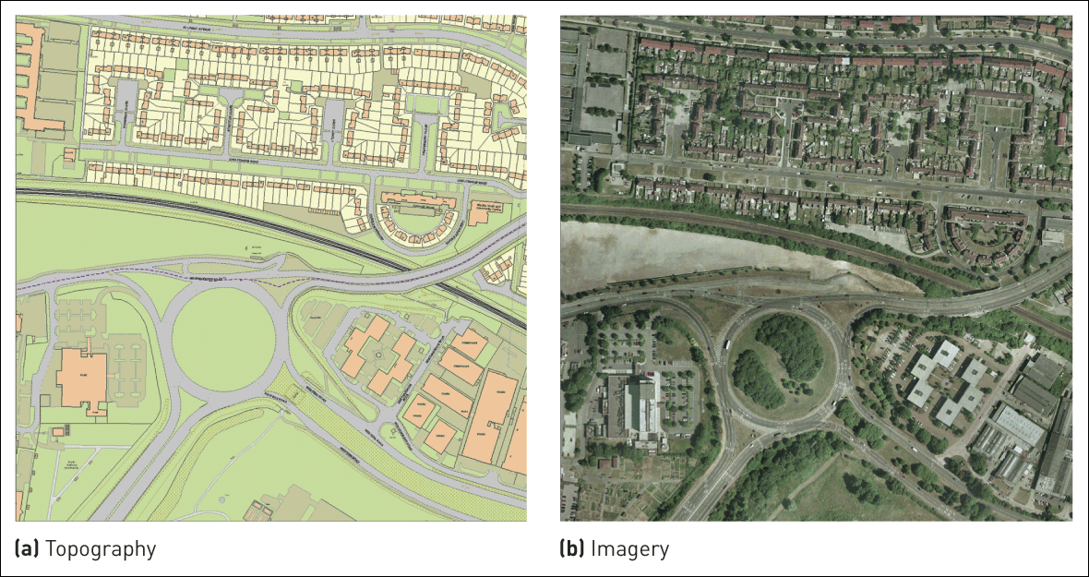
Ordnance Survey MasterMap
Source: Reproduced by permission of Ordnance Survey on behalf of HMSO. © Crown Copyright 2006. All rights reserved. Ordnance Survey Licence number 100030901

Slide 12
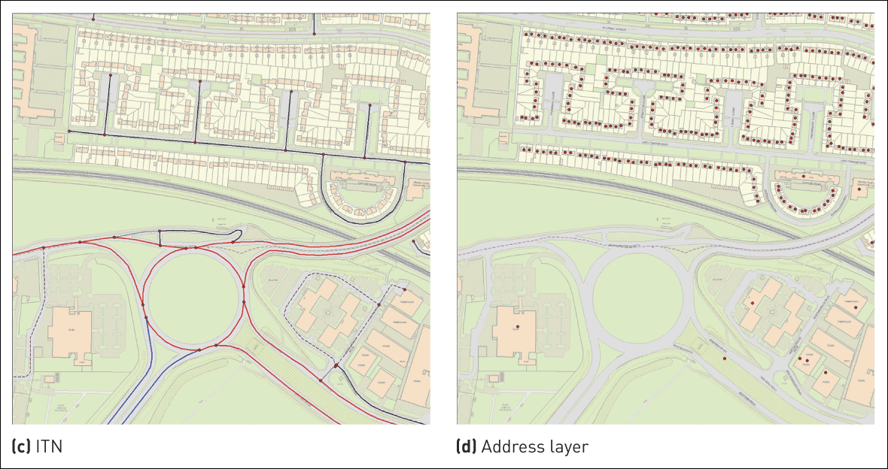
Ordnance Survey MasterMap (Continued)
Source: Reproduced by permission of Ordnance Survey on behalf of HMSO. © Crown Copyright 2006. All rights reserved. Ordnance Survey Licence number 100030901

Slide 13
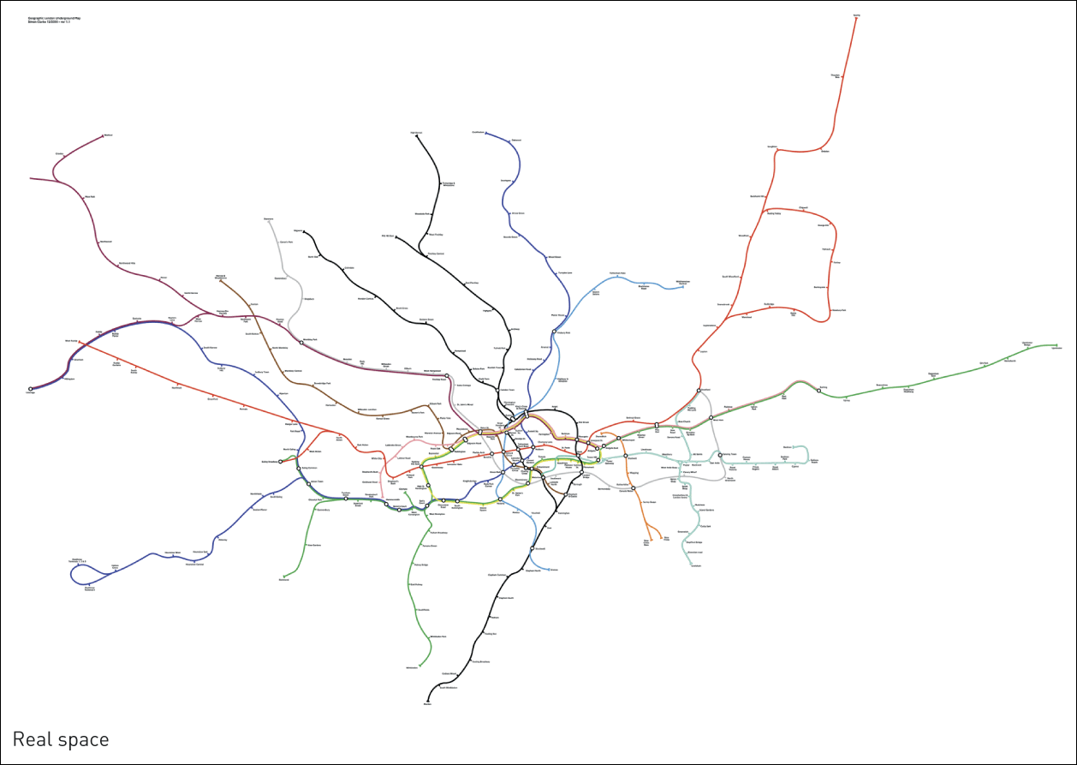
A representation of the London Underground network
Source: From SimonClark.org, © Simon Clark 2000, with permission

Slide 14
2D
The above slides indicate how we store information in 2 dimensions to represent geographical reality.
This can be done in raster or vector format.
The GIS software is able to distinguish between the data types.

Slide 15
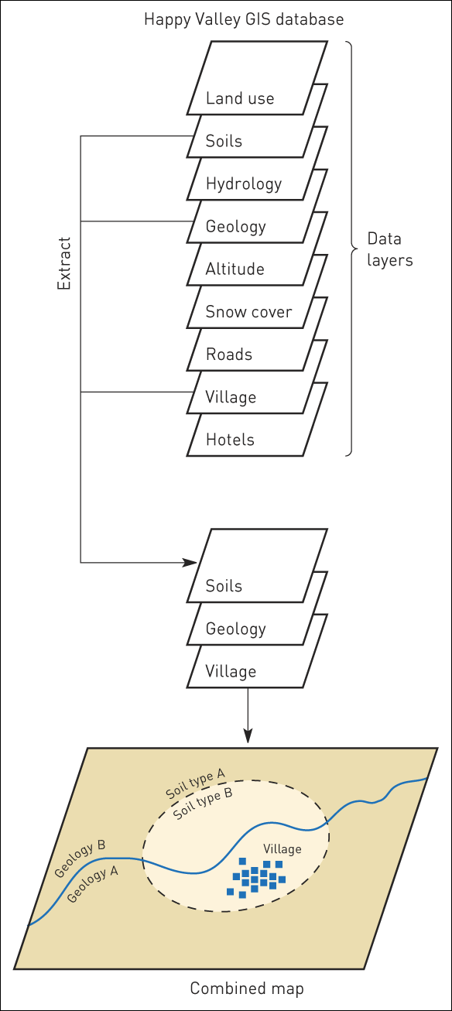
The layer-based approach

Slide 16
source
Hywood, Cornelius and Carver, An Introduction to Geographical Information Systems, 3rd Edition © Pearson Education Limited

Slide 17
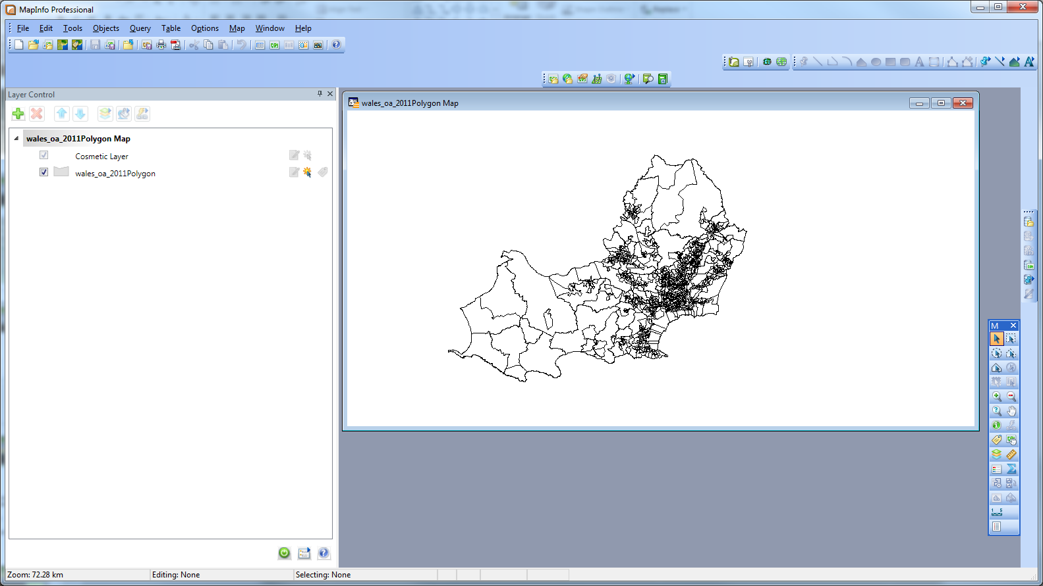
Data from UK Borders and outline or Swansea using Wales output area

Slide 18
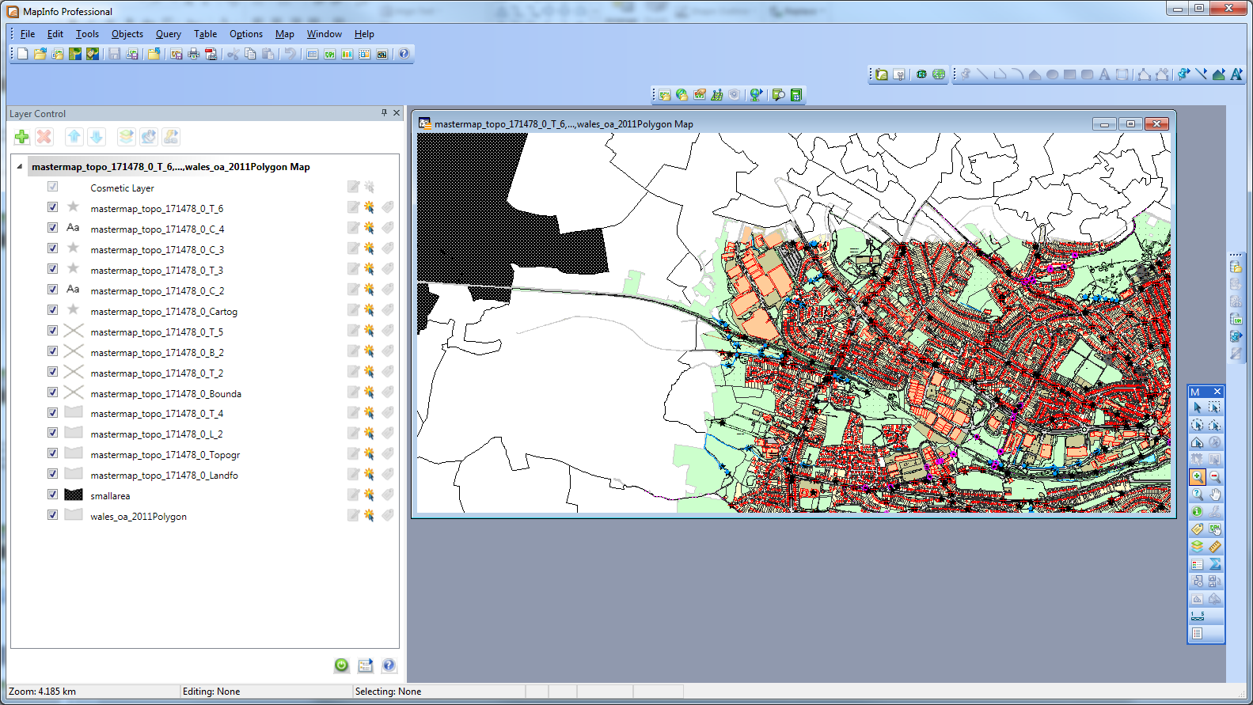
Master Map Data of Swansea

Slide 19
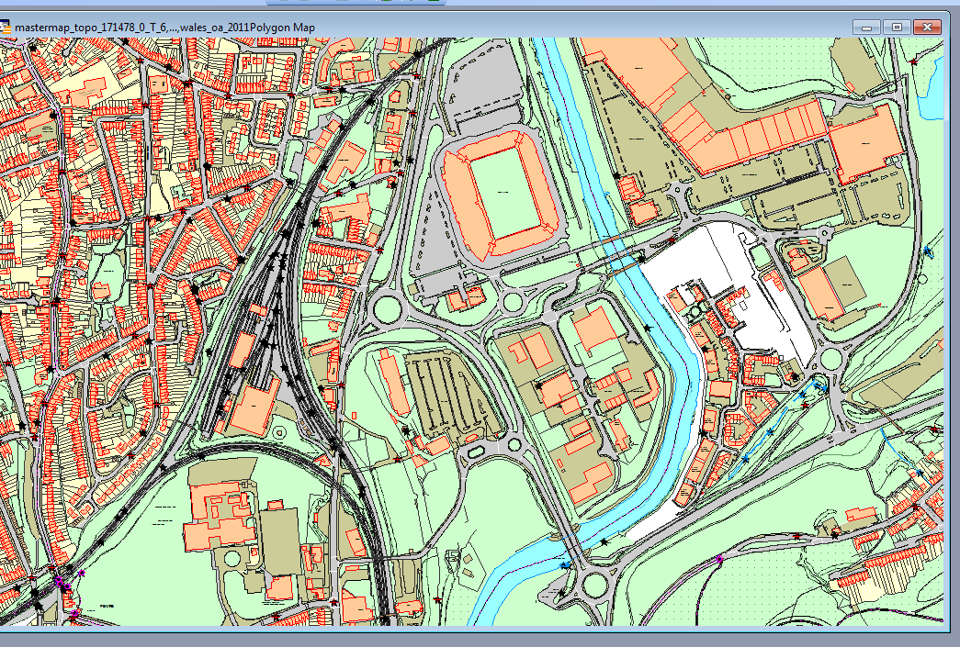
Zoomed in detailed view

