Slide 1

Advancing to the Doctoral Research Stage (LCDB 7012)
Week 2 - Paradigm, Methodology and methods
Dr. Helen Lee

Slide 2
Class schedule
1. Concept
2. Activity and sharing
3. Assignment brief
4. Activity
5. Q&A

Slide 3
Agenda
Paradigm, Methodology and methods
Activity(ies) 1-3
Epistemological positions and methodology in business research

Slide 4

Please note
This presentation will introduce you to some aspects of research methods – but it is NOT intended to replace key reading, such as Bryman, Crotty, Creswell, Maxwell, Denscombe, Denzin, Guba and Lincoln and Cohen.
SAUNDERS SHOULD NOT BE USED IN MY MODULES.
You must read key texts and beyond at doctoral level that cover the method and for this you may have to go beyond your modules reading list.
Again some slides will not be focused on and you are expected at this doctoral level to be motivated, engaged and understand the areas you need to explore.
Notes:
For him is Paradise packed with bounties, pleasure and delight and spiritual sustenance and comforts

Slide 5
Paradigm, Methodology And Methods
What is (Research) Paradigm ?

Slide 6

Paradigm, Methodology And Methods
A paradigm is a way of describing a world view that is informed by philosophical assumptions about;
The nature of social reality (known as ontology – that is, what do we believe about the nature of reality?)
Ways of knowing (known as epistemology – that is, how do we know what we know?)
And ethics and value systems (known as axiology – that is, what do we believe is true?) (Patton, 2002)
See Figure 1

Slide 7
Paradigms

Slide 8
Paradigm, Methodology And Methods
Philosophical belief such as epistemology
Ontology relates to whether we believe there is one verifiable reality or whether there exist multiple, socially constructed realities (Patton, 2002).
Epistemology inquires into the nature of knowledge and truth. It asks the following questions:
What are the sources of knowledge?
How reliable are these sources?
What can one know?
How does one know if something is true?

Slide 9

Paradigm, Methodology And Methods
What is Methodology ?

Slide 10
Paradigm, Methodology And Methods
Methodology
The methodology summarizes the research process, that is, how the research will proceed.

Slide 11
Paradigm, Methodology And Methods
Deciding on a methodology starts with a choice of the research paradigm that informs the study.
The methodological process, therefore, is guided by philosophical beliefs about the nature of reality, knowledge, and values and by the theoretical framework that informs comprehension, interpretation, choice of literature and research practice on a given topic of study (see Figure 2).

Slide 12
Paradigm, Methodology And Methods
Methodology is where assumptions about the nature of reality and knowledge, values, and theory and practice on a given topic come together.
Methods are the means used for gathering data and are an important part of the methodology.

Slide 13
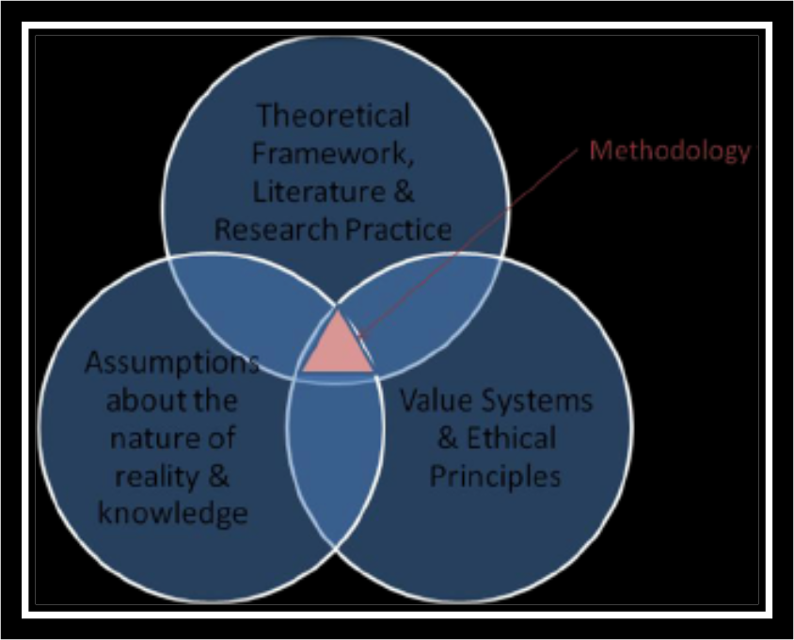
Paradigm, Methodology And Methods
Methodology

Slide 14
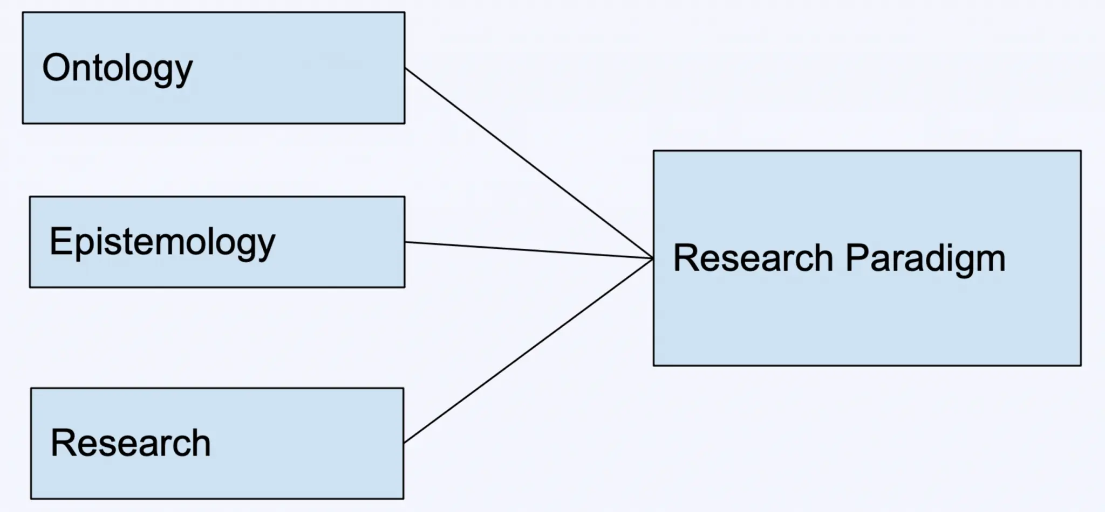
Paradigm, Methodology And Methods

Slide 15

Paradigm, Methodology And Methods

Slide 16

Paradigm, Methodology And Methods

Slide 17
Paradigm, Methodology And Methods
● Ontology answers the question: “What is reality?” That is, does a single reality exist within your research?
Example : Does Wind exist?” There are two possible realities (or ontologies) in response to this question: “Yes, Wind exists,” or “No, Wind does not exist.”
In business Context : ?

Slide 18
Paradigm, Methodology And Methods
Epistemology is the study of knowledge. It answers the question: “How is it possible to know reality?” Epistemology incorporates the validity, parameters, and methods of acquiring knowledge. An example of an epistemological question would be: “How is it possible to know whether wind exists or not?”
In business Context : ?

Slide 19
Paradigm, Methodology And Methods
Research Methodology answers the question: “How do we go about discovering the answer or reality?” This includes the process of data collection and analysis. Research methodology should outline how you conduct your research and demonstrate that the findings are valid.

Slide 20

Paradigm, Methodology And Methods
Example : A positivistic paradigm typically assumes a quantitative methodology

Slide 21
Paradigm, Methodology And Methods
Positivist Paradigm First proposed by a French philosopher, Auguste Comte (1798 – 1857), the Positivist paradigm defines a worldview to research, which is grounded in what is known in research methods as the scientific method of investigation.
Comte (1856) postulated that experimentation, observation and reason based on experience ought to be the basis for understanding human behaviour, and therefore, the only legitimate means of extending knowledge and human understanding.

Slide 22
Paradigm, Methodology And Methods
Example 2: The Interpretivist Paradigm/Constructivist Paradigm
Interpretivist paradigm is to understand the subjective world of human experience (Guba & Lincoln, 1989)
Emphasis is placed on understanding the individual and their interpretation of the world around them.
The belief that realities are multiple and socially constructed

Slide 23

Activity 1
Please provide ONE example in business research that explains the relationship between Paradigm, Methodology And Methods
E.g. Ontology, Epistemology

Slide 24

Activity 2 - Writing Task
1. Research Paradigm Analysis Exercise
- Take a business phenomenon you're interested in (e.g., leadership, innovation, change)
- Write one research question for each epistemological position
- For each question, outline:
What data you would collect
How you would collect it
What knowledge you expect to gain
- Compare and reflect on how each position changes your approach

Slide 25
Activity 2 – Recommended reading
"The importance of being earnest: The relationship between research paradigms and philosophical assumptions in business research methodologies" by Morgan, G., & Smircich, L. (1980) from Academy of Management Review, 5(4), 491-500 https://www.jstor.org/stable/257453

Slide 26
Paradigm, Methodology And Methods
Research Paradigm | Epistemological Position | Methodology | Research Design Focus | Quality Criteria | Key Characteristics
Positivism
Interpretivism
Social Constructionism
Critical Realism
Pragmatism

Slide 27
Paradigm, Methodology And Methods
Example : A positivistic paradigm typically assumes a quantitative methodology
Research Question :
Data Collection Methods :
Quality Criteria :

Slide 28
Paradigm, Methodology And Methods
Table - Methods and Data Collection by Epistemological Position
Epistemological Position | Primary Methods | Data Types | Analysis Approach
Objectivism
Subjectivism
Constructionism
Modified Objectivism
Pragmatism

Slide 29
Activity 3 - Vignettes, Approaches, Interpretivism and Constructivism
Week 2_3 – Exercise on Handout Vignettes, Approaches, Interpretivism and Constructivism

Slide 30
Next session
Two readings :
Reading 1 - Berger, R. (2013). Now I see it, now I don’t: researcher’s position and reflexivity in qualitative research. Qualitative Research, 15(2), 219-234. https://doi.org/10.1177/1468794112468475 (Original work published 2015)
Reading 2 - Malterud, K. (2001) Qualitative research: standards, challenges, and guidelines, The Lancet, Volume 358, Issue 9280, 483 – 488. https://doi.org/10.1016/S0140-6736(01)05627-6

Slide 31
Reference
Kivunja, C. & Kuyini., A.B. (2017) . Understanding and Applying Research Paradigms in Educational Contexts, International Journal of Higher Education, ISSN 1927-6052 (Online) https://doi.org/10.5430/ijhe.v6n5p26

