Slide 1
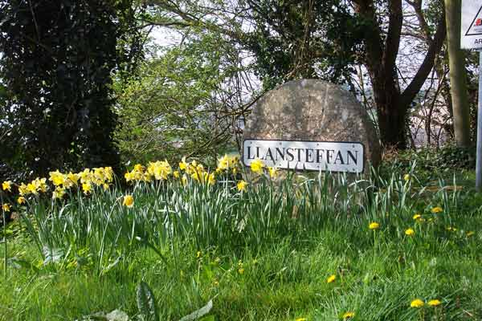

LLANSTEFFAN BEACH CLEAN

Slide 2
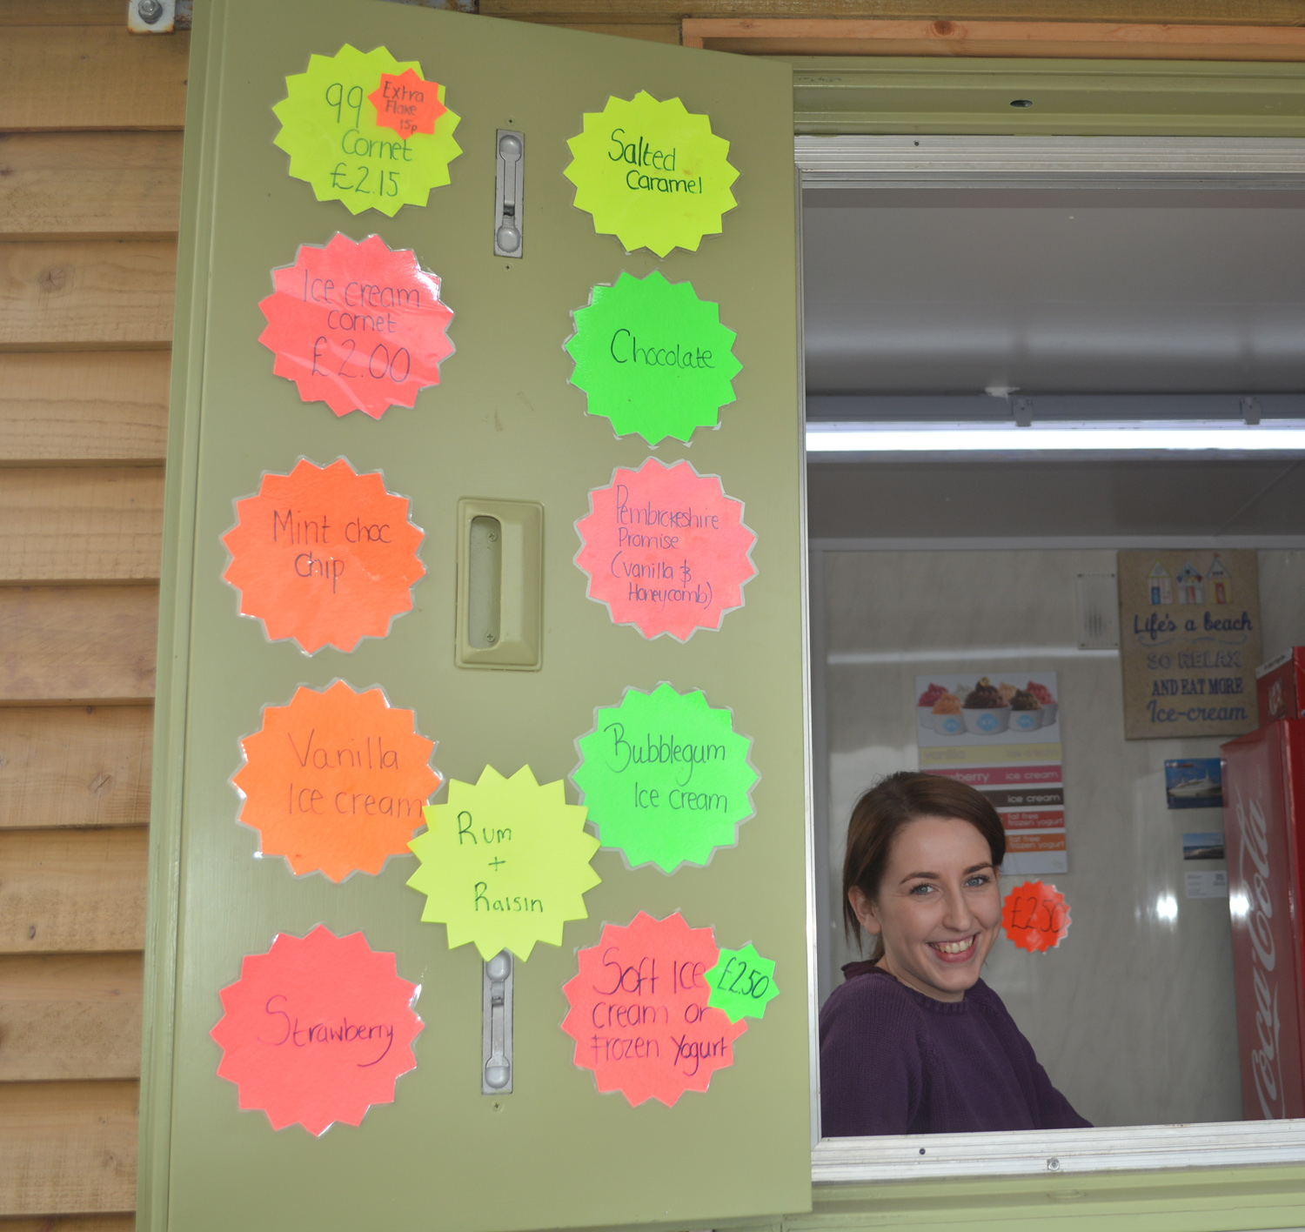
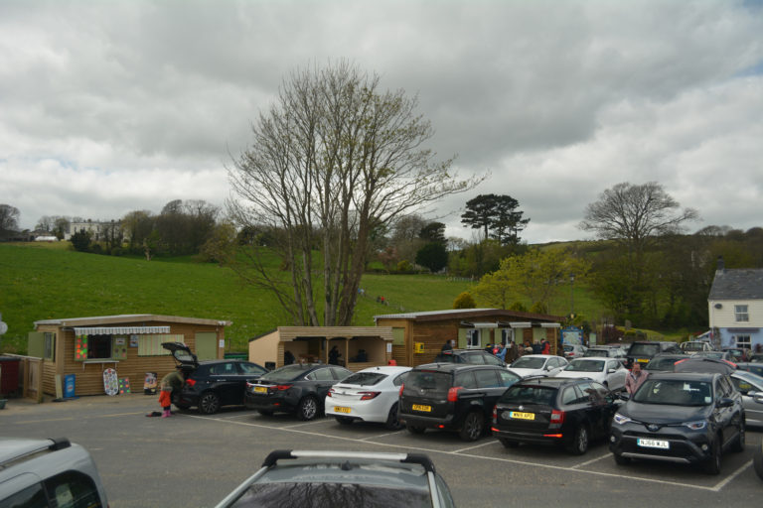

Slide 3
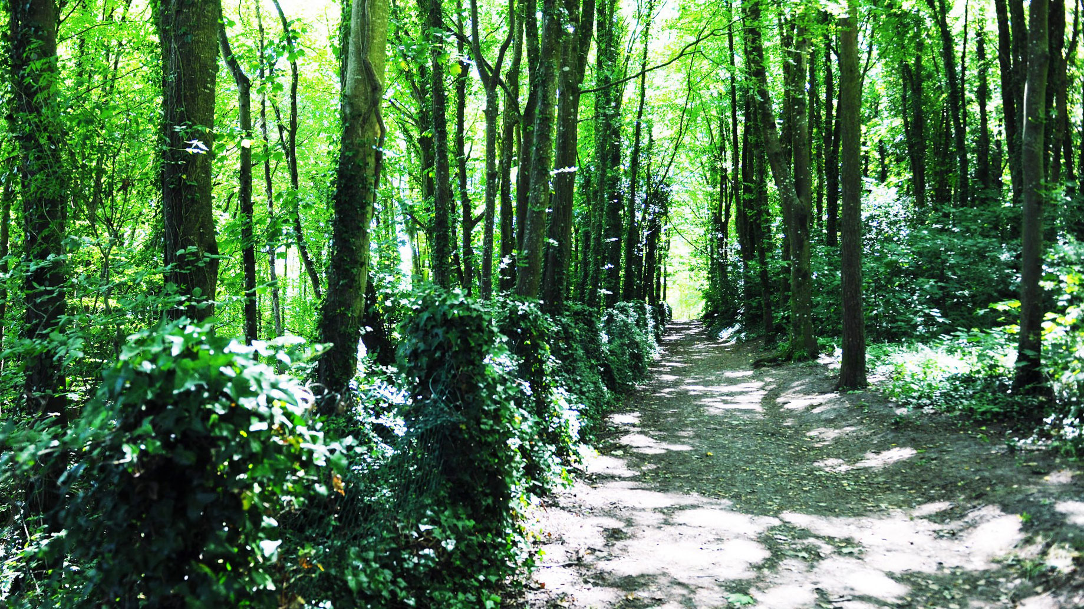
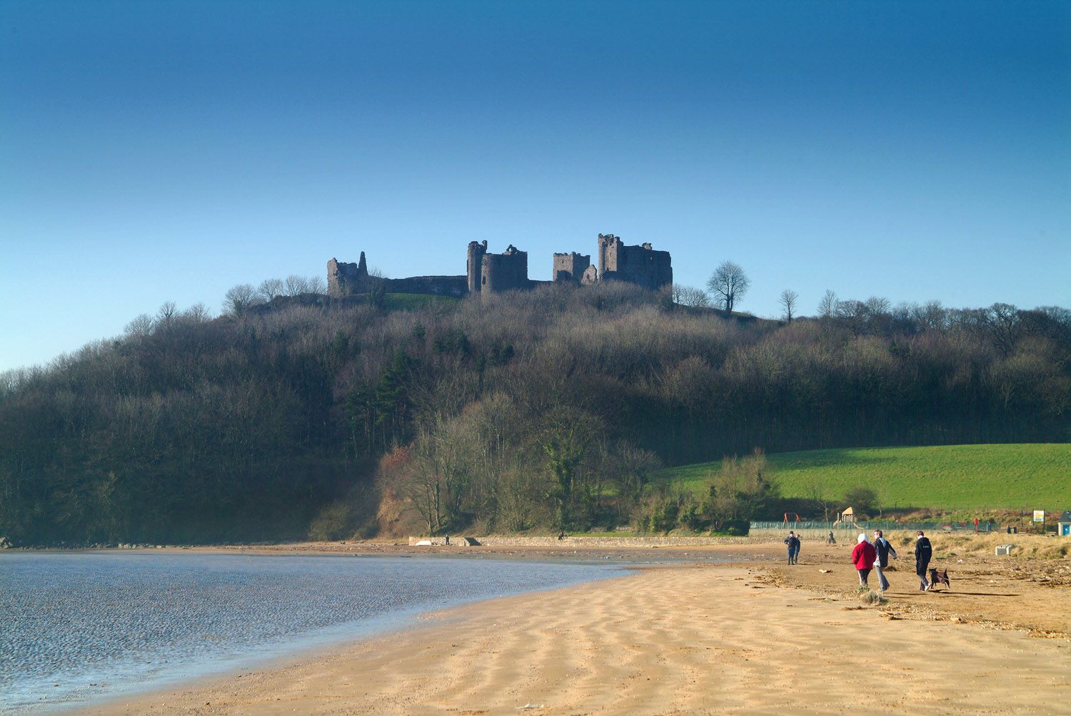
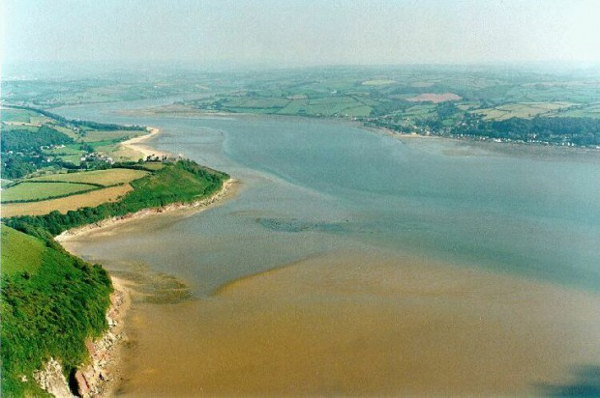

Slide 5
REFERENCES
Llansteffan sign pic www.llansteffan.com
Car park pic www.llansteffan.com
Florries ice cream pic www.llansteffan.com
Llansteffan castle pic www.llansteffancastle.com
Llansteffan castle woods pic www.llansteffancastle.com
Three estuaries at Llansteffan pic www.llansteffan.com/walking
Plastic waste inputs pic (feb 2015) time.com
Info about Llansteffan www.llansteffan.com
Castell Llansteffan castle www.llansteffancastle.com
Three estuaries at Llansteffan www.llansteffan.com/walking
Sifferlin A. (feb 2015) here how much plastic ends up in the worlds ocean time.com

