Slide 1

Managing People LCBB 5004
Lecturer Name : Uju Ugochukwu
Student Name : George Valentin Priboi
Student Number : 2029732

Slide 2

Introduction
Through the slides below, the potential relationships between the organizational structure, culture, people, and organisational performance have been analyzed coherently.
Furthermore, in the below slides, the essential nature of managerial work has been identified while considering the management function and processes, along with the role played by leaders and the aspects that determine the effectiveness of managers and leaders in the organizational context.
An approach related to behavioural aspects of managers has been applied for identifying the factors that affect differences in individual behaviour.

Slide 3
Analysing the relationship between people, culture, structure, and organisational performance

Slide 4
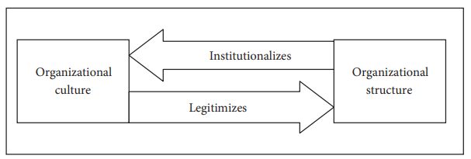
Relationship between organizational structure, culture, and employees’ behaviour (1)
The organizational structure explains the method based on which the work flows through the organization (SHRM, 2022). It relates and aligns with the parts of the organization while making it capable of achieving its maximum performance.
According to Eze et al. (2017), the organisational structure has a significant impact on its overall performance of the organization. The organization's strength is determined by the structure they hold.
The organizational culture explains the values and beliefs shared by the people within the organization wherein the values and beliefs are established by the leaders and then they are reinforced and communicated through several methods.
The organizational culture directly influences the employees’ performance with its impact on the perception, behaviour and understanding of the employees (SHRM, 2022).
The introduction of the right structure helps in easily adopting the organizational culture positively.
If the organizational structure and culture are well aligned, it results in effective management and leadership wherein effectively management has a positive influence on the performance and productivity of the employees (Brightons, 2022).

Slide 5
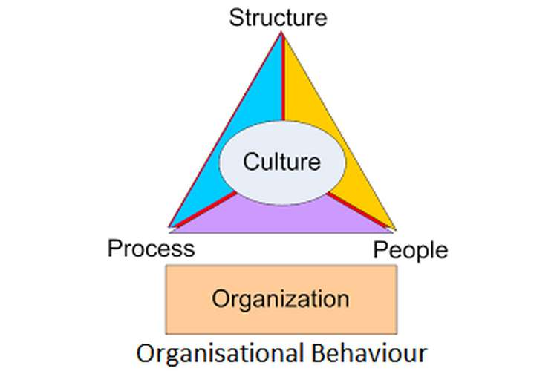
Relationship between organizational structure, culture, and employees’ behaviour (2)
The organizational structure ensures the employees’ behaviour is in accordance with the existing culture, values, assumptions, and norms. Therefore, the organizational culture becomes institutionalized through the organizational structure (Janicijevic, 2015).
A hierarchical or authoritarian culture means a high level of centralization due to unequal distribution of power. The high level of centralization results in tighter managerial control and it can further lead to an inflexible workforce due to a lack of workers’ autonomy (Kampin, 2018).
The organizational culture wherein the accomplishment of goals and problem-solving are of much priority results in a formal structure (Janicijevic, 2015). The greater formalization further improves the efficiency of the employees, however, it also increases the employees’ inflexibility.

Slide 6
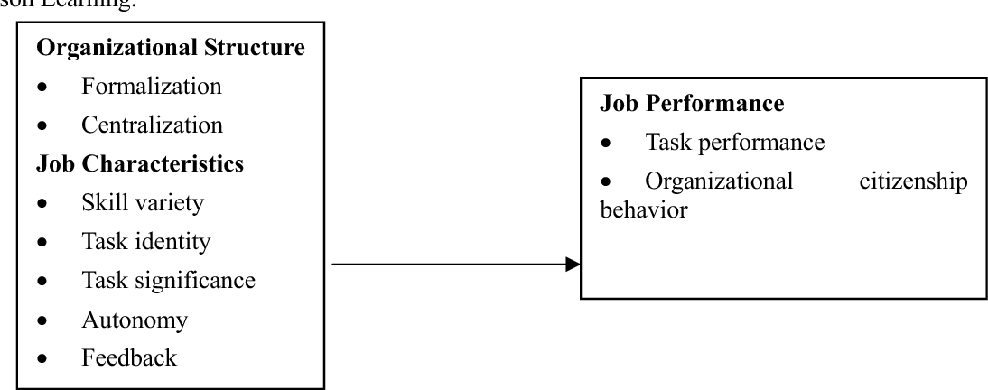
Relationship between organizational structure, employees’ performance, and organizations performance
The organizational structure plays a very critical role in determining how tasks are divided, how the relationships are reported, and how the employees are controlled, coordinated, and motivated wherein these factors further influence the achievement of the organizational goals.
In the case of a highly formalized organizational structure, the rules are very explicit. The explicit rules are said to obstruct the flexibility and impulsiveness required for internal innovation.
The formalization explains standardisation of jobs by procedures and rules. The greater formalization tends to improve the employees’ efficiency, however, it may also lead to increased employees' inflexibility whereby they become incapable of performing non-standardized tasks (Kampini, 2018). The formal structure in a stable environment tends to positively influence organisational performance.
In the case of the centralized organizational structure, this structure tends to create a non-participatory environment wherein the non-participative environment tends to reduce task commitment, communication, and involvement among the employees. Centralization is when the authority of decision-making lies in the hands of top-level executives (Fedayi, 2015).

Slide 7
Relationship between organisational culture, employees’ behaviour and organizations’ performance
An ineffective organizational culture result in disengaged employees wherein the disengagement of the employees leads to poor customer relations, higher turnover, and lower profits.
A strong culture positively influences organizational performance wherein it enhances the trust and cooperation among the employees, ensures fewer disagreements, and ensures more efficient decision-making.

Slide 8
Identification of the essential nature of managerial work

Slide 9
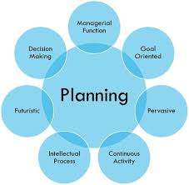
Nature of Planning aspect of managerial work
Planning is the most basic managerial function wherein the managers work to establish the aims and the techniques are defined, and methods by which the goals can be achieved.
Planning is an act of decision-making, wherein the managers decide in advance what needs to be done as a projected course of action.
Planning is pervasive as it is performed by managers at different levels i.e., the higher level, the middle level, and the lower level.
Planning is a continuous process as the managers have to revise the plans every time new changes occur in the external business environment.

Slide 10
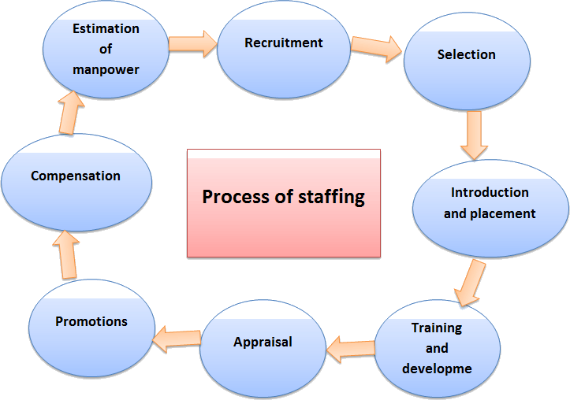
Nature of Staffing aspect of managerial work
Staffing is a managerial function wherein the managers work to recruit, select, train, develop, promote, and compensate the personnel.
Staffing is the ongoing management process wherein the managers need to constantly work on the development of people (Egyankosh, 2015).

Slide 11
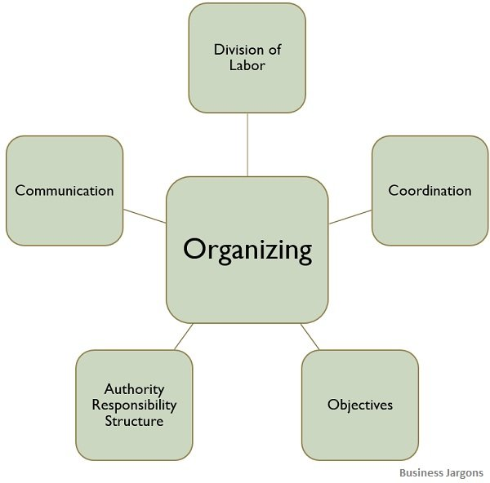
Nature of Organizing aspect of managerial work
Organizing as a process involves the division of tasks, a grouping of the activities that are interrelated, assigning tasks based on competencies, the delegation of authority, and coordinating the group efforts.
Organizing as a structure involves systematically combining people, functions, and physical activities to ensure the achievement of a common objective. In the case of organizing as a structure, the managers are required to perform activities analysis, decision analysis, and relations analysis (Chand, 2021).

Slide 12

Nature of Leading aspect of managerial work
Leading involves binding a group together with a common goal. The leaders are required to infuse energy into the organization by activating its people and keeping them in motion (Maxwell, 2015).
Leading entails the formulation of a mission, vision, and strategic goals and communication of the same to the people with orders and instructions.
Leading in a continuous process, leaders need to constantly implement change to improve performance.
The use of social power and the management of social and political processes are ubiquitous constructs in leading.
Leading is cognitive as it involves modelling environmental events and interpreting them to organizational members, determining the nature of the problem, and engaging in strategic thinking for the long term (Zaccaro, 2015).

Slide 13
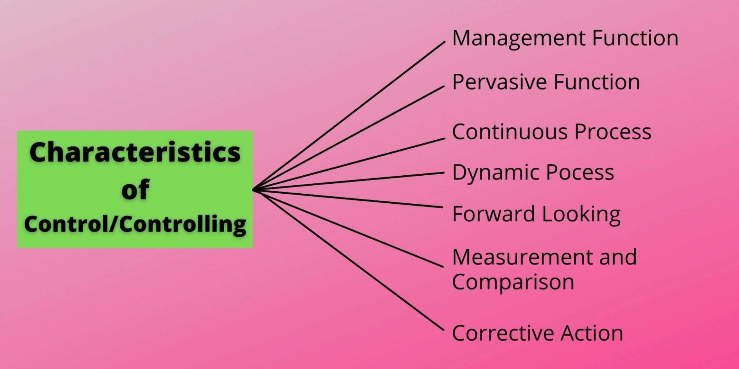
Nature of Controlling aspect of managerial work
Controlling as a function of management involves following up on the actions of the other function of management to control the activities assigned to them,
Controlling is a dynamic process as the managers have to continuously review the standards of performance and take corrective action to make changes in the other management functions.
Controlling is a continuous process as the managers need to constantly revise and analyse the standards to figure out deviations between planned performance and actual performance (DDRCMT, 2015).

Slide 14

Explaining the variables that help in the determination of successful leadership and management
According to Eblin et al. (2015), the three variables that determine effective management and leadership involves
Time: Effective management and leadership are determined by the time the managers and leaders have in a week and the deadline they are setting for getting something done. They have the option to shift the deadline however there is nothing they can do about the hours they have in a week.
Money: For acquiring the expertise, the managers and the leaders need to buy, rent, build, and get something done. However, the activities depend on the amount of money available to them and any deadline constraints on acquiring the expertise.
Resources: Resources mean people and the leaders need to mobilize and motivate the people to get things done. However, leaders are required to manage themselves first wherein they need to ensure that they are capable of explaining the problems and solutions to themselves so that they can do the same for others.

Slide 15
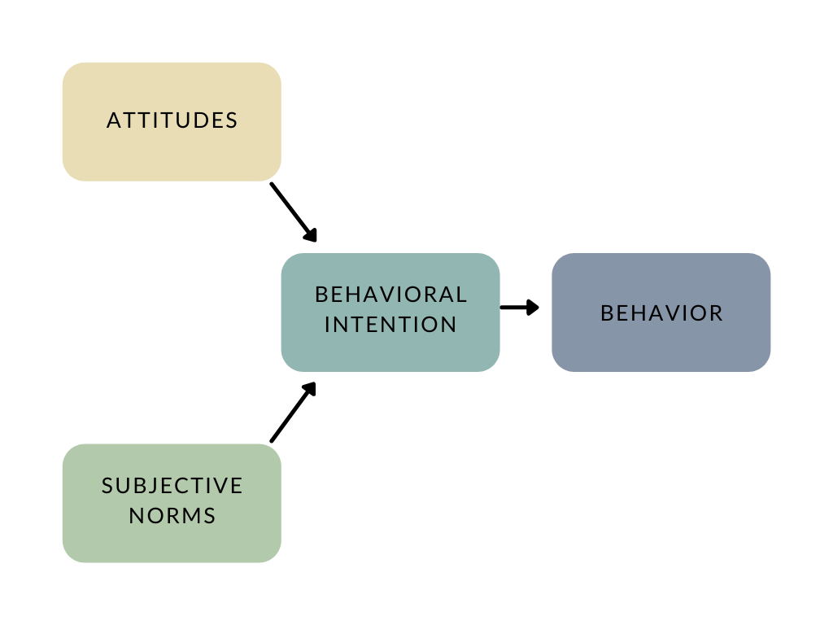
Evaluating the behavioural approach towards management in terms of individual behaviour
According to Quain et al. (2020), the behavioural approach to management is applied with the main focus on the human dimension of the workplace.
The application of the behavioural management approach enables leaders to effectively handle various human resource problems through an understanding of how people respond to conflicts and coming up with the best ways to motivate employees and manage their expectations.
According to the behavioural approach, the individual’s behaviour is determined by their unique and own subjective views persisting in their mind, their experiences, and their feelings and emotions.
The multitude of perceptions, values, and attitudes prevalent among employees characterize their individual behaviour and these factors also have a significant impact on their performance (Gordan, 2022).

Slide 16
Conclusion
From the information provided in the above slides, it can be said there is a positive relationship between the organizational structure, culture, people, and organisational performance.
A hierarchical or authoritarian culture means a high level of centralization and the high level of centralization results in tighter managerial control while leading to an inflexible workforce due to a lack of workers’ autonomy (Kampin, 2018).
The organizational structure has a very critical role in determining how tasks are divided, how the relationships are reported, and how the employees are controlled, coordinated, and motivated wherein these factors further influence the achievement of the organizational goals.
From the above findings, it can further be said that the three variables that determine effective leadership and management involve time, money, and resources. It is determined by how the leaders and managers use each of these variables effectively to ensure the successful achievement of the desired goals.

Slide 17
Referencing
Eze, S.C., Bello, A.O. and Adekola, T.A., 2017. The Effects of Organizational Structure on the Performance of Organizations. European Journal of Business and Innovation Research, 5(6), pp.46-62.
Shrm. org. 2022. Understanding Organizational Structures. Available at: < https://www.shrm.org/resourcesandtools/tools-and-samples/toolkits/pages/understandingorganizationalstructures.aspx> [Accessed October 12 2022].
Fadeyi, O., Maduenyi, S., Oke, A. and Ajabge, M.A., 2015. Impact of organizational structure on organizational performance. In International Conference on African Development. Covenant University (pp. 354-356).
Kampini, T., 2018. Impact of organization structure on employee performance. Case of New Era secondary school, Munich. Available at: < https://www.grin.com/document/434752> [Accessed October 12 2022].
Shrm. org. 2022. Understanding and Developing Organizational Culture. Available at: < https://www.shrm.org/resourcesandtools/tools-and-samples/toolkits/pages/understandinganddevelopingorganizationalculture.aspx> [Accessed October 12 2022].
Brightonsbm. Com. 2022. Is There a Relationship Between Organisational Structure and Culture? Available at: < https://www.brightonsbm.com/news/relationship-organizational-structure-culture/> [Accessed October 12 2022].

Slide 18
Referencing
Janićijević, N., 2015. The mutual impact of organizational culture and structure. Economic annals, 58(198), pp.35-60.
Chand, S, 2021. Nature of Organisation: Organisation as Process & Organisation as a Structure. Available at: < https://www.yourarticlelibrary.com/organization/nature-of-organisation-organisation-as-process-organisation-as-a-structure/25665> [Accessed October 12 2022].
Zaccaro, S, 2015. The Nature of Organizational Leadership An Introduction. Available at: < https://www.researchgate.net/publication/242546000_The_Nature_of_Organizational_Leadership_An_Introduction> [Accessed October 12 2022].
Ddrcmt. Com. 2022. (TOPIC 1) Nature, purpose and process of controlling. Available at: < http://ddrcmt.com/principle%20of%20mgt%20unit%204%20BBA%202nd.pdf> [Accessed October 12 2022].
Eblin, S, 2015. The 3 Variables of Leadership. Available at: < https://www.govexec.com/management/2013/10/3-variables-leadership/72023/> [Accessed October 12 2022].
Quain, S, 2021. Examples of Behavioral Approaches in Business Management. Available at: < https://smallbusiness.chron.com/examples-behavioral-approaches-business-management-39059.html> [Accessed October 12 2022].
Gordon, M, 2022. Behavioral Science Theory of Management - Explained. Available at: < https://thebusinessprofessor.com/en_US/management-leadership-organizational-behavior/what-is-behavioral-science-theory-of-management> [Accessed October 12 2022].

