Slide 1
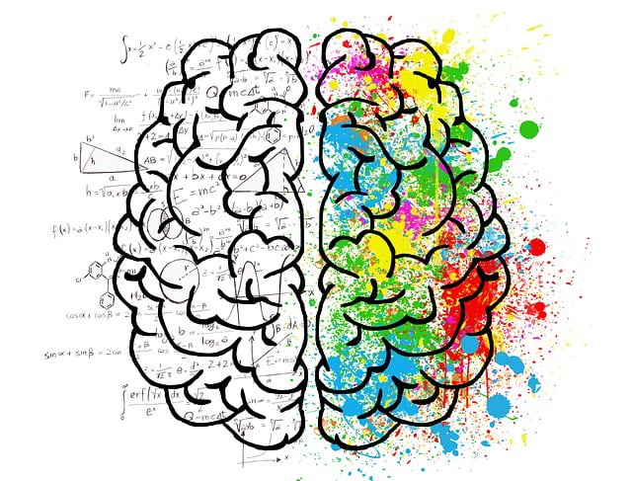
BMHP6029
Psychopathological Classifications and Provisions
Week 3
Schizophrenia
Sept 2024

Slide 2

Mental Health Acts
Mental Capacity Acts
Schizophrenia
This Photo by Unknown Author is licensed under CC BY-SA
Notes:
H

Slide 3

Purpose of mental health legislation
Care and treat individuals with mental disorders
It provides a legal framework for individuals, who are admitted within a hospital setting due to a mental disorder.
The act could primarily be used to assess and treat the identified mental disorder only
Based on the act, individuals could be brought into hospital or detained either on a voluntary or involuntary basis.
However, safeguarding is in place to protect such individuals.

Slide 4

Powers of Mental Health Legislation
The powers within the mental health acts could be enforced by the following people only
  Approved mental health professionals (AMHPS)
  Approved / responsible clinician (RCs)
  Doctors and professionals have the capacity and authority to make recommendations

Slide 5
The principles of mental health
The mental health act tells professionals what they are required to do. The mental health act code states how an individual is required to do it.
Mental Health Act
The Mental Health Act 1983
The Mental Health Act 2007
Mental Capacity Act
Mental Capacity Act 2005
Mental Capacity Act 2007t 2007
All professionals are required to abide by the mental heath act by law.
  The mental health act code of practice 2008
  The mental health act code of practice 2015 (revised version)

Slide 6

Key Principles & Code of Practice
All clients will be assumed to have capacity unless they are assessed and identified to lack capacity.
An individual’s right to make a decision should be empowered. Even if there might be circumstances, where unwise decisions may have been made.
A person is not to be treated as unable to make a decision unless all practicable steps to help him to do so have been taken without success.
An act done, or decision made, under this Act for or on behalf of a person must be done, or made, in their best interests.
All decisions made in the best interest of the client, should always adhere to the least restrictive approach, where the freedom and rights of the client is taken into consideration.
Notes:
Least restrictive option
Keep people in hospital if they really need it
Independence maximisation
Help patients get well and be independent
Empowerment and involvement
Involve patients in planning their treatment care and plan
Listen to what is important to them
Document their views and wishes
Give patient information and support to be involved in decisions
Involve family and carers if the patient wants them.
Respect and dignity
Understand that every patient is different and what this means for their treatment and care.
Purpose and effectiveness
Efficiency and equity
Keep people in hospital for the shortage of time necessary

Slide 7

The Mental Health Act (2007)
When a patient can be given treatment even if they do not want it
When they can be held in a hospital for assessment or treatment for your mental health disorder
What the patient’s rights are
Treating patients fairly and equally

Slide 8
Changes to the 1983 MHA in 2007
Conditions for detention
Duration
Short 72 hours detention order
b. The patient must be suffering from a mental disorder that requires detention
c. The patient must be a danger to themselves or others
Doctors can authorise 6 months if 2b and 2c
The treatment is required for the patient’s health and safety and the protection of others
The detention can be authorised for a further 6 months
A nearest relative can apply for MHRT (Mental Health Review Tribunal)
Can be applied by nearest relative or MHP
can be done if waiting for a 2nd doctor would cause unnecessary delay
a. Two doctors must approve order
1983 MHA was about the rights of the patient
2007 was about greater protection for the public
Notes:
Section 2 of MHA 2007 means an approved mental health professional can apply for a detainment order (and a near relative) for 28 days
Two doctors must approve order
The patient must be suffering from a mental disorder that requires detention
The patient must be a danger to themselves or others
Section 3
Doctors can authorise 6 months detention if the patient is suffering from a mental disorder that means they are a danger to themselves or others
The treatment is required for the patient’s health and safety and the protection of others
The detention can be authorised for a further 6 months
A nearest relative can apply for MHRT (Mental Health Review Tribunal)
Section 4
A nearest relative or mental health professional can apply for a 72 hour detention order
This can be done if waiting for a 2nd doctor would cause unnecessary delay

Slide 9
Help people be safe (MHA, 2007)
Section 136
2) A police station should only be used as a safe space if there is nowhere else to take that person.
Section 47
Ministry of justice orders a person to be transferred from prison to hospital for treatment
You can be kept under this section for up to 6 months.
Section 135
unable to look after yourself and live alone.
A magistrate can issue you a warrant authorising a police office (with a doctor and approved mental health professional to enter any premises where you are being kept and take you to a place of safety.
Placed under this section if there is reasonable cause to suspect you have a mental health disorder and
1) Police will keep the person in a place of safety until an approved mental health professional can examine the person
If police need to take someone away from public places to keep them safe from themselves or others,
you are being ill treated or neglected
Treat people in places that are safe
Help them get help by referring to the correct agencies and support

Slide 10
What are your rights
You don’t have a choice in being sectioned
You can apply to be discharged from hospital if you think you are ready
This can be done by applying to the Mental Health Tribunal
You or a family member or carer can apply to the MHT
The final decision is made by either a responsible clinician
The person who has overall responsibility for your care in hospital

Slide 11
Community Treatment order (CTO)
An order made by an authorised psychiatrist
For a person having a mental illness
Involuntary treatment order while not being detained in approved mental health services.

Slide 12
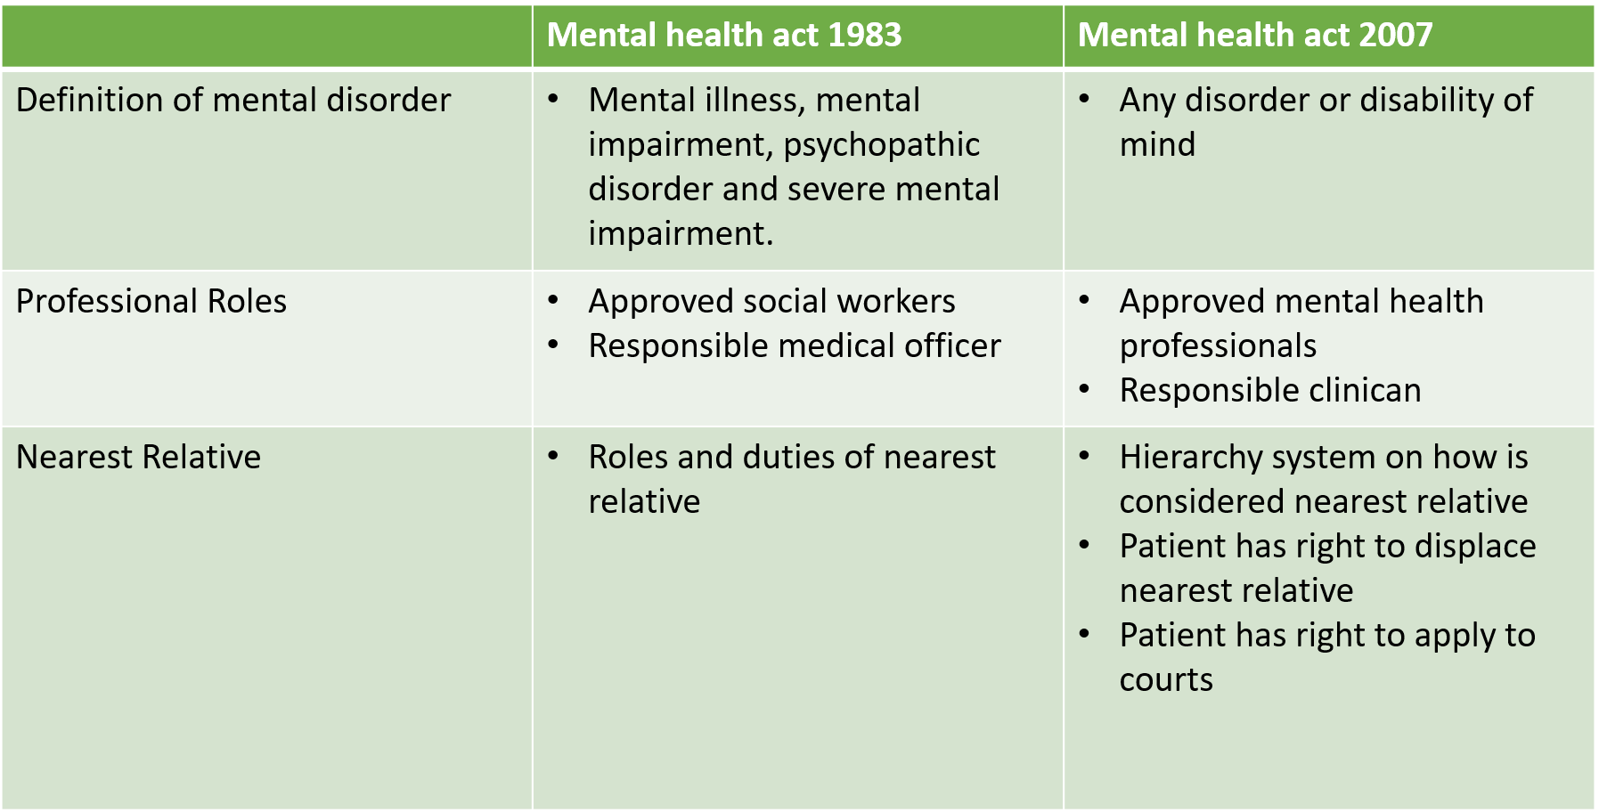
Changes in MHA Legislation (1983 to 2007)
Notes:
Summarizing notes for the comparison table:
The removal of all different categories of mental health
The term ‘mental disorder’ is categorised as being any disorder or disability of the mind.
MHP Role changes include:
1. Created Approved Mental Health Professionals (AMHP’s)
2. Instead of the Responsible clinicians (psychiatrists on duty) to detain or discharge patients
3. Wider professions such as nurses, psychologist, social workers, occupational health will be trained to do so.
Nearest relative and patient’s right to displace them
Nearest relative list:
Husband, wife or civil partner or a partner, who had lived with the patient for more than 6 months
Eldest child
Eldest parent
Eldest brother or sister
Eldest grandparent
Eldest grandchild
Eldest Aunt or uncle
Eldest niece or nephew
Someone who had lived with the patient for at least 5 years
Illegitimate child
Illegitimate child is still treated as legitimate child
Always for mother
For father – only if parental responsibility was shared by father
Half blood relative
Full blood relative would generally be preferred
Adoptive Relationship
Adoptive relationship will be treated as nearest relative but a step-relationship will not be.
UK Resident
The nearest relative should always be a resident of UK
Exception would be, if the patient is a foreign national
Displacing nearest relative
There is no nearest relative
Nearest relative is ill and not within capacity to engage in such role
Nearest relative has objected unreasonably
The nearest relative has discharged the patient without taking into account the patient’s needs or safety
The nearest relative is unsuitable

Slide 13
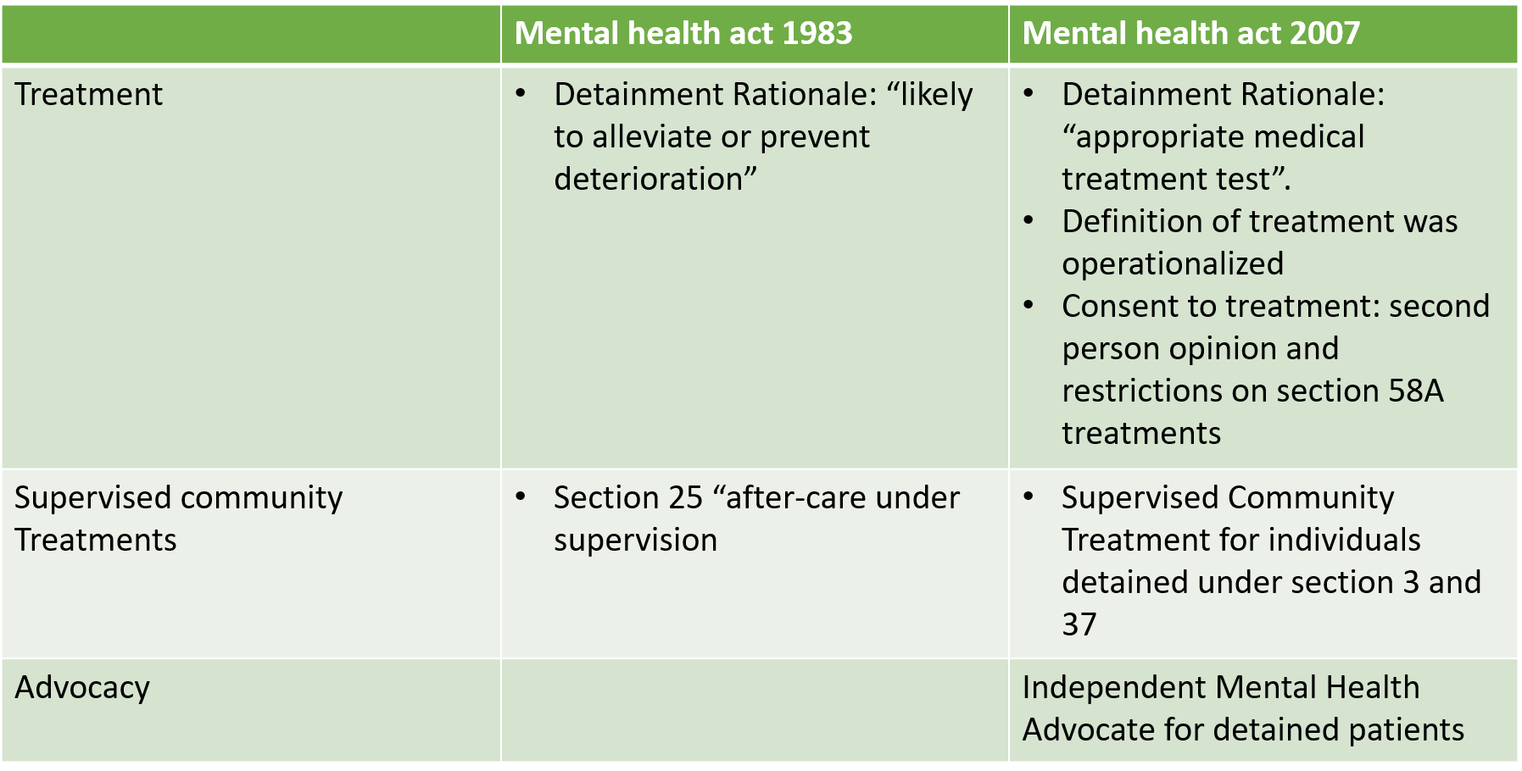
Notes:
Definition and delivery of treatment
Community Treatments
Added advocacy

Slide 14

How would the changes in the 2 mental health acts change the care and support for individuals with mental health disorders?
This Photo by Unknown Author is licensed under CC BY-SA-NC

Slide 15
Mental Capacity Acts
The goal of the mental capacity act is to protect individuals, who may lack capacity to make an informed decisions.
The act is in place to support individuals and their carers to make a decision, based on the best interest of the client.
The key mental capacity acts
Mental Capacity Act (2005)
Mental Capacity Act (2007)

Slide 16

Mental Capacity
Capacity is the ability for an individual to make an informed decision and have the ability to recall it.
An individual would be deemed to lack capacity
  If they are unable to make a decision
  Or if an individual finds it challenging to make a decision within a given time period
  Mental capacity is both time and decision specific.
  Note: It might be crucial to assess an individuals understanding of risks associated with a particular behavior, when they are making an informed decision.

Slide 17
5 Statutory principles of Mental Capacity Act (2005)
Section 1
A person must be assumed to have capacity unless it is established that they lack capacity.
A person is not to be treated as unable to make a decision unless all practicable steps to help him to do so have been taken without success.
A person is not to be treated as unable to make a decision merely because he makes an unwise decision.
An act done, or decision made, under this Act for or on behalf of a person must be done, or made, in their best interests.
Before the act is done, or the decision is made, regard must be had to whether the purpose for which it is needed can be as effectively achieved in a way which is less restrictive of the person’s rights and freedom of action.
Notes:
Always assuming that one has capacity to make their own decision unless it is proven otherwise.
Every measure should be taken prior to determining that an individual is not capable of making a decision.
It is not unreasonable for an individual to make unwise decisions.
Every decision made on behalf of an individual, who lacks capacity should take into account their best interest.
Decisions made on behalf of individuals, who lack capacity should always be least restrictive while taking into account their basic needs.

Slide 18
Putting MCA in practice (Beale, Lee-Davey, Lee, & Keene, 2022)
Mr A is a 47-year-old man who has been detained under section 3 of the MHA 1983 for the past 3 months. He has a diagnosis of schizophrenia and this is his fifth admission to hospital. He is being treated with a depot antipsychotic and occasional benzodiazepines for agitation. He is slowly improving but remains psychotic and does not believe he is unwell. His consent to treatment is due. Over the past few weeks he has been complaining of intermittent epigastric pain and nausea, and has had episode of melaena. Blood tests have shown a mild anaemia. He has lost some weight since admission. You have discussed the situation with a gastroenterologist, who advises that Mr A should have an endoscopy. Mr A refuses this.

Slide 19

Discuss the case of Mr A and see how the principles may apply.
How will you approach the assessment of capacity regarding Mr A’s physical and mental health?
This Photo by Unknown Author is licensed under CC BY
Notes:
“Mr A faces decisions about both his physical and mental health, both requiring a capacity assessment if his decision-making ability is in doubt. In relation to the treatment for psychosis, it is necessary to assess his capacity to consent in order to decide which limb of section 58 of the MHA is going to be relied on. Consent to an endoscopy is unrelated to the MHA: what is being considered is not medical treatmentformental disorder but a procedure toinvestigate his epigastric pain and nausea. Despite the fact that he is a patient detained under the MHA, the test is that set out in the MCA – because the basis for treatment will either be (a) capacitous consent or (b) the operation of section 5 of the MCA” (Beale et al., 2022, p.3)
A capacitous refusal to consent to the endoscopy is a bar, whereas a capacitous refusal to consent to treatment for psychosis under the MHA is not. We have chosen to discuss the principles of the MCA in relation to the endoscopy, as this decision falls within the remit of this Act. In describing how to approach the test for capacity, we focus on the decision to take depot antipsychotic medication, as it is this for which a psychiatrist will be the decision maker. Although this is treatment under the MHA, the MHA Code of Practice (Department for Constitutional Affairs 2015) makes clear that, for purposes of determining this issue, while the statutory language is that of ‘capable’, the test is actually that under the MCA (para 24.31).
The statutory (legal) check list:
Avoid making assumptions about someone’s best interests merely on the basis of the person’s age, appearance, condition or behaviour.
Consider a person’s own wishes, feelings, beliefs and values and any written statements made by the person when they had capacity.
Take account of the views of family and informal carers.
Can the decision be put off until the person regains capacity?
Involve the person in the decision-making process.
Demonstrate that you have carefully assessed any conflicting evidence or views.
Provide clear, objective reasons as to why you are acting in the person’s best interests.
Take account of the views of any Independent Mental Capacity Advocate.
Take the less restrictive alternative or intervention.

Slide 20
Mental Capacity Act (2005)
The deprivation of liberty safeguard was eventually introduced
  Providing the least restrictive treatment option
  Ensure the best interest of the patient is always taken into consideration
  Ensure an individual has the right to appeal in courts if required
  Ensure an individual is in place to represent the patient

Slide 21
“C led a life that ‘sparkled’, characterised by impulsive and self-centred decision-making. She had four marriages, numerous affairs and spent money recklessly. Her life revolved around her looks, men and material possessions. Aged 49 she was diagnosed with breast cancer and underwent a lumpectomy and radiotherapy. She also suffered a relationship breakdown, leading to the loss of her business and home and resultant significant debt. C unsuccessfully attempted suicide.... She has been placed on dialysis, but maintains her desire to die. Those caring for her are cautiously optimistic of recovery…. The Medical profession consider that C lacks capacity and wish to enforce treatment on her…in her best interest” (Smith and Parkhouse, 2020, p.87). Based on real life case in London in 2015.

Slide 22
Discuss whether the medical profession should be allowed to enforce the treatment on C.
Use the information covered so far on Mental Capacity Act in your discussion.
This Photo by Unknown Author is licensed under CC BY
Notes:
The judge ruled that C still had her capacity and her decision to refuse treatment, although unwise, should be respected. The medical profession should continue to convince C to change her mind but should not enforce treatment on her.
The statutory (legal) check list:
Avoid making assumptions about someone’s best interests merely on the basis of the person’s age, appearance, condition or behaviour.
Consider a person’s own wishes, feelings, beliefs and values and any written statements made by the person when they had capacity.
Take account of the views of family and informal carers.
Can the decision be put off until the person regains capacity?
Involve the person in the decision-making process.
Demonstrate that you have carefully assessed any conflicting evidence or views.
Provide clear, objective reasons as to why you are acting in the person’s best interests.
Take account of the views of any Independent Mental Capacity Advocate.
Take the less restrictive alternative or intervention.
C continued to refuse treatment and passed away a few days following the ruling.

Slide 23
Assessing capacity
First Stage
Identifying if there is an impairment or disturbance in the functioning of the individual’s brain
The level of impact such impairment would have on one’s decision-making skills.
Second Stage
It would be determined that an individual is not able to make a decision if:
They are unable to understand the information about the decision that has to be made
They are unable to remember information
They are unable to use the information received to evaluate the consequences of their decision
Unable to communicate their decision effectively
Factors to be considered in assessing for capacity
General intellectual ability
Memory
Attention and concentration
Reasoning
Information processing
Verbal comprehension and expression
Cultural influences
Social context
Ability to communicate.
Notes:
We will be discussing the issue of cognitive impairments when we cover schizophrenia in the second half of the session.

Slide 24

Legal Power of Attorney and Safeguarding
Independent Mental Capacity Advocate (IMCA)
  Works with the decision maker
  May challenge decision maker
  Communicates based on client’s wishes, beliefs and values.
Decision Maker
  Next Kin in Family
  Request through legal documentation
  Assign specific decision-making power to the decision maker
  Involve IMCA in decision making process
  Court may choose one, if one was unable to decide due to lack of capacity
Advanced Decision
  Decisions based on limitations placed on future treatments

Slide 25

What are the impacts of the MHAs, MCAs?
How did each act affect the everyday living of individuals with mental health disorders?
How did each act change the training, provisions and support?
What are the factors in determining the successful implementation of the MHA and MCA?
Are the MHA and MCA fit for purpose? From the introduction of the first MHA in 1983, DSM has gone through four updates whereas ICD changed from version 9 to 11.
Where can you find research literature to answer the questions above?
Notes:
The answers to these questions are embedded in the next activity.
There is a section on mental health acts and MCAs in the online reading list!!! Please plug this function to the students.
Two of the main charities have been asking for changes and update to the act.
Here are the changes in DSM and ICD since the mental health act in 1983
DSM III (1980) DSM III –R (1987) DSM IV (1994) and DSM V (2013) DSM V- TR (2022)
ICD-9 (1975) ICD -10 (1994) and ICD-11 (2022)

Slide 26


Forum Activity: Mental Health Act
Information and relevant links about this activity can be found in Moodle Week 3 tile.
Download this poster template from: billboard8_48x36.pptx (live.com)
Choose one of the documents/blogs on the mental health act.
Read and summarise the key points.
Turn the key points into three takeaway messages and add them to the poster template.
Make sure to provide citations and references.
Save and upload your poster on the week 3 forum.

Slide 27
Contemporary debates on Schizophrenia

Slide 28





Portrait of a schizophrenic
“Someone who has psychotic experiences is different from normal people, because his brain (note that the stereotype includes the presumed gender of the individual) is damaged or different, probably because of his genes. He is “a schizophrenic,” who is not understandable, is dangerous, has no legitimate voice and requires control through drugs that target the underlying brain disorder” (Cooke and Kinderman, 2018 p. 59).
This Photo by Unknown Author is licensed under CC BY-NC
This Photo by Unknown Author is licensed under CC BY-SA-NC
This Photo by Unknown Author is licensed under CC BY-NC

Slide 29
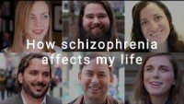
How Schizophrenia Affects My Life
How do your impression of these individuals compare to your initial description of a person with schizophrenia?
How do these individuals compare to Cooke and Kinderman’s stereotypical portrait of a person with schizophrenia?

Slide 30
What does ‘schizophrenia’ mean?
In 1910, the Swiss psychiatrist Paul Eugen Bleuler (d. 1939) coined the term 'schizophrenia’ from the Greek words schizo (‘split’) and phren (‘mind’).
However, whilst people with schizophrenia can experience symptoms that affect their thought processes and perceptions of the world around them, such as delusions and hallucinations, they do not have two separate personalities.

Slide 31
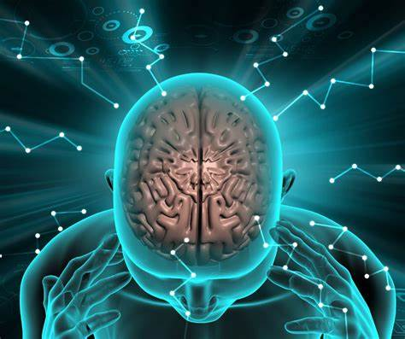
What is Schizophrenia?
Schizophrenia is a severe long-term mental health condition. Schizophrenia is more common than people think, affecting about 1 in every 100 people, affecting around 20 million people worldwide (WHO, n.d.).
It causes a range of different psychological symptoms, characterised by distortions of thought, perception and emotion, language, sense of self (WHO. n.d.), behaviour and social withdrawal.
Some may describe schizophrenia as a type of psychosis as the person may not always be able to distinguish their own thoughts and ideas from reality.
Source: https://www.nhs.uk/mental-health/conditions/schizophrenia/overview/

Slide 32
Schizophrenia psychosis
Schizophrenia and psychosis may be confused for one another, but they’re not the same. Schizophrenia is a mental health condition — psychosis is a collection of symptoms, distorted thoughts and perceptions, leading to a break from reality (National Institute of Mental Health, n.d.).
During an episode of psychosis, a person may hear voices, see things that aren’t real, or believe things that aren’t true. Psychosis is related to several mental health disorders, including schizophrenia, severe depression and bipolar disorder. It is also linked to Parkinson’s disease, Althamer’s disease and related dementias (National Institute of Mental Health, n.d.).

Slide 33
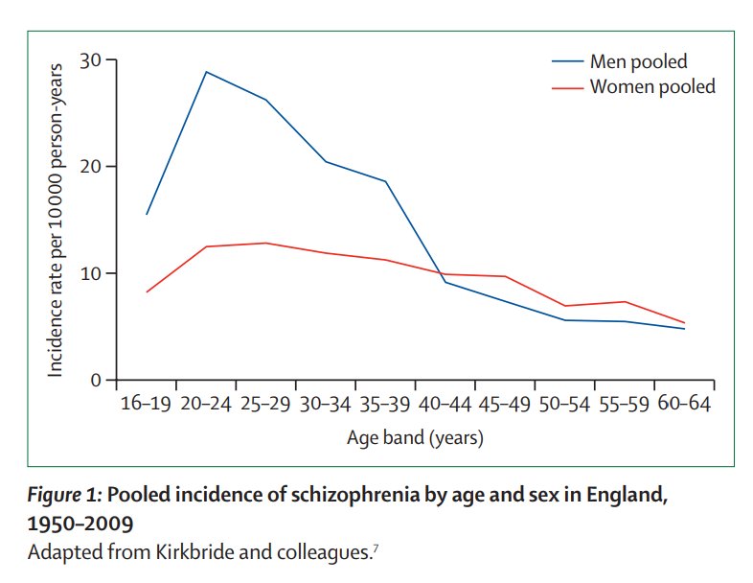
Trends and figures
Affects around 24 million worldwide (Jaeschke et al., 2017; World Health Organisation, 2022)
Onset peaked in early 20s (Jongsma et al., 2019)
  Onset in childhood is extremely rate
Gender differences (Jauar, Johnstone and McKeena, 2022)
  Affects more men than women (1:0.70)
  Sharp increase and steep decline in men
  Later onset and flatter trend with age observed in more women than men (Ochoa et al., 2012)
Notes:
It is more common among males (12 million), than females (9 million).
Schizophrenia also commonly starts earlier among men.
Schizophrenia is associated with considerable disability and may affect educational and occupational performance.

Slide 34
ICD-11 Classification of Schizophrenia 6A20
Schizophrenia is characterised by disturbances in multiple mental modalities, including thinking (e.g., delusions, disorganisation in the form of thought), perception (e.g., hallucinations), self-experience (e.g., the experience that one's feelings, impulses, thoughts, or behaviour are under the control of an external force), cognition (e.g., impaired attention, verbal memory, and social cognition), volition (e.g., loss of motivation), affect (e.g., blunted emotional expression), and behaviour (e.g., behaviour that appears bizarre or purposeless, unpredictable or inappropriate emotional responses that interfere with the organisation of behaviour). Psychomotor disturbances, including catatonia, may be present. Persistent delusions, persistent hallucinations, thought disorder, and experiences of influence, passivity, or control are considered core symptoms. Symptoms must have persisted for at least one month in order for a diagnosis of schizophrenia to be assigned.
The symptoms are not a manifestation of another health condition (e.g., a brain tumour) and are not due to the effect of a substance or medication on the central nervous system (e.g., corticosteroids), including withdrawal (e.g., alcohol withdrawal)
Notes:
This opening page on ICD 11 includes a lot of information. Students can access this using the ICD-11 coding tool ICD-11 Coding Tool Mortality and Morbidity Statistics (MMS) (who.int)
Ask the students to identify keywords in the description of symptoms (and their related examples).
Once they have identified the keywords, get them to group the keywords. Can they map their groups to the core symptoms below?
These are the core symptoms in ICD-11:
Persistent delusions, persistent hallucinations, thought disorder, and experiences of influence, passivity, or control are considered core symptoms.
Ask students to identify the duration and exclusion criteria.

Slide 35
Symptoms of Schizophrenia
Positive symptoms
Known as psychosis or the psychotic syndrome
Hallucinations Delusions (persecution, grandeur, control).
Formal thought disorders
Negative symptoms
Absence or reduction of normal behaviour (Correll & Schooler, 2020)
Flattened emotional response
Poverty of speech Lack of initiative and persistence Social withdrawal.
Notes:
Positive symptoms are ones that are experienced in addition to reality
Thought disorders – A pattern of disorganised, irrational thinking; the most pronounced symptom of schizophrenia. [speech that is difficult to follow, sometimes to the point of incomprehensibility
Hallucinations – Perceptions of stimuli (usually, but not exclusively, auditory) that are not actually present.
Delusions – Beliefs that are obviously contrary to fact, e.g. beliefs that others are plotting against oneself (persecution), false beliefs in one’s own importance (grandeur), and beliefs that others are controlling oneself by radio receivers in the brain (control).
Negative symptoms:
These symptoms are known by the absence of normal behaviour, but they are not specific to schizophrenia. They can be found in other mental disorders.

Slide 36

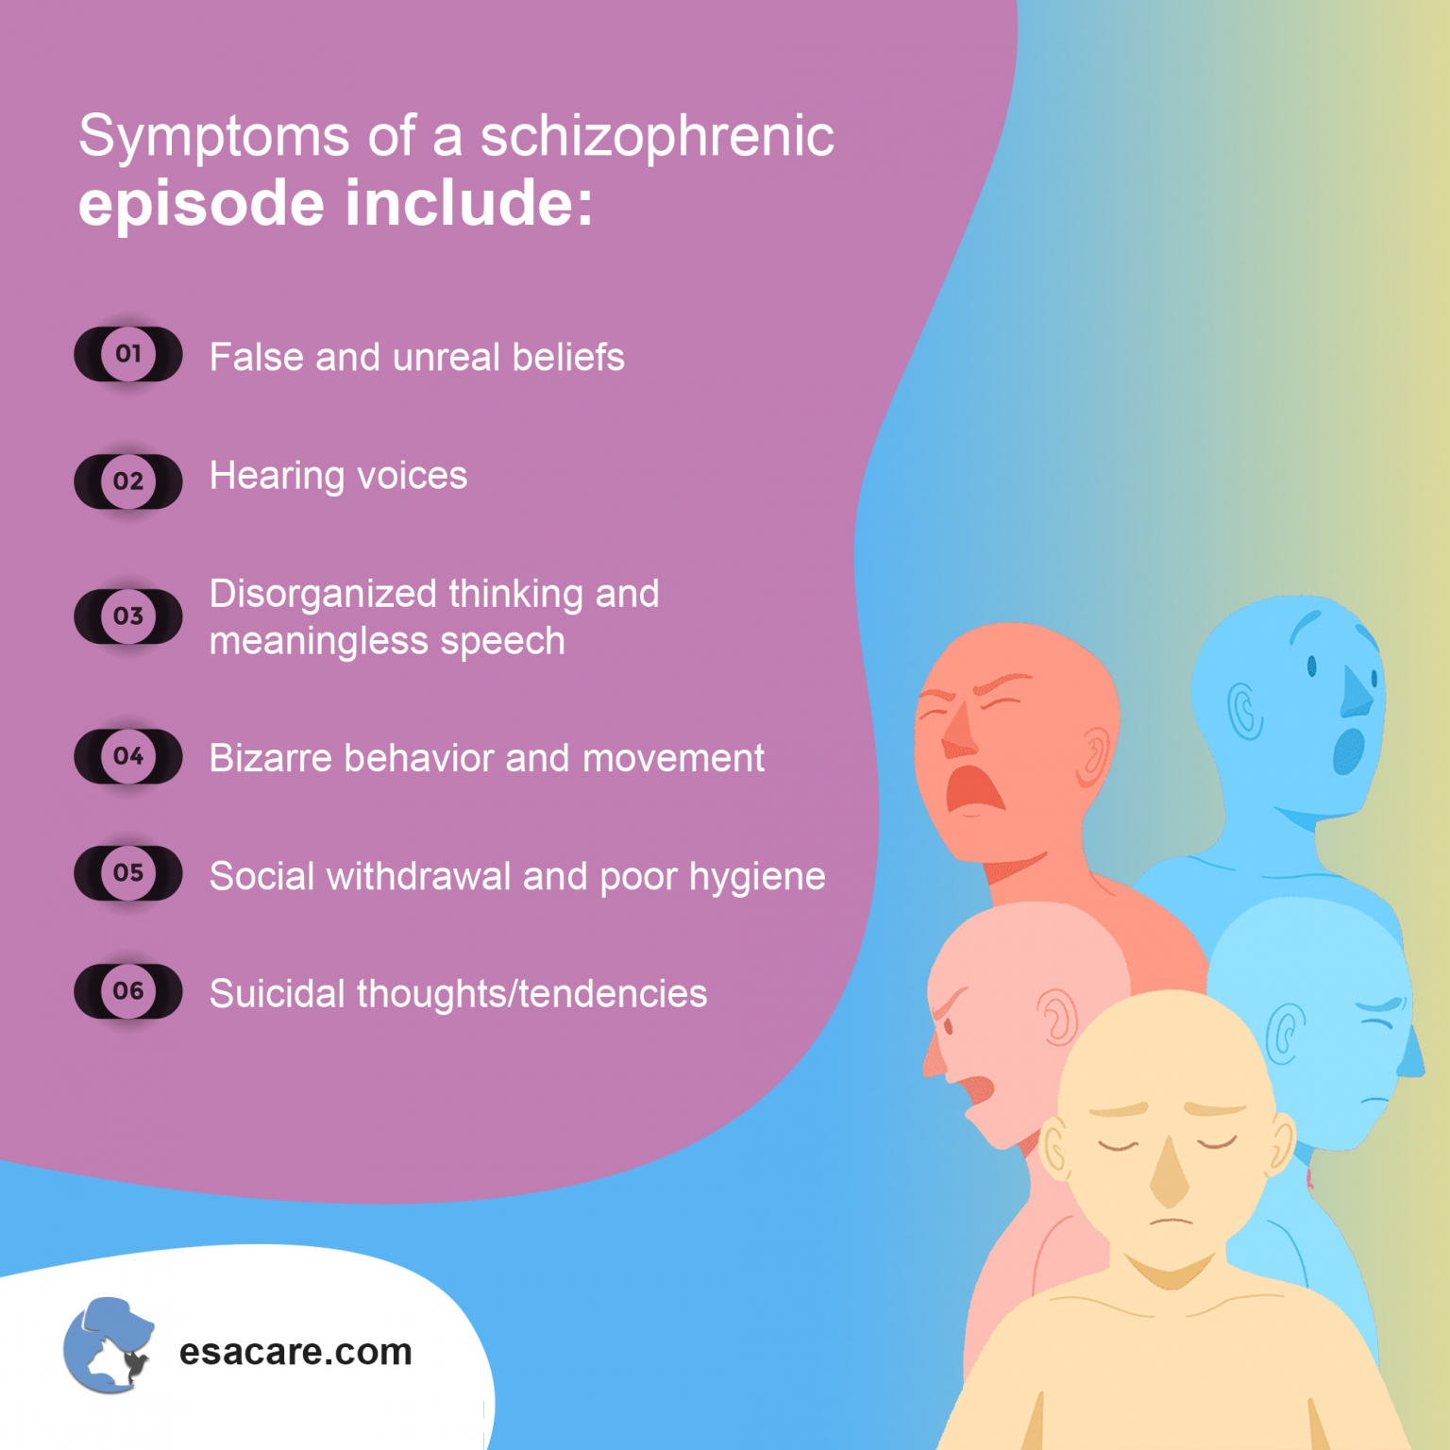
Searching activity
Research the following terms:
Delusion
Hallucinations
Notes:
Talk to students about creditable sources

Slide 37
Hallucinations and Delusions
Hallucinations: Hallucinations are experiences that appear real but are created by your mind. They include seeing things, hearing voices, or smelling things others around you don’t experience.
Delusions: A delusion occurs when you believe something despite evidence or facts to the contrary. They are fixed false beliefs or suspicions not shared by others in the person’s culture and that are firmly held even when there is evidence to the contrary
Are hallucinations and delusions unusual experiences?
Notes:
They are not unusual experiences. We can experience either to some extent. High fever or substance use can induce hallucinations whereas we all know someone with delusional ideations. e.g. beliefs that others are plotting against oneself (persecution), false beliefs in one’s own importance (grandeur), and beliefs that others are controlling oneself by radio receivers in the brain (control). They are best seen as a spectrum.
This is a good case in point where the categorical approach used by ICD and DSM is not entirely effective. A dimensional approach would be more helpful with these two.

Slide 38
In addition to hallucinations and delusions, common experiences may include:
abnormal behaviour: disorganised behaviour such as wandering aimlessly, mumbling or laughing to self, strange appearance, self-neglect or appearing unkempt
Impaired cognitive functioning
disorganised speech: incoherent or irrelevant speech
disturbances of emotions: marked apathy or disconnect between reported emotion and what is observed such as facial expression or body language.
These can lead to disability and loss of education or employment
Source: https://www.who.int/news-room/fact-sheets/detail/schizophrenia

Slide 39
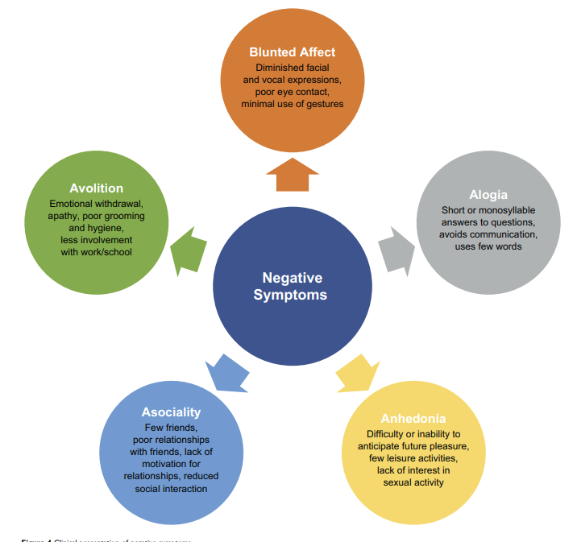
Negative Symptoms and treatments (Correll & Schooler, 2020)
Higher prevalence of negative symptoms are related to men, unemployed, and people with reduced functioning
Majority of patients with schizophrenia may show prominent negative symptoms. Clinicians need to rule out conditions also share presentation of negative symptoms
Medical conditions such as multiple sclerosis or Parkinson’s disease
Psychiatric conditions such as depression, anxiety, obsessive compulsive disorder, posttraumatic stress disorder, autism, intellectual disability, substance misuse
Patients rarely complain about negative symptoms due to lack of insight. Therefore clinicians are less aware of their impact.
Efficacy of Medication and CBT is less clear

Slide 40
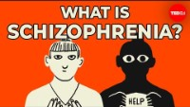
Video: What is schizophrenia?
Source: https://www.youtube.com/watch?v=K2sc_ck5BZU

Slide 41

Causes of schizophrenia
Did ICD-11 identify the cause in its definition?
Research has not identified one single factor. It is thought that an interaction between genes, neurological and a range of environmental factors may cause schizophrenia (Jauhar et al., 2022).
Psychosocial factors may also contribute to schizophrenia but to a less extent.

Slide 42
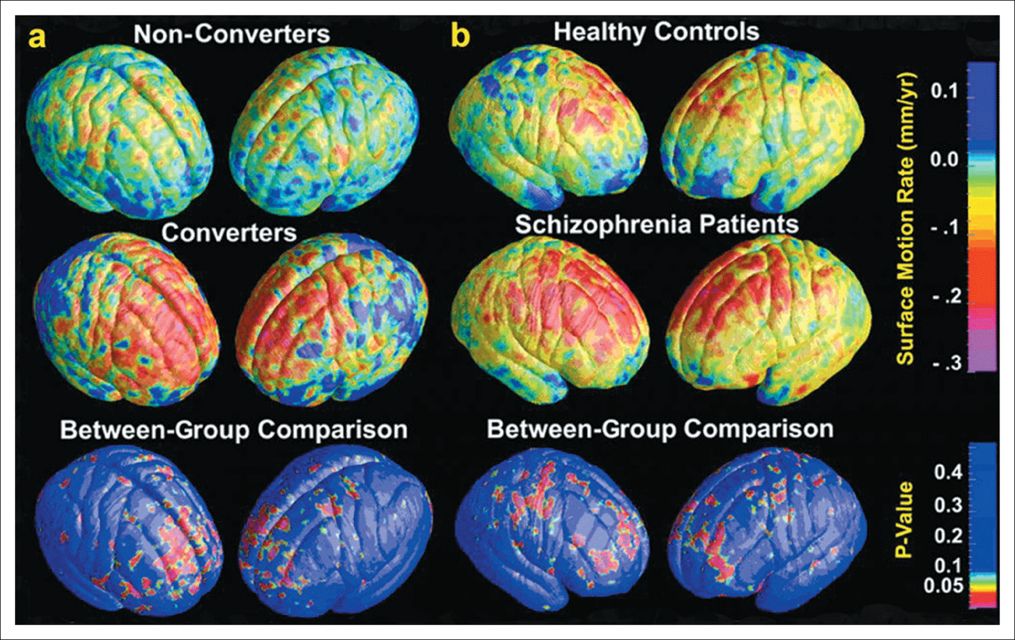
Causes of schizophrenia
Recent studies have suggested that imaging tests completed on people with schizophrenia may show abnormalities in certain brain structures.
Ongoing research in this area continues. Chemical abnormalities in the brain are believed to be responsible for many of the symptoms seen in schizophrenia (Martin & Calson, 2023). But note the exclusion criterion about biochemical cause in ICD-11
Researchers also believe low levels of certain brain chemicals that affect emotions and behaviour may contribute to this psychiatric disorder: the dopamine hypothesis
(Martin & Carlson, 2023)
Source: https://www.healthline.com/health/schizophrenia#causes
Notes:
Figure 17.8
Changes in brain volume between healthy people, schizophrenic patients and those at risk of developing schizophrenia who later go on to develop (or not develop) the disorder.
Neurotransmitters - The dopamine hypothesis
There is a significant link between high levels of dopamine
(which overstimulate the dopamine receptors in the brain)
and schizophrenia =
Hyperdopaminergia

Slide 43
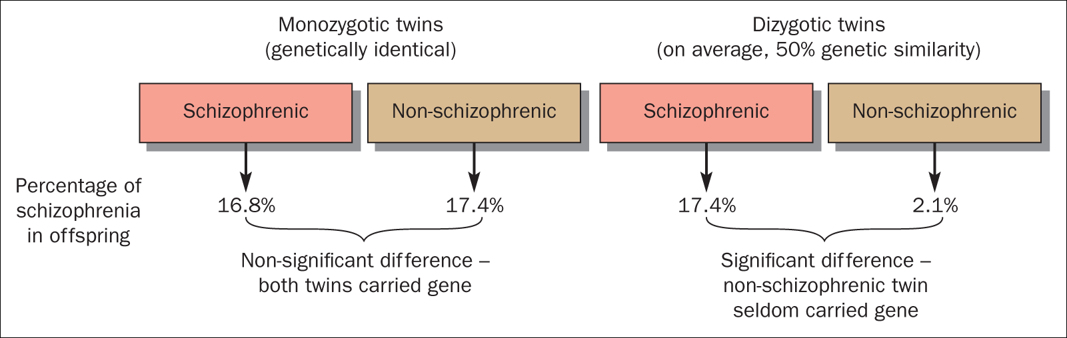
Heritability of schizophrenia (Martin & Carlson, 2023)
carrying a ‘schizophrenia gene’ does not mean that a person will necessarily become schizophrenic.
The environment may be an important trigger for the activation of a biological predisposition.
Polygenetic is the current thinking regarding genetic links in schizophrenia
Notes:
Figure 17.6
Heritability of schizophrenia. An explanation for evidence that people can have an unexpressed ‘schizophrenia gene’.
Gottesman and Bertelsen (1989) have provided strong evidence that schizophrenia is heritable:
For monozygotic twins, the percentage of schizophrenic children born to schizophrenic and non-schizophrenic parents is nearly identical (16.8% and 17.4% respectively).
For dizygotic twins, the percentages are 17.4% and 2.1%.
Therefore, carrying a ‘schizophrenia gene’ does not mean that a person will necessarily become schizophrenic.
The environment may be an important trigger for the activation of a biological predisposition.

Slide 44
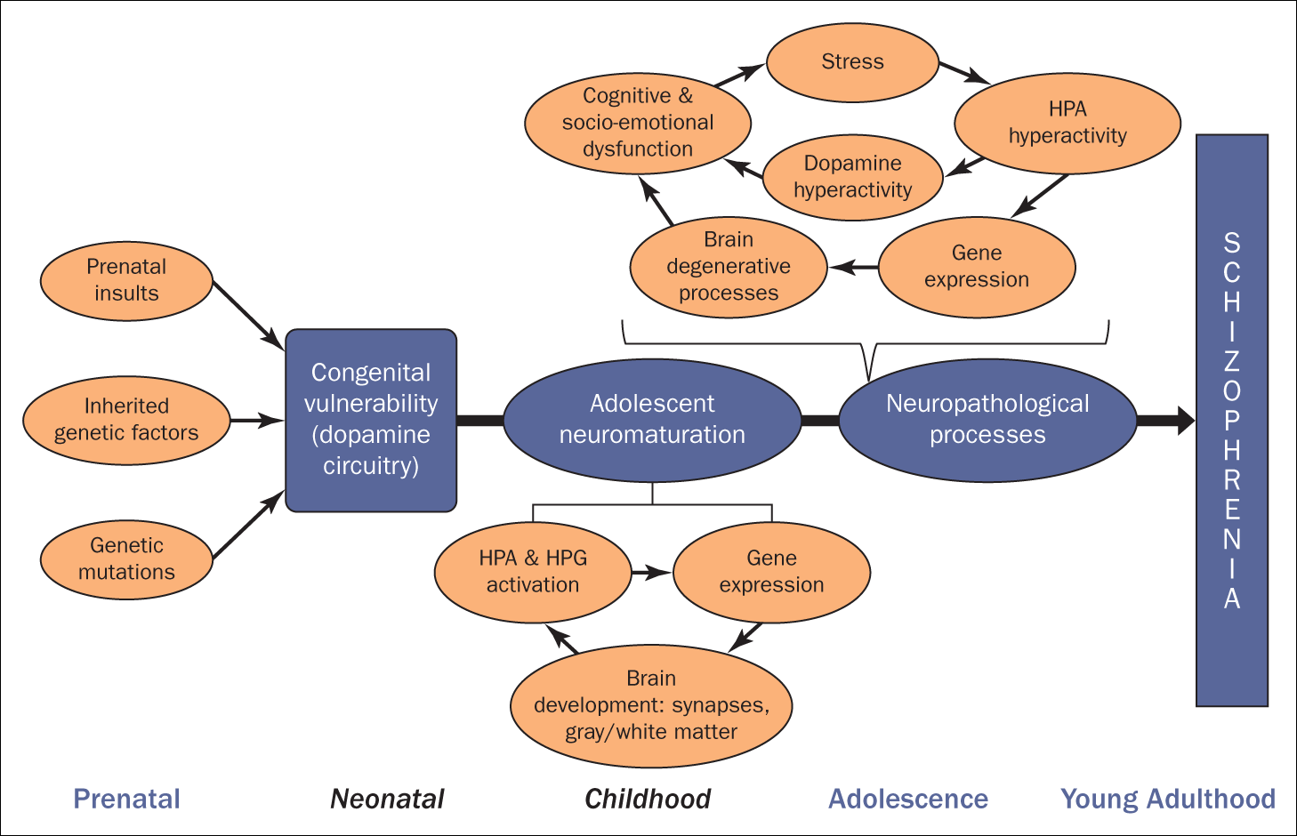
Some of the risk factors for
Schizophrenia (Martin & Carlson, 2023)
Exposure to toxins or a virus before birth or during early infancy that caused oxygen deficiency
The link to early childhood adversity is mostly established by retrospective studies. The link is not as clear when the data are obtained by longitudinal or prospective studies (Jauhar et al., 2022)
Using mind-altering drugs
high stress levels
Having an inflammatory or an autoimmune disease
Source: https://www.who.int/news-room/fact-sheets/detail/schizophrenia
Notes:
Figure 17.7
Some of the risk factors for schizophrenia.

Slide 45

Schizophrenia complications
Schizophrenia is a severe mental illness that shouldn’t be ignored or left untreated.
The disorder increases the risk of serious complications, such as:
  self-injury or suicide
  anxiety
  phobias
  depression
  alcohol or drug use
  Relational problems within family

Slide 46
Family’s experience of the disorder in the 1960s
“When people are very psychotic, they lose their friends, a lot of them. In fact, I will say that people not only lose their friends, but there can be distance from their relatives on both sides. I don’t mean that the relatives were nasty, they were both nice families and we had happy childhoods, but mental health is too much, apparently, to come to grips with and you know, even, extended family, and so we have been more or less on our own with the medical authorities, and of course Rethink and special friends who can take it” (Brumby, 2020. p. 196).
Notes:
A sister talked about her younger brother with schizophrenia

Slide 47
How has schizophrenia evolved through time?
The history of schizophrenia is complex and does not lend itself easily to a linear narrative. Accounts of a schizophrenia-like syndrome are rare in records before the 19th century.
The earliest cases detailed were reported in 1797, and 1809. Dementia praecox, meaning premature dementia ( brain dementia odf the young) was used by German psychiatrist Heinrich Schüle in 1886, and then in 1891 by Arnold Pick in a case report of hebephrenia (Disorganized schizophrenia, or hebephrenia, is a subtype of schizophrenia)
In 1893 Emil Kraepelin used the term in making a distinction, known as the Kraepelinian dichotomy, between the two psychoses – dementia praecox, and manic depression (now called bipolar disorder).
Kraepelin (1893) believed that dementia praecox was probably caused by a systemic disease that affected many organs and nerves, affecting the brain after puberty in a final decisive cascade. It was thought to be an early form of dementia, a degenerative disease. When it became evident that the disorder was not degenerative it was renamed schizophrenia by Eugen Bleuler in 1908.

Slide 48
Historical treatments
The earliest attempts to treat schizophrenia were psychosurgical, involving either the removal of brain tissue from different regions or the severing of pathways. These were notably frontal lobotomies and cingulotomies which were carried out from the 1930s. In the 1930s a number of shock therapies were introduced which induced seizures (convulsions) or comas.
Insulin shock therapy involved the injecting of large doses of insulin in order to induce comas, which in turn produced hypoglycaemia and convulsions.
The use of electricity to induce seizures was developed, and in use as electroconvulsive therapy (ECT) by 1938. Stereotactic surgeries were developed in the 1940s.
Treatment was revolutionized in the mid-1950s with the development and introduction of the first typical antipsychotic, chlorpromazine. In the 1970s the first atypical antipsychotic clozapine, was introduced followed by the introduction of others.

Slide 49

Medications
Antipsychotic medication, is the most common treatment for schizophrenia: Dopamine blocker.
Medication can help stop:
hallucinations
delusions
symptoms of psychosis
If psychosis occurs, an individual may be hospitalized and receives treatments under close medical supervision.
This Photo by Unknown Author is licensed under CC BY

Slide 50

Effectiveness of medications
For paranoid schizophrenia, seeking medical diagnosis and medications can be met with resistance
What is the average length of time?
Are there long term side effects?
How did the patients with schizophrenia react to the medication?
Jauhar et al’s comprehensive review is recommended. Find it in the online reading list.

Slide 51

Recall our earlier discussion about MCA and the public’s stereotypical view that individuals with schizophrenia are dangerous?
This Photo by Unknown Author is licensed under CC BY

Slide 52
Human rights violations
“People with schizophrenia often experience human rights violations both inside mental health institutions and in community settings. Stigma against people with this condition is intense and widespread, causing social exclusion, and impacting their relationships with others, including family and friends. This contributes to discrimination, which in turn can limit access to general health care, education, housing, and employment.” (WHO, 2022)
Source: https://www.who.int/news-room/fact-sheets/detail/schizophrenia

Slide 53
I was labelled with all sorts: eating disorder not otherwise specified, major depressive disorder, borderline personality disorder, schizoaffective disorder and eventually schizophrenia . . . that was the one that knocked the stuffing out of me completely. What was the point in fighting if I was going to be suffering from a lifelong brain disease forever? (Sally Edwards quoted in Cooke, 2017, p. 12)
My family has been shamed and defamed by psychiatric diagnosis. Our lives, historical and present, are forever affected by it. We have felt different. We have felt defective and unacceptable. We felt that our genes were inadequate and shouldn’t be reproduced. We felt that our diagnoses had to be hidden because others might think us dangerous or unpredictable. At times, we felt so ‘other’ that we had to hide our experiences even from one another. We lived with secrets and silence that reached into every corner of our lives. (Thomas, 2013)

Slide 54
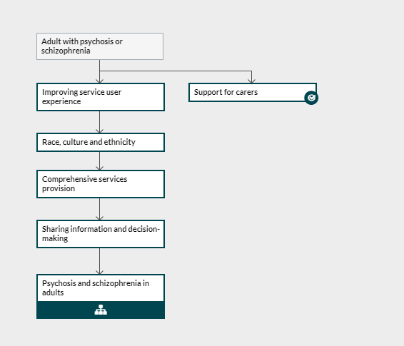
Principles of care for adults with schizophrenia
There is no cure for schizophrenia. Individuals diagnosed with this disorder will need lifelong treatment and care.
Treatments can control or reduce the severity of symptoms.
Schizophrenia is usually treated with an individually tailored combination of talking therapy and medicine.
Why do practitioners need to ask question about these?
NICE clinical guidance (2016)
Notes:
Over representation of black males and people from more challenging backgrounds in mental health hospitals

Slide 55
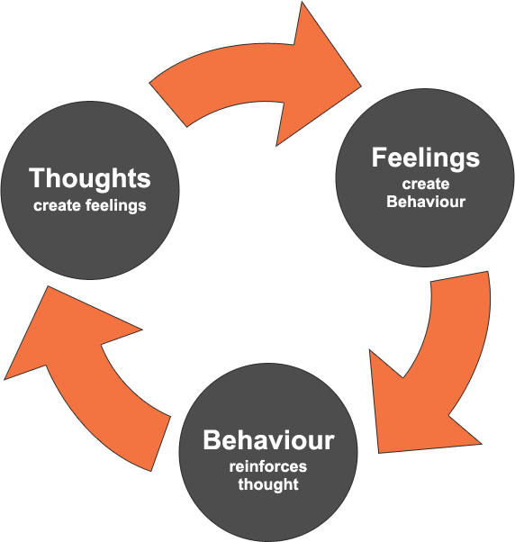
Psychosocial intervention
Psychosocial intervention includes individual therapy to help people with this condition cope with stress and illness.
CBT is commonly used tool in psychosocial intervention (see graph) but the effect size for schizophrenia is small in recent meta-analyses (Jauhar et al., 2022)
To a less extent, social training may improve social and communication skills. Family therapy and support are important.
More on CBT to follow

Slide 56
What is Libermann and Kopelowicz’s recovery model for schizophrenia (2002; 2005)?
Download and read page 3 in Damsgaard and Angel’s paper (2021) from the online reading list on Moodle.
Damsgaard, J.B. and Angel, S. (2021) “Living a Meaningful Life While Struggling with Mental Health: Challenging Aspects Regarding Personal Recovery Encountered in the Mental Health System”. Int. J. Environ. Res. Public Health, 18, 2708. https://doi.org/10.3390/ ijerph18052708
What is the duration of sustained recovery?

Slide 57

According to Damsgaard and Angel (2021), what is personal recovery and how does it differ from the formal treatment based recovery for schizophrenia?
Page 3

Slide 58


“The idea of schizophrenia may be doing more harm than more harm than good” (Cooke & Kinderman, 2018. p. 54)
Effectiveness of treatments
Cannabis as cause of schizophrenia
Childhood adversity as cause of schizophrenia whether there is progressive brain change after onset
This Photo by Unknown Author is licensed under CC BY-NC-ND
Notes:
Ongoing debates:
Cooke, A. and Kinderman, P. (2018) “But what about real mental illnesses? Alternatives to the disease model approach to “schizophrenia”. Journal of humanistic psychology, 58(1), pp.47-71.
Also the stigma that it induces in people.
Strong neurological links lead to medication being the dominant approach in treatment. However, some argue whether schizophrenia being a social construct
Hearing voice movement in the early 90s: individuals learn to embrace their hallucinations and learn to adapt to it rather than using medication to rid of it.
Effect size of Childhood adversity is more marked when measured with retrospective methods. However more recent longitudinal studies or prospective studies show no to small effect size. Still ongoing to explore the links and mechanisms.

Slide 59

This Photo by Unknown Author is licensed under CC BY-SA

