Slide 1
Coaching with Creativity – Developing reflection and reflexivity using visual practices and artifacts
Julie Crossman
Notes:
Recap on Johari window
Insights giving and receiving feedback

Slide 2
Link creativity and coaching with a quote

Slide 3

NASA and Creativity

Slide 4
Scores in NASA creativity test
Age
5
10
15
>25
No. tested
1600
same group
same group
200,000
% “highly creative”
Land, G. and Jarman, B. (1992)

Slide 5
Scores in NASA creativity test
Age
5
10
15
>25
No. tested
1600
same group
same group
200,000
% “highly creative”
98
Land, G. and Jarman, B. (1992)

Slide 6
Scores in NASA creativity test
Age
5
10
15
>25
No. tested
1600
same group
same group
200,000
% “highly creative”
98
30
Land, G. and Jarman, B. (1992)

Slide 7
Scores in NASA creativity test
Age
5
10
15
>25
No. tested
1600
same group
same group
200,000
% “highly creative”
98
30
12
Land, G. and Jarman, B. (1992)

Slide 8
Scores in NASA creativity test
Age
5
10
15
>25
No. tested
1600
same group
same group
200,000
% “highly creative”
98
30
12
2
Land, G. and Jarman, B. (1992)

Slide 9
OPPORTUNITYNOWHERE

Slide 10
OPPORTUNITYNOWHERE

Slide 11
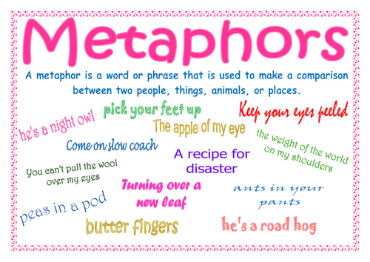

Slide 12
“We live the world of our own personal perceptions and are limited by the boundaries of that perceptual world – boundaries that we have put in place ourselves”, Peltier (2010:196-197)
“Metaphors help us to understand and to change, and they bypass normal resistance to change… and cause us to notice things that we had never noticed before”, Peltier (2010:204)

Slide 13
“So, we need to knock respectfully at the client’s metaphorical ‘front door’, waiting to be invited in rather than barging in and throwing our weight (advice, opinions) around”, Finlay (2022:31)

Slide 14
Metaphors
“The application of a word or phrase to an object or concept that it does not literally denote…can often convey meaning of abstract material as well as…help to explain concepts or processes.”
Sousa (2011:156)

Slide 15

Guess the metaphor

Slide 16


Slide 17


Slide 18
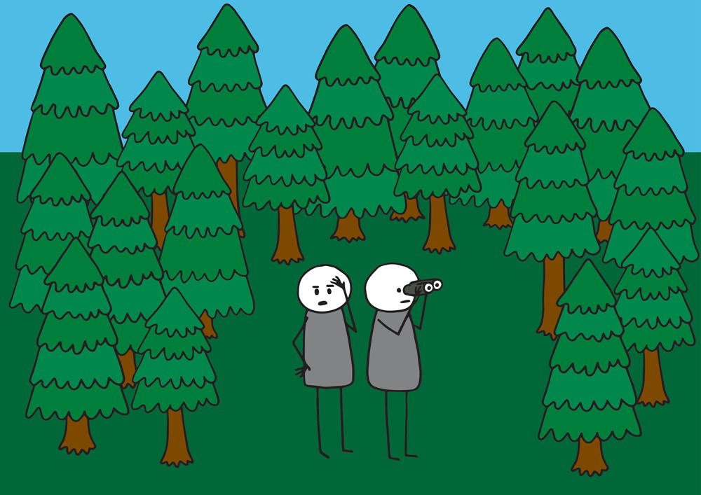

Slide 19


Slide 20
Metaphorical mirror
“Reflective practice involves examining ourselves to see our practice more visibly and giving attention to what we see…Becoming a self-aware professional is a crucial part of reflexivity.
The term ‘reflection’ is a metaphor, likening the practices of introspection and considering one’s actions consciously to our common everyday experience of seeing ourselves reflected ‘back’ to us…reflection permits us to see ourselves as we really are.”
Beckett-McInroy (2022)

Slide 21
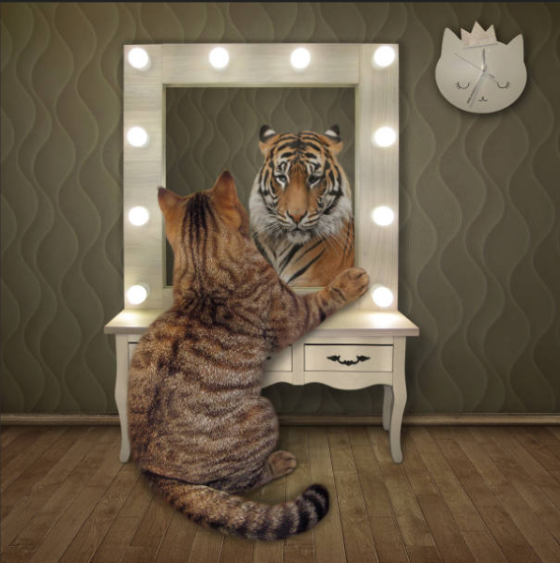

Slide 22
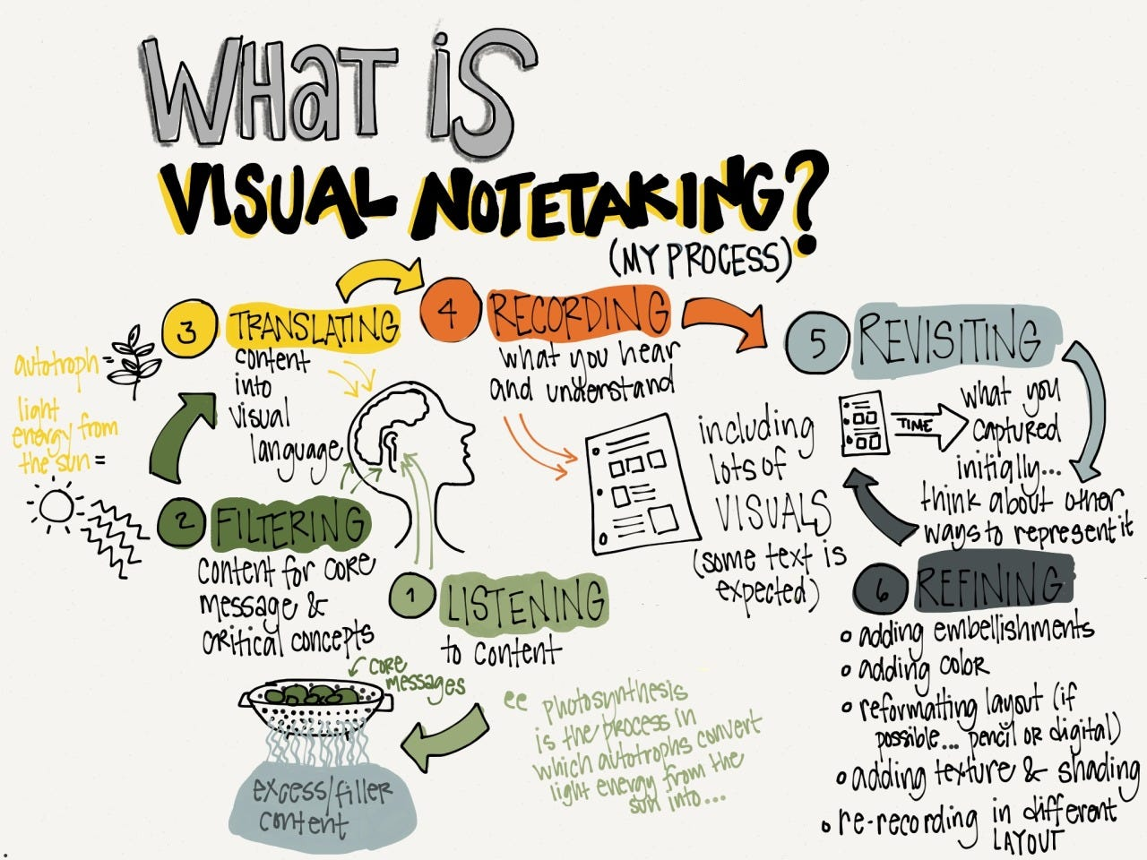

Slide 23
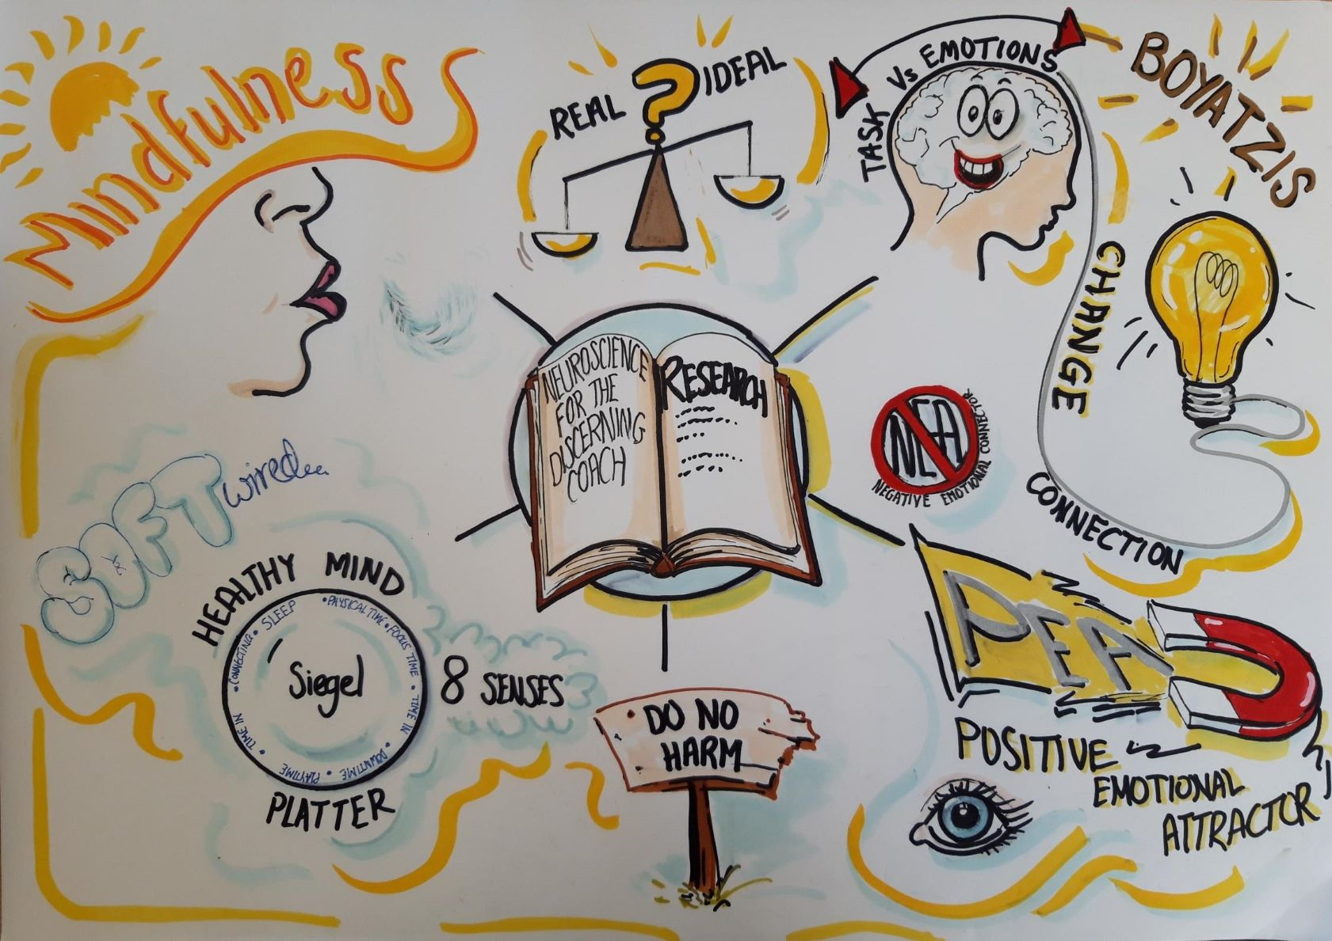

Slide 24
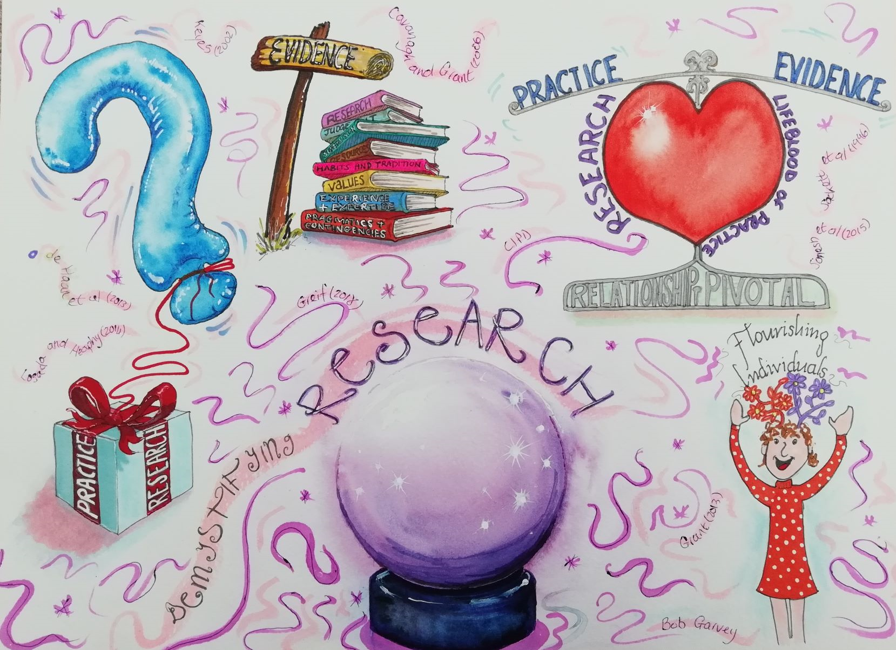

Slide 25
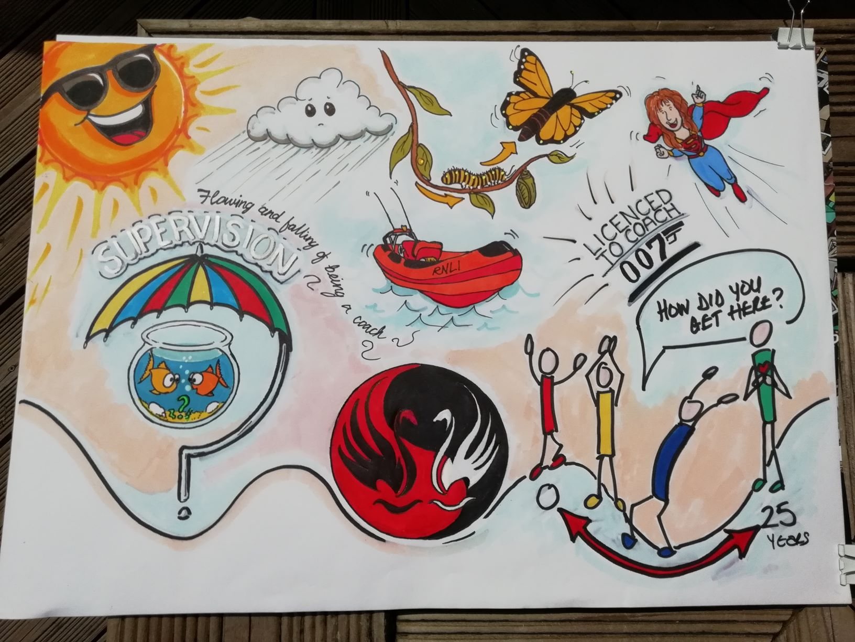

Slide 26


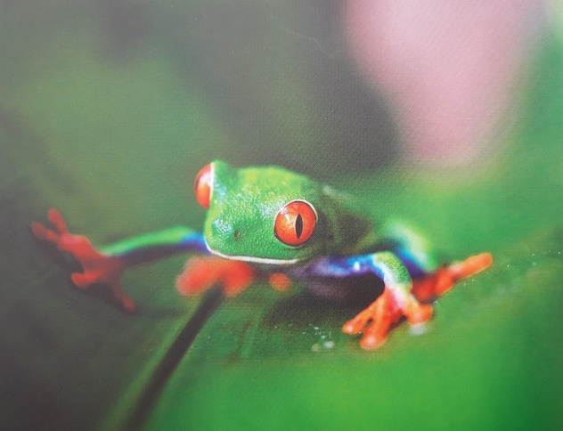

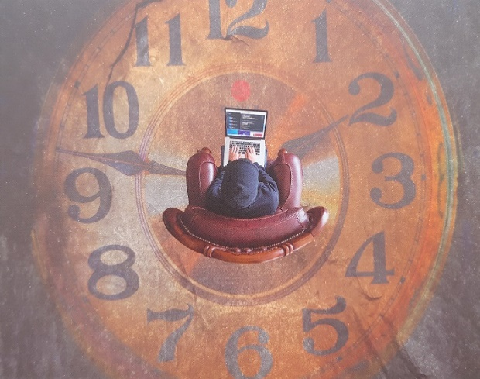

Choose one image
Notes:
Images – we will come back to the image chosen during a group activity at the end, time permitting

Slide 27

Any questions?

Slide 28


Slide 29
Bibliography
Beckett-McInroy, C. and Baba, S.A. (2022). Creative Reflective Practice. 2nd ed. Beckett McInroy Publishing.
Finlay, L. (2022). The Therapeutic Use of Self in Counselling and Psychotherapy. London: SAGE Publications Ltd.
Land, G., (2011). The Failure of Success. [Video].
Available at: https://www.youtube.com/watch?v=ZfKMq-rYtnc&t=4s
(Accessed 2nd June 2023).
Land, G. and Jarman, B. (1992). Breakpoint and Beyond: Mastering the Future Today. Harper Business
Sousa, D.A. (2011). How the Brain Learns. 4th Ed. London: SAGE Publications Ltd
Vint, L. (2005). Fresh Thinking Drives Creativity and Innovation. QUICK - Journal of the Queensland Society for Information Technology in Education, Issue 94, pp. 20-22.

