Slide 1
PROBLEM SOLVING & DECISION MAKING
LCLM4004
LETICIA SANTOS MARQUES SILVA
2443053
DR FAIZU EDU
Assignment 1: Presentation

Slide 2
Overview
Introduction
Company background
Problem: nature and scope
PESTLE ANALYSIS: Green Haven Florists
Cause and effect analysis: Fishbone diagram
Conclusion
References

Slide 3

Introduction
Green Haven Florists is a small business founded by Liam and Priya.
Their shop has taken a significant hit to its revenue, and foot traffic has reduced.
Key Business Analysis Points I will discuss throughout:
Problem Identification to discover why the business has been affected.
PESTEL Analysis to examine external environmental factors and how the business could
change its strategic approach.
Cause and effect analysis to investigate the roots of the problems.
Lastly, discuss key takeaways and suggested improvements for the Florists.

Slide 4







Company Background
Products:
^{Founded in:}
^{Key Details:}
​
Small Business
Independent
Drop in Sales
Bespoke Floral Arrangements
2016
​
Location:
Clients:
Norwich, UK
​
Walk Ins
Independent
Weddings
Online
Owners:
Type:
Liam & Priya Patel
Eco-Friendly
Sustainable

Slide 5


Problem: Nature and Scope
The 5W2H Questions
Who? Liam and Priya Patel.
What? A florist business, focusing on sustainable bespoke products, which is currently struggling.
Where? Norwich, UK. Used to be a busy high street but is now quieter and has less footfall.
When? Over the last 12 months.
Why? Not keeping up with digital trends. Multiple close competitors. No flexible delivery or subscription.
How? Rising costs of fresh flowers. Outdated website and shift to online shopping.
How Much? 30% decline in store sales & reduced revenue.

Slide 6
PESTLE ANALYSIS: Green Haven Florists
POLITICAL
Import fees and regulations affecting the supply chain that are providing the flowers to the company.
Brexit impact resulting in a fall of EU imports (Freeman et al., 2022)
ECONOMIC
Inflation in the UK. 32% of businesses in 2025 reported increased prices to buy goods to sell. (Office for National Statistics, 2025)
Post COVID impact on business.
SOCIAL
Culture change to ordering everything to the home instead of visiting shops.
Influencers on Instagram changing expectations.

Slide 7
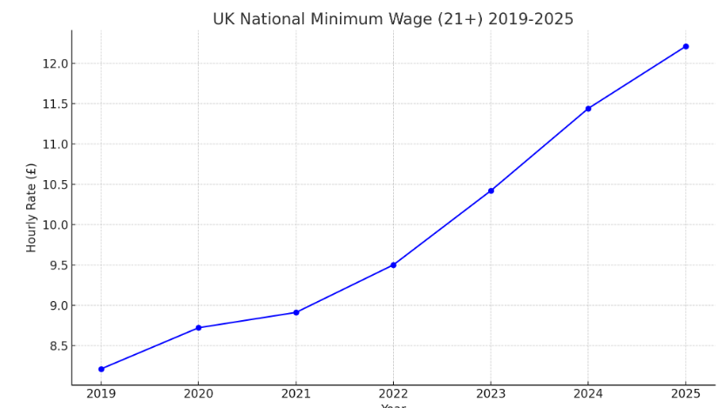
PESTLE ANALYSIS: Green Haven Florists
TECHNOLOGICAL
Increasing use of AI in business, more than 52% of UK businesses using AI. (Amazon Web Services, 2025)
Customers using websites with faster deliveries.
LEGAL
Staffing costs due to employment laws – minimum wage increasing.
Health and safety laws must be followed.
ENVIRONMENTAL
Climate change is affecting flower production, reducing the availability of certain types of flowers for Green Haven.
Sustainability change such as Net Zero by 2050 in the UK (House of Lords Library, 2021)
(UK Government, 2025)

Slide 8
Cause and effect analysis: Fishbone diagram
People
Technology
Methods
Word of mouth
Outdated website
No subscriptions
Small town with closing businesses
No mobile app
No same day delivery
Reduced high street customers
Lack of digital marketing
Rising operational costs
Green Haven – Reduced sales and reduced profit
Climate change
Inflation for products
Less local grown flowers
Competition from other businesses
Less variety of flowers
Expensive sustainable materials
Environment
Materials

Slide 9
Conclusion
Green Haven Florists reduced revenue is mainly caused by less customers, rising costs, growing competitors and not keeping up with digital trends.
The PESTLE and Fishbone analysis show that focusing on online shopping trends and improving technology such as the website could help sales increase.
I suggest Green Haven should modernise its website, make more delivery options and promote their business through new digital marketing.

Slide 10
References
Amazon Web Services (2025) Unlocking the UK’s AI potential: UK business adoption. Available at: https://www.aboutamazon.co.uk/news/aws/aws-unlocking-ai-report-uk-business-adoption (Accessed: 1st November 2025).
Freeman, R., Manova, K., Prayer, T. & Sampson, T. (2022) ‘UK Trade in the Wake of Brexit’, Single Market Economics Papers, European Commission, 22nd December 2022.
House of Lords Library. (2021) Climate change targets: the road to net zero? London: House of Lords. Available at: https://lordslibrary.parliament.uk/climate-change-targets-the-road-to-net-zero/ (Accessed: 2nd November 2025).
Office for National Statistics (2025) Business insights and impact on the UK economy: 22 May 2025. Available at: https://www.ons.gov.uk/businessindustryandtrade/business/businessservices/bulletins/businessinsightsandimpactontheukeconomy/22may2025 (Accessed: 2nd November 2025).
UK Government (2025) National Minimum Wage and National Living Wage rates. Available at: https://www.gov.uk/national-minimum-wage-rates (Accessed 5th November 2025).

Slide 11
Any Questions?
THANK YOU FOR LISTENING

