Slide 1


Slide 2

Holcombe hypnotherapy and coaching
Chevonne Richards 1814098
Cowin Kelly 2027494
Victoria Holcombe 202807
Obinna Nkwocha
Group 2
Emmanuel le-Maire 2027297

Slide 3

Executive Summary
The Business The business was created in this way as the pandemic delayed some training the owner was going to participate in so it had to be changed to allow time for restrictions to ease and things to be back to normal.
Ownership Background Victoria Holcombe (owner): mentoring management diploma in coaching diploma in employability the team is staff is as follows
Marketing team within 6 months to a year, we hope the business will be in a position where it can hire staff to run it whilst I spend more time with the family.
Virtual assistant
Receptionist
Admin
Graphic designer
Web designer
within 6 months to a year, we hope the business will be in a position where it can hire staff to run it whilst I spend more time with the family.

Slide 4
Company Overview
The business will be structured as a sole proprietorship.
marketing team self-employed Receptionist admin and VA/admin receptionist self-employed practitioners.
we aim to provide hypnotherapy coaching personal training we market the services they provide with tv style advertising on social media
each practitioner will be self-employed and will be given referrals. And charged a subscription fee monthly .
London office
0300 number
Open ten –six five days a week
Website
Social media adds tv style advertising

Slide 5
Products and services
Hypnotherapy
life coaching
personal training
affordable tv style advertising for Sosial media channels
Subscription service payments same price every month
Interpersonal service no online interaction
Practitioners get the full fee they earn in a session

Slide 6

Marketing
Social Media
Google adverts
Brochures
3rd party

Slide 7
Social media
Instagram
Using influencers
Colaborations
Sponsored post
Facebook
Facebook adverts
Business page
Yotube
Promotional videos
Video / pictures of services
twitter
Updates
Queries
Notes:
Social media is one of the fastest ways to showcase businesses to potential customers and investors. Networking with already established influencers on Instagram is a great way to reach a wider target market. You can use analytical tools to view insights of what influencers or companies generate high amount of traffic which is quite useful and helps guarantee you a certain amount of reach per post.
Tailored Facebook adverts are a great way to reach people at all different ages. Creating a separate business page for the brand would be ideal to keep customers updated with current and new services
Using twitter can provide customers and potential customers with service updates, new products etc. using twitter is a god way of giving quick responses to queries and questions.
Creating youtube videos of the type of services would give people a better visual representation of what to expect from us.

Slide 8
Google Adverts
Bigger target audience
Cost effective
Flexible
Notes:
Google advert will open business no matter how small or large to a wider target audience. We will pay for adverts to bring in traffic to our business whenever anyone uses words like hypno, hypnotherapy, personal training, personal trainers etc because we would come up in the first few searches.
You can set a budget of how much you want to spend per click, google will calculate the cost over a period of month no extra cost. Good way of setting budgets and sticking to them
You can access tools for your advert at anytime and anywhere

Slide 9
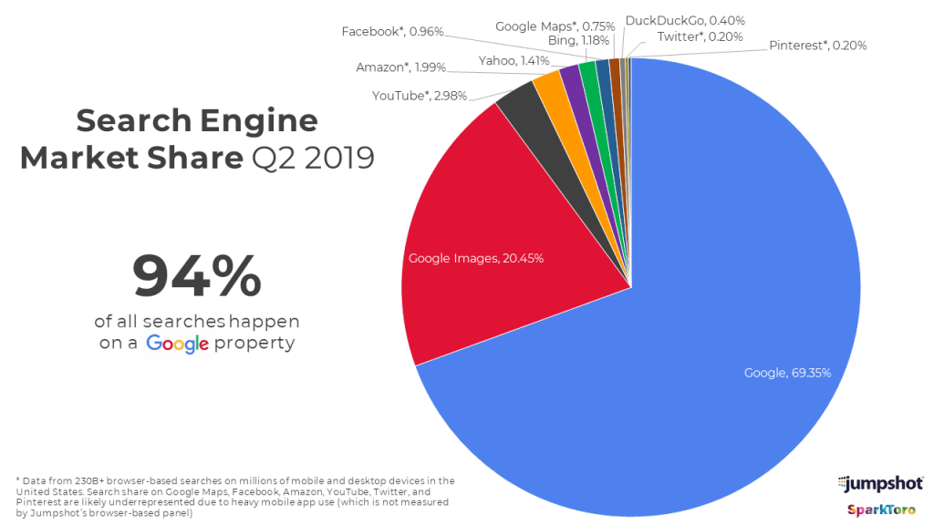
Google adverts
  Free ad software
  Track performance
  CTR (clicks through rate
  CPC Cost per conversion
Notes:
Free google ads software- gives you full insight analytics, you can use to track how well your advert is performing, this will help make us necessary adjustments if their needed to be.

Slide 10

Pestle analysis
Political ...GDPR compliant in uk
Economical..... online work virtual office no paperwork
Social …..benefits everyone all ages
Technological ….all online

Slide 11

Swot analysis
Strengths
Popular product
Lucrative profits
Residual income (once set up) subscription service
Weakness
Not much startup capital
Opportunities
Strong marketing networking has introduced us to some really good contacts e.g., social media
Threats
Competition from other companies

Slide 12

Brochures
Tv advertising to create referrals for practitioners
Life coaching
Hypnotherapy
Personal training
0333 577 0307
Notes:
Getting information from a brand in hand gets the attention of potential customers,
They are cost effective and pocket friendly.
Potential customers can find direct information about the business and what they are offering.

Slide 13
CASH FLOW FORECAST
Cash flow is the main source of strength that keeps business growing. To create a successful business, there must be cash from the beginning of the business and throughout. Cash on hand helps business owners to pay for some relevant expenses. The cash is something which stands as an intercessor, as the merit calculation, and as way of making future payments (Mayer et al 1995: 20).

Slide 14
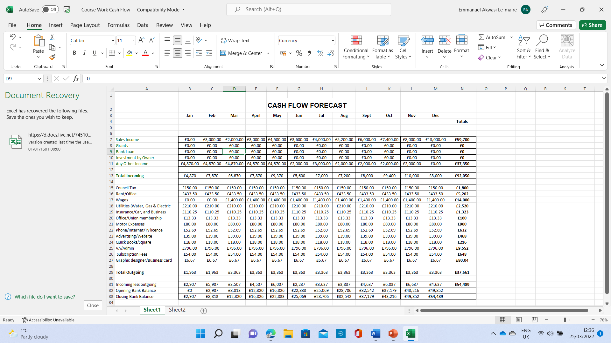
CASH FLOW FORECAST

Slide 15
FORECAST PROFIT & LOSS ACCOUNT.
This is the statement that shows the difference between sales and expenses, whether there is any profit or loss on a certain period of time. Always when sales are bigger than expenses, the balance of the income statement will come as positive, which means business is gaining profit.
Whereas, if the expenses are bigger than the sales, the balance of the income statement will show as business not profiting.

Slide 16
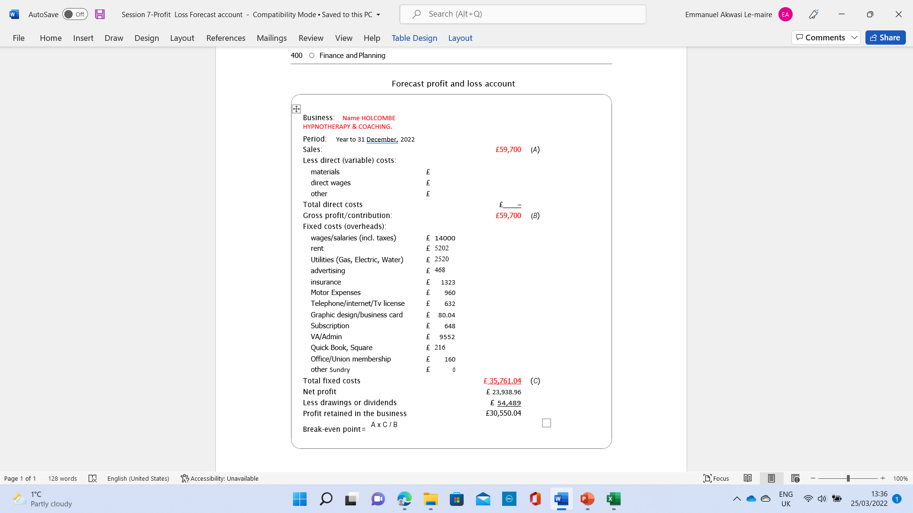
FORECAST PROFIT & LOSS.

Slide 17
References
Saripah, Iip, et al. 2022 "Mentoring Model of Business Plan Competition Program in Improving Social Entrepreneuship." Journal of Nonformal Education 8.1
Localiq. (2022). How to Advertise on Google & Grow Your Business. Available: https://www.wordstream.com/advertise-on-google. Last accessed 25 march 2015.
Ana Gotter. (15 July). Getting Started on IG: A Beginner’s Guide to Instagram Marketing. Available: https://www.shopify.co.uk/blog/instagram-marketing. Last accessed 25 march 2022.
david ingram. (2007). what are the seven procedures in accounting . Available: ttps://smallbusiness.chron.com/seven-internal-control-procedures-accounting-76070.html. Last accessed 25 m arch 2022.
Wheadon, J. D., & Duval-Couetil, N. (2014). Business plan development activities as a pedagogical tool in entrepreneurship education. The Journal of Engineering Entrepreneurship, 5(1), 31-48.

