Slide 1
Control Phase
By
Andrew Thorn

Slide 2
Control Phase Elements
Update SOP & Training Plan
Develop Control Plan
Develop Control Strategy

Slide 3
Control Phase
Is a means for sustaining improvement by either eliminating the opportunity for defects or monitoring process performance using a feedback system
While the control measures remain in place on an ongoing basis, the control phase is considered completed once SOPs are updated, and training has been conducted to institutionalise the revised methods

Slide 4
Control Phase
Project Team will develop
A control strategy based upon the results of the previous four phases
A control plan that incorporates changes into the process in a timely way
An updated (SOP) and training plan to document the changes and improvements

Slide 5
Control Phase Objectives
Recognise when to apply prevention techniques or detection techniques when developing the control strategy
Incorporate methods associated with visual controls that enable an individual to immediately recognise the standard and any deviation from it
Gain the ability to develop MSA actions and when to apply them

Slide 6
Control Phase Objectives
Demonstrate the ability to develop control plan and the data collection related to the ongoing measurement of any variation
Identify when to utilise the reaction plan to adjust the process if one of the control charts begins showing data plots outside of the control limits

Slide 7
Purpose of Control
Control is a means of sustaining improvement by either eliminating the opportunity for defect or monitoring the process and using a formal feedback system
Need to establish an effective strategy to ensure improvements are sustained

Slide 8
Control Strategy
This step allows the Project Team to determine what has been done to either design errors out of the process or detect them if they occur

Slide 9
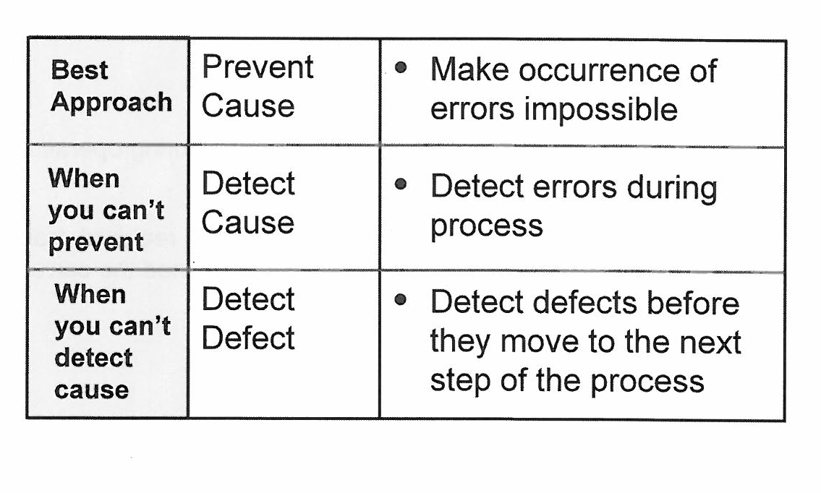
Prevention Vs. Detection

Slide 10
Prevention Vs. Detection
Prevention: - means to change a process or product in a way that eliminates the opportunity to produce a defect
Detection: - means to identify a defect before it leaves the current process step
Prevention of any error is the most effective way to reduce potential customer dissatisfaction

Slide 11
Error Proofing
Is the avoidance of an error before it occurs
Error proofing consist of: - (1) techniques applied to manufacturing operations and business processes and; (2) Processes designed to minimise required training while allowing operations to be performed the correct way everytime

Slide 12
Error Proofing
The ultimate goal is to make it impossible for an operation to be performed incorrectly
Error proofing requires no formal training because the process operation is designed so that it can be done the correct way only
Since the work can be done the correct way only it is not necessary to inspect that operation

Slide 13
Error Proofing Techniques
Eliminating redundant, non-value added process steps that are prone to producing errors; e.g. double entry of data
Using bar codes to make sure key information can be communicated easily from one operation in a process to the next

Slide 14
Error Proofing Techniques
Revising software so all data must be input before the user can advance to the next screen
Pre-assembling individual parts into components so they can be validated as “good” prior to final assembly

Slide 15
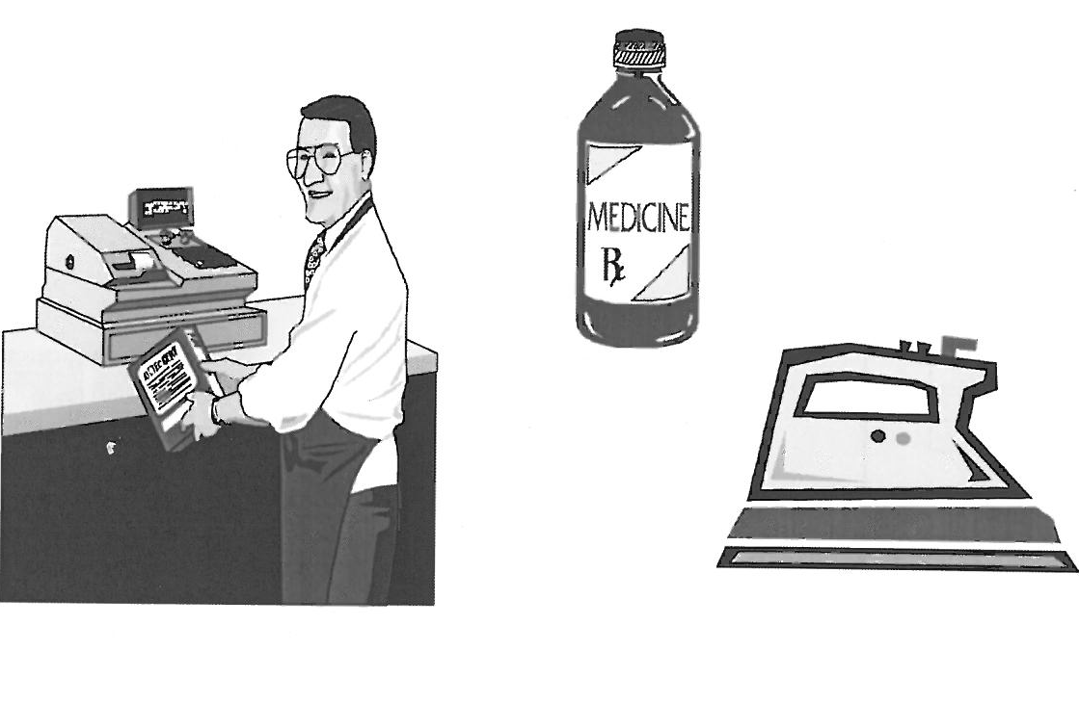
Error Proofing

Slide 16
Steps to Follow for Error Proofing
Describe the defect or potential defect and how often it occurs
Identify where the defect occurs in the process (process step)
Analyse the tasks associated with the process step identified

Slide 17
Steps to Follow for Error Proofing
Apply “Five-why” analysis to determine the root cause
Identify possible error proofing strategies
Verify the effectiveness of error proofing actions

Slide 18
Visual Displays and Visual Controls
Visual Displays: - communicate important information, but do not control what people or machines do
Visual Controls: - communicate information and/or build controls into the process so activities are performed according to standards

Slide 19
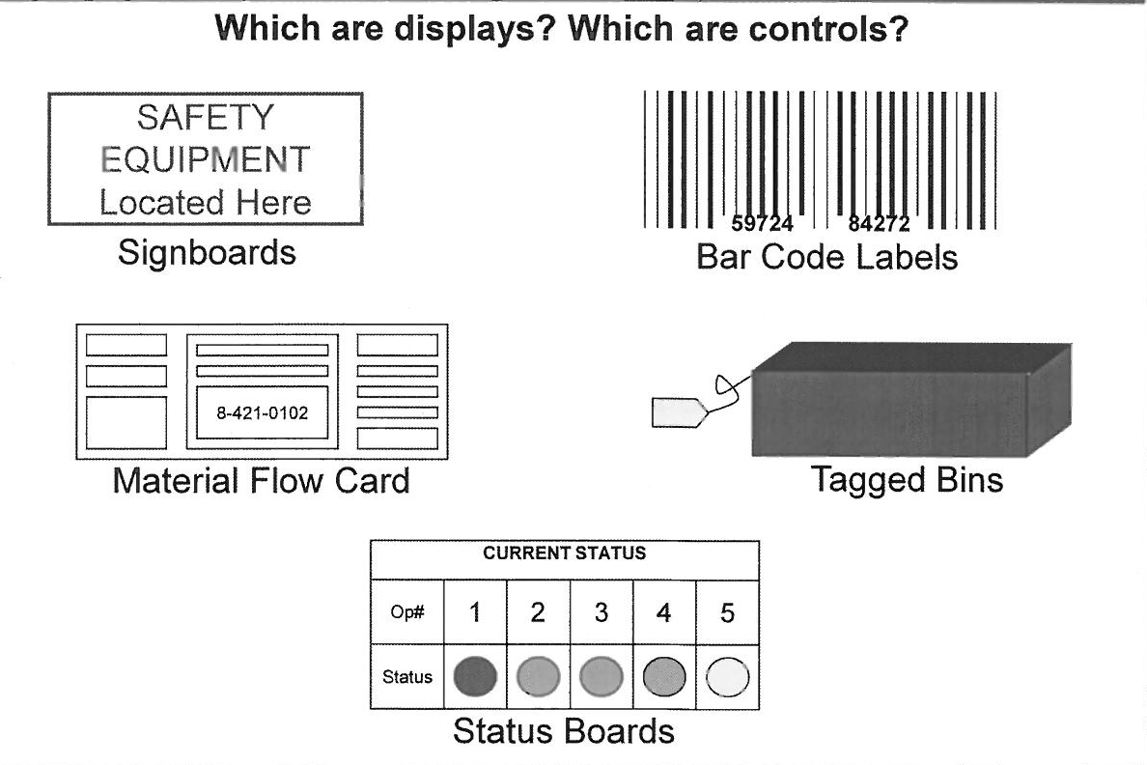
Visual Displays and Visual Controls

Slide 20
Error Proofing Exercise
What examples of visual controls or visual displays are in your work setting?

Slide 21
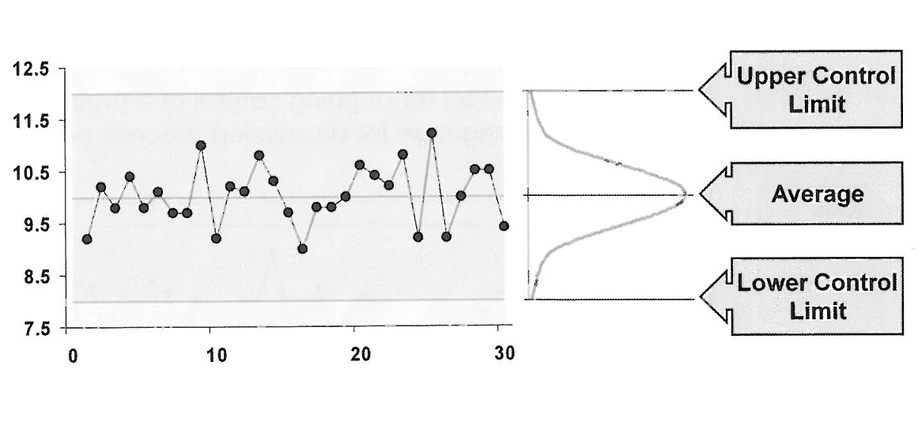
Understanding Control Limits

Slide 22
Understanding Control Limits
A control chart is a Trend/Run chart with upper and lower control limit lines drawn on either side of the process average
The positions of the upper control limit and lower control limit lines are determined by the data
The lines are calculated at ± 3.0 standard deviations away from the centre line

Slide 23
Purpose of Control Charts
Focus attention on detecting and monitoring process variation overtime
Distinguish special causes from common causes of variation, as a guide to local or management action
Serve as a tool for ongoing control of a process and provide a common language for discussing process performance

Slide 24
Purpose of Control Charts
Offer a way to note unwanted variation
Unwanted variations are a variety of “special cause” variation
If timely follow-up action is not taken after determining there is special cause, the primary purpose of control is not met
If a special cause variation occurs, corrective action must occur quickly in order to keep the process in control

Slide 25
Common Vs. Special Cause
Common Causes
Require action on the system
Require the authority of management to take actions needed to remove
Inherent to the process, thereby affecting each part
Special Causes
Can usually be eliminated by some local actions
Can usually be removed by the operations employees
Does not affect each part equally

Slide 26
Common Causes
Are issues in a process that generate variation through interaction. Common causes affect everyone working in the process and affect all of the outcomes. Common causes are always present and thus are generally predictable
They are generally accepted sources of variation and offer opportunities for process improvement

Slide 27
Special Causes
Are issues in a process that generate variation due to extraordinary circumstances. Special causes are not always present, do not effect all of the outcomes
Special causes are not predictable

Slide 28
Why bother about Common Vs. Special Cause?
Guide us in our future analysis
Help us determine whether our actions are likely to deal with local issues (special cause) or systematic issues (common cause)

Slide 29
Types of Control Chart
Variable data
- X bar/R chart
- I – MR chart
Attribute data
- p chart
- u chart

Slide 30
X bar/R chart
X bar = Average value calculated from a set of data (subgroup)
R (range) = The difference between the highest and lowest values in a subgroup
Variable data consists of measurements made on a continuous scale
The X bar chart is used to monitor time to variation, and the R chart is used to monitor piece to piece variation

Slide 31
X bar & R chart
The X bar chart uses a sampling process and the team takes a number of measurements, for example 5
Then calculate the average of the measurements and plot a single data point on the chart
Note that individual points can fall outside the control limits, but only the average point is plotted

Slide 32
I- MR Chart
Individuals & Moving Range Chart
There are cases where the team cannot take a set of measurements, but the process still needs to be monitored
In these cases, there might be a sample size of 1 measurement, which would create a single data point on our chart
In a MR chart, we calculate the Moving range by using more than one sample data point

Slide 33
Control Limits and Specification Limits
Specification limits should be based on the voice of the customer and established during the design process
These limits define the range of customer satisfaction
Control limits are based on the voice of the process are a reflection on how the process is running
Therefore it is possible to have a process that is “in control” but producing results that are outside the specification limits and outside customer expectations

Slide 34
“In Control”
Process performance where only random variation is evident and the data points fall between the upper and lower control limits

Slide 35
Out of Control Conditions
Points on or outside of the control limits
A run of 7 consecutive points up or down
7 consecutive points above/below the centre line
Cyclical Patterns

Slide 36
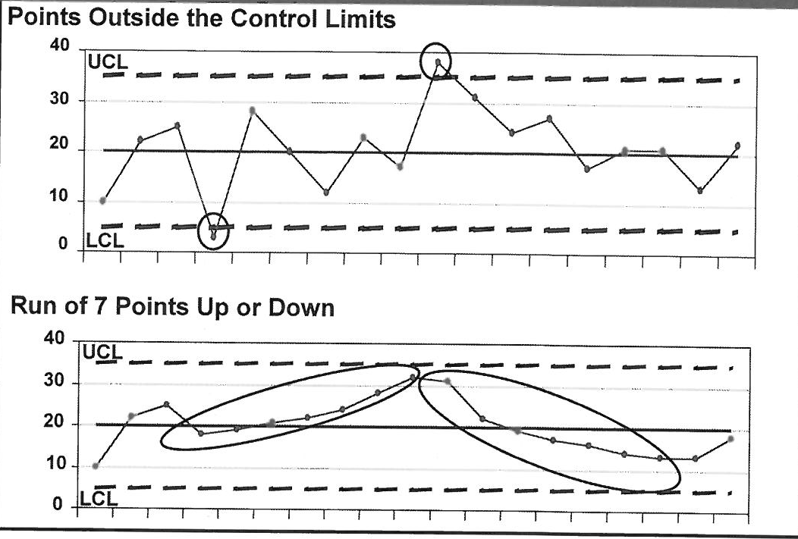
Out of control Conditions

Slide 37
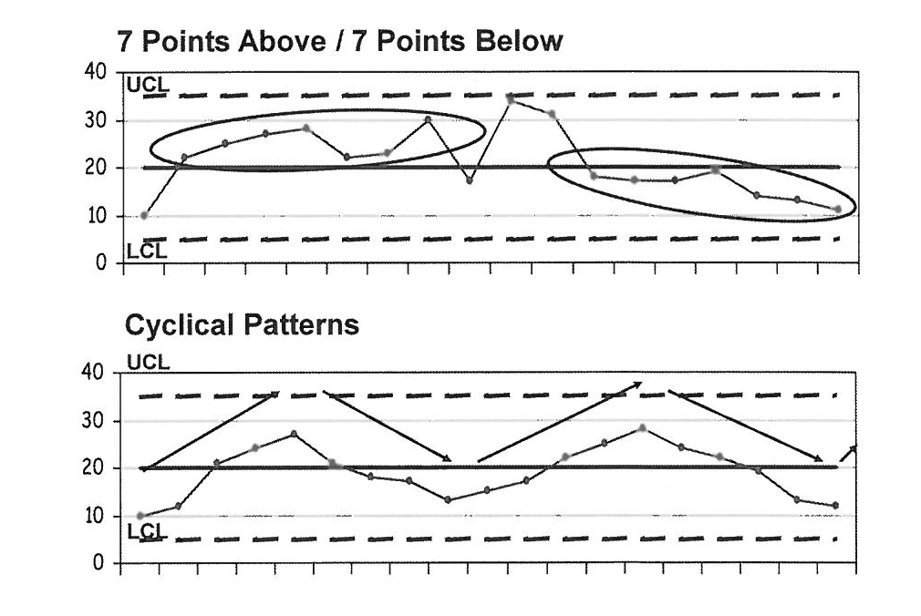
Out of Control Conditions

Slide 38
Out of Control Conditions
7 consecutive points above/below the centre line can tell us that something has changed in the process, and whatever it was, it is holding steady
Cyclical patterns can indicate our process is being affected by things like tool wear, improper maintenance of equipment, external factors like temperature or humidity, etc.

Slide 39
Control Vs. Capability
In-control, producing acceptable product
In-control, producing non-acceptable product
Not In-control, producing acceptable product
Not In-control, producing non-acceptable product

Slide 40
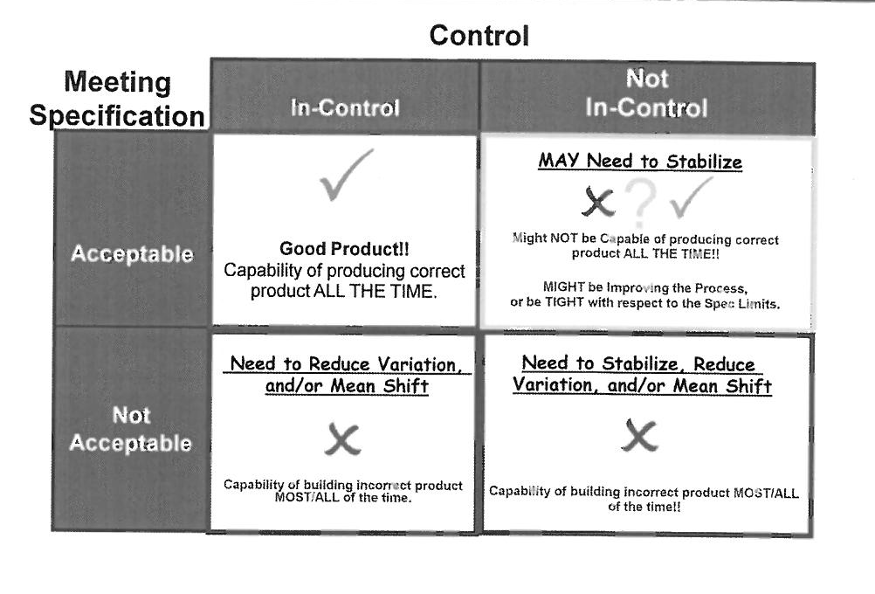
Control Vs. Capability

Slide 41
Variable Data- I-MR Chart
Tracks process variation and indicates special causes of variation
Provides both an individual chart and a moving-range chart in the same graph window
Tracks individual measurements, not averages of subgroups or measurements

Slide 42
Advantages of I-MR vs. X bar/R Chart
Allows us to chart in a situation where we are doing “destructive” sampling
Only requires the collection of one sample per point
Can be used in low volume situations

Slide 43
Disadvantages of I-MR vs.
X bar/R Chart
Single samples per point do move toward normal data over time
Out-of-control conditions are not always seen as quickly, more points needed for a trend
Moving Range cannot tell us as much as Range
Requires 30-100 data points to calculate centre line and limits
Requires normal data to calculate limits and capability

Slide 44
Attribute Data
Pass/fail
Go/No go
Present/Absent

Slide 45
Attribute Data- p Charts
Tracks the proportion of defective units observed in a sample
Notes special causes relative to upper and lower control limits
Applies to both constant and non-constant sample size

Slide 46
Attribute Data – U chart
Tracks the number of defects per unit sampled
Shows defect data compared to upper and lower control limits
Applies to constant and non-constant samples sizes

Slide 47
Attribute Data Out-of-Control Conditions
Point is plotted on or above the upper control limit (UCL)
Point is plotted on or below the upper control limit (LCL)
Run of seven consecutive points greater than the process mean
Run of seven consecutive points lower than the process mean
Trend of seven successive increasing points
Trend of seven successive decreasing points

Slide 48
Steps for Implementing Control Charts
Select the appropriate characteristic to control
Select the data collection point
Select the type of control chart
Establish the basis for subgrouping and determine the appropriate sample size and frequency
Determine the measurement method/criteria

Slide 49
Steps for Implementing Control Charts
Perform the measurement system analysis
Perform an initial capability study for collecting and charting data
Develop procedures for collection, charting, analysing and acting on information
Provide written instructions and train personnel

Slide 50
Developing a Long-Term MSA
Definition
Long-term MSA reviews how accurate and
consistent measurement is. The quality of a process cannot be understood and controlled without confidence in the measuring system.

Slide 51
Developing a Long-Term MSA
A long-term MSA documents how process measurements will be monitored over time to ensure that they remain constant
Remember, the purpose of a measurement system analysis is to understand the sources of variation that can influence the results produced by the system
It must be done using the people environment and tools that will reflect the ongoing situation to fully understand the total measurement system

Slide 52
Elements of a Long-Term MSA
The long-term MSA should address the documentation that is required for the plan and how the documentation will be managed
Information on calibrating the measurement system over time (or some way to assess accuracy)
Detail regarding maintenance of the measurement system

Slide 53
Elements of a Long-Term MSA
When to reassess Repeatability and Reproducibility
What changes require reassessment (new people, new equipment, new environment
Details regarding measurement owner (who manages the data collection process)

Slide 54
Develop Control Plan
The control plan includes a description of the improvements in place as well as a Reaction Plan that describes what to do if the improvements are not sustained.

Slide 55
Benefits of Developing Control Plans
Improve overall quality by reducing chances of quality deviations
Reduce defects by keeping processes centred
Aid in timely troubleshooting of process
Serve as a communication tool for changes in CTQs
Help to sustain improvements

Slide 56
Developing and Implementing a Control Plan
A control plan is a written description of the strategy for ensuring improvements are sustained
The control plan describes the actions required at each step of the process to ensure that all process outputs (Ys) will be in a state of control

Slide 57
Reaction Plan
Having a reaction plan helps ensure control issues are addressed quickly and corrective actions are taken
A reaction plan is the part of the control plan that provides details on actions to be taken should control charts indicate the revised process is no longer in control

Slide 58
Reaction Plan
This document will be used by the process owner as a guide for adjusting the process should one of the control charts begin showing data that plots outside of the control limits
Reaction plans provide a process monitoring and control mechanism that can be used in a systematic way to take appropriate short-term and long-term actions

Slide 59
Developing a Reaction Plan
Include: -
How to differentiate between a special cause and a process trend?
What to use as a signal for action?
What actions should be taken?
Who is responsible for implementing those actions
Who is responsible for verification?

Slide 60
Update SOP and Training Plan
Updating standard operating procedures and training plans in the practice of revising existing process documentation to reflect the process improvements

Slide 61
Control Phase Summary
Apply prevention techniques or detection techniques when developing the control strategy
Incorporate visual controls methods enabling an individual to immediately recognise the standard and any deviation from it
Ability to develop MSA actions and when to apply them

Slide 62
Control Phase Summary
Ability to develop a control plan and data collection related to the ongoing measurement of any variation
Utilise the reaction plan to adjust the process if one of the control charts begins showing data plots outside of the control limits

