Slide 1
BMST4004
Muscle Healing

Slide 2

Muscle Healing
LEARNING OBJECTIVES
To be able to:
Explain common mechanisms of muscle injuries
Describe grade and severity of muscle injury
Understand the regenerative capacity of muscle tissue
Discuss the application of rehabilitation and recovery from muscle injury

Slide 3
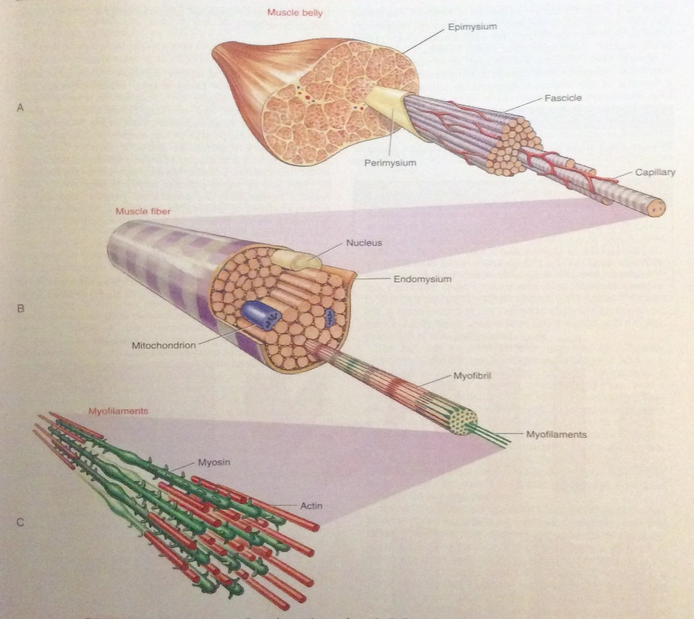
Muscle architecture
Largest organ
Types – skeletal, smooth, cardiac
Total weight
Skeletal
  MALES 40-44%
  FEMALES 31-33%
Myofibrils – CABLE LIKE STRUCTURES
Sarcomeres
  INDIVIDUAL CONTRACTILE UNITS
  PRODUCE FORCE TO BE ABLE TO MOVE
Notes:
Skeletal, hamstrings glutes, biceps etc
Smooth – Walls of the stomache, intestines, bladder, uterus, blood vessels and lymphatic system
Cardiac – heart

Slide 4
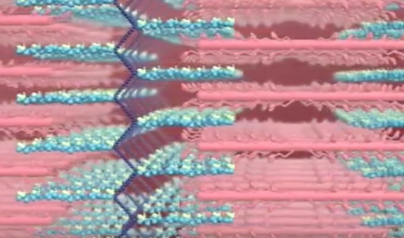
Sarcomere
Actin and myosin (proteins)
Cross bridges
Contractile
Sarcoplasm (cytoplasm of mm cells)
Huxleys sliding filament

Slide 5
Fibre types
Type I / TYPE IIa/ type IIb
  TYPE I – SLOW TWITCH, HIGH AEROBIC CAPACITY, SPEED OF CONTRACTION (110MS), LOW SARCOPLASMIC DEVELOPMENT, 10-180 FIBRES PER MOTOR UNIT.
  TYPE IIA – FAST TWITCH, MODERATE AEROBIC CAPACITY, SPEED OF CONTRACTION (50MS), HIGH SARCOPLASMIC DEVELOPMENT, 300-800 FIBRES PER MOTOR UNIT.
  TYPE IIB – FAST TWITCH, LOW AEROBIC CAPACITY, SPEED OF CONTRACTION (50MS), HIGH SARCOPLASMIC DEVELOPMENT, 300-800 FIBRES PER MOTOR UNIT.
Factors influencing fibre type – GENETICS, TRAINING TYPES (ENDURANCE/PLYO), AGING
Generally, recruitment follows slow to fast…..

Slide 6
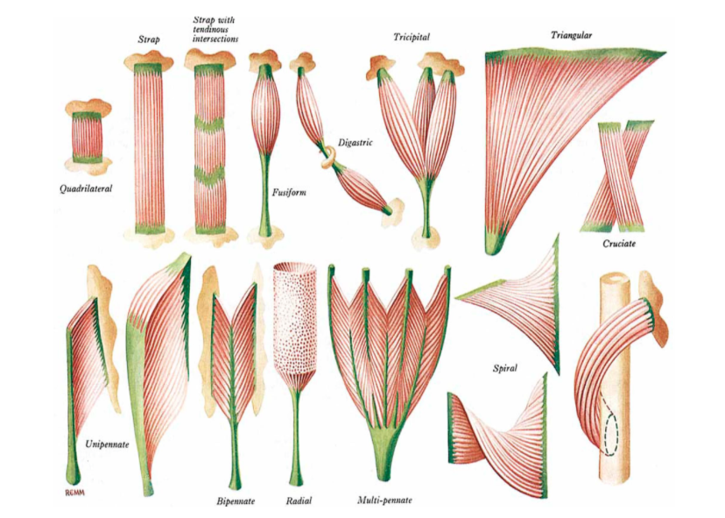
Muscle architecture
Majority of muscles in body are pennate (oblique attachments like a feather) and generate more force than their fusiform cousins
Physiologic cross-sectional area (PCSA) and pennation angle determine the amount of force transmitted through M-T complex
Pennation angle refers to angle of orientation between the muscle fibres and tendon

Slide 7
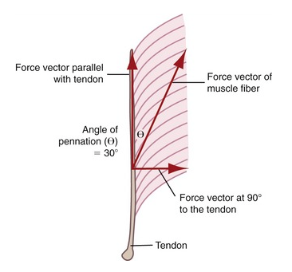
Muscle architecture
The high PCSA allows for pennate muscles to transmit high forces
If the muscle was directly below the tendon 100% of the force would be transmitted
In the example of Gastrocnemius 86% of the force is transmitted through the Achilles tendon
You can workout force vectors by using cosine
The conundrum = PCSA v Angle of Pennation
Notes:
PCSA – Physiological Cross Sectional Area

Slide 8
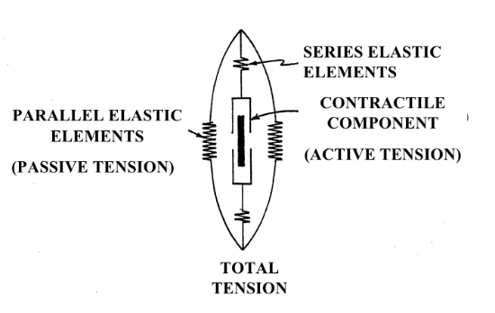
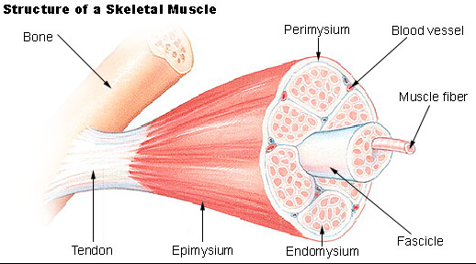
Length-tension in muscles
Passive Length Tension (PLT)
Two components involved
Series elastic components
(titin)
Parallel elastic components
(perimysium, epimysium)
Assists with Movement/Stability
PLT
- slow adaptability
- significant lengthening required
- Ability to store energy (plyos)

Slide 9
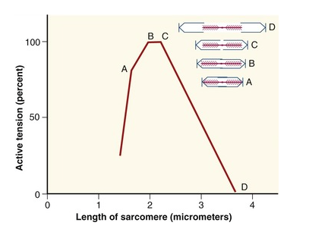
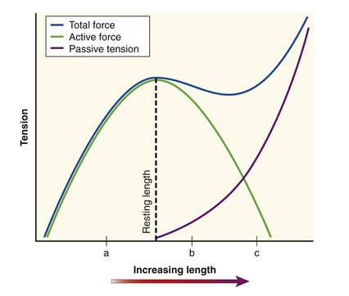
Length-tension in muscles
Active Length Tension (ALT)
Muscle Length is changed by active contraction or passive elongation – alters the overlap between Actin & Myosin
As the muscle length increases the number of potential cross bridges reduces
PLT and ALT allows for functional versatility (force & length)
Notes:
How could this affect training, rehab, injury risk?
i.e. less Actin/Myosin bridges at longer lengths = less force = less strength

Slide 10
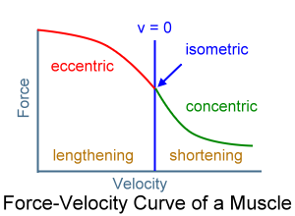
Types of contraction
Concentric (lower force)
Force produced inversely proportional to velocity of shortening muscle. High speed leads to low cross bridge formation
Isometric
Muscle produces most amount of cross bridges
Eccentric (higher force)
Greater force on cross bridges as pulled apart/ reattached
Rapid reattachment phase
PLT produced by the series and parallel elastic properties allows force to be stored and transmitted
Notes:
How does this apply to training?

Slide 11
Skeletal muscle
FATIGUE
Adenosine Triphosphate (ATP) provides the energy for the muscle contraction
As stimulus continues the bodies ability to replenish ATP results in twitch responses becoming weaker, eventually hitting zero.
Other possible causes are thought to be:
Reduced excitability at neuromuscular junction
Reduced excitability at sarcolemma
Reduced blood flow and O₂
Reduced availability of intra-cellular calcium
Eventually leads to reduced co-ordination and increased injury risk.

Slide 12
Skeletal muscle
ADAPTATION
Lengthening
With MT unit stretching:
Addition of sarcomeres to muscle fibres
In region on myotendinous junction
Strengthening
Max strength achieved between 20-30yrs
Cross-sectional area of muscle is greatest
Resistance training increases myofibrillar diameter
Cross-sectional Area
female is 75% of male
Response to resistance training in males via hypertrophy
Whilst strength gains in females due to increased fibre recruitment
Notes:
Diagram here of max potential strength

Slide 13
Skeletal muscle
IMMOBILISATION
Marked reductions in muscle strength and atrophy
Loss of strength can be 3-6% per day in the first week
Predominance toward higher proportion of Type II fibres
If immobilised in shortened position, then protein degradation is promoted
Resistive exercise can reverse the effects of chronic immobilisation of a limb.
Low intensity and long duration exercise important during the early phases.

Slide 14
Skeletal muscle
ATROPHY
Atrophy (CSA) rate normally at 50% of the strength loss of the muscle
CSA reduced due to protein degradation
Can be prevented by placing muscles under some passive tension
Isometric activity can maintain many of the Type II fibres and can safely reduced atrophic factors
Notes:
How might his apply in rehabilitation, Finley?

Slide 15
Skeletal muscle
HYPERTROPHY
Hypertrophy is enlargement of muscle fibres within the muscle: NOT more fibres being created
Also, neurological adaption: recruitment of motor units and synchronisation of muscle activation
Direct relationship between muscle cross-sectional area and strength

Slide 16
MUSCLE INJURIES
CLASSIFICATIONS AND TYPES
Contusion – Heavy compressive load usually by direct blow
Muscle Strain – Excessive load leading leading to overstrain of myofibrils, hence potential strain or possible rupture
Laceration – epidermal breakage (only 10% of all muscle injuries)

Slide 17
MUSCLE INJURIES
CONTUSIONS
Intramuscular Contusion
  Blood pools within intact muscle fascia and increase intramuscular pressure
  P1 ++ on passive stretch
Intermuscular Contusion
  Bleeding from the damaged blood vessels in the muscle
  Fascia surrounding muscle is also torn so blood can move out of compartment into surrounding area
  Point tender over area of damage with Bruising +++

Slide 18
MUSCLE INJURIES
TYPES of MUSCLE INJURIES

Slide 19
MUSCLE INJURIES
MUSCLE STRAINS

Slide 20
MUSCLE INJURIES

Slide 21
MUSCLE INJURIES
MUSCLE STRAINS
When muscle-tendon-bone units are pulled to failure, tears could occur at:
Bone-tendon junctions (Avulsion #)
Muscle Belly
Myotendinous junction (McMaster 1933)
Myotendinous junction (Garrett et al, 1988)
Within muscle cell approx 0.5mm from myotendinous junction (Tidball & Chan, 1989)

Slide 22
MUSCLE INJURIES
SKELETAL MUSCLE REPAIR
Healthy skeletal muscle has substantial ability to repair itself
Muscle regeneration
  Satellite Cells
  Fuse with adjacent myofibres to repair and regenerate muscle tissue
  Restore and replace muscle cells routinely damaged by activity (Caplan et al, 1988)
  Replace injured muscle tissue with new muscle tissue
  When the mass of damaged muscle is larger than 3 g (0.1 oz) muscle healing occurs through scar tissue and goes through the normal healing sequence

Slide 23
MUSCLE INJURIES
REGENERATION OF CONTRACILE ELEMENTS
Regeneration similar regardless of mechanism (contusion or strain)
Activation of satellite cells that are normally passive and are found in between the basal lamina and the sarcolemma
More satellite cells in Type I fibres
Satellite cells are self-proliferating
Disruption of basal lamina activates satellite cells mitosis
Blood vessel disruption

Slide 24
MUSCLE INJURIES
REGENERATION OF CONTRACTILE ELEMENTS
Trauma or strain (satellite cell activated: aka Myofibroblasts )
Muscle fibres that are torn RETRACT
Gap is formed
At the ends intact sarcomeres HYPERCONTRACT
Myofibroblasts attracted to the ends of the basal lamina, fuse and grow into the gap.
Scar tissue laid down in the gap

Slide 25
MUSCLE INJURIES
REGENERATION OF CONTRATCILE ELEMENTS
Myotubes mature in to myofibres (14/7) and reunite?
Mini-musculotendinous junction where myotubes attach to scar tissue?
Immobilisation increases ‘interlacing’ of myotubes with granulation/scar tissue (Lehto et al 1985)
Scar tissue decreases over months, may bring myofibres edges together (fuse?)
Aarimaa et al (2004) maintaining close proximity of muscle fibres after injury leads to reduced presence of new junctions. Fibre regeneration is greatly enhanced , notable improvement of tissue strength

Slide 26
MUSCLE INJURIES
Jarvinen et al.(2005). Muscle injuries biology and treatment. The American Journal of Sports Medicine, 33, 5, pg. 747

Slide 27
MUSCLE INJURIES
Time | Activity
6/24 | Fragmentation of injured fibres begin Macrophages appear
1-4/7 | Fibroblasts appear At 2d marcrophages become most dominant inflammatory cell (removal of necrotic tissue
7/7 | 5-7/7 number of leucocytes and macrophages decreases considerably 7/7 myotubes have grown in between damaged basal laminae, new basal lamina is apparent Collagen/scar tissue is seen in large muscle injuries in the central zone in between basal lamina
8-11/7 | Tensile strength reaches near normal
10/7 | Large numbers of phagocytes : primary marcophages are seen at the injury site
14/7 | Maturation of myotubes into myofibres complete
18/7 | Cross-striated muscle fibres appear
6/52 – 6/12 | Contraction ability is 90% of normal , scar tissue volume decreases, myofibres may fuse

Slide 28
HEALING: SKELETAL MUSCLE
MOBILISE EARLY
Strengthen tissue more quickly
May prevent myofibrils from joining
More scar tissue in the gap
Mini-musculotendinous jt: predispose to recurring injury
Scar tissue reduces extensibility of muscle
IMMOBILISE EARLY
Limit scar tissue formation
Regenerating myofibrils penetrate more easily
Normal muscle performance restored
Potential for atrophy

Slide 29
Rehabilitation Implications
Don’t stretch for first 7-10/7
Immobilise in shortened position to encourage myotubes infill.
Ice and compress (15-20mins every 30-60mins)?
Continue with intermittent ice for 6 hours?
When ready (pain free)?
  Isometrics
  Concentric
  Eccentric
Maintain CV fitness without compromising the injury
Ensure biomechanical factors are worked on during initial phases as allowed
BEWARE of Myositis Ossificans – Bone growth in muscle tissue
Notes:
Task to do Ice? Pain free? Mini research

Slide 30
SUMMARY
Classification of muscle injuries
HUGE regenerative capacity if managed well
DO NOT STRETCH INJURED TISSUE
Mobilise to pain free limits
Be aware of complications

