Slide 1

The Digital Tools
Nazreen Akhtar (2128933)
Saira Arshad (2125447)
Olinda Furtado Sani (2132944)
Digital Skills & Research Methods (LCHS4002_BIRM)
Dale Clark
1

Slide 2
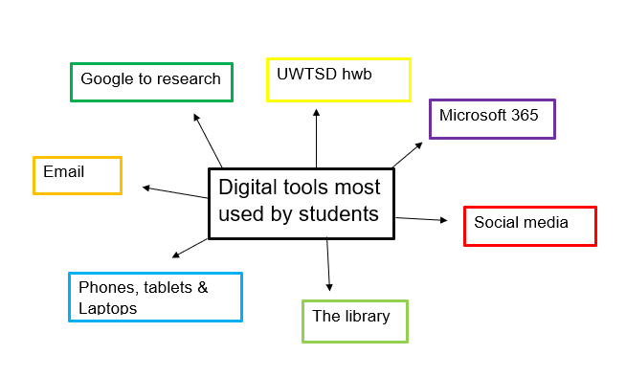
Which digital tool is most used by students UWTSD to collaborate together?
Introduction
In this presentation we will be analysing different types of digital tools used by students to collaborate with one another to share information, view each other’s work, gain knowledge and study together. We also can do online lessons by using these tools and much more.
Nazreen Akhtar
2

Slide 3

Proposed Method
We did our research via questionnaire using Quantitative and quantitative research we did forms of questionary in Microsoft forms and the data had been collected, analysed and we will discuss that later in class.
Saira Arshad
3

Slide 4

Questionnaire
https://forms.office.com/Pages/DesignPageV2.aspx?subpage=design&FormId=-REPTm4EBUWcuNshUjEeIfGu4c9v9BNMgkz0yhPHsb9UMUlWRk42RVdOT1JHSDBYVTNCUTNCNFE1Si4u&Token=8dd9821234e744f58f654987e9c30181
Saira Arshad

Slide 5
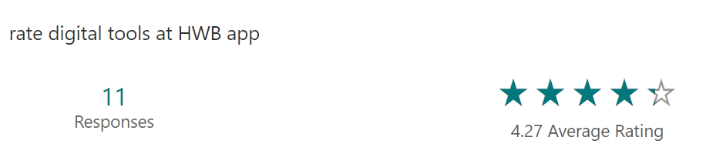

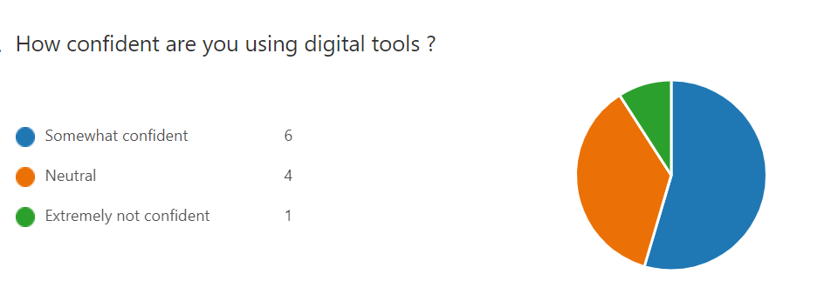
Results
Saira Arshad

Slide 6
Research Timeline
Activities | Week 1 | Week 2 | Week3 | Week 4 | Week 5 | Week 6
Research skills
Finding $ understanding information
Use of PowerPoint
Using MS Forms
Introduction
Literature review
Collecting Data
Nazreen Akhtar

Slide 7



Rationale
WhatsApp function as extensions of your mobile WhatsApp account, and all messages images and links. It’s easy to access and safety wise this application is the best to rely on because it’s fully encrypted.
UWTSD hwb it’s the university application give students information and helps to collaborate students and staff more efficiently.
Email is another application easy to access and share links, information. It’s another method can send safely an secure to another person.
Nazreen Akhtar
7

Slide 8

Ethical Considerations
We understand that when gathering data using digital tools, students and researchers must always follow a set of rules.
We plan to use a set of principles and procedures which is known as ethical considerations in this research.
The different types of Ethical Considerations our group will apply is as follow we will:
Ensuring confidentiality of Data
Accurate analysis and Reporting of Date
Uphold Data and Protection Laws
Ensure the Safety of the researcher
Olinda Furtado Sani
8
Notes:
8

Slide 9

Hypothesis
The UWSTD Hwb is a digital tool provided by the University of Wales Saint David. The Hwb is used by all students in the University. This digital tool gives students access to all their studies and gives them the opportunity to engage with each other. This therefore provides a faster and efficient learning experience for the students.
Students have claimed that this technology helps them study and relearn there lessons at any given time.
In the review from QAA they outline that “The University’s ‘Student Hwb’ provides students with a comprehensive and accessible electronic contact and information point that effectively supports their learning experience.“
Press Releases 2022 | University of Wales Trinity Saint David (uwtsd.ac.uk)
Its evident that the students are more engaged. On average, PISA test results showed that pupils who reported using school technology lightly to moderately performed better than non-users, whereas those who used technology heavily performed worse than their peers who used technology lightly or not at all.
Olinda Furtado Sani
9

Slide 10
conclusion
Conducting the research in this particular way proved that:
Most of students find digital technology easier to use
Some of the students prefer to seek more training
Moodle is the most used app by students at UWTSD
Minority feel anxious using HWB app
Majority agreed the digital tools are the fastest way to collaborate together

Slide 11
Reference List
Research-Methodology. 2022. Ethical Considerations - Research Methodology. Available at: <https://research-methodology.net/research-methodology/ethical-considerations/> [Accessed 20 June 2022]
Bouygues, H., 2019. Does Educational Technology Help Students Learn? Forbes. Available at: <https://www.forbes.com/sites/helenleebouygues/2019/06/14/does-educational-technology-help-students-learn/?sh=280d1b0c4539> [Accessed 2 July 2022]
11

