Slide 1

Jayne Pierson School of Fashion, Art & Design
Project reference: 6023
Prepared by Jack Keenan

Slide 2
Jack Keenan
What is a hybrid system? – Timber & steel systems/Timber & concrete systems.
Material properties
Advantages and Disadvantages of both systems
Brief overview on construction methods and machinery

Slide 3
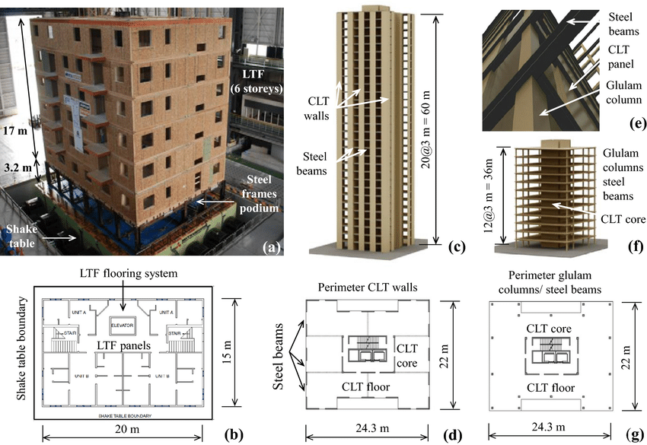
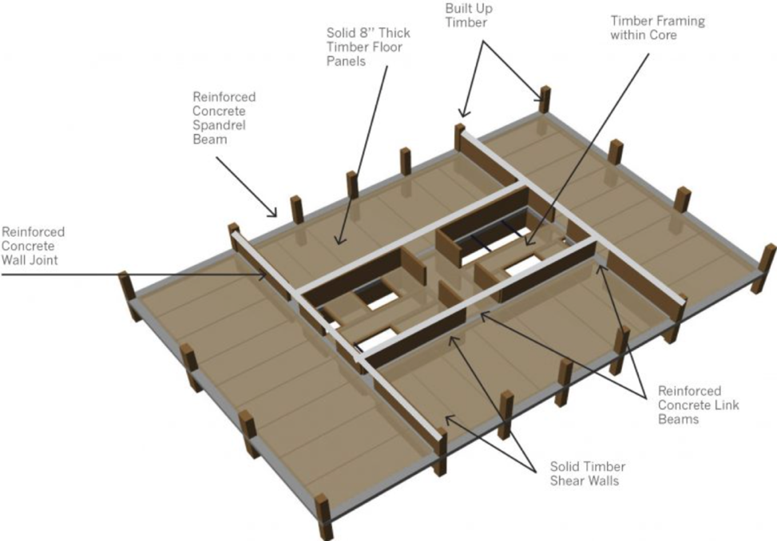
Jack Keenan
Steel plus timber system
Concrete jointed timber frame diagram

Slide 4
Next steps
Research into connection points and fixing details
Implement hybrid system into site progamme and cost plan
Clarification of construction methods and machinery to be used
Clarification of landscaping

