Slide 1
OCCUPATIONAL PSYCHOLOGY
PSYCHOMETRIC TESTING AND INDIVIDUAL DIFFERENCES

Slide 2
INDIVIDUAL DIFFERENCES
Most branches of psychology are interested in human behaviour under different conditions
The assumption made is that all people are pretty much the same
BUT! This assumption is wrong…
    Some children develop faster than others
    Some adults are less conscientious than others
    Some people are more intelligent than others

Slide 3
PSYCHOMETRIC TESTING
Psychometrics is the branch of psychology concerned with the scientific measurement of individual differences
Accurate measurement of I.D’s is important because theories can be tested if and only if the constructs involved can be measured

Slide 4
PSYCHOMETRIC TESTING
The field of psychometrics and behavioural statistics has been expanding with unprecedented speed
These rapid and technically rigorous developments have created a need for a new breed of quantitative scientist who can work at the interface between mathematical stats and applied research

Slide 5

WHY??

Slide 6
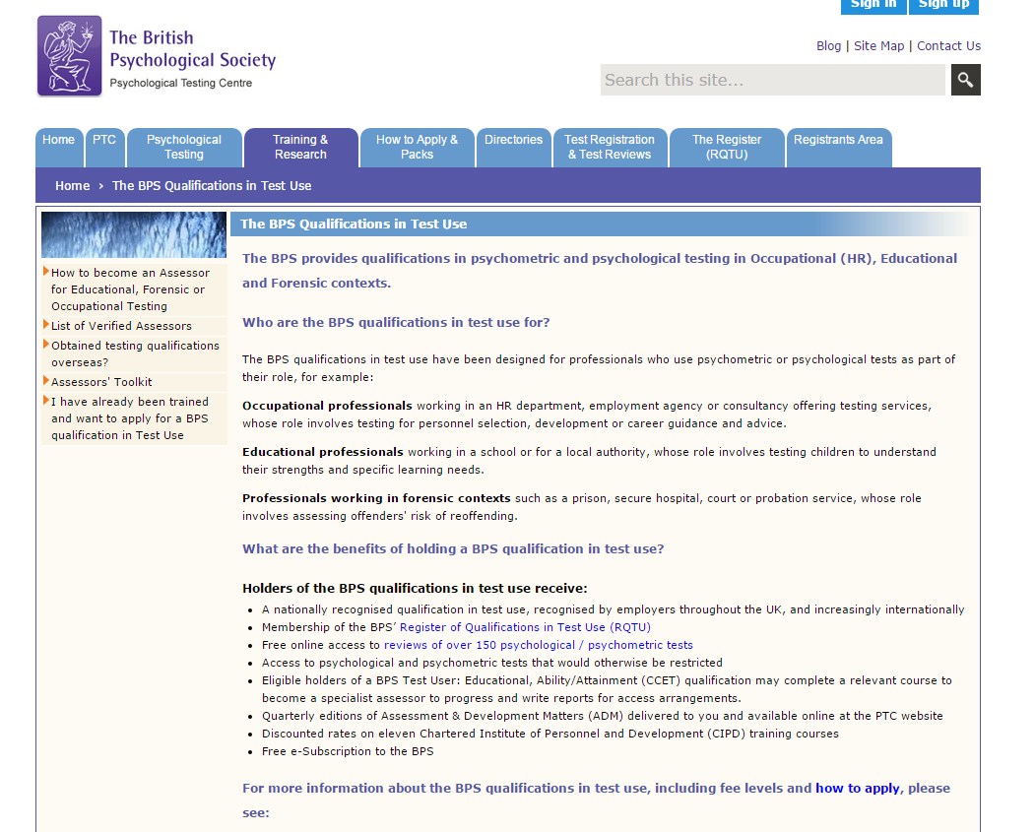

Slide 7
BPS QUALIFICATIONS IN TEST USE
Occupational, educational and forensic
Benefits?
  Nationally recognised qualification
  Access to psychological/psychometric tests that would otherwise be restricted

Slide 8
OCCUPATIONAL TESTING
Level 1: Assistant test user
  Qualifies the delegate to administer psychometric tests, teaches the basics of ethical test use and computer-based testing
Level 2: Test User (Ability)
Level 2: Test User (Personality)
  Qualifies delegate to score, interpret and provide feedback on tests
  Delegate will get trained in specific tests (e.g., NEO PI-R)

Slide 9
PERSONALITY

Slide 10
WHAT IS PERSONALITY?
In certain respects, each of us is:
  Like all other people
  Like some other people
  Like no other people
Personality: distinctive and relatively enduring ways of thinking, feeling, and acting that characterise a person’s responses to life situations

Slide 11
TRAIT PERSPECTIVE
Goals of Trait Theorists:
  Describe the basic classes of behaviour that define personality
  Devise ways of measuring individual differences in personality traits
  Use these measures to understand and predict behaviour

Slide 12
TRAIT PERSPECTIVE
Shy
Outgoing
Tense
Introverted
Extraverted
Notes:
Trait theories perhaps come closest to describing the structure of personality in a way that matches our everyday use of the term personality. Trait theories use words such as shy, outgoing, tense and extraverted to describe the basic factors of human personality. These basic elements – traits – represent predispositions or tendencies to behave in certain ways, in a variety of different situations

Slide 13
PERSONALITY AND JOB PERFORMANCE
Is personality a useful construct for understanding performance at work??
  Task performance?
  Leadership?
  Team working skills?
  Resilience to stress?

Slide 14
PERSONALITY AND JOB PERFORMANCE
How do we know?
How do we measure personality?
  Which models/theories?
  Which assessment method?
What other factors do we need to consider?

Slide 15
PERSONALITY AND JOB PERFORMANCE

Slide 16
Personality and job performance
Personality traits are useful if they:
Describe consistent differences between individuals
Predict work-related behaviour independently from cognitive ability
Does ‘typical behaviour’ at work matter more than ‘maximal performance’?

Slide 17
Personality and job performance
Are some personality traits within the Five Factor Model (such as conscientiousness) generally better predictors of performance at work than other traits?
Are some traits more predictive of performance in specific settings than others?

Slide 18
recap
The Five Factor Model (Costa & McCrae, 1992)
Openness to experience
Conscientiousness
Extraversion
Agreeableness
Neuroticism

Slide 19
Recap
Barrick, Mount and Judge (2001):
Conscientiousness (in particular) and neuroticism are the best personality predictors of job performance across all occupations
Extraversion and agreeableness are important in jobs requiring a high degree of interpersonal work
Less consistent evidence for Openness to experience
Salgado et al. (2003):
Conscientiousness is a valid predictor of performance across most jobs and organisational settings; criterion-related validity 0.23

Slide 20
Ones et al. (2007):
Unlike ability testing, the predictive validity of personality measures for ‘overall job performance’ is not seen across all occupational settings and areas
E.g., for managerial roles, the ‘achievement’ and ‘dependability’ facets of conscientiousness predict job performance

Slide 21
Conscientiousness
The most important personality predictor of performance at work:
Assesses individual differences in:
  Responsibility
  Dutifulness
  Achievement striving
  Organised planning
  Self-control

Slide 22
Conscientiousness
Conscientious people set ambitious goals and work hard to meet them (Barrick, Mount & Strauss, 1993)
A general marker (like GMA?) of people’s typical performance or work ethic?

Slide 23
Neuroticism
Inconsistent findings but generally negatively associated with performance at work
Neuroticism linked to job and training performance particularly under stressful conditions
Matthew (1999) - better performance in air traffic controllers amongst individuals high in N
Marker of individual differences in stress-reactivity?

Slide 24
Extraversion
Inconsistent evidence
Positive associations between Extraversion and sales/managerial performance
Interaction between Extraversion and Neuroticism may be a better predictor of performance at work than one alone

Slide 25
Agreeableness
Predicts performance in:
Customer service type jobs (Hurtz & Donovan, 2000)
Team-work based jobs (Barrick et al., 1998)
But generally negatively associated with career success/income: Correlations of -.11 to -.32
Interaction with conscientiousness!
High C + low A = conflict with others!

Slide 26
Openness to experience
Inconsistent in predicting work performance
May reflect lack of clarity of what the trait consists of:
  Driven by fantasy?
  Artistic?
  Liberal?
  Need for cognition?
Relevant predictor in creative industries
Predicts training success generally

Slide 27
Critically evaluating the Big Five
Some personality dimensions tend to be more stable over the lifespan than others
Introversion-Extraversion, self-esteem, emotionality, and activity level remain relatively stable
Neuroticism, openness and extraversion tend to decline with age
Agreeableness and conscientiousness tend to increase with age

Slide 28
Critically evaluating the Big Five
But, is it better to explore smaller facets of the ‘big five’ in order to predict performance at work?
Each contains six sub-facets that allow for sharper predictions
Does ‘conscientiousness’ tap into general mental ability?

Slide 29
Personality assessment

Slide 30
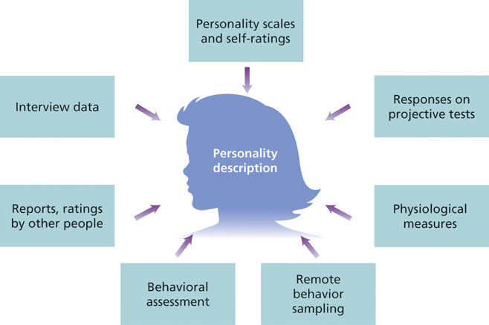
PERSONALITY ASSESSMENT

Slide 31
PERSONALITY SCALES
Eysenck Personality Questionnaire (EPQ; Eysenck & Eysenck, 1964)
Measures:
    Extraversion; neuroticism; psychoticism
The 16 PF5 (Cattell et al., 1970)
  short and long versions available
  measures 16 personality factors (e.g., submissiveness, self-assurance, tender-mindedness, etc.)

Slide 32
PERSONALITY SCALES
The Occupational Personality Questionnaire (SHL, 1990)
  Thirty personality dimensions
  Origins of questions come from people’s behaviour in the workplace
  E.g., measures: caring, emotional control, forward planning, etc

Slide 33
PERSONALITY SCALES
The Myers-Briggs Type Indicator (MBTI)
  Very different from the Big Five; uses Jung’s theory of psychological types
  Uses dichotomies rather than positions on a scale
  Shown to correlate with the Big Five
  However, there are qualitative differences in what the MBTI measures because it is based on a different underlying theory…

Slide 34
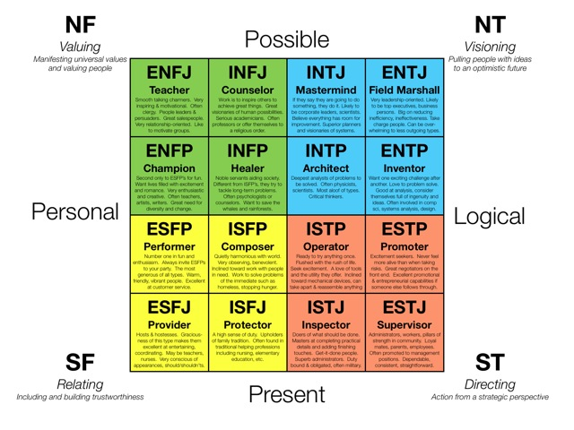
MBTI
Notes:
The MBTI assesses personality as a whole of 1 out of 16 possibilities. The MBTI is one of the personality scales that can only be used if you are qualified in occupational testing.

Slide 35
THE BIG FIVE INVENTORY
44 items
Measures all five factors
Your task:
  Fill out the BFI-10 and score yourselves on this personality measure
  Be aware that this does involve reverse scoring!

Slide 36
THE BIG FIVE
Costa and McCrae (1992)
Openness to experience
Conscientiousness
Extraversion
Agreeableness
Neuroticism
Notes:
A fairly high degree of consensus has emerged that the five-factor structure represents an almost universal template for describing the basic dimensions of personality. The big five dimensions of personality also contain sub-facets – these facets help us to understand the breadth of each of the big five and to appreciate how the model attempted to measures the richness of individual differences in personality.

Slide 37
THE BIG FIVE
Low scorers
High scorers
Extraversion
Loner; Quiet; Passive; Reserved
Joiner; Talkative; Active; Affectionate
Agreeableness
Suspicious; Critical; Ruthless; Irritable
Trusting; Lenient; Soft-hearted; Good-natured
Conscientiousness
Negligent; Lazy; Disorganised; Late
Conscientious; Hard-working; Organised; Punctual
Neuroticism
Calm; Even-tempered; Comfortable; Unemotional
Worried; Temperamental; Self-conscious; Emotional
Openness to experience
Down-to-earth; Uncreative; Conventional; Uncurious
Imaginative; Creative; Original; Curious
Notes:
In reading about the big five you may see that some personalities are more desirable than others. However, as researchers and critical thinkers you need to recognise that there may be some danger to assuming this – most of our personality can in fact depend upon the social context within which the person is behaving.

Slide 38
PERSONALITY SCALES
The revised NEO Personality Inventory (NEO PI-R, Costa & McCrae, 1992)
  240 items
  Measures the Big Five plus facet scores for six subscales within each of the five domains
  Designed for a wide range of purposes (e.g., clinical, research and occupational uses)
  Can only be purchased, administered and scored by an individual with occupational test user qualification

Slide 39
NEO PI-R
Neuroticism
Anxiety
Angry hostility
Depression
Self-consciousness
Impulsiveness
Vulnerability
Extraversion
Warmth
Gregariousness
Assertiveness
Activity
Excitement seeking
Positive emotion
Openness to experience
Fantasy
Aesthetics
Feelings
Actions
Ideas
Values
Conscientiousness
Competence
Order
Dutifulness
Achievement striving
Self discipline
Deliberation
Agreeableness
Trust
Straightforwardness
Altruism
Compliance
Modesty
Tender mindedness

Slide 40

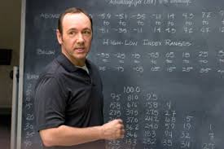

INDIVIDUAL DIFFERENCES ACROSS OCCUPATIONS
Lawyer
Lecturer
Pilot

Slide 41
LAWYER - EXTRAVERSION
Richard (1993);
57% (of 3014) lawyers were more introverted than extraverted
Stark contrast to the finding that, in the general population, 75% of people are more extraverted
Richard (2002);
Lawyers are more autonomous than 89% of the general population – they prefer to work alone
Lawyers judged as ‘excellent’ were less sociable than 87.5% of the people in a general population

Slide 42
LAWYER - NEUROTICISM
Foster et al. (2010);
Results suggest that the average lawyer may score more highly on the neuroticism domain than 56% of the general population
Lawyers have a tendency towards becoming tense and overly critical – more than 68% of the general population
Relatively low degree of adjustment; relatively high degree of excitability.
Notes:
Neuroticism is associated with negative emotions such as anxiety, self-consciousness, and irritability. Individuals scoring highly on the neuroticism domain tend to be more prone to fear, anger and distress.

Slide 43
SUMMARY - LAWYER
According to research:
The typical lawyer is inclined towards introversion and is likely to prefer working by him/herself
The introverted tendency may be exaggerated among highly successful lawyers
Lawyers are low in extraversion when considered as a group

Slide 44
LECTURER – PREFERENCES BY STUDENTS
Chamorro-Premuzic et al. (2008);
Students prefer lecturers who were emotionally stable (low in N) and high in C
Students prefer lecturers who are similar to themselves in all personality traits except N, and particularly for O and C
Generally, students want lecturers who are stable, conscientious, extraverted, agreeable and open

Slide 45
LECTURER
Conscientiousness
On the plus side, high C is associated with academic and occupational achievement; on the negative side, it may lead to annoying fastidiousness, compulsive neatness and workaholic behaviour

Slide 46
LECTURER PERSONALITY??
20 80
Extraversion
Neuroticism
Openness
Agreeableness
Conscientiousness
Notes:
20-35 = very low levels
35-45 = low levels
45-55 = average
55-65 = high levels
65+ = very high

Slide 47
PILOT PERSONALITY
Jessup (1971);
Success rates highest in stable introverts
But; failure rates higher in neurotic introverts than neurotic extraverts
Lambrith et al (2003);
Conscientiousness considered most important dimension and predictor of performance for pilots

Slide 48
Issues in personality assessment

Slide 49
1) ‘Faking’
The tendency for people to present a favourable image of themselves on questionnaires
Social desirability response bias affects the validity of a questionnaire
Job applicants have been found to score more highly on desired personality traits
    Motivated to ‘fake good’? (Barrick & Mount, 1996)

Slide 50
1) Faking
Easy to identify the ‘desirable response’ on a personality test
May influence the ordering of candidates re: hiring decisions!
Is there a solution?
Ipsative tests:
  ‘forced choice’ scale - respondents compare two or more equally desirable options and pick the one that is most preferred

Slide 51
2) State or trait??
E.g., Laziness
State or trait?
State = something that changes depending upon an individual's mood, situation, etc
Trait = general trait of the individual across all settings

Slide 52
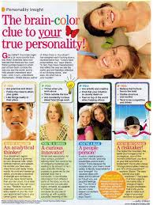
3) Spurious validity
Tests can have high face validity but no true validity
e.g., graphology, magazine quizzes

Slide 53

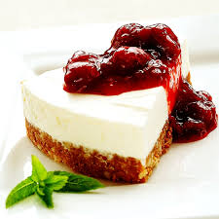

4) Barnum effects
The tendency to regard generalised descriptions as accurate comments of an individual’s personality
E.g., the dessert personality

Slide 54
Psychometrically valid and reliable...

Slide 55
Validity
Construct validity:
The degree to which a test measures a specified construct
Rests on the psychological theory underpinning a testing instrument
Predictive validity:
The degree to which scores on a test predict future behaviour on a criterion variable
Face validity:
‘Experts’ review contents to determine if they are appropriate ‘on their face’

Slide 56
Reliability
Many forms of reliability; the one you are most interested in is ‘internal consistency’ or ‘Cronbach’s alpha’
Measures the homogeneity of the test - i.e., the degree to which the various parts of an instrument measure the same variable

Slide 57
Reliability
Interpretation of Cronbach’s Alpha
Certain benchmark values have been proposed in order to interpret Cronbach’s alpha:
α < .60 = poor!
.60 < α < .70 = adequate
.70 < α < .80 = good
.80 < α < .90 = very good!
α > .90 = perhaps too good...

Slide 58
Personality Measures
You will be discussing how reliable and valid you think a number of personality measures are in today’s seminar…

Slide 59
The BFI
Alpha reliabilities for scales typically range from .75 to .90 and average above .80;
Three-month test-retest reliability mean of .85

Slide 60
Ten-Item Personality Inventory (TIPI)
Gosling, Rentfrow and Swann (2003);
Extraversion - α = .68
Agreeableness - α = .40
Conscientiousness - α = .50
Neuroticism - α = .73
Openness to experience - α = .45
Why are some of these so low??

Slide 61

Questions?

Slide 62
Your report assessment
You need to choose:
A psychometrically robust measure of personality
  i.e., valid AND reliable..
A stress-inducing cognitive task
  Think about what it is you’re looking to assess with this task. How can something be ‘stress-inducing’?

Slide 63
Your report assessment
You are then required to:
Complete the proposal and ethics form to obtain ethical approval to run your study
  This must be submitted by 5pm Friday 9th February- only one form per group. Outcomes disseminated by Tuesday 13th Feb.
Collect data in your groups
  Tip: think carefully about how many participants you are going to need to collect data from based upon the design of the study you are running…

Slide 64
Your report assessment
Writing up the report:
Appropriately report the use of any measures in the materials section of your report
  Example on Moodle; this will be scrutinised in your final submission.
Report the reliability analysis as compared to previous literature
  Remember that you must have all your data entered into SPSS before you can do this.
  Reading any journal article will show you how to report this correctly.
Conduct the multiple regression analysis on your data set; correctly report descriptive and inferential statistics according to APA standards and using correct terminology
  Stats books needed! Any APA journal will give you an idea of how this should be presented. Example on Moodle, also.

Slide 65
Final Questions?

