Slide 1
Critical Perspectives on Management
Dr Caroline Jawad 2018

Slide 2
What is business ethics?
Business ethics focuses on what constitutes right or wrong behavior in the world of business
Corporate business executives have a responsibility to their shareholders and employees to make decisions that will help their business make a profit
But in doing so, business people also have a responsibility to the public and themselves to maintain ethical principles

Slide 3
Continued
Although ethics provides moral guidelines, individuals must apply these guidelines in making decisions
Ethics that applies to business is not a separate theory of ethics
It is an application of ethics to business situations
High ethical standards are imposed upon professionals who serve as social models, such as politicians, lawyers, doctors and business people

Slide 4
The Relationship Between Law and Ethics
The law is an expression of the ethical beliefs of our society.
Law and ethics are not the same thing. The question, “Is an act legal?” is different from the question, “Is an act ethical?” The law cannot codify all ethical requirements. Therefore, an action might be unethical, yet not necessarily illegal. For example, it might be unethical to lie to your family, but it is not necessary illegal.

Slide 5
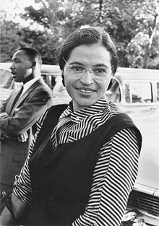
Who is she ?

Slide 6
What she did ?
Montgomery, Alabama 1 December 1955
Sat in a seat in the middle of the bus, driver told her to move to back of the bus so a white passenger could sit in the front of the bus
Parks refused to move - National Association for the Advancement of Colored People (NAACP)
Like so many others she was tired of being treated as a lower class person because of the colour of her skin
She was arrested - led to the Montgomery bus boycott - 381 days – law changed. Black people could sit wherever they wanted to on the bus

Slide 7
Continued
Because an act is illegal does not necessarily mean it is immoral
Rosa Parks was acting illegally when she refused to give up her seat on the bus to a white male, but that does not necessarily mean she was acting unethically
Should an individual obey the law even if it would be unethical to do so?
Martin Luther King, Ghandi - immoral laws deserve to be disobeyed
Examples

Slide 8
Main ethical theories
Consequentialism – rightness depends on consequences
Deontology – rightness depends at least in part on a formal moral rule or principle
Virtue ethics - person rather than action based: it looks at the virtue or moral character of the person carrying out an action, rather than at ethical duties and rules, or the consequences of particular actions
Rights Theories - legal, social, or ethical principles of freedom or entitlement

Slide 9
Task 1
Imagine that you are the corporate manager of a company. You have been hired by the board of directors to make the company more profitable. Across your desk is a proposal from a local charity urging you to donate £800 of the company’s money to help the local soup kitchen that provides food for the homeless and there is another letter from an environmental activist group that wants a donation of £500 to help clean up a local river. There is no direct benefit for the company in this.
Do you divert funds from the company to help either of these groups? If so, why?

Slide 10
continued
The mantra: that the strong must look after the weak! That the responsible thing to do is to take care of the planet and make it sustainable.
Breach of fiduciary responsibilities.
Charity – do it in your own time with your own money.

Slide 11
Task 2
You are the corporate manager of a company and that you can hide company debt through “creative financial reporting” to keep the price of stocks up and get more people to invest in your company. Should you maximize profits this way, after all it is your duty towards the company to increase profits?

Slide 12
Continued
This was the case of Enron, one of the biggest business-scandals in recent years. When the scandal was uncovered the stocks fell from $90 to 4 cents. The stockholder theory holds as a side-constraint that deception and fraud is prohibited in the pursuit of profit. Behaving as Enron did, a company that before the scandal was much heralded for its environmentally friendly agenda and its CSR profile, is unacceptable in the pursuit of profit according to the stockholder theory.

Slide 13
Task 3
You are an executive in a corporation located in India pumping up water to make soft-drinks, where your explicit corporate purpose is to maximize profits. Pumping up the water in large quantities in order to earn more profits has the effect that local villagers are being deprived of their much needed water as well as having negative health-consequences.
What do you as a corporate manager do?

Slide 14
Continued
This was the case of Coca-Cola in Kerala province, India, and they decided to continue pumping up the water. This is against another side-constraint of the stockholder theory; that a person or company should avoid exposing others to negative externalities and also abide by the law. Western countries would not accept such behaviour, but what then if the place of business is in a country that would like a big corporation to come in and provide jobs and tax-money, and would be willing to look away from adverse consequences to a part of its poor population. Does it morally alter anything, since the action seems to be sanctioned by the government?

Slide 15
continued
Do you continue to increase profits by depriving the villagers of their water?
How do you as a corporate executive deal with the issue of negatively affected third parties?
Do you as an executive of a corporation have any social responsibility to the affected parties?

Slide 16
Task 4
You are an executive in the oil business and that in order to get a lucrative oil contract you have to pay a bribe to local officials, bureaucrats and politicians. This is the social norm and the industry norm and it is practiced by everyone. The consequences of not paying the bribe is that somebody else, who is willing to pay the bribe will get the contract, corruption will continue and you will be forced to reduce the number of employees at your company, which again will have negative effects for the families involved, some of which will not be able to pay of the mortgages on their houses.
What should you do?

Slide 17
Answers
Any normative theory of business ethics worthy of its name would need to provide answers to such questions.
Normative theories of ethics or moral theories are meant to help us figure out what actions are right and wrong – includes utilitarianism, the categorical imperative, Aristotelian virtue ethics.
Notes:
https://ethicalrealism.wordpress.com/2010/08/20/ethical-theories/

Slide 18
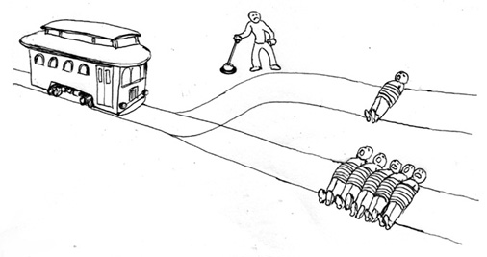
The Trolley Problem

Slide 19
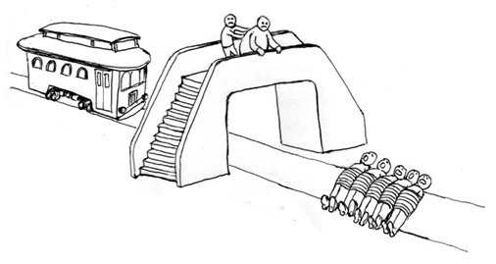
The Trolley Problem: take 2

Slide 20
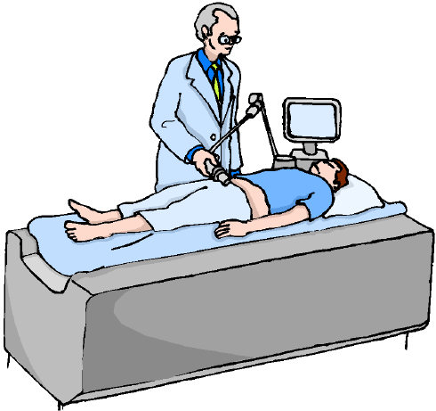
The Transplant Surgeon

Slide 21
The Social Responsibility of Business is to Increase Its Profits
“...there is one and only one social responsibility of business–to use its resources and engage in activities designed to increase its profits so long as it stays within the rules of the game, which is to say, engages in open and free competition, without deception or fraud.”
Friedman states that profit-maximization is not just a fiduciary responsibility, but also a “social responsibility”; and infact the only responsibility.

Slide 22
Restrictions on the limitations on profit maximisation
Rules of the game
Social norms
Ethical customs
Law in the society that the business functions within
Writing at a pre-globalised time ….

Slide 23
Subject matter
Business ethics
Stockholder theory
The only social responsibility of corporations is to increase its profits, while staying within "the rules of the game" which are a set of side-constraints on profit-maximization

Slide 24
Deontology and teleology
Friedman offers two broad set of arguments in favour of his position.
The first is a set of deontological or Kantian arguments in favour of fiduciary duties and against Corporate Social Responsibility (CSR).
The second line of argumentation is a utilitarian or broadly teleological or consequentialist argument against corporations taking on CSR.

Slide 25
Friedman’s central point.
Business does not have a “social responsibility” in the sense of having an obligation to promote desirable “social” ends, for example, clean environment, fulfilling jobs, prejudice-free society, etc.
Business (as a general type of enterprise) is not the kind of thing that can have responsibilities – social or otherwise.
  The internet does not have responsibilities.
  The weather does not have responsibilities.
  Business is the same type of general system.

Slide 26
Friedman’s 2nd supporting point.
Sometimes businesses are treated by the law as (artificial) individuals (or agents) and assigned a set of responsibilities.
  However, this is always done for a specific legal purpose, such as establishing a source of funds for product liability cases.
  No one thinks the business has really become a person and started having responsibilities of the type that persons have.

Slide 27
Friedman’s 3rd supporting point.
On the other hand, corporate managers certainly are individuals, and they definitely have responsibilities.
However, these responsibilities are to the people who own the equity of the corporation, and they can be summarized as: Make the most profit (that is, the largest return in investment) possible.
  This is sometimes referred to a Friedman’s “shareholder theory,” since in modern corporations profits ultimately accrue to the shareholders of the corporation’s stock.
  NOTE: “shareholder” = “owns shares of stock”

Slide 28
What if a manager decides to pursue a social end rather than maximum profit?
This is spending other people’s money on his or her personal political goals.
  That is, it converts market mechanisms into a political process, but this is socialism rather than capitalism.
Managers would have no idea what to do anyway.
  They have only their private beliefs, which is not at all the same thing as genuine social purpose.
  Moreover, each manager would have too small a view to expect his or her beliefs to be correct.

Slide 29
argument in favour of the stockholder theory two-pronged.
The first are a set of arguments that are closely linked that when put together add up to a deontological argument for fiduciary duties and that engaging in CSR would be tantamount to breaching these duties.
The second group of arguments is utilitarian and consequentialist oriented.

Slide 30
two arguments
Firstly, Friedman “questions the competence of business leaders (or any other individuals) to discern and directly promote the general good” and argues that CSR should not be undertaken.
Secondly, he argues that “the market itself is the best mechanism by which to promote the public good” and that by pursuing profit, business is already giving back to the community in the most efficient manner possible.

Slide 31
Profit maximisation argument
1. Corporate Managers are fiduciaries of the corporate owners (e.g. stockholders)
2. Corporate owners have only one interest in and reason for hiring managers to maximize profits
3. Therefore, corporate managers would violate their fiduciary trust by engaging in actions that are unrelated to (or which consciously minimize) profit maximization

Slide 32
Social responsibility argument
4 .Acts of corporate charity (“social responsibility”) lessen the amount of profits the firms and/or owners receive
5. If corporate managers act in ways described in #4, they would violate their contractual responsibilities to owners. (by #3)
6. A call for managers to be “socially responsible” is a call for them to violate their contractual obligations. (by #4 and 5)
7. Thus, managers should not direct their firms into “socially responsible” activities

Slide 33
Friedman’s conclusion.
Friedman says the only responsibility of businesses, and the managers who run them, is to make as much profit as possible.

Slide 34
However, Friedman also says this does not mean anything goes.
Friedman says that businesses are obliged to follow laws, rules, and regulations.
  Note: Some of these may incorporate social ends.
Friedman also says that businesses should adhere to generally accepted social standards and expectations.
  He points out that if a corporation operates in violation of the moral standards and expectations that are generally accepted in its society, it runs the risk of losing business, which, of course, would decrease profit.

Slide 35
continued
Managers, executives, and employees are bound by their work contract to advance the interest of their employer, stockholder or business-owner and the purpose set forth in that agreement.
Executives are free to spend their own personal funds anyway they see fit on any charitable or socially beneficial project they wish in their role as a private citizen, but when functioning in their capacity as executives they are an agent of the stockholders and are duty-bound not to divert business resources away from the purposes expressly authorized by the stockholders.

Slide 36
Rival normative business ethics theories
Stakeholder
Social contract

Slide 37
So, Friedman’s final word?
He says that businesses should legally and prudently pursue profit – NOT that business should pursue it with reckless abandon.
This is a more subtle and complex position than people mistakenly attribute to him.

Slide 38
A rough and ready summary of Friedman.
Maximize profits,
  but never forget that short-term focus can undermine long-term gains,
  and never forget that breaking the rules of society – both formal rules like laws and informal rules like generally accepted norms of business behavior – will put you out of business.
This comes close to Utilitarian ethical theory, which requires you to weigh ALL of the outcomes -- NOT just short term economic benefit to you.

Slide 39
A Stakeholder Theory of the Modern Corporation

Slide 40
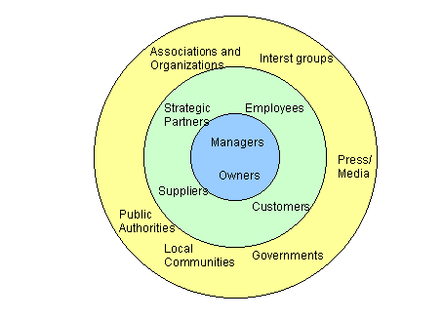
Stakeholder theory

Slide 43
definition
Any person or organisation who can be positively or negatively impacted by, or cause an impact on the actions of a company (Freeman,1984).
The individuals and constituencies that contribute, either voluntarily or involuntarily, to its wealth-creating capacity and activities, and are therefore its potential beneficiaries and / or risk bearers (Post, Preston & Sachs, 2002).

Slide 44
Facebook
Users/Members (most important)
Advertisers
Employees
Governments
Communities

Slide 45
Stakeholder theory in the context of the organisation
The objective of a business is to make profits for its shareholders (The Shareholder Value Perspective)
... or ...
Companies are networks of parties working towards a shared goal. Employees, suppliers, shareholders, external interest groups and customers co-operate to create mutually beneficial results (The Stakeholder Value Perspective)

Slide 46
Why use stakeholder analysis
Identify the stakeholders likely to be affected by or influence the activities of the organisation
Assess how those stakeholders could be impacted or impact upon the organisation
Anticipate the consequences of any change in the organisation’s activities
Identify stakeholders’ ‘success criteria’
Assure a successful outcome for the organisation by developing co-operation with stakeholders

Slide 47
Meeting stakeholder needs
Where does your organisation create stakeholder value?
How can the organisation do that better?
Can the organisation eliminate or reduce focus on processes which do not add stakeholder value?
How does the organisation communicate with stakeholders?
Do communications of the organisations encourage stakeholder exchange?
Does the organisation communicate the stakeholder value?

Slide 48
Typical stakeholders
Owners, stockholders, investors
Government, regulators: local, national, international
Banks and creditors
Partners, suppliers
Professional and industry associations
Buyers, customers, prospects
Media: local, national, trade, financial
Management
NGOs
Communities and otherinterest groups
Employees, unions, works councils
Competitors

Slide 49
Categorising stakeholders
Internal
external
Within the organisation eg employees, management
Outside the organisation eg government, trade associations

Slide 51
Categorising stakeholders primary, secondary and key stakeholders
Directly affected: eg employees and stockholders
Indirectly affected: eg government and media
Most significantly affected: those with the most influence from either group

Slide 52
Stakeholder analysis process
Identify all stakeholders (Brainstorming)
Identify stakeholder needs and interests
Classify groups of interests (Stakeholder Mapping)
Identify areas of conflict: Organisation v Stakeholder, Stakeholder v Stakeholder
Prioritise, reconcile and balance stakeholders
Align significant stakeholder needs with organisation’s strategies and actions

Slide 53
Stakeholder analysis matrix
Stakeholder | Stakeholder Interests | Assessment of Impact | Potential Strategies

Slide 54
Techniques for stakeholder mapping
Helps identify which stakeholders may support or oppose change / organisation’s actions
Which stakeholders are the most powerful, have most influence
Help decision makers formalise / prioritise strategies

Slide 55
Power interest matrix
Classifies stakeholders in relation to their power and the extent to which they are likely to show interest in the actions of the organisation.
Can be used to indicate the nature of the relationship which should be adopted with each group

Slide 56
Power/interest

Slide 57
Power/interest matrix
Stakeholders in group A: Need only minimum effort and monitoring
Stakeholders in group B: Should be kept informed as they may be able to influence more powerful stakeholders
Stakeholders in group C: Are powerful, but level of interest is low. Generally expected to be passive, but may move into group D on an issue of particular interest
Stakeholders in group D: Are both powerful and interested. Their co-operation is of key importance for new strategies

Slide 58
Business v ethical decisions
If this decision is made, for whom is value created and destroyed?
Who is harmed and/or benefited by this decision?
Whose rights are enabled and whose values are realized by this decision (and whose are not)
What kind of person will I become if I make this decision?
Most people, most of the time, want to, actually do, and should accept responsibility for the effects of their actions on others.

Slide 59
How do Friedman and Freeman differ in analyzing a case?
Friedman says to maximize profit a) within the law and b) without violating social standards.
  So, in looking at a business decision (or analyzing a case), identify relevant laws and regulations – and also identify current social standards and opinions.
  Maximize profit without breaking laws/regulations AND without “disturbing” society so much that it decreases profits.
Freeman says to a) identify stakeholder groups and b) make a decision that “takes them into account.”
  So, in looking at a business decision (or analyzing a case), identify all stakeholder groups.
  Identify available options and determine the effect they will have on the stakeholders.
  Select and apply an ethical theory to these options to determine the best one.

Slide 60
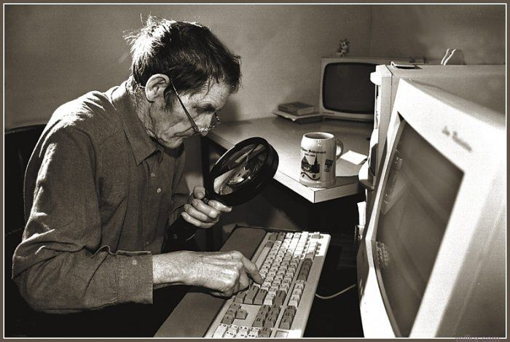
This
changed
everything

Slide 61
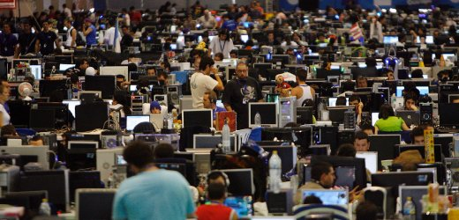
Notes:
The Internet feels like the ultimate free lunch.
Pay for basic access – for free services and content is at our fingertips.
This it is not falling to Earth like manna from heaven. What powers the “free” Internet are data collection and advertising. In essence, the relationship between consumers and online content and service providers isn’t governed by any formal contract, but rather by an unwritten quid pro quo: tolerate some ads or we’ll be forced to charge you for service. Most consumers gladly take that deal but calls for regulation persist.
The lower house of the French parliament has approved a draft bill that will allow the state unprecedented control over the Internet. Although the government says it will improve security for ordinary citizens, civil rights activists are warning of a "new level" of censorship and surveillance.
For members of the French administration, it is a law against digital crime. For civil rights activists and politicians from opposition parties, it is a plan for censorship that excites fear and loathing -- and even conjures up the specter of Big Brother and the surveillance state.
The new legislation could in the future force Internet service providers (ISPs) to shut off access to criminal sites, should they be officially instructed to do so. According to the draft legislation, the law "makes it the responsibility of each Internet service provider to ensure that users don't have access to unsuitable content."

Slide 62
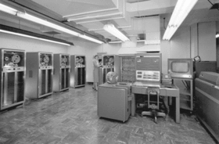

Slide 63
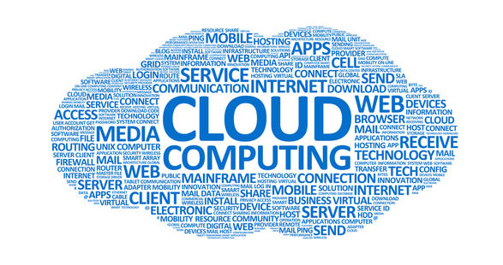

Slide 64
Internet – new ethical challenges
Globalisation, enabled by IT, has changed economic relationships
Speed of communication
Worldwide scope of instant communication
Environment is interactive
The Internet enables anonymous communication
New ways exist to reproduce information

Slide 65
Netiquette and censorship
No tone of voice no body language (Scheuermann, Taylor, 1997)
To disguise who you really are (Langford, 2000)
Internet used as a tool to exclude from social circles (Careaga, 2005)
39% of teens admitted to saying things online they would not normally
No one is in control of internet communication (Scheuermann, Taylor, 1997).
Filters on library computers – AOL censorship - thought police (Kandra, 2004, Langford, 2000)
Rights to free speech and the issue of privacy (Langford, 2000).
Notes:
Ethics and the Internet
Scott P. Muir
Introduction
The Internet is having a substantive effect on how people in our society behave and interact. For the first time in our history children are more comfortable and knowledgeable with a technology than are their parents, and there are important considerations in this switch (Tapscott, 1998). Telecommunication networks and computer technology are leading the change that is transforming our lives and we lack the resources to understand how to cope with the ethical changes (Stahl, 1999). The internet put us in touch with the entire interconnected world with the ability to hurt, misunderstand, or infuriate through unintended cultural differences (Langford, 2000).
The extensive amount of time some spend online (Sparks, 2005) can lead to depression and other mental health related problems due to the lack of meaningful interactions and close relationships with friends and family. Young people who spend hours online and limit their social interactions with their peers can become socially isolated as they lack opportunities to improve their social skills (Bostick, 2005). Online interaction is just not the same. New students on a campus may find that they do not explore their new environment and make friends through their campus, potentially leaving them isolated and alone. And Dad has now been replaced by the Internet for advice (Internet replaces dad, 2005).
In our day-to-day dealings with other people, there are social mores that govern our interactions with each person. We likely behave differently with our boss than with a co-worker; we treat a professor or dean differently than a classmate. And typically in dealing with people we do not know, we maintain some polite social distance. However on the internet, we lack many of those same ethical touchstones to guide our behaviour.
This paper will not discuss intentional criminal behaviour; things such as identity theft, scamming people for money, breaking into unauthorized computer systems and other such behaviours that go beyond the scope of this research. Instead this paper will focus on netiquette and censorship, plagiarism, copyright, and music downloading.
Netiquette and Censorship
A search of the Internet brings forth a number of articles about rampant rudeness on the web (Merle). The term “Netiquette” has been around for quite some time. It was formed from a combination of the words “network” and “etiquette” (Scheuermann, Taylor, 1997). It is used to describe codes of behaviour that various online communities have developed over time (Ornatowski, 2001). The intent of netiquette is to provide guidelines or rules of behaviour online in an effort to combat rudeness. Americans use the very poorest etiquette when using the email and cell phones, etc. that they rely on the most and distance makes it easier to be confrontational (Careaga, 2005). While not included here there are a number of sources for appropriate etiquette on the internet (Langford, 2000; Merle; Scheuermann, Taylor, 1997). There are a number of challenges here because there is no tone of voice and no body language that gives us clues in our day-to-day in person communications (Scheuermann, Taylor, 1997). It is also easy to disguise who you really are (Langford, 2000). A child can pose as an adult, a young man, or as an old woman.
In many ways behaviours online mirror those in everyday life. A Pew study showed that teenage girls use Instant Message buddy lists as a tool to exclude other girls from their social circles (Careaga, 2005). Researchers have also found that 39% of American teens aged 12 to 17 admitted to saying things over text messaging or instant messaging that they would not normally say to someone in person. A key part of the challenge is that no one is exactly in control of internet communication (Scheuermann, Taylor, 1997).
In some cases, an organization providing the internet service tries to control what happens, although that can be very controversial. For example, witness the implementation of filters on library computers. In other cases, a corporation such as AOL will censor some of what occurs on their site. This, too, is controversial and they are sometimes referred to as thought police (Kandra, 2004, Langford, 2000). This also raises important concerns on the rights to free speech and the issue of privacy (Langford, 2000).
When Internet filters try to control what people can see, it raises a question. Are these filters a valuable tool to eliminate violence and explicit sexual content or are they instead some form of extremist thought control? Each of these filters is subjective and some of them eliminate sites that might provide useful information, such as the classic case of a site that filtered out information on breast cancer in an attempt to avoid pictures of breasts in a pornographic sense. Filters have another downside in that they can limit access based on social decisions, e.g. sites on AIDS or homosexuality (Krantz, 1997). It also raises the question when a site such as AOL filters information, are they acting in good faith or are they starting to take responsibilities more appropriately assigned to parents?
Finally there are questions about the effectiveness of filters. Statistics from one study show that they are only 80% effective and that students can work around them. This same study also shows that 70% of 13 and 14 year olds go into chat rooms where they might be exposed to adult content and discussions (Jones, 2002).
This area is perhaps the grayest of the three areas in this paper because it brings together the issue of free speech and freedom of choice into potential conflict with good behaviour and the welfare of society as a whole. This will continue to be a topic of conversation for some time as we determine how to handle these ethical choices.
Plagiarism
Plagiarizing is easier today in the Internet environment than it ever has been. There are a number of traditional reasons why students plagiarize, but these will not be explored here. Cut-and-paste or easily purchased prewritten papers have shifted the ease with which it can occur (http://www.plagiarism.org). In the past, a plagiarist at least had to go to the library, do some research, copy down notes or photocopy the material where others could watch, possibly hide the source document somewhere in the library to avoid being caught, making this a very public event. Now one can do it all online in the privacy of one's own room (Bugjea, 2004). However, plagiarism is not a technology problem; it is a problem of ethical behaviour, honesty, and correct citation of resources (Hansen, 2003).
Plagiarism is a form of cheating and cheating sets a pattern for life (Phillips & Horton, 2000). It rips at the fabric of our society and is a key part to a student’s moral development. Students who cheat are less likely to learn writing skills needed for their future assignments and careers (Martin, 2005; Phillips & Horton, 2000). We have seen university presidents resign and the New York Times was rocked by scandal when Jason Blair’s plagiarism and made up stories became public (Hansen, 2003).
One change is a generational factor. The issue is not so much that students today are more dishonest or less moral, but the ease of transfer of information has formed new and different attitudes about information, intellectual property, and authorship (Wood, 2004; Kraus, 2002). Many students believe that materials that they find online are free for the taking (Hansen, 2003). The idea is that they are just circulating what already exists similar to a webpage that is often less important for original content than for the links it contains (Kraus, 2002). The sheer volume of resources available through the web can create a sense that there is nothing new to be said about a given topic (Hansen, 2003). In the past students began with a blank sheet of paper in a typewriter, but today it is the already filled screen of the internet (Kraus, 2002).
Collaborative groups also give students mixed messages about intellectual ownership (Wood, 2004). The Wikipedia collective work has created a different perspective on intellectual property (Kraus, 2002). Students do not consider their own work as being original and having value. While they would not steal, this seems different and they do not see plagiarism as stealing (Wood, 2004). Finally, one student opined that because he had paid for a paper purchased online that it was “his” (Hansen, 2003).
Statistics from organizations such as plagiarism.org (http://www.plagiarism.org) and other sites show high rates of plagiarism and other forms of academic dishonesty. Students lean best how to do stuff by doing it themselves (Kraus, 2002). Teachers need to educate students thoroughly on what plagiarism is and they should be taught how to cite correctly. Teachers need to be very clear on penalties for plagiarism. Most importantly teachers can help their students understand and hear their individual voices (Kraus, 2002).
Copyright and Music Downloading
96% of Canadian students agreed that stealing software from a store is a serious offense, but only 40 % felt that way about downloaded software (Weber, 2005). For some reason this is not viewed as the same thing as walking into a record store and swiping a CD. A Pew (2000) study showed that half to three quarters of those who download music do not think of it as stealing, and over half of internet users say that downloading music is not stealing, with almost a third stating it is just a high-tech version of swapping audio cassettes, which has been done without impunity. While there is some question on the legality of cassette swapping, most record studios only pursued the most egregious violators (Adrianson, 2003). Today, digital technology allows high quality, nearly perfect copies that are easily swapped or sold via the internet, and this has changed the dynamic.
The Recording Industry Association of America (RIAA) blames file swapping and music sharing for a 31% drop in CD sales since 2000 (Batstone, 2004). Another study shows that there are declining sales going from sixty million for the Top-Ten albums in 2000 to thirty-four million in 2002 (Adrianson, 2003). As a result the RIAA has filed hundreds of lawsuits against individuals downloading music is an effort to combat declining sales.
The web is a very public forum and this allows of the detection of file swapping (Adrianson, 2003). One can be caught if one downloads only one song (Drexel, 2000), because the RIAA can search a peer-to-peer network and see the transactions. Some claim that the RIAA has engaged in bullying and intimidation tactics. While file swapping is a likely cause of some of the decline, other factors that impact sales might be the high unemployment rate and the poor performance of the economy (Henderson, 2004).
The RIAA is basing its lawsuits on the Digital Millennium Copyright Act (DMCA) which protects copyrighted materials by forbidding circumventing technological measures that are intended to protect some materials (Spinello, 2004). The DMCA has given unprecedented extensions to the copyright of materials (Henderson, 2004). This law is 200 pages in length and unclear to most people. The less understandable and less workable a law, the less likely people are to comply with it and less likely to feel they are violating the law (Litman, 2003; Henderson, 2004).
Today’s copyright law also views your favorite singer in the same legal eyes as it does Microsoft. Copyright law is not protecting the artists anymore; it is protecting the big corporate interests (Henderson, 2004). Given the belief that the RIAA does not represent the individual artists, but the big recording industry itself, many people who download consider themselves ripping off a big corporation and not the artist (Henderson, 2004). There is also considerable anger about the fact that the music industry once said CDs would last forever. People feel they are paying twice now that they have to buy DVDs to replace CDs, and they wonder how long DVDs will last (Carlo, 2005).
There are some interesting parallels to the 1984 case in which the Motion Picture Association of America (MOA) sued to stop the sale of the now defunct SONY Betamax VCR. As it turned out the home entertainment industry was the salvation of the movie industry with the advent of VCRs, DVDs, and digital cable (Drexel, 2000; Batstone, 2004). So perhaps the solution is to look at this in a different light. The Electronic Frontier Foundation suggests a payment system similar to radio broadcasting. Since record companies already monitor what is sold and traded via the peer to peer networks internet, they can use that as a basis for calculating fees owed to artists, based on a pay per play model (Adrianson, 2003).
Like many areas, court rulings sometimes have unintended affects. A Norwegian man created descrambling software so he could view movies on a different machine than one on which the movie was intended to be viewed. In doing so, he intentionally circumvented the Decode Content Scrambling System. He also posted his code to a website so that others could use it. U.S. courts ruled that not only could a website in the U.S. not have that descrambling code which was deemed a violation of the law, but they also ruled that a website could not point (link) to another site which held the code. The court’s decision raises some significant concerns about linkages since this ruling also can suppress links to copyrighted material. Linking permits immediate access from one site to another. That was part of the intended design of the web and without such linkages, the power of the web is greatly diminished. This court ruling raises serious concerns about the future of linking and free speech (Spinello, 2004). An additional concern is that new government regulations might have a negative impact on new developing technologies (Adrianson, 2003).
Conclusion
Moral philosophers base theories of ethical behaviours on the human face; but, in Internet communication there is likely not that human face. This has left a conundrum in which we are shifting from what can be done on the Internet to what should be done and there is no overall philosophical approach. The Internet has flourished because of the freedom it allows without the controls from governments or powerful self-interest groups. Along with this democratic approach one can find all kinds of information considered morally wrong by many, e.g. racist hate speech, child pornography, promotion of terrorism and the incitement to commit violence. The Internet also involves an international perspective, for behaviour illegal in one part of the world may be perfectly legal in another. This has left us with a sense of uncontrollability – who makes the rules and who enforces them. A big challenge is the problem of jurisdiction and the application of protections (Langford 2000).
This paper has shown that the Internet has dramatically changed our communications, social, and education interactions. We will continue to explore ethical issues surrounding intellectual property, downloading, copyright, and personal interactions on the web, because no clear methodology for fully addressing this has emerged. At the 2005 Special Libraries Association conference, Bill Buxton, a noted interface designer, keynoted the second day stating that the effects of technology are not neutral, and we must ensure that they are not detrimental. He also expressed that we must have a human-centered perspective on technology (Carolyne, 2005).
Perhaps most important is a proposal that we need to look at this with a whole new perspective, something along the lines that we are putting new wine into old bottles (Jennings, 2004) and how we use and manage technology needs to be considered carefully, perhaps with new models in mind. As Sydney J. Harris once said, "The real danger is not that computers will begin to think like men, but that men will begin to think like computers."
References
Adrianson, A. (2003, October). Stopping music piracy without breaking the Internet. Consumers Research Magazine, 86 (10) , 10-15.
Batstone, D. (2004). Soujourners Magazine. Retrieved on August 1, 2005 from http://www.sojo.net/index.cfm?action=magazine.article&issue=soj0401&article=040166.
Bostick, K. (2005, August 5) Disconnect? with so many teens online, one group wants them to shut down for week. RedNova. Retrieved on August 5, 2005 from http://www.rednova.com/news/technology/198008/
disconnect_with_so_many_teens_online_one_group_wants_them/.
Bugeja, M. (2004, October). Don’t let students “overlook” Internet plagiarism. Education Digest, 70 (2), 37-44.
Careaga, A. (2005, July 29). Wired for rudeness? Downloaded on August 13, 2005 from http://www.e-vangelism.com/2005/07/wired-for-rudeness.html
Carlo. ( 2005, August 11). Tech Dirt Blog. Retrieved on August 11 from http://www.techdirt.com/articles/20050811/1426247_F.shtml.
Carolyne. (2005 June 07). The information auditor. Downloaded on August 3, 2005 from http://www.theinformationauditor.com/blog/archives/2005/06/sla_2005_bill_b.html
Downes, S. (2004, September 28) Stephen’s Web. Retrieved on August 6, 2005 from http://www.downes.ca/cgi-bin/website/find.cgi?string=site~Business%20Software%20Alliance.
Drexel University. Office of Judicial Affairs. (2000, November 1). Illegal downloading. Retrieved on August 11, 2005 from http://www.drexel.edu/judicial/illegaldownloads.htm.
Hansen, B. (2003, September 19). Combating plagiarism. The CQ Researcher Online, 13, 773-796. Retrieved August 8 2005, from http://library.cqpress.com/cqresearcher/cqresrre2003091900. Document ID: cqresrre2003091900.
Henderson, K. (2004, Fall). Deconstructing the RIAA’s litigious solution to online music piracy. Journal of Information Ethics, 13 (2), 24-37.
Internet Replaces Dad. (2005, August 11). SkyNews. Retrieved on August 11, 2005 from http://www.sky.com/skynews/article/0,,30400-13407864,00.html.
Jennings, M. (2004) A contrarians view: new wine in old bottles, new economy and old ethics-can it work? Social, ethical and policy implications. Macon, Georgia: Mercer University, 2004.
Jones, C. (2002, October, 22) Do internet filters work? CBC News. Retrieved on August 5, 2005 from http://www.cbc.ca/consumers/market/files/health/kids_online/.
Kandra, A. (2004, July). When ISPs think they know best. Consumer Watch. Retrieved on August 9, 2005, from http://www.pcworld.com/howto/article/0,aid,116012,00.asp.
Krantz. M. (1997, August 11). Censor’s sensibility, Time, 150, 488-9.
Kraus, J. (2002, Fall/Winter) Rethinking plagiarism: what our students are telling is when they cheat. Issues in Writing, 13 (1), 80-95.
Langford, D. (2000). Internet ethics. New York, NY: St. Martin’s Press.
Litman, J. (2003). Ethical disobedience. Ethics and Information Technology, 5 (4), 217-223.
Martin, D. (2005, January/February) Plagiarism and technology: a tool for coping with plagiarism. Journal of Education for Business , 80 (3), 149-52.
Merle. (no date). Rampant rudeness on the internet: what would 'Miss Manners' say?
Retrieved on August 3, 2005 from http://www.ideamarketers.com/library/article.cfm?articleid=14230&from=PROFILE.
Ornatowski, C. (2001, July 19). Ethics and the internet. Lore: Rhetoric, Writing, and Culture. Downloaded on August 7, 2005 from http://www-rohan.sdsu.edu/dept/drwswebb/lore/2_2/ornat_internet.html
Pew Internet and American Life Project. (2000, September 20). Press Release. Retrieved on August 10, 2005 from http://www.pewinternet.org/PPF/r/7/press_release.asp.
Phillips, M & Horton, V. (2000). Cybercheating: has morality evaporated in business education? The International Journal of Education Management, 14 (4), 150-155.
Scheuermann, L & Taylor, G. (1997). Netiquette. Internet research: electronic Networking applications and Policy, 7 (4), 269-273.
Sparks. G. (2005, July 26). Professor: students should put away technology to make friends. Ascribe. Retrieved on August 4, 2005 from http://news.uns.purdue.edu/html4ever/2005/050725.T.Sparks.college.html.
Spinello, R. (2004, Fall). The DMCA, copyright law and the right to link. Journal of Information Ethics, 13 (2), 8-23.
Stahl, W. (1999). God and the Chip. Waterloo, CN: Wilfrid Aurier University Press.
Tapscott, D. (1998) Growing Up Digital. New York: McGraw-Hill.
Weber, T. (2005, August 8). Reading, writing and file swapping. Downloaded on August 8, 2005 from http://www.theglobeandmail.com/servlet/story/RTGAM.20050808.wsoft0908/BNStory/Technology/
Wood, G. (2004). Academic original sin: plagiarism, the internet and librarians. The Journal of Academic Librarianship, 30 (3), 237-242.
you are: contents > Article 4 (top)
The content and opinions expressed in this electronic journal are those of the participants and not necessarily representative of the Michigan Library Association.

Slide 66
Continued
Filters - tool to eliminate violence and explicit sexual content or thought control?
Filters – subjective - social decisions –
Issue of free speech and freedom of choice into potential conflict with good behaviour and the welfare of society as a whole
Notes:
When Internet filters try to control what people can see, it raises a question. Are these filters a valuable tool to eliminate violence and explicit sexual content or are they instead some form of extremist thought control? Each of these filters is subjective and some of them eliminate sites that might provide useful information, such as the classic case of a site that filtered out information on breast cancer in an attempt to avoid pictures of breasts in a pornographic sense. Filters have another downside in that they can limit access based on social decisions, e.g. sites on AIDS or homosexuality (Krantz, 1997). It also raises the question when a site such as AOL filters information, are they acting in good faith or are they starting to take responsibilities more appropriately assigned to parents?
Finally there are questions about the effectiveness of filters. Statistics from one study show that they are only 80% effective and that students can work around them. This same study also shows that 70% of 13 and 14 year olds go into chat rooms where they might be exposed to adult content and discussions (Jones, 2002).
This area is perhaps the grayest of the three areas in this paper because it brings together the issue of free speech and freedom of choice into potential conflict with good behaviour and the welfare of society as a whole. This will continue to be a topic of conversation for some time as we determine how to handle these ethical choices.

Slide 67
Weckert
G globalisation
U uncontrollability
R reproducibility
I interactivity
A anonymity

Slide 68
Weckert's "What is New or Unique About Internet Activities?"
A book chapter simply raises some issues and areas of controversy that suggest why discussions of ethics and the internet might be important. Of the various issues raised (i.e. globalization, anonymity, interactivity, reproducibility, and uncontrollability)
Which do you think are easily handled by traditional ethics and politics?
Which do you think raise the most pressing ethical concerns?
Do you think the computer is a "neutral" technology with respect to the issues raised by Weckert, or does it predispose its users to behave in certain ways (with respect to ethical issues)?

Slide 69
Plagiarism
Not a technology problem; it is a problem of ethical behaviour, honesty, and correct citation of resources (Hansen, 2003)
Generational factor, ease of transfer of information has formed new and different attitudes about information, intellectual property, and authorship (Wood, 2004; Kraus, 2002)
Group work can give students mixed messages about intellectual ownership (Wood, 2004)
Wikipedia created a different perspective on intellectual property (Kraus, 2002)
plagiarism not stealing (Wood, 2004)
Notes:
Plagiarizing is easier today in the Internet environment than it ever has been. There are a number of traditional reasons why students plagiarize, but these will not be explored here. Cut-and-paste or easily purchased prewritten papers have shifted the ease with which it can occur (http://www.plagiarism.org). In the past, a plagiarist at least had to go to the library, do some research, copy down notes or photocopy the material where others could watch, possibly hide the source document somewhere in the library to avoid being caught, making this a very public event. Now one can do it all online in the privacy of one's own room (Bugjea, 2004). However, plagiarism is not a technology problem; it is a problem of ethical behaviour, honesty, and correct citation of resources (Hansen, 2003).
Plagiarism is a form of cheating and cheating sets a pattern for life (Phillips & Horton, 2000). It rips at the fabric of our society and is a key part to a student’s moral development. Students who cheat are less likely to learn writing skills needed for their future assignments and careers (Martin, 2005; Phillips & Horton, 2000). We have seen university presidents resign and the New York Times was rocked by scandal when Jason Blair’s plagiarism and made up stories became public (Hansen, 2003).
One change is a generational factor. The issue is not so much that students today are more dishonest or less moral, but the ease of transfer of information has formed new and different attitudes about information, intellectual property, and authorship (Wood, 2004; Kraus, 2002). Many students believe that materials that they find online are free for the taking (Hansen, 2003). The idea is that they are just circulating what already exists similar to a webpage that is often less important for original content than for the links it contains (Kraus, 2002). The sheer volume of resources available through the web can create a sense that there is nothing new to be said about a given topic (Hansen, 2003). In the past students began with a blank sheet of paper in a typewriter, but today it is the already filled screen of the internet (Kraus, 2002).
Collaborative groups also give students mixed messages about intellectual ownership (Wood, 2004). The Wikipedia collective work has created a different perspective on intellectual property (Kraus, 2002). Students do not consider their own work as being original and having value. While they would not steal, this seems different and they do not see plagiarism as stealing (Wood, 2004). Finally, one student opined that because he had paid for a paper purchased online that it was “his” (Hansen, 2003).
Statistics from organizations such as plagiarism.org (http://www.plagiarism.org) and other sites show high rates of plagiarism and other forms of academic dishonesty. Students lean best how to do stuff by doing it themselves (Kraus, 2002). Teachers need to educate students thoroughly on what plagiarism is and they should be taught how to cite correctly. Teachers need to be very clear on penalties for plagiarism. Most importantly teachers can help their students understand and hear their individual voices (Kraus, 2002).

Slide 70
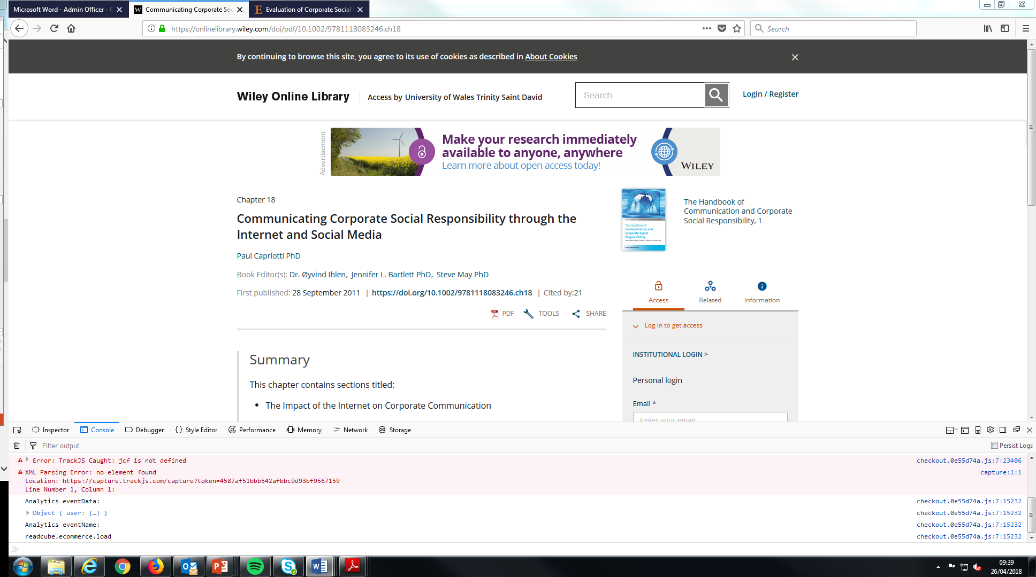
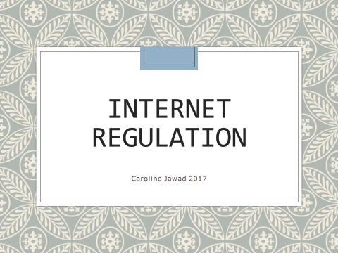

Slide 71
Copyright and music downloading
96% students agreed that stealing software from a store is a serious offense, but only 40 % felt that way about downloaded software (Weber, 2005)
Pew (2000) study - a third stating it is just a high-tech version of swapping audio cassettes
digital technology allows high quality, nearly perfect copies that are easily swapped or sold via the internet, and this has changed the dynamic
declining sales
lawsuits against individuals downloading music
web - public forum - detection of file swapping (Adrianson, 2003)
Unemployment - economy (Henderson, 2004).
Notes:
96% of Canadian students agreed that stealing software from a store is a serious offense, but only 40 % felt that way about downloaded software (Weber, 2005). For some reason this is not viewed as the same thing as walking into a record store and swiping a CD. A Pew (2000) study showed that half to three quarters of those who download music do not think of it as stealing, and over half of internet users say that downloading music is not stealing, with almost a third stating it is just a high-tech version of swapping audio cassettes, which has been done without impunity. While there is some question on the legality of cassette swapping, most record studios only pursued the most egregious violators (Adrianson, 2003). Today, digital technology allows high quality, nearly perfect copies that are easily swapped or sold via the internet, and this has changed the dynamic.
The Recording Industry Association of America (RIAA) blames file swapping and music sharing for a 31% drop in CD sales since 2000 (Batstone, 2004). Another study shows that there are declining sales going from sixty million for the Top-Ten albums in 2000 to thirty-four million in 2002 (Adrianson, 2003). As a result the RIAA has filed hundreds of lawsuits against individuals downloading music is an effort to combat declining sales.
The web is a very public forum and this allows of the detection of file swapping (Adrianson, 2003). One can be caught if one downloads only one song (Drexel, 2000), because the RIAA can search a peer-to-peer network and see the transactions. Some claim that the RIAA has engaged in bullying and intimidation tactics. While file swapping is a likely cause of some of the decline, other factors that impact sales might be the high unemployment rate and the poor performance of the economy (Henderson, 2004).
The RIAA is basing its lawsuits on the Digital Millennium Copyright Act (DMCA) which protects copyrighted materials by forbidding circumventing technological measures that are intended to protect some materials (Spinello, 2004). The DMCA has given unprecedented extensions to the copyright of materials (Henderson, 2004). This law is 200 pages in length and unclear to most people. The less understandable and less workable a law, the less likely people are to comply with it and less likely to feel they are violating the law (Litman, 2003; Henderson, 2004).
Today’s copyright law also views your favorite singer in the same legal eyes as it does Microsoft. Copyright law is not protecting the artists anymore; it is protecting the big corporate interests (Henderson, 2004). Given the belief that the RIAA does not represent the individual artists, but the big recording industry itself, many people who download consider themselves ripping off a big corporation and not the artist (Henderson, 2004). There is also considerable anger about the fact that the music industry once said CDs would last forever. People feel they are paying twice now that they have to buy DVDs to replace CDs, and they wonder how long DVDs will last (Carlo, 2005).
There are some interesting parallels to the 1984 case in which the Motion Picture Association of America (MOA) sued to stop the sale of the now defunct SONY Betamax VCR. As it turned out the home entertainment industry was the salvation of the movie industry with the advent of VCRs, DVDs, and digital cable (Drexel, 2000; Batstone, 2004). So perhaps the solution is to look at this in a different light. The Electronic Frontier Foundation suggests a payment system similar to radio broadcasting. Since record companies already monitor what is sold and traded via the peer to peer networks internet, they can use that as a basis for calculating fees owed to artists, based on a pay per play model (Adrianson, 2003).
Like many areas, court rulings sometimes have unintended affects. A Norwegian man created descrambling software so he could view movies on a different machine than one on which the movie was intended to be viewed. In doing so, he intentionally circumvented the Decode Content Scrambling System. He also posted his code to a website so that others could use it. U.S. courts ruled that not only could a website in the U.S. not have that descrambling code which was deemed a violation of the law, but they also ruled that a website could not point (link) to another site which held the code. The court’s decision raises some significant concerns about linkages since this ruling also can suppress links to copyrighted material. Linking permits immediate access from one site to another. That was part of the intended design of the web and without such linkages, the power of the web is greatly diminished. This court ruling raises serious concerns about the future of linking and free speech (Spinello, 2004). An additional concern is that new government regulations might have a negative impact on new developing technologies (Adrianson, 2003).

Slide 72
Continued
Extensions to the copyright of materials (Henderson, 2004)
Individual artists, but the big recording industry
CDs would last forever
Concerns about the future of linking and free speech (Spinello, 2004)
Additional concern - government regulations might have a negative impact on new developing technologies (Adrianson, 2003)
Notes:
The RIAA is basing its lawsuits on the Digital Millennium Copyright Act (DMCA) which protects copyrighted materials by forbidding circumventing technological measures that are intended to protect some materials (Spinello, 2004). The DMCA has given unprecedented extensions to the copyright of materials (Henderson, 2004). This law is 200 pages in length and unclear to most people. The less understandable and less workable a law, the less likely people are to comply with it and less likely to feel they are violating the law (Litman, 2003; Henderson, 2004).
Today’s copyright law also views your favorite singer in the same legal eyes as it does Microsoft. Copyright law is not protecting the artists anymore; it is protecting the big corporate interests (Henderson, 2004). Given the belief that the RIAA does not represent the individual artists, but the big recording industry itself, many people who download consider themselves ripping off a big corporation and not the artist (Henderson, 2004). There is also considerable anger about the fact that the music industry once said CDs would last forever. People feel they are paying twice now that they have to buy DVDs to replace CDs, and they wonder how long DVDs will last (Carlo, 2005).
There are some interesting parallels to the 1984 case in which the Motion Picture Association of America (MOA) sued to stop the sale of the now defunct SONY Betamax VCR. As it turned out the home entertainment industry was the salvation of the movie industry with the advent of VCRs, DVDs, and digital cable (Drexel, 2000; Batstone, 2004). So perhaps the solution is to look at this in a different light. The Electronic Frontier Foundation suggests a payment system similar to radio broadcasting. Since record companies already monitor what is sold and traded via the peer to peer networks internet, they can use that as a basis for calculating fees owed to artists, based on a pay per play model (Adrianson, 2003).
Like many areas, court rulings sometimes have unintended affects. A Norwegian man created descrambling software so he could view movies on a different machine than one on which the movie was intended to be viewed. In doing so, he intentionally circumvented the Decode Content Scrambling System. He also posted his code to a website so that others could use it. U.S. courts ruled that not only could a website in the U.S. not have that descrambling code which was deemed a violation of the law, but they also ruled that a website could not point (link) to another site which held the code. The court’s decision raises some significant concerns about linkages since this ruling also can suppress links to copyrighted material. Linking permits immediate access from one site to another. That was part of the intended design of the web and without such linkages, the power of the web is greatly diminished. This court ruling raises serious concerns about the future of linking and free speech (Spinello, 2004). An additional concern is that new government regulations might have a negative impact on new developing technologies (Adrianson, 2003).

Slide 73
A Question Of Ethics
Each year, the recording industry loses 4.3 billion dollars, in sales, a trend that began in 1999. There is recent evidence that this trend is reversing.
The 10 most popular albums sold 40 million copies worldwide last year, down 20 million from the year before - according to the RIAA.
Most recording artists make only $1.50 per CD. While many live very comfortable lives we must remember that they have earned it and therefore deserve it. If we were in their position, what would we think? Who makes the rest of the money?

Slide 74
Global digital sales
2015
+39.0% Subscription streaming
+38.6% Ad-supported streaming
2016

Slide 75
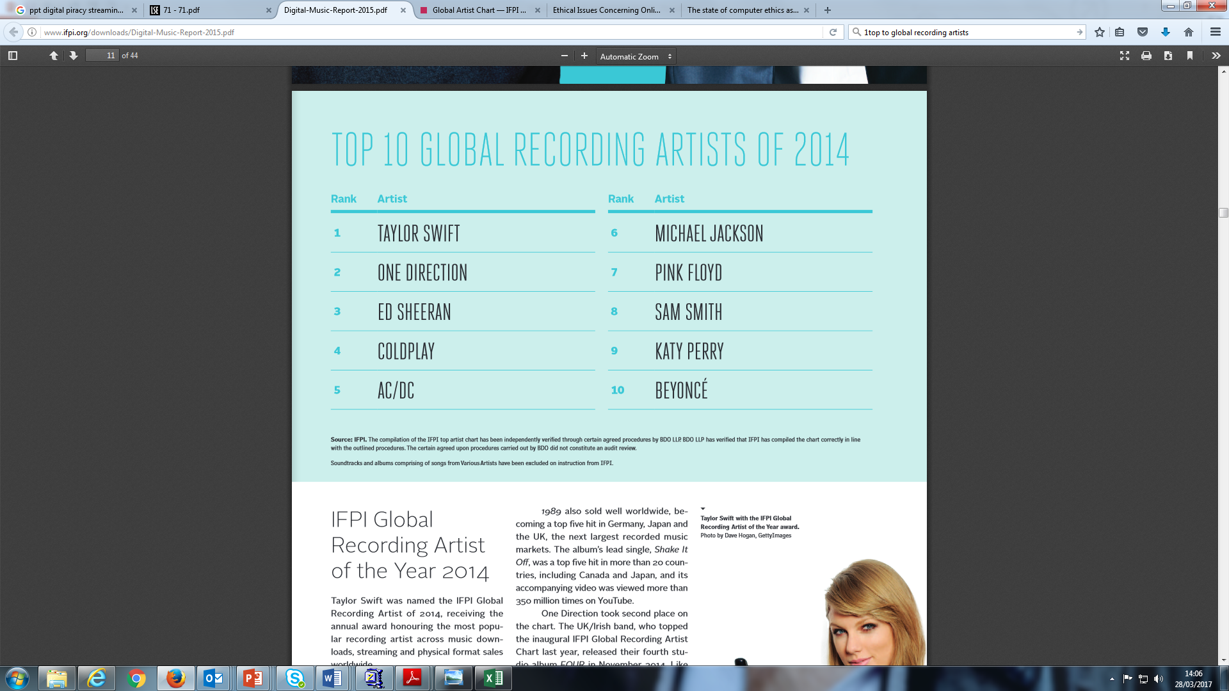

Slide 76
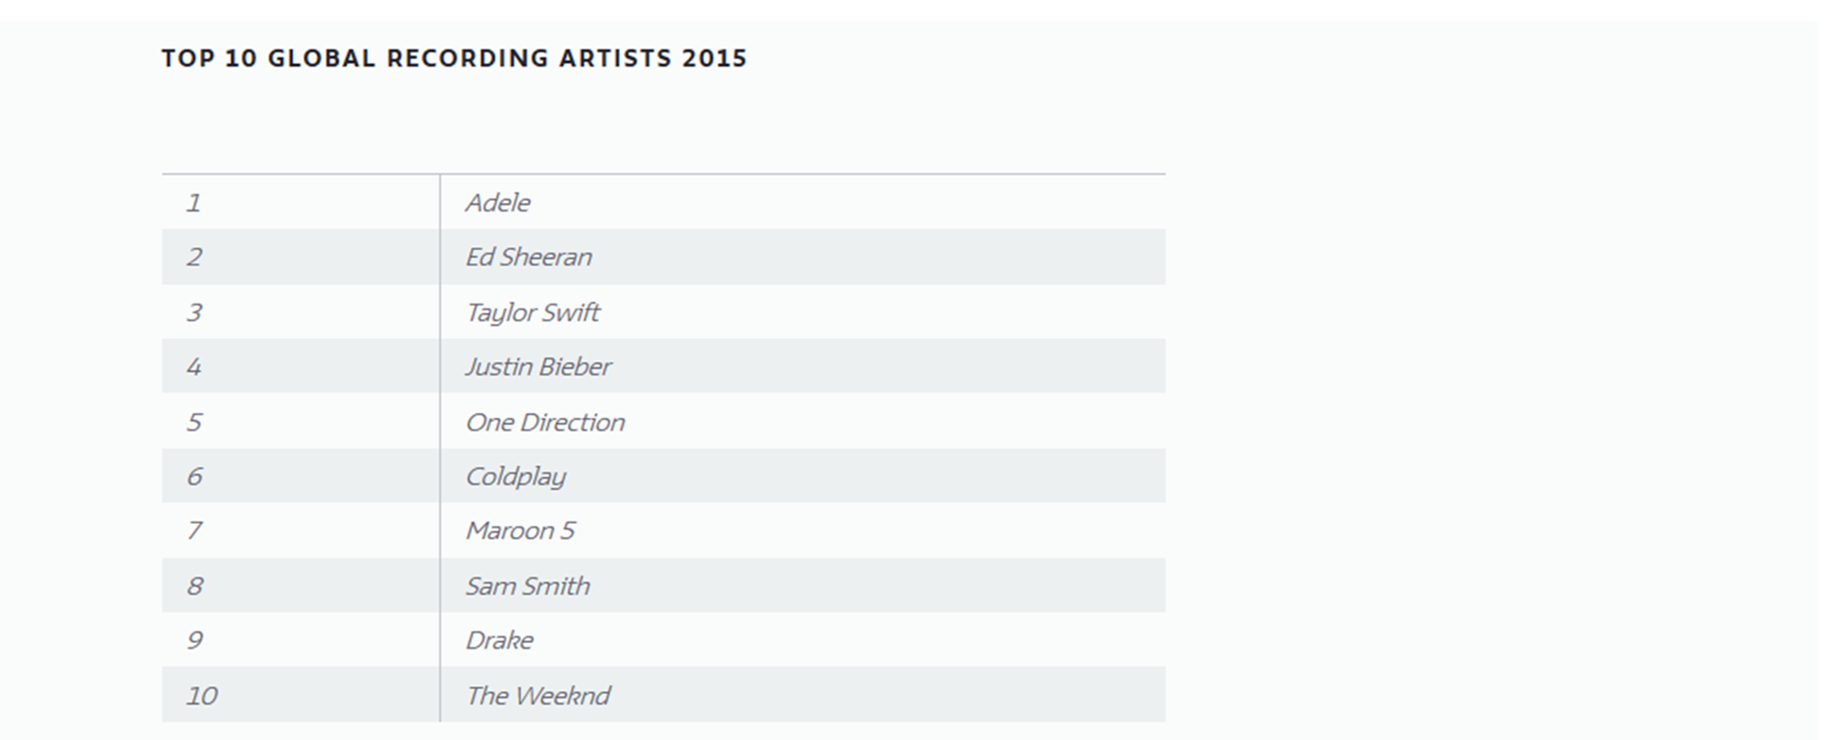

Slide 77
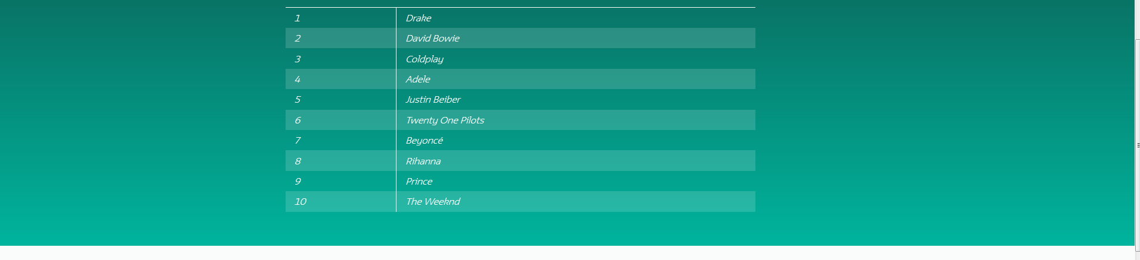
Top 10 global recording artists 2016

Slide 78


Slide 79
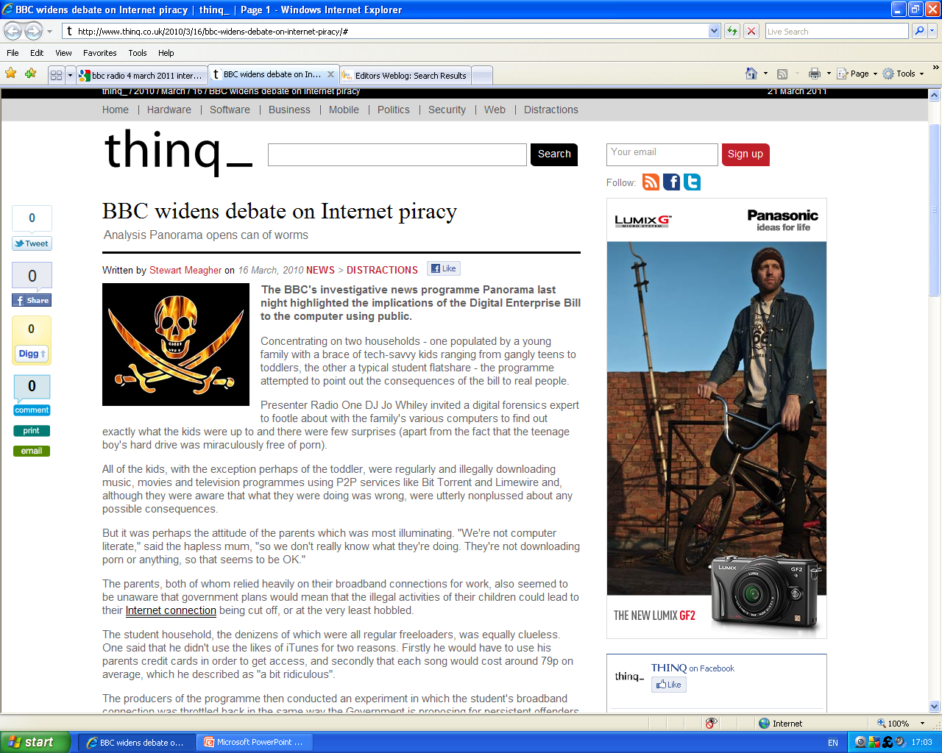

Slide 80
Technology and information
Computer technology has enabled malleability of information; the ability of all to shape it
This creates new possibilities for human activity
Information revolution is not only technological but social and ethical
Thesis: “Many new activities made possible by the new technology are so different from the previous ways of doing things that we need a new set of rules of the game’.” (Baase, p. 26)
  Sara Baase. A Gift of Fire, 3rd ed. Pearson Prentice Hall, 2008.

Slide 81
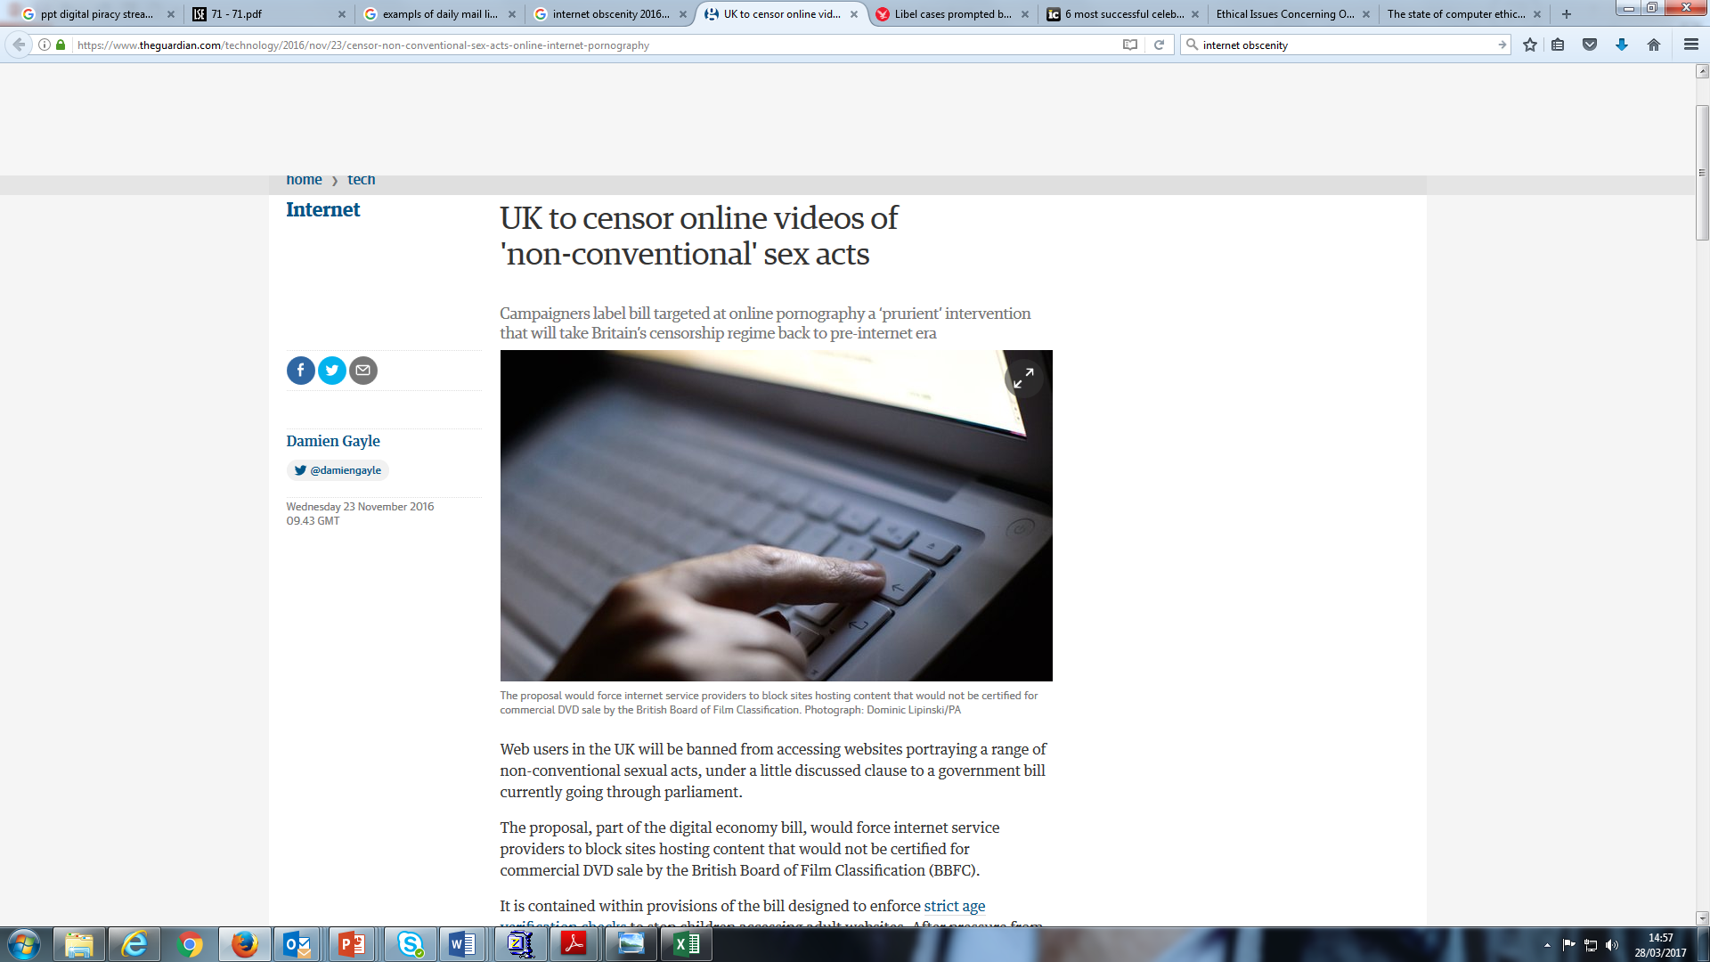

Slide 82
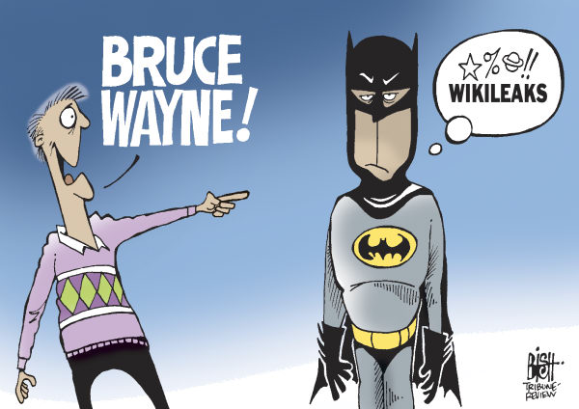
Notes:
Starting with an example before any theory - Wikileaks - the most obvious lesson is that it represents the first really sustained confrontation between the established order and the culture of the internet. There have been skirmishes before, but this is the real thing.
Julian Assange – Australian – Nov 2010 - WikiLeaks collaborated with major global media organisations to release US cables. Servers located in Sweden and elsewhere because those countries gives information providers legal protection. Bullet-proof hosting.
On threats by various governments toward Assange, it has been argued that Assange is the target of a global smear campaign to demonise him as a criminal or as a terrorist, without any legal basis.

Slide 83
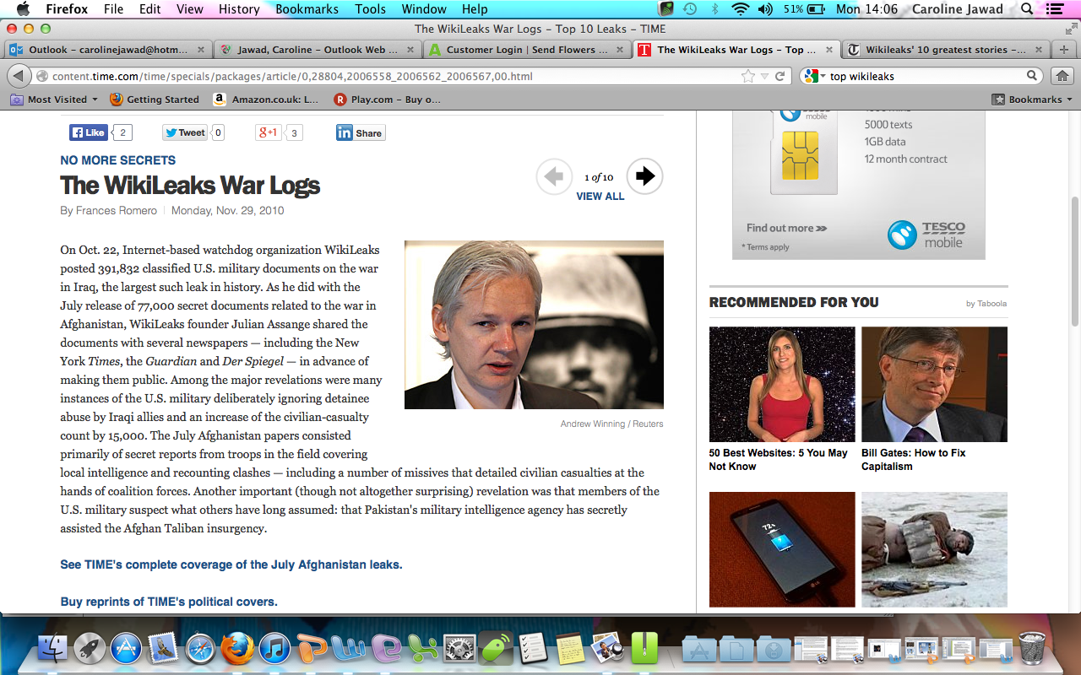

Slide 84
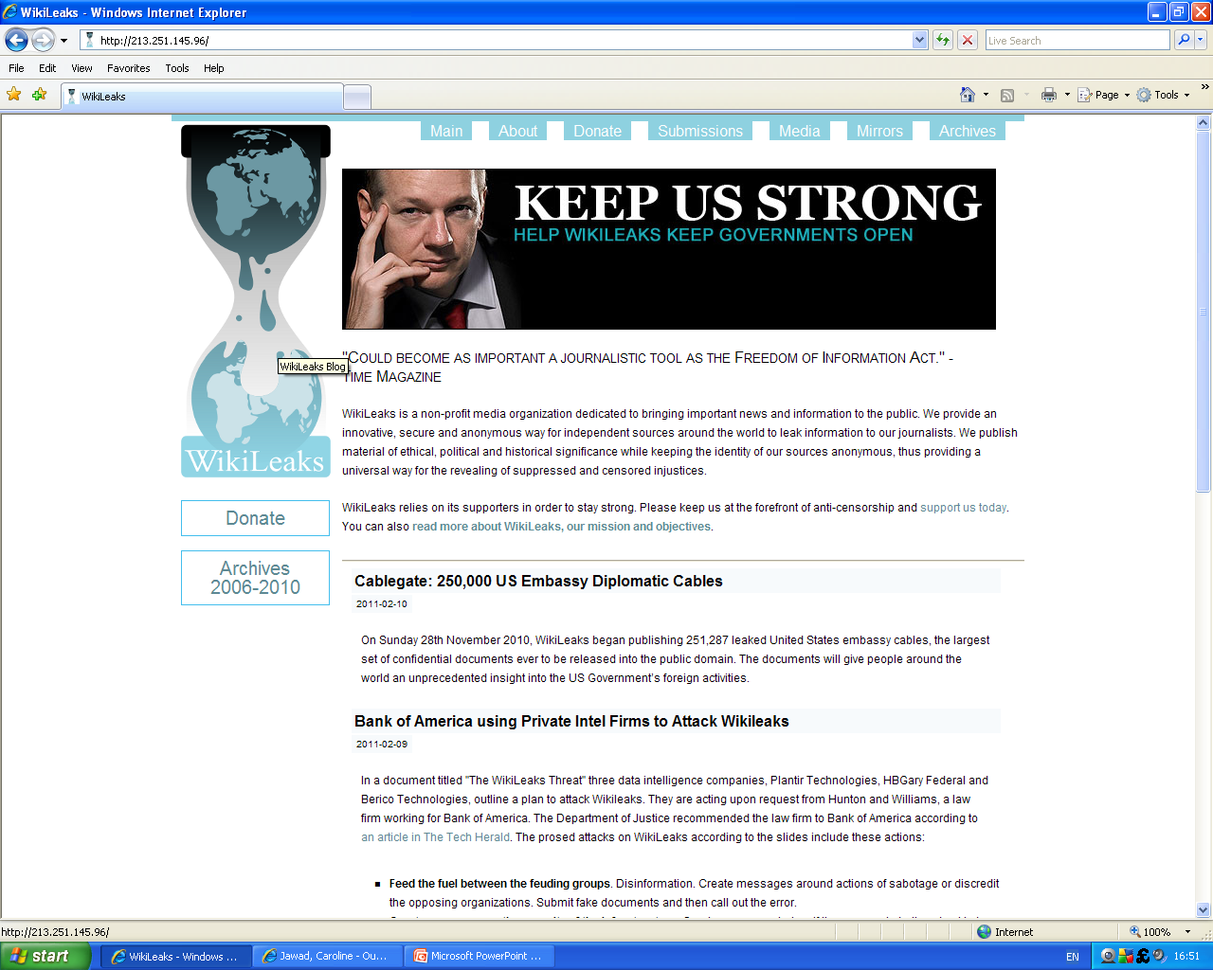

Slide 85
Wikileaks
Two diametrically opposed views of the Internet:
Open Internet advocates, a ragtag conglomerate of journalists, activists, theorists, academics, hackers, and everyday users
More closed and controlled Web we have what can be considered the establishment: governments, corporations, some media organisations, conservative commentators, politicians and old-fashioned authoritarians.
Notes:
http://www.technollama.co.uk/internet-regulation-and-wikileaks-what-have-we-learned-so-far
The release of thousands of leaked diplomatic cables by Wikileaks have presented us with the ultimate case study into the interaction between regulation and the Internet.
Wikileaks contrasts two opposed views of the Internet.
In one corner, we have the open Internet advocates, a ragtag conglomerate of journalists, activists, theorists, academics, hackers, and everyday users. On the side of a more closed and controlled Web we have what can be considered the establishment: governments, corporations, some media organisations, and right-wing proponents, conservative commentators, politicians and old-fashioned authoritarians.
Essentially – it a s row between government power and Internet.

Slide 86
Continued
Wikileaks exemplifies the very idea of the Internet as an unregulated space, a new country where self-organisation reigns supreme.
Also code is being used as a tool by both camps as a regulatory tool, in a nod towards Lessig’s ideas.
The Internet’s architecture favours distributed solutions, therefore making websites like Wikileaks very difficult to successfully shut
Notes:
https://projects.eff.org/~barlow/Declaration-Final.html
The father of cyber-libertarianism John Perry Barlow – pls read. Wikileaks exemplifies the very idea of the Internet as an unregulated space, a new country where self-organisation reigns supreme, the very essence of Barlowian theory. Similarly, code is being used as a tool by both camps as a regulatory tool, in a nod towards Lessig’s ideas. The Internet’s architecture favours distributed solutions, therefore making websites like Wikileaks very difficult to successfully shut
down.
Irony in the fact that so-called liberal democracies want to shut WikiLeaks down.
Consider, how the views of the US have - Hillary Clinton made a speech about internet freedom, which many people welcomed and most saw as a rebuke to China for its attack on Google. "Information has never been so free," declared Clinton. "Even in authoritarian countries, information networks are helping people discover new facts and making governments more accountable.“
She went on – Obama defended the right of people to freely access information - the more freely information flows the stronger societies become. Access to information helps citizens to hold their governments accountable, generates new ideas, and encourages creativity.
Given what we now know, that Clinton speech reads like a satirical masterpiece.
One thing that might explain the official hysteria about the revelations is the way they expose how political elites in western democracies have been deceiving their electorates.

Slide 87
Continued
Amazon removed Wikileaks
Domain removed by their DNS provider
Paypal froze their donation account
Mastercard and Visa froze funds
Twitter filtered Wikileak posts
Arrest of Julian Assange
Notes:
The attacks against the infrastructure that sustains Wikileaks has been mildly successful.
Amazon removed Wikileaks from its cloud services alleging breach of their terms and conditions. Then Wikileaks was removed by their DNS provider.
PayPal froze their donation account, and the bank holding funds for the legal defence of Julian Assange followed suit. Facebook deleted Wikileaks fan page!!
Financial tightening continued when Mastercard and Visa froze the Wikileaks funds they held.
Twitter has been accused of filtering all Wikileaks-related topics from trending.
So, who won the First Internet World War? From the above is the establishment winning?
Are Amazon, Visa, PayPal etc – instruments of US policy ??
At the same time - Visa and Mastercard refused to pass funds to the Russian music download site allofmp3.com, even though the site was legal within Russia, but that attracted little attention because it was about cheap music and not freedom of expression.

Slide 88

Notes:
Internet has become angry ………………
But looking again, the regulatory solutions offered have made the Internet angry just like Hulk, you don’t want to see the Internet angry. Hell hath no fury like a geek scorned.
John Gilmore said that the Internet interprets censorship as damage, and reroutes around it. This is a prime example of that.

Slide 89
Internet regulation
Internet regulation is basically restricting or controlling access to certain aspects or
Information
Net neutrality (The principle that Internet service providers should enable access to all content and applications regardless of the source, and without favouring or blocking particular products or websites)
Too much regulation stifles productivity, innovation, and prosperity
Existing laws
Notes:
Lying on the Internet could soon be a crime ………….
http://digitalenterprisemanagement.com/tag/internet-regulation/
Too much regulation stifles productivity, innovation, and prosperity … the old argument. It chokes industry, leaving businesses gasping, unable to expand and create jobsJ
Obamacare - with its mandate that companies provide health insurance for their full-time employees. Many like Hardees are demoting their employees to part-time status, in order to keep within the bounds of the law, while managing to remain open.
There are already laws against plagiarism and defamation, and if someone has been violated, there are proper legal actions that can be taken that involve a court - there is no reason to make Uncle Sam the guardian of the Internet.
Its bad for liberty, and its bad for business when the government regulates generally.

Slide 90
4 phases of Internet regulation
PHASE 1: THE OPEN INTERNET (THE 1960S TO 2000)
Cyberspace – a separate space, unregulated
Open Internet allows more free speech from more people
Access more information than ever before in human history at little cost
Force for democratisation – facilitator of forming of groups
Blogs – people of various cultures create environments and talk in a virtual environment joined by a common language
Notes:
The first phase, roughly from the Internet's inception in the 1960s through about 2000, is the period of the "open Internet." The dominant theory- tho few thinking about regulation was that the Internet itself was a separate space - cyberspace. – almost science fiction. Until the 1990s, most states ignored online activities or to regulate them very lightly –treating them differently from activities in real space.
Open Internet – we can hear more speech from more people than ever before – but in closed regimes ??? If the state controls the mouthpieces – same for Internet ???
Governments can become more open said the Obama administration (Noveck 2008). Cross-cultural understanding could flourish - digital networks connect people in new and important ways at low cost.
How have individual and groups responded ? The individual has greater autonomy in a networked public sphere (Benkler 2005). One can access more information than ever before in human history at little cost. An individual can access a vast store of information.
Collective action good for democracy - group formation and power - an impact on democracy and governance.
Blogs and conversations – lens of ways various cultures talk in a virtual space – all mapped.
Egypt - Egyptian blogosphere - state with a fair amount of control over media but discussion going on online in Egypt, in which people are talking about Islam, politics, foreign affairs.
Problems associated with what people do in these spaces. This is true whether the context is the Unites States or Burma (Myanmar).

Slide 91
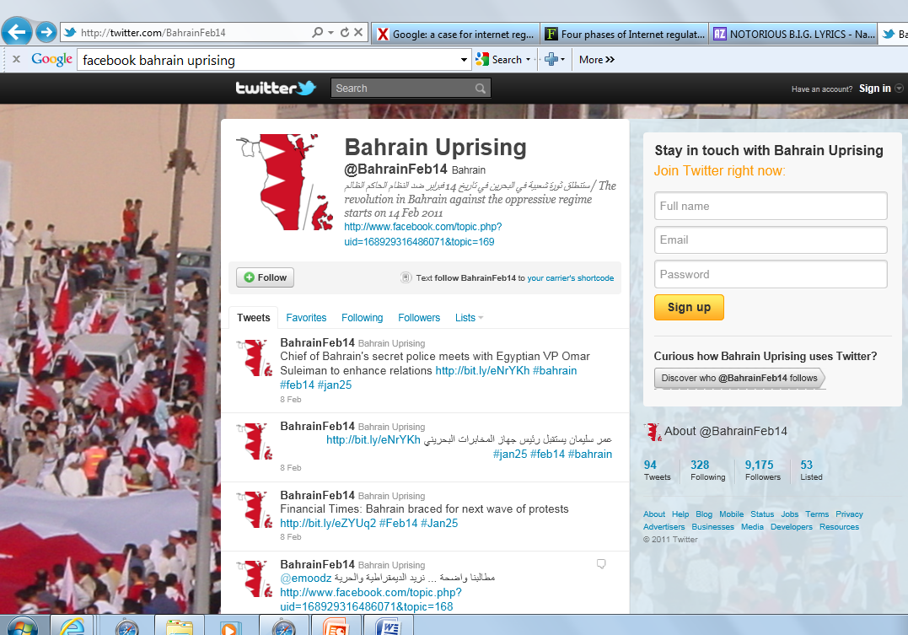

Slide 92
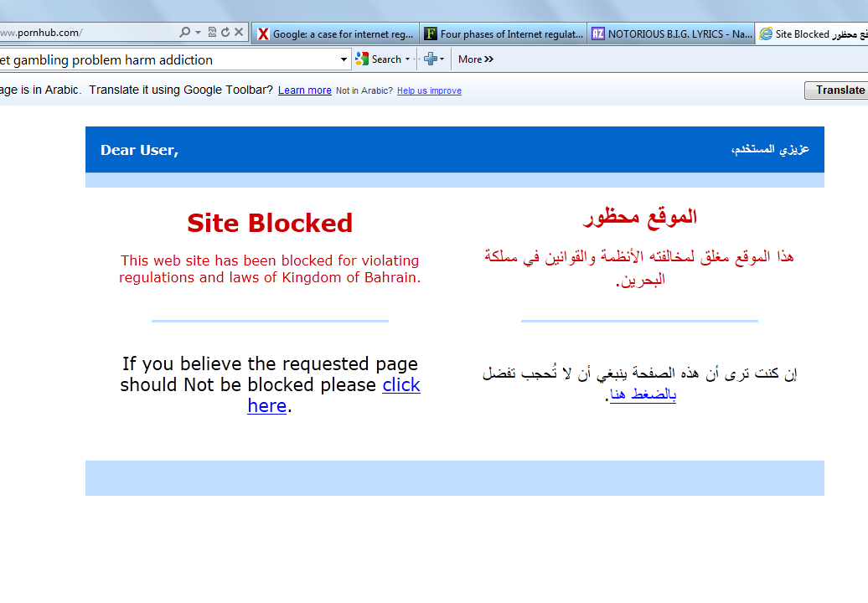

Slide 93
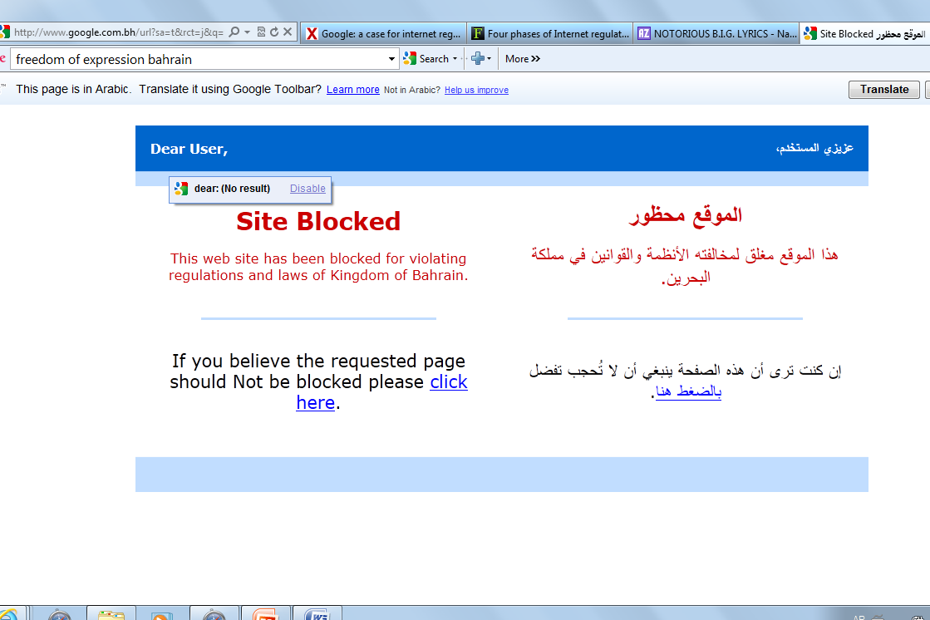
Notes:
Studies have combined a review of whether individual citizens could access sites in a "global basket" of bellwether sites to test in every jurisdiction across a variety of sensitive areas--akin to a stock index sorted by sector--as well as a list of websites likely to be sensitive only in some countries.
Finstance, was to erect filters or other means to block people from accessing certain information.

Slide 94
Continued
Filtering – global
Child pornogaphy – Northern Europe
Info filtering in libraries and schools – US
Wordpress locked – Turkey
Facebook blocked – China, Vietnam, Iran, Uzbekistan, Pakistan, Syria and Bangladesh
States- direct control of ISPs
Saudi Arabia – delayed Internet access until filters in place
Notes:
Internet filtering is not a phenomenon in states with histories of hostility to free expression. Democratic states participate in extensive regulation of the Internet, just as authoritarian states do.
Northern Europe filters associated with child pornography.
US - the state regulates what children can see in libraries and schools, as one means of limiting access to information deemed to be harmful to them. One may feel differently about these child protection measures.
In the case of overfiltering, states block more than is necessary to achieve the regulatory purposes, such as blocking all blogs on WordPress (in the case of Turkey) or all usage of the social network Facebook (in Pakistan), when the offending material could be targeted and blocked precisely and without limiting the expression of nonoffenders.
States may control ISPs or state may require private or semiprivate ISPs to implement the blocking as part of their service.
The government of Saudi Arabia, for example, made the ability to filter a prerequisite of public Internet access, delaying any such access for a period of several years until the resources to filter were set in place.the blocking of speech by activists on the fringe of nondemocratic societies, but the practices involve similar technical mechanisms in both types of settings.

Slide 95
Problems ….
‘Savvy’ citizens can circumvent filters
Game of cat and mouse between state and resourceful citizens
Substantial technical, financial and human sources to police Internet
States can erect digital gates – effective though forms of control
Online environment can be regulated as in real-space
Notes:
Citizens with technical knowledge can generally circumvent filters that a state has put in place. Some states acknowledge as much – including Saudi Arabia.
Expatriates in China, as well as those citizens who resist the state's control, find up-to-date proxy servers through which to connect to the Internet and through which they can evade filters in the process.
While no state will ultimately win a game of cat-and-mouse with those citizens who are resourceful and dedicated enough to employ circumvention measures, a preponderance of users will never do so--rendering filtering regimes at least partially effective despite the obvious workarounds.
Some of the early theories in the "open net" period - suggested that such state-run control of Internet activity would not work. States such as China have proved that an ambitious regulatory body can, by devoting substantial technical, financial, and human resources, exert a large measure of control over what their citizens do online. States, if they want, can erect digital gates at their borders, even in cyberspace, and can render these gates effective through a wide variety of modes of control (Lessig 2000; Goldsmith and Wu 2006: 65-86). These controls have proved right the claims of Jack L. Goldsmith and others who have emphasized the extent to which the online environment can be regulated and the ways in which traditional international relations theory will govern in cyberspace as in real-space (Goldsmith 2003).

Slide 96


