Slide 1
Organisational Strategies/Managing Stress/Empathy
Julie Thomas

Slide 2
Strategies/Techniques to Improve EI and linked concepts
An overall strategy should seek to shape the culture of the organisation so that it is supportive of emotional intelligence concepts such as empathy. It should be an integrated approach and reflected in the organisation’s mission and/or values.
Management and employee training can be part of this strategy. Introducing mechanisms for supportive conversations (like the WAP) is another one. What other strategies could organisations deploy to improve levels of EI/resilience/wellbeing?

Slide 3
Examples of Strategies
Change the culture to be supportive of EI- words like compassion, empathy, kindness as organisational values
Policies and processes to support culture – reward desired behaviour (e.g. promote compassionate managers), peer recognition for acts of kindness, Wellness Action Plans, ‘nudges’ like walking meeting plans, give managers time for people management activities
Wellbeing strategy – specific initiatives to improve all aspects. Social events like online comedy nights, employee assistance lines.
Compassionate and authentic leadership, role-modelling of behaviour, giving people support to get their jobs done
Notes:
Refer to CIPD’s Factsheet for more ideas regarding wellbeing.

Slide 4
Strategies Continued
Training for managers and employees – EI, mindfulness, resilience, stress management
Psychological safety – build trust so people can speak up, learning culture rather than harsh blame culture
Employee voice mechanisms, good communication
Resources – books, online materials, e-learning.
Diversity and inclusion strategy – everyone feels they belong
Swift and positive conflict resolution – mutual trust and respect
Tailored individual support – such as referring individuals to a wellbeing centre

Slide 5
HSE Management Standards
To help with Stress Management.
Cover 6 key areas of work design that if not properly managed are associated with poor health, lower productivity and increased accident and sickness rates.
Demands
Control
Support
Relationships
Role
Change
Notes:
They cover six key areas of work design that, if not properly managed, are associated with poor health, lower productivity and increased accident and sickness absence rates. The Management Standards are:
Demands – this includes issues such as workload, work patterns and the work environment
Control – how much say the person has in the way they do their work
Support – this includes the encouragement, sponsorship and resources provided by the organisation, line management and colleagues
Relationships – this includes promoting positive working to avoid conflict and dealing with unacceptable behaviour
Role – whether people understand their role within the organisation and whether the organisation ensures that they do not have conflicting roles
Change – how organisational change (large or small) is managed and communicated in the organisation

Slide 6
Development Plan
Use the template on Moodle
Be specific – give detail about which book you will read, what website you will consult, when etc.
List at least 2 detailed entries.

Slide 7
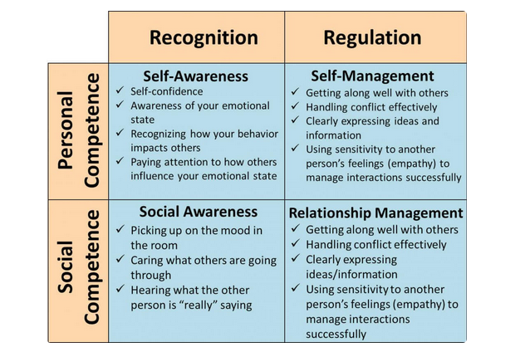
Image: Riopel, (2019)

Slide 8
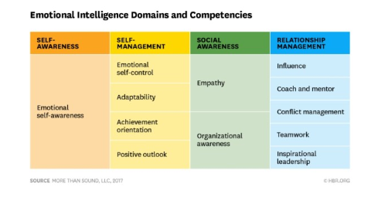
12 Competencies

Slide 9
Ways to Develop EI
Develop self-awareness – quizzes, ask others for feedback, assess your self against the 12 competencies.
Develop self-regulation - become aware of your emotional triggers. Reframing – make a conscious effort not to take offence. ‘I will use what she said to improve’.
Glass half-full perspective. Get into the habit of seeing the bright side.
Do activities that encourage positive emotions – be kind, be grateful (fill up your reserve so that you are more resilient when negative events occur). Kindness breeds kindness so this will have an effect on others’ behaviour.
Develop empathy for others – show that you care about how they are, their well-being.
Practise your listening and communication skills.
Read a book (e.g. Daniel Goleman), read articles on the Positive Psychology website, complete a free course (‘MOOC’).

Slide 10
Empathy
Julie Thomas

Slide 11
Reminder – What is Empathy?
‘The capacity for one person (a perceiver) to share and understand internal states of someone else (a target)’. It is ‘a social bridge that allows us to connect with one another’ (Weisz and Zaki, 2017).
Corporate empathy is about understanding our emotional impact on others and making change as a result (Parmar, 2016).
‘Empathy is about earnest listening, relating to one another, and putting yourself in someone else’s shoes’ (Ackerman, 2020).
Empathy is the ‘social awareness’ element of Emotional Intelligence
Notes:
Corporate empathy – businesses should understand their impact on employees and change if their impact adversely affects them.

Slide 12
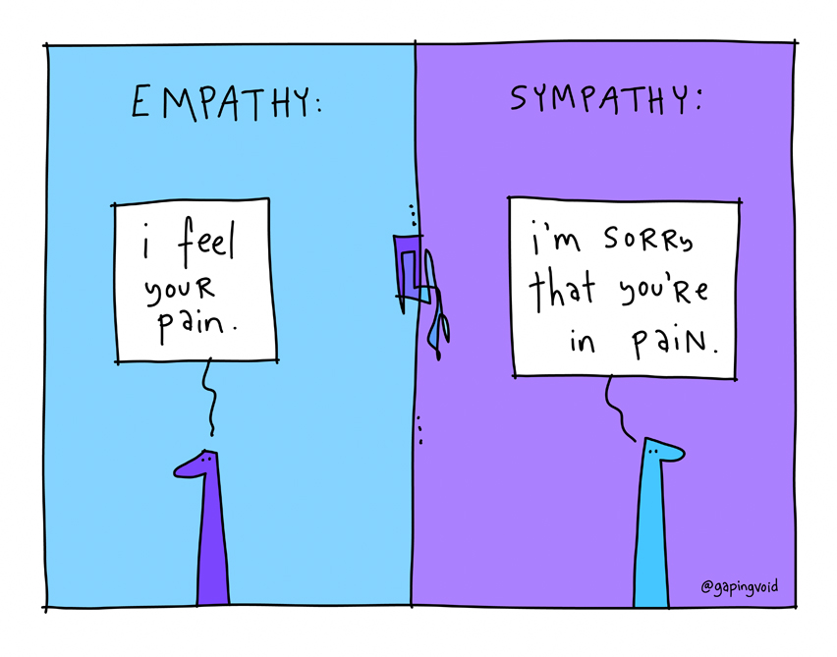
Difference between Empathy and Sympathy

Slide 13
Why is Empathy important?
To fully support employees to perform at their best, we need to understand the challenges employees have, as well as their feelings and emotional state
We need to confirm our thoughts about their perspective
Showing you care matters – people need to feel valued and appreciated. This aids motivation, loyalty and retention.

Slide 14
Activity (10 minutes)
I’m going to read out a statement. Listen to the response and give it one of the following labels. The aim of the exercise is to spot the empathic (and therefore ideal) response!
ADVISING
ONE -UPPING
EDUCATING
CONSOLING
STORY-TELLING
SHUTTING-DOWN
SYMPATHISING
INTERROGATING
EXPLAINING
CORRECTING
FIXING IT
EMPATHISING

Slide 15
What type of response is it?
A I’m worried about having enough money to pay my bills this month.
B I’ll loan you the money.
ADVISING
ONE -UPPING
EDUCATING
CONSOLING
STORY-TELLING
SHUTTING-DOWN
SYMPATHISING
INTERROGATING
EXPLAINING
CORRECTING
FIXING IT
EMPATHISING

Slide 16
What type of response is it?
A Look at my scar from the cycling accident.
B That’s nothing, you should see the one I have on my knee
ADVISING
ONE -UPPING
EDUCATING
CONSOLING
STORY-TELLING
SHUTTING-DOWN
SYMPATHISING
INTERROGATING
EXPLAINING
CORRECTING
FIXING IT
EMPATHISING

Slide 17
What type of response is it?
A I got caught in traffic for 2 hours in 100 degree fahrenheit weather and no air conditioning.
B That reminds me of the time....
ADVISING
ONE -UPPING
EDUCATING
CONSOLING
STORY-TELLING
SHUTTING-DOWN
SYMPATHISING
INTERROGATING
EXPLAINING
CORRECTING
FIXING IT
EMPATHISING

Slide 18
What type of response is it?
A I feel so sad that my son was court ordered to a rehab centre.
B It’s not your fault, you are a good parent. You did the best you could.
ADVISING
ONE -UPPING
EDUCATING
CONSOLING
STORY-TELLING
SHUTTING-DOWN
SYMPATHISING
INTERROGATING
EXPLAINING
CORRECTING
FIXING IT
EMPATHISING

Slide 19
What type of response is it?
A I just got the lab report back and it was what I most feared.
B Oh you poor thing.
ADVISING
ONE -UPPING
EDUCATING
CONSOLING
STORY-TELLING
SHUTTING-DOWN
SYMPATHISING
INTERROGATING
EXPLAINING
CORRECTING
FIXING IT
EMPATHISING

Slide 20
What type of response is it?
A I have so much to do today.
B Are you feeling overwhelmed and wanting support?
ADVISING
ONE -UPPING
EDUCATING
CONSOLING
STORY-TELLING
SHUTTING-DOWN
SYMPATHISING
INTERROGATING
EXPLAINING
CORRECTING
FIXING IT
EMPATHISING

Slide 21
What type of response is it?
A I lost my job.
B Cheer up, let’s go eat
ADVISING
ONE -UPPING
EDUCATING
CONSOLING
STORY-TELLING
SHUTTING-DOWN
SYMPATHISING
INTERROGATING
EXPLAINING
CORRECTING
FIXING IT
EMPATHISING

Slide 22
Activity (10 minutes)
Describe a time when you’ve felt empathy towards someone else, meaning that you felt sad or happy because you could sense what they were feeling.
How did you respond? Could your response have been better?
Empathy is just like any other skill: the more we practise it, the stronger it gets. How might you increase your empathy by showing care and concern for others?

Slide 23
Tips to increase your ability to empathise
Have one conversation a day in which your sole purpose is to understand the other person, not to solve problems or give advice
When listening, stop what you are doing and give that person your full attention. Notice their body language, tone of voice, emotional cues – what are they really saying?
When making a decision that impacts others, think about the personal implications of the decision. Address these issues.
(Smith, Oosten and Boyatzis, 2020)

Slide 24
Quiz in own time
Empathy Quiz | Greater Good (berkeley.edu)

