Slide 1
Session 2:
Scales & Psychometrics scale data transformations & calculations in spss
MSc Applied Psychology
ARDA: Lecture 2
Dr Ceri Phelps

Slide 2
Types of data
Two broad types of data:
Categorical
  e.g. gender, personality type
  Limited number of groups to which people can belong/can only belong to one group
Continuous
  e.g. age, scores on a stress scale, seconds taken to complete a task.
  Can take a vast range of values often from zero to an infinite number of different values
You can turn continuous data into categorical but not vice versa

Slide 3
Why does it matter?
Will influence the quality of your results, the type of conclusions you are able to draw
and the type of statistical analyses you are able to conduct

Slide 4
scale type properties of scale
  nominal records differences
  A is red, B is blue
  ordinal records differences &
  magnitudes
  A is larger than B
  interval records differences & magnitudes
  & has equal intervals
  A is two units larger than B
  ratio records differences & magnitudes,
  has equal intervals & a true zero
  A is twice as large as B •

Slide 5
Study design: A brief refresher
Choosing appropriate methodology for a study is not always as simple at it may appear
Need to think carefully about what it is you actually want to find out and what the best way doing this is
Different ethical and practical considerations for every project depending on the nature of the research question, target population or intervention
Critical thinking key!

Slide 6
Questions to consider
What sort of design issues does your methodological approaches raise?
What ethical issues are specific to this approaches?
What type of research questions should such an approach employ?

Slide 7
Quantitative Measures
Choosing appropriate measures for your study is another vital aspect of study design
Need to think carefully about what it is you actually want to measure (think about your operational definition!) and what the best way of measuring this is....
Measures capturing psychological constructs are expected to be reliable and valid.

Slide 8
Measures
Choosing a reliable and valid scale is always the best option:
you know that you are measuring something in a robust way
you have existing data from other studies to compare your findings with
Sensitive to change within studies (if appropriate)
Allows for stronger statistical analyses

Slide 9
Psychometric Standards

Slide 10
Psychometric Standards
Key measurement concepts:
Reliability
  Is the measure consistent and stable over time?
Validity
  Is it an accurate and precise measure i.e., does it measure what it claims to measure?
Standardization

Slide 11
Validity: how well a test actually measures what it is designed to measure

Slide 12
E.g., a scale of Extraversion
                Very much so Moderately so Somewhat so Not at all so
I feel at ease with people.
I start conversations.
I take charge.
I am the life of the party.
I am skilled in handling social situations.
I make friends easily.
I talk to a lot of different people at parties.
I know how to captivate people.
I do not mind being the centre of attention.
I feel comfortable around other people.
response to each item should be correlated with the response to every other item – otherwise not tapping into the same thing!

Slide 13
  Face validity
  – test looks plausible at face value i.e., does it look like it is measuring what it claims to be measuring?
  E.g., Life Orientation Test (Scheier & Carver, 1985): a measure of dispositional optimism
In uncertain times I usually expect the best
If something can go wrong for me, it will
I’m always optimistic about my future
I hardly ever expect things to go my way

Slide 14
  Construct Validity
  does the test successfully measure the psychological construct it is designed to measure?
  E.g., intelligence
  Assessed by looking at the relationship between test scores and other behaviours that it should be related to
    Do scores on a new IQ test relate to academic performance?
    does a measure of psychological distress report similar scores to a psychiatric interview.
  Should be related to measures of the same construct – convergent validity – and it should be unrelated to measures of unrelated constructs – discriminant validity

Slide 15
  Content Validity
  whether the items on a test measure all the knowledge or skills that are assumed to underlie the construct of interest
  E.g. does a measure of intelligence capture all types of intelligence or just certain types e.g. problem-solving ability; numerical reasoning;

Slide 16
Criterion-related Validity
  the ability of test scores to correlate with meaningful criterion measures
  are they able to predict future outcomes?
    Test should predict present or future outcomes that are influenced by the construct being measured
    e.g. does a measure of IQ successfully predict future performance/success in that job?
    e.g., Do scores on a measure of conscientiousness predict future academic performance?

Slide 17
Reliability – consistency or stability of a measure.

Slide 18
Test –retest reliability
  consistency of measurement over time
    Assessed by administering the measure to the same group of participants on two or more separate occasions and correlating the sets of scores
    If the construct being measured is stable, scores should be consistent over time
    E.g., you would not expect the results of a test of IQ or personality traits to be different if measured more than once.

Slide 19
Split half reliability
- internal consistency between two sets of scores
Inter-rater reliability
  – extent to which two different raters agree in their evaluations
  consistency of measurement when different people observe the same event or score the same test

Slide 20
  Internal Reliability/Consistency: consistency of measurement within the test itself
    All the items on a test should measure the same thing
    Items should correlate highly with each other
    Internal consistency reliability – the extent to which a test has homogenous content
    Cronbach’s alpha – response to each item is correlated with the response to every other item
    Note : Interpreting Reliability .70 or above

Slide 21

10 minute Screen break
Think about…. What are the key ethical considerations that an ethics committee would want to see consideration of when carrying out applied research?
How many can you think of…?

Slide 22
Transforming scale data in spss

Slide 23
  Internal Reliability/Consistency: consistency of measurement within the test itself
    All the items on a test should measure the same thing
    Items should correlate highly with each other
    Internal consistency reliability – the extent to which a test has homogenous content
    Cronbach’s alpha – response to each item is correlated with the response to every other item
    Note : Interpreting Reliability .70 or above

Slide 24
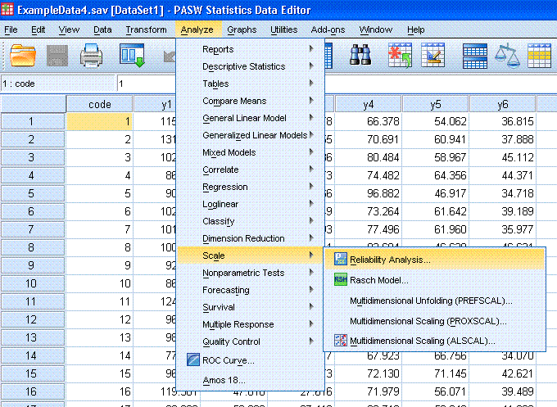

Slide 25
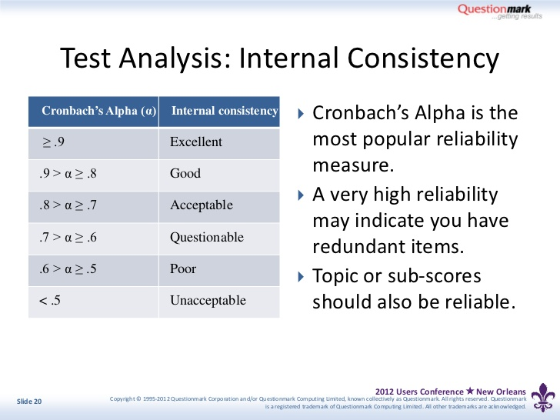

Slide 26
Scales and sub-scales
Some psychological measures may include sub-scales
Sometimes can either add up all items for total score, or create separate sub-scales for each
Sometimes have to keep each sub-scale separate from others.

Slide 27
E.G., Impact of Event Scale, Horowitz et al. 1979
  INTRUSION SUB-SCALE: Seven items measure intrusive thoughts “intrusion” about a stressful event (0-35)
  “I thought about it when I didn’t mean to….”
  AVOIDANCE SUB-SCALE: Eight items measure attempts to avoid those thoughts “avoidance” (0-40)
  “I stayed away from reminders of it”
  Can be combined to create a “Global distress Scale” (0-75)

Slide 28
Impact of Event Scale (Horowitz et al., 1979)
(Tick one box from each row) | Not at all | Rarely | Sometimes | Often
I thought about it when I didn’t mean to | o | o | o | o
I avoided letting myself get upset when I thought about it or was reminded of it | o | o | o | o
I tried to remove it from my memory | o | o | o | o
I had trouble falling asleep or staying asleep, because of pictures or thoughts about it that came into my mind | o | o | o | o
I had waves of strong feelings about it | o | o | o | o
I had dreams about it | o | o | o | o
I stayed away from reminders of it | o | o | o | o
I felt as if it hadn’t happened or wasn’t real | o | o | o | o
I tried not to talk about it | o | o | o | o
Pictures about it popped into my mind | o | o | o | o
Other things kept making me think about it | o | o | o | o
I was aware that I still had a lot of feelings about it, but I didn’t deal with them | o | o | o | o
I tried not to think about it | o | o | o | o
Any reminder brought back feelings about it | o | o | o | o
My feelings about it were kind of numb | o | o | o | o

Slide 29
Reverse-coding
Some scales contain items which need to be reverse-coded (to prevent demand characteristics/lazy responses)
    E.g., Life Orientation Test (Scheier & Carver, 1985): a measure of dispositional optimism
In uncertain times I usually expect the best
If something can go wrong for me, it will
I’m always optimistic about my future
I hardly ever expect things to go my way

Slide 30
Other data transformations
Recoding (according to scale instructions)
Turning continuous data into categories
Creating total scores/means scores for total scales and sub-scales
Missing data commands

Slide 31
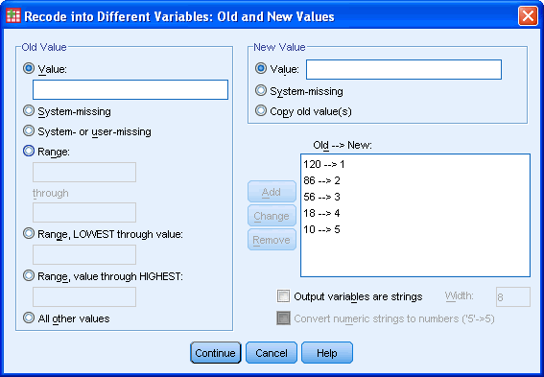
1 = 5
2= 4
3 = 3
4= 2
5 = 1

Slide 32
Summary
Choosing appropriate measures for your study is a vital aspect of study design
Need to think carefully about what it is you actually want to measure (think about your operational definition!) and what the best way of measuring this is....
Measures capturing psychological constructs are expected to be reliable and valid.
Need to understand how a scale has been constructed in order to analyse it properly
  Recoding instructions?
  Reverse scoring?
  Sub-scales?

