Slide 1
HPHP6901
SEX, SEXUALITY & GENDER
UNIT FOUR

Slide 2

Revision
In the last lecture we examined some of the more complex aspects of the work of Michel Foucault, particularly the way in which he sees truth, power, and knowledge interacting.
We covered the nature of truth, and power’s role in shaping our knowledge of it.
In this lecture, we will take somewhat of a step back, filling in some detail of feminist theory, in order to prepare us for the second of our key theorists – Judith Butler.

Slide 3
Revision
Foucault's insight means that our “truths” become detached from any innate nature.
We do not HAVE to have categories of sane and insane, nor do those categories have to be formed the way they are.
Truth is produced by power through the categorisation of knowledge.
Knowledge is formed by the power to categorise new experiences according to existing categories
Power operates obviously, through systems of control like institutions, and diffusely, through social norms and expectations.
We choose to have them
We could choose not to have them…

Slide 4
Feminist history

Slide 5

So, What is Feminism?
Feminism is a range of political movements, ideologies, and social movements that share a common goal: to define, establish, and achieve political, economic, personal, and social equality of sexes.
Generally, the history of feminism is divided into three / four ‘waves’ which occur in historically defined times and generally have different goals in addressing forms of gender imbalance.
We also see differences in activist politics (how to go about getting what you want) and differences in the value ascribed to contemporary society (just how wrong are things / can things ever be good).

Slide 6
So, What is Feminism?
We begin with feminist theory here for two reasons –
First, that it emerges as one of the earliest coherent intellectual movements to highlight the issues of power and social construction that we have seen in the work of Foucault, picking up on the way in which the knowledge of society is ordered by power to maintain current gender hierarchies.
Second, because many of the discussions that happen in feminist history mirror current debates in the field of gender, sex, and sexuality, with old debates returning with new vigour.

Slide 7
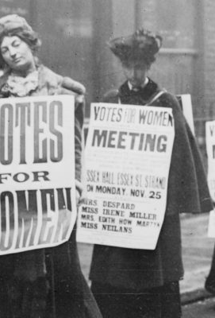
1st wave
First wave feminism was a wave of social and political activism that occurred across the western world in the late 19th / early 20th century.
Its focus was largely on the establishment of legal equality between genders, such as the right to vote or property ownership, and access to equal educational opportunities.

Slide 8
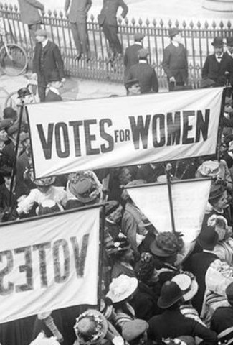
1st Wave
In the UK, it focused on the work of the Suffragettes, Bessie Rayner Parkes and Mary Stopes.
This form of feminism aimed to address structural and legal inequality between genders which privileged males to the disadvantage of females.
It was driven largely by independently wealthy individual white women from the upper and middle classes and, while aiming to expand opportunity for all women, was largely focused only on those areas of concern to the type of women involved – education and politics.

Slide 9
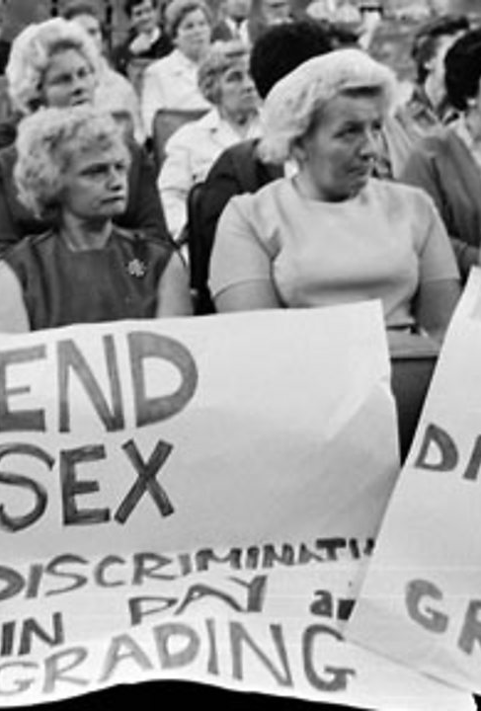
2nd wave
Second-wave feminism is a period of feminist activity and thought that first began in the early 1960s in the United States, and eventually spread throughout the Western world and beyond.
Whereas first-wave feminism focused mainly on voting rights and overturning legal obstacles to gender equality, second-wave feminism broadened the debate to a wide range of issues:
e.g. sexuality, family, the workplace, reproductive rights, de facto inequalities, and official legal inequalities

Slide 10
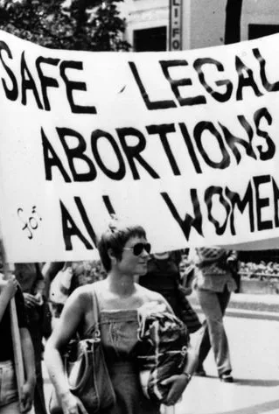
2nd Wave
Second-wave feminism also drew attention to domestic violence and marital rape issues.
Generally, second wave feminism was driven by largely white middle class women in the developed world in reaction to the increased domesticity of feminine roles post WW2.
Significant legal victories of the movement in the US were extending full affirmative action rights to women, the Women's Educational Equity Act ,the outlawing of marital rape, and Supreme Court cases such as Roe v. Wade in 1973.

Slide 11
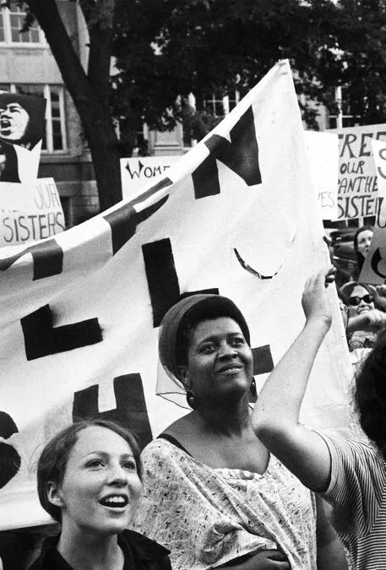
3rd wave
Many historians view the second-wave feminist era in America as ending in the early 1980s with the intra-feminism disputes of the feminist sex wars over issues such as sexuality and pornography, which ushered in the era of third-wave feminism in the early 1990s
Born in the 1960s and 1970s as members of Generation X, and grounded in the civil-rights advances of the second wave, third-wave feminists embraced individualism and diversity and sought to redefine what it meant to be a feminist

Slide 12
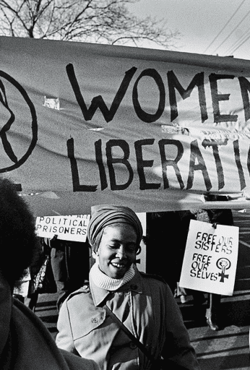
3rd Wave
This focus on the individuality of women, as opposed to the binarism of male / female, drove an increasing focus on issues of race and gender and the intersection between them.
While second wave feminism is largely seen as being driven by white middle class concerns, third wave feminism is seen as focused on matter of race and class.
It also paid attention to matters of equal outcome and equal opportunity, seeking to challenge underlying male domination of public spaces and professional zones.

Slide 13

4th wave
Fourth-wave feminism is "defined by technology" and is characterized particularly by the use of Facebook, Twitter, Instagram, YouTube, Tumblr, and blogs.
Cochrane describes the fourth wave as focusing on sexual harassment (including street harassment), workplace discrimination, body shaming, sexist imagery in the media, online misogyny, assault on public transport, and intersectionality, relying on social media for communication and online petitioning for organizing.

Slide 14
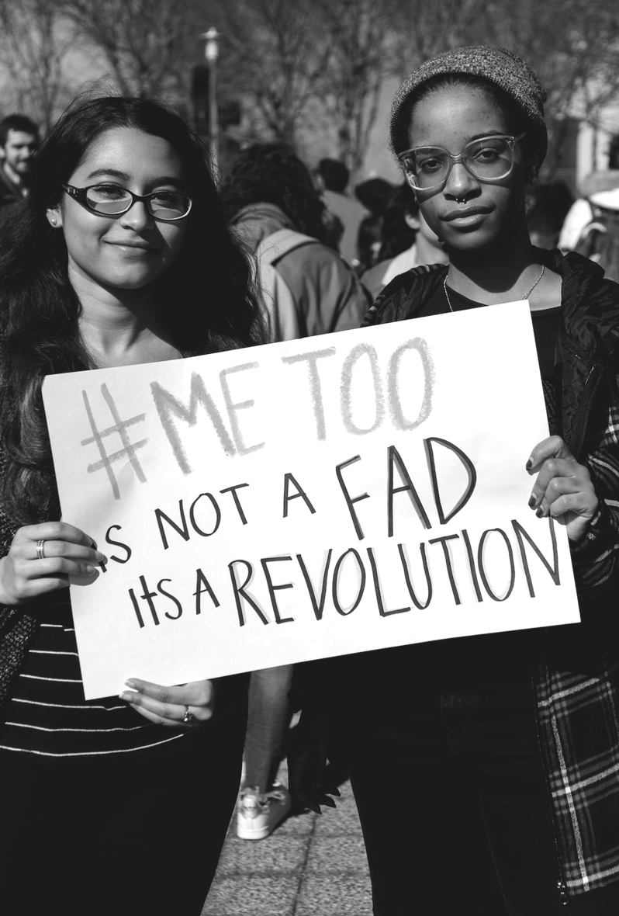
4th Wave
Criticisms include its reliance on technology (which involves issues of class, access, and ableism), its focus on individuality and individualism drawing focus away from shared experiences that define social categories of gender, its limited political and social activism beyond cyberspace, and the factionality seen in contemporary divisions within 4th wave feminism.
Contemporary forms of feminism are often in conflict with earlier forms – see TERF’s and transgenderism, or clashes over sex work – just as earlier forms of feminism critiqued those going before.

Slide 15
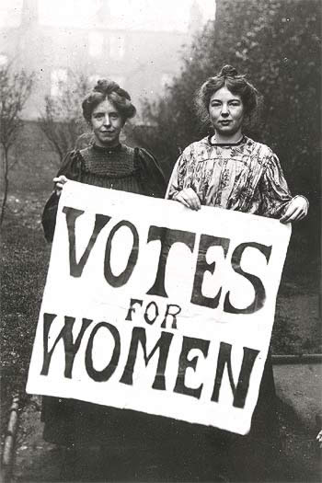

Slide 16
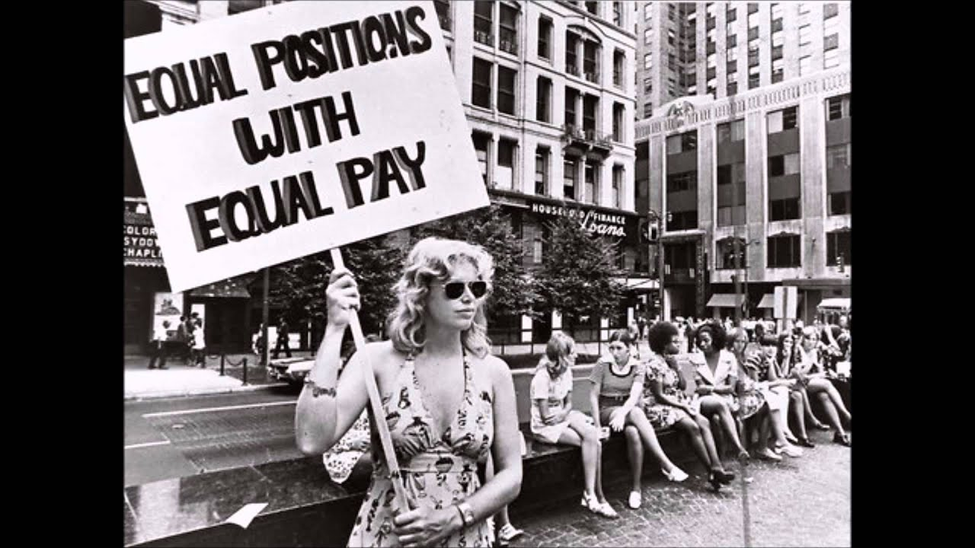

Slide 17
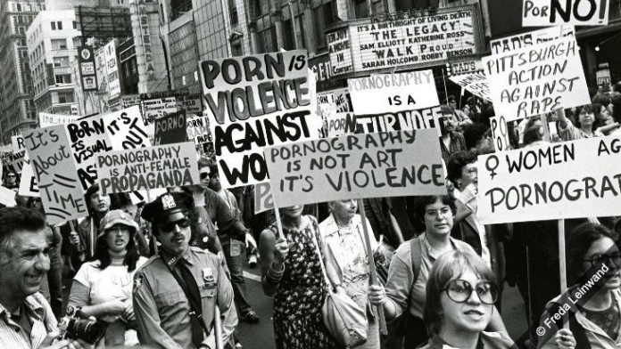

Slide 18
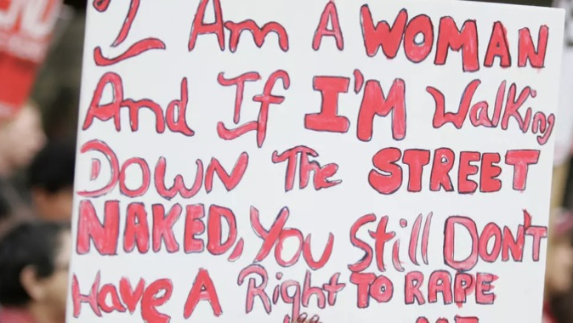

Slide 19
Feminism and Gender

Slide 20

Feminist views of gender
Traditionally, feminism has had a nuanced view of the relationship between sex (male / female) and gender (masculine / feminine), drawing attention to the way in which male society codes certain things as female in a way that is not necessary.
This has allowed feminism to articulate an equal position within society based on a freeing of biological sex from the necessity of male-constructed gender roles like motherhood.

Slide 21

Feminist views of gender
However, largely, feminism has done so from a belief in the shared, essential, natures of two sexes, male and female.
By this, feminism argues that all woman share in some form the experience of womanhood and that this experience is connected innately to their sex. So, too, men’s experiences of manhood are formed by their location on a sexual binary.
This has formed a dynamic that supposed a gender and sexual binary, with the discourse aiming to loosen the gendered restrictions on women.

Slide 22

Gayle Rubin – “The Traffic in Women: Notes on the Political Economy of Sex”
Gayle Rubin (for instance) uses the phrase ‘sex/gender system’ in order to describe “a set of arrangements by which the biological raw material of human sex and procreation is shaped by human, social intervention” (1975, 165).
Rubin describes gender as the “socially imposed division of the sexes” (1975, 179).
Rubin's thought was that although biological differences are fixed, gender differences are the oppressive results of social interventions that dictate how women and men should behave.

Slide 23
Gayle Rubin – “The Traffic in Women: Notes on the Political Economy of Sex”
Women are oppressed as women and “by having to be women” (Rubin 1975, 204).
However, since gender is social, it is thought to be mutable and alterable by political and social reform that would ultimately bring an end to women's subordination.
Feminism should aim to create a “genderless (though not sexless) society, in which one's sexual anatomy is irrelevant to who one is, what one does, and with whom one makes love” (Rubin 1975, 204).

Slide 24

Discussion POINT
1 – What does Rubin mean when she says, ‘Women are oppressed as women and “by having to be women”’ (Rubin 1975, 204)?
2 – How does this relate to Foucault’s work on power / knowledge / truth?
3 – Is there a potential contradiction in attempting to organise against oppression as women on the basis of being women?

Slide 25
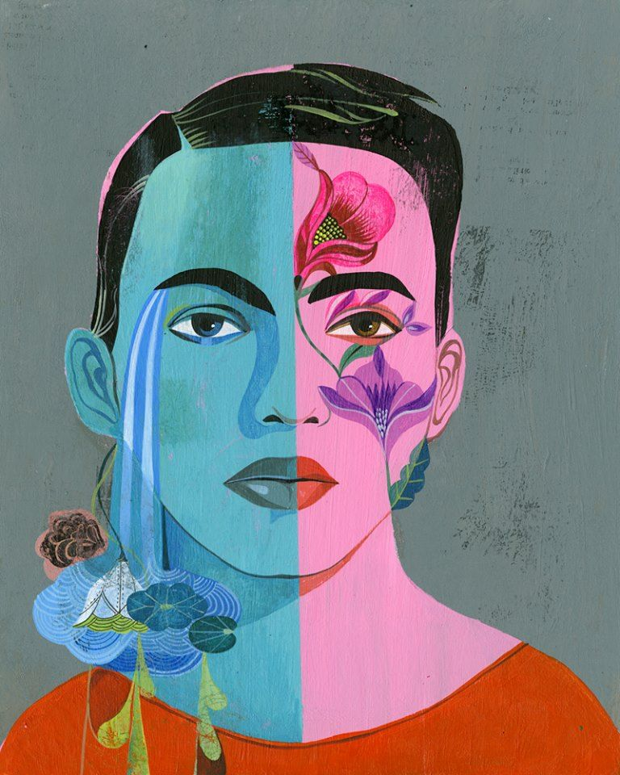
Feminist views of gender
Under the influence of post-modern critical theory (and Foucault!) much recent feminism (3rd wave onwards) has been much more careful about articulating two things:
1 - a universal account of “woman’s experience” as a basis for feminist politics – that all women experience womanhood in the same way, and that this universal experience provides a ground of organisation.
2 - a direct gender / sex correlation between male / female and masculinity / femininity that presupposes a dependant binary – that the category of woman can be defined according to physical characteristics and that this categorisation can be used as the basis for a categorisation of oppressor / oppressed.
Olaf Hajek “Teaching Tolerance” 2013

Slide 26
Judith Butler
MAIN IDEAS

Slide 27

Judith Butler
As a theorist, Judith Butler draws on a wide range of different theorists that may have come across before in your studies - Hegel, Freud, Simone de Beauvoir, Althusser, Foucault, Derrida etc.
Her work is complicated, and written in a very dense and complex style, with many allusions and references to other theorists. This can make it quite difficult to follow and understand.
If you are interested in finding out more about her, read her most famous work is Gender Trouble (1990), of which you have part to read, as well as parts of ‘Understanding Judith Butler’

Slide 28
Judith Butler
The key aspects of Butler’s thought are as follows:
1 - Gender is not something we are automatically born with, it is something we continually “perform”
2 - This means that we have to stop thinking of gender as a “natural” category
3 - Subversion of the gender order is possible

Slide 29
Discussion POINT
1 – How do we perform our genders in everyday life? What does the word “performance” mean here?
2 – Why is gender unnatural? What aspects of your gender performance are ‘unnatural’?
3 – How might our performance of gender be subverted? What does subversion do to ‘naturalness’?

Slide 30
Judith Butler
“The notion that there might a "truth" of sex, as Foucault ironically terms it, is produced precisely through the regulatory practices that generate coherent identities through the matrix of coherent gender norms.
The heterosexualization of desire requires and institutes the production of discrete and asymmetrical oppositions between "feminine" and "masculine," where these are understood as expressive attributes of "male" and "female.“”
(1990, p. 17)
Butler’s work begins to unpick the assumption in earliest feminist theory that sexual differences are the basis for gender inequality, instead focusing on the way in which even sex differences are constructed within a social matrix.
This reverses the idea that our genders (our presentation) flow from our sex (our physical attributes) – instead, Butler proposes that our construction of a binary of sex (physical attributes) flows from the social power desire for gender (our presentation) binaries.

Slide 31
Judith Butler
Butler’s work in this arena draws very heavily on the Speech Act Theory of JL Austin. This argues that when we speak, we are not just describing things or communicating information.
Rather, our speech can perform acts that bring about change in the world.
So when a vicar says “I now pronounce you man and wife” he is actually joining two people together legally – think of Foucault’s account of ‘discourse’

Slide 32
Judith Butler
Butler argues that we continually perform our gender through our actions, bringing about social change through our repeated actions:
“Gender is the repeated stylization of the body, a set of repeated acts within a highly rigid regulatory framework that congeal over time to produce the appearance of substance, of a natural sort of being.” (1990, p. 33)
Our repetition of actions associated with a particular gender congeals that identity around (and within!) us – our actions produce change in our self-definition and in others’ definition of us.

Slide 33

Reading
Today, we have begun our discussion of the work of Judith Butler, as well as preceding feminist theories.
Your reading for this session is “Subject of Sex/Gender/Desire” from ‘Gender Trouble’ by Judith Butler.
A permalink to this book is included on the Moodle page.

