Slide 1
1.先看看汉字龙。在中国汉字龙和龙的历史都很长。
2.中国人很喜欢龙，我们龙的传人。中国有很多有关龙的神话故事。
2.在中国龙是英雄，是神。2.中国龙的样子：9种动物
3.中国龙和西方龙的区别

Slide 2
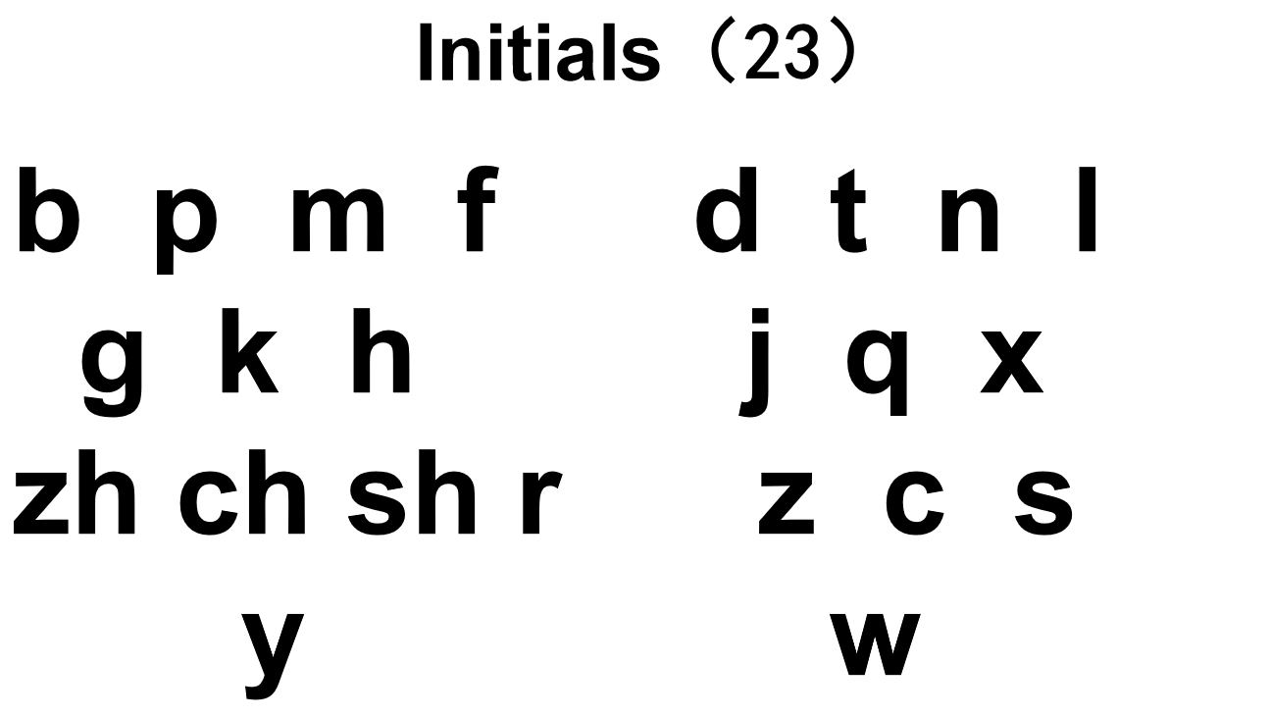

Slide 3
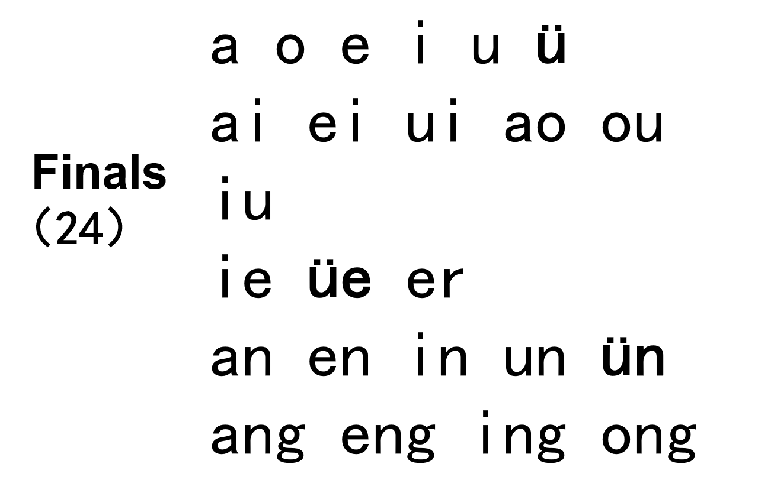

Slide 4
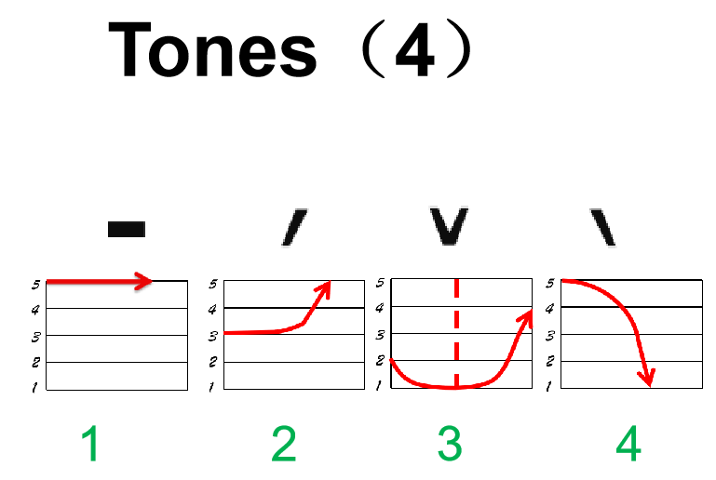

Slide 5
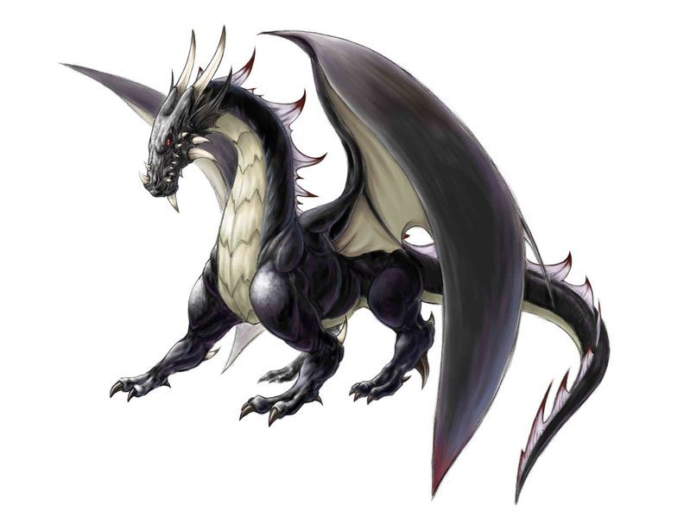
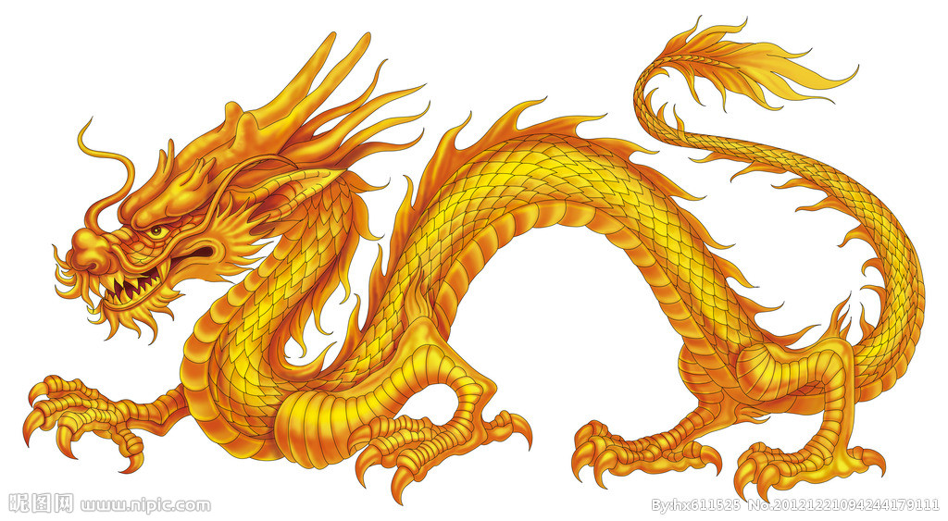
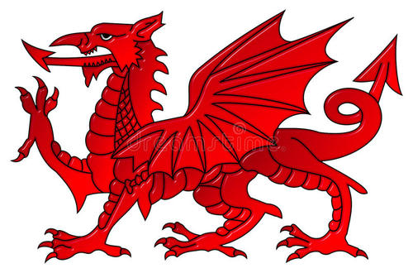
Notes:
世界各地都有龙的故事。但中国的龙代表了：外表：中国龙的形象也是变化的，有很多种不同的龙

Slide 6
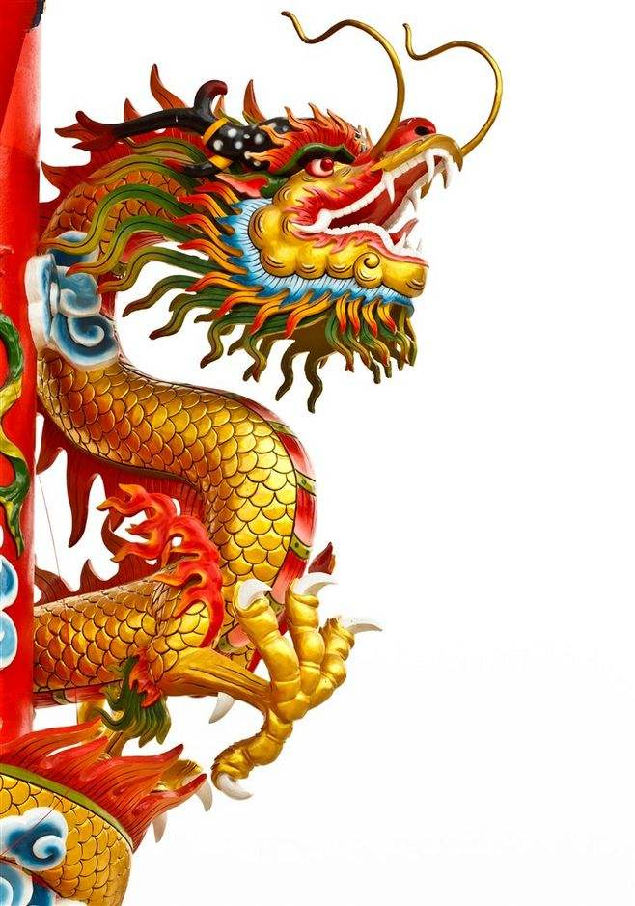
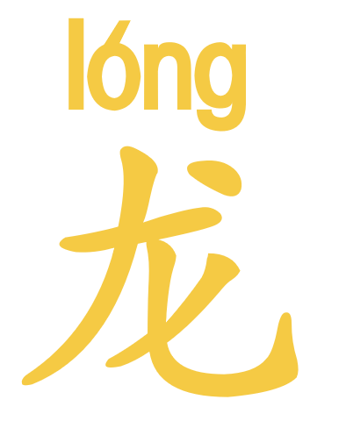
Notes:
中国龙，美国鹰，俄罗斯熊，英国狮子，法国公鸡

Slide 7
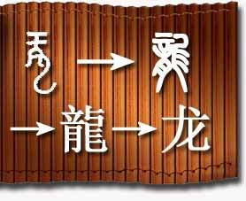


Notes:
龙字的演变。写一下龙字。

Slide 8
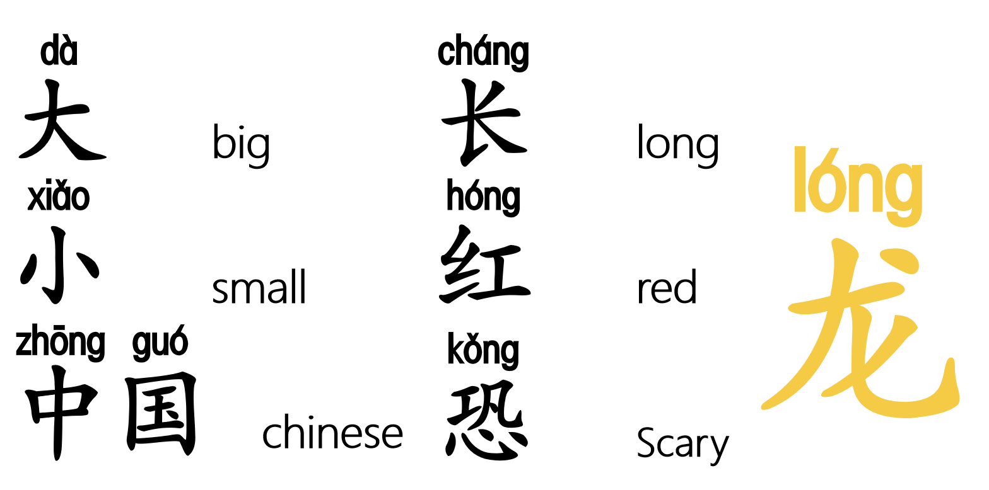

Slide 9
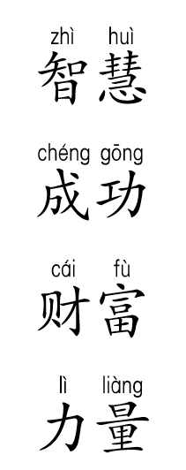

Power
Wisdom
Success
Wealth
Chinese are proud of been called "descendants of the dragon"
Notes:
在中国人心中龙是英雄，是神。

Slide 10
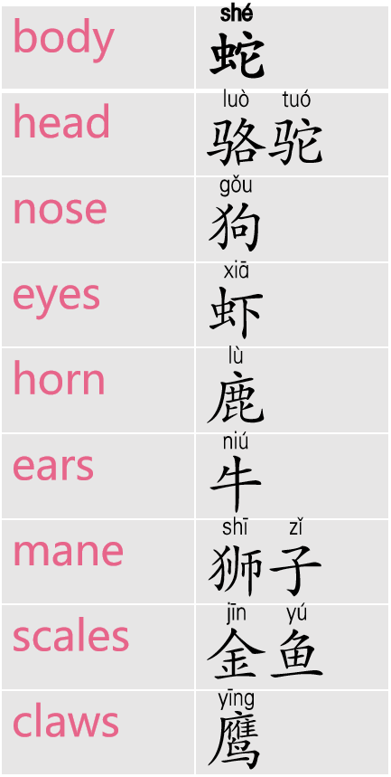
Mythical Creature
The Chinese Loong looks like a combination of 9 animals.
Notes:
Chinese dragon, also known as East Asian dragon or Long, are legendary creatures in Chinese mythology,. Chinese dragons have many animal-like forms but are most commonly depicted as snake-like with four legs.

