Slide 1


Slide 2
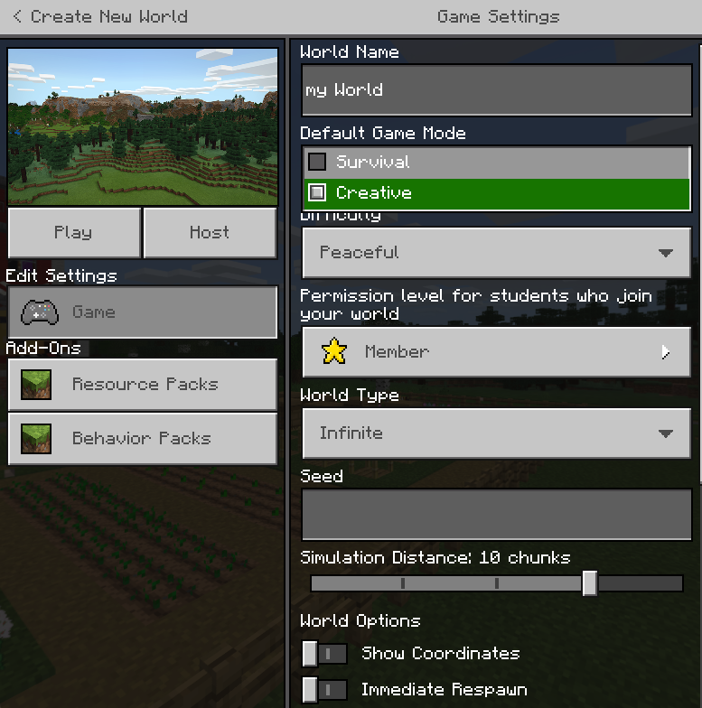
Setup
Play
Create
New
Give a name
Game Mode: change to Creative
World Type: change to flat

Slide 3
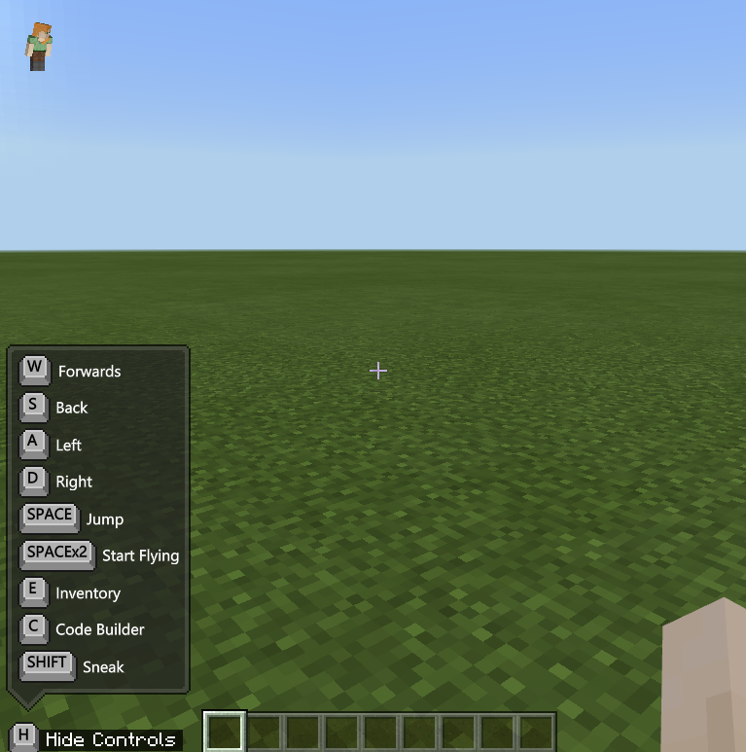
Getting to know the area
Move around
Jump a bit
Don’t worry about the inventory etc yet

Slide 4
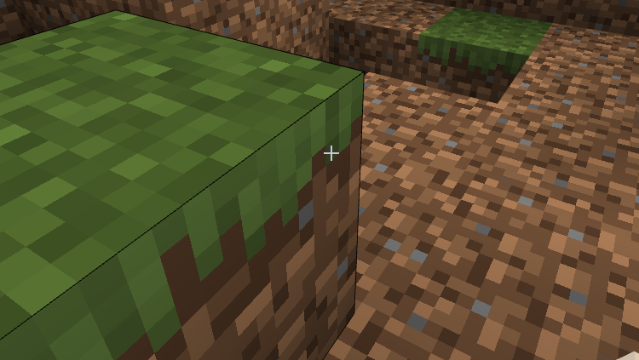
Left Click to DESTROY!

Slide 5
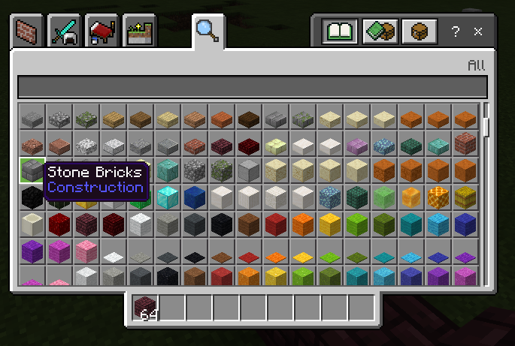
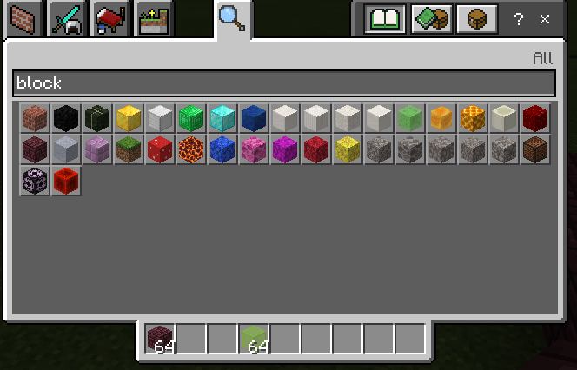
E is for inventory
Click and drag some objects to your inventory
If unfamiliar, type block into the search and click and drag a few blocks into your inventory
Press ESC or E again to exit
All possible items
Your items

Slide 6
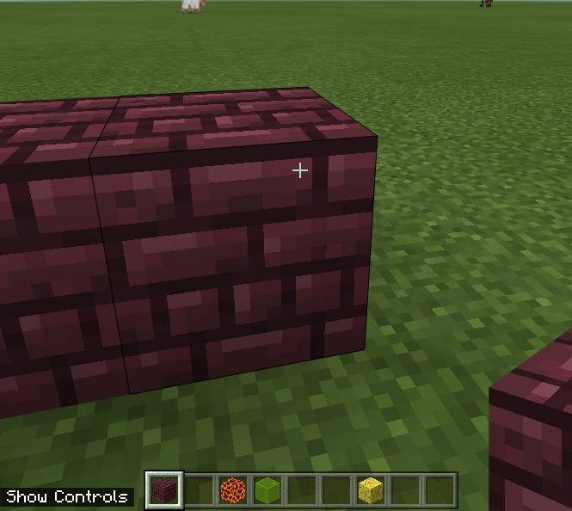
Build!
Each inventory slot is a number
Switch objects and use RIGHT CLICK to build
Build something!

Slide 7
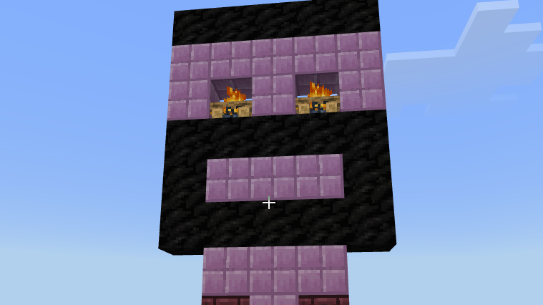

Slide 8
BUILDING IS MUGS WORK!

Slide 9
Coding
Press C to open coding
Select new project
Give it a name

Slide 10
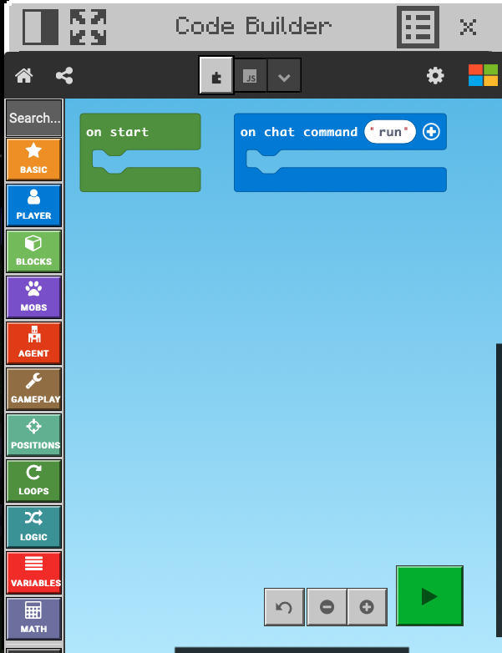
Look familiar?
#

Slide 11
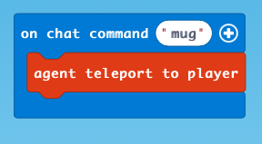
Lets get a mug to build for us

Slide 12
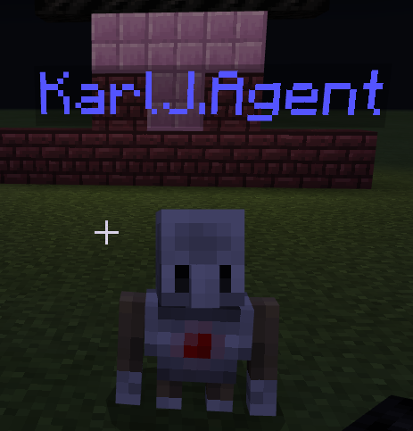
To me, mug!
Open chat in the game with ENTER
Type your command word

Slide 13
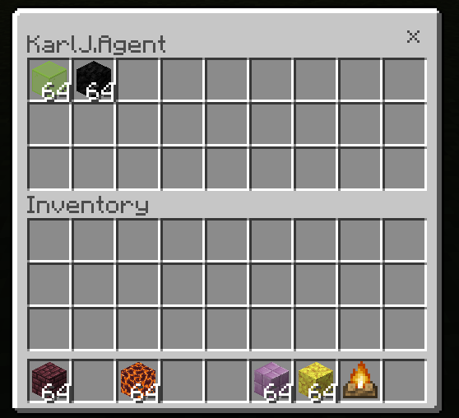
Give him some items
Right click on your agent
Give him some items

Slide 14
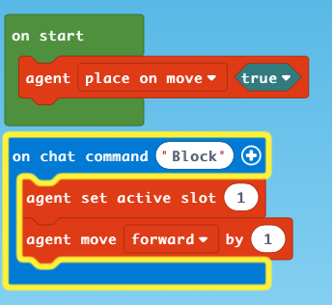

Slide 15
A useful guide
Steps 19-31 for looping
https://education.minecraft.net/wp-content/uploads/MakeCode-for-Minecraft-Agent.pdf

Slide 17
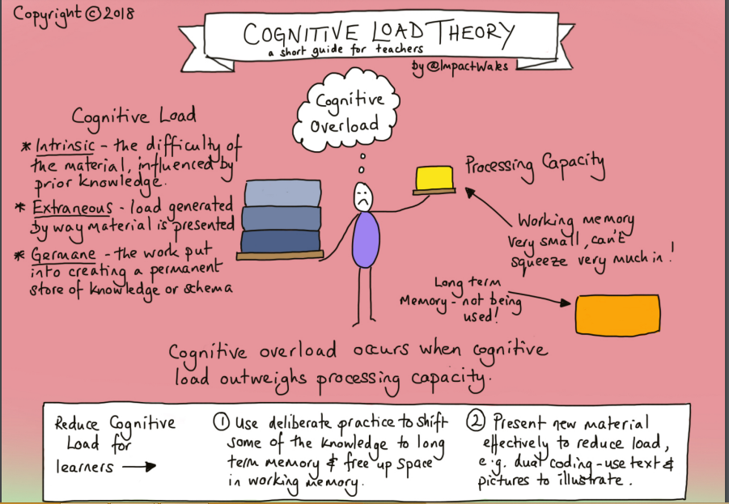

Slide 18
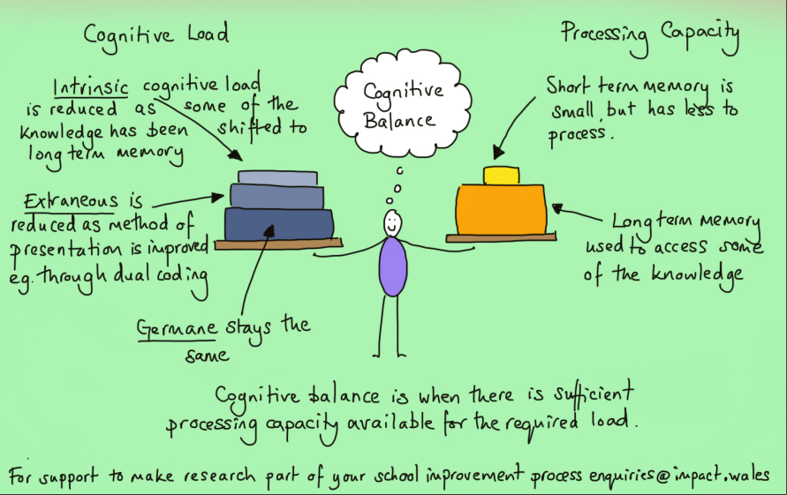

Slide 19
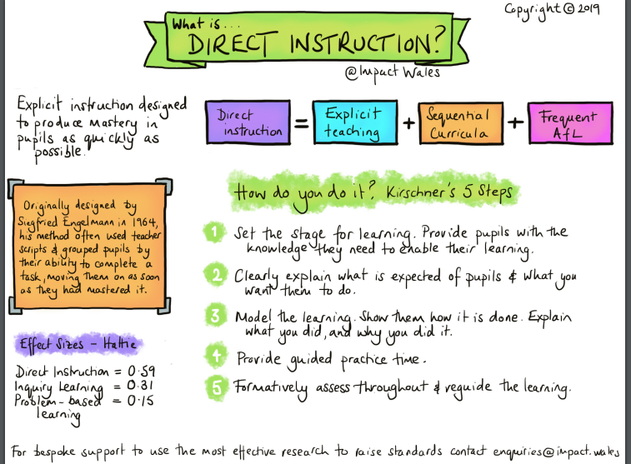

Slide 20
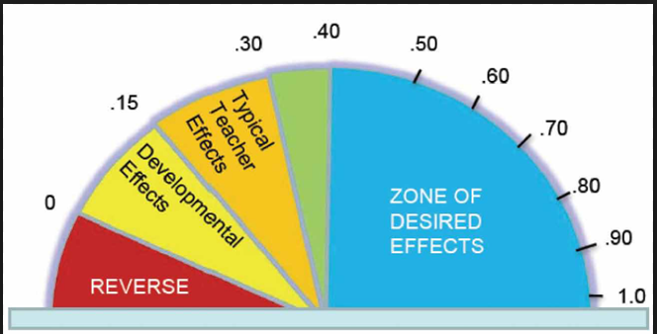
Effect Sizes - Hattie
Notes:
According to Hattie’s research, desired effects have a size of .40 or more. Some of the strategies associated with these desired effects are:
Feedback 0.73
Teacher-Student Relationships 0.72
Mastery Learning 0.58
Challenge of Goals 0.56
Peer Tutoring 0.55
Expectations 0.43

Slide 21
Hatties Desired Effects
What are those then?

Slide 22
How can we make use of these in our teaching and learning?

Slide 23
Microteach Discussions
Make sure your lesson plan covers 1 hour
You will have 20-30 mins max for your teaching part – think about:
    Length of activity/teaching
    Any setup needed
    Any assumed prior knowledge
Clear thought out objectives in your plan
Consider how you will assess if they have been met

Slide 24
Microteach Discussions
What activities will you make use of?
How can you incorporate AFL in your plan
Have you considered any theory in your planning? E.g. Rosenshine
Where does your lesson sit in the “wider” scheme, e.g. medium and long term

Slide 25
Micro-micro-teach
You must design an activity for excel – it must teach someone a basic function in Excel and can ONLY take a maximum of 5 minutes
You will deliver this activity to the group today

