Slide 1
Gateway to the Humanities
Religious Studies
New Religious Movements

Slide 2
New Religious Movements (NRMs): the secularisation theory, the nature of post World War Two society, approaches to NRMs, types of NRMs, why join an NRM?

Slide 3

http://ssdd.samsbiz.com/store/item/2pwaa/Tapestries/Flower_Power_Tie_Dye_Tapestry.html

Slide 4
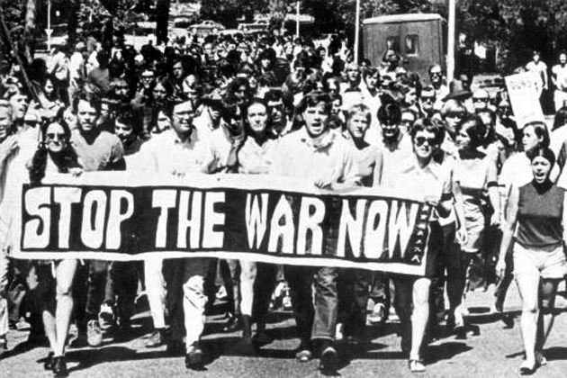
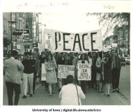

http://today.uconn.edu/wp-content/uploads/2012/07/FSU_protest_Tallahassee_rc01458.jpg
http://digital.lib.uiowa.edu/cdm/ref/collection/ictcs/id/4949

Slide 5
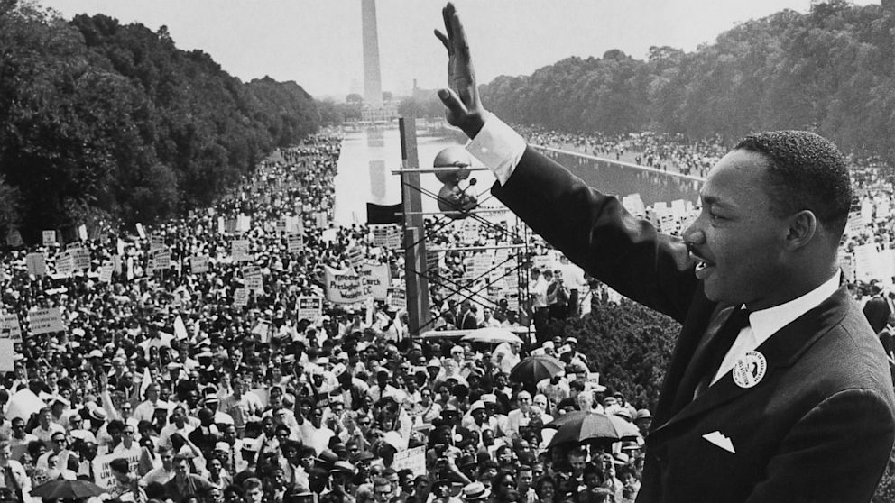

Slide 6
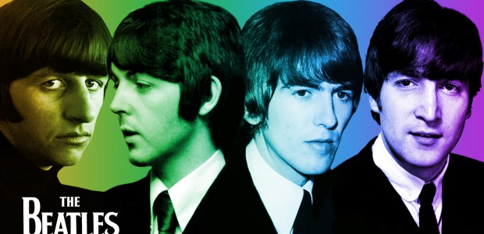

Slide 7


Slide 8
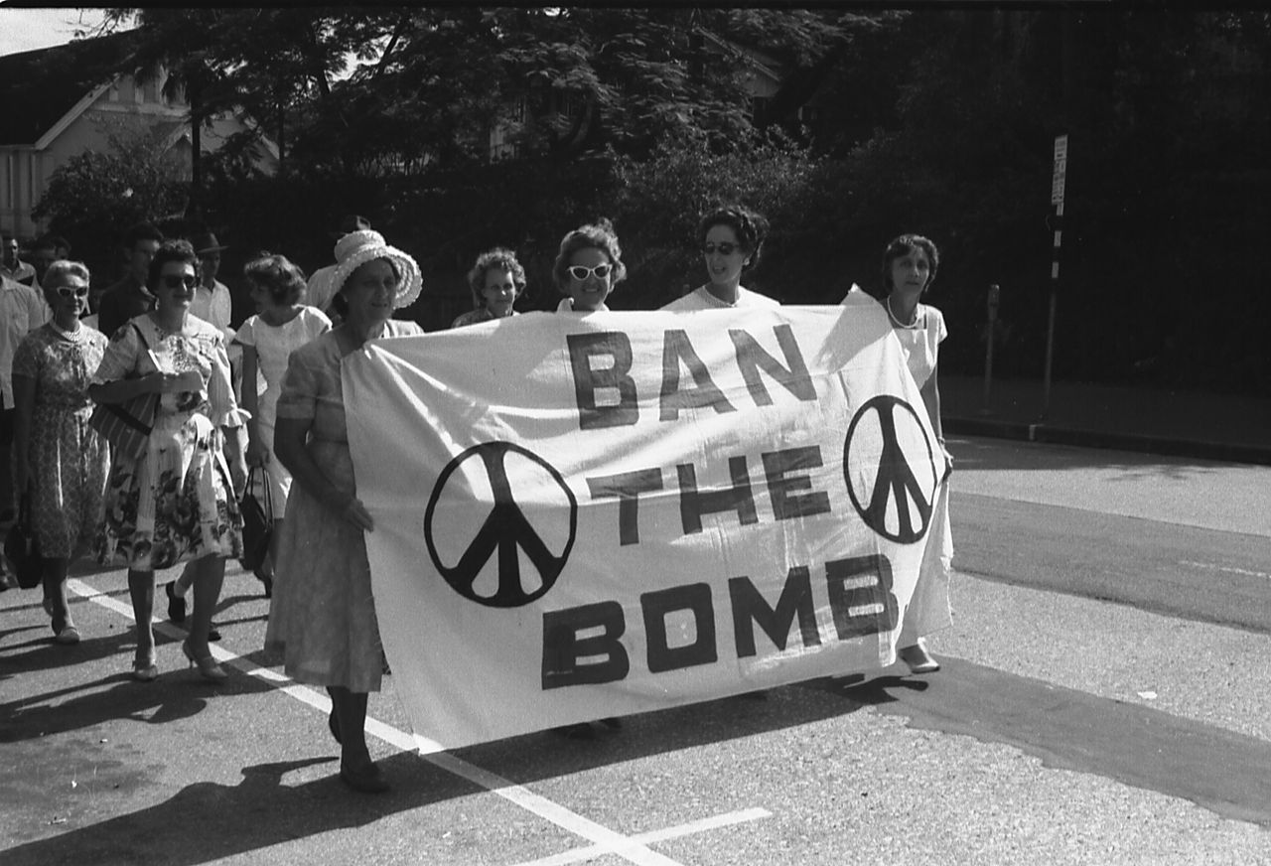

Slide 9
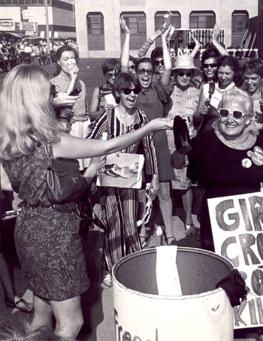

Slide 10
Politics
Communiciation
Education
Travel
INNOVATIONS IN RELIGION

Slide 11
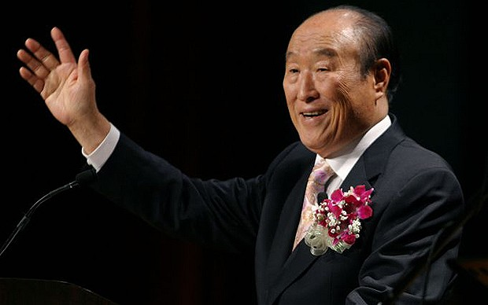
Sun Myung Moon, Unification Church
http://www.telegraph.co.uk/news/obituaries/9517193/The-Rev-Sun-Myung-Moon.html

Slide 12
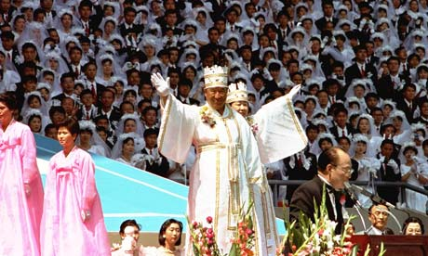
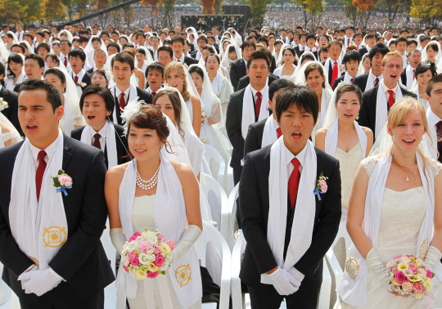
http://www.guardian.co.uk/world/2009/oct/13/unification-church-moonie-cult
http://weddingstory.blog.com/

Slide 13
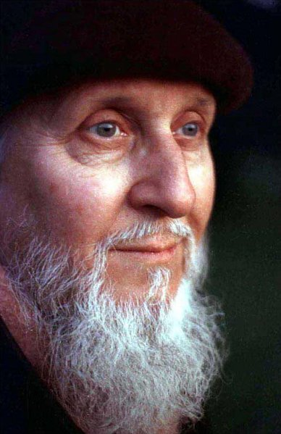
David Berg: The Family International

Slide 14
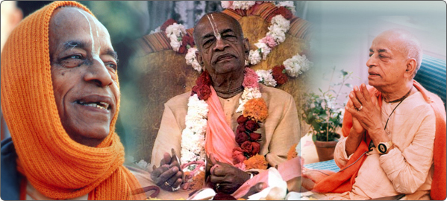
A C Bhaktivedanta Swami Praphupada – International Society for Krishna Consciousness (ISKCON)
http://www.iskconpune.in/srilaprabhupada.php

Slide 15
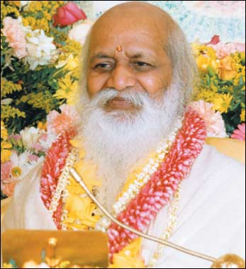
Maharishi Mahesh Yogi – Transcendental Meditation (TM)
http://www.rediff.com/news/2008/feb/06yogi.htm

Slide 16
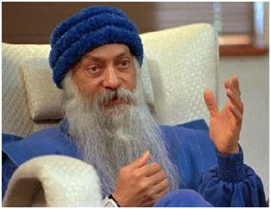
Bhagwan Shree Rajneesh (Osho)
http://www.kevinrdshepherd.net/html/24___cults_and_suspect_parties.html

Slide 17
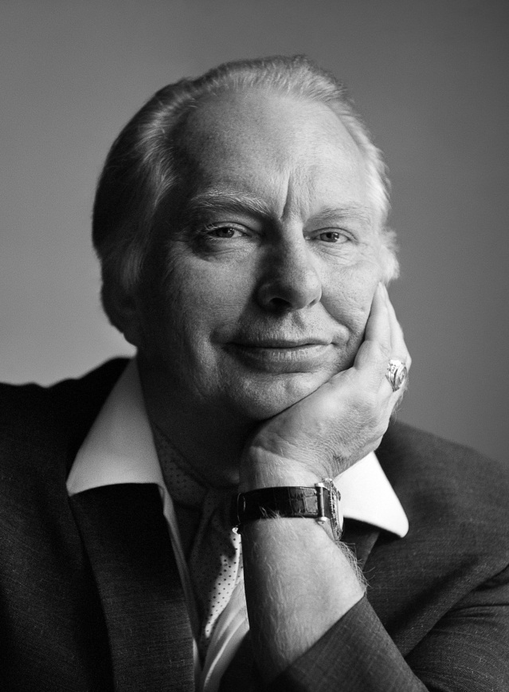

Ron Hubbard: Scientology

Slide 18
Church attendance and affiliation
1851 Religious Census of Horace Mann – nonconformity did nearly as well as Anglicanism.
Peter Brierley’s (2006) church attendance surveys produced the following results:
1979 12%
1989 10%
1998 7.5%
2005 6.3%
Robin Gill (2003) identifies long-term denominational trends:
1821-1851 general increase
1851-1880s Free Church increase & Anglican decline
1880s-1919 general Protestant decline
1920-2000 continuing decline.
This dramatic decline has been described as ‘the death of God’ (Bruce: 2002) and, somewhat more modestly, but no less starkly, ‘the death of Christian Britain’ (Brown: 2001).

Slide 19
The 2011 Census
(compared with the 2001 census)
“The largest religion in the 2011 Census for England and Wales was Christianity with 33.2 million people (59.3 per cent of the population).
Compared with the 2001 Census the most significant trends were
an increase in the population reporting no religion – from 14.8 per cent of the population in 2001 to 25.1 per cent in 2011,
a drop in the population reporting to be Christian - from 71.7 per cent in 2001 to 59.3 per cent in 2011, and
an increase in all other main religions. The number of Muslims increased the most from 3.0 per cent in 2001 to 4.8 per cent in 2011” (ONS).

Slide 20
The emergence of NRMs has led to a questioning of the secularization theory and a realisation that religion has not disappeared.

Slide 21
New Religious Movements (NRMs)
Barker (1992, 9) “The term New Religious Movement is applied to a number of unrelated organisations, most of which have emerged in their present form since the 1950s. Most offer some form of answer to the basic questions of existence – religious, spiritual, philosophical”.

Slide 22
Characteristics of NRMs
Charismatic leadership
First generation converts
Socio-ecomonic status of members
Zealous proselytising
Controversial

Slide 23
Terms, types and approaches
Church, denomination, sect, cult
Differences between a church-type and a sect
NEW – RELIGIOUS – MOVEMENT
Sociology, Theology, Psychology
Bryan Wilson (1970): Introversionist, Adventist, Manipulationist
Roy Wallis (1984): World-affirming, World-accommodating, world-rejecting

Slide 24
Christian nrms
Christian indecision –
Jesus Christ – divine or human?
Hell/resurrection – literal or figurative?
Saturday or Sunday Sabbath (Friday in Judaism)?
Transubstantiation (RC) or consubstantiation (Protestant)?
Predestination or free will?
Priests – married or celibate?
Women priests or men only?
Charismatic, Fundamentalist, Evangelical Christianity
Christian new religions: The Children of God (The Family International), The Unification Church, the Churches of Christ, the Jesus Army, the Branch Davidians

Slide 25
Eastern nrms
Removal of East/West barriers
Eastern product for western needs or spiritual dimension to psychology
Are they new?
The International Society for Krishna Consciousness (ISKCON)
Transcendental Meditation (TM)
The Rajneesh Movement
Soka Gakkai

Slide 26
Self religions
Religious Psychology and the Psychology of Religion
Religion and Psychoanalysis
Are they religions?
Scientology
Neurolinguistic Programming
Landmark
School of Economic Science

Slide 27
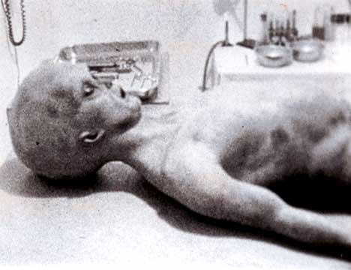
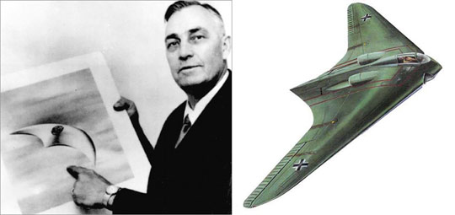
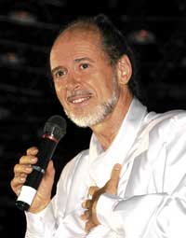
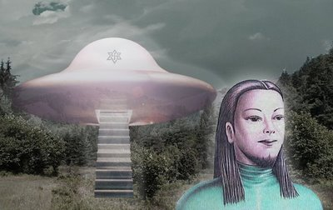
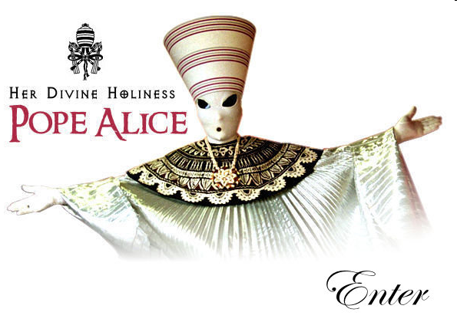
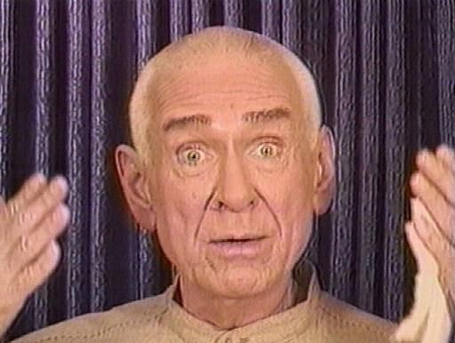

Ufo nrms
Heaven’s Gate
The Raelians

Slide 28
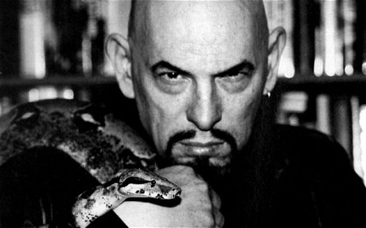
Satanic nrms
Satan as a deity (esoteric Satanism) or a life principle (rational Satanism)
The Church of Satan
1960s counterculture (1966)
Charismatic leader - Anton Szandor LaVey (1930-1999)
The Satanic Bible
Upper-middle class converts
Routinization, rebellion, tension, schisms, controversy, anti-cult movement
Atheistic, humanistic, self religion
Schisms – Church of Satanic Brotherhood and the Temple of Set

Slide 29
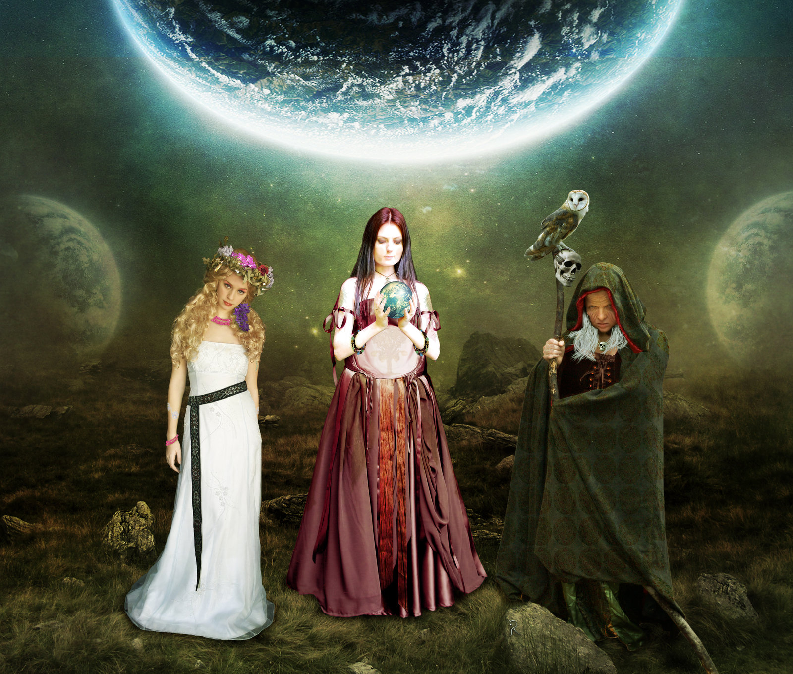
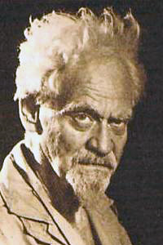
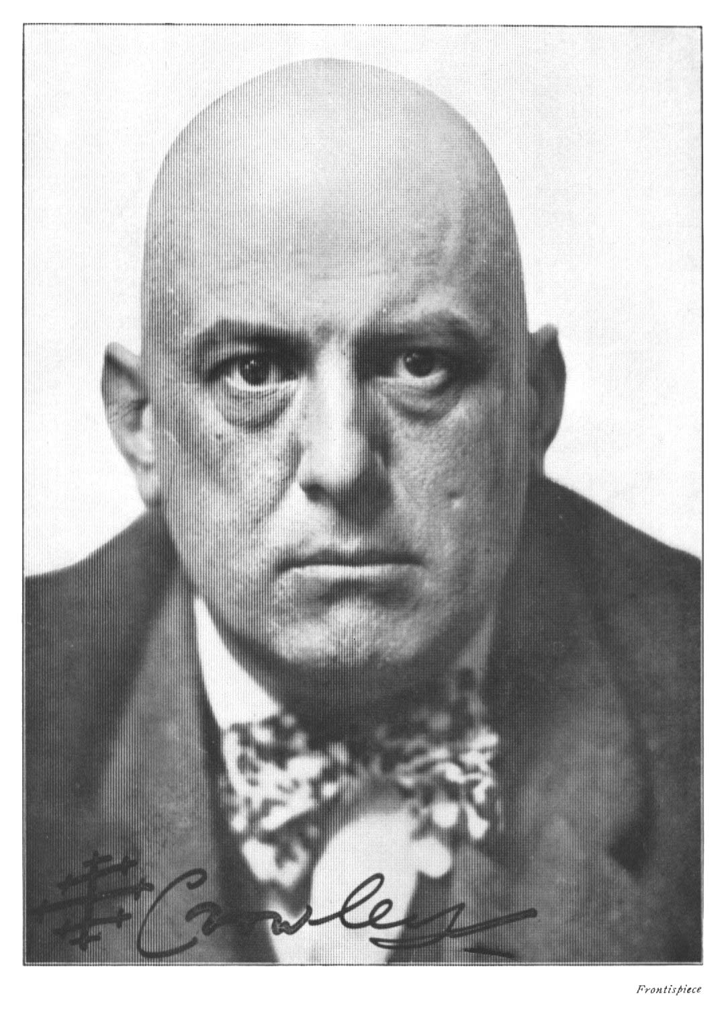
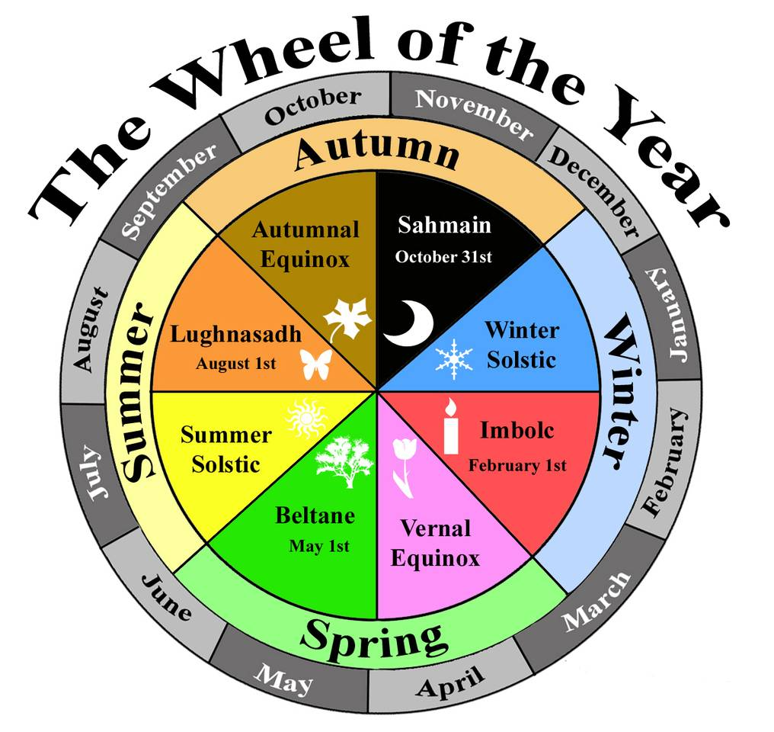
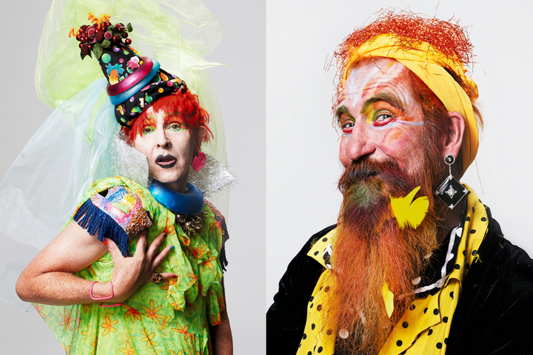
Pagan nrms
Numerous paths: Druidry, Wicca, Witchcraft, Shamanism, Goddess, Heathenism, Radical Faeries
Pre-Christian balance
Nature religions

Slide 30
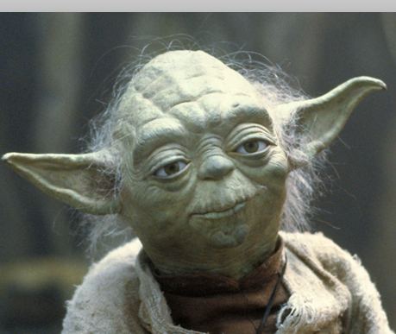
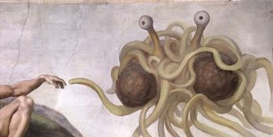
Invented religions
‘Here are fake religions…doing real, authentic religious work in cyberspace by negotiating what it means to be a human person in a human place’ (Chidester, ix)
Jedaiism:
2001 Census in various countries, inc the UK.
George Lucas’ Star Wars,
Yoda
The Force (religious concept) ch’i
Hope and heros, rites of passage (Cusack, 2010, 119).
Church of the Flying Spaghetti Monster (FSM):
Bobby Henderson 2005
Protest against Creationism taught in Schools alongside Evolution. Rapidly gained popularity: 1) appeal of claims 2) humour – spaghetti with meatballs for eyes and recreation of Michaelangelo’s The Creation of Adam, with the FSM’s ‘noodly apendage’ touching Adam’s hand 3) the stand against Creationism (Cusack, 2010, 133).

Slide 31
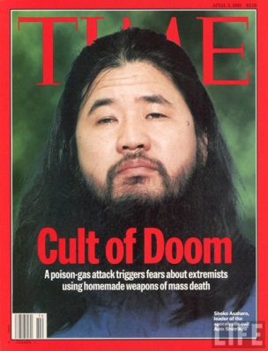


NRMs and news media

Slide 32
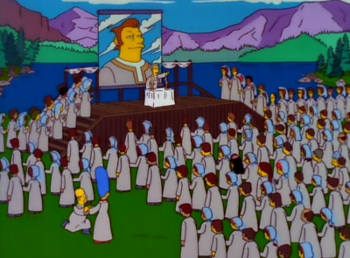
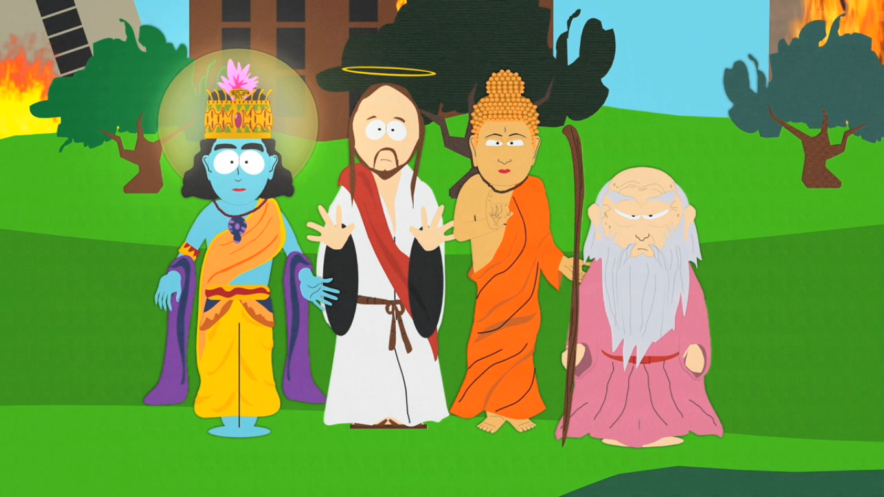
Nrms in the entertainment media
‘The Joy of Sect’, February 8, 1998, introduces The Movementarians, based on several movements including a Scientology-style group.
South Park ‘Super Best Friends’,
4 July 2001

Slide 33
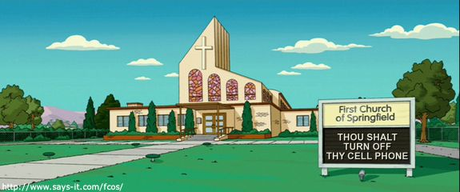


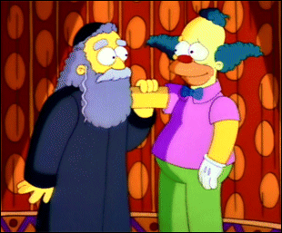

Slide 34


