Slide 1
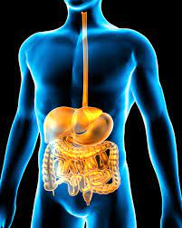
THE DIGESTIVE SYSTEM AND IRRIATABLE BOWL SYNDROME (IBS)
KAMILAH MAYNARD
2014670
Lecturer: Muhammad Humza Saeed
BMHP5003_BIRM
“Your digestive system breaks down nutrients into parts small enough for your body to absorb and use for energy, growth, and cell repair” (NIH, 2017).

Slide 2
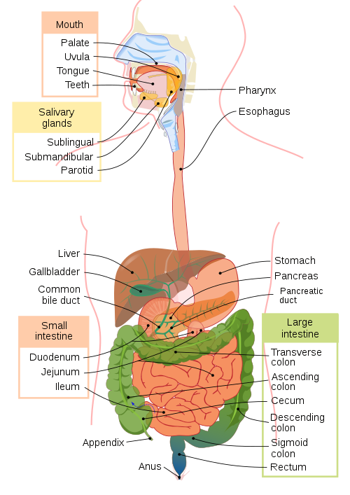
THE DIGESTIVE SYSTEM
Mouth – breaks down the food using the teeth inside the palate.
Salivary glands – lubricates and prepares the food for digestion.
Liver - aids the food break down further retaining nutrients. The bile supports the liver which the Gallbladder concentrates and stores.
Small intestine - final stage of digestion with mucus guarding the gut wall absorbing mainly water and nutrients.
Anus - releasing of the faeces.
Pharynx - used to swallow. Esophagos – food transportation.
Stomach - storage for first digest stage stirring food. Energising enzymes, killing any germs. Walls protected by mucus and pepsin digests the protein.
Pancreas - hormones managing blood. glucose levels, stomach acid neutralised by bicarbonates. Protein digested by trypsin & chymotrypsin. Amylase digesting polysaccharides. Lipase digesting lipids.
Large intestines - creates & holds faeces. Reingesting ions and water. With the rectum expelling faeces after storage.
(Source: Wikipedia, 2022).

Slide 3
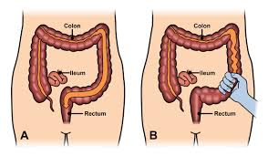
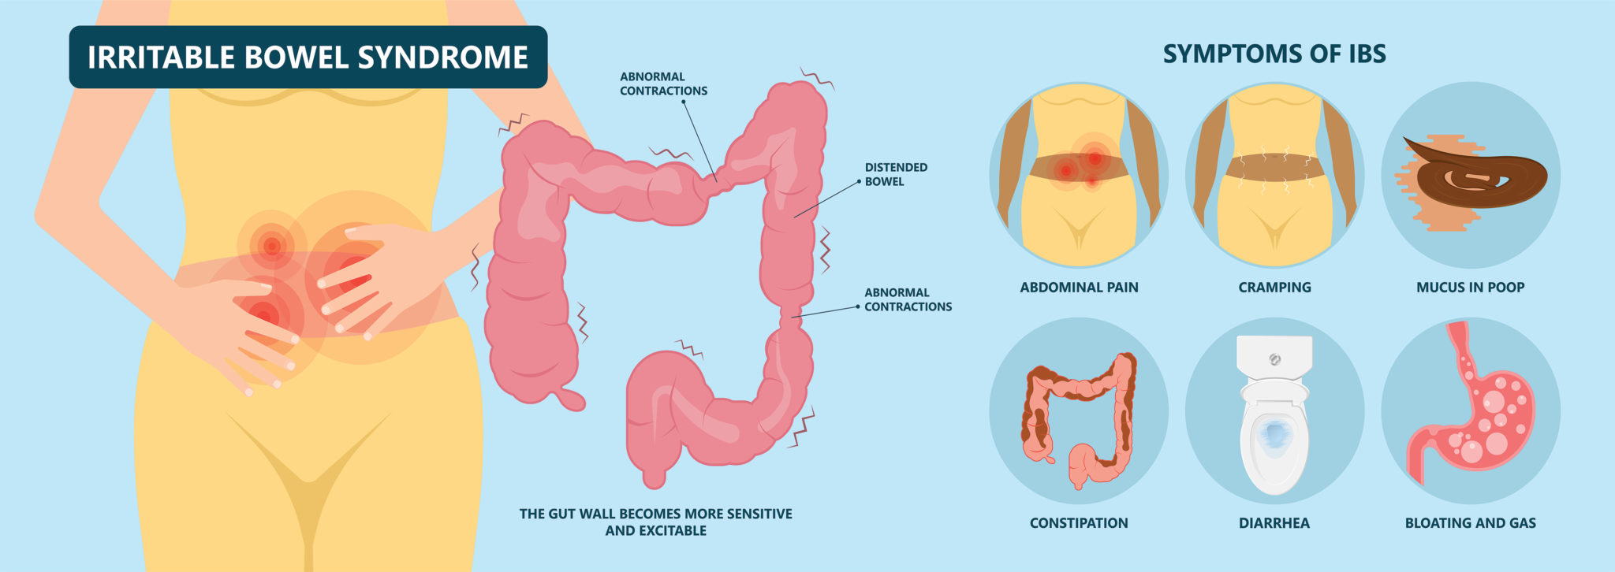
THE DIGESTIVE SYSTEM VS IRRITABLE BOWEL SYNDROME (IBS)
(Source: ASCRS, 2020).
IBS “Abnormal functioning or communication between the nervous system and bowel muscles” (ASCRS, 2022)
Symptoms of IBS
Pain and cramping in the abdominal area
Feeling full
Bloated and increased gas
Feeling uncomfortable changes in bowel
Experiencing constipation and/or diarrhoea
(Source: NAVA Health, 2021).

Slide 4
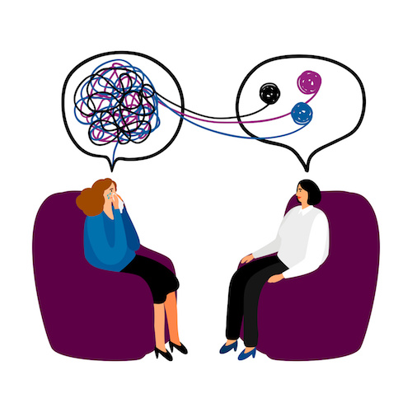
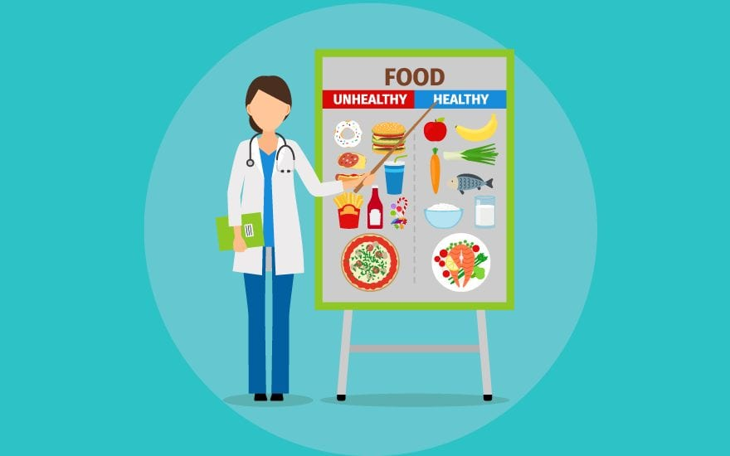
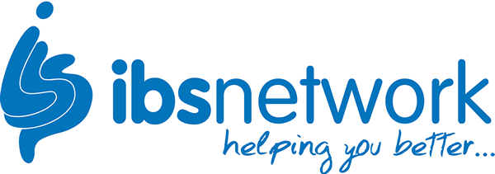


HOW TO CARE FOR IRRITABLE BOWEL SYNDROME (IBS)
Cognitive Behaviour Therapy (CBT) for Stress, Anxiety, and Depression.
IBS Dietitian – FODMAP diet (IAPT) avoiding foods that do not effortlessy digest.
GPs can offer medication – laxatives, antidepressants and antibiotic precriptions.
IBS Support Network - National Charity gives guidance and information.

Slide 5
REFERENCES
Ali, S. (2018) Therapy Concepts Everyone Needs to Know. [Online Image Therapy]. Available at: https://www.nami.org/Blogs/NAMI-Blog/April-2019/Therapy-Concepts-Everyone-Needs-to-Know (Accessed: 12 June 2022).
American Society of Colon Rectal Surgeons (ASCRS). (2020) Irritable bowel syndrome IBS. [Online] Available at: https://fascrs.org/patients/diseases-and-conditions/a-z/irritable-bowel-syndrome (Accessed: 12 June 2022).
American Society of Colon Rectal Surgeons ASCRS. (2020) Irritable bowel syndrome IBS. [Online Image Bowels]. Available at: https://fascrs.org/patients/diseases-and-conditions/a-z/irritable-bowel-syndrome (Accessed: 12 June 2022).
Australian Government Department of Health AGDH. (2019) What is bladder and bowel health? [Online]. Available at: https://www.health.gov.au/health-topics/bladder-and-bowel/about-bladder-and-bowel-health/what-is-bladder-and-bowel-health (Accessed: 12 June 2022).
Daniel, C. (2022) A Look Inside Your Digestive System. [Online Image Digestive System]. Available at: https://www.verywellhealth.com/tour-the-digestive-system-4020262 (Accessed: 6 July 2022).
Hightower, N. (2022) Encyclopaedia Britannica: Human Digestive System. [Online]. Available at: https://www.britannica.com/science/human-digestive-system (Accessed: 15 June 2022).
National Institute of Diabetes and Digestive and Kidney Diseases. (2017) Treatment for irritable Bowel Syndrome. [Online]. Available at: https://www.niddk.nih.gov/health-information/digestive-diseases/irritable-bowel-syndrome/treatment (Accessed: 12 June 2022).
National Institute of Diabetes and Digestive and Kidney Diseases. (2017) Your Digestive System & How it Works. [Online]. Available at: https://www.niddk.nih.gov/health-information/digestive-diseases/digestive-system-how-it-works (5 July 2022).
National Health Service (NHS). (2021) Further help and support – irritable bowel syndrome (IBS). [Online]. Available at: https://www.nhs.uk/conditions/irritable-bowel-syndrome-ibs/further-help-and-support/ (Accessed: 12 June 2022).
New Road Dental. (2022) Affordable private dental care. [Online image NHS]. Available at: https://newroaddentalpractice.com/welcome/nhs-patients/ (Accessed: 12 June 2022).
Pottie, Z. (2021) IBS Awareness Month: What is IBS? Everything You Need to Know. [Online Image IBS] Available at: https://painresource.com/irritable-bowel-syndrome/ibs-awareness-month/ (Accessed: 15 June 2022).
Rees, V. (2020) EMA recommends seven medicines for approval after September meeting. [Online Image Medication]. Available at: https://www.europeanpharmaceuticalreview.com/news/128992/ema-recommends-seven-medicines-for-approval-after-september-meeting/ (Accessed: 12 June 2022).
Team Leverage Education. (2021) Dietician Course. [Online Image Dietician] Available at: https://leverageedu.com/blog/dietician-course/ (Accessed at: 12 June 2022).

