Slide 1
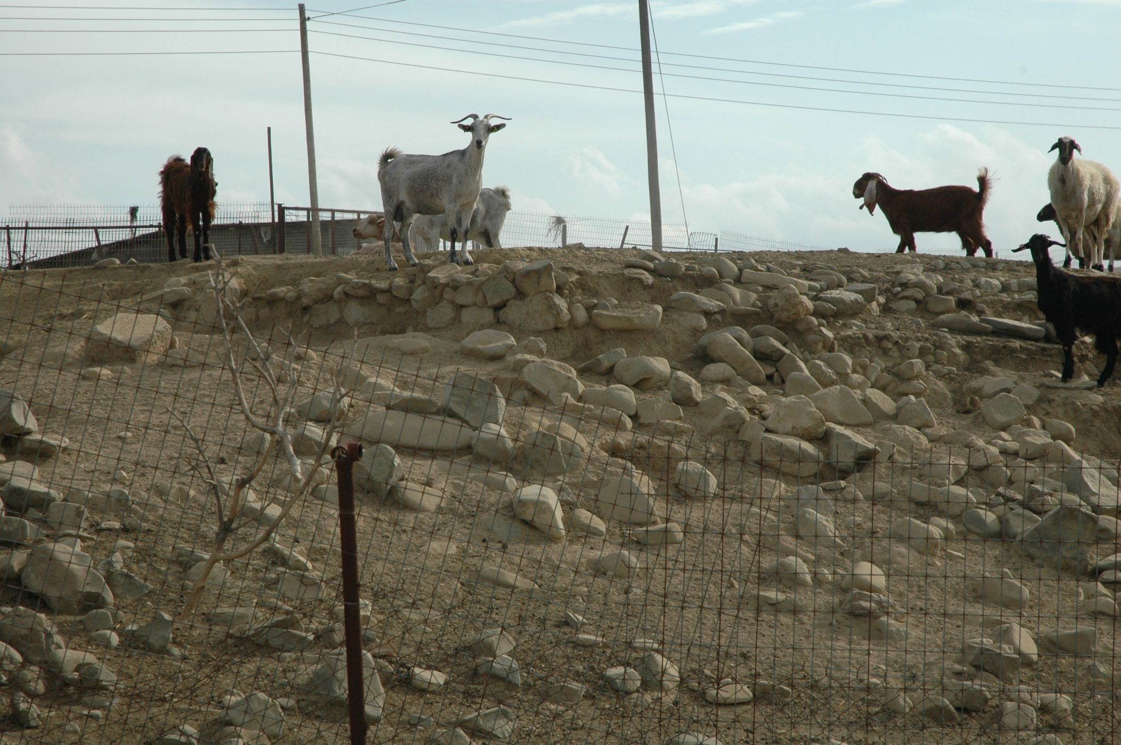
Research Methodologies
Ethics & Archaeology

Slide 2
Ethical Issues in Archaeology
Ethics: critical appraisal of human conduct
  Set of rules
  Values, goals, & ideals
Scarre, C. & Scarre, G. (eds) 2006. The Ethics of Archaeology: Philosophical Perspectives on archaeological Practice. Cambridge: CUP.
Tarlow, S. 2001. Decoding Ethics, Public Archaeology 1: 254-59.
Vitelli, K.D. (ed.) 1996. Archaeological Ethics. Walnut Creek, CA: Altamira Press.

Slide 3
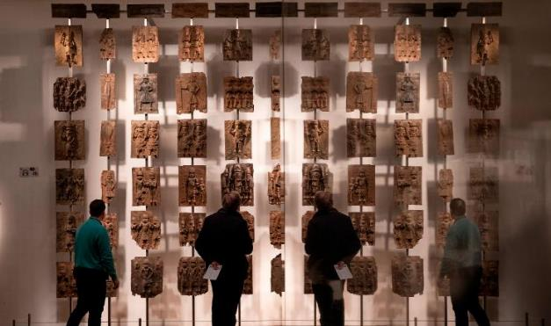
Ethical Issues in Archaeology
How do ethics affect you as a practising archaeologist?
  Is this an issue you need to engage with?
Centred around ownership &/or control of archaeological materials
Archaeological engagement with living communities
Archaeological treatment of ancient populations
Plaques, part of the Benin Bronzes displayed at The British Museum

Slide 4
Ethics in Archaeology
Relationship with indigenous peoples
  & local communities
Professional standards & responsibilities of researchers
Ownership & custodianship
Meaning & moral implications of ‘heritage’ locally & universally
  The concept of heritage?
Who owns the past & has the right to interpret it?

Slide 5
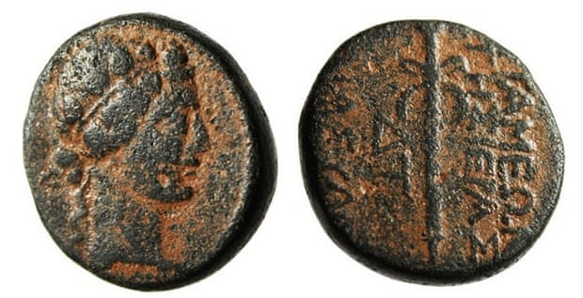
Ethical Issues...
Problems of looting
  & the trade in antiquities
Repatriation:
  of skeletal material
  of culturally significant objects
Appropriate treatment of the dead
Syrian coin c.500 BC, possibly looted by Isis, & listed for sale on eBay

Slide 6
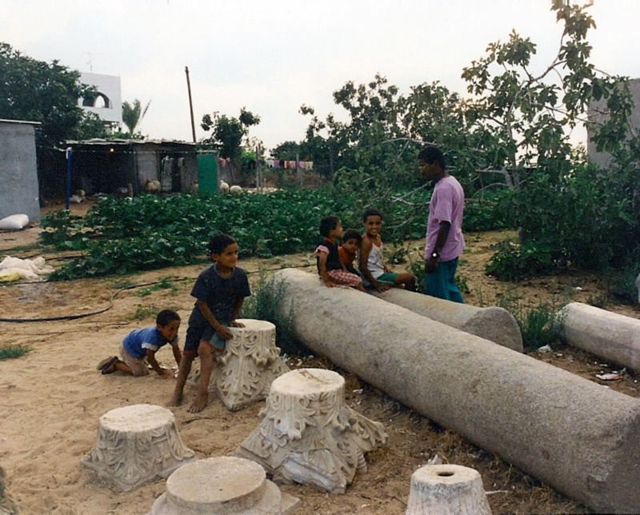
Archaeologists & Host Communities
Local knowledge is an important archaeological resource: but it is very important not to abuse this
A fine balance between sharing knowledge, education & deciding what is the appropriate treatment of archaeological materials
Whose archaeology is it?
Tell Sannam, Gaza

Slide 7
Our Responsibilities
Communication...
How do we disseminate our findings to local communities?
Importance of language
What about the discovery of sensitive materials
What is our role as archaeologists?
With village priest, Arediou

Slide 8
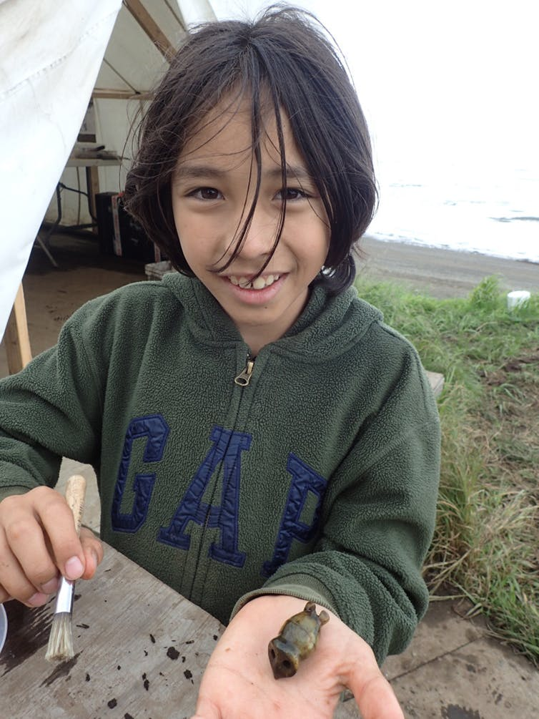
Archaeology and Politics
Knowledge & control of the past is a source of power
  frequently see manipulation of archaeology by political elites to legitimize their position
Indigenous populations & attempts to regain control & independence
  both through control of archaeology
  & through a denial of the significance of archaeology to their cosmology
Local volunteer with ivory toggle he excavated from Nunalleq

Slide 9
Archaeology & Ethics
This largely comes down to relationship with modern communities
Should we prioritize archaeological aims (science) over other value systems?
What may be considered of interest for the archaeologist may be completely at odds with local values:
  Excavation of a burial ground: a source of rich data for archaeologists on ancient populations, religious beliefs, distinct cultural practices....
  But possibly viewed as culturally significant sites, of religious importance

Slide 10
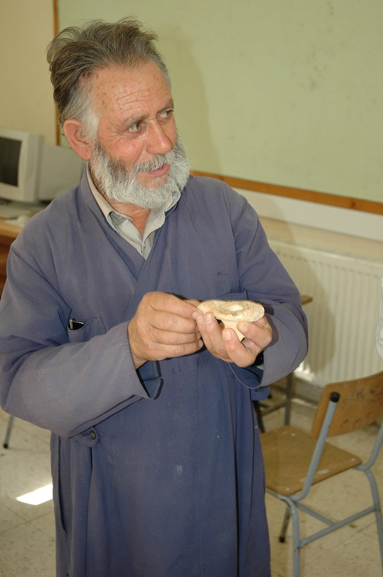
Ownership of Cultural Objects
4 categories of potential owner:
  Individual collectors
  Museums / archaeological community
  A cultural grouping, a nation, people
  Humanity as a whole
How should we prioritise these potentially conflicting claims?
Arediou: village priest discussing finds

Slide 11
Ownership of Cultural Objects
Should the local population automatically inherit rights to objects which lie in their territory (perhaps through the accident of history?)
Should we emphasize the values of the living population ?
Should we ensure:
  preservation/conservation of the object
  public access to the object
  or the desirability to reunite culturally significant artefacts?
Basalt tripod mortar,
Al-Moghraqa

Slide 12
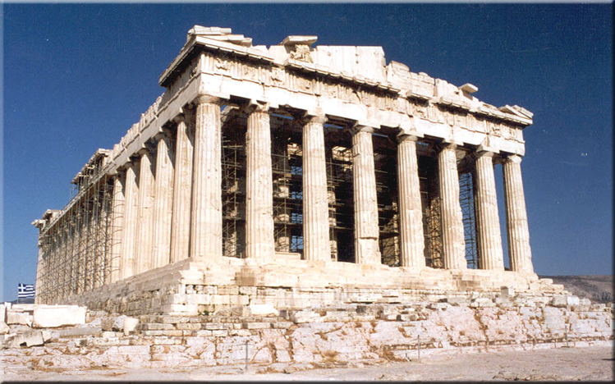
Commodification of Cultural Property
What is cultural property?
  Objects & buildings which embody the values & traditions of a community
  Therefore ownership of these things transcends western concepts of ownership & private property
Looting of archaeology by local communities:
  Exploitation of ancestral capital for local gain?
Parthenon

Slide 13
Actions of Local Communities
Looting of archaeological sites
Destruction of sites in agricultural practices and/or building activities
Conflicting ethics:
  Archaeologist seeking to preserve & manage archaeological sites
  Needs of local communities to gain a livelihood
Archaeologists should be careful to not alienate the local community
Arediou Vouppes (Lithosouros)

Slide 14
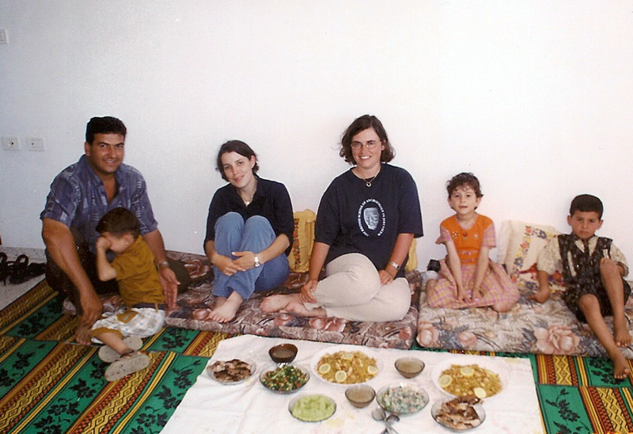
Working with Communities
Anthropology provides a template for ethical consideration of the needs & wishes of local communities
Archaeologists should gain the support & understanding of local community before a project begins:
  Particularly important if this involves excavation of human remains (ancient & modern)
Archaeologists should respect the wishes of the local community
Adel’s family Gaza

Slide 15
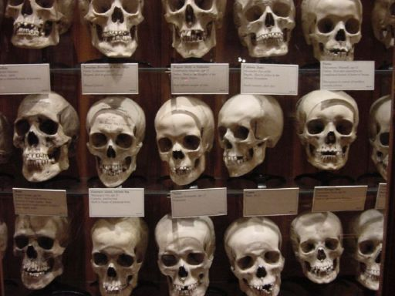
Respect for Ancient Populations
How should we treat human remains?
  Is it necessary & appropriate to excavate these?
  What about analyses? Invasive & non-invasive techniques?
  Should human remains be displayed?
Are human remains an appropriate research resource, educational tool...?
Skulls on display at the Mütter Museum, Philadelphia

Slide 16
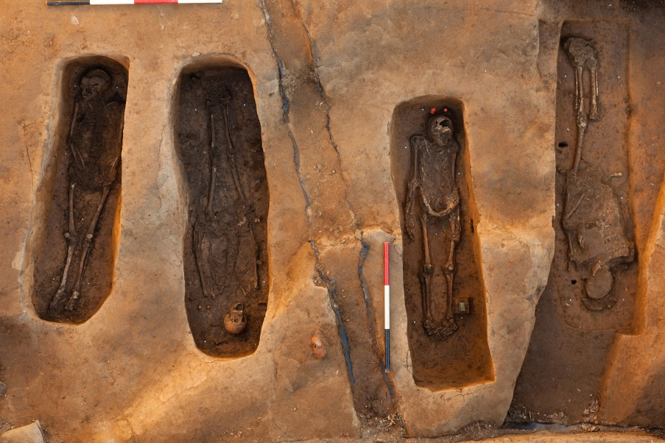
Ethical Considerations
Most archaeologists agree that the excavation & analysis of human remains are undertaken…
…in pursuit of knowledge which has value to society
…in the consciousness that the remains under study still represent human subjects, with residual rights & innate dignity
Jamestown cemetery

Slide 17
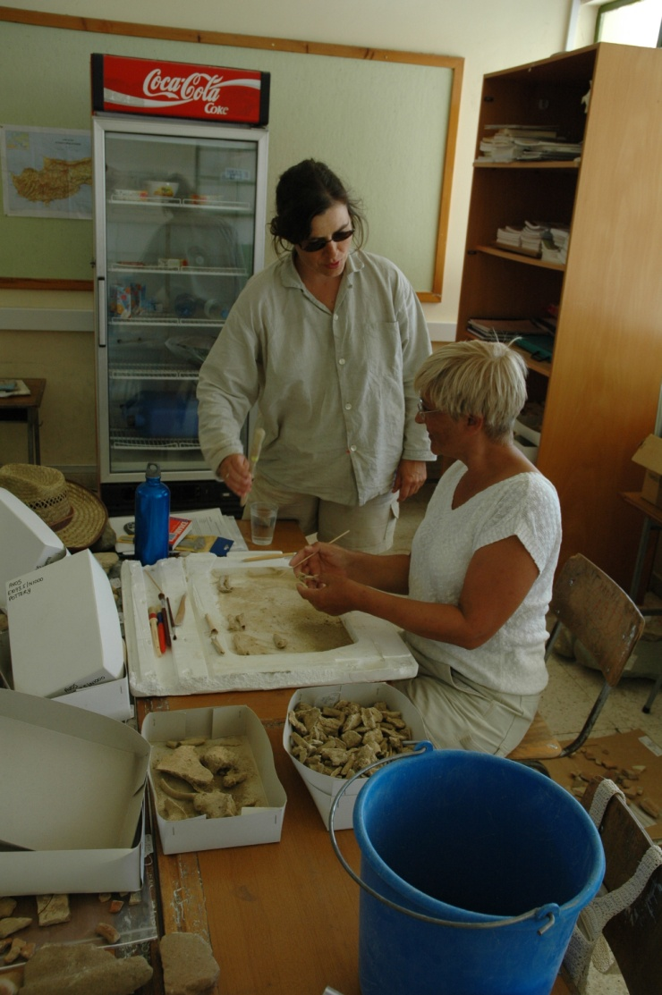
Appropriate Treatment of Human Remains
Not disturbing them period
Handling them sensitively in the field & in post-excavation analyses
Using for serious, scholarly purposes
Reburial, storage…?
Studying bones, Arediou

Slide 18
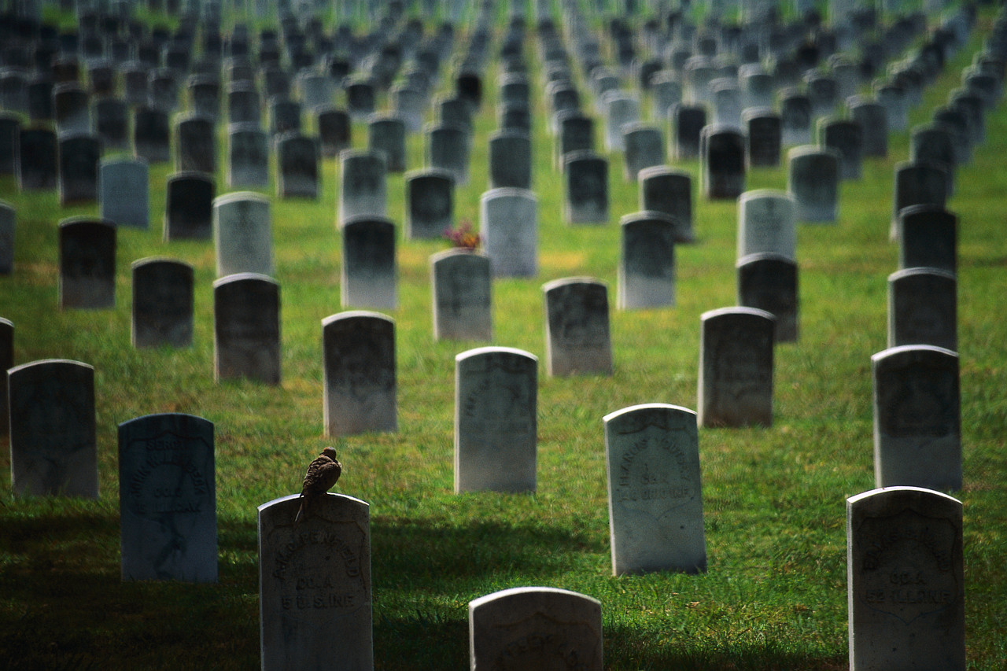
“Clearly there is emotion, power politics and variable belief systems involved, and one can only hope for interaction and discussion at various levels”
(Brothwell 2005: 415)

Slide 19
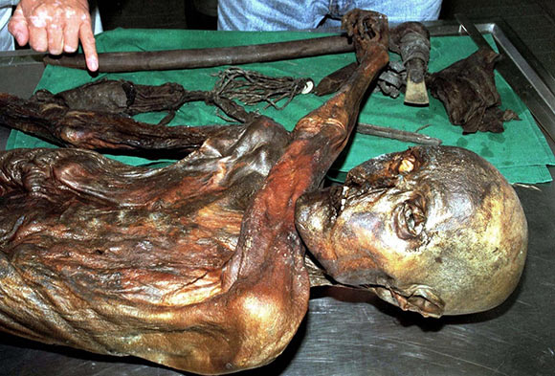
Consent
Ethics and modern biological research: informed consent
Consent from a near relative: genetic proximity

Slide 20
Respect and Consent
If we accept that the treatment of human remains should be appropriate to the wishes of the individual how do we proceed?
  Attitudes to death, disposal of human remains & their subsequent treatment are culturally situated
  Therefore, how can we best ensure sensitive treatment of human remains, respect for other beliefs…
  … & also satisfy our own need/desire to further our own knowledge base?

Slide 21
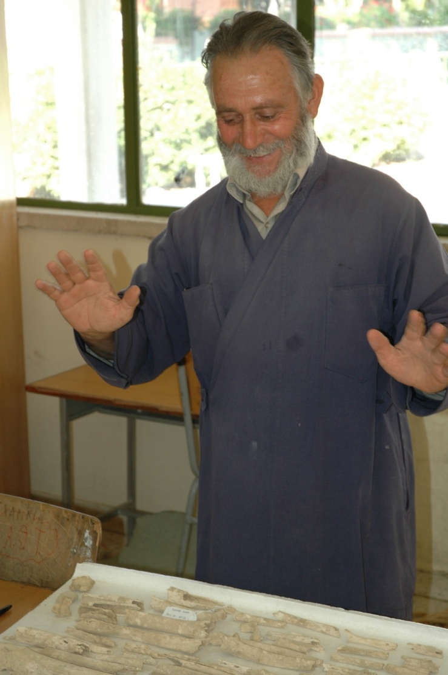
Consent in the Archaeological Context?
Should archaeologists decide?
Archaeological ethics also emphasise genetic proximity
But genetic kinship is not a universal understanding for relatedness.
  The rights or ownership of bones might be meaningless
Arediou, village priest viewing human remains from Bronze Age tomb

Slide 22
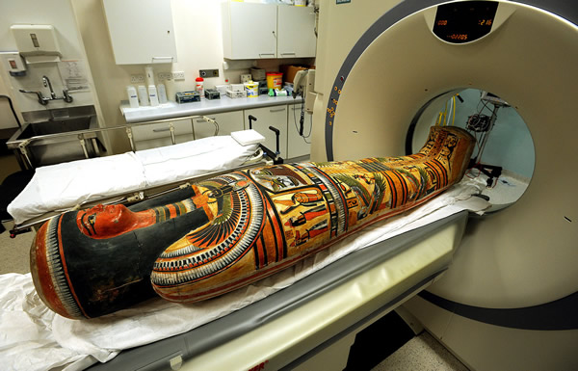
Consent in the Archaeological Context?
What about individuals who died in antiquity (or even a more recent past)? Is consent a reasonable ethical requirement?
Burial practices might clearly indicate that an individual would not have welcomed post-moretm disturbance
Historical sources might tell us about the importance of the integrity of the corpse: should invasive procedures be carried out in the present?

Slide 23
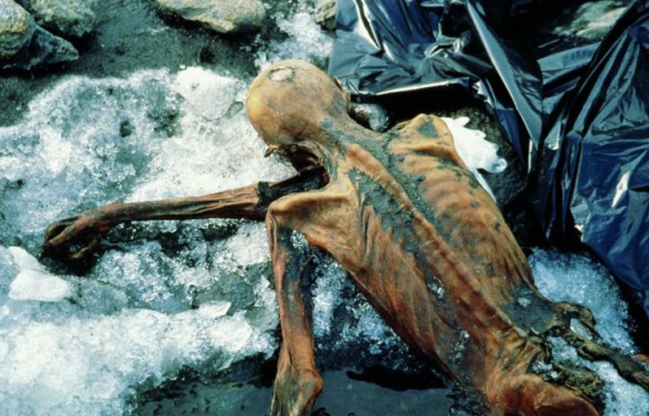
Dignity and Privacy
Ethical guidelines for “biohistory”?
Are there details of past lives that are too intimate or sensitive to publish?
What about knowledge of ancient diseases: parasitic infections, syphilis….
Does it matter that the individual is in effect anonymous?
Dignity & privacy are culturally constructed & might not be universal concerns
Ötzi, the iceman

Slide 24
Common “World” Heritage
Some cultural objects & archaeological sites are of such importance to humanity as a whole they should not belong to private owners, local communities or other interest groups...
We are guardians of the past for future generations
UNESCO World Heritage Convention

Slide 25
Final Observations
Do archaeologist hold some privileged status in dealing with remains of the past?
  ...and should they?
On what grounds do we prioritize archaeological & cultural remains?
Who are our obligations to?
  the living communities?
  the dead?
Who does the past belong to?

