Slide 1

Effective
Communication when launching a new service
Krystal Lewis, Nicola Lita Riley, Keisha Williams
BMSW4002 Dami Pokubo

Slide 2
Introduction
In this presentation we will be discussing the various models of communication and how they can be utilized by Green-crop to ensure any issues faced by barriers of communication can be eliminated for successful translation.

Slide 3
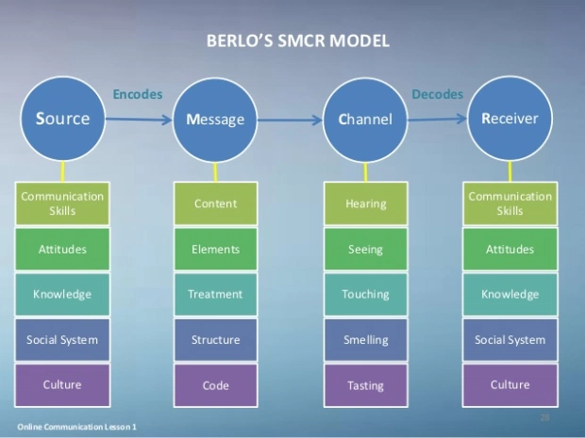
Theories relating to models of communication
David Belo's SMCR model of communication (1960) represents the process of communication in the simplest form. SENDER , the source in which the message is being sent .
MESSAGE, the package of information being sent.
CHANNEL, the form in which the message is sent, i.e. email or text etc
RECIEVER, the person or persons who is in receipt of the message.
Mass communication always involves technical tools such as a phone or the Internet in this case the message is transmitted via vision and sound .
Jagruti Mahajani – October 2016

Slide 4
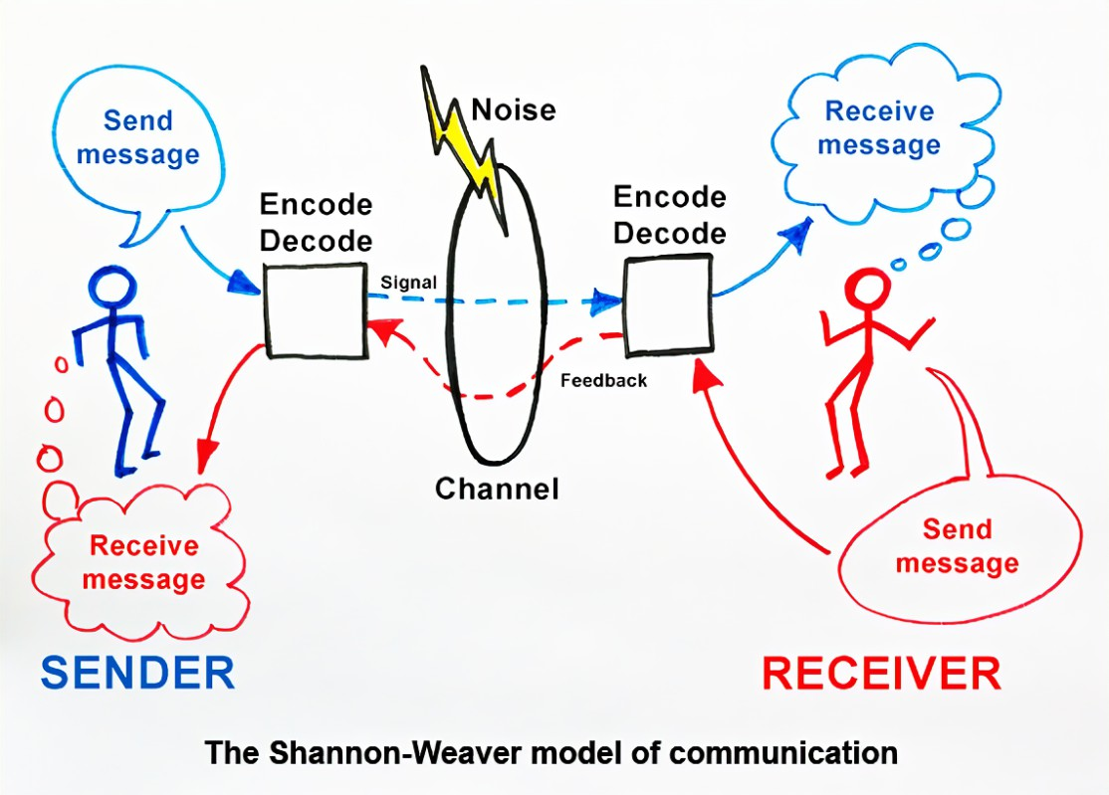
What are the channels of communication used by the organization and channels that can be used to improve communication?
We know for communication to be effective between individuals it's important that you can communicate
Effectively. This model of communication is known as the Shannon Weaver model it demonstrates how messages and face to face communication can be met by using this theory
The source – Of information this is known as the sender to the receiver this can be done in multiple ways such as orally in writing and can even be shown by a person's body language
Encoding (transmitter) - This converts messages into signals
Channel – Next step of the theory shows channel this is infrastructure that allows information from sender to transmitter from the decode to receiver
Noise – Before a message is received it has to then be decoded in a way the recipient understands
Receiver – This is the recipient of the message that was sent out by transmitter or sender
Decoder – Has to be encoded in a way that the receiver understands
Receiver – This is the end point of the theory were the receiver now has the message

Slide 5
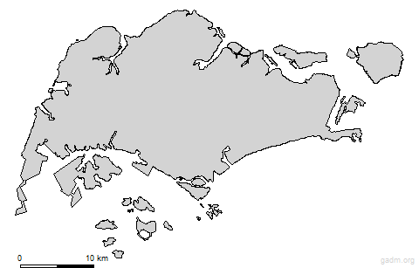
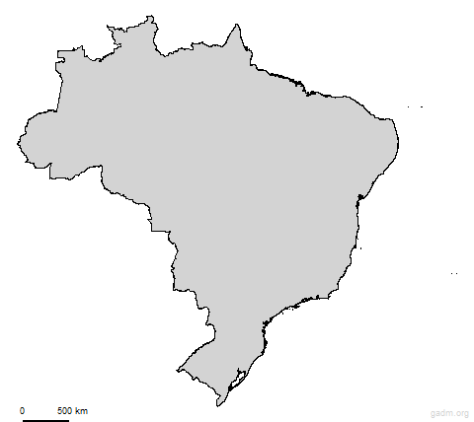
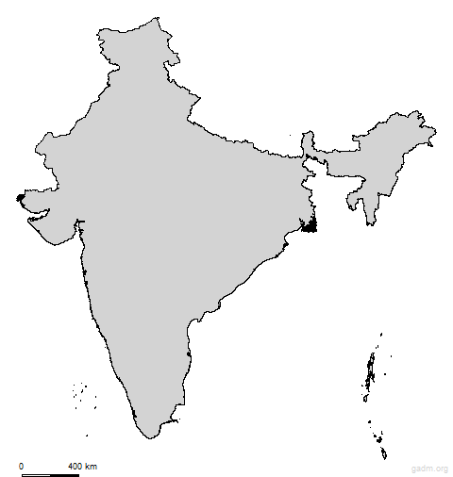
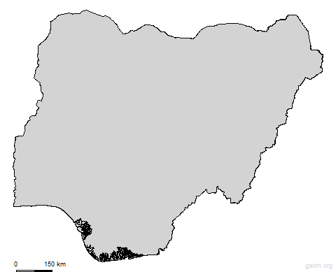
Berol’s Model can be adapted to assist the communication breakdown caused by poorly translated instructions. The head office is located in Australia which is a predominantly English speaking country along side New Zeeland. However English is not everyone's first language. The other countries in this multinational company such as Singapore where they speak Tamil, Malay and Mandarin Chinese. In India they speak Hindi, Brazil they speak Portuguese and in Nigeria the use of English is predominant but large sectors speak Yoruba, Igbo or Fula. With all these different languages spoken it is essential Green- Crop take a more in-depth approach to ensure the correct knowledge is shared and the receiver knows what the sender is communicating in all eventualities.
Singapore
Brazil
India
Nigeria
© 2018 GADM - license

Slide 6
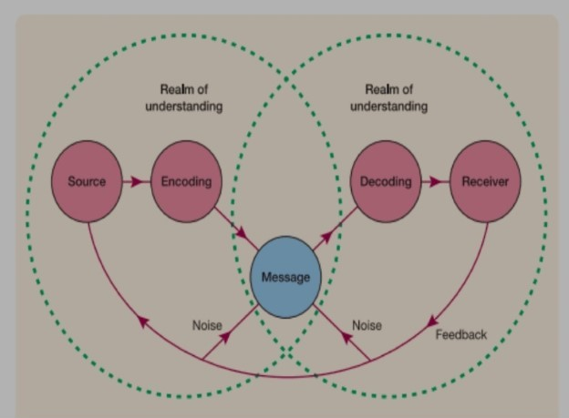
Theories relating to models of communication
This brings me to discus the Schramm’s model
The SCHRAMMS model regards communication as a process between an encoder and a decoder most importantly this model accounts for how people Interpret the message. Schramm argued that a person s background, experience and knowledge are factors that impact interpretation. Meaning that body language plays a key role in how a message is sent and how it is received. There can be many barriers through communication attitude as mentioned earlier can play a major role in how a message is received. Especially if the sender and receiver have different points of views or strong emotions or beliefs.
Schramm’s Model of Communication- An Interactional Model – Dec 2020

Slide 7
Channels of communication & their uses
Lendle- Daft created the theory of channel richness by creating a model that clearly demonstrates the effective use of communication, using comparison of the message being communicated and the intention of what is being portrayed to the recipient. This is where using a visual approach such as video conferencing, time zone permitting, to communicate could be helpful when bridging language barriers.

Slide 8
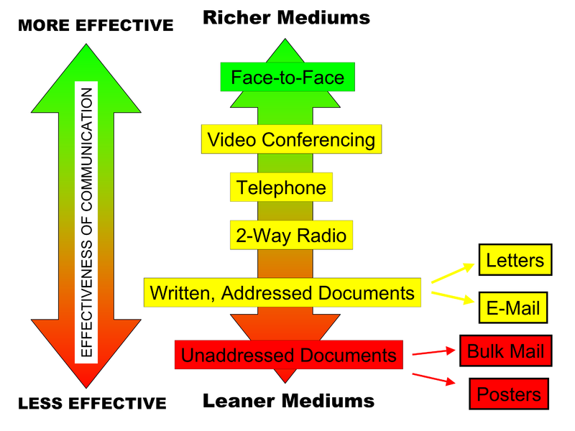
Communication barriers affecting communication between Green-Crop and clientele
The most obvious barrier that could prevent communication with a worldwide business would be the time zone difference in different continents. This could create problems as one country could be sleeping whilst the other is active and continuing there working day. This could slow the communication process down and cause delays. A task that should take ten minutes in a company could take up to 24hrs if having to communicate through email , according to (Daft and Lengel 1984) "characteristics of media that determine richness of information processed"
Emails are low in richness but are one of the most suitable tools of communication for global businesses. When communication through emails it is important to send emails early enough for the "sleeping businesses" to be able to process the information and respond effectively. This will keep the flow of communication running smoothly.
Lumen – Principles of Management John/Lynn Bruton and Lumen Learning. April 2016

Slide 9
The impact of poor communication to Green-Crop and the advantages of effective communication to the organisation
Due to Green-crop being a multinational organisation, the current feedback received from its investors should be viewed as negative, but there is room for improvement. With the clientele being unable to understand the current set instructions within the equipment manuals provided this could create potential health and safety issues for the end users . Putting any potential for future investments at risk.
According to Tenzer, H & Pudelko, M., (2015). when crossing language barriers instructions must be clear and concise for translation purposes, if this is not the case it can evoke negative emotions such a frustration for the receiving party who are trying hard to understand how to proceed safely with their new machinery.
Bridging the linguistic gap is paramount for Green-crop and its potential customers. One strategy could be meeting with the mangers from each country who are fluent in English to come together and work on a set of comprehensive translated guides for each country ensuring all dialects/ languages and potential customers are catered for in a comprehensive adaptable instruction template.

Slide 10
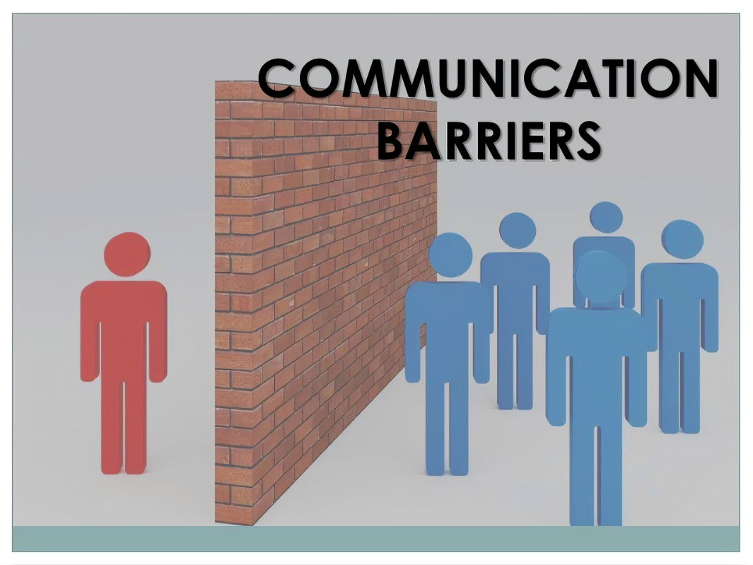
The types of barriers that can prevent effective communication between the organization and their external stakeholders.
Another form of communication barrier can be national culture with green co being a multinational organisation it's very important today to stay cultural aware and being able to respond in a non-judgemental professional manner is exceptionally important when communicating with other colleague's and service profession.
As we know taking into consideration that people come from different background cultures for some speaking firm and abruptly can be very normal in one's culture but may be perceived as rude to another culture
Most communication barriers tend to be directly attributed by inaccuracies and misunderstanding
Another barrier of communication is listening though we may seem very present in the moment when someone is speaking does not always mean that you are being listened too how well you listen has a major impact on relationships with colleagues and will affect the quality of relationships that's why actively listening is a way of putting effort into communication.

Slide 11
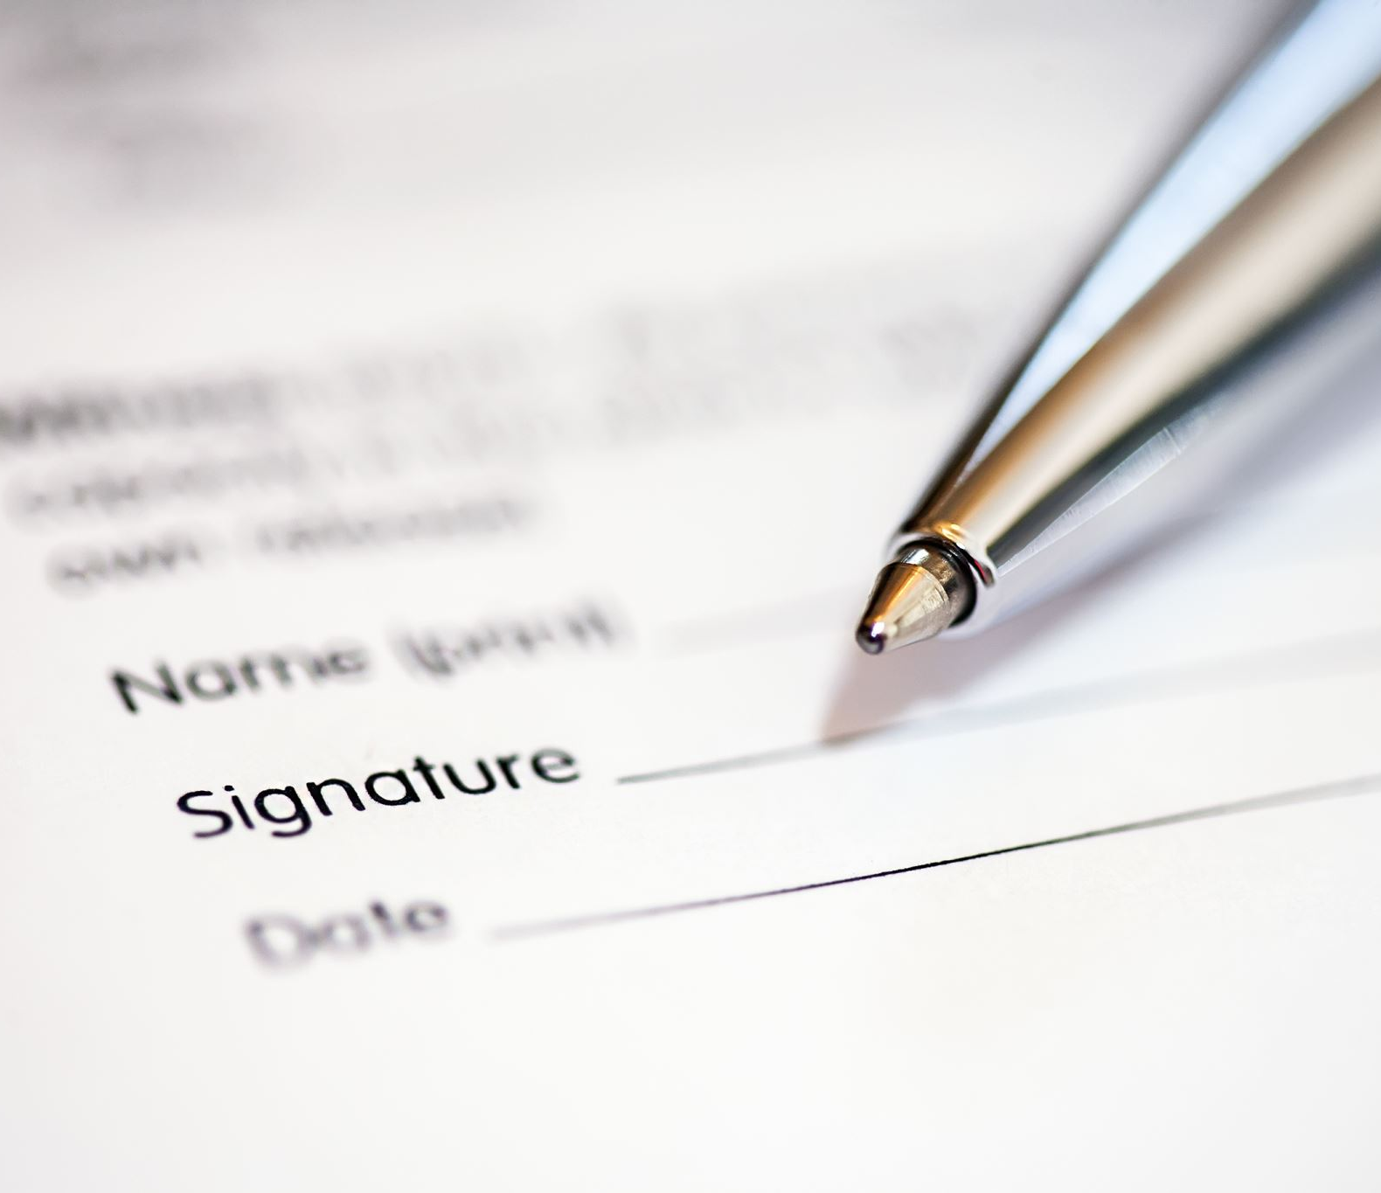
Conclusion
The ramifications for Green- Crop not being able to master the language barrier scenario could be detrimental to the brand, each country that has purchased equipment could be subject to different health and safety requirements, if the equipment is not used properly maintained or misused due to the customer not understanding the instructions they could be liable to any injuries and fatalities that occur whilst the customer uses the products purchased.

Slide 12
References
Tenzer, H. and Pudelko, M., 2015. Leading across language barriers: Managing language-induced emotions in multinational teams. The Leadership Quarterly, 26(4), pp.606-625.
https://lumenlearning.com/courses/principles-of-management/
https://courses.lumenlearning.com/wm-principlesofmanagement/chapter/channels-of-business-communication/
https://michellemathiasfsp.blogspot.com/2020/12/schramms-model-of-communication.html
https://etechmethod.wordpress.com/2016/10/11/berlos-smcr-model-of-communication/

Slide 13
Teamwork Evaluation | Team responses.
Who was in your team? | Krystal , Nicola, Kiesha & Gail
What were the key strengths of your team? | Krystal and Nicola communicated effectively even though we couldn’t meet face to face we managed to send ideas back and forth to complete presentation, we are unable to comment on the other members unfortunately.
What were the challenges that you overcame as a team? | Illness, faulty equipment, conflicting timetables, Not sharing contact details in order to receive feedback.
What would you do differently if you worked as a team again? | Ensure I am placed in a group that actually wants to take part in the work and share the workload evenly
How would you rate your team working? Out of 10? | 6

