Slide 1

800 Yards of Flavour – Business Plan
Rafal Boguszewski – Group 3
Student ID: 2429418
Module: LCLM4006 – Enterprise and Entrepreneurship
Lecturer: Charles Obinwa

Slide 2
Business Idea Overview
Moroccan–European fusion casual fine dining concept.
Bold Moroccan spices paired with refined European techniques.
Management: Founder, Manager, Head Chef, Bar & Service Leads.
Legal Structure: Limited Company (Ltd).

Slide 3
PESTEL Analysis
Political: Supportive local policies; possible import tax impacts.
Economic: Inflationary pressures but strong tourism.
Social: Growing demand for multicultural, authentic dining.
Technological: Digital booking, social media, restaurant tech.
Environmental: Local sourcing and sustainability focus.
Legal: Food safety, licensing, labour regulations.

Slide 4
Marketing Strategies
Influencer collaborations & strong social media branding.
Online booking system & digital quick-order app.
Seasonal, sustainability-focused menu promotion.
Partnerships with hotels, tourism boards & events.

Slide 5
Funding & Allocation (£50,000)
Premises & Renovation: £14,000
Kitchen Equipment: £12,000
Furniture & POS: £6,000
Licences & Insurance: £3,000
Initial Stock & Marketing: £4,000
Contingency + Working Capital: £11,000

Slide 6
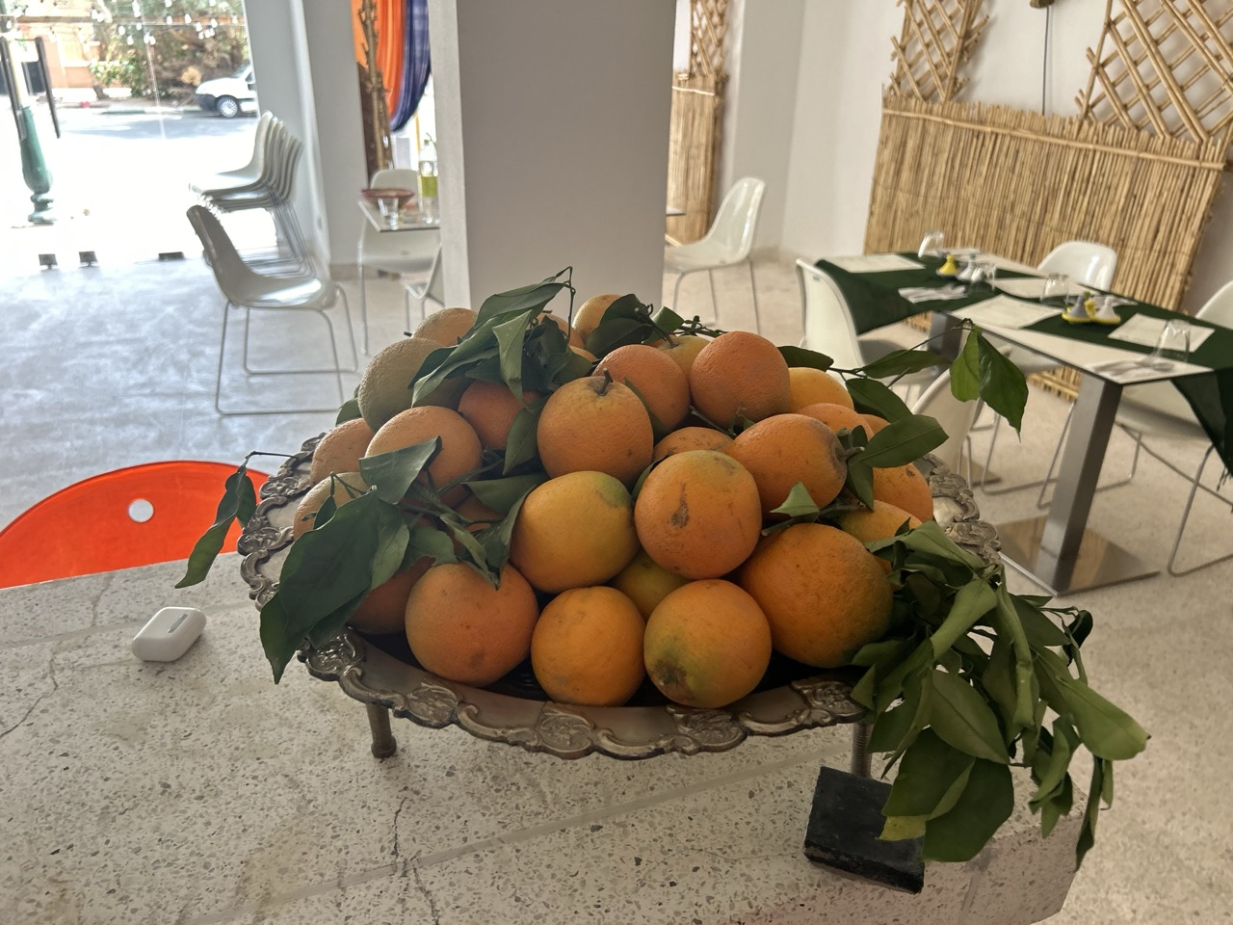
Brand & Cultural Inspiration

Slide 7
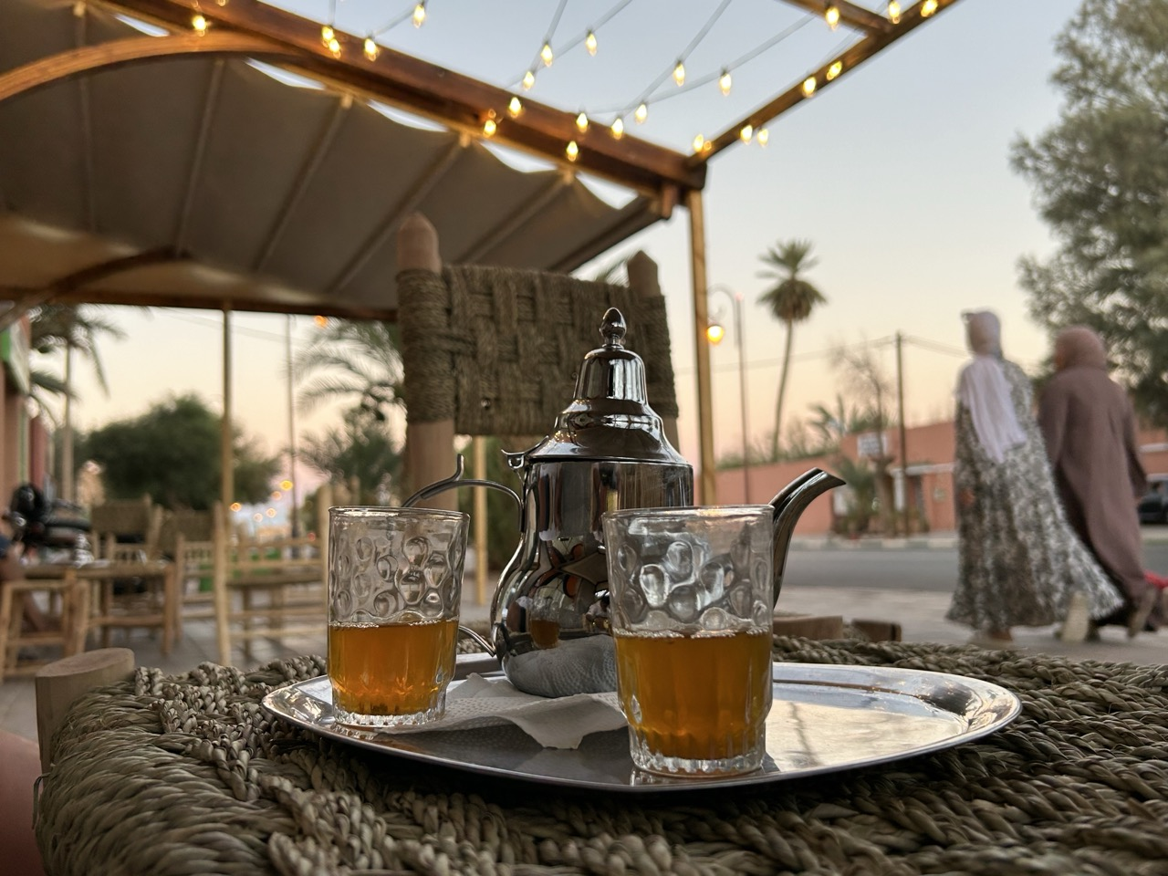
Brand & Cultural Inspiration

Slide 8
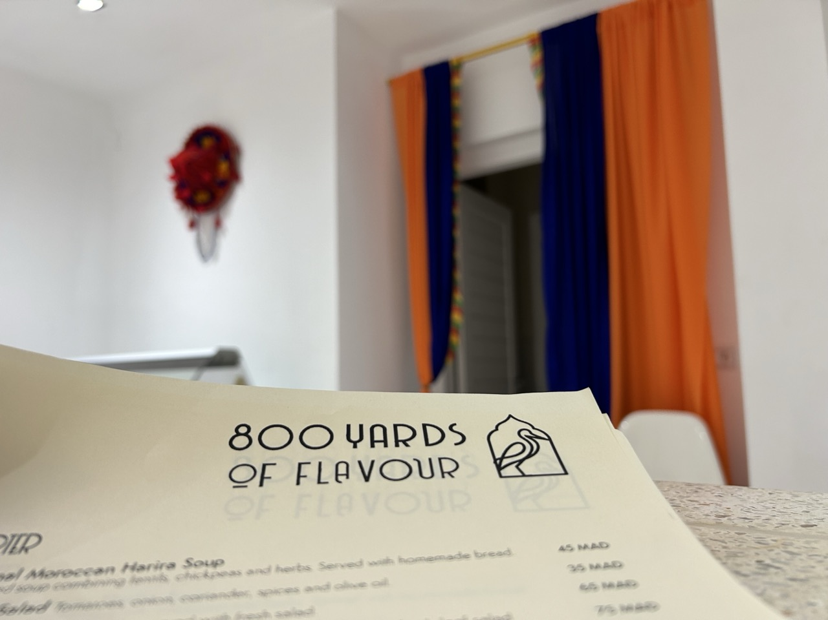
Brand & Cultural Inspiration

Slide 9
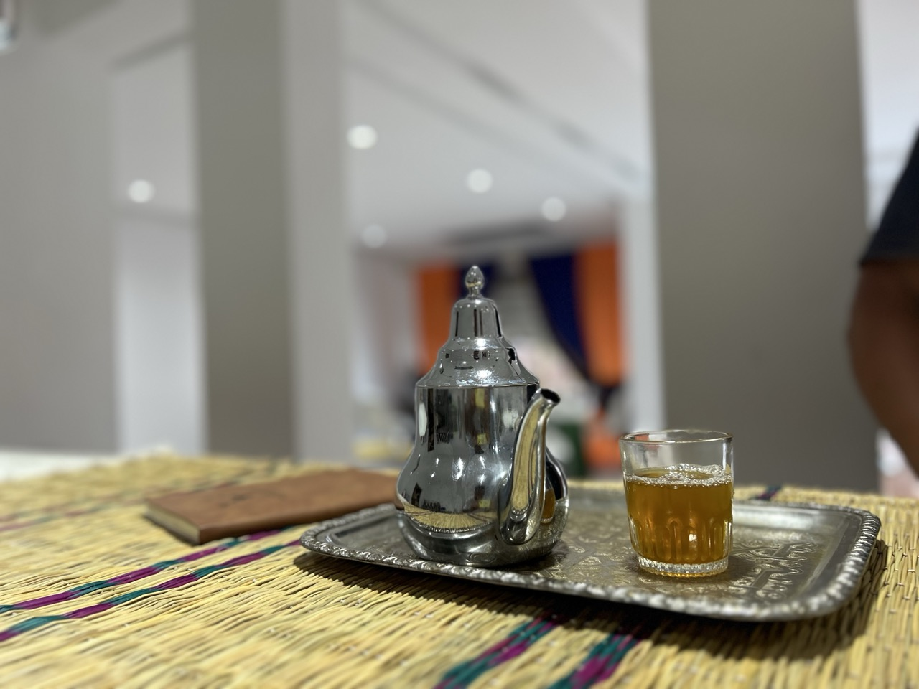
Brand & Cultural Inspiration

Slide 10
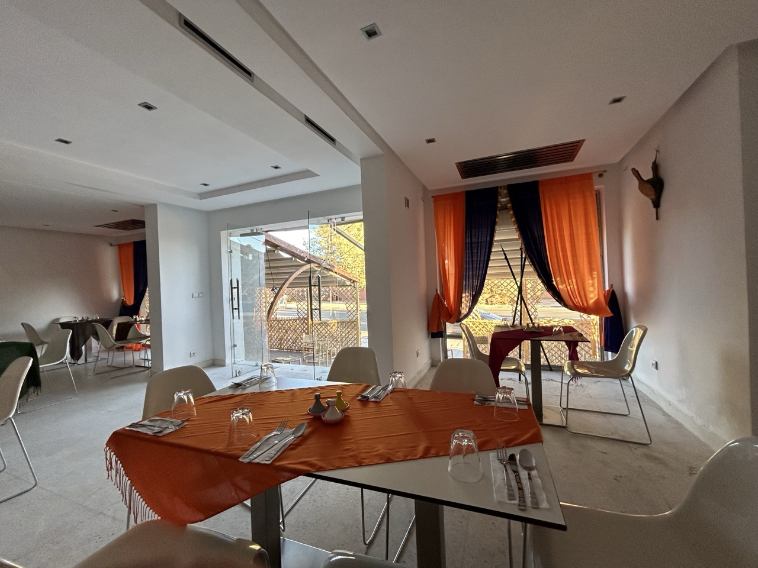
Brand & Cultural Inspiration

