Slide 1
LCBB5015
Principles of Marketing
Week 6 Session 1
Consumer Behaviour

Slide 2
Learning Objectives
To understand the difference between a high and low involvement product.
To identify and determine the stages in the consumer decision making process.
To understand the individual and social/cultural influences on consumer behaviour.

Slide 3


Consumer Behavior
Consumer Behavior: a wide spectrum of things that affect, derive from, or form the context of human consumption.
Perspectives:
Consumers are Systematic decision makers
  Maximize the benefits from purchases defines the response
Consumers are Active interpreters
  Cultural/social membership defines response

Slide 4
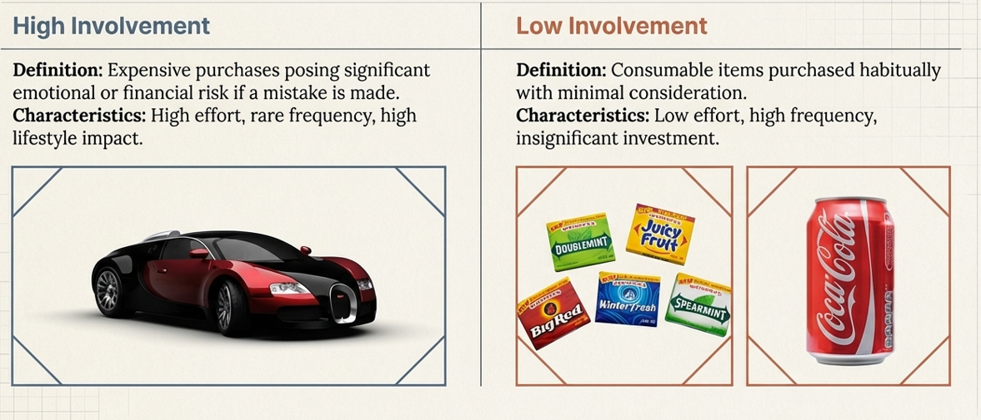
High Involvement and Low Involvement Products

Slide 5
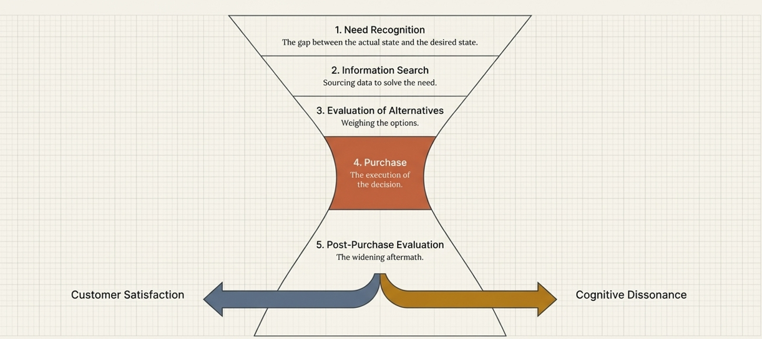
Consumer Decision-Making: The Systematic Decision Maker

Slide 6
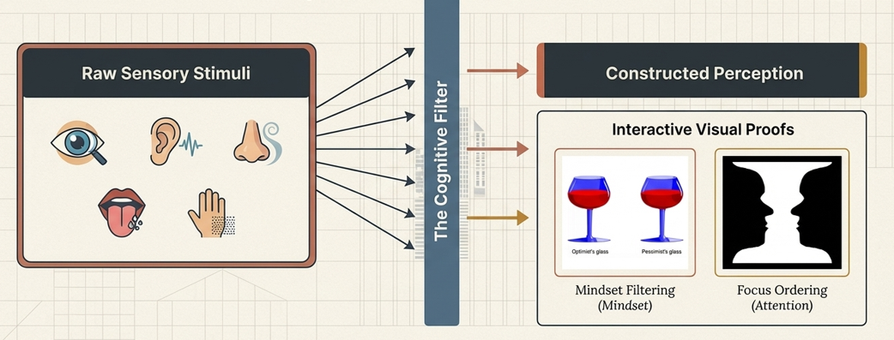
Definition of Perception
Sensory receptors take in stimuli, when the stimuli is ordered and interpreted perception occurs.

Slide 7

Perception

Slide 8
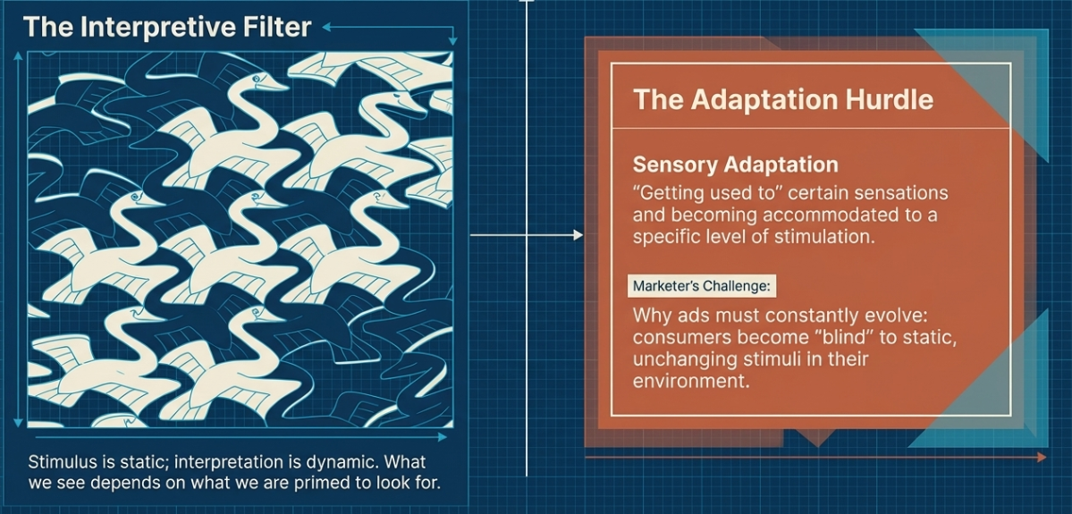
Perception

Slide 9
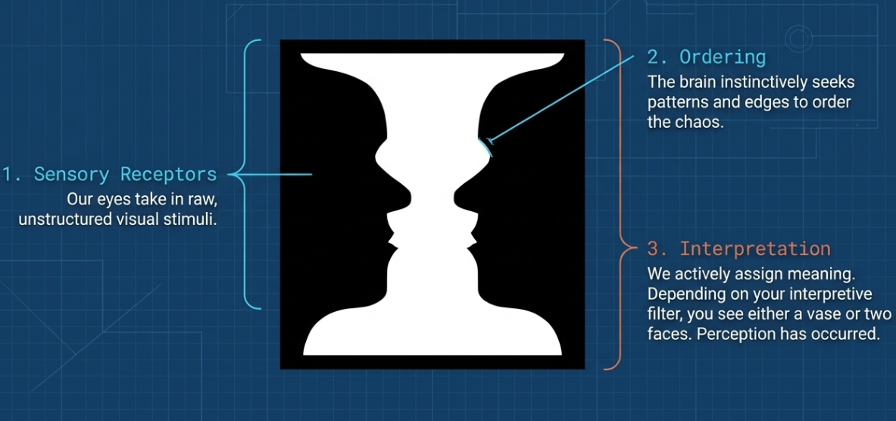
Perception

Slide 10
Sensory adaptation
The term adaptation refers specifically to ‘getting used to’ certain sensations, becoming accommodated to a certain level of stimulation.

Slide 11
Attitude
Your attitude to something is the way that you think and feel about it, especially when this shows in the way you behave.
Source: https://www.collinsdictionary.com/dictionary/english/attitude

Slide 12
Structural Models of Attitudes
Motivated by a desire to understand the relationship between attitudes and behaviour, psychologists have sought to construct models that capture the underlying dimensions of an attitude.
Tricomponent Attitude Model: Attitudes consist of three major components: A cognitive component, an affective component, and a conative component.

Slide 13
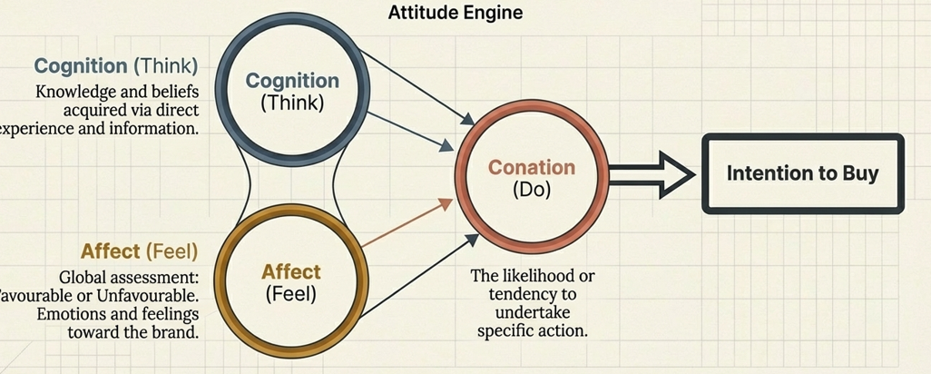
Tricomponent Attitude Model

Slide 14
The Cognitive Component
Consists of a person’s cognitions, that is, the knowledge and perceptions that are acquired by a combination of direct experience with the attitude object and related information from various sources.
This knowledge and resulting perceptions commonly take the form of beliefs.

Slide 15
The Affective Component
A consumer’s emotion or feelings about a particular product or brand constitute the affective component of an attitude.
These emotions and feelings capture an individual’s direct or global assessment of the attitude-object.
The extent to which the individual rates the attitude object as ‘favourable’ or ‘unfavourable’

Slide 16
The Conative Component
Conation is concerned with the likelihood or tendency that an individual will undertake a specific action or behave in a particular way with regard to the attitude object.
Conative component linked to the consumer’s intention to buy.
Intention to buy scales.

Slide 17
Activity: Analysing Consumer Behaviour (Group Task)
Each group selects ONE product:
Smartphone, Car, Clothing item, Everyday product (e.g. shampoo, snacks)
Group Discussion Questions
Identify whether your product is: High involvement or Low involvement
Justify your answer using: Price, Level of risk, Frequency of purchase
Explain the consumer decision-making process: Problem recognition, Information search, Evaluation of alternatives, Purchase decision, Post-purchase evaluation
Identify TWO factors influencing the decision:
  Psychological (e.g. motivation, perception)
  Social (e.g. family, peers)

Slide 18
Question
How can marketers change consumer’s attitudes?

Slide 19
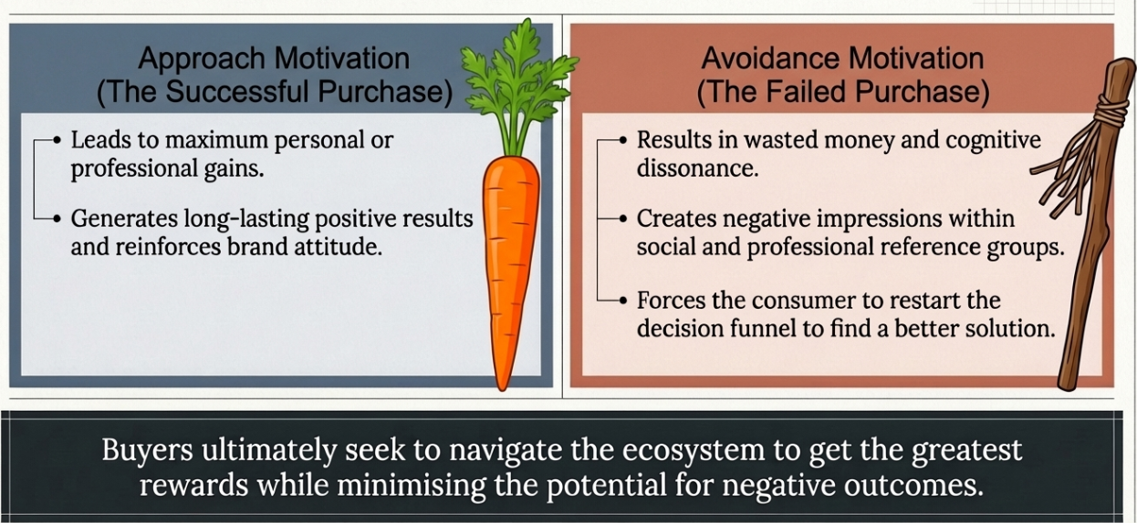
Motivation

Slide 20
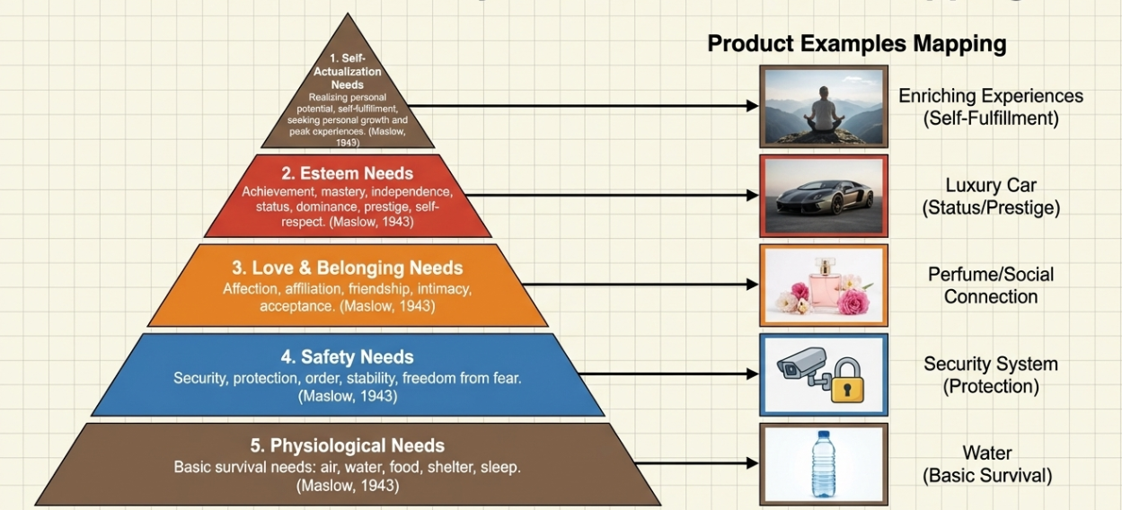
Maslow’s Hierarchy of Needs

Slide 21
Activity 1 – Brand Mapping to Maslow’s Pyramid
Task: Match Brands to Consumer Needs
Instructions:
Draw or use the Maslow pyramid provided.
Choose 5 emerging or modern brands (see examples below). For each brand, identify:
  A product or service they offer
  A slogan or marketing message
  Which need level on the pyramid it appeals to
Place each brand at the correct level of the pyramid.
Be ready to explain why it fits there.
Debrief Questions:
Which needs are most often targeted by these modern brands?
Do any brands try to cover multiple levels?
How do emotional and social messages affect consumer loyalty?

Slide 22
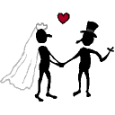
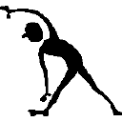
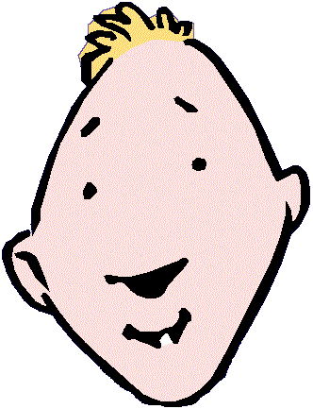
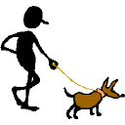
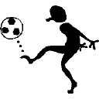
Consumer as Social Being
I buy what I am

Slide 23
Sociocultural Consumption
Values
Object
Meaning
Family
Social
class
Rituals
Community
Gender
Culture
Society
Race /
Ethnicity
Reference
Groups

Slide 24
Factors Affecting Decision Making
REFERENCE
GROUPS
VALUES / ATTITUDES
CULTURE
SITUATIONAL
FACTORS
NEEDS
CONSUMER
DECISIONS
EDUCATION
PLEASURE
PERSONALITY
GENDER
MARKETER-
CONTROLLED
STIMULI
FAMILY
MEDIA
SOCIAL
CLASS
NEWS
MAGAZINES
RADIO
TELEVISION
DIRECT MEDIA
PAST
EXPERIENCE
PRICE
PACKAGING
ADVERTISING
PROMOTION
PERSONAL SELLING
LIFE-STYLE
SUBCULTURES

Slide 25
Conclusion
Ultimately, buyers want to get the greatest rewards and minimize the potential for negative outcomes in a highly involving purchase. A successful purchase can lead to maximum personal or professional gains from the use of the product or service, and to long-lasting results. A bad purchase leads to wasted money, negative impressions in social or professional groups, and the need to purchase another solution to better meet your needs.

Slide 26
Summary
In this lecture we have discussed the difference between a high and low involvement product.
We have identified and determined the stages in the consumer decision making process.
We have discussed the individual and social/cultural influences on consumer behaviour.

Slide 27
References
“Definition of Attitude.” Collinsdictionary.com, HarperCollins Publishers Ltd, 2 Feb. 2020, www.collinsdictionary.com/dictionary/english/attitude.
Jim, Blythe, and Zubin Sethna. Consumer Behaviour. SAGE, 2019.
Kotler, Philip, and Gary Armstrong. Principles of Marketing. 17th ed., Harlow, Pearson Education Limited, 2017.
Schiffman, Leon, and Et Al. Consumer Behaviour. Frenchs Forest, Nsw, Pearson Education Australia, 2018.

