Slide 1

Cyswllt at yr egwyddorion addysgegol:
Link to pedagogical principles
2.
7.
12.

Slide 2

Amcanion y sesiwn
Session aims
Deall y gwahaniaeth rhwng asesu crynodol a ffurfiannol Dechrau gwerthuso strategaethau Asesu ar gyfer Dysgu Defnyddio'r wybodaeth a gyflwynwyd i wella cynllunio yn ECAD6008 a PTE1/2 | To understand the difference between summative and formative assessment To begin to evaluate Assessment for Learning strategies To use the information presented to enhance planning in ECAD6008 and PTE1/2

Slide 3

Pam asesu?
Why assess?
Notes:
Discussion

Slide 4
It allows us to monitor progress against tangible data
Formal assessment needed to track progress throughout the course or key stage.
Informal assessment needed to check pupils know what to do and how to progress
Control! I am accountable for results and need to manage the learning
Realistic targets can be set so learners know where they are and how to progress
Notes:
These are genuine responses from teachers I have asked

Slide 5
It allows us to monitor progress against tangible data
Formal assessment needed to track progress throughout the course or key stage.
Informal assessment needed to check pupils know what to do and how to progress
Control! I am accountable for results and need to manage the learning
Realistic targets can be set so learners know where they are and how to progress
Notes:
Discussion

Slide 6
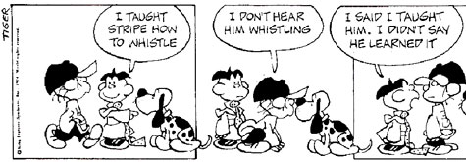

Asesu: Y bont rhwng addysgu a dysgu
Assessment: The bridge between teaching and learning

Slide 7


Diffiniad o asesu ffurfiannol
Definition of formative assessment
‘…encompassing all those activities undertaken by teachers, and/or by their students, which provide information to be used as feedback to modify the teaching and learning activities in which they are engaged’
Black and Wiliam, 1998:7
Notes:
Definitions about formative assessment revolve around the purpose of assessment being to improve learning
Formative assessment has been under development in various manifestations for the last couple of decades
Current interpretations of formative assessment - also known as AfL – are often linked to Black and Wiliam’s (1998) review of literature and subsequent developments by the UK’s Assessment Reform Group (2002)

Slide 8
‘The teacher’s job is not to transmit knowledge, nor to facilitate learning. It is to engineer effective learning environments for the students. The key features of effective learning environments are that they create student engagement and allow teachers, learners, and their peers to ensure that the learning is proceeding in the intended direction. The only way we can do this is through assessment. That is why assessment is, indeed, the bridge between teaching and learning.’
(Wiliam, 2011:50)

Slide 9
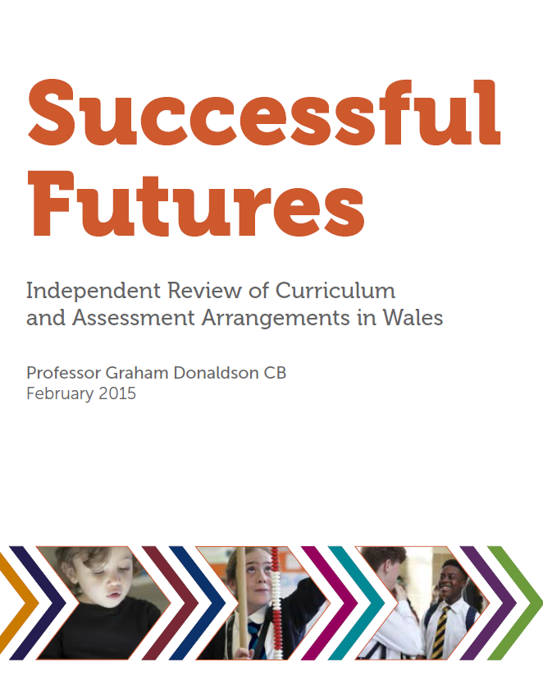
Welsh government’s response to the Successful Futures:
“Assessment is integral to successful learning. The most important purpose of assessment is to inform learning and teaching”
“…developing a new assessment and evaluation framework that prioritises assessment for learning…”

Slide 10
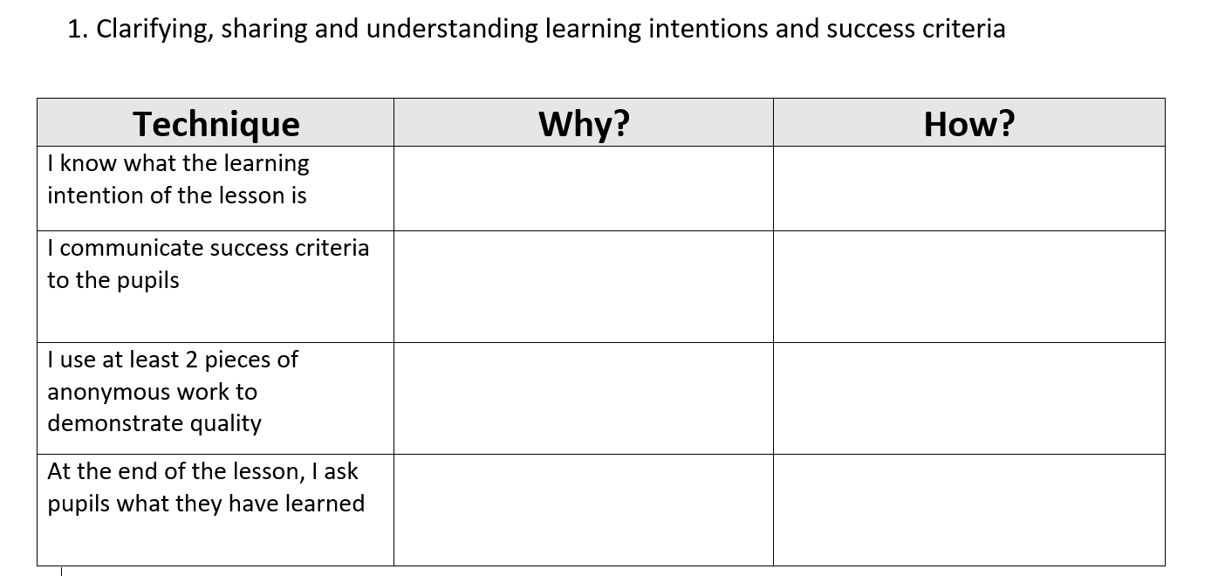
Wiliam and Leahy (2015) consider the following techniques to be at the heart of Assessment for Learning. Take some time to think about WHY you may use them in your teaching and HOW you may use them.
Notes:
Word document

Slide 11
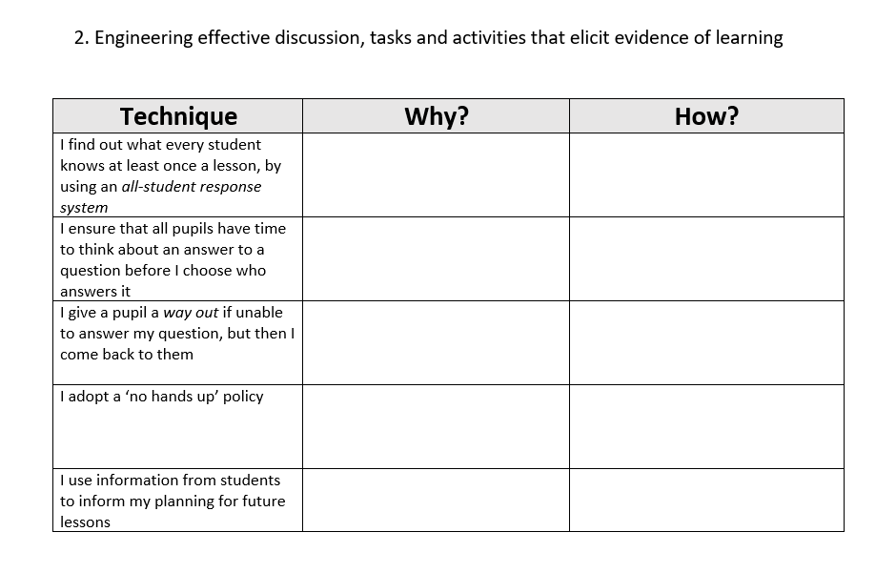

Slide 12
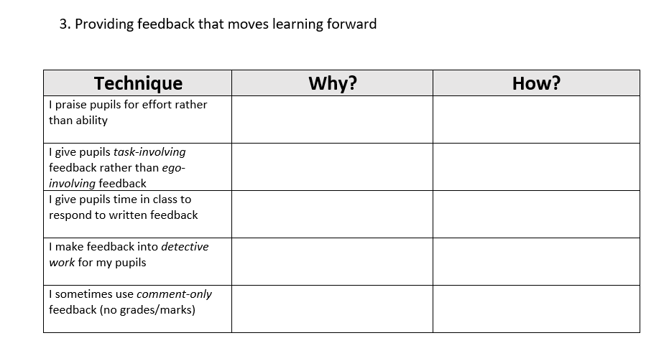

Slide 13
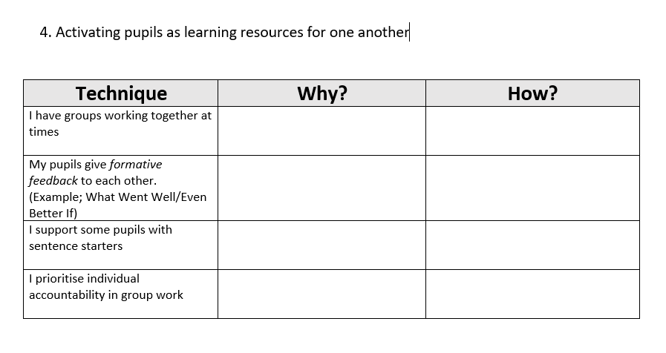

Slide 14
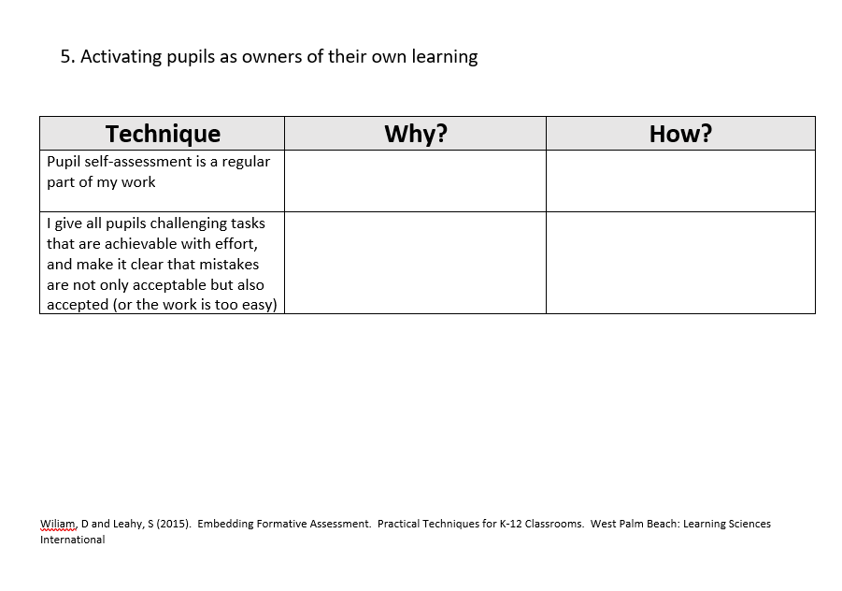

Slide 15
Assessment OF learning | Any summative test or assessment Audits taken to use as evidence of pupils’ learning to assess achievement against learning goals and standards
Assessment FOR learning | Any formative practice which provides information to pupils about what to do to improve Teacher provides feedback to pupils about their learning
Assessment AS learning | Involves pupils in learning process where they monitor their own progress, ask questions and practise skills Pupils use self-assessment and teacher feedback to reflect on their learning, consolidate understanding and work towards learning goals
S Clarke, 2008

Slide 16
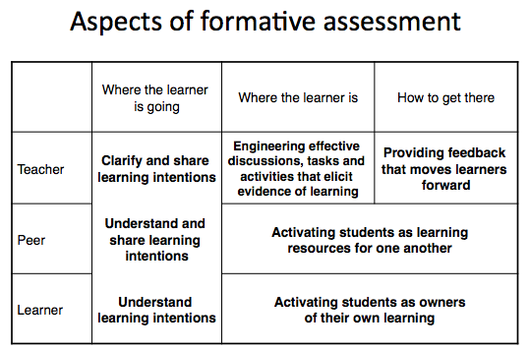
What is AfL based on?

Slide 17
What is AfL based on?

Slide 18
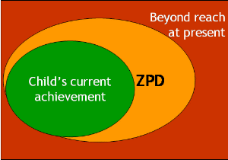
What is AfL based on?
Based on constructivist view
Vygotsky 1978
Notes:
AfL is founded on a constructivist view of learning, which strongly recognises that learning is something that happens inside the mind of the learner – it is something they DO.
No matter what ARTISTRY we employ as teachers, learning is still something that learners do for themselves
It’s all too easy to get in to the habit of talking about learning as a product – as the outcome of teaching. AfL focuses on learning as a PROCESS, giving pupils the opportunity to reflect and make sense of their recent learning experiences
Question should NOT be “How can I teach better?” but “How can I help my pupils to become better learners?”
Therefore, the role of the teacher is to provide sufficient structure to SCAFFOLD tasks and activities and to REGULATE learning by intervening and providing FEEDBACK
Each new task will generate a different ZPD

Slide 19
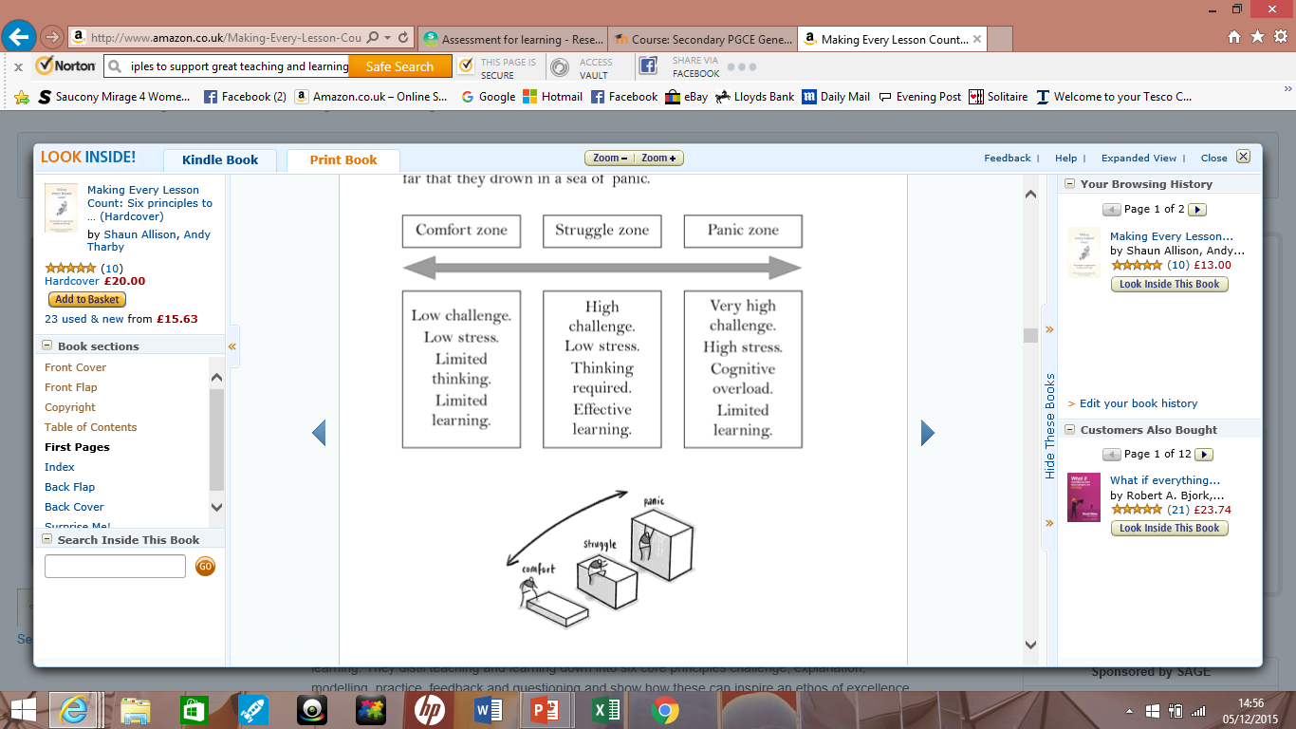
Providing Challenge…

Slide 20
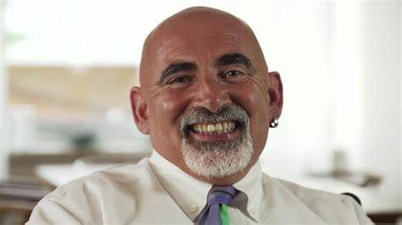

‘We cannot predict what students will learn as a result of any particular sequence of instruction. Formative assessment involves getting the best possible evidence about what students have learned and then using this information to decide what to do next’
Wiliam, D (2011:50)

Slide 21

https://www.wjec.co.uk/qualifications/religious-studies-gcse/#tab_keydocuments
https://www.wjec.co.uk/qualifications/religious-studies-as-a-level/#tab_keydocuments
Familiarise yourselves with the WJEC Religious Studies website by Wednesday 11/10

