Slide 1


Sutton Park Grange Care Home
136 Birmingham Road
Sutton Coldfield
Birmingham
B72 1LY
BMSW_4002
Joanne Davies
Samina Mumtaz - 2119016
Shazia Begum - 2117727
Rubina Akbur - 2118370

Slide 2
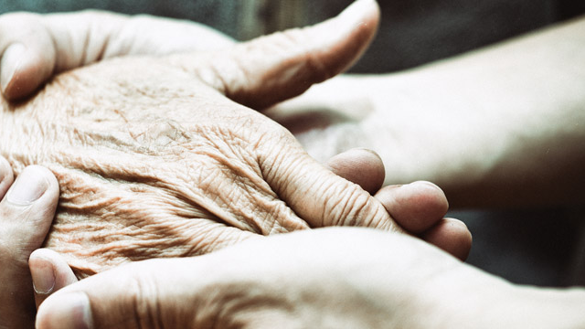
INTRODUCTION
Cinnamon Luxury Care, which includes Sutton Park Grange, is honored to be named and is among the Top 20 Mid-Sized Care Facility Organisations for the Fourth Consecutive Year. It is an unblemished care home, situated in Sutton Coldfield.
It provides patients with person-centered residential care and respectful, loving dementia care, as well as top-notch services that enable people to lead rich, complete lives. Sutton Park Grange provides guesthouses and assisted living at the same time. (Cinnamon Luxury Care, 2022).
SHAZIA

Slide 3


COMMUNICATION STRATEGIES IN HEALTH AND SOCIAL CARE ORGANISATIONS
HOW TO COMMUNICATE
Ideas/Thoughts
Eye contact
UNDERSTANDING COMMUNICATION
To be able to understand language spoken
Understanding and utilisation of information
FUNCTIONS OF COMMUNICATION
Control – Managing staff
Emotional expression – Tone of voice
Verbal/Non-verbal words
Transferring information
Ability to see and listen
Memory for knowledge intake and processing
Sharing information – Policies and Procedures
Motivational – Rewards and Recognition
Inter- personnel communication – Sending and Receiving messages
Email
Braile
Sign language/ Touch
Sutton Park Grange is pleased to state that it is a pioneering company with these abilities.
In the healthcare industry, communication must be productive and useful. The most common channel used is writing. Vermeir et al.,(2015)
SHAZIA

Slide 4

BENEFITS OF EFFECTIVE COMMUNICATION IN HEALTH AND SOCIAL CARE .
Druskat et al, (2001) lists three requirements that must be met for a team to succeed: trust among team members, a shared sense of identity, and group effectiveness. These characteristics are something that Sutton Park Grange promotes as a company.
At Sutton Park Grange, effective communication and teamwork is crucial because a team's success depends on its ability to communicate with one another. Another important element of a successful team is having the ability to work well within a team.
Davis et al,(2022) Researchers and practitioners recognise effective communication and teamwork as key factors in achieving optimal results in the workplace.
Group effectiveness
Team Success
Promotes Trust
Resolves issues
Better client relationships
SHAZIA

Slide 5
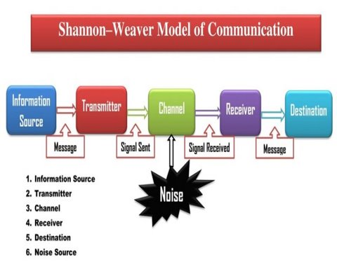
MODELS OF COMMUNICATION
Shannon and Weaver's created a Model of communication which was a mathematical theory of communication (Krippendorff, 2009).
In addition to text, receiver, carrier, communication direction, encoder, and decoder, the model also considers other factors such as noise, which can have a negative success on the effectiveness of the communication (Chandler, 1994).
(Garthbox, 2012)
Samina Mumtaz

Slide 6
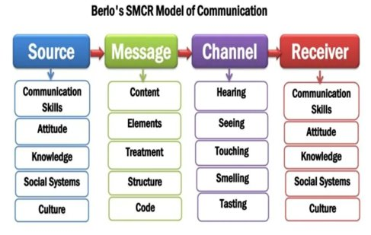
BERLO'S SMCR MODEL
As you can see there is only four parts to this model and the important part is the source and receiver have similar characteristics (Muyanga 2021).
(Kobiruzzaman 2021)
Samina Mumtaz

Slide 7
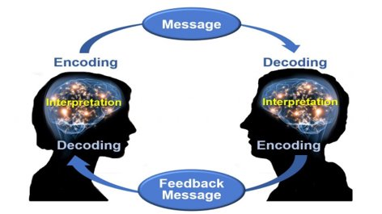
SCHRAMM'S MODEL COMMUNCIATION
(Kisspng 2018)
Both the sender (encoder) and the receiver (decoder) must use effort and talent to communicate effectively, this model allows instants feedback (Lunenburg, 2010).
Samina Mumtaz

Slide 8
Barriers that can prevent effective communication in healthcare and their external stakeholders.
First stage to communicating effectively is realising that there are human and ecological obstacles.
Personal
Not having the ability to listen to others.
Beliefs and values
Enviroment
Not have enough time
Conflicts in the workplace
Management not promoting intraorganisational communication
Lack of compassion/ Language barriers
External stakeholders can be residents and patients.
Emotional Barrier – fear, disbelief and speculation.
The first stage to communicating effectively is realising that there are two types of obstacles in healthcare such as, human and ecological (Guo and Sanchez, 2005).
Managers must be good speakers in a health care setting since they spend majority of their time interacting with partners outside the sector to gather data and make tactical choices. (Guo and Sanchez, 2005).
Samina Mumtaz

Slide 9
WHAT ARE THE CHANNELS OF COMMIUNICATION USED IN ORGANISATION AND CHANNELS THAT CAN IMPROVE COMMUNICATION?
Telephones
Internet
Social media
Television
Radio
Newspaper
The process through which a message is sent from one party to another is referred to as a "channel." There are many different types of communication channels, including telephone calls, social media, radio, newspapers, and television as well as the five senses :
Hearing
Seeing
Touching
Smelling
Tasting- is a form of communication, according to Berlo (1972). The five channels listed above are crucial for human communication (Kobiruzzaman 2021).
In a Health And Social Care Setting these channels are essential.
Rubina Akbur

Slide 10
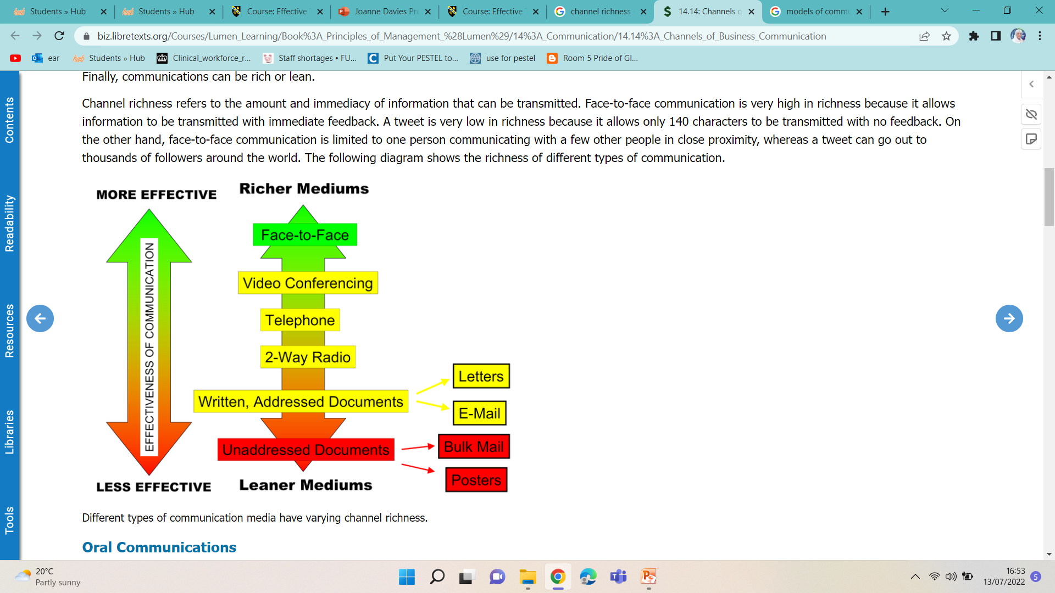
COMMUNICATION CHANNELS
This figure illustrates how various communication mediums affect people differently, both positively and negatively. In a health and social care setting face to face communication is more effective as you know the other person is listening and being attentive.
According to Tarulescu (2006), face-to-face discussion allows for the reading of nonverbal cues such as facial expressions, gestures, and tone of voice.
(LibreTexts 2020)
Rubina Akbur

Slide 11
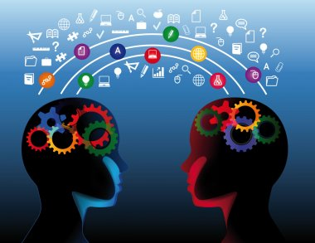
CHANNELS IMPROVING COMMUNICATION
The term "communication channel" refers to the medium or media that the message travels through (Rayudu, 2009).
Communications channels are methods of communicating with others that include phone calls, text messages, emails, social media, and even video calls. These are some of the most effective methods of communicating in health and social care.
Rubina Akbur

Slide 12
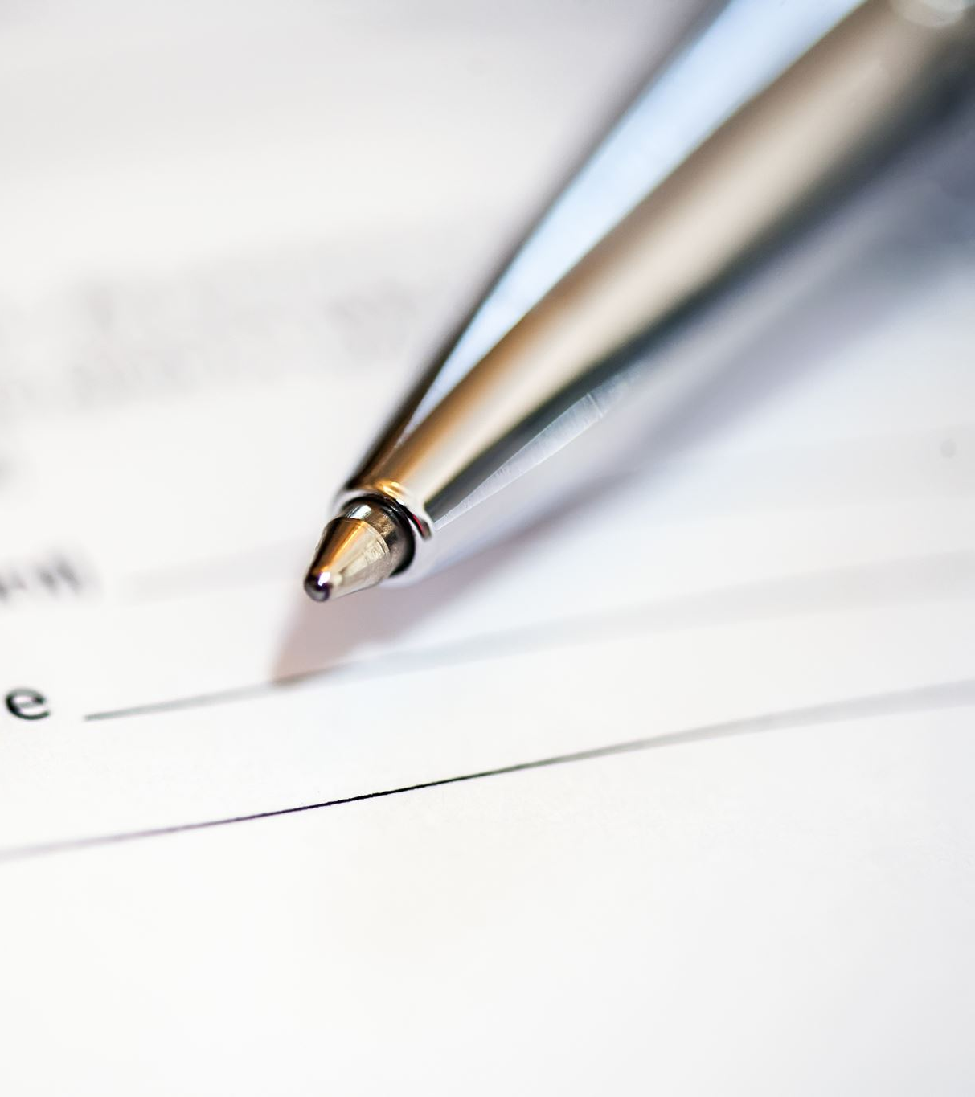
CONCLUSION AND RECOMMENDATION
To conclude, when communication is established well, all engaged individuals are consistently satisfied and feel like they have accomplished something.
Once a message has been sent through the proper channels, there is no opportunity for misinterpretation or the need for revisions.
Additionally, face-to-face contact is among the finest methods of communication in Health and Social Care since it allows you to observe a person's attitude and level of understanding.
Overall, after examining all the model theories, using the SCHAMMS model in Health and Social Care is advised since it is the only one that enables you to receive feedback after interacting.
Summerlin (1991). This model included the ideas of encoding and decoding as well as the principles of feedback in the sender and receiver.
Rubina Akbur

Slide 13
Reference Page
Belbin, R.M,(2010). Management teams why they succeed or fail . 3rd edn. Oxford :, Butterworth-Heinemann.
Chandler, D., (1994). The transmission model of communication. Available at: http://visual-memory.co.uk/daniel//Documents/short/trans.html. (Accessed: 13 July 2022).
Cinnamon LuxuryCare, (2022). Available at: https://www.cinnamoncc.com/care-homes/sutton-park-grange/.(Accessed; 29 June 2022).
Davis, A.S. et al., (2022). ‘Team Belonging: Integrating Teamwork and Diversity Training Through Emotions’, Small group research, 53(1), pp. 88–127.
Garthbox, (2012). The Shannon Weaver Model. Available at: http://garthbox.com/the-shannon-weaver-model/ (Accessed: 6 July 2022).
Griffith, BA, & Dunham, EB, (2014). Working in Teams Moving from High Potential to High Performance, SAGE Publications Incorporated, Thousand Oaks. Available at: ProQuest Ebook Central. (Accessed: 29 June 2022).
Guo, L.C. and Sanchez, Y, (2005). Workplace communication. Organizational behavior in health care, 4, pp.77-110.
Krippendorff, K., (2009). Mathematical theory of communication. Departmental Papers (ASC), p.169.
Kisspng, (2018). The Communictaion Process. Available at: https ://ecampusontario. Pressbooks. pub/communicationatwork/chapter/1-3-the-communication-process/. (Accessed: 6 July 2022).

Slide 14
REFRENCE PAGE
Kobiruzzaman, M.M.,(2021) SMCR Model of Communication. Available at: https://newsmoor.com/smcr-model-of-communication-david-berlos-smcr-model-of-communication-example/ (Accessed: 6 July 2022).
LibreTexts,(2020)Science as a Way of Understanding the Natural World Available at: https://biz.libretexts.org/Courses/Lumen_Learning/Book%3A_Principles_of_Management_%28Lumen%29/14%3A_Communication/14.14%3A_Channels_of_Business_Communication. (Accessed: on 13 July 2022).
Lunenburg, F.C.,(2010) Communication The process, barriers, and improving effectiveness. Schooling, 1(1), pp.1-10.
Muyanga, C.C.,(2021) Assessment of effective communication in international schools in Lusaka based on BERLO'S SMCR MODEL .Lusaka, The University of Zambia.
Rayudu, C.,(2009) Communication, Global Media, Mumbai. Available from: ProQuest Ebook Central.(Accessed: 18 July 2022).
Stead, B.A.,(1972) ‘Berlo’s Communication Process Model as Applied to the Behavioral Theories of Maslow, Herzberg, and McGregor’, Academy of Management journal, 15(3), pp. 389–394.
Summerlin, R.D.,(1991). An evaluation of the use of sermonic illustrations by Frank William Boreham, Harry Emerson Fosdick, and Joel Cliff Gregory by utilizing Wilbur Schramm's models of communication, New Orleans Baptist Theological Seminary.
The Osgood-Schramm model of communication, (2017) Avaliable at: Sources: Kisspng, 2018; Web Editor 4,ixingneeds fix
Tarulescu, M.,(2006). Advantages and disadvantages Advantages and disadvantages of face-to-face business business communication communication communication. BULETIN ğTIIN IFIC, p.62.
Vermeir, P., Vandijck, D., Degroote, S., Peleman, R., Verhaeghe, R., Mortier, E., Hallaert, G., Van Daele, S., Buylaert, W. and Vogelaers, D., (2015). Communication in healthcare: a narrative review of the literature and practical recommendations. International journal of clinical practice, 69(11), pp.1257-1267.

Slide 15
TEAM EVALUATION
Team Evaluation | Team Responses
Who was in your team | Samina Mumtaz, Shazia Begum and Rubina Akbur
What were they key strengths of your team | We all had our own set of skills. And we communicated well.
What were the challenges that you overcame as a team | Sometimes we disagreed on the structure and wording, but then we made a group decision in the end.
What would you do differently if you worked as a team again | We would allocate each points to individuals and have a look at it as a group in the end
How would you rate your team working? Out of 10. | 8/10

