Slide 1

Programme: BA (Hons) Business Management
Module code: LCBB6022
Module name: Leadership and Management Theory and Practice
Student name: Corina Seni
Student ID: 2217836
Assignment Title: Component 1 – Practical Individual Presentation
Lecturer name: Rebecca Stewart

Slide 2
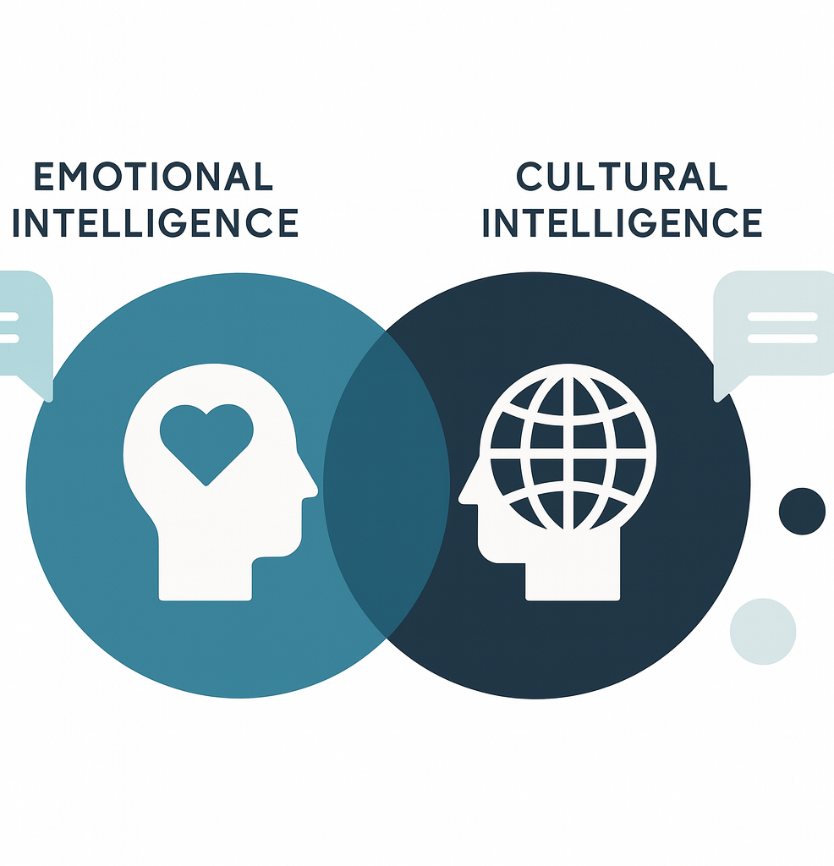
Introduction
Leadership in modern organisations is increasingly shaped by globalisation, cultural diversity, and the need for effective cross‑cultural collaboration. As Edith Heard’s reflections suggest, contemporary leadership requires more than technical or administrative competence, it demands the ability to engage empathetically and navigate cultural complexity.
This presentation examines Emotional Intelligence (EI) and Cultural Intelligence (CQ) as critical capabilities that support leadership effectiveness in multicultural contexts. Drawing on established theoretical models, it evaluates their strengths and limitations, situates them within broader leadership and management theory, and illustrates their organisational relevance through real‑world business examples.
Overall, the analysis argues that EI and CQ function as essential enablers of inclusive, adaptive, and relationally effective leadership in diverse organisational environments.

Slide 3
Title and Context
Title: Emotional and Cultural Intelligence in Leadership: Critical Analysis and Application in Multicultural Organisations
Context:
Inspired by Edith Heard’s leadership philosophy emphasising empathy, collaboration, and cultural awareness (Heard, 2022).
Her experience in multilingual, multicultural environments highlights the growing need for leaders who can navigate diversity with emotional and cultural sensitivity.
Why this matters now:
Globalisation and hybrid work increase cross-cultural collaboration.
Diverse teams requires leaders who can build trust, psychological safety, and shared purpose.
EI and CQ are now strategic capabilities for organisational performance.

Slide 4
Learning Outcomes and Structure
This presentation will:
• Critically evaluate Emotional Intelligence (EI) and Cultural Intelligence (CQ).
• Compare leadership styles and classical/modern management theories.
• Apply EI and CQ concepts to multicultural organisational contexts.
Structure:
Leadership vs Management
Classical management foundations
Leadership styles
EI and CQ models
Critical evaluation
Business examples
Strategy for developing EI and CQ
Conclusion and references

Slide 5
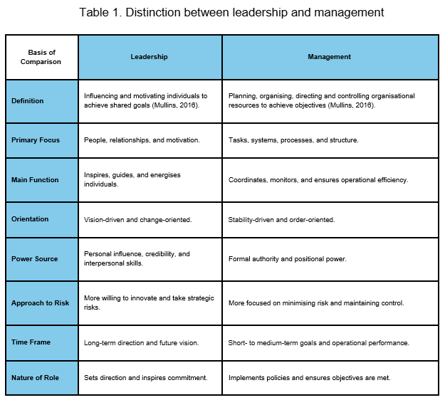
Defining Leadership and Management

Slide 6
Classical Management Foundations
Henri Fayol laid out 14 rules for management aimed at boosting group results. Among those, a few stand out as crucial:
Unity of Command - One step at a time, each worker links to just one boss so things stay clear and smooth across the team.
Authority - Managers need authority so they can issue directions. Yet it must come with clear duties tied to decisions.
Equity - People at work deserve honest treatment. Respect matters just as much as equal chances do. A balanced approach builds trust over time instead of pressure. Fairness shows up in small moments more than big announcements ever could.
Esprit de Corps - What holds groups together might simply be shared purpose. Team spirit and unity often lift spirits when things get tough.
Though Fayol’s method leans heavily on order and rank being mechanistic, ideas like fairness and group morale already showed awareness of people in groups (Fayol, 1949).

Slide 7
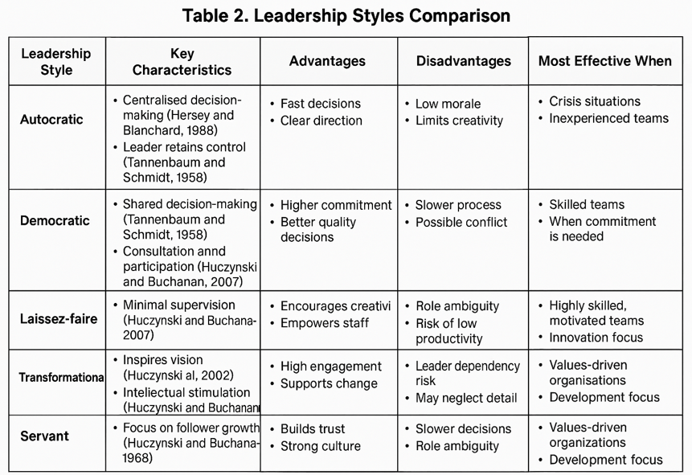
Leadership Styles Spectrum

Slide 8
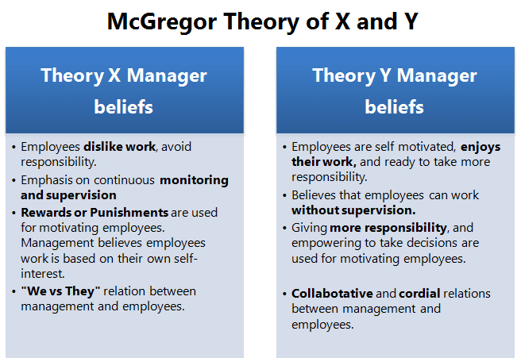
Management Assumptions About People
When leaders believe people can take part responsibly, they often invite input, trust choices, give freedom. Such mindset shifts how work gets done (McGregor, 1960).
Trust shapes Theory Y leadership, not rules or titles. Relationships built on honesty hold it together. Confidence between people matters most. Respect goes both ways, quietly steering decisions.
At Theory Z, people think that when workers trust their employer, they tend to stay committed and work better over time (Ouchi, 1981).

Slide 9
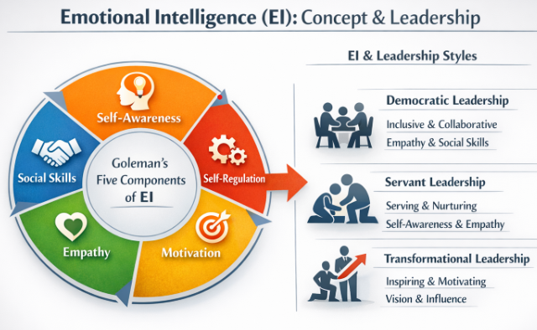
Emotional Intelligence (EI): Concept and Model
The ability to identify our own emotions as well as those of others, to inspire ourselves, and to effectively manage emotions in both our personal and interpersonal relationships is known as emotional intelligence. (Goleman, 1998).

Slide 10
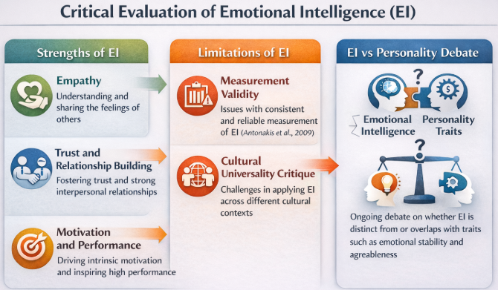
Critical Evaluation of EI
To improve leadership effectiveness, emotional intelligence (EI) emphasises the significance of empathy, trust, and intrinsic motivation (Goleman, 1995). Critics contest its conceptual uniqueness from well-established personality traits, cultural universality, and measurement validity (Antonakis et al., 2009).

Slide 11
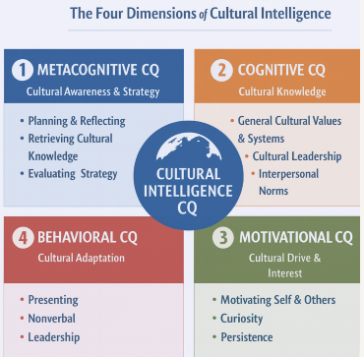
Cultural Intelligence (CQ): Concept and Model
According to Earley and Ang (2003), cultural intelligence (CQ) is a multifaceted skill that helps people work well in culturally heterogeneous environments. Its four dimensions—behavioural, motivational, cognitive, and metacognitive—offer a thorough framework for recognising cross-cultural effectiveness. CQ differs from emotional intelligence in that it emphasises cultural flexibility and the capacity to communicate with people around the world.
CQ is becoming more acknowledged as a crucial skill for international participation, teamwork, and leadership in today's globalised society.

Slide 12
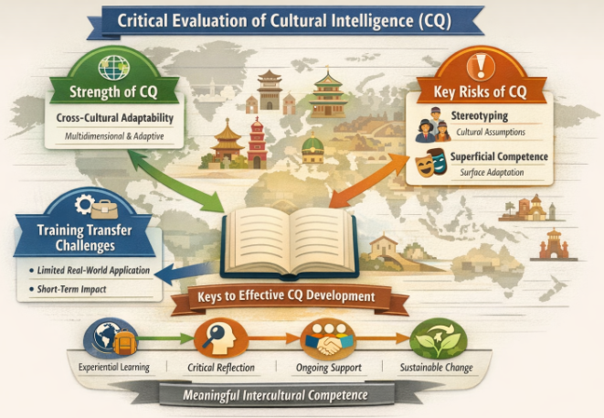
Critical Evaluation of CQ

Slide 13
Integrating EI, CQ and Leadership Styles
Emotional Intelligence (EI) → Servant / Democratic Leadership
EI leads to empathy, self-regulation, trust
Positively correlated with transformational leadership effectiveness (Barling, Slater and Kelloway, 2000)
Enhances organizational performance, follower outcomes (Wang et al., 2011)
Aligns with participative, servant, and democratic (Hoch et al., 2018)
Cultural Intelligence (CQ) → Participative / Transformational Leadership
Enables leaders to lead in various cultural settings (Ang et al., 2007)
Predicts cross-national leadership success beyond IQ & EI (Rockstuhl et al., 2011)
Enhances inclusive, future-focused leadership in multicultural teams
Limitations of Autocratic Leadership
Decisions made by leader only; little input from team
Associated with negative relational outcomes and burnout (De Hoogh and Den Hartog, 2009)
Poor fit for diverse, complex, knowledge-intensive teams

Slide 14
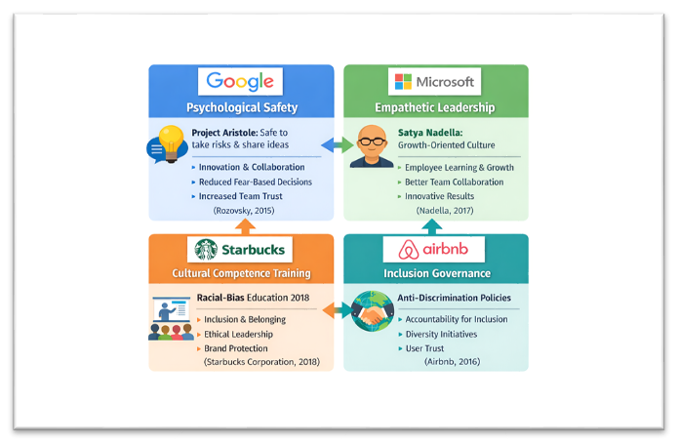
Business Examples

Slide 15
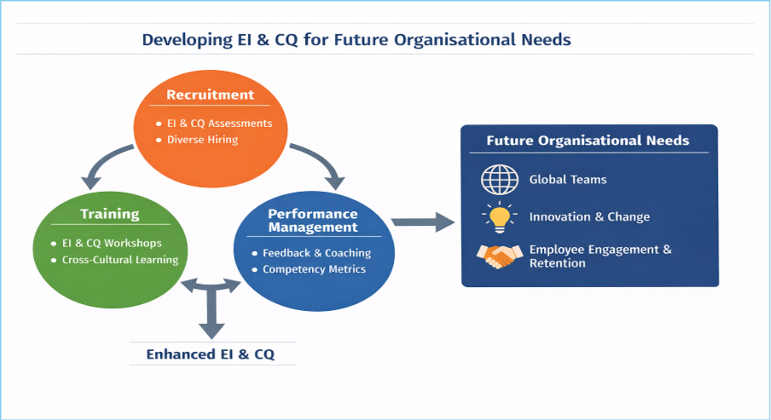
Strategy Design and Implementation
Organisations can improve workforce effectiveness and future-proof themselves by integrating Emotional Intelligence (EI) into employee recruitment, training, and performance management (Goleman, 1998).

Slide 16
Conclusion
Leadership is not confined to a manager’s role, as leaders inspire people emotionally and culturally. Emotional and Cultural Intelligence enable leaders to build trust, understanding, and promote cross-cultural collaboration in diverse organisations. They are not a one-size-fits-all solution but require strategic application, organisational relevance, and an ethical framework. Through considering Edith Heard’s vision, we can see that a humanistic, collaborative framework, based on empathy and cultural intelligence, creates a strong foundation for fostering sustainable organisational performance.

Slide 17
References
Airbnb (2016) Airbnb Community Commitment & Anti-Discrimination Policy. Available at: https://www.airbnb.com/help/article/1150/community-commitment (Accessed: 10 February 2026).
Ang, S., Van Dyne, L., Koh, C., Ng, K.Y., Templer, K.J., Tay, C. and Chandrasekar, N.A. (2007) ‘Cultural intelligence: Its measurement and effects on cultural judgment and decision making, cultural adaptation and task performance’, Management and Organization Review, 3(3), pp. 335–371.
Antonakis, J., Ashkanasy, N.M. and Dasborough, M.T. (2009) ‘Does leadership need emotional intelligence?’, The Leadership Quarterly, 20(2), pp. 247–261.
Barling, J., Slater, F. and Kelloway, E.K. (2000) ‘Transformational leadership and emotional intelligence: An exploratory study’, Leadership & Organization Development Journal, 21(3), pp. 157–161.
De Hoogh, A.H.B. and Den Hartog, D.N. (2009) ‘Neuroticism and locus of control as moderators of the relationships of charismatic and autocratic leadership with burnout’, The Leadership Quarterly, 20(4), pp. 605–619.
Earley, P.C. and Ang, S. (2003) Cultural intelligence: Individual interactions across cultures. Stanford, CA: Stanford University Press.
Fayol, H. (1949) General and industrial management. Translated by C. Storrs. London: Pitman.
Goleman, D. (1995) Emotional intelligence: Why it can matter more than IQ. New York: Bantam Books.
Goleman, D. (1998) Working with emotional intelligence. London: Bloomsbury.
Heard, E. (2022) ‘I apply the same leadership principles to every part of my life…’, Financial Times, 27 February.
Hersey, P. and Blanchard, K. (1988) Management of organizational behaviour: Utilizing human resources. 5th edn. New Jersey: Prentice Hall.
Hoch, J.E., Bommer, W.H., Dulebohn, J.H. and Wu, D. (2018) ‘Do ethical, authentic, and servant leadership explain variance above and beyond transformational leadership? A meta-analysis’, Journal of Management, 44(2), pp. 501–529.
Huczynski, A. and Buchanan, D. (2007) Organizational behaviour. 6th edn. Harlow: Prentice Hall.
McGregor, D. (1960) The human side of enterprise. New York: McGraw-Hill.
Mullins, L.J. (2016) Management and organisational behaviour. 11th edn. Harlow: Pearson Education.
Nadella, S. (2017) Hit refresh. New York: Harper Business.
Ouchi, W.G. (1981) Theory Z: How American business can meet the Japanese challenge. Reading, MA: Addison-Wesley.
Rockstuhl, T., Seiler, S., Ang, S., Van Dyne, L. and Annen, H. (2011) ‘Beyond general intelligence (IQ) and emotional intelligence (EQ): The role of cultural intelligence (CQ) on cross-border leadership effectiveness in a globalized world’, Journal of Applied Psychology, 96(4), pp. 825–840.
Rozovsky, J. (2015) ‘The five keys to a successful Google team’, re:Work. Available at: https://rework.withgoogle.com/blog/five-keys-to-a-successful-google-team/ (Accessed: 10 February 2026).
Starbucks Corporation (2018) Racial Bias Education Announcement. Available at: https://stories.starbucks.com/stories/2018/racial-bias-education/ (Accessed: 10 February 2026).
Tannenbaum, R. and Schmidt, W. (1958) ‘How to choose a leadership pattern’, Harvard Business Review, 36(2), pp. 95–102.
Wang, G., Oh, I.S., Courtright, S.H. and Colbert, A.E. (2011) ‘Transformational leadership and performance across criteria and levels: A meta-analytic review of 25 years of research’, Journal of Applied Psychology, 96(5), pp. 1134–1154.

Slide 18

Thank You!

