Slide 1
Writing for publication
Challenges, solutions and the peer review process

Slide 2

Today we will
Focus on writing for publication
Explore the peer review process
Introduce the Research Development framework
Discuss presenting at doctoral level

Slide 3

Why Publish?
It is increasingly expected that doctoral students will have published aspects of their work by the time they finish.
‘Published’ here generally means publishing an article in a peer-reviewed academic journal.
However, if the reason for publishing is to share knowledge, we need to think whether this is always the best option.
Other reasons might be:
  Dissemination of research findings
  Stimulate debate
  Expectation of peers and employers
  Prestige
  Credibility
  Financial incentives

Slide 4

Writing for publication
Level of scholarly rigour when writing must be higher.
Expected to support statements with references.
Contextualise what is known about the subject and any gaps in the evidence.
How your article/opinion piece/conceptual paper add to the body of knowledge.

Slide 5


Slide 6
Where to publish?
Where you choose to publish depends on what you want to say and how.
Some research findings are best written as a journal article, where you can elaborate a detailed, theoretically-grounded argument.
However, if the main audience for these findings ought to be the professionals they might most affect or benefit, then other media and forms of writing might be more appropriate.
  Professional publications (trade journals, magazines, and newspapers) here
  Online: established blogs such as the British Educational Research Association (BERA) here or WONKHE (higher education blog) here; personal blogs (you could start one).
  Mainstream media: The Financial Times, The Economist, etc.
  Facebook
  Twitter
These are just examples. There are many more. If these seem out of reach at this stage, do not worry. They are there to help you think more generally about what publishing might look like.

Slide 7
How?
One of the key aspects of something being worth publishing (from an editorial perspective) is also one of the key criteria of a good standard of doctoral work: it makes an original contribution to knowledge.
You are doing the groundwork for this now:
  a thorough literature review
  a robust research design
Doing these well will mean that you have:
  identified a gap (or gaps) in our existing knowledge
  devised a way to research these
So, focus on these, and see your work as contributing to the field you are researching rather than just being about it.

Slide 8
Where to start?
You may already be working in academia and feel confident about writing articles for peer-reviewed international journals.
Here is a list of business conferences in 2021 with open call for papers.
If not, there are other places to start:
  Offer to write a book review for a journal or professional publication
  Submit a draft paper to an early career/doctoral student part of a conference
  Submit a draft paper to a work in progress session at a conference
  Submit a poster at a conference
  Offer to present at a departmental seminar

Slide 9

Writing for a journal
Decide which is most appropriate for your work (style and approach as well as substantive topic).
Write for that particular journal: this does not mean changing your argument to fit what they might want to hear but acknowledging how that topic has been discussed in that journal previously and following its style guidelines.
Be realistic about the peer-review process: it can take time; practices are changing but some feedback may not be as constructive as it could be; rejection is not uncommon.
This is why sending your work to the right place, and getting experience of writing (e.g., book reviews) and peer review (e.g., submitting to conferences) might help.
Yet you are not alone in this. Your tutors have experience of this process and are there to support you.
Also: Is ‘open access’ important to you? Open access is an increasing priority - i.e., research not sitting behind paywalls - but the most established journals currently charge high fees to publish in open access (this is changing but something to be aware of); some journals do not charge, so check in advance.

Slide 10
What are The challenges of writing for academic journals?
Correct use of grammar and appropriate syntax.
Use of citations for support and validation of own ideas.
Making reference to the published literature.
Structuring and organisation of argument.
Textual organisation and appropriate disciplinarity.
Relating text to audience.
Making appropriate and justified knowledge claims.
Using hedging language to indicate caution expected by the academic community.
Be aware of different cultural views regarding the nature of academic processes.
Azizah & Budiman (2017)

Slide 11
What is peer review?
Single-blind review
Double-blind review
Open review
Post-publication open review

Slide 12
Writing a peer review report
Step 1. Research the journal
Step 2. Write your report
Step 4. Make a recommendation
Step 3. Provide detailed comments

Slide 13
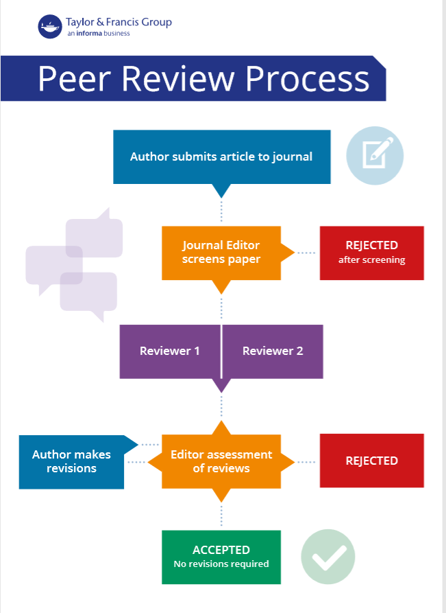
The peer review process

Slide 14
Shortcomings of peer reviewing
Possible bias (peer reviews).
Peer-review bias (peer reviews).
Too many sources to review (review for own research).
Inconsistency among reviewers (peer reviews).
Low confidence (only 32% trust current peer review system).
Slow and expensive nature of the process (peer review).
Questionable predictive validity of judgements of significance.

Slide 15
What are the potential outcomes of a peer review?
Accept
Minor revisions
Major revisions
Reject
Celebrate!
Typographical errors
Incomplete list of references
Requires a reworking in terms of structure
Inclusion of additional materials
Not relevant
Plagiarised
Not responded to referee/s comments (if asked to revise)

Slide 16
How to avoid rejection?
Consider your audience
01
Revise and make clear your message
02
Set the context/scene /scope
03
Research the editorial team
04
Read the guidelines carefully
05
Read published papers (disciplinarity, style)
06
Consults with experienced colleagues
07
Approach local scholars’ network

Slide 17
How to present something new?
A new and current review of the literature on your topic, or a new analysis of the context you are working in and the particular pressures, challenges and opportunities that this presents.
Revisiting a familiar area of academic work but with a fresh approach, perhaps taking a different philosophical viewpoint or methodological stance that merits more examination.
Applying a particular concept or set of ideas to practice in a novel way or in an unfamiliar context or industry.
Exploring a new dilemma only brought to light because of, for example, social or technological change.
Presenting a novel set of methods for gathering and analysing data.
Recommending particular management or industry strategies on the basis of your work.
Anderson et al. (2017)

Slide 18
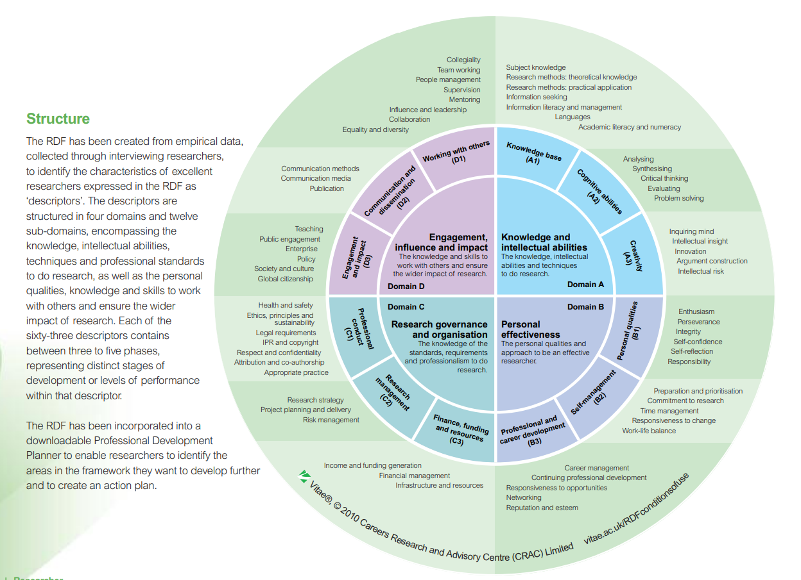
the Vitae Researcher Development Framework

Slide 19
Presenting successfully at postgraduate level
Always consider your Module Learning Outcomes and Task Description carefully.
Check the specific Assessment Requirements.
Check your Marking Criteria for assessment.
Your presentation should demonstrate critical thinking and original insights, demonstrating an understanding of the module concepts.
The presentation should be supported by credible sources in addition to reading material supplied on the module and the referencing integrated within the presentation.
Your presentation should be accompanied by the presentation material (most often PowerPoint) and a written commentary detailing the recommendations. This should contain a bibliography of resources used to compose your analysis.

Slide 20

Good PPT
Background
Organisation
Text
Pictures and graphics
Balance

Slide 21

Background
Photographs used as backgrounds lose resolution.
Dark backgrounds are easier on the eye.
Colour backgrounds can attract the viewer.
Use background/foreground contrasts (think how you use colour combinations).

Slide 22
organisation
Introduce
Compare
Conclude
Bibliography

Slide 23
Text
Establish a hierarchy of importance using the font size:
  Title: the biggest size
  Subheadings: smaller than the title
  Body text: the smallest
AVOID USING ALL CAPS (has the effect of shouting)
Use note form and bullet points; do not use full sentences and paragraphs.
Use left justification (easier to read).
Use standard academic fonts
  Times New Roman
  Arial
Be consistent in font type and size
Use bold, italics, or underline to emphasise words.
Do not use all three. Overkill!
Do not change fonts to emphasise a word.
Check your spelling and proofread for typing errors.

Slide 24


Pictures and graphics
JPEG formats is easiest to use.
Use light backgrounds with dark photos and vice versa.
Neutral/gray backgrounds enhance colour photos while white backgrounds reduce their impact.
Fluorescent lighting can change the colour.
Try to make all graphics and figures the same size for consistency.

Slide 25
Specifics
Your presentation must be uploaded to Turnitin in the form of a transcript along with your Powerpoint (PPT) or other chosen media format.
Due to the pandemic, the plan will be to present via Teams.
The presentation must be logical, accurate, coherent, fluent and presented well.
Please use either Times New Roman or Arial font 12 with at least 2.5 cm space at each edge, double spaced and page numbers entered.
The document should have a clear title page with course and name or ID number, numbered and titled blogs, references and if appropriate, appendices.

Slide 26

Academic writing support feedback
What went well?
What didn’t go so well?
Hopes, fears, expectations?

