Slide 1
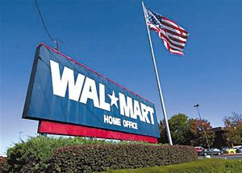
Wal-Mart’s
attempt to enter Germany
International Business Communications Failure
Presented by Man Luo
Tutor: Antje Cockrill
Dec.6 2017

Slide 2

July 2,1962
Sam Walton opened the first Wal-Mart store in Rogers, Ark.
mid-1990’s
Timeline of Wal-Mart’s
failure in Germany
(Corporate.walmart.com, 2017;
GERHARD, HAHN, 2005)
Wal-Mart had grown to be the largest retailer in the U.S..
1997
Wal-Mart entered the German market through purchase of 21 existing Wertkauf stores.
1998
Wal-Mart purchased 74
Interspar hypermarkets.
2006
Wal-Mart sold its assets to its German competitor Metro and left the market.

Slide 3
The Six Dimensions of National Culture
(Hofstede Insights, 2017)
Germany & the U.S.

Slide 4

PART ONE
Mismanagement
PART TWO
Competition
PART THREE
Laws &Regulations
PART FOUR
Customers’ Demands
Mismanagement
Wal-Mart managed German employees in the American way.
(Shurrab, 2014; Marcilla, 2014; Geisler, 2012)
The man in charge, David Wild, was not German
Mistreatment of colleagues
The autocratic governing style in decision making
Power distance stands for
“ the extent to which the less powerful members of institutions and
organizations within a country expect and accept that power is
distributed unequally. ”
(Hofstede and Minkov, 2010, p. 61)
35
40
POWER DISTANCE

Slide 5
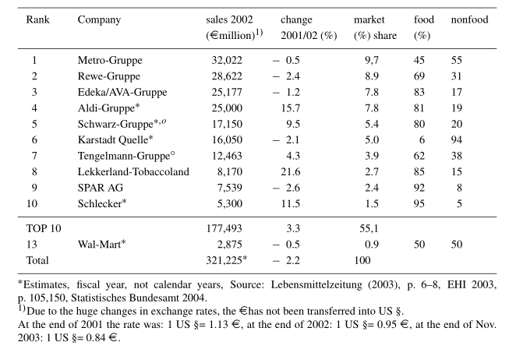
PART ONE
Mismanagement
PART TWO
Competition
PART THREE
Laws &Regulations
PART FOUR
Customers’ Demands
Competition
Wal-Mart did not consider the strong competition between retailers
in Germany.
The German retail market was dominated by a few major players:
Aldi, Metro, Rewe, Tengelmann, Schwarz and so on.
(Marketline, 2016; GERHARD and HAHN, 2005; Geisler, 2012)
“ A society is called masculine when emotional gender roles are
clear distinct: men are supposed to be assertive, tough, and
focused on material success, whereas women are supposed to
be more modest, tender, and concerned with the quality of life. ”
（Hofstede and Minkov,2010,p.140）
66
62
MASCULINITY

Slide 6
PART ONE
Mismanagement
PART TWO
Competition
PART THREE
Laws &Regulations
PART FOUR
Customers’ Demands
Laws & Regulations
As Hall and Hall discussed(1989), Germany is a typical low context
society. The Germans tend to follow rules and standards.
Wal-Mart was shocked by several regulations after entering the
German market. (Shurrab, 2014; Marcilla, 2014; Geisler, 2012)
Limits over store hours
Land-use regulations & stringent zoning requirements
Price regulations
The relationship with trade unions
Uncertainty avoidance is
“ the extent to which the members of a culture feel threatened
by ambiguous or unknown situations. ”
（Hofstede and Minkov,2010,p.191）
65
46
UNCERTAINTY
AVOIDANCE

Slide 7
PART ONE
Mismanagement
PART TWO
Competition
PART THREE
Laws &Regulations
PART FOUR
Consumer Needs
Consumer Needs
Wal-Mart considered Germany as a similar western society to the U.S.,
and overlooked many areas of consumer research. (Marcilla, 2014; Geisler, 2012)
Environmental protection —“Bag-it-yourself” strategy
German shopping habits on price
Long term orientation stands for
“ the fostering of virtues oriented toward future rewards
—in particular, perseverance and thrift. ”
（Hofstede and Minkov,2010,p.239）
83
26
LONG TERM ORIENTATION

Slide 8
PART ONE
Mismanagement
PART TWO
Competition
PART THREE
Laws &Regulations
PART FOUR
Consumer Needs
Consumer Needs
Wal-Mart lacked understanding of consumer needs in Germany.
(Conaty, 2016; Geisler, 2012; CHRISTOPHERSON, 2007)
People in low context cultures such as Germany tend to be assertive and
use explicit communication as Hall and Hall discussed(1989).
Wal-Mart’s greetings and smiling cashiers
Unsuitable products in America style
Indulgence stands for
“ a tendency to allow relatively free gratification of basic and
natural human desires related to enjoying life and having fun. ”（Hofstede and Minkov,2010,p.281）
40
68
INDULGENCE

Slide 9
Conclusion
Based on six dimensions of national culture theory(Hofstede, 2010) and high/low context communication theory(Hall, 1989), distinctions between German culture and American culture can be shown.
Mismanagement, the competitive retail market, limits of law and regulations, ignorance of consumer needs were all causes of Wal-Mart’s failure in Germany.
Therefore, to achieve successful international expansion, the market analysis of the target country is crucial. Based on the market analysis, making reasonable and feasible managements is also essential.
However, Wal-Mart has been able to take the mistakes they made in Germany and has successfully expanded in 28 countries so far. (Corporate.walmart.com, 2017)

Slide 10
REFERENCES
CHRISTOPHERSON, S., 2007. Barriers to 'US style' lean retailing: the case of Wal-Mart's failure in Germany. Journal of Economic Geography, 7(4), pp. 451-469.
Conaty, P., 2016. International Expansion in the Retail Industry: A Multi-Case Study on Strategic Expansionary Variables.
Corporate.walmart.com., 2017. Our History. [online] Available at: https://corporate.walmart.com/our-story/our-history [Accessed 25 Nov. 2017].
Corporate.walmart.com. (2017). Our Story. [online] Available at: https://corporate.walmart.com/our-story [Accessed 1 Dec. 2017].
GERHARD, U. and HAHN, B., 2005. Wal-Mart and Aldi: Two Retail Giants in Germany. GeoJournal, 62(1-2), pp. 15-26.
Geisler, M., 2012. International Marketing and Walmart's Missed Opportunity.
Hofstede Insights., 2017. Country Comparison - Hofstede Insights. [online] Available at: https://www.hofstede-insights.com/country-comparison/germany,the-usa/ [Accessed 27 Nov. 2017].
Hall, E.T. & Hall, Mildred Reed, 1989. Understanding cultural differences : germans, french and americans, Yarmouth, Me.: Intercultural Press.
Hofstede, G.H., Minkov, G.J. & Minkov, Michael, 2010. Cultures and organizations software of the mind : intercultural cooperation and its importance for survival. Dawsonera. [online] Available at: https://www-dawsonera-com.ezproxy.uwtsd.ac.uk/readonline/9780071770156 [Accessed 27 Nov. 2017].
Marketline, 2016, Food & Grocery Retail in Germany, MarketLine Industry Profile, [online] Available at: http://advantage.marketline.com.ezproxy.uwtsd.ac.uk/Product?ptype=Industries&pid=MLIP2133-0017 [Accessed 28 Nov. 2017].
Marcilla, L. B., 2014. Business analysis for Wal-Mart, a grocery retail chain, and improvement proposals.
Shurrab, H., 2014. Wal-Mart’s German Misadventure.

