Slide 1
﻿LCMB7007
﻿Creativity, Innovation and Intellectual Property (CIIP)
Week 1
Topic: Creativity

Slide 2
Psychological contract for this module
RIGHTS
Effective and engaging
lectures
Supportive seminars
Submission of draft assignment (one occasion)
Formative feedback (one occasion)
RESPONSIBILITIES
Attendance
Punctuality
Silence & Phones off
No in & out except emergency
Full engagement
Full partcipatation

Slide 3
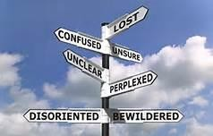
Creativity; Past, Present & Future…..
“How Can we Know Where We’re Going Without Knowing First Where We ‘ve Been?”

Slide 4
Creativity: What is it???……
“The ability to create and innovate has been observed throughout history and even though the fundamental tools may have changed the ability has been prevalent in every civilisation” (Hisrich, Peters and Shepherd, 2005, p. 8).
“May our species be resurrected and awakened by the Spirit of Creativity for this coming century” (Fox, 2002).

Slide 5
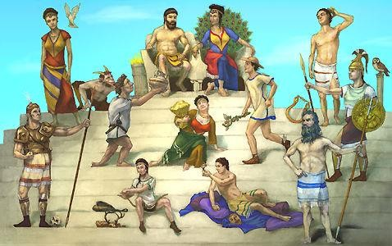
The Past…….
“Throughout history, the process of creation whether;
paintings or musical compositions were thought of as
‘spiritual experiences in the service of whatever muse held the artist in her thrall”
(Thorsby, 2001, p. 95).
“The artist was a channel for a superior power, creativity a gift from the gods, and the imagination a divine spark”
(Thorsby, 2001, p. 94).

Slide 6












A Gift from the Gods or a New Phenomenon?
Or…Could Both Be True????...... Maybe?
Natures Creation? | or | Human Creation
Venoms & Poisons | or | Anaesthetics
The Leaf | or | Solar Panel (energy from light)
Brain | or | Computer/Electronic Circuitry
DNA | or | Computer Program
Ear Drum | or | Microphone
Eye | or | Camera (lens, focus, iris, film)
Eye Lid | or | Windshield Wiper
Tears | or | Wiper Fluid
Incisor Teeth | or | Knife
Heart | or | Pump
Spinal Chord/Nervous system | or | Communication/Telephone Cables
Song Birds | or | Music

Slide 7
Creativity: Nature or Nurture?
If we want to be great musicians what do we need?
  A good “ear” – which may have some biological origin
  Talent – again, an innate trait.
  But also THEORY, STUDY, PRACTICE, PRACTICE, PRACTICE!
  If I am super-talented through natural chance, I may become a great pianist – but only if I study hard
  If I am not super-talented but I study hard, I may not be the greatest pianist in the world, but I can certainly become competent – and even make a living from it.

Slide 8
Creativity: Nature or Nurture (2)
If business creativity depends on nature, then only a few of us can
operate in that sphere.
Result – business grinds to a halt!
Luckily, we know, from experience and from research that we can learn techniques which support creativity.
So, we may not all be creative business gurus who come up with fabulous ideas while sitting in our armchairs
BUT
We can apply creative techniques and thinking processes which help us
develop new ideas and kee

Slide 9
Why is Creativity Important?
business sectors seek novelty
Consumer products
Media
Fashion
Travel
Even seemingly conventional sectors respond to novelty, e.g. medicine seeks new formulations of existing drugs.
Note that some novelty may be “better”, e.g. better medicine, some is
simply a response to the desire for something new, e.g. fashion.
So, a continual drive for novel developments suggests that creative thinking is key to success.

Slide 10
Creativity
“There is no doubt that creativity is the most important human resource of all. Without creativity there would be no progress, and we would be forever repeating the same patterns”
(Edward de Bono).

Slide 11
Who is Creative?
Are creative people born or made?
Think back to your first year management studies and discussions of what constitutes an entrepreneur, and whether these skills can be learned.
The literature suggests that creativity can be innate (you’re born with it), but can also be learned (you get better with practice).

Slide 12
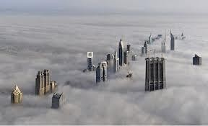
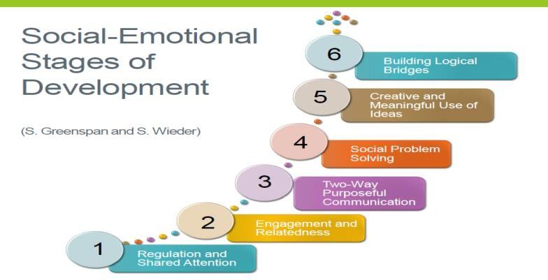
The Elite View
Two views of Creativity
V’s
The Developmental View

Slide 13
The Elitist View…
Getting New & Valuable Ideas
A Rare Talent
Creating Great Works of Art or Scientific Discoveries
Unable to be Taught
Not Relevant in My Job/ Organisation
A Lonely Individual Process

Slide 14
The Developmental View…
Available to Everyone
Evident in Personal & Modest Insights
Released Through Training & Development of Personal Potential
Within the Scope of All Jobs
Encouraged or Discouraged Within Groups According to their Climate
Escape from ‘Personal Stuckness’ & Reveals Itself in Results Which are Original & Potentially Valuable

Slide 15
Which View Do You Agree With?

Slide 16
The Reality…..
Creativity Is Not Exclusively for ‘Elite’ People
It Can be Developed in All Persons
Creativity is a Personal Problem-solving Process of a Non-routine Kind
It Can be Learned, Practiced & Successfully Applied by all – in Every
Walk of Life
Can we learn?
We can argue that although we might not be able to learn how
to turn ourselves into creative people, we can learn how to think
about business creatively.

