Slide 1
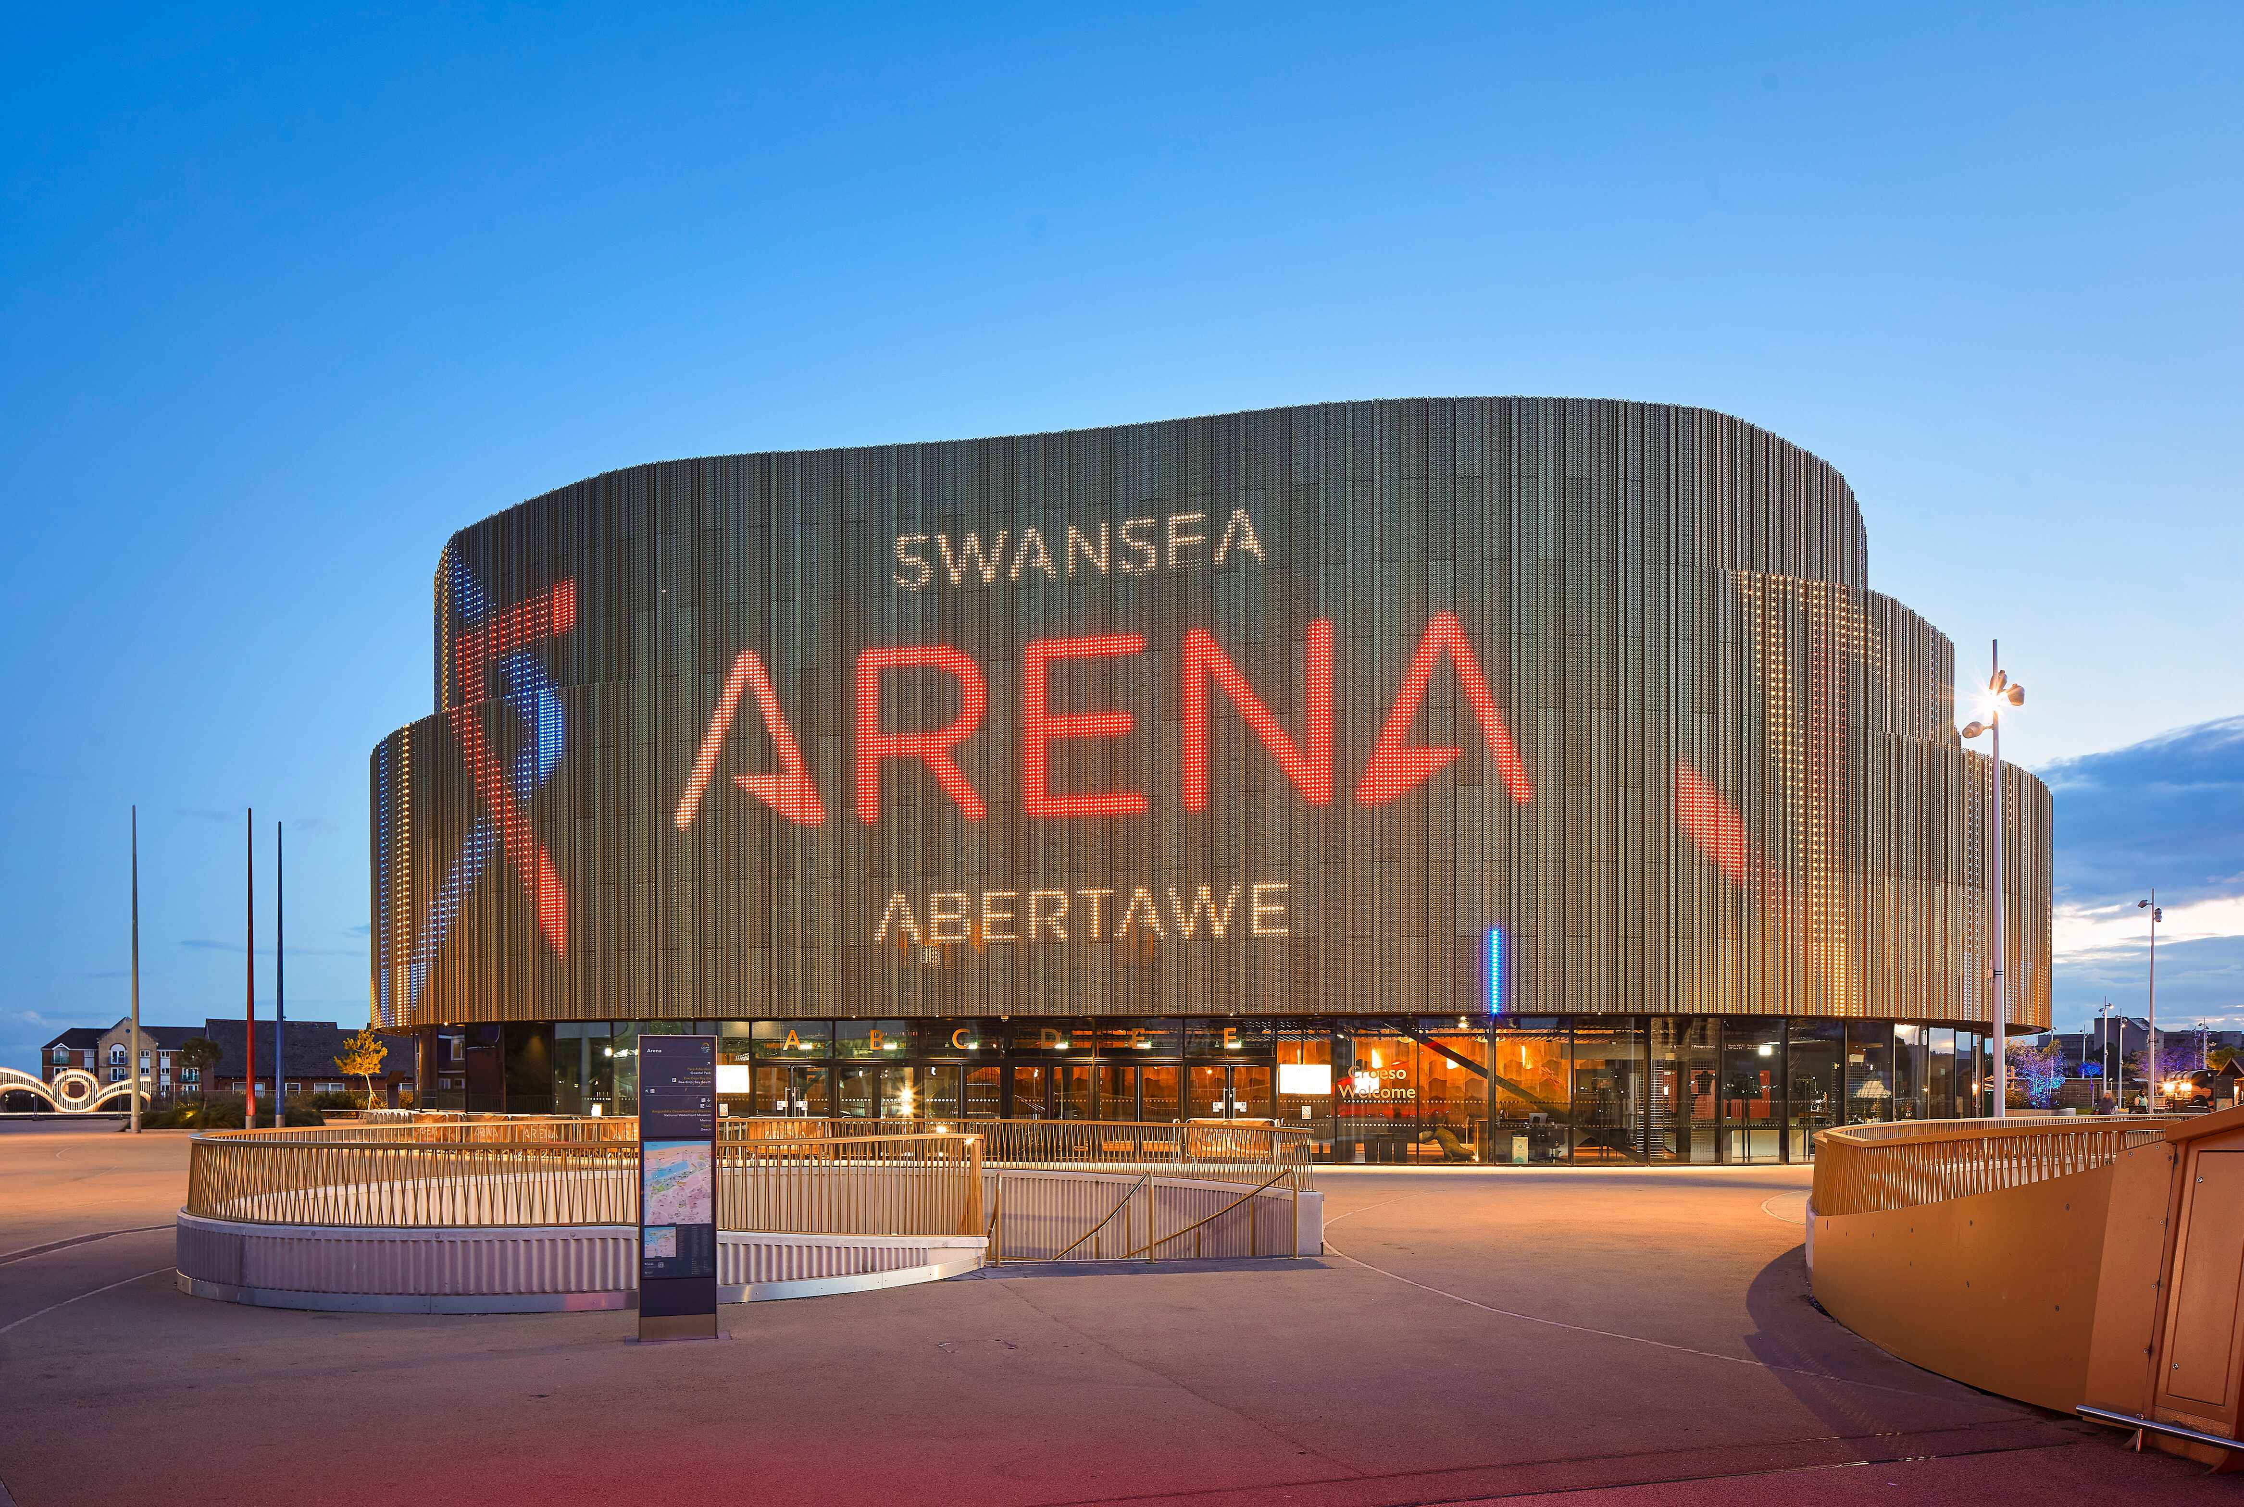
(Swansea Bay City Deal, 2022)
Notes:
Introduction – Hi , my name is Susie-May & I'm here today to share the outcomes of my research project

Slide 2

Sustainable Travel Choices to Swansea Arena Events
Susie-May James
2404489
BMTP5022
Research Methods & Field Study Experience
Lisa Bassler
10 Minute Video Presentation
(Andrew, 2017)

Slide 3
Research Project Recap
My chosen research method – Survey / Questionnaire
Chosen venue – Swansea Arena!
Aim of project – Explore attendees transport behaviours to Arena events, as well as their views on sustainable transport
Notes:
Okay so before I delve into presenting the outcomes of my research, I think its important that I give a little background recap on what I've chosen to do my research on!
The research method I chose was a 5 minute survey for the public to complete via a QR code that they could access & scan on their phones to complete! I decided to conduct my research on suposedly one of Swansea's biggest attraction & venues – Swansea Arena! Now as you watch the following video I will go into further depth about this incredible venue & its significance within the tourism & events industry!

Slide 4
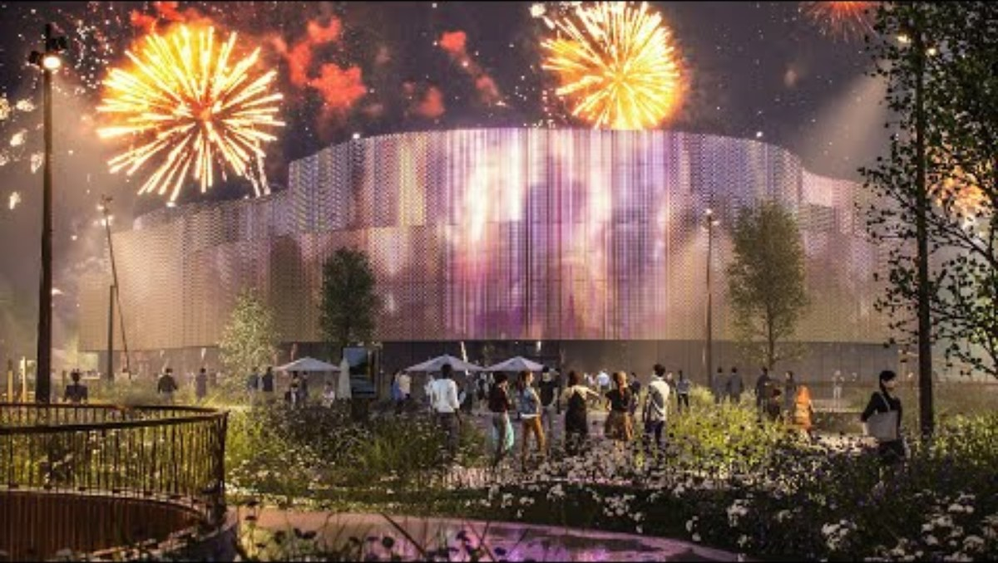
(Swansea Arena, 2021)
Notes:
Now, you might wonder what exactly Swansea Arena is?? Well, being located in the heart of Swansea - it is a multipurpose indoor arena that has a capacity of 3,500 people! It hosts over 200 events a year from live music, musical theatre performances, comedy shows, business conferences and so much more (Swansea Building Society , 2025)! Since its opening in 2022, it has made a record breaking total of just under 1 million visits (Swansea Council, 2022)! In the recent year of 2025 alone, it had over 245,000 people come to attend their wide variety of events! As you can see, this venue attracts soo many attendees from across the region to be apart of these events, therefore sustainable transport plays a huge role in venues like Swansea Arena. (Kosareva, 2025) In fact, a Forbes article stresses the importance & role of sustainability transportation in event attractions & venues.
We will now move onto some examples of the survey questions & the public's view on these & the status of sustainability transport in Swansea!

Slide 5
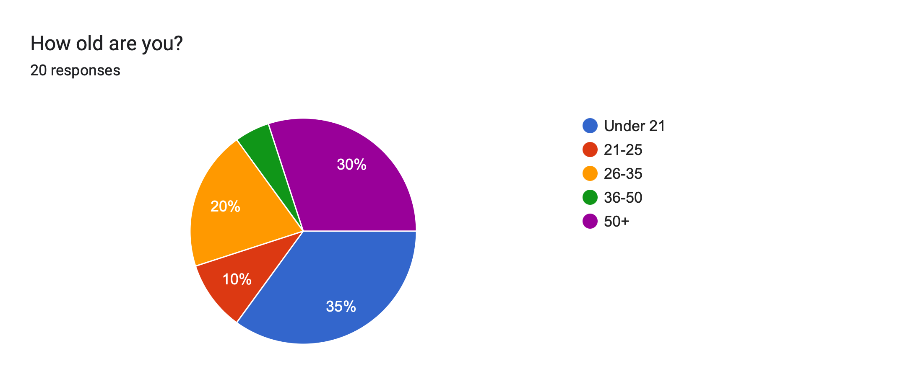
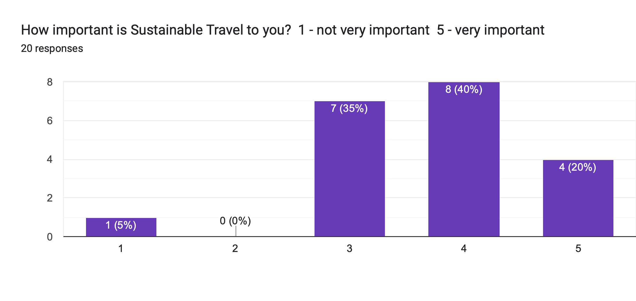

Slide 6
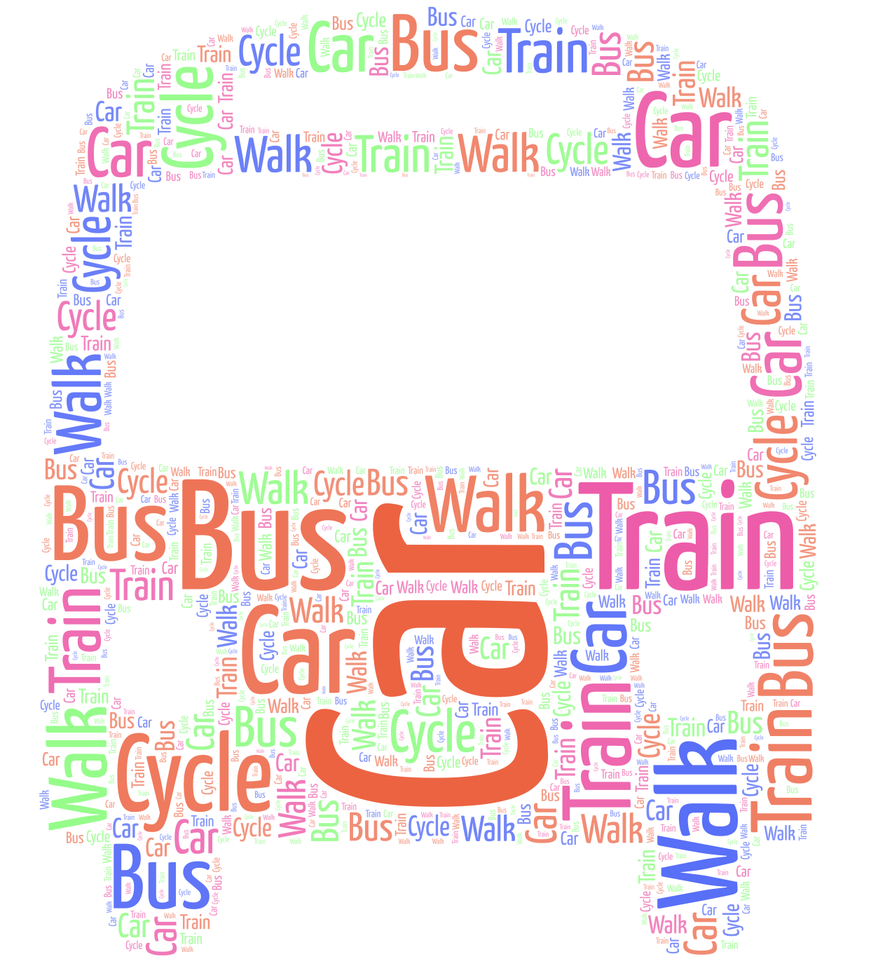
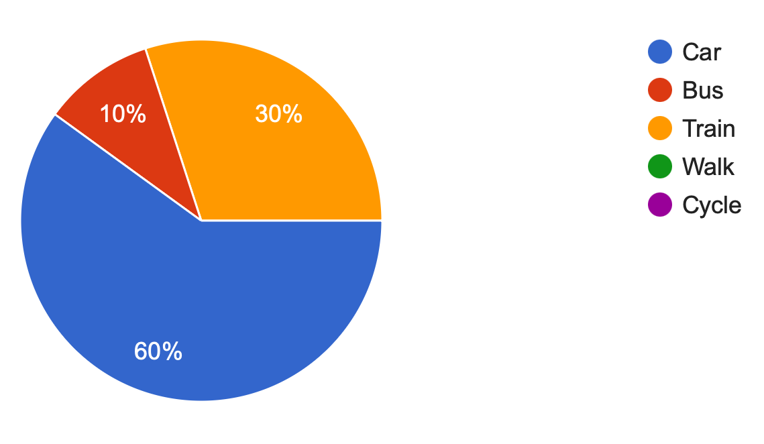
"How did you travel to Swansea Arena today?"
(WordArt, 2019)

Slide 7
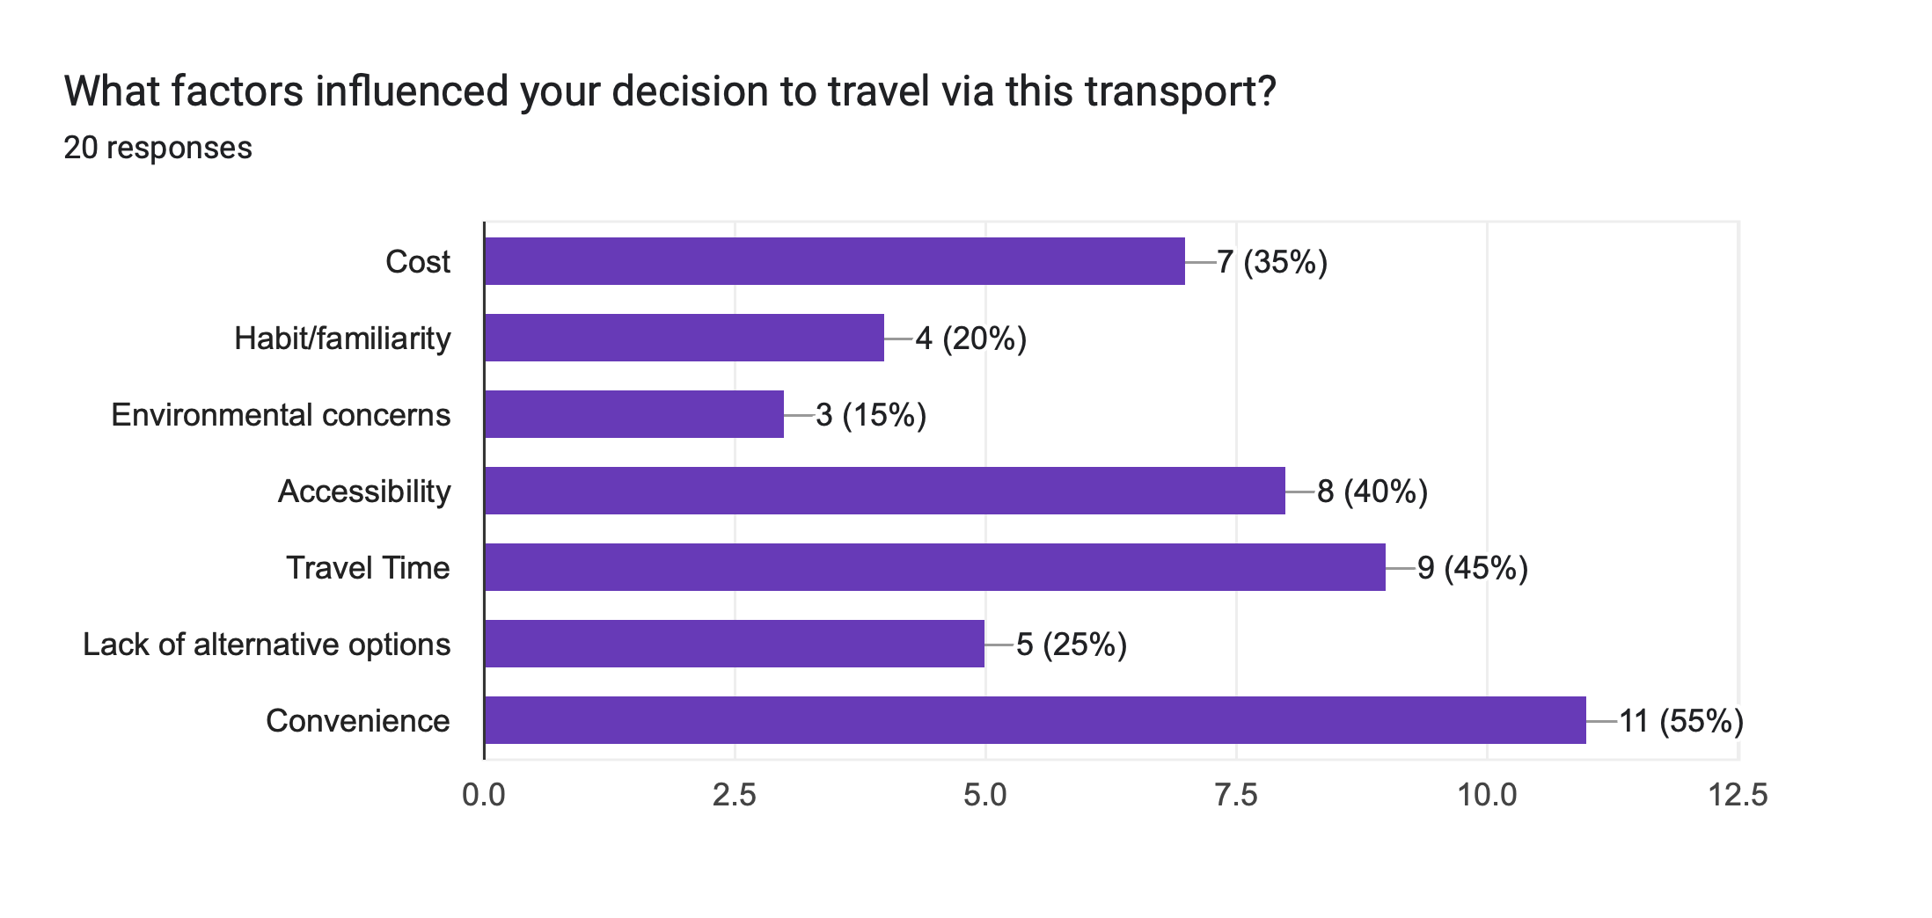
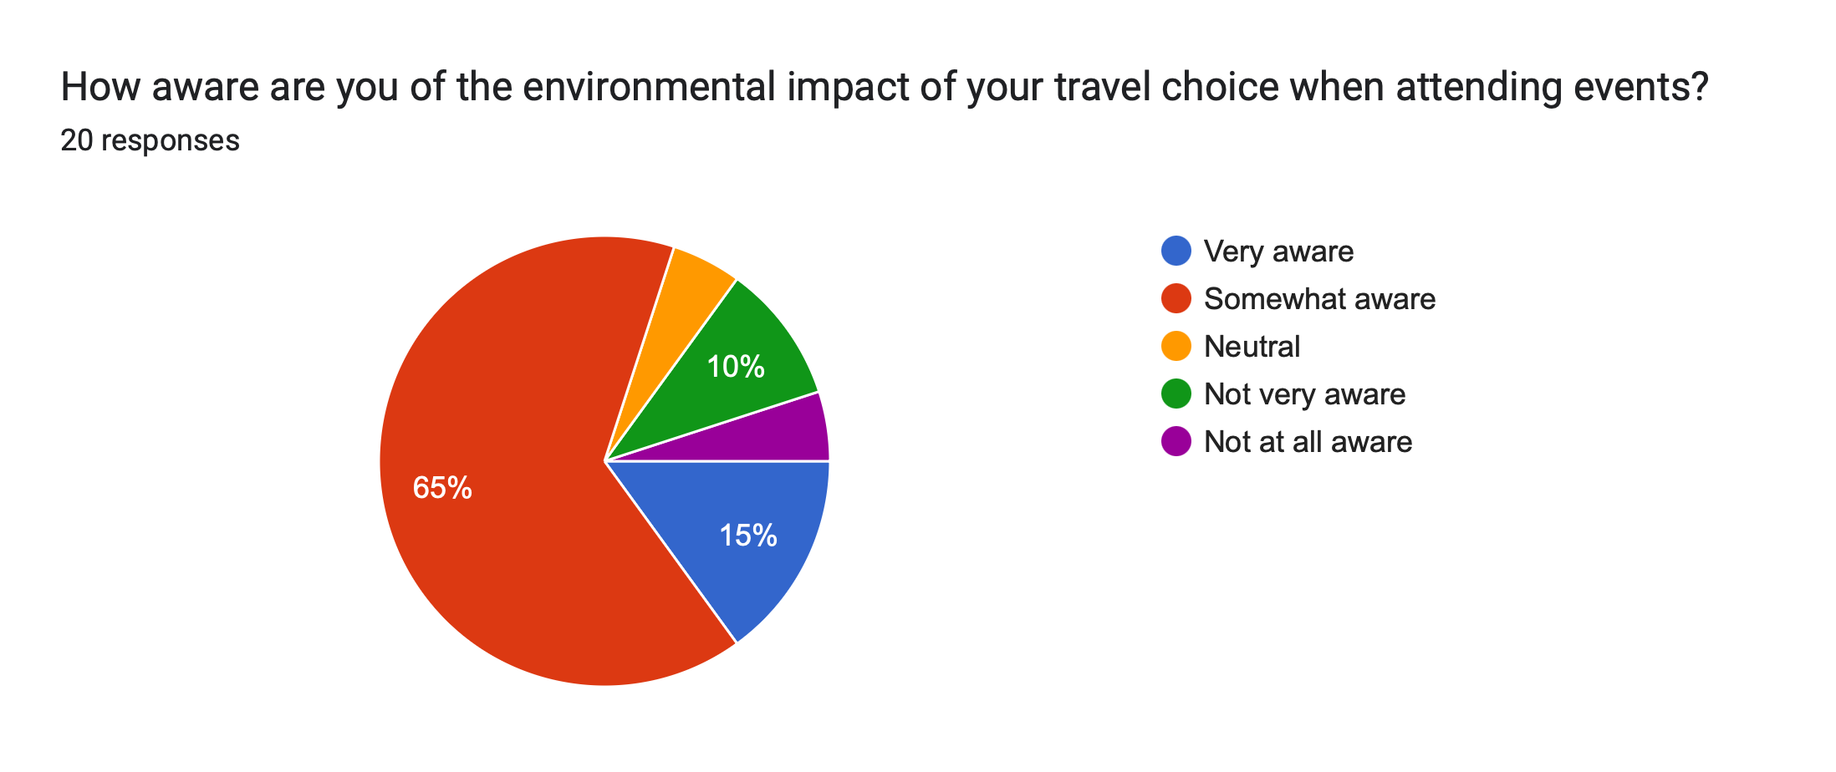

Slide 8
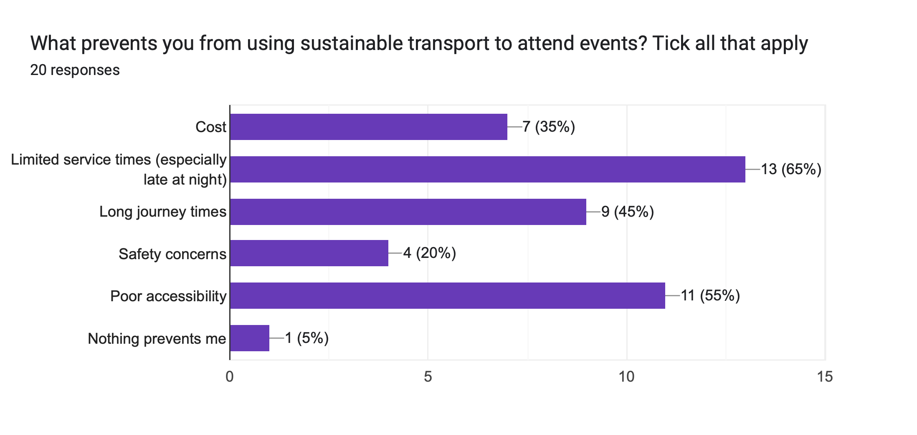
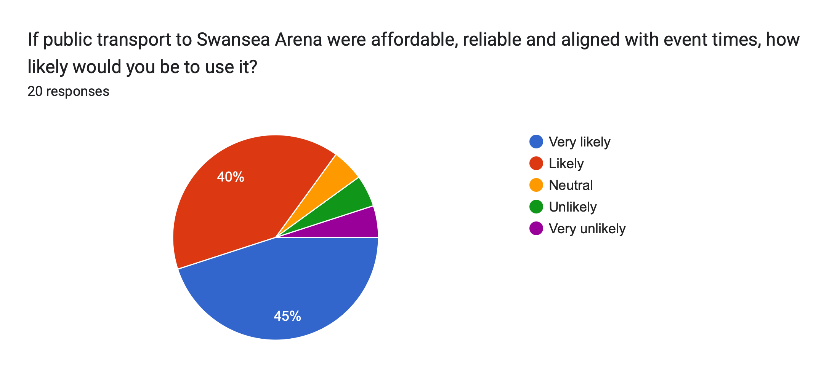

Slide 9
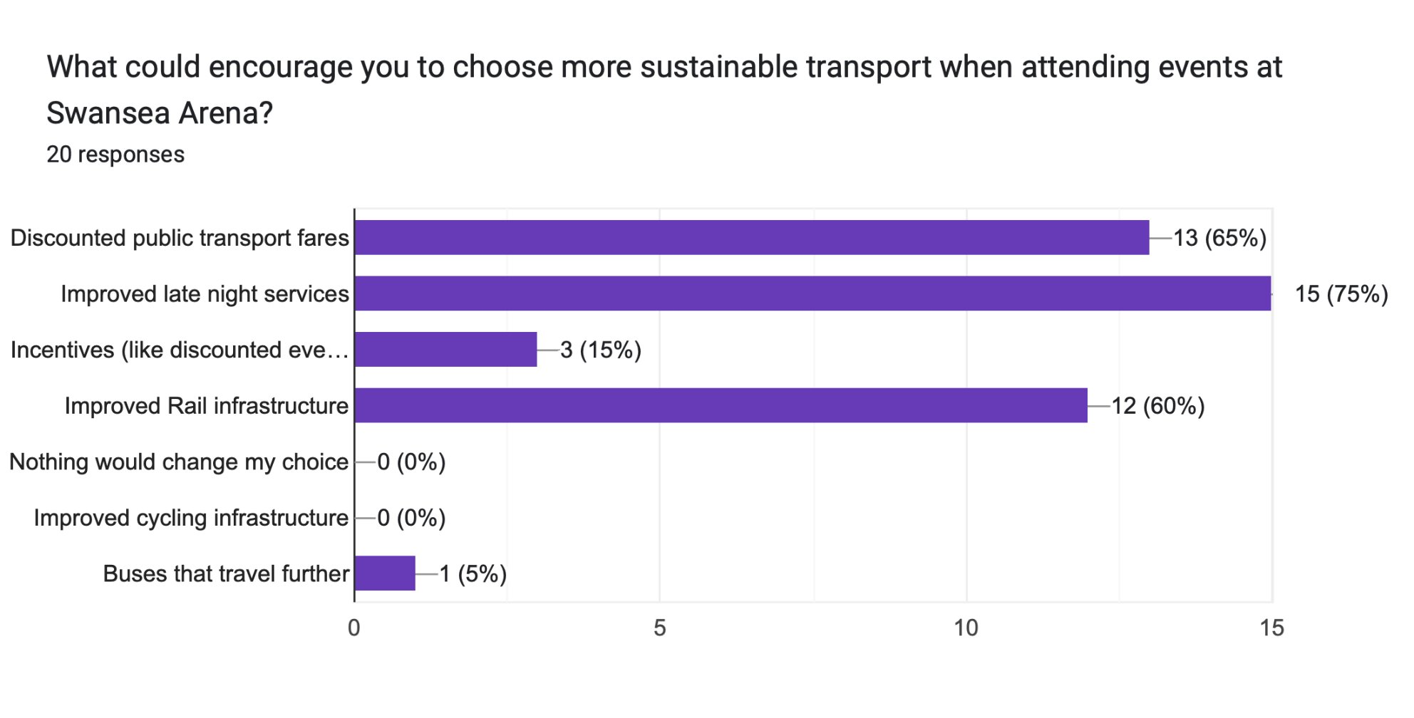
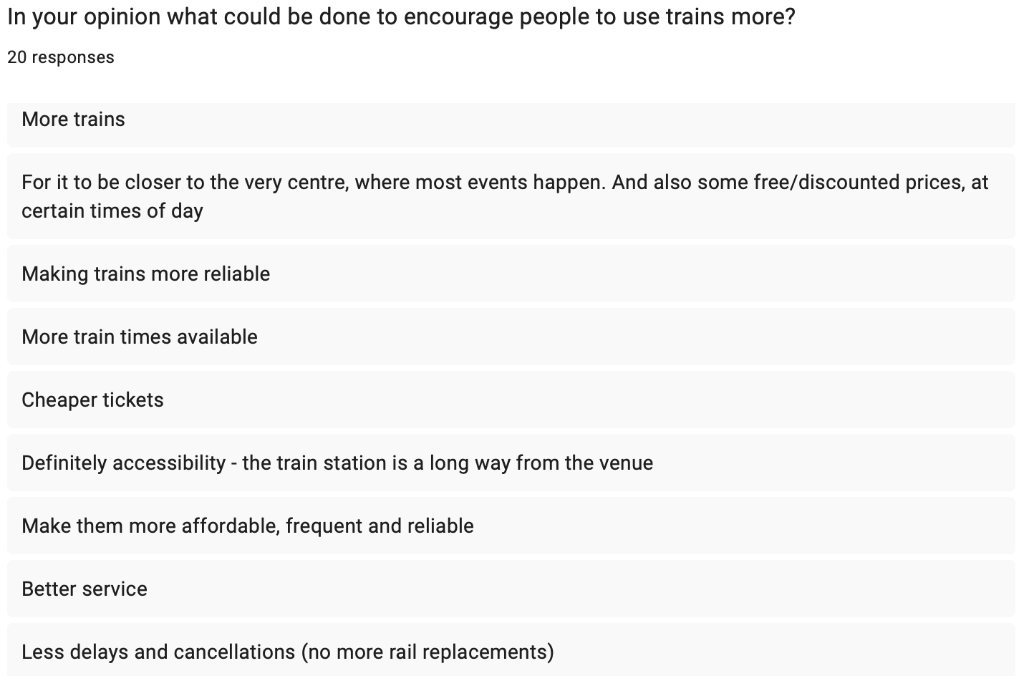
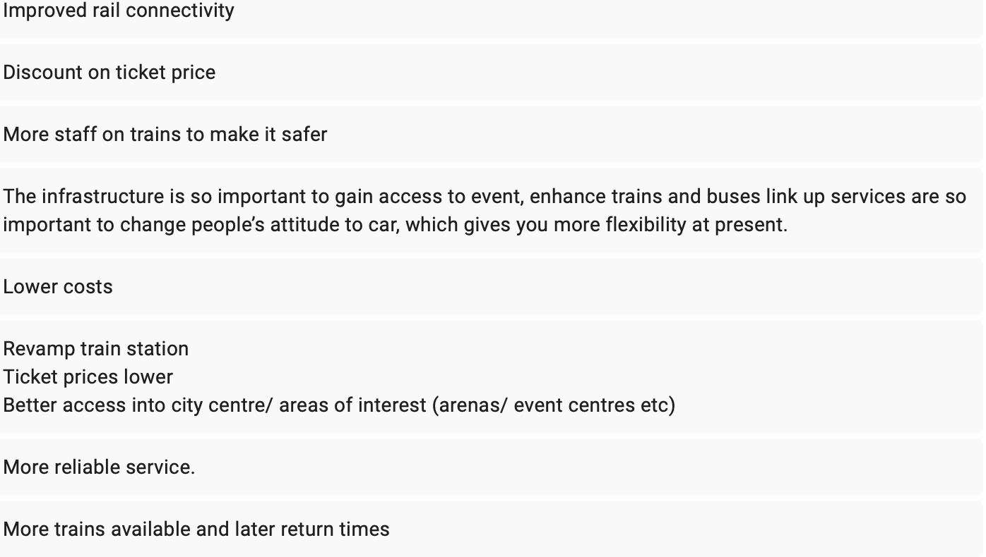

Slide 10
Reflections and Limitations
Chosen Method ----> Survey​
​
Target responses 25 people​
​
Final result – 20 respondents​
​
Critical evaluation of the following:
Strengths & weaknesses of research approach & findings
Personal reflections
Confidence
Academic reflections
New knowledge & insights into how to conduct a research project
Notes:
For more confirmed & reliable responses & results
I chose to use surveys as my primary research method, in which I thought was the most suitable for my project. Having conducted this research I can reflect & say that although it was successful in gaining the research that I needed, I did not reach my target response figures. Therefore to rectify this problem, I could have used incentives for people to complete the QR code form as this definitely would have got more engagement! In a similar way, I perhaps could have expanded my research types & conducted interviews with people to further support my results & responses!
While I thought that leaving the QR code in public display was a good idea as it meant people could complete the form on their own terms & timeframe, it also meant that not many people were made aware .. affected my results as didn’t get the full picture
Personal reflections
In terms of my personal reflections, I have not conducted a research project to this depth before, therefore it was a new experience of me that has definitely taught me a lot in terms of my capabilities, confidence & ability to complete future research projects! If I had to do this again, I would definitely use more
This project has enabled me to

Slide 11
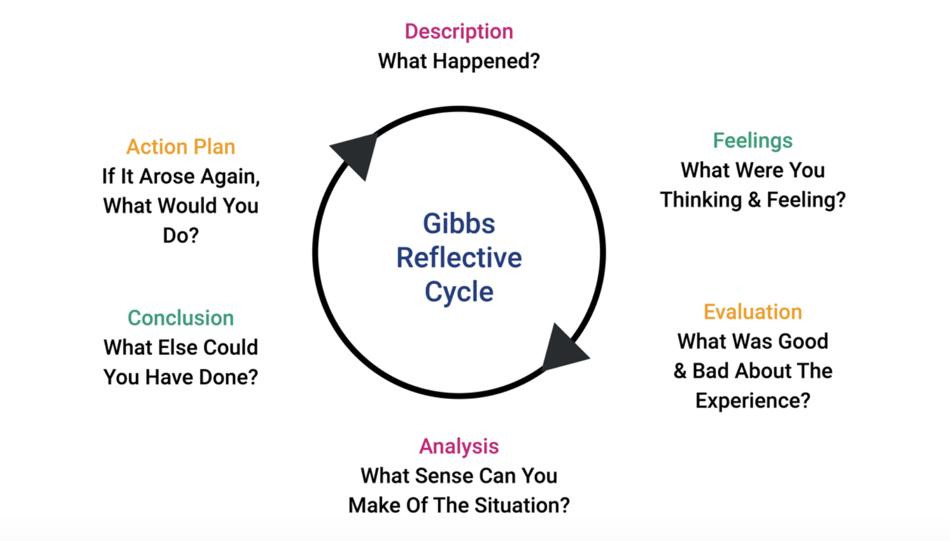
Evaluation Model – Gibb's Reflective Cycle
(Dynamic Training, 2025)
Notes:
(The University of Edinburgh, 2024) The Gibb's Reflective Cycle is a model that offers reflection through six stages of a particular experience!
As you can see from the image displayed here, it shows the process in which an individual can assess & reflect upon a situation. In which I have used to reflect upon what went well throughout this experience & how this could be rectified for next time!

Slide 12
Thanks for listening !

Slide 13
Reference List:
Andrew, H. (2017). UWTSD Logo | Discover Dylan Thomas. Discover Dylan Thomas. Available at: https://www.discoverdylanthomas.com/portfolio-items/dylan-day-poetry-share-uwtsd-carmarthen/print-2 [Accessed 2 Feb. 2026].
Dynamic Training (2025). Understanding Gibbs’ Reflective Cycle | Dynamic Training. [online] Dynamictraining.org.uk. Available at: https://www.dynamictraining.org.uk/learner-pulse/study-skill-gibbs-reflective-cycle/ [Accessed 4 Feb. 2026].
Kosareva, N. (2025). The Role of Eco-Friendly Transport in Sustainable Tourism. Forbes. [online] 13 Nov. Available at: https://www.forbes.com/councils/forbesbusinesscouncil/2025/11/13/the-role-of-eco-friendly-transport-in-sustainable-tourism/ [Accessed 4 Feb. 2026].
Swansea Arena (2021). Swansea Arena Flythrough. [online] YouTube. Available at: https://www.youtube.com/watch?v=S7Pk3KqtMgI [Accessed 2 Feb. 2026].
Swansea Bay City Deal (2022). Swansea Bay City Deal | Swansea Building Society Arena. [online] Swansea Bay City Deal. Available at: https://swanseabaycitydeal.wales/projects/swansea-city-waterfront-digital-district/swansea-building-society-arena/ [Accessed 2 Feb. 2026].
Swansea Building Society (2025). Swansea Arena | About Us. [online] www.swansea-arena.co.uk. Available at: https://www.swansea-arena.co.uk/about [Accessed 3 Feb. 2026].
Swansea Council (2022). Arena Has Now Welcomed Close to a Million Visits - Swansea. [online] Swansea. Available at: https://www.swansea.gov.uk/article/42673/Arena-has-now-welcomed-close-to-a-million-visits [Accessed 3 Feb. 2026].
Swansea University (2026). Welcome To Zscaler Directory Authentication. [online] Swansea.ac.uk. Available at: https://www.swansea.ac.uk/travel/public-transport/ [Accessed 9 Feb. 2026].
The University of Edinburgh (2024). Gibbs’ Reflective Cycle. [online] The University of Edinburgh. Available at: https://reflection.ed.ac.uk/reflectors-toolkit/reflecting-on-experience/gibbs-reflective-cycle [Accessed 8 Feb. 2026].
University of Cumbria (2020). Gibbs’ Reflective Cycle. [online] University of Cumbria, University of Cumbria, pp.1–4. Available at: https://my.cumbria.ac.uk/media/MyCumbria/Documents/ReflectiveCycleGibbs.pdf [Accessed 8 Feb. 2026].
WordArt (2019). Edit Word Art - WordArt.com. [online] Wordart.com. Available at: https://wordart.com/create [Accessed 3 Feb. 2026].

