Slide 1

Module LCLM4004
Problem Solving and Decision Making
Individual Presentation
Student Name: Ivanna Purtova
Student ID: 2430786
Module Leader: Anita Nan

Slide 2
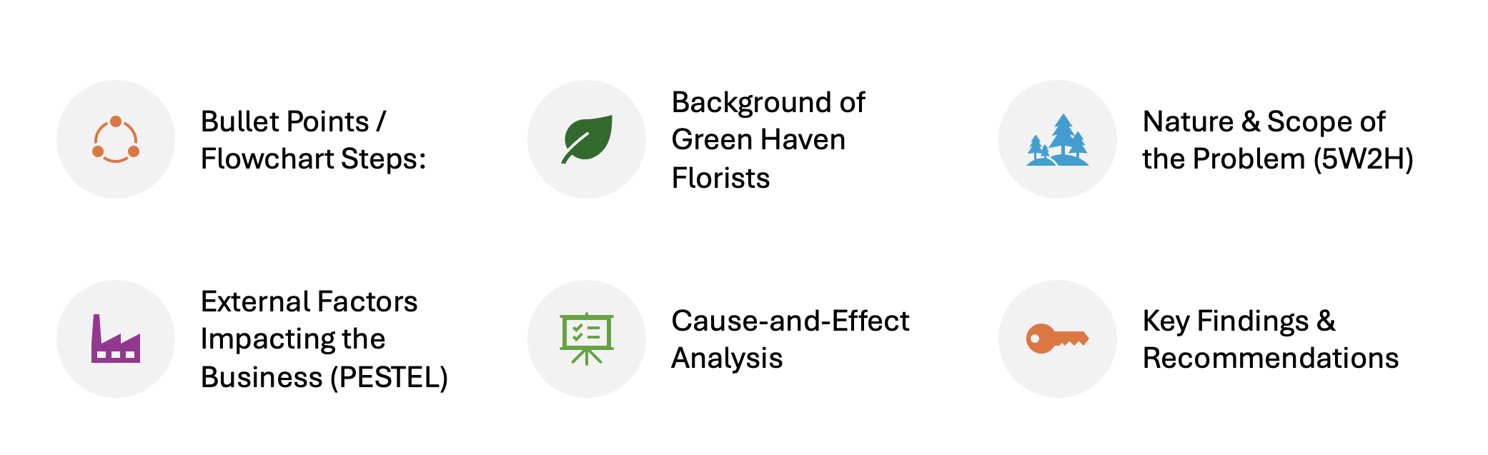
Presentation Overview

Slide 3
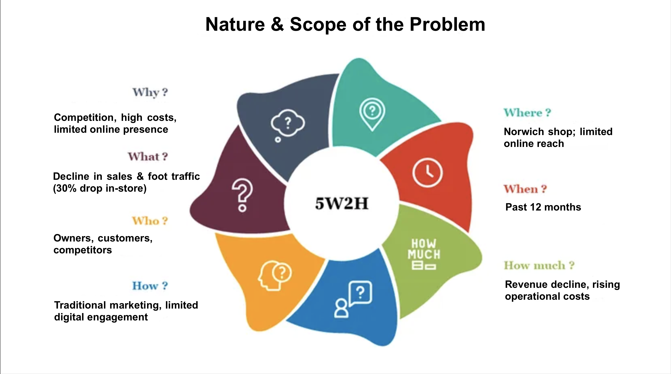
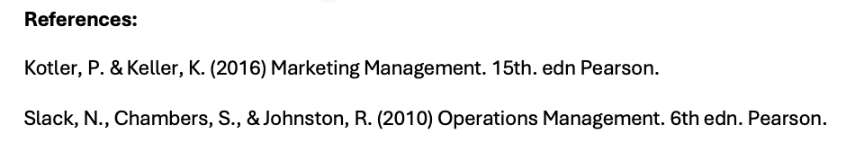

Slide 4
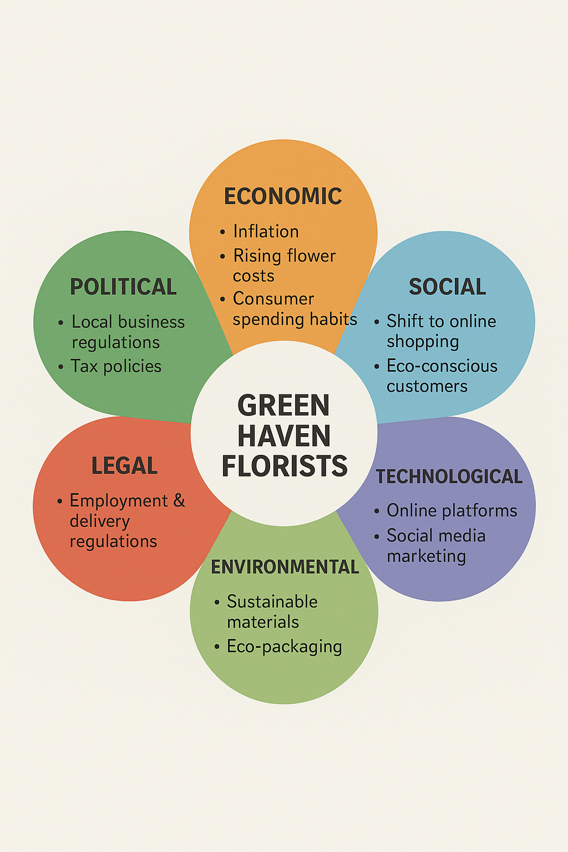
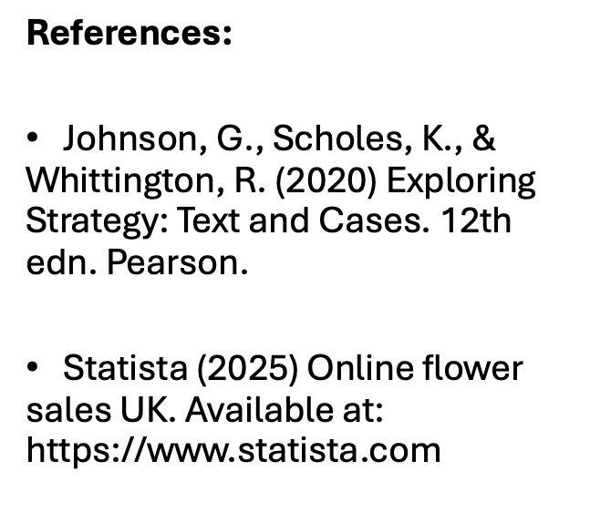

Slide 5
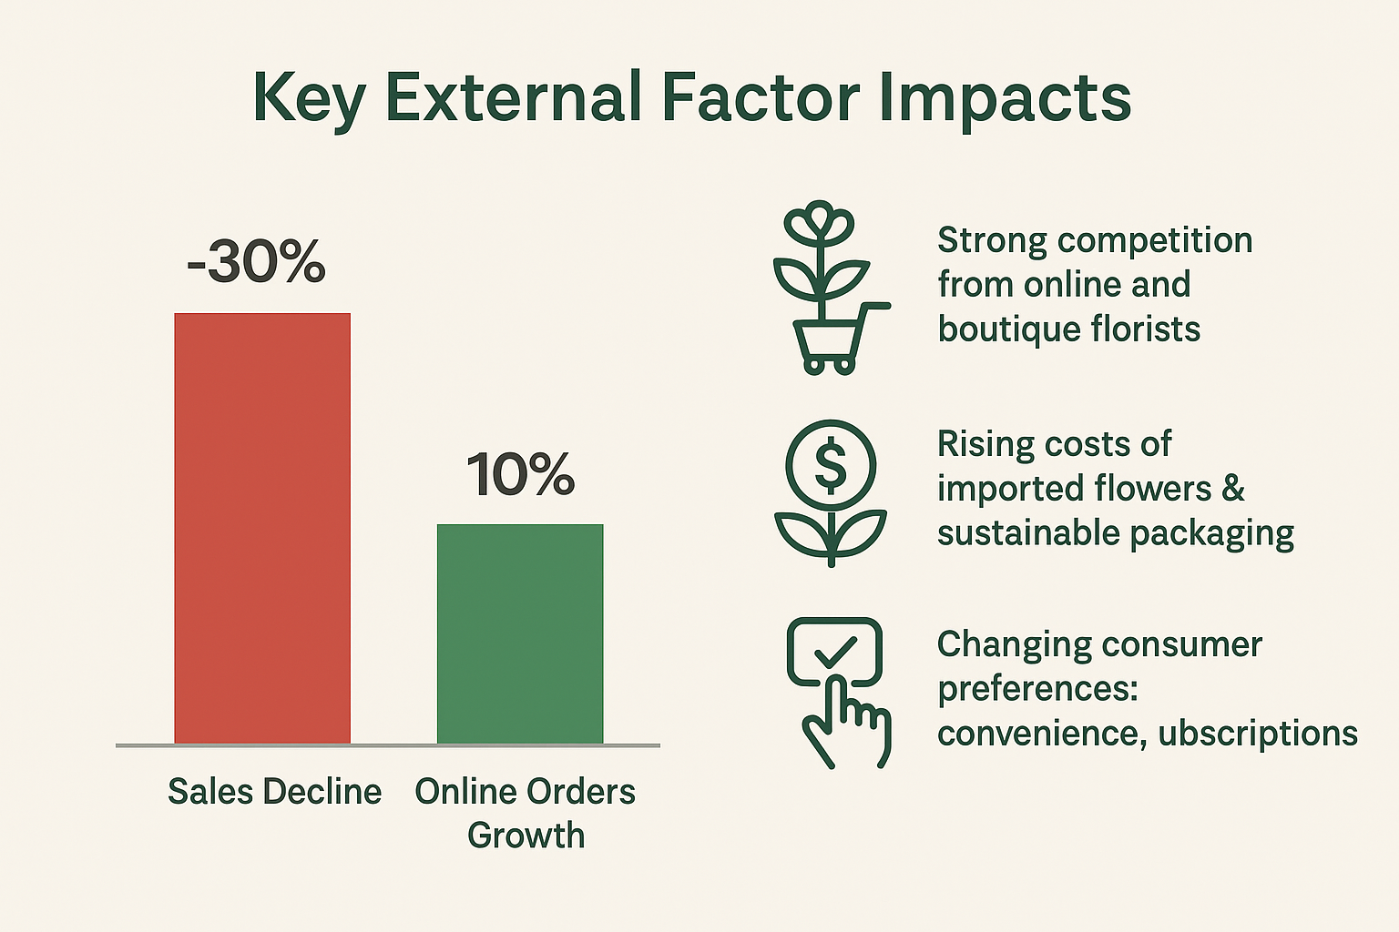
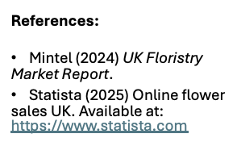

Slide 6
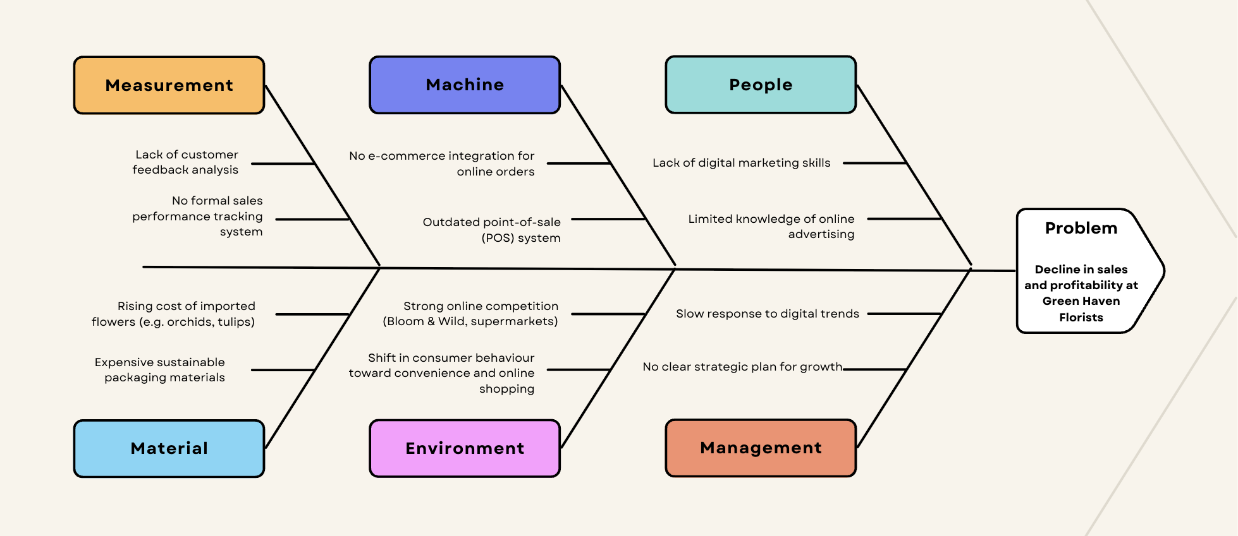
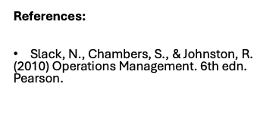
Cause-and-Effect Analysis

Slide 7
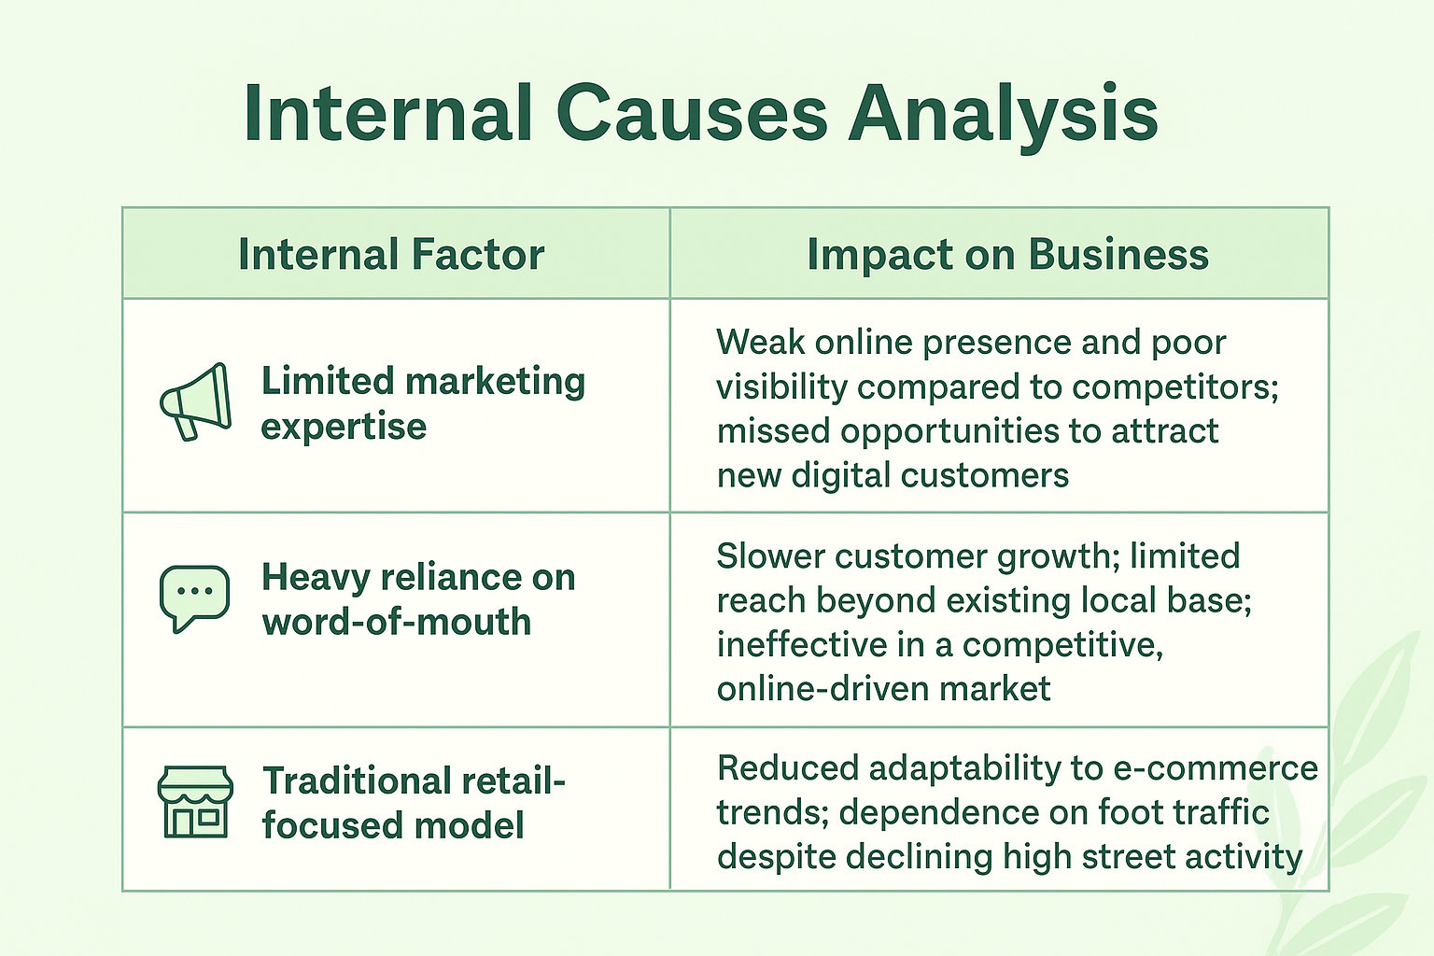
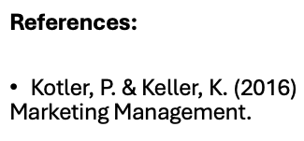

Slide 8
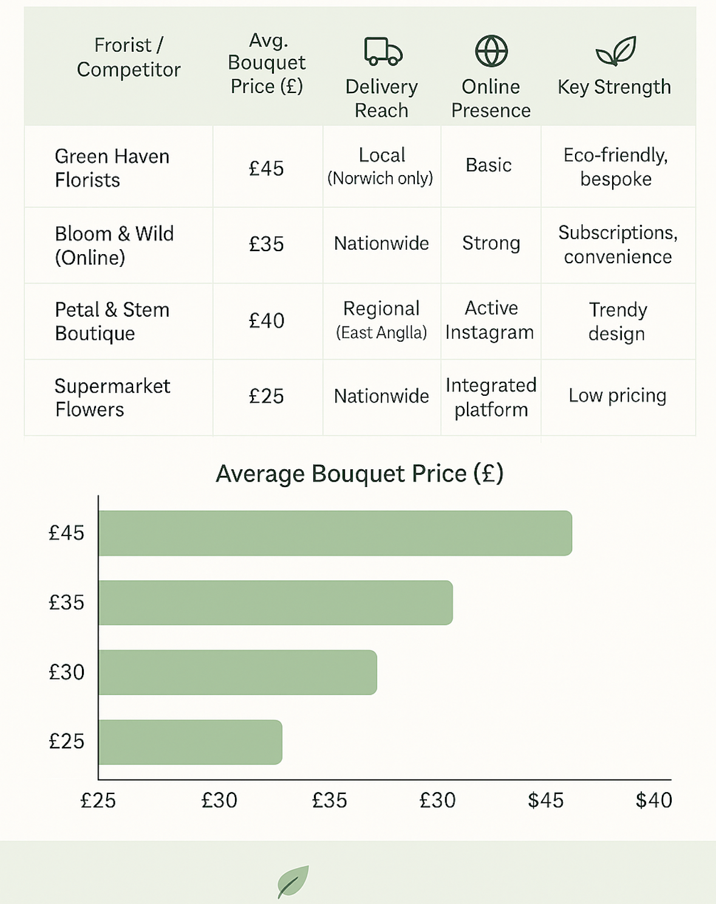
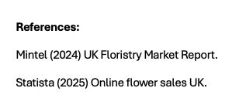
External Causes Analysis
- Green Haven has a limited delivery radius and a little online presence, but they maintain elevated price.
- Bloom & Wild and supermarkets are superior rivals due to their enhanced convenience, greater number of outlets, and lower pricing.
- Green Haven must enhance its internet visibility and expand delivery options to maintain competitiveness.

Slide 9
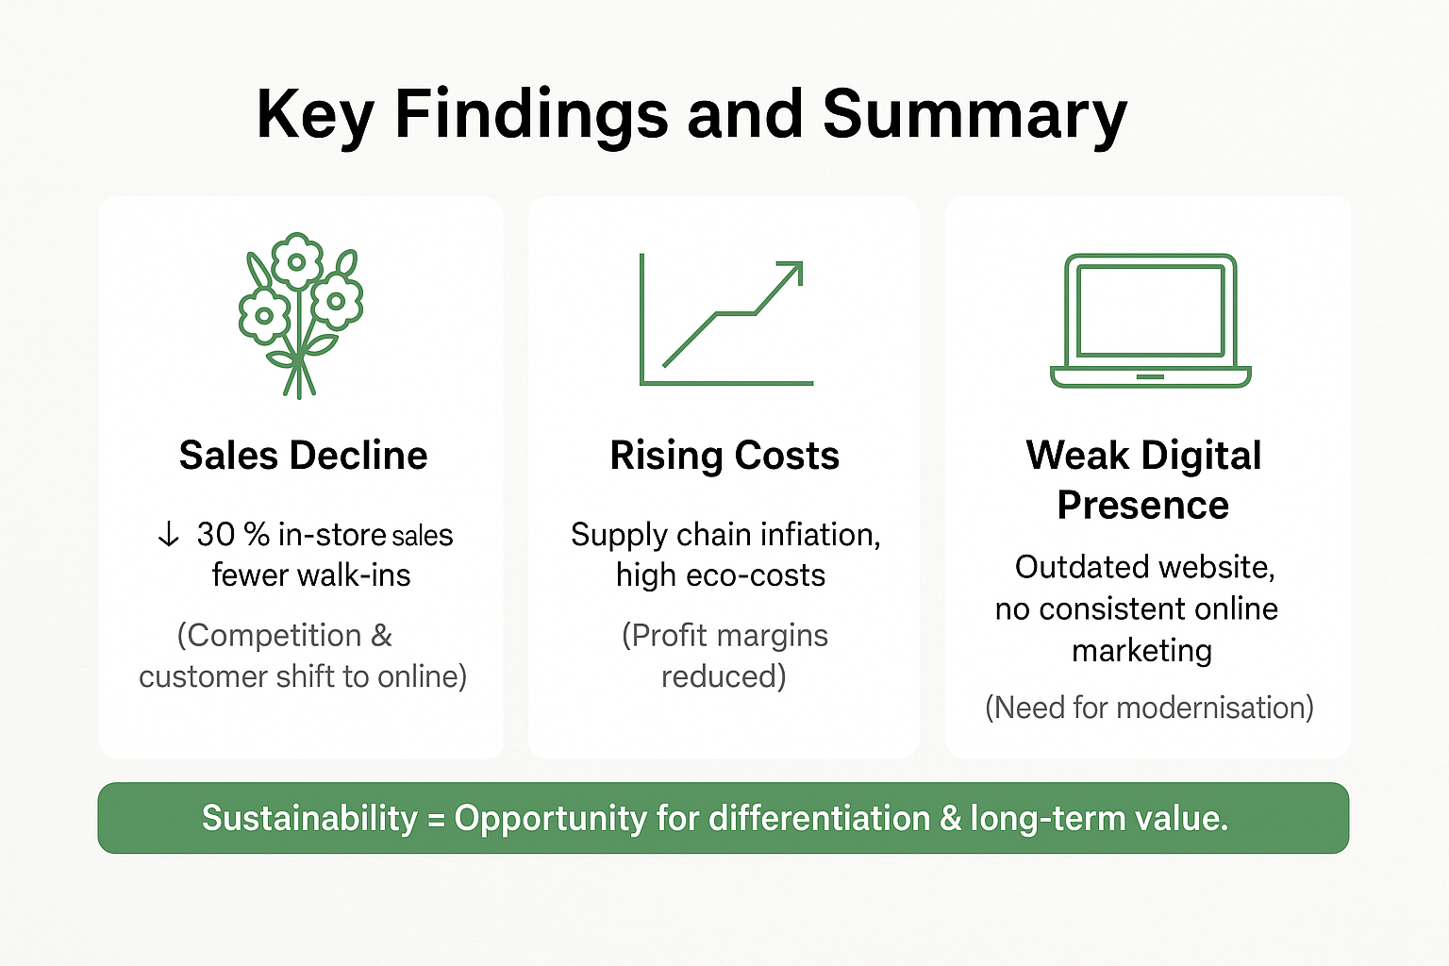
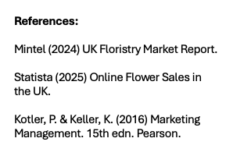

Slide 10
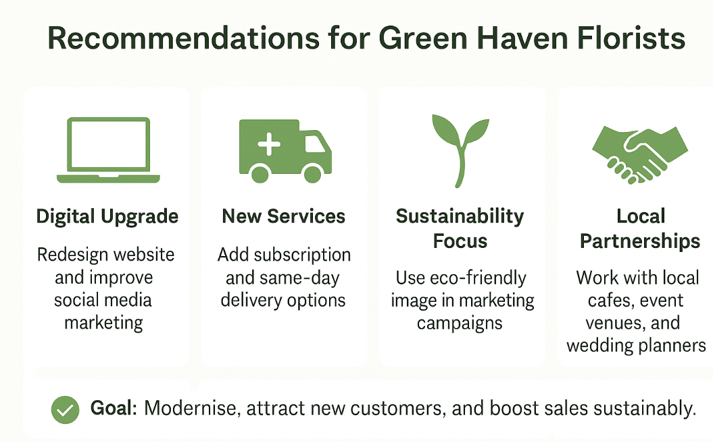
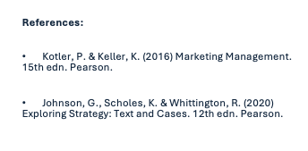

Slide 11
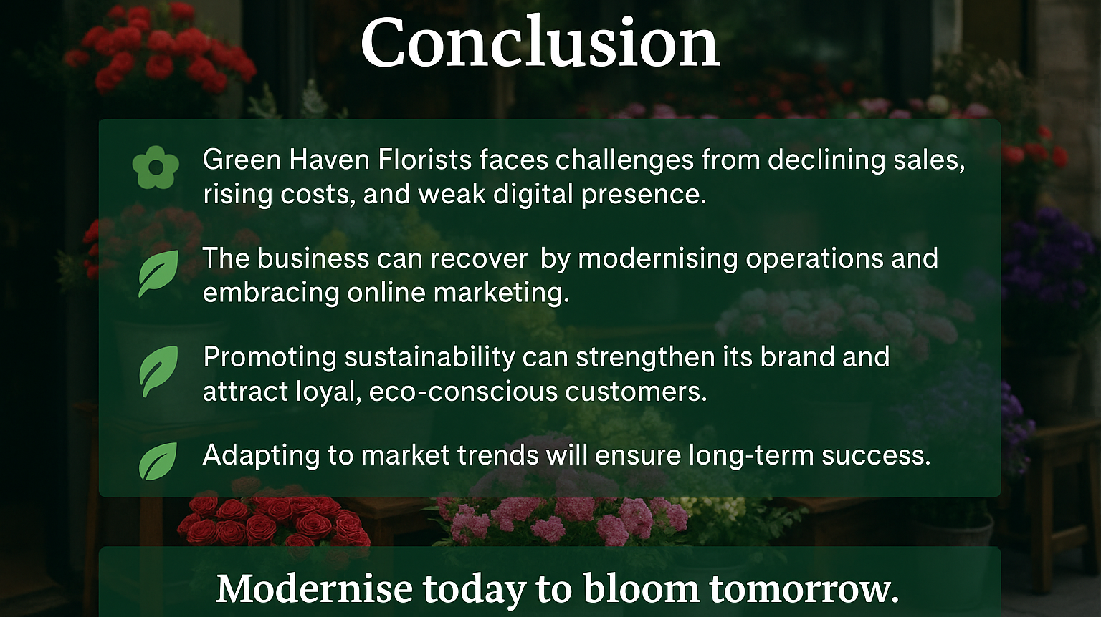

Slide 12
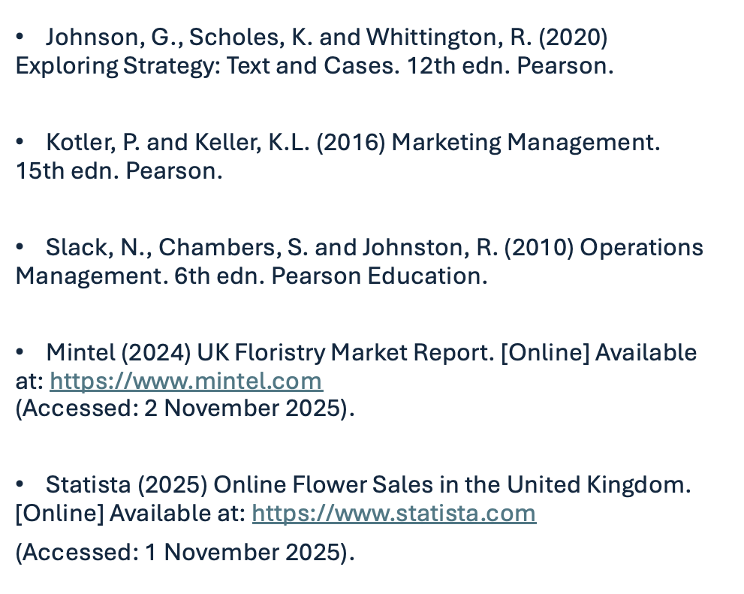
References

