Slide 1

The role and importance of quality service, hospitality and guest services within the hotel industry for Intercontinental Hotels
Ritz-Carlton
Name: Elena-Petronela Ciubotariu
Student number: 2219782
Hospitality and Guest Services (BMIH4003)
Lecturer Name: Charlotte Joyner

Slide 2
Contents
Introduction
The main consumers
The nature, scop and role of the guests services and facilities
The role and functions of guest service
The importance of hospitality meet/exceed guest expectation
Conclusion
References

Slide 3
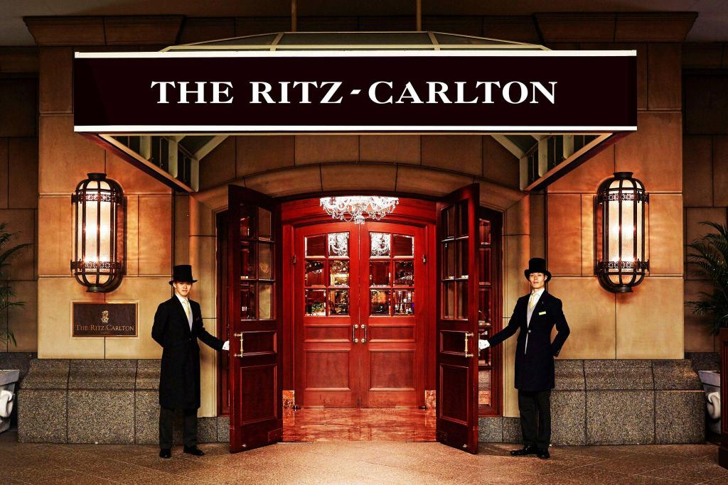
1.Introduction
The first Ritz-Carlton was opened in America, Boston, in 1927 and was operated by Edward Wyner
The Ritz-Carlton Hotel Company formed in 1983
By 1992, the company had grown up to 23 properties
Today, The Ritz-Carlton Hotel Company it is a global leader in luxury
It is a part of Marriott International and has more than 100 hotels and resorts (The Ritz-Carlton Hotel Company, 2023)

Slide 4
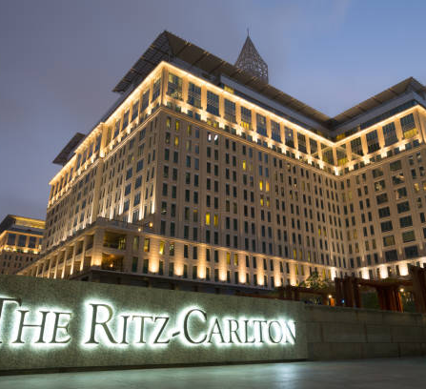
2.The main consumers
The main consumers at Ritz-Carlton are:
-The business executive
-Corporate
-Leisure travellers
-Middle-aged persons and elders
-Families from the upper and upper-middle class (Julia Shorr, 2019)

Slide 5


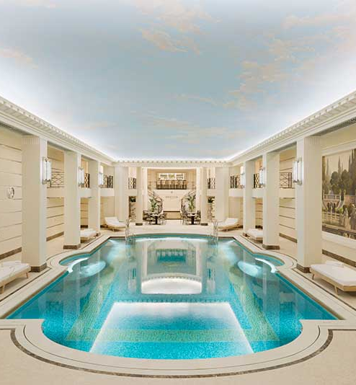

3.The role of the guest services and facilities
Spacious rooms
Private baths
Spa and Wellness
Restaurants, bars, beach clubs, golf course (The Ritz-Carlton Hotel Company, 2023)
Free room service
Conference halls
24-hour front desk services (Hitesh Bhasin, 2023)

Slide 6
4.The role and functions of guest service
The Ritz-Carlton set 5 new gold principles (Joseph A. Michelli, 2008)
Motto
Credo
Twelve service values
Three steps of service
Employee: an unmatched asset
Training
Employee engagement (Catherine Morine, 2019)
Creating wow moments (Hosco, 2022)

Slide 7
5.The importance of hospitality, guest expectation
The hospitality plays a very important role in the luxury hotel brand. Ritz-Carlton it is known for the exceptional standard of hospitality, and creates memorable experiences for the guests. (Perry Group International, 2017)
Guest expectations:
-First impression
-Personalised service
-Attention to detail
-Staff training and Empowerment
-Anticipating guests needs
-Memorable experience (Sagar Rajgopal, 2022)
"Once you establish yourself as a luxury brand that's going to deliver and execute on service, then you have to not only deliver on expectations but exceed them," said Ritz-Carlton (Anonymous, 2016)

Slide 8
6.Conclusion
As a result from this presentation, the role of quality service, hospitality, and guest services are the most important within the hotel industry, especially for Ritz-Carlton. By exceeding guest expectation, paying attention to detail, and consistently delivering exceptional service.

Slide 9
7.References
Ritz-Carlton, (2023) Our legacy, Available at: https://www.ritzcarlton.com/en/about-the-ritz-carlton/our-legacy/ (Accessed on: 10 May 2023)
Shorr, (2019) Luxury vs Millennials and Their Technology: The Ritz-Carlton, Available at: https://www.linchikwok.net/2019/05/luxury-vs-millennials-and-their.html#:~:text=The%20Ritz%2DCarlton's%20typical%20target,middle%20class%20section%20of%20society. (Accessed on: 12 May 2023)
Bhasin, (2019) Marketing Mix of Ritz-Carlton Available at: https://www.marketing91.com/marketing-mix-of-ritz-carlton/ (Accessed on: 12 May 2023)
Hosco, (2022) Creating WOW Moments at The Ritz-Carlton: The job of a guest services Manager Available at: https://advice.hosco.com/en/creating-wow-moments-at-the-ritz-carlton-the-job-of-a-guest-services-manager/ (Accessed on: 14 May 2023)
Michelli, (2008) The New Gold Standard: 5 Leadership Principles for Creating a Legendary Customer Experience, Available at: https://ebookcentral.proquest.com/lib/trinity/reader.action?docID=6255316&ppg=5 (Accessed on: 14 May 2023)

Slide 10
Rajgopal, (2022) Hospitality Brands Can Succeed With A Customer Experience Philosophy, Available at: https://www.forbes.com/sites/forbesbusinesscouncil/2022/09/16/hospitality-brands-can-succeed-with-a-customer-experience-philosophy/?sh=315cf00e2040 (Accessed on: 15 May)
The Ritz-Carlton Hotel Company, (2023) The Ritz-Carlton Experience Available at: https://www.ritzcarlton.com/en/about-the-ritz-carlton/experience/ (Accessed on: 17 May 2023)
Anonymous, (2016) Ritz-Carlton Top Luxury Tier, vol.33, Iss.13, Available at: https://www.proquest.com/docview/1819073051?accountid=130472&parentSessionId=I8z8QLuq3UTjBNXXWoGGq7UIDdkSF6m4Lq72ZqZLasc%3D&pq-origsite=primo​ (Accessed on: 15 May 2023)
Morin, (2019) How the Ritz-Carlton Creates a 5 Star Customer Experience, Available at:
https://crm.org/articles/ritz-carlton-gold-standards​
Perry Group International, (2017) The Importance of Hospitality in The Hotel Industry, Available at:https://www.perrygroup.com/importance-hospitality-hotel-industry/#:~:text=If%20you%20own%20or%20manage,hotel%20in%20a%20positive%20way. (Accessed on: 18 May 2023)

