Slide 1

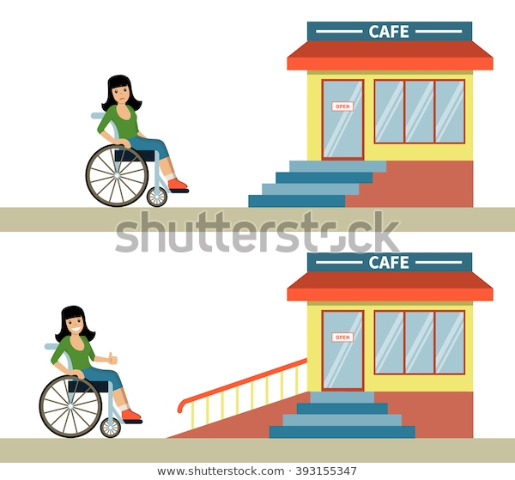

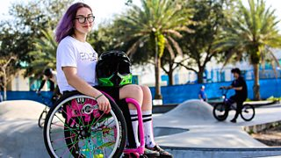
Social model of disability
Environment
Not
Person
© 2003-2020 Shutterstock, Inc.
Fact
Or
Views
© 2019 clipartkey.com
First WCMX champion of the uk
Lily Rice
Copyright © 2020 BBC
Medical model of disability | Social model of disability
You cant do this because: Your in a wheel chair Limited control Mentally incapable | You can do this if we change theses to: Introduce a ramp Change to make it easier Changes to explain it

Slide 2
https://www.vecteezy.com/free-vector/poster-background
© 2020 Eezy Inc. All rights reserved
https://www.bbc.co.uk/programmes/p08gthqb
Copyright © 2020 BBC
https://www.clipartkey.com/search/opinion/
© 2019 clipartkey.com
https://www.shutterstock.com/image-vector/young-woman-wheelchair-front-cafe-stairs-393155347
© 2003-2020 Shutterstock, Inc.

