Slide 1

Leading and Managing health & social care teams
07.02.2019 lecture 2:
Creating a positive workplace culture

Slide 2
Today’s objectives
Brief recap from last week
Timeline for the module; assessment
Managing a service: creating a positive workplace culture

Slide 3
Learning Outcomes
1. To critically examine the application of models, styles and techniques and methods of managing in Health and Social Care practice
2. To interrogate the legislation governing management practice and understanding of the legal framework that informs the topic

Slide 4
Lesson Content
This module takes a 2 pronged approach in this respect:
The legislative framework that governs leadership and management in health and social care
The knowledge and skills necessary to be an effective leader or manager in health and social care - 6 core areas in this context: working with people, managing yourself and personal skills, providing direction, facilitating innovation and change, achieving results using resources

Slide 5
Assessment
Two assessment activities for the module:
1. A two 2 hour open book exam. Topic: To demonstrate understanding of the legislation governing management practice via interrogation and analysis of a high profile health and social care case where there has been a systemic failure that has had an adverse impact on patient and service user outcomes.
2. A 20 minute Self Reflective presentation and an accompanying 1500 word Supporting Paper which examines management and leadership within health and social care. Deadline:

Slide 6
Timeline
7th February
14th February
21st February
28th February
7th March
14th March – prep for the presentation
21st March assessment: reflective presentation
28th reflective presentation 2nd group (differentiated) & exam prep
2nd May Exam

Slide 7

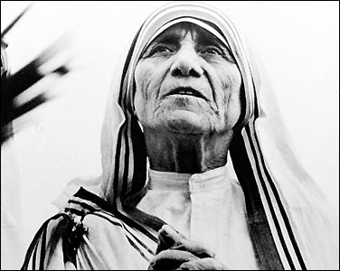
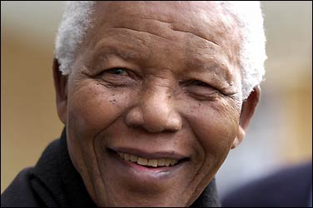
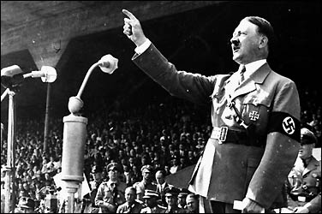
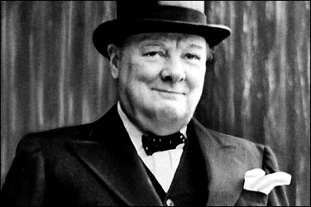

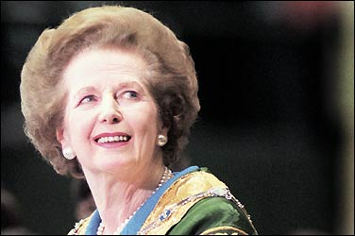
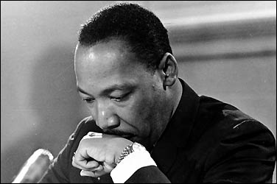


News
Nation
Investigations
Photos & Video
Discussions
World
Education
Entertainment
Corrections
Metro
Health
Columns & Blogs
Innovations
Politics
Politics Blogs
House/Senate Votes
White House
Congress
Political Browser
In Depth
Polls
The Fed Page
DC | MD | VA
Opinions
Opinions Home
Outlook
Local Opinions
Discussions
Toles Cartoons
On Faith
Telnaes Animations
PostGlobal
Business
Business and Policy
Local Business
Entrepreneurship
Economy Watch
Technology
Columns & Blogs
Global Economy
Personal Finance
On Leadership
Local
Metro News
District
Weather
Obituaries
The Extras
Education
Maryland
Traffic
Local Explorer
Local Business
Columns & Blogs
Virginia
Crime
Community Handbook
Yellow Pages
Sports
TODAY'S NEWSPAPER
Subscribe | PostPoints
Hello undefined |
Change Preferences | Sign Out
| Register Now
Redskins
Mystics/WNBA
Colleges
Columnists
Capitals/NHL
United/Soccer
High Schools
Blogs
Nationals/MLB
Wizards/NBA
Leagues & Sports
Wires
Arts & Living
Buy a Car
Sell a Car
Experts & Advice
Dealer Directory
Used Car Specials
Coupons
Real Estate
Buy a Home
Sell a Home
Neighborhoods
Recent Home Sales
Tools and Calculators
Local Address
Rentals
Find a Rental
Rent Your Place
Classifieds
Web
| Search Archives
washingtonpost.com > Photo
» THIS STORY:READ +|WATCH +| Comments
» THIS STORY:READ +|WATCH +| Comments
Ghana Welcomes Obama
The streets of Ghana's capital city buzz with anticipation and excitement as President Obama pays his first presidential visit to sub-Saharan Africa.
Style
Entertainment News
Museums
Columns & Blogs
Comics
Pets
Food & Dining
Fashion & Beauty
KidsPost
Crosswords
Movies
Travel
Home & Garden
Post Magazine
Sudoku
Going Out Guide
Find Restaurants
Visitors Guide
Find Movies
Best Bets
Find Bars & Clubs
Go Out List
Find Local Events
Going Out Gurus
Jobs
Find a Job
Post a Job
Get Expert Advice
Employer Login
Cars
Web
» THIS STORY:READ +|WATCH +| Comments » THIS STORY:READ +|WATCH +| Comments
© 2009 www.washingtonpost.com
News | Politics | Opinions | Business |Local | Sports | Arts & Living | Going Out Guide
Jobs | Cars | Real Estate | Rentals | Classifieds
SEARCH:
washingtonpost.com
Notes:
After this get them to group together characteristics of managers and leaders. Then on next slide could give them some definitions

Slide 8
Distinguishing between leadership and management
There are many different interpretations of the terms ‘leadership’ and ‘management’ (Mullins, 2016) and often the terms are used interchangeably (McKibbin et al., 2008).
What is the difference between a manager and a leader?
What skills would you associate with a leader that you wouldn’t with manager?
Can someone be a good manager without leadership skills?
Notes:
Similarities/differences between leaders and managers – who are the leaders in health and social care and what do they do? Based on your own experience of management and leadership in care settings, consider the notions of being a manager and being a leader and make notes on what you consider are the similarities and differences between them – the do the chopped up thing. Then show them the next slide – identify them – are these leaders or managers? Why is that?

Slide 9
Defining leaders
Buchanan and Huczynski (2010, p. 596) define leadership as, ‘the process of influencing (original emphasis) the activities of an organised group in its efforts towards goal-setting and goal achievement’.
Mullins (2016) sees leadership as a relationship through which one person influences the behaviour or action of other people
McGregor (1987) suggests that leadership is a dynamic form of behaviour with a number of variables affecting the leadership relationship, namely: characteristics of the leader; attitude, needs and other personal characteristics of the followers; nature of the organisation; social, economic and political environment

Slide 10
Strategies, policies, legislation, guidance
Funding for/provision of services across the four UK countries differs – it is important that leaders and managers are aware of current national priorities, the organisation they work for and the resultant impact on patients/clients/service users
Usually, health and social care policy in the United Kingdom (UK) tends to emanate from the governing political party’s values and goals linked to care provision.
The day-to-day activities of leaders and managers are influenced and guided by government strategies, policies and legislation, by codes of practice, guidelines, and also surveys and research (see Gopee and Galloway, 2014).
Notes:
Explain that it is important to know that the day-to-day activities of all care managers are influenced by various government strategies, policies and legislation, codes of practice. Why is it important that they are aware of all of this? Cos they need to know what the objectives of govt. Policy are and how this will affect their profession and patients/clients. Health and social care organisations need to translate this and assess the impact on their business/services

Slide 11
Government policy
The Social Services Wellbeing Act (Wales) 2014
The Act imposes duties on local authorities, health boards and Welsh Ministers that require them to work to promote the well-being of those who need care and support, or carers
who need support.
Lays out how care and support should be provided to all who those who require it, from children to vulnerable adults.
Notes:
Can they find a Welsh Government docu produced by the Government that set out their proposals for future legislation. White Papers are often published as Command Papers and may include a draft version of a Bill that is being planned. This provides a basis for further consultation and discussion with interested or affected groups and allows final changes to be made before a Bill is formally presented to Parliament’. From this link:
http://www.parliament.uk/site-information/glossary/white-paper/
Useful link:
‘Acts of Parliament are known as primary legislation. Collectively, they make up Statute Law which along with conventions, court decisions and treaties is seen as the basis of the UK constitution. If a Bill is passed by both Houses of Parliament and receives the Royal Assent it becomes an Act of Parliament and part of UK law’ - this is also from the glossary of www.parliament.co.uk as above
https://library.leeds.ac.uk/skills-referencing-harvard#activate-act_of_parliament
Principal aim of the White Paper and subsequent act is to establish the medium for delivering continuously improving healthcare, whilst building upon reforms made over preceding years. First lecture – explore the prevailing strategies, policies and ethos within which health and social care pros and care managers carry out their duties and an examination of the context in which health and social care is delivered – e.g. epidemiology/demography, current pressures etc.
Green Papers are consultation documents produced by the Government. The aim of this document is to allow people both inside and outside Parliament to give the department feedback on its policy or legislative proposals.
Copies of consultation documents such as Green Papers are available on the related departmental websites.
http://www.parliament.uk/site-information/glossary/green-papers/

Slide 12
Guidance and Practice frameworks
All Wales Child Protection Procedures
Processes and Procedures for multi-agency workforce to safeguard the children of Wales. 2008 (currently being reviewed)
Wales Interim policy and procedures for the protection of vulnerable adults from abuse 2010 & 2013 (review)
Guides the safeguarding work of all those concerned with the welfare of vulnerable adults employed in the statutory, third (voluntary) and private sectors, in health, social care, the police and other services.

Slide 13
Leadership and management in contemporary care provision
Outcomes of effectiveness, safety and patient satisfaction with health and social care services are generally very good (see Appleby and Robertson, 2015).
But there have been a number of high-profile instances of systemic failure in both health and social care services that have had an adverse impact on patient and service user outcomes.
Notes:
Outcomes of effectiveness, safety and patient satisfaction with health and social care services are generally good – e.g. http://www.kingsfund.org.uk/projects/public-satisfaction-nhs/bsa-survey-2015#e9893f5e-a594-4191-99a0-e9041b6249ed - link to this – also put up ApplebyRobertson pdf. - Can they tell me about high-profile cases?

Slide 14
Creating a positive workplace culture
Management skills, Knowledge & practice

Slide 15
What do we mean by the ‘culture’ of a workplace?
Notes:
Flipchart paper exercise: ensure to elicit values, norms of behaviour, standards, amosphere, ethos etc

Slide 16
Shared values and assumptions
The values within a positive workplace culture should align with the values needed for person-centred, high quality care and support. What kind of values might they be?
They might be values such as:
dignity and respect
working together
showing a commitment to quality care and support
learning and reflection.

Slide 17
Recruitment
It’s essential to recruit people who have the right values to work in health and social care, and continue to develop these values to maintain a positive workplace culture.
When the values of your staff match your workplace values this can help you deliver high quality and consistent care and support, and maintain a positive workplace culture.
When they don’t, it can lead to recruitment and retention challenges and foster bad practice which can damage your culture.

Slide 18
Exercise
Read the handout and answer the questions:
Who would you choose to work in Mike’s service?
What factors influenced your decisions?

Slide 19
How to develop and embed shared values in your workplace
Taking a values-based approach to recruitment and retention can help you develop and embed shared workplace values.
This approach involves identifying your workplace values and embedding them throughout your organisation, including in your recruitment and retention practices. This ensures that you recruit staff who have the right values to work in your organisation, and therefore are a ‘cultural fit’, and more importantly keep them!

Slide 20
References
Andrews-Evans, M. (2012). ‘Senior nurses’ views about factors that lead to service failures’, Nursing Management, 10 (18), pp. 26 – 31.
Armstrong, M. (2012). A Handbook of Human Resource Management Practice. (12th edn.). London: Kogan Page.
Beveridge, W. (1942). Social insurance and allied services. London: HMSO.
Bryman, A. (1988). Quantity and Quality in Social Research. London: Unwin Hyman
Buchanan, D. A. and Huczynski, A. A. (2010). Organisational Behaviour (7th edn.). London: Prentice Hall/Financial Times
Castell, A. M. (2011). ‘Contemporary Approaches to Leadership and Management’, in Barnard, A. (Ed.). Key Themes in Health and Social Care: a Companion to Learning. Abingdon: Routledge, pp. 229 – 248.

