Slide 1
Porth Agored
Graduate Certificate Consolidation
Workshop 2
Collaboration and Co-production
Welsh context
Observation of Practice – Task 2

Slide 2
Ground Rules for Virtual Workshop
Confidentiality
Respect
One person speaking at one time, if on line please use the button for putting your hand up if you would like to make a comment
If on line use the discussion box during the presentation to type in any questions you have. Please keep camera’s on unless internet connectivity doesn’t allow this.
Participation – please ensure you engage and focus

Slide 3
Aims
Increase understanding of undertaking and writing up the observation of practice – Task 2
Consider the meaning of collaborative working, co-production and participation
Build knowledge of how to evidence the SCW learning outcome working collaboratively with people in need of care and support, their carers and other professionals withing the portfolio
Develop understanding of Welsh context and how to evidence this within the portfolio
Developing knowledge of critical practice and how this links to values, ethics and communication methods.

Slide 4
Observation - Task 2
Task 2 (Page 7)
Need to complete 1 observation
Seek the individual's permission before hand
The observation must be least 30 minutes long or of a suitable duration to meet the learning outcomes if virtually or over the phone
Emphasis is on communication skills and methods, values, ethics and the Code of Professional Practice
Include reference to the Active offer.
Observer gets feedback from individual, following the observation (Page 10 handbook/easy read version on Moodle).

Slide 5
Question - Task 2
Context
Set out the social work objectives and give a brief description of the situation including geographical and legislative contexts and any relevant cultural, ethnicity and language issues, including how consent was gained and how you have considered the impact of the observation on the individual in need of care and support and/or their carers. (300 words +/-10%)
Question
Critically reflect on your communication methods and skills during the observation; including how you identified whether you had the necessary communication skills to work with the individual in need of care and support and/or their carers. You must use a person-centred approach to demonstrate the integration of social work ethics, values and the Code of Professional Practice. This must include culturally and linguistically sensitive practice and the principles of the “Active Offer” and make reference to “More than Just Words” (Welsh Government, 2012). (1300 words +/-10%)

Slide 6
Collaboration/Co-production
Exercise 1
What do you think is meant by collaboration/co-production as referred to in the Social Services & Wellbeing (Wales) Act 2014? (NB does it have the same meaning as partnership or consultation?)
What would you say are the main ‘drivers’ for a more collaborative approach in social work? (Consider the potential outcomes, as well as relevant legislation).
Group discussion – feedback from this exercise

Slide 7

Definition of Collaboration, Co-production and Partnership
Collaboration: To work with another on a project
Collins English Dictionary
Co-production: Citizens and professionals sharing power and working together as equal partners
Co-production should aim to:
Recognise people as assets who have a positive contribution to make to the design and operation of the services, they use that builds on capabilities
Social Services and Well-Being (Wales) Act 2014

Slide 8

Inter-Professional Collaboration
... social work practice is, as they say, everyone’s business. The transition from a position of multi-professionalism, where there are many people from different disciplines working in isolation, to a state of inter-professionalism, where those professionals work collaboratively, is not as straightforward as it sounds; it impacts on everyone involved and everyone involved influences the process.
Crawford, K (2012) Interprofessional Collaboration in Social Work Practice”, London: Sage Publications

Slide 9

Effective Communication
Developing a shared understanding of what the relationship is about; including information sharing
Maximising choice and control; whilst remaining honest about available choices
Responsiveness; including practical and emotional
Reliability; significantly affects trust and confidence
Honesty; including giving unwanted news
Unhurried pace; changes the quality of work done
Respect; overarching concept which relates to social work values
Koprowska, J (2020)
“Communication & Interpersonal Skills in Social Work” : Learning Matters Ltd.

Slide 10
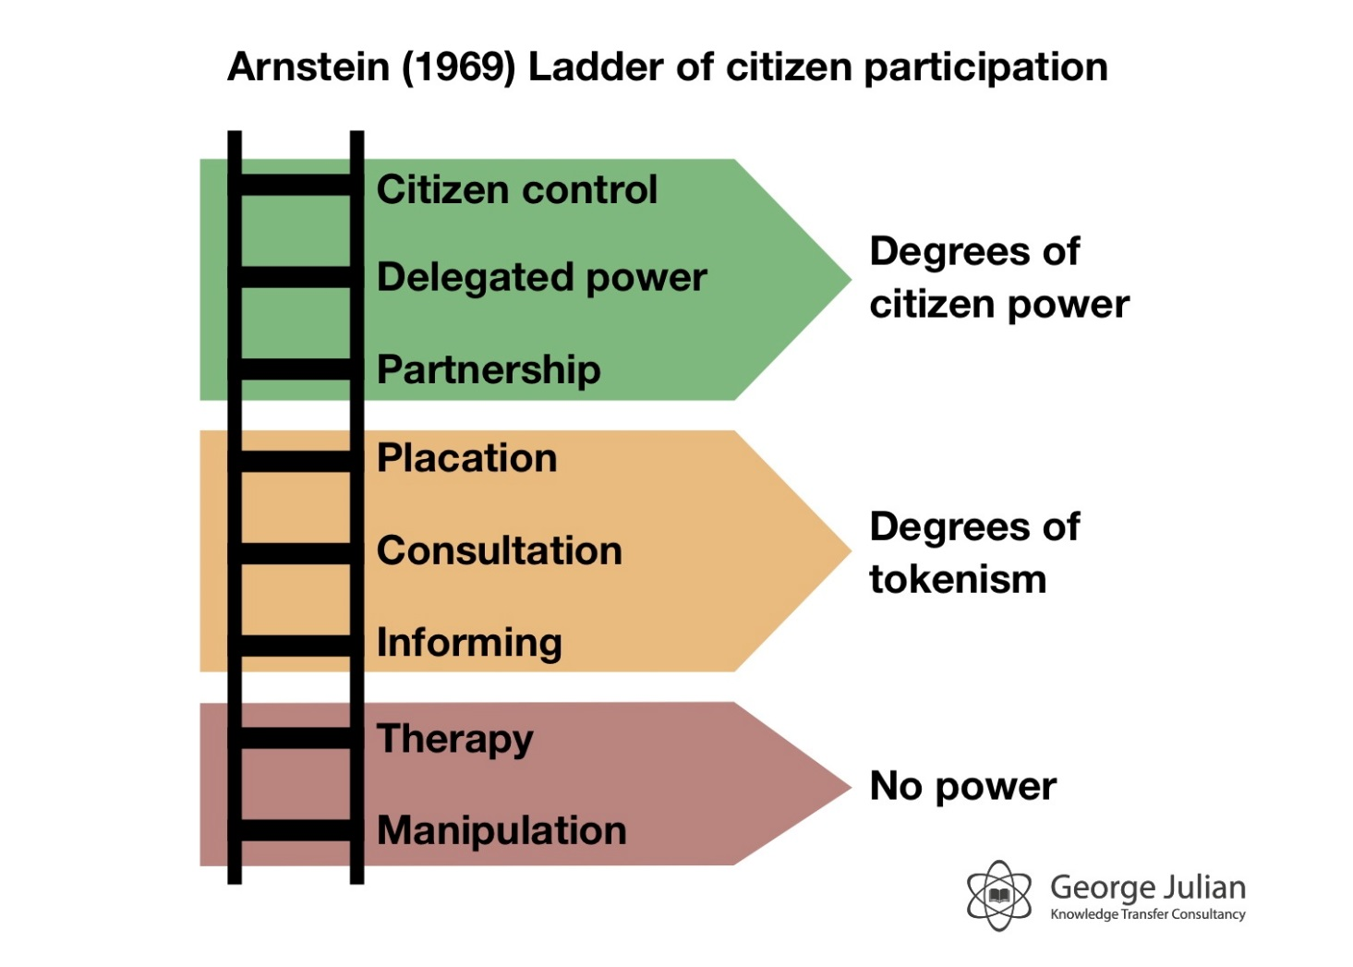
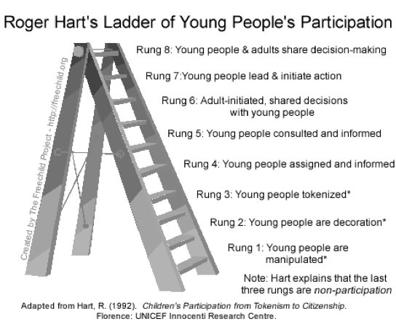
Models of Participation

Slide 11
Exercise 2 - Models of Participation
Using one of the models of participation consider a recent case you have been involved in where you feel you worked well with individuals/families/carers (use another model if you have one you prefer)
What stage of participation did you reach in this piece of work?
What difference do you think your practice made to the individuals/families/carer’s experience?
What would you identify as the most important aspect of collaboration in this piece of work?

Slide 12
What Really Matters
What really mattered to me by Mr David Britton
https://youtu.be/dgRpfZ2WyD8
Knowing what really matters to people by Lucy Warren, social worker.
https://youtu.be/hh57sJ4it7I

Slide 13
Critical Thinking in Effective Collaborative Practice
Part of the context and rationale for practising in an effective collaborative manner is the identification and management of risk, social work obviously deals with risk, complexity and contingency and so on:
There will be a range of ‘solutions’;
Things will change;
Outcomes cannot be predicted with utter certainty;
Certain values and assumptions may not be valid in the future;
There will be many other perspectives on a situation
Rutter, L and Brown, K (2012) “Critical Thinking and Professional Judgement for Social Work”,

Slide 14
Critical practice
Critical practice focuses more on critical evaluative approaches to practice, rather than just meeting deadlines, or uncritical dependence on methods and techniques .

Slide 15
Exercise 3 - Working collaboratively
In your groups choose a case one of you has worked on where collaborative work has been central
Questions;
What/who can you identify as being the relevant individuals and agencies you need to collaborate with?
How did you approach communication in this case?
Did you need to adapt your communication methods to meet the individual’s needs? If so how did you do this?
Where there any barriers you came across in relation to working collaboratively? If so what did you do to over come these?

Slide 16

What the individual/families/carers we work with are saying:
...the majority of interviewees cited effectiveness ‘knowing what they’re doing’ and ‘doing what they say they’re going to do’ as being the most important qualities for effective social work practice.
However, most interviewees did also see good communication skills, sensitivity and consideration as essential to forming a good collaborative working relationship with social work practitioners.
Amanda Moss 2015

Slide 17
What the individual/families/carers we work with are saying:
“I’ve learned a lot about how to talk to my son from his social worker.”
“My social worker has a lovely way about her and always treats me with respect.”
“My social worker is usually late and looking at his watch while he’s with me.”
“What I mostly want is a social worker who knows their job and can get me the help I need.”
“Whenever I ask for help, I’m told how busy social workers are and how hard their job is.”

Slide 18
Feedback from the people you work with
Exercise 4
Considering the feedback you have received from the individuals/families you work with.
What would you like people you work with to say about you?
What would you like other professionals to say?
You can use a picture, image, word or a short sentence to sum up what you would like the individuals you work with to say about you. Feel free to be creative as you want here.

Slide 19

Welsh Language and Culture

Slide 20
Social Services and Well-being (Wales) Act, 2014 The Active Offer - More than Just Words
The ‘Active Offer’ simply means providing a service in Welsh without someone having to ask for it
The Welsh language should be as visible as the English language
Providing a service that is centred to those who use services is fundamental to the ‘Active Offer’
What this means in practice is providing a tailor-made service that enables the individual to be assured that he/she is in control and fully understands the services being offered.

Slide 21
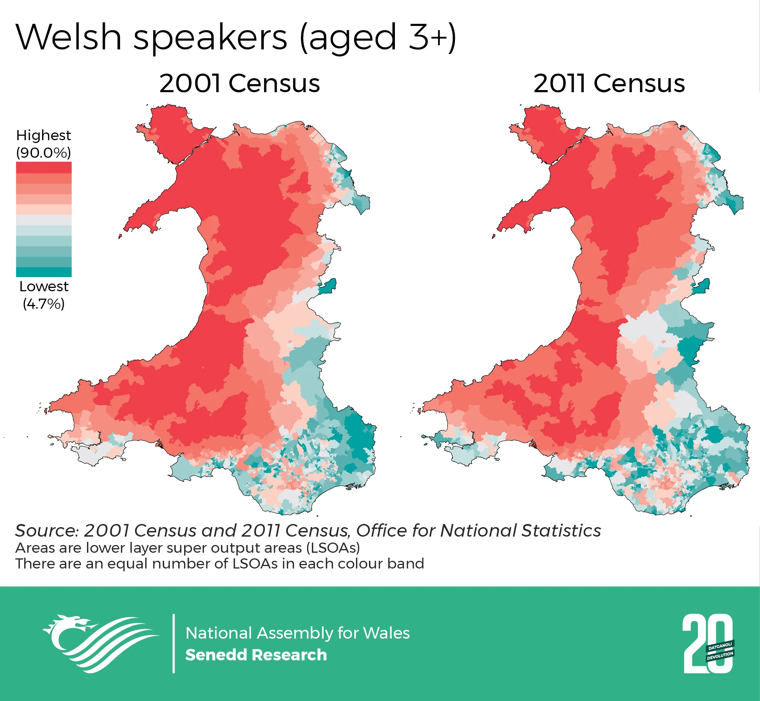
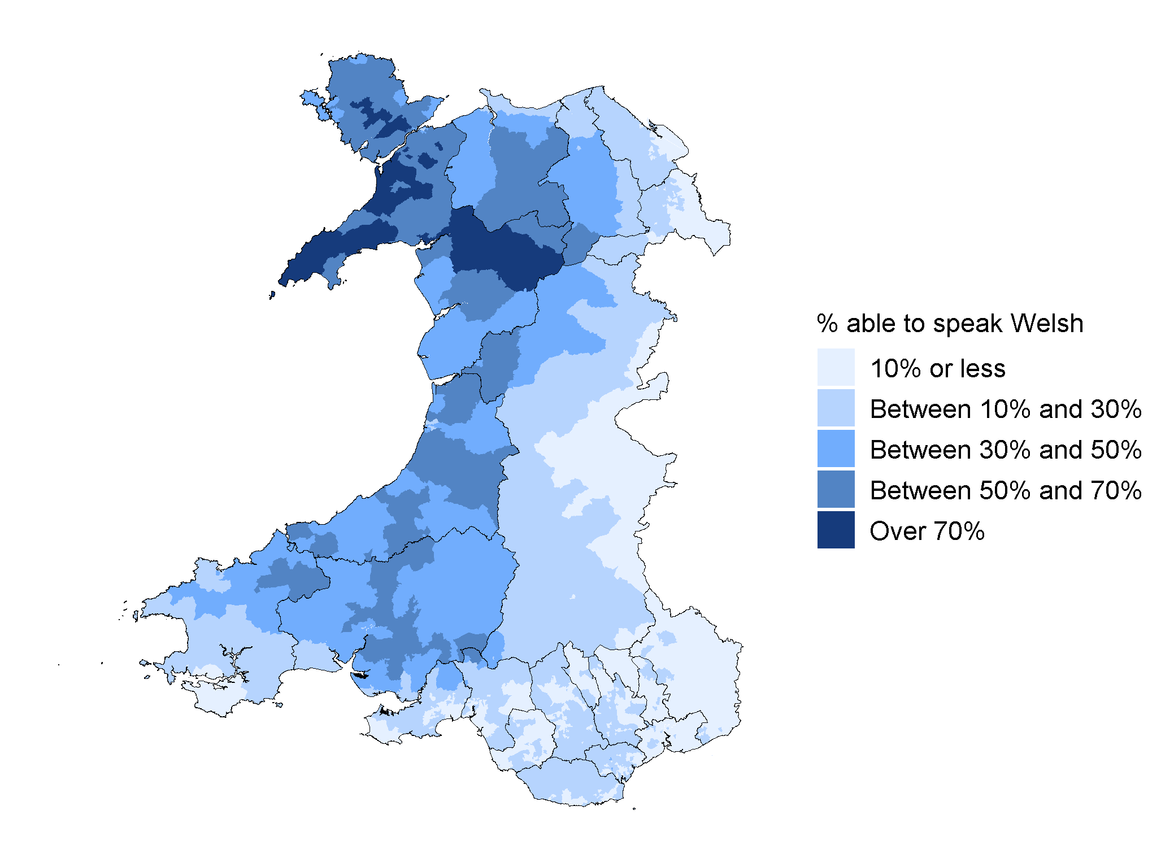
Percentage of people ages 3 years or older able to speak Welsh, by LSOA, 2021

Slide 22
More than Just Words
More than just words - Gwenan Prysor https://youtu.be/qS-9F_qqOXo
More than just words - Hywel Jones
https://youtu.be/YTzMZ4Hqo7Y
More than just words - Wyn Gruffydd
https://youtu.be/IOOs62dzOE4
More than just words - Iola Gruffydd
https://youtu.be/2iF41nNoM5M
Please ensure you watch all of the video clips which can be accessed through Moodle as these will help you think about your own experience and to reflect on why language should be a integral part of the assessment process and service provision.

Slide 23
Welsh Context within Task 2 -Observation
Watch the 4 video clips “More than just words” and use these to help your critical reflection
Provide a range of examples in relation to language need and use including cultural sensitivity
Reflection on personal experience as to why language must be an integral part of assessment and service provision
Including the principles of the “Active Offer” and make reference to “More than Just Words” (Welsh Government, 2012).

Slide 24

The Active Offer
It means not making assumptions that all Welsh speakers speak English anyway!
It ensures Welsh speaking individuals who request/use services are treated with dignity and respect by asking them what their preferred language is and acting on it
It is a proactive approach that ensures language need is identified as an integral part of safe high quality service provision
Making an ‘Active Offer’ is also about creating the right environment where individuals we work with feel empowered and confident that their needs will be met.
More than Just words - www.gov.wales (available on Moodle)

Slide 25

Welsh Language (Wales) Measure, 2011
Became law in 2011
Abolished the Welsh Language Board
Established a Welsh Language Commissioner
Confirmed official status of Welsh
Created rights for Welsh speakers
Introduces duties in the form of Welsh Language Standards

Slide 26
Welsh Language (Wales) Measure, 2011
The Welsh Language Wales Measures, 2011 provides that the Welsh Ministers can specify 5 types of standards in regulations:
Service delivery standards
Policy making standards
Operational standards
Promotion standards
Record keeping standards.
The Welsh Ministers specifies the standards, and it is for the Commissioner to decide which standards a body has to comply with by serving the body with a compliance notice. The compliance notice can require a body to comply with one or more standards, or with standards in some circumstances or in some areas. The Commissioner is not obliged to require everybody to comply with every standard.

Slide 27
Group discussion
Exercise 5
Why should language needs be an integral part of the assessment process and service provision in Wales?
What language needs do you need to consider in your work setting when working with individuals/carers?
What can you do to ensure you are working to the principals of the Active Offer?
What legislation/policy/procedure might you need to consider in relation to effective communication and language needs in your workplace?

Slide 28



Welsh context
You may want to consider:
Industrial decline
Poverty
Unemployment
Poor housing
Geographical location
Religion
Area of deprivation
The role of women in the family and the workforce
Issues of gender and sexual orientation
Political framework/institutions/legislation
Infrastructure
Equality Issues
Equal access to information and services
Translation and interpreter services
Informed choice and informed consent
Limited resources
Public accountability
Social exclusion
Access to the cultural group
Health inequalities

Slide 29

Additional Needs of
Ethnic Minority Groups in Wales
May be disadvantaged e.g. poverty, geography, area, housing, educational attainment, discrimination.
Social isolation (can be greater in rural areas)
Unsure how the system works: seek help, referral
May have complex health needs
Not an homogenous group - adds to the complexities
Access to health and benefit entitlements
Different health beliefs and cultural practices
Different spiritual beliefs and practices
English or Welsh not first Language

Slide 30
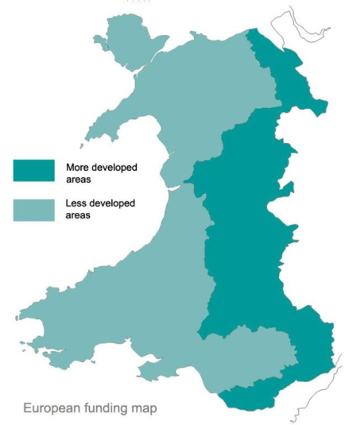

Culture and Communication
Social Work in a Rural Context
Gast and Patmore (2012) discuss shared meanings within communities
In terms of ‘in-groups’ and ‘out-groups’ which can be linked to language spoken:
Common languages help to develop cultures
Social workers’ own culture and communication style can impact on services provided
Language of work setting can create barriers e.g. communication shorthand – how messages are relayed and received etc.
You could identify:
Issues relating to living and working in a rural area
Marginalisation
Problems individualised
‘Rural idyll’
‘Invisibility’
Needs of different cultures and ethnicities
Rural poverty.

Slide 31

Task 2
Observation of Practice

Slide 32

The Observation
Understanding and management of role: incl. use of frameworks/paperwork; preparation/background knowledge of situation
Interpersonal communication: incl. sensitivity to different feelings and communication styles/needs
Self-management: incl. awareness of professional boundaries; tensions/conflicts; impact of social work role and own social identity on the situation; structural inequalities.
When writing up the observation it is important to give a clear geographical context including culture, ethnicity, language needs etc.
The emphasis of the observation is on communication and communication methods; make sure this is evidenced within your work and links to theory/models of communication.

Slide 33
Preparation for the Observation
Choose a case which will enable you to evidence the learning outcomes and assessment criteria.
It must be direct work with an individual and/or their carer
It must be of sufficient complexity for the interaction to last for 30 minutes if it is face to face work.
Virtual or telephone observations do not need to be a minimum of 30 minutes; however, it must be a substantive enough piece of work to evidence the learning outcomes and meet the requirements of the question.

Slide 34
Permission/Consent
Permission of the individual must be gained before the observation takes place and check again before commencing the observation this and the impact of the observation on the individual must be discussed in the “context” section of task 2.
Discuss/prepare the individual/family/carer for being asked for feedback after the observation. Advise the individual that it is fine to give constructive criticism.

Slide 35


Virtual or Telephone Observations
Where possible please undertake the observation face to face, however if this is not possible a phone or virtual observation allows plenty of room to meet the criteria
Consider;
Communication methods and skills; overcoming barriers to this in a phone/virtual conversation. How did you support people to participate?
Environment - is the individual in a safe place, can they focus, are outside influences affecting the interaction? Is the interaction affected by access to internet? How can you ensure confidentiality and empower an individual to participate?
You need to effectively critically reflect on the conversation considering the challenges. For instance, how did you compensate for lack of non-verbal cues e.g., using a solutions focused approach?

Slide 36
Exercise 6 – Observation of Practice
In groups consider a possible observation you intend to undertake (or the observation you have already undertaken):and answer the questions below.
Briefly describe the context/situation, e.g. geographical and legislative contexts as well as cultural, ethnicity, communication and language needs
Set out the social work objectives relating to the work being undertaken.
Consider how you will gain permission for the observation for the individual/family you are working with.
Reflect on potential language and communication needs and approaches including how you ensured person centred practice.
Discuss relevant values and ethics (including the role of the Code of Professional Practice and/or any other guidance relevant to the situation.

Slide 37
Feedback and comments from people in need of care and support and/or their carers
After the observation the individual and/or their carer will be asked for feedback/views on how they think it went
Please take time to discuss this with them in advance
Where the observation is virtual or via a phone call you may need to consider in advance the best way to get feedback from the individual.
You can design your own feedback methods if this is more appropriate for the individual you are working with, in fact this is positively encouraged.
This feedback can be used in Task 1 part b to reflect on feedback from individuals you work with and how it has impacted on your practice.

Slide 38


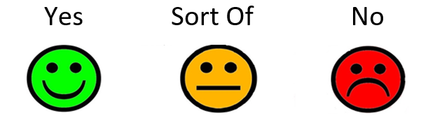


You can design your own feedback methods if this is more appropriate for the individual you are working with, in fact this is positively encouraged.
An easy read version of the questions is available if you are sending the questions out to the individual. New slide with pictures notes when they would use easy read version encourage.

Slide 39
Effective Communication
Good communication is key to the development of effective collaborative relationships.
The ways in which human beings communicate includes:
Verbal (spoken and written)
Non-verbal (body language, facial expression)
Symbolic (meanings behind actions, e.g. being late) wearing of religious symbols, looking at watch, etc.)
Proximity (personal space)
Positions (sitting vs standing, sitting next to someone, sitting opposite, etc.)
Types of questions invite certain answers, e.g. closed vs open
Compare quality of information gained by open and indirect questions and responding to cues.

Slide 40

Obstacles to communication
Uncomfortable environment
Interruptions
Preoccupation with another situation, next visit etc.
Stereotyping and making assumptions about the individual
Past negative experience of social services
Transference – possibly from a previous worker or significant person.

Slide 41
First and Second Order Skills
Koprowska (2010) refers to ‘first order’ and ‘second order’ skills:
First order skills are needed in direct communication
Second order skills are used when planning how we will communicate; thinking, observing, taking feedback, reviewing and modifying future communications accordingly
Compare second order skills with ‘reflection-in-action’ and ‘reflection-on-action’ (Schon, 1984)

Slide 42
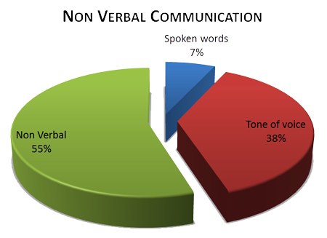
Non verbal communication
Most communication is non verbal
We therefore need a heightened level of self awareness
The degree of acceptable eye contact varies between cultures as do other methods of communication
Research suggests gender differences in communication – women encode and decode better then men and build rapport and smile more often?
(Hall, 2006)
How is this affected when communication is not face to face?

Slide 43
Exercise 7
Reflect upon the reasons why social workers need to be conscious of the range of communication needs and approaches to use to meet these needs.
Consider the ways in which social workers may communicate and the impact of communication on the individuals we work with
Identify any theories and/or models of communication that are or could be relevant to your observation of practice.

Slide 44
Differing Needs
Face-to-face contact and proximity for people with hearing impairments (this can be highly relevant when working with people with mental health issues)
Experience of emotional abuse can lead to difficulties and confusion in reading facial expressions/interpreting tone of voice etc.
People with visual impairments are more attuned to tone of voice, pace of speech and larger body movements which they can hear, see or feel
People with autism can find face-to-face contact disturbing and recognition of emotion difficult.

Slide 45
Workshop 3 Requirements
Complete in discussion with mentors a draft of Task 1 part a of the portfolio
Consider in discussion with your mentor/supervisor a suitable case for the safeguarding assignment for discussion at the next work shop. See portfolio Task 3 and the learning outcomes in the handbook for further details
Go the Social Care Wales hub and look at Social Services and Well-being (Wales) Act 2014 in relation to the Assessment and Safeguarding (Code of Practice) https://socialcare.wales/resources/information-and-learning-hub

