Slide 1



Evaluating the Effectiveness of Structured AI-Assisted Feedback in Secondary School Computing Education
Research Proposal Presentation
MSc Software Engineering & AI
Kelly Casey
2026

Slide 2

Research Context and Background
Artificial intelligence is increasingly integrated into educational environments, with rapid growth in AI-supported learning tools across education sectors [1].
Systematic evidence highlights expanding research into AI applications within primary and secondary school settings, yet structured classroom-aligned implementations remain limited [2].
Programming is widely recognised as challenging for beginner learners, particularly when interpreting technical compiler feedback [3].
Structured and formative feedback plays a critical role in improving learning outcomes and student confidence [4].
However, there remains limited empirical research evaluating structured AI-assisted feedback within secondary school computing education.

Slide 3

Research Problem and Literature Gap
Existing research demonstrates growing AI integration within educational contexts [1], [2].
However, empirical focus has largely centred on higher education or general AI applications, with limited evaluation of structured AI feedback within secondary computing education.
Beginner computing learners frequently struggle with debugging and interpreting technical feedback [3].
While structured formative feedback improves learning outcomes [4], its implementation through AI systems in secondary computing classrooms remains under-examined.
There is therefore a need to empirically evaluate whether structured AI-assisted feedback can improve understanding and confidence among secondary school computing students
[6]

Slide 4
Research Aim and Objectives
Aim - To design and evaluate a structured AI-assisted feedback system and examine its impact on understanding and confidence in secondary school computing students.
Research Objectives
• To conduct a structured literature review on AI in education, programming education, and feedback theory.
• To identify common debugging and feedback challenges experienced by secondary school computing students.
• To design and develop a prototype system delivering structured AI-assisted feedback aligned with educational principles.
• To implement and test the prototype with secondary-level computing learners.
• To collect and analyse quantitative and qualitative data measuring perceived understanding, confidence, and usability.
• To evaluate the effectiveness of structured AI-assisted feedback compared to standard technical feedback.

Slide 5
Research Methodology
Research Philosophy – Positivism
Objective measurement of impact using measurable and observable data.
Research Approach – Deductive
Testing the hypothesis that structured AI feedback improves understanding and confidence.
Research Design – Design Science Research
Development and evaluation of a prototype system.
Research Strategy – Experimental Case Study
Controlled testing within a secondary-level learning setting.
Method Choice – Mixed Methods
Quantitative (confidence & understanding scores)
Qualitative (student reflections & usability feedback)
Time Horizon – Cross-Sectional
Data will be collected during a single controlled study session rather than over a long period.

Slide 6
Research Onion Framework
Strategy
Time
Philosophy
Cross-Sectional
Mixed Methods
Experimental Case Study
Deductive Approach
Positivism
[5]
Method Choice
Approach

Slide 7


Data Collection & Evaluation
Experimental Design
Students will complete computing tasks under two conditions:
Standard technical feedback
Structured AI-assisted feedback
This enables comparison between feedback types.
Participants
Secondary-level computing students
Data Collection
Quantitative Data: Confidence rating scales
Perceived understanding scores System usability ratings
Qualitative Data:
Short reflective responses
Views on usefulness and trust
Data Analysis
Numerical data will be analysed using descriptive statistics and appropriate comparison tests.
Written responses will be analysed thematically to identify common patterns.

Slide 8
Project Planning
Phase 1 – Literature Review & Ethics (March–April 2026)
• Structured literature review
• Finalise research design
• Submit and obtain ethical approval
Phase 2 – Prototype Design & Development (May–June 2026)
• Design structured AI feedback framework
• Develop and internally test prototype
• Iterative refinement of prototype
Phase 3 – Data Collection (July 2026)
• Recruit secondary-level participants
• Conduct controlled experimental sessions
• Collect quantitative and qualitative data
• Contingency planning for participant recruitment
Phase 4 – Data Analysis (August 2026)
• Statistical analysis
• Conduct thematic analysis of qualitative responses
• Interpret findings
Phase 5 – Writing & Final Submission (September 2026)
• Complete dissertation
• Edit and refine
• Final submission

Slide 9
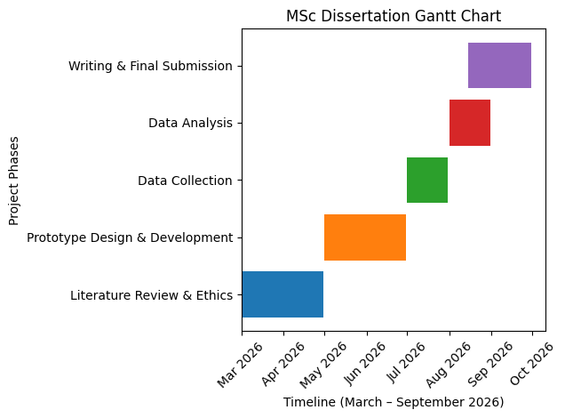

Slide 10



Project Resources and Management
Prototype Development
• Visual Studio Code – code development environment
• HTML, CSS and JavaScript – prototype interface development
• Node.js – backend functionality
• GitHub – version control and project management
Data Collection Tools
• Google Forms – participant questionnaires and confidence ratings
• Task-based programming exercises – controlled computing tasks for participants
• Observation notes during participant tasks– capturing participant interaction
Data Analysis Tools
• Microsoft Excel – descriptive statistics and comparison analysis
• Python (Jupyter Notebook) – statistical analysis and data visualisation
• Thematic analysis – qualitative coding of written responses
Ethics and Data Management
• University ethics approval process
• Participant consent forms
• Secure storage using university OneDrive
• Compliance with GDPR and institutional data protection policies
Participants
• Secondary school computing students (ages 11–16)
• Recruitment through local schools

Slide 11


Project Impact and Limitations
Project Impact and Limitations
• AI-assisted feedback tools may improve understanding of programming concepts
• Structured feedback may help students interpret technical errors more clearly, improving learning confidence.
• The project could provide evidence on how AI tools may support computing educationrather than replace teachers.
• Findings may help inform future classroom use of AI-supported learning tools in computing education.
Limitations
• The study will involve a relatively small participant sample, which may limit generalisability.
• The prototype system will be simplified and experimental, rather than a full production system.
• Results will be based on short-term interaction with the system, rather than long-term learning outcomes.
• Participant responses may include subjective perceptions, which may influence qualitative findings.

Slide 12

References
[1]O. Zawacki-Richter, V. I. Marín, M. Bond, and F. Gouverneur, “Systematic review of research on artificial intelligence applications in higher education – where are the educators?,” International Journal of Educational Technology in Higher Education, vol. 16, no. 1, pp. 1–27, Oct. 2019, doi: https://doi.org/10.1186/s41239-019-0171-0.
[2]S. J. Lee and K. Kwon, “A systematic review of AI education in K-12 classrooms from 2018 to 2023: Topics, strategies, and learning outcomes,” Computers and Education: Artificial Intelligence, vol. 6, no. 100211, p. 100211, Jun. 2024, doi: https://doi.org/10.1016/j.caeai.2024.100211.
[3]A. Robins, J. Rountree, and N. Rountree, “Learning and Teaching Programming: A Review and Discussion,” Computer Science Education, vol. 13, no. 2, pp. 137–172, Jun. 2003, doi: https://doi.org/10.1076/csed.13.2.137.14200.
[4] J. Hattie and H. Timperley, “The Power of Feedback,” Review of Educational Research, vol. 77, no. 1, pp. 81–112, 2007, doi: https://doi.org/10.3102/003465430298487.
[5]M. Saunders, P. Lewis and A. Thornhill, Research Methods for Business Students, 8th ed. Harlow, UK: Pearson Education, 2019.
[6] “Performance 101: Feedback Importance And How To Make It Constructive,” HROne HR Software, Jun. 14, 2024. https://hrone.cloud/blog/performance-101-feedback-importance/ (accessed Mar. 04, 2026).

