Slide 1

Consultancy Project
Anna Nesterova
P140421

Slide 2
Morgans Hotel
Morgans Hotel is Privately owned organization.
The hotel was opened in 2002
The building of the hotel is listed and has historical background
Hotel has 2 main parts of the building( the main building and townhouse)
All together hotel has 42 rooms
3 restaurants, 2 bars and a conference room all can bee used for functions

Slide 3
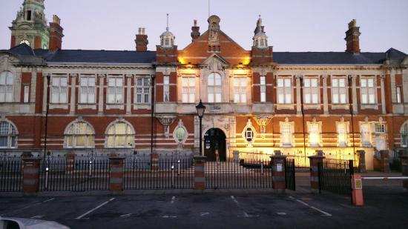

Slide 4
Management
Martin Morgan
Christine Major
Gemma Cleare
HR Manager
Georgina Watts
General Manager
Rachel Evans
Events Manager
Chris
Head Chef
Mark Reynolds
Debbie Jones
Emma Waren
Rhiannon Evans
Orane Nelsonn
Other Staff
F&B
House keeping

Slide 5
Consultancy
"The provision to businesses of objective advice and assistance relating to the strategy, structure, management and operations of an organization in pursuit of its long-term purposes and objectives. Such assistance may include the identification of options with recommendations; the provision of additional resources; and/or the implementation of solutions."

Slide 6
Why consultancy is important for Organization
The organization faced dramatic drop in employment
Management changed for a number of times
No strategy placed on employment motivations
Long hours/ Unhappy Staff

Slide 7
Aims & Objectives
Aim
To make improvements in staff motivations & work effectiveness in Morgans
Objectives
To work close with F&B staff and Managers
To question members of staff, analyze issues
To reflect collected information to managers
Come up with effective plan on how to make improvements

Slide 8
How I am going to achieve my objectives (Timescale)
Meet with members of staff once a week and question employees
Come in once a week and observe the work effectiveness
In the end of the week hold a meeting with member of management reflect observations and collected information
With management create an effective plan on motivations
Start working on the plan and observe improvements

Slide 9
Time Scale
21stFebruary | Bid Presentation
26thFebruary |  | Organize a meeting with F&B
4thMarch |  |  | Do questionnairs with F&B
9thto 11thMach |  |  |  | Come in for an Observation
14th March |  |  |  |  | PID
18th March |  |  |  |  |  | Meet with managers (reflect)
25th March |  |  |  |  |  |  | Come up with action Plan
1st April |  |  |  |  |  |  |  | Come in to observe
2nd May |  |  |  |  |  |  |  |  | Project report

Slide 10
Overall
To come up with effective plan on how to motivate staff and how to improve work
Create a strategy document how to motivate staff
Come up with team exresises, to build team spirit
To bring staff & management together
Create happy environment for staff

