Slide 1


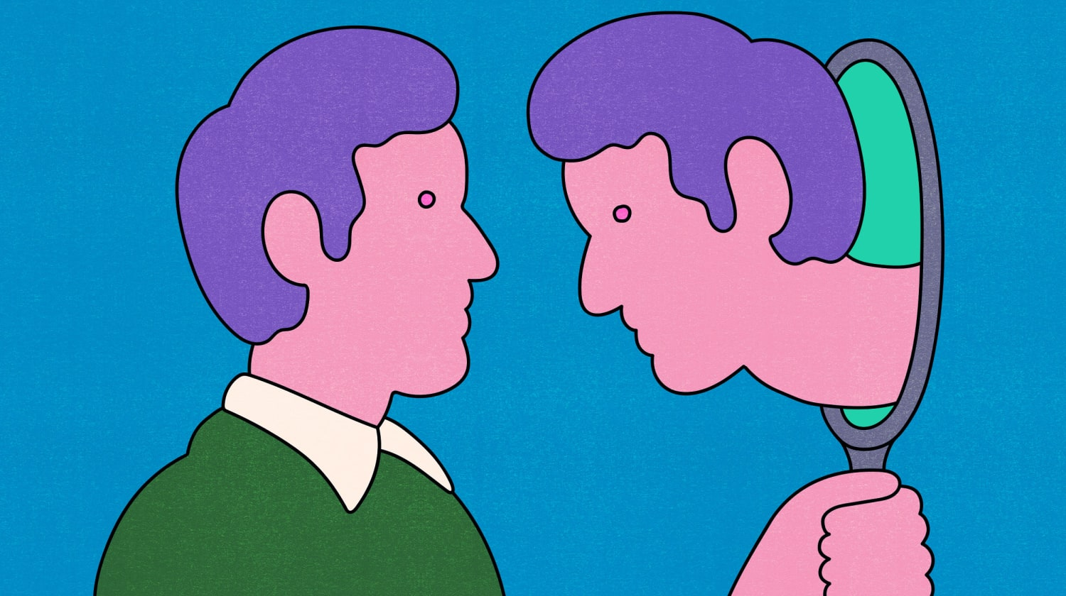

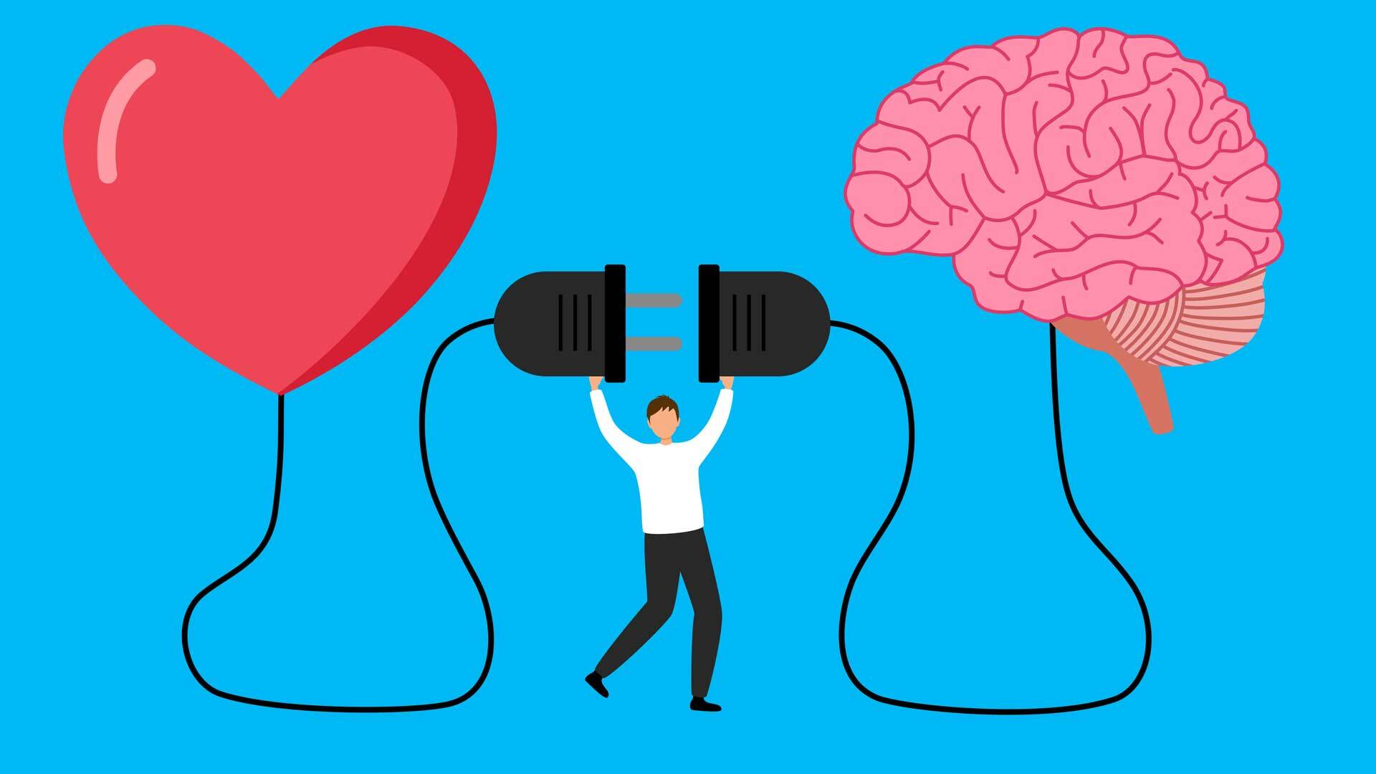
The impact of our emotions on Emotional Intelligence
Rozalia-Mia Dragan
Student ID: 2330749
Module Title: LCLM 5006 Developing Emotional Intelligence Skills
Emotional Intelligence (EI) is defined as the ability to recognise, understand, manage, and use emotions effectively in oneself and others (Mayer, Salovey & Caruso, 2004). Goleman (1995) emphasises that self-awareness is the foundation of emotional intelligence, suggesting that individuals who are disconnected from their own emotions struggle to interpret emotions in others. Within higher education, emotional intelligence is closely linked to stress management, motivation, academic engagement, and performance (Schutte et al., 2007). This poster critically discusses how personal emotions influence emotional intelligence and how students can develop mindfulness to enhance academic success.
Research indicates that emotional intelligence positively influences academic achievement by improving motivation, resilience, and stress tolerance (Schutte et al., 2007).
Key factors contributing to success:
Emotional self-regulation
Motivation and persistence
Effective communication and collaboration
Adaptability to academic challenges
Actions to address EI challenges:
Seeking academic and emotional support
Maintaining healthy routines
Engaging in reflective learning practices
Developing peer interaction skills
Students with higher emotional intelligence are better equipped to manage academic pressure and sustain long-term success (Goleman, 1995).
Introduction
Emotional Intelligence and Academic Success
Students frequently experience stress, anxiety, and self-doubt due to academic demands. Emotional control begins with acknowledging emotions rather than suppressing them (Kabat-Zinn, 2003).
Effective strategies include:
Mindful awareness: Observing emotions without judgement reduces emotional reactivity (Kabat-Zinn, 2003).
Time management: Structured planning reduces emotional overload and anxiety (Schutte et al., 2007).
Cognitive reframing: Viewing challenges as learning opportunities supports emotional resilience (Goleman, 1995).
Self-compassion: Accepting mistakes promotes emotional balance and persistence (Mayer, Salovey & Caruso, 2004).
Breathing and grounding techniques: These techniques help regulate stress responses and improve focus (Kabat-Zinn, 2003).
Mindfulness enhances concentration, emotional regulation, and academic confidence.
Emotional intelligence is not fixed and can be developed through intentional practice (Goleman, 1995).
Key development strategies include:
Self-awareness: Recognising emotions as they occur allows individuals to understand emotional triggers and behavioural responses (Mayer, Salovey & Caruso, 2004).
Self-regulation: Managing emotional impulses supports rational decision-making and reduces stress (Goleman, 1995).
Empathy: Understanding others’ emotional perspectives strengthens interpersonal relationships and communication (Goleman, 1995).
Reflection and feedback: Reflective practices improve emotional insight and emotional growth over time (Schutte et al., 2007).
Mindfulness: Mindfulness practices enhance emotional control and attentional focus (Kabat-Zinn, 2003).
Developing emotional intelligence requires continuous reflection and emotional awareness.
Controlling Emotions and Developing Mindfulness as a Student
How Can Someone Develop Emotional Intelligence?
Emotional intelligence begins with self-awareness. As highlighted by Goleman (1995), understanding one’s own emotions is essential for understanding others and achieving academic success. By developing mindfulness and emotional regulation strategies, students can enhance emotional intelligence, improve well-being, and perform more effectively in their studies.
Conclusion
Goleman, D. (1995). Emotional Intelligence. Bantam Books.
Kabat-Zinn, J. (2003). Clinical Psychology, 10(2), pp.144–156.
Mayer, J.D., Salovey, P. & Caruso, D.R. (2004). Psychological Inquiry, 15(3), pp.197–215.
Schutte, N.S. et al. (2007). Personality and Individual Differences, 42(6), pp.921–932.
References
Notes:
Goleman, D. (1995). Emotional Intelligence. Bantam Books.
Kabat-Zinn, J. (2003). Clinical Psychology, 10(2), pp.144–156.
Mayer, J.D., Salovey, P. & Caruso, D.R. (2004). Psychological Inquiry, 15(3), pp.197–215.
Schutte, N.S. et al. (2007). Personality and Individual Differences, 42(6), pp.921–932.

