Slide 1
Week 2: Session 1:
Research Process
Independent Project
LCBB6014

Slide 2
Why Do Business Research?
Reasons for conducting business research include:
  There is a gap in the literature;
  There is inconsistency amongst studies;
  There are unresolved issues;
  Societal development prompts a research question;
  To understand a topic or phenomena better

Slide 3
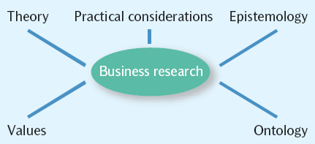
Influences On Business Research

Slide 4
Business Research in Context
The following factors affect the context within which research takes place:
  Academic theories
  Existing knowledge
  Researcher’s assumptions and views regarding the research process
  Researcher’s assumptions regarding the nature of social phenomena
  Quality criteria used to evaluate research
  Values of research community
  Political context of research study
  Training and personal researcher values

Slide 5
The Role Of Theory In Research
  Which comes first, theory or research?
  Should we examine a problem, and then try to work out how it is caused, and how it might be solved (inductive reasoning)?
  OR
Should we take a generally accepted theory of how things work and find evidence for it in the problem we examine (deductive reasoning)?

Slide 6
Relevance of Research to Practice
  An applied field understanding organizations and solving problems?
  Has management research lost touch with the concerns of practitioners (Tranfield and Starkey, 1998)?
  A resource for managers to make inform decisions based on scientific evidence (Rousseau, 2006:256)?
  Can dynamic and changing nature of organizations challenge generally applicable best practices (Reay, et al, 2009)?

Slide 7
Evidence-based Management
  Evidence-based management is the systematic use of the best available evidence to improve management practice (Reay, Berta and Kohn 2009).
  The concept was developed to reduce variation in (clinical) practice.
  Information comes, in part, from the expertise and judgement of managers working in individual firms.

Slide 8
Knowledge Is ‘Produced’ In Two Modes
Mode 1
  traditional, university-based
  academic audience
  pure and applied
  built upon existing knowledge
  more linear process
  limited emphasis on dissemination
Mode 2
  Involves academics, policy-makers, and practitioners
  trans-disciplinary
  related to context (and therefore not easily replicated)
  less linear process
  more emphasis on dissemination and exploitation

Slide 9
The Process of Business Research
Literature Review
Concepts and Theories
Sampling
Research Questions
Data Collection
Data Analysis
Writing Up
The research process is a series of linked stages and gives the appearance of being organised in a linear manner.

Slide 10
The Process of Business Research
Literature Review
  What is already known about the topic?
  What concepts and theories have been applied to it?
  What research methods have been applied in studying it?
  What controversies exist about the topic and about how it is studied?
  What clashes of evidence (if any) exist?
  Who are the key contributors to research on the topic?

Slide 11
The Process of Business Research
Concepts
Concepts are the way that we make sense of the social world.
Concepts are labels that we give to aspects of the social world that seem to have significant common features.
Choice between deductive and inductive approaches

Slide 12
The Process of Business Research
Research Questions
Types of research question (Denscombe, 2010):
  Predicting an outcome (does y happen under circumstances a and b?)
  Explaining causes and consequences of a phenomenon (is y affected by x or is y a consequence of x?)
  Evaluating a phenomenon (does y exhibit the benefits that it is claimed to have?)
  Describing a phenomenon (what is y like or what forms does y assume?)
  Developing good practice (how can we improve y?)
  Empowerment (how can we enhance the lives of those we research?)

Slide 13
The Process of Business Research
Sampling
  E.g. in survey research, or case study research
Data Collection
  E.g. Structured interview or participant observation
Data Analysis
  Transcriptions, coding, thematic analysis, secondary analysis
Writing up
  Generally to include the literature review, research methods, results, discussion and conclusion

Slide 14
The Messiness of Business Research
The process of business research is not always so linear in reality – it can be much messier.
Flexibility is important as you navigate the research process.
Your own research community (i.e. classmates and/or supervisor, etc) is important to support you through the process.

Slide 15
Key Points
Business research and business research methods are embedded in wider contextual factors.
Business research practice comprises elements that are common to all (or at least most) forms of business research.
Attention to these steps is what distinguishes academic business research from other kinds of business research, such as market research conducted by private companies.
Although we can attempt to formulate general principles for conducting business research, we have to recognize that things do not always go entirely to plan.

Slide 16
Business Research?
Cooper and Schindler (2001, p. 15): “A systematic enquiry that provides information to guide business decisions.”
Zikmund (1997, p.6): “The systematic and objective process of gathering, recording, analyzing data for aid in making business decisions.”
Research is systematic, disciplined and focused on gathering information to understand a phenomena, answer questions or solve research problems.

Slide 17
Pure vs. Applied Research
Pure / Basic Research: Also known as basic research. Research that is done for the sake of knowledge or to develop and extend understanding of specific phenomena within a field of study. There is no immediate managerial decisions and implications to be made.
Applied Research: Has a practical problem-solving emphasis. Directed much more to making immediate managerial decisions.

Slide 18
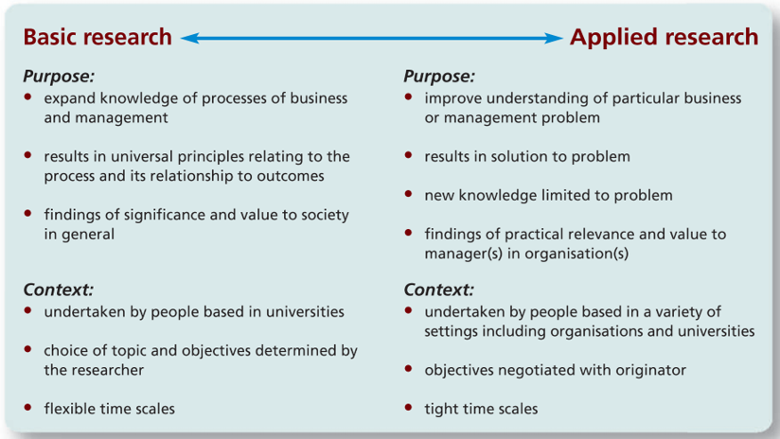
Pure vs. Applied Research

Slide 19
Purpose of Research
Reporting: The most elementary level to provide an account or summation of some data or to generate some statistics.
Descriptive: To discover or verify answers to the questions who, what, when, where, and, sometimes, how. Does not have the potential for drawing powerful inferences.
Explanatory: Goes beyond description and attempts to explain the reasons for the phenomenon that the descriptive study only observed. Grounded in theory and theory is created to answer why and how questions. Provide a plausible explanation for an event after it has happened.
Predictive: Rooted in theory as explanation to predict when and in what situations the event will occur.

Slide 20
What is Good Research?
Purpose clearly defined
Research process detailed
Research design thoroughly planned
High ethical standards applied
Limitations frankly revealed
Adequate analysis
Findings presented unambiguously
Conclusions justified
Researcher’s experience reflected

Slide 21

Any Questions?
Thank You ☺

Slide 22
Sources:
Saunders, M.N.K. (2019) Research methods for business students. 8th ed. Harlow: Pearson.
Adams, J. (2014) Research Methods for Business and Social Science Students. New Delhi: SAGE Publications.
O’Gorman, K. (2015) Research methods for business & management: a guide to writing your dissertation. 2nd ed. Oxford, England: Goodfellow Publishers Ltd.
Zikmund, W. G. (2010) Business research methods. 8Th ed. Mason, OH: South-Western Cengage Learning.
Clippinger, D. (2017) Business research reporting. Business Expert Press.

