Slide 1

Distribution of Weight Transfer by looking at roll stiffness

Slide 2
Simple Case of Cornering Car with Rigid Suspension
Inner Wheel
Car cornering to
Outer Wheel
Left
Centre
of Gravity
M_{t}
H
T
WT
WT

Slide 3
Simple lateral weight transfer calculation – rigid vehicle
Over turning moment = M_{t}a_{y}H
Reaction moment = WT x T
For equilibrium Reaction = Overturning moment
Giving WT = M_{t}a_{y}H
T

Slide 4
Three Mass Weight Transfer
A simple method can be used to obtain an effective indication of the effect of changes to the suspension setup on load transfer
This calculates the weight transfer produced by three distinct causes

Slide 5
Weight transfers
Weight transfer due to the unsprung mass
Weight transfer due to sprung mass which is taken as acting at the roll centre height.
Weight transfer due to the sprung mass which is taken as acting about the roll centre

Slide 6
Example Data
Data
Tf Front track 1.270 m
Tr Rear track 1.335 m
L Wheel base 2.248 m
H CG height above roll axis 0.350 m
Msf Front sprung mass 312 kg
Msr Rear sprung mass 328 kg
Musf Front total unsprung mass 60 kg
Musr Rear total unsprung mass 70 kg
r Rolling radius of tyre 0.277m
hf Front RC height 10 mm
hr Rear RC Height 50 mm
Kwr Rear wheel rate 21875 N/m
Kwf Front wheel rate 20483 N/m
Karr Rear anti roll bar wheel rate 4500 N/m
Karf Front anti roll bar wheel rate 5000 N/m
a_{y} Lateral acceleration 6m/s2
Front suspension - unequal length double wishbones
Rear suspension - unequal length double wishbones

Slide 7
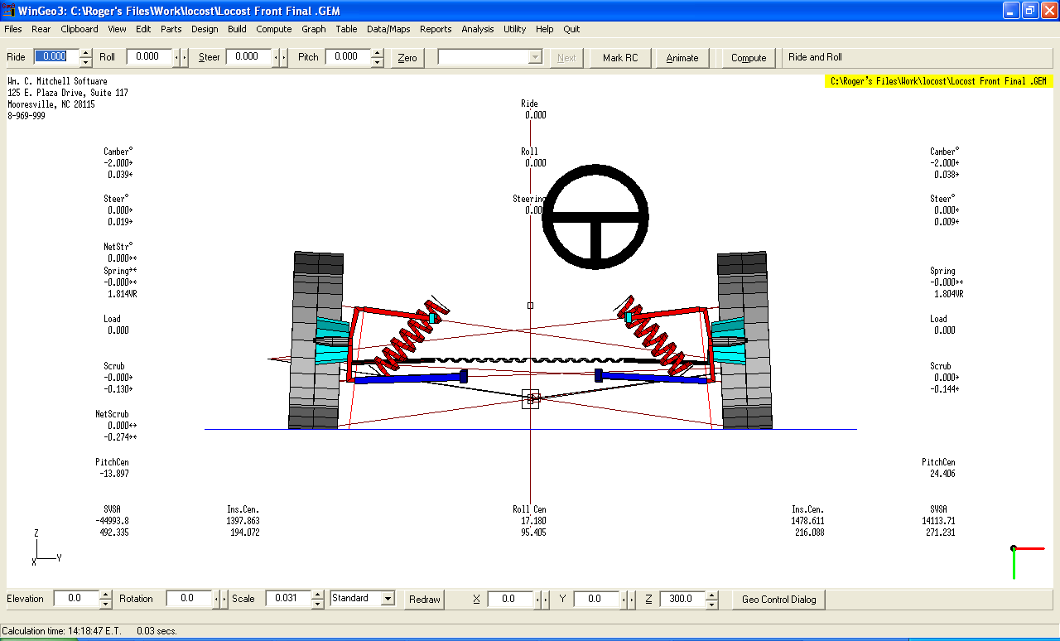
Weight Transfer of Sprung Mass acting about the Roll Axis
For the purpose of this exercise we will look at this, the most important weight transfer for a car with an independent suspension system

Slide 8
Weight transfer due to the sprung mass which is taken as acting about the roll centre and which is resisted by the springs.

Slide 9
Vehicle roll
he diagram below symbolises a lateral axis of the body The car has rolled through θ radians causing a deflection of inner and out wheels of δ m. As a wheel rate of Kw is defined (which is the effective spring rate at the wheel) the wheel displacement can be taken as the effective spring displacement.
The diagram below symbolises a lateral axis of the body The car has rolled through θ radians causing a deflection of inner and out wheels of δ m. As a wheel rate of Kw is defined (which is the effective spring rate at the wheel) the wheel displacement can be taken as the effective spring displacement.
The diagram below symbolises a lateral axis of the body The car has rolled through θ radians causing a deflection of inner and out wheels of δ m. As a wheel rate of Kw is defined (which is the effective spring rate at the wheel) the wheel displacement can be taken as the effective spring displacement.
The diagram below symbolises a lateral axis of the body The car has rolled through θ radians causing a deflection of inner and out wheels of δ m. As a wheel rate of Kw is defined (which is the effective spring rate at the wheel) the wheel displacement can be taken as the effective spring displacement.
Eqn 3

Slide 10
Roll Moment
Anti- roll moment produced by the springs = Mϕ
Equ 4
Equ 5

Slide 11
Roll Stiffness
Roll stiffness of the front suspension = Kϕ Nm/rad
Kφ = M φ
θ
But
So roll stiffness of an independent suspension =
Kφ = (T² x Kw )
2

Slide 12
Roll stiffness at each end
Front
Kφf = (Tf² x Kwf ) Eqn 6f
2
and similarly for the Rear
Kϕr = (Tr² x Kwr) Eqn 6r
2

Slide 13
Total Roll Stiffness for the Car
Total roll stiffness for the car = Kϕt
Kϕt = (Tf² x Kwf ) + (Tr² x Kwr )
2 2
So
Kϕt = (Tf² x Kwf ) + (Tr² x Kwr ) Nm/Rad Eqn 7 2

Slide 14
Roll Angle
When cornering, an overturning moment (Mot) is produced by d’Alemberts force acting on the centre of mass about the roll axis with a moment arm of H m.
Nm Eqn 8
This is resisted by the springs and the roll angle produced in cornering is therefore:
Radians

Slide 15
Roll Angle
The roll angle produced by a lateral acceleration of a_{y} = θ Radians
Radians Eqn 9

Slide 16
Work to do
Calculate the roll stiffness at each end and hence the total roll stiffness and resultant angle for the vehicle described in the data list on Slide 6 of this presentation

Slide 17
Solutions to example
Kϕtf = 16518.5 Nm/rad
Kϕtr = 19 493.1 Nm/rad
Kϕt tot = 36011.6 Nm/rad
Mot = 1344 Nm
θ= 0.0373 rad (ie 2.14 deg)

Slide 18
Weight transfer due to sprung mass acting about the roll axis
Knowing the value of θ, the weight transfer due to the sprung mass which is taken as acting about the roll centre axis can be determined.
Although still a simplification it can be assumed that the load transfer distribution front to rear for the sprung mass acting about the roll axis will be in proportion to the roll stiffness front to rear.

Slide 19
At each end of the car the increased spring load produced by the upward deflection of the outer wheel is equivalent to the weight transfer of the sprung mass acting about the roll axis, WTs . The chassis is assumed to be infinitely stiff and so roll angle θ is assumed to be the same at each end of the car.

Slide 20
Weight transfer WTs due to sprung mass at each end of the car
So
and
Eqn 11f
Eqn 11r

Slide 21
Calculation of weight transfers
The roll angle and roll stiffness for the worked example has already been determined at 0.0373 rad ( 2.14 deg)
The actual weight transfer now needs to be calculated using these equations .
Giving :
WTsf = 0.0373*1.27*20483/2 = 485.2 N
Giving :
WTsr = 0.0373*1.335*21875/2 = 544.6 N

Slide 22
To find the total weight transfer
For the purpose of this exercise (and because they have a much smaller influence on the total weight transfer) the weight transfers produced by the sprung mass acting at roll centre height and unsprung mass at wheel centre height will be ignored

Slide 23
Determination of individual wheel loads due to sprung mass acting about roll axis
The following suffixes are used to identify the wheel loads .
o = outer i = inner z = vertical y = lateral
So, for example, Fzof = Vertical load on the outer front tyre
The front outer wheel load be determined by taking the static wheel load and adding the load transfer to it
Similarly the front inner wheel load can be determined by subtracting the load transfer from the static load.

Slide 24
To final individual corner loads
Direction of turn ←
Front ↑

Slide 25
Example - Front Outer Wheel Load
Fzof = (Msof + Musof) x 9.81 + Total Front weight Transfer

Slide 26
Front outer wheel load for example data
The car is turning left so the weight transfer calculated will be added to the static load of the front right wheel
Static load = (Musf/2 + Musf/2 ) x 9.81
= (312/2 +60/2 ) x 9.81
= (156 + 30) x 9.81
= 1824.66 N

Slide 27
Front outer wheel load
Weight transfer = 485.2 N
Total wheel load = 1824.66N + 485.2 N
= 2309.86 N

Slide 28
Now find the other corner loads
? | 2309.9
? | ?

Slide 29
Dynamic corner load distribution
1339.6 | 2309.9
1407.6 | 2497.6

Slide 30
Rowley Split Table - static loads

Slide 31
Rowley Split Table - dynamic loads

Slide 32
Significance of results obtained
It can be seen that the front and rear load split difference ( in the green cell) is 119.7 N
ie the rear load split is greater than the front load split. This should mean the rear will have less grip than the front but all parameters such as tyre size compound and pressure , damping etc. will have an effect.
So this value would need to be compared with the actual behaviour of the car – for example 119.7 N may give an ideal understeer characteristic.

Slide 33
Significance of results obtained
If the suspension were changed and the the results for the car cornering at 6m/s² now gave a split of say 300N difference ( ie the rear split is now even greater than the front split) then we would know that the level of understeer would be reduced

Slide 34
Modification when using a live axle
Where the vehicle has a rear axle the spring track is used instead of the wheel
track and spring rate is used instead of the combined wheel and tyre rate.
The body now compresses the springs across the spring track Ts rather
than the wheel track.

Slide 35
Roll angle for a car with a live axle
The analysis is exactly the same but Spring track, Ts replaces Tr and Kwr
is equal to Ksr (unless some suspension leverage exists due to the positioning of the Spring) and the deflection δ of the wheel is now the direct deflection of the spring on the axle.
The equation for θ then becomes :
Rad Eqn 10

Slide 36
Weight transfer with live rear axle
With a live rear axle the load increase at the spring is not the weight transfer experienced at the wheel. As the body rolls relative to the axle the outer spring is compressed and the spring load increase is Fsr then:
The increased wheel load produced by this increased spring load is WTsrl

Slide 37
To find the weight transfer reacted at the wheel,
Equate the moment produced by the increased wheel load WTsrl with moment produced by increased spring load Fsr
Substituting for Fsr gives
Eqn 13r

Slide 38
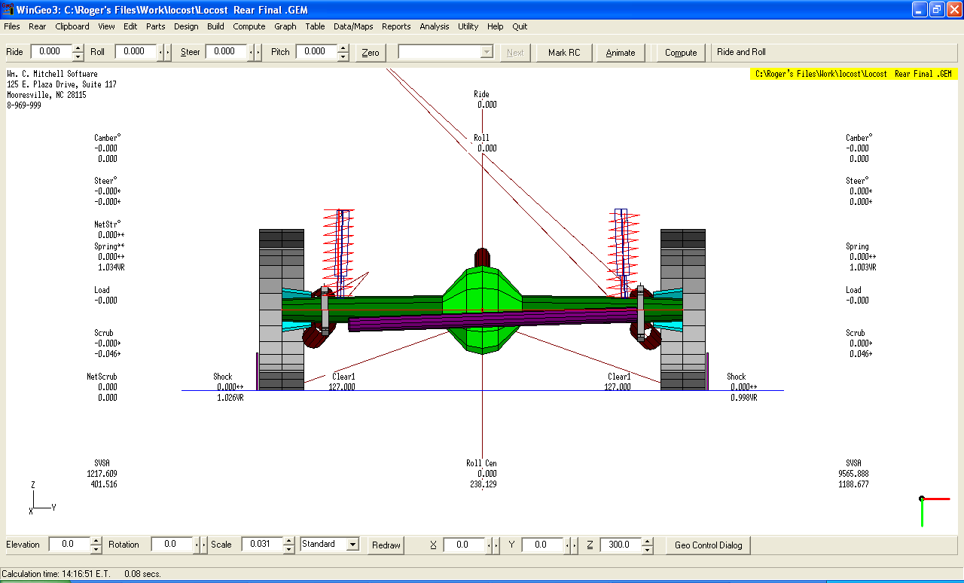
Finding roll centres from WinGeo3

