Slide 1
Clah4007 Defenders
404-354 Imperialism and Chaos: Persia and the Greeks

Slide 2
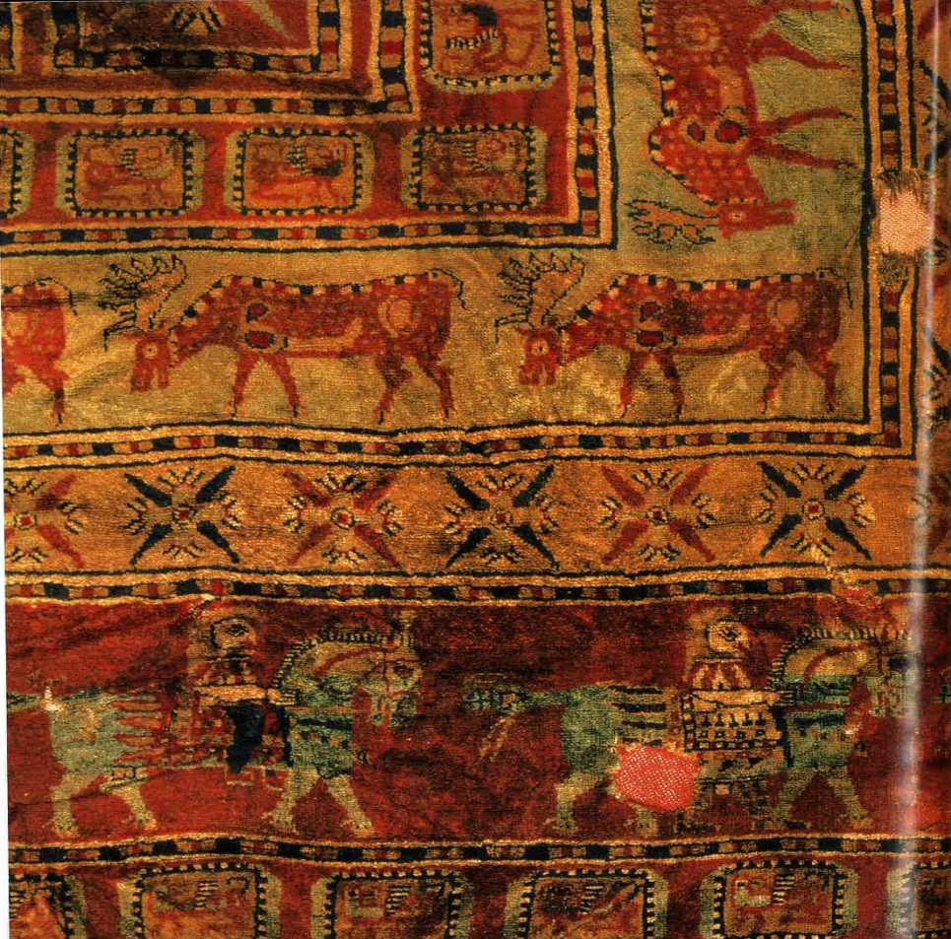
Persia and the greeks
404-366

Slide 3
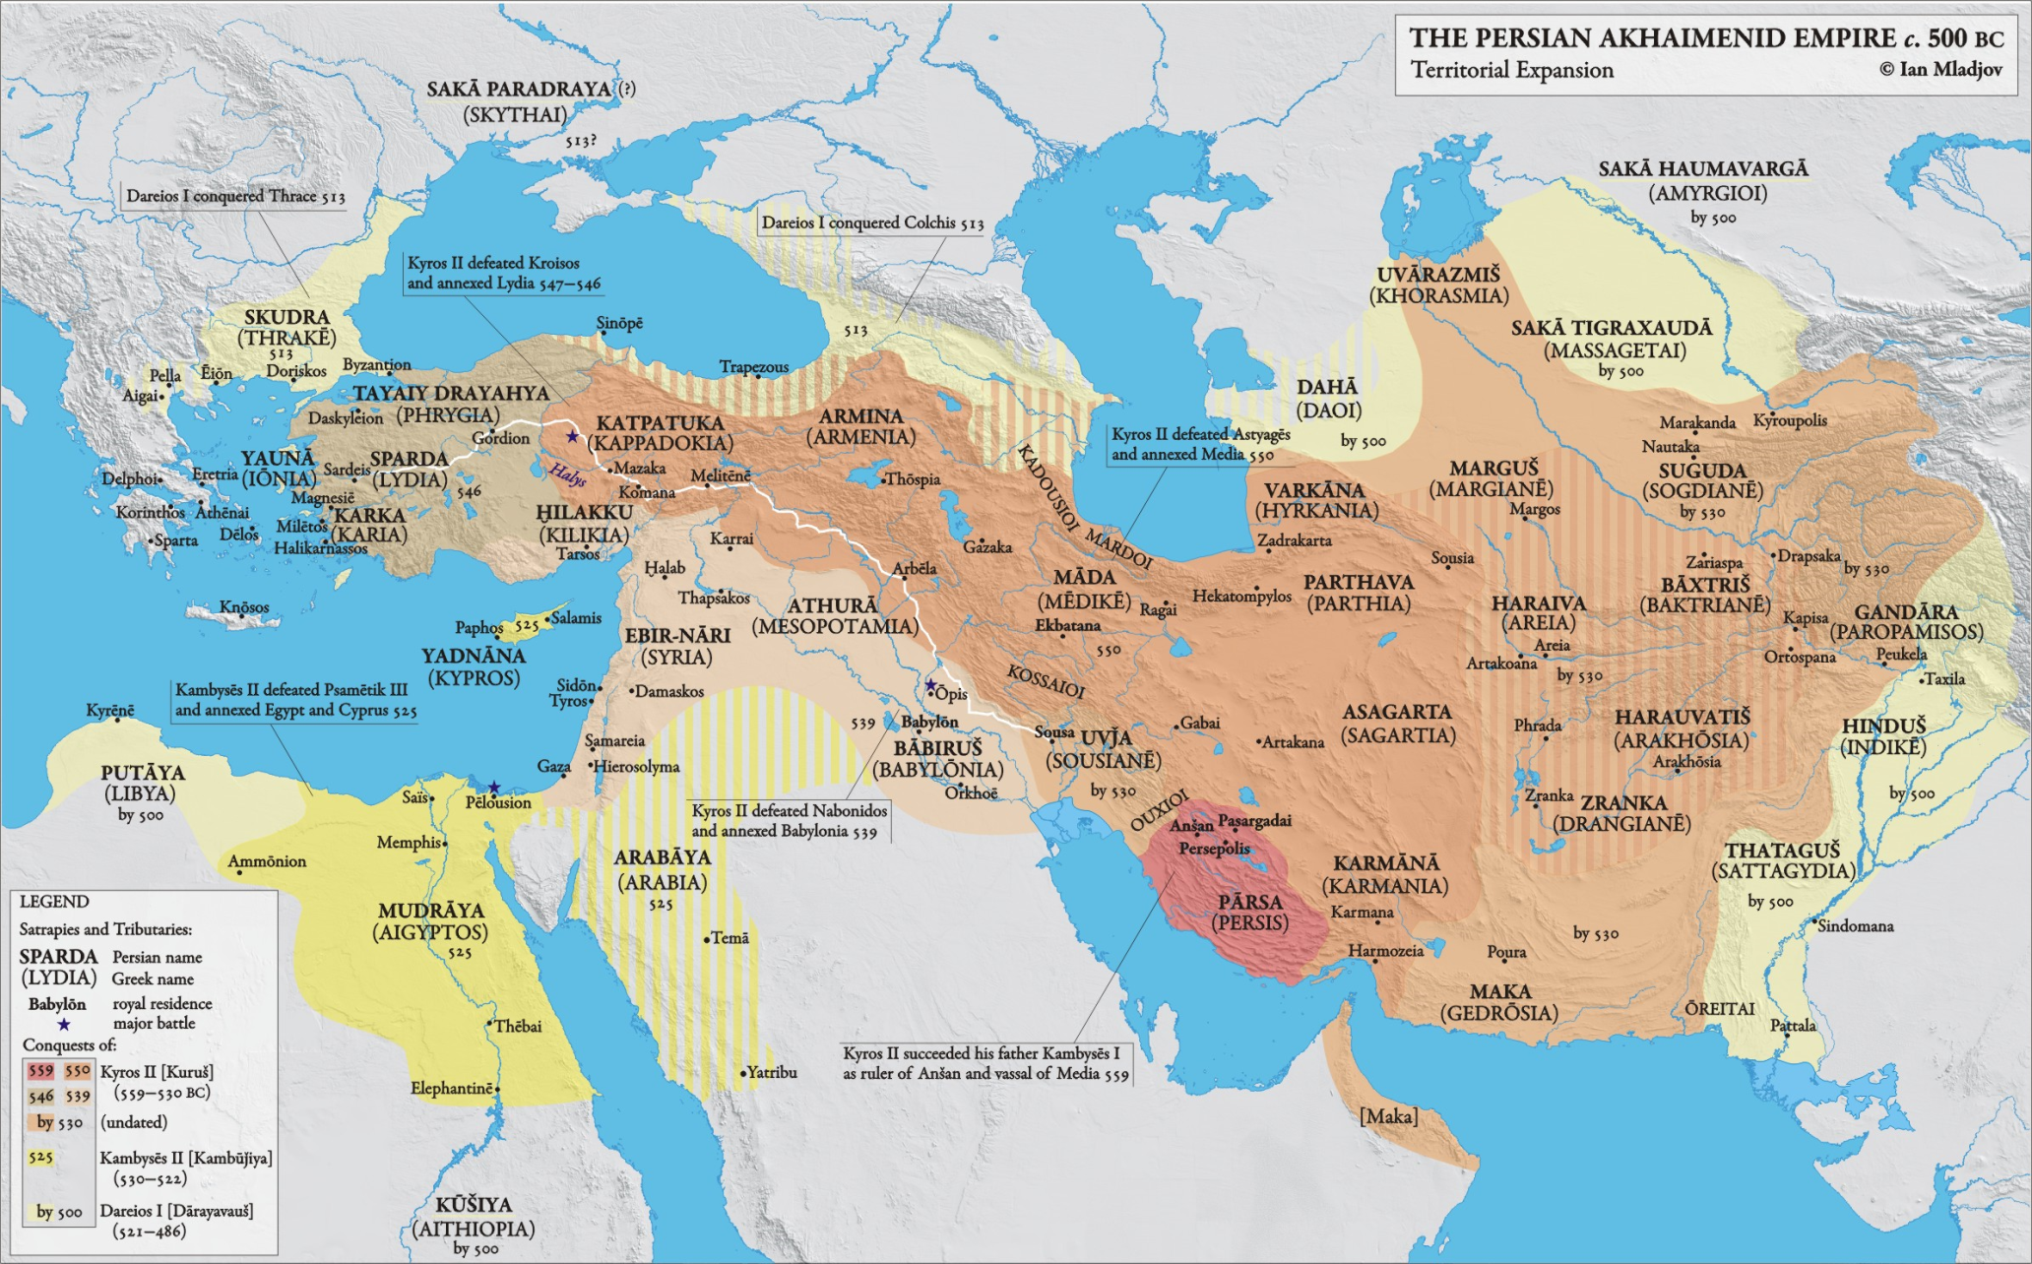
The Persian Empire

Slide 4
The Freedom of the Greeks
But they, both because they wanted to be free and because they feared Tissaphernes, inasmuch as they had chosen Cyrus...instead of him, refused to admit him into their cities and sent ambassadors to Lacedaemon asking that the Lacedaemonians, since they were the leaders of all Hellas, should undertake to protect them also, the Greeks in Asia, in order that their land might not be laid waste and that they themselves might be free. [4] Accordingly, the Lacedaemonians sent them Thibron as governor, giving him an army made up of a thousand emancipated Helots and four thousand of the other Peloponnesians. Xenophon Hellenika 3.1.3-4
412: Sparta allies with Persia against Athens.
406/5: In Cyrus’ absence, Lysander made de facto satrap of Asia Minor.
401-400: Revolt of Cyrus the Younger against the Persian king. Sparta supports him. Cyrus loses.
396: Spartan campaign to “free” Asia Minor from Persia.

Slide 5
The Corinthian War
395-386
Between Sparta (and allies) and an alliance of Athens, Argos, Corinth, and Thebes.
The importance of Persian support becomes obvious.
Ends with the King’s Peace (387/6).

Slide 6
Persian support against Sparta
But now Tithraustes, …sent Timocrates the Rhodian to Greece, giving him gold to the value of fifty talents of silver, and bade him undertake, on receipt of the surest pledges, to give this money to the leaders in the various states on condition that they should make war upon the Lacedaemonians. So Timocrates went and gave his money, at Thebes to Androcleidas, Ismenias, and Galaxidorus; at Corinth to Timolaus and Polyanthes; and at Argos to Cylon and his followers. [2] And the Athenians, even though they did not receive a share of this gold, were nevertheless eager for the war, thinking that theirs was the right to rule. Xenophon Hellenika 3.5.1-2
After the Spartan defeat at Knidos, Persia supported openly a major revolt against Sparta in Greece itself.
By providing money for the anti-Spartan alliance, Persia brought Sparta to bay very quickly and stopped any Spartan effort to “free” Asia Minor.

Slide 7
The King’s Peace: 387/6.
With Persian support, Sparta concluded a Peace guaranteed by the Persian King with the other Greeks.
The treaty put Sparta in a position of power and with Persian support it was almost impossible to dispute her power in Greece.

Slide 8
The King’s Seal and the Autonomy Clause
“King Artaxerxes thinks it just that the cities in Asia should belong to him, as well as Clazomenae and Cyprus among the islands, and that the other Greek cities, both small and great, should be left autonomous, except Lemnos, Imbros, and Scyros; and these should belong, as of old, to the Athenians. But whichever of the two parties does not accept this peace, upon them I will make war, in company with those who desire this arrangement, both by land and by sea, with ships and with money.” Xenophon Hellenika 5.1.31

Slide 9
2nd Athenian League and the King’s Peace
For the good fortune of the Athenians and the allies of the Athenians. So that the Spartans shall allow the Greeks to be free and autonomous, and to live at peace occupying their own territory in security, and so that the peace and friendship sworn by the Greeks and the King may be in force and endure in accordance with the agreements… Rhodes & Osborne 22.7-14

Slide 10
Another King’s Peace
371: Battle of Leuctra, Theban victory over Spartans.
367-6: Efforts to create another King’s Peace, only under Thebes this time. Effort fails.
And now the Thebans, who were continually planning how they might obtain the leadership of Greece, hit upon the idea that if they should send to the King of the Persians, they would gain some advantage in him. Thereupon they immediately summoned their allies, on the pretext that Euthycles, the Lacedaemonian, was also at the King's court; and there went up thither Pelopidas for the Thebans, Antiochus, the pancratiast, for the Arcadians, and Archidamus for the Eleans; an Argive also went with them. And the Athenians, upon hearing of this, sent up Timagoras and Leon. Xenophon Hellenika 7.1.33

Slide 11

The Satraps’ Revolt – 360s
Diod. 15.90.3-4:

