Slide 1
Business plan pitch presentation for
Italia Wheels
A Sustainable Italian Food Truck Venture in London
Program of Study: Certificate in Higher Education Business Skills for the Workplace
Module Name & Code: Enterprise and Entrepreneurship LCLM4006
Lecturer's Name: Ejike Udeogu
Presenter: Ionela-Ramona Axente
Student ID: 2507866

Slide 2
Overview
Concept: Italia Wheels is a
mobile sustainable food truck in London.
Menu: Freshly made, authentic Italian food like pasta, pizza, focaccia sandwiches, desserts and coffee.
Locations: Business districts, university campuses, local markets and community festivals.
Unique Selling Point (USP): High quality authentic recipes at affordable prices with sustainable and environmentally friendly operations.
Legal Format
Structure: Sole proprietorship in startup phase.
Advantages:
  Simple and low cost
  Minimal administrative
  burdens
  Operational flexibility base
  on customer feedback
  Complete control over profit
  and direction of company.
  (Burns, 2020)
Future: potential transition into limited company after business growth for better legal protection.
Management Structure
Lean management and operational structure: Maximise customer value while controlling waste and overheads.
(Scarborough and Cornwall, 2019)
Managing director/owner: The managing director retains ownership of the business and oversees all financial management, strategic planning, procurement and marketing. (Burns, 2020)
Team: one part-time food
assistant will help with
daily kitchen prep and customer service, as well
as temporary staff for bigger events when
needed.
Table of Contents
Overview
Legal Format
Management Structure
PESTEL Analysis
Marketing Strategies
Funding requirements and allocation
Reference List

Slide 3
Overview
Concept: Italia Wheels is a
mobile sustainable food truck in London.
Menu: Freshly made, authentic Italian food like pasta, pizza, focaccia sandwiches, desserts and coffee.
Locations: Business districts, university campuses, local markets and community festivals.
Unique Selling Point (USP): High quality authentic recipes at affordable prices with sustainable and environmentally friendly operations.
Legal Format
Structure: Sole proprietorship in startup phase.
Advantages:
  Simple and low cost
  Minimal administrative
  burdens
  Operational flexibility base
  on customer feedback
  Complete control over profit
  and direction of company.
  (Burns, 2020)
Future: potential transition into limited company after business growth for better legal protection.
Management Structure
Lean management and operational structure: Maximise customer value while controlling waste and overheads.
(Scarborough and Cornwall, 2019)
Managing director/owner: The managing director retains ownership of the business and oversees all financial management, strategic planning, procurement and marketing. (Burns, 2020)
Team: one part-time food
assistant will help with
daily kitchen prep and customer service, as well
as temporary staff for bigger events when
needed.
Table of Contents
Overview
Legal Format
Management Structure
PESTEL Analysis
Marketing Strategies
Funding requirements and allocation
Reference List

Slide 4
Social
Italian cuisine popularity: Italian food is one of the most
popular international food categories in the United Kingdom.
Consumers trends: there is a growing social demand for quick, convenient, mobile dining options that fit busy professionals' schedules. (Department for Business and Trade, 2024)
Technological
Social Media Platforms: Most of the marketing will be done through maintaining a
strong social media
presence.
Mobile payment systems: streamlining operational efficiency.
Online ordering platforms: Bringing value to
customers by making the food more accessible.
Economic
Rising inflation and food prices:
low impact on food trucks
due to their simple operational structure,
while traditional restaurants
are struggling with rising
overheads.
Affordable menu options: attract
customers in periods of economic uncertainty
PESTEL analysis and Marketing Strategies
An overview of the 3 most important PESTEL factors
2 major marketing strategies used

Slide 5
Economic
Rising inflation and food prices:
low impact on food trucks
due to their simple operational structure,
while traditional restaurants
are struggling with rising
overheads.
Affordable menu options: attract
customers in periods of economic uncertainty
Social
Italian cuisine popularity: Italian food is one of the most
popular international food categories in the United Kingdom.
Consumers trends: there is a growing social demand for quick, convenient, mobile dining options that fit busy professionals' schedules. (Department for Business and Trade, 2024)
Technological
Social Media Platforms: Most of the marketing will be done through maintaining a
strong social media
presence.
Mobile payment systems: streamlining operational efficiency.
Online ordering platforms: Bringing value to
customers by making the food more accessible.
PESTEL analysis and Marketing Strategies
An overview of the 3 most important PESTEL factors
2 major marketing strategies used

Slide 6
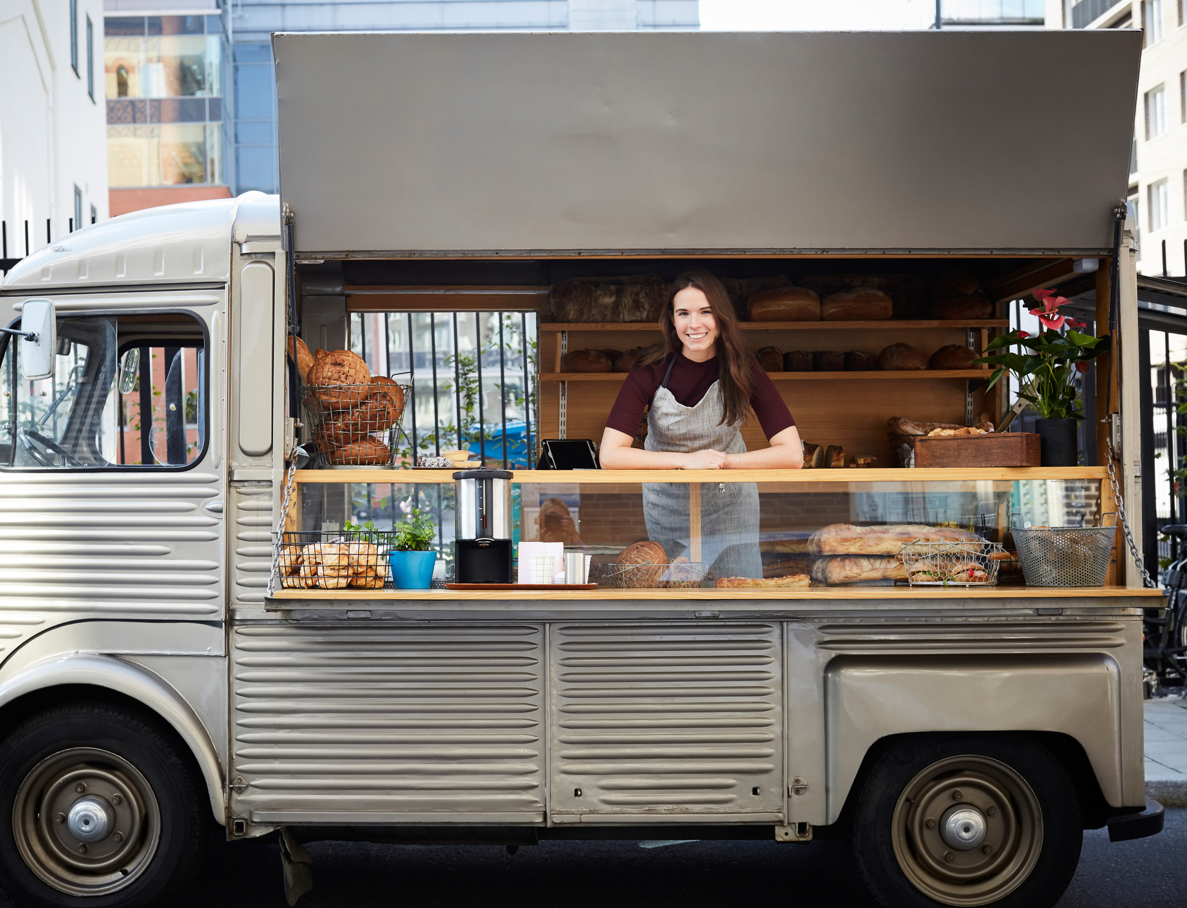
Marketing Strategies
Content Marketing
Referral and Loyalty programs

Slide 7
Storytelling:
Social media content that highlights the passion behind the brand and food preparation.
Frequency-based reward system: Implement card system where customers get a free meal after several purchases.
Content marketing
Referral and loyalty programs
Live location and schedule updates:
Actively broadcast real-time location tracking and weekly schedules.
Referral incentives: reward existing customers with discounts or menu perks for introducing new customers to the food truck.
Value-driven bundles: Incentivise customers to spend more per visit by offering bundled meal pricing options.
Highlight eco-friendliness:
Show commitment to sourcing ingredients locally and using biodegradable and recyclable packaging.
Customer engagement and reviews:
Encourage customers to engage with the social media posts and leave positive reviews.
Strategic location promos: offer loyalty perks, student discounts and corporate employee bundles.

Slide 8
Storytelling:
Social media content that highlights the passion behind the brand and food preparation.
Frequency-based reward system: Implement card system where customers get a free meal after several purchases.
Content marketing
Referral and loyalty programs
Live location and schedule updates:
Actively broadcast real-time location tracking and weekly schedules.
Referral incentives: reward existing customers with discounts or menu perks for introducing new customers to the food truck.
Marketing
Highlight eco-friendliness:
Show commitment to sourcing ingredients locally and using biodegradable and recyclable packaging.
Value-driven bundles: Incentivise customers to spend more per visit by offering bundled meal pricing options.
Customer engagement and reviews:
Encourage customers to engage with the social media posts and leave positive reviews.
Strategic location promos: offer loyalty perks, student discounts and corporate employee bundles.

Slide 9
Funding requirements and allocation
Funding requirements | Amount | Initial cost allocation | Amount
Personal savings | £10.000 | Vehicle purchase and kitchen fit-out | £22.000
Loan | £20.000 | Initial food and beverage inventory | £2.000
 |  | Working capital reserve | £3.700
 |  | Launch marketing and branding | £1.000
 |  | Local council trading licences and permits | £800
 |  | Initial business and asset insurance | £500
Total funding required | £30.000 | Total initial cost allocation | £27.000

Slide 10
Reference List
Burns, P. (2020) Entrepreneurship and Small Business: Start-up, Growth and Maturity. 5th edn. London: Red Globe Press.
Chaffey, D. and Ellis-Chadwick, F. (2022) Digital Marketing. 8th edn. Harlow: Pearson.
Department for Business and Trade (2024) Business Population Estimates for the UK and Regions 2024. Available at: https://www.gov.uk/government/statistics/business-population-estimates-2024/business-population-estimates-for-the-uk-and-regions-2024-statistical-release (Accessed: 23 June 2026).
Scarborough, N.M. and Cornwall, J.R. (2019) Essentials of Entrepreneurship and Small Business Management. 9th edn. Harlow: Pearson.

