Slide 1

Module Title: Psychology in Health and Social Care
Moudule number:LCHS4010
Assignment: Assignment 1
Student name: Jordan alum student ID: 2411818
Lecturers name :Peace Ukachukwu
-+

Slide 2
Introduction
Jane Piaget's Theory
Amiras Case
Whats Happening
Action Plan
Nature Vs Nuture
Limits Of Piaget's Theory

Slide 3
Jane piagets theory of cognative developement
Piaget theory states that there are 4 stages that a child must go throught before they could be able to think like think like young adults.
The 4 stages are
Semsorimotor -0 to 2 years of age (object permanece , language)
pre operational stage from 2yrs - 7 years
Concrete operational stage - 7 -11 yeards
Formal operational stage 11 - older
Piagets believed that child me go through these stages at different speeds but one cant obtains until the stage before is mastered making it innate

Slide 4
Senario
You are a practitioner in an early years nursery setting. You are supporting a 3-year-old child named Amira who has recently joined the nursery. Amira is showing signs of anxiety when left by her carers, limited verbal communication, and difficulty engaging in group play. Your role is to understand her developmental needs and contribute to a support plan that promotes her emotional, social, cognitive, and physical wellbeing.
Amira is in her preoperational stage and is finding it difficult move on due to not fully exploring hey senses and actions in her sensorimotor stages so she can not move on to the next stage.

Slide 5
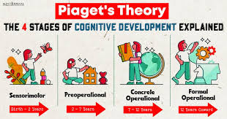
whats happening with amira
At 2 years of age i cold should start their pree operational stage
In amiras case it seem she is just understanding the idea of object permanence so she knows the when her cares are not in her site they still exist. Amira is ne to nursery and probably has not been left without a carer so this could be the vause if her anxiety. And as piagets theory state until a child has completed the stage before they can not move on to the next so a plan would need to be but in place to give amira the correct support in order to feel more confident in her self. (nhs,2022)

Slide 6
Action plan
Art therapy
Positive words
Reassureance
Commuication with parents
Routine
Comfort items

Slide 7
Nature vs Nuture
Nature is the stuff u are born with likr dna physical appearance and character
Nutrure is the things in your environment that shape who you are (Kendra Cherry, MSEd,2025)

Slide 8
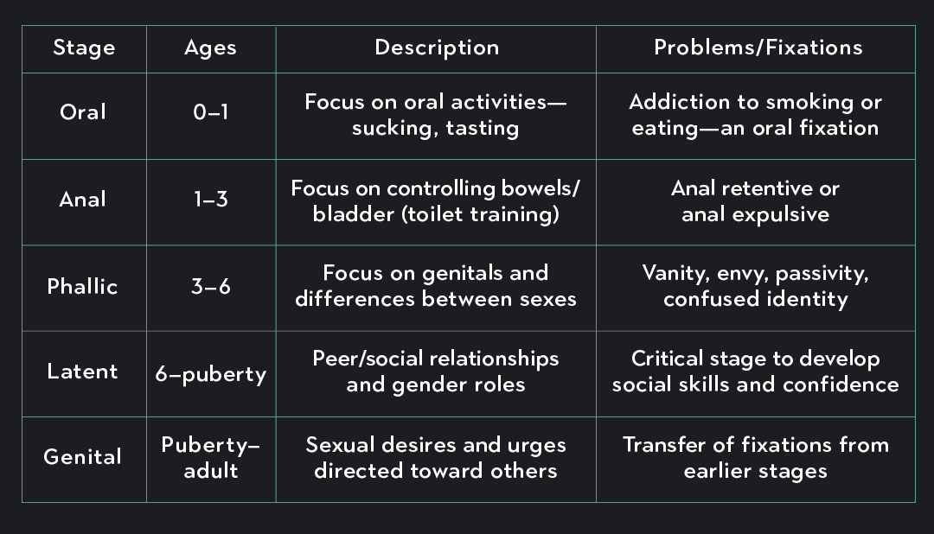
Limitations of pigets theory
Does nor consider :
Individuality
Lack of social and psychological aspect
Too Rigied
When compared with other theories you can see the where her theory lacks
For example freud

Slide 9
The End
Any Questions

Slide 10
Reference
Separation anxiety (nhs august 2020) Separation anxiety - NHS
How Nature vs Nurture Shapes Who We Become (Kendra Cherry, MSEd,2025) Nature vs. Nurture: Genetic and Environmental Influences

