Slide 1

Assessment 1
Individual Presentation psychology In Health and Social Care LCHS4010
Name: Sabirah Gardiner 2318899
Lecturer: Helen Parsons

Slide 2

Introduction To The Professional's
This presentation will explain of the lifespan perspective in Psychology, which for some is a study of human life from 0 to death. This perspective helps us understand that development is a lifelong process, It brings to us the reality that we all go through physical, cognitive, social and emotional behaviors on our journey from birth to the end of life. It is by exploring these stages that we can really get to understand and relate to the different stages in our own personal lives. There are many professional's that helped shape the minds of people to look and analyze things we do, why and when we do them. As we studied this module, we learnt of Erikson a German born psychoanalyst and he's 8 stage theory starting from conception to death, Piaget’s born in Switzerland had a 4-stage theory based on cognitive and development, Russian born Vygotsky was on a sociocultural theory and British born Bowlby’s was of an attachment theory both were psychologist. We can see that they all had different beliefs on the lifespan and its stage’s. I have been given a choice to choose one lifespan as a practitioner in an early year's nursery, 3yr old Amarna has just joined and showing signs of anxiety when left by the carer, difficulty engaging in group play and limited verbal communication.my presentation today will be based on that scenario. Before that let us take a brief look at the following, by exploring these stages, and take a closer look so that we can really begin to understand the lifespan through the lens of those Professionals mentioned previously.

Slide 3
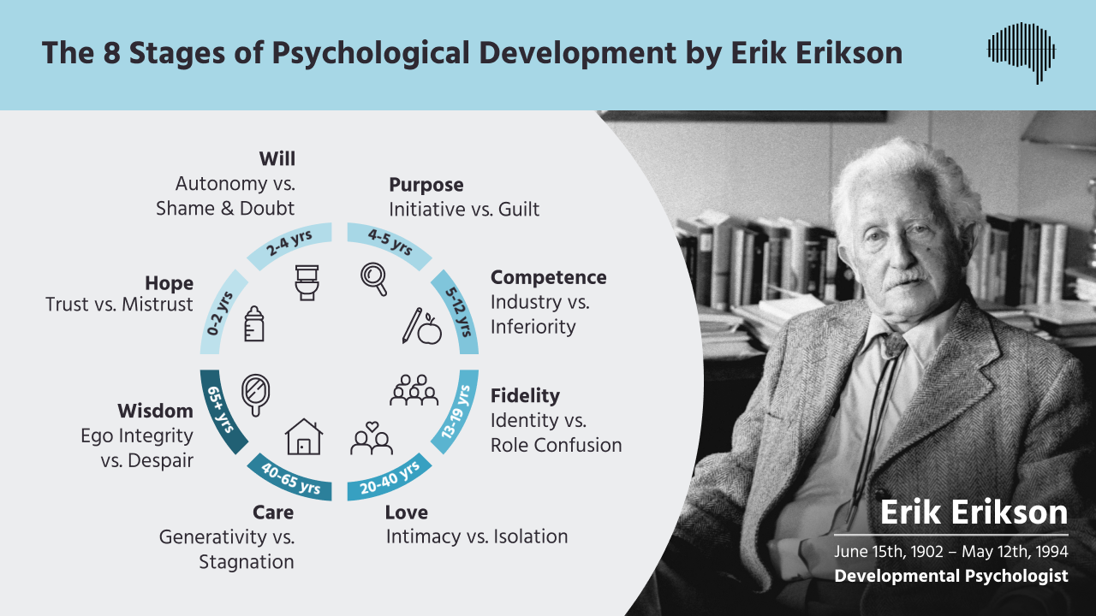
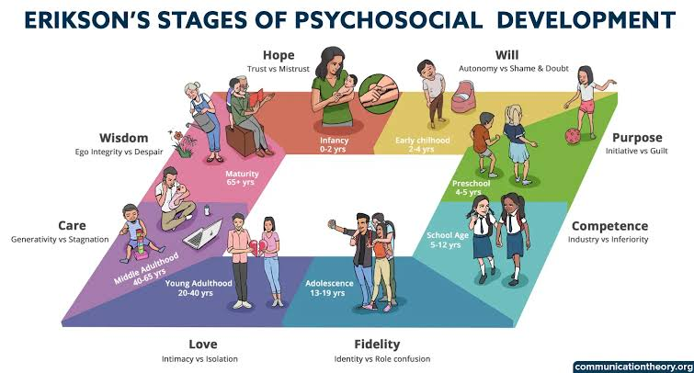
ERIKSON'S 8 STAGE THEORY
Source: Scicovery, 2023
Childhood are the first 4 stages in Erikson's theory. These stages are when the child from 0-2yrs, 2-4yrs, 4-5, and
5-12yrs.1st. As care giver, be it mother, father, foster parent and so on, We help the child's development and growth we love care comfort and build a bond of trust, the opposite will cause mistrust and may have effect in further stages.2nd stage allow the child to get to know themself and make mistakes, e.g.: they may put clothes on back to front, wet themself constantly, criticism or punishment will leave child feeling shame and with doubt this can leave the child feeling dishearten or negative of their own abilities.3rd They find initiative, friends, play and now engage to new ideas or things, the opposite will be caused by any negativity from the care giver.4th The competence that a child feels at completion of tasks, learning a new skills, accomplishment at school or any after school activities and receiving praise, builds confidents.
5th Adolescence they will be more independent, choose friends, things to wear, things they like to do, where they like be and it can be a little confusing as they try to find their own identity. Cognitive skill is also higher as they are mentally being prepared to become a young woman or man in the world and make decisions.
6th Adulthood 19-40yrs, 40-65yrs, 65+yrs old. We now are at our young adult life and start to know who we choose to have in our lives as friends and family, decisions of work, ideas for the future, attracted to the opposite sex and what of them we find attractive, we now have a social circle of friends, we learn of love and intimacy. However, if the previous stages have not been great, it can have an impact such as lack confidence, isolated, unhappy and depression.7th We identify who we are, wanting to start a family, care for others and want to contribute to the world or teach the younger's the opposite would mean you feel like underdeveloped, have not reached certain goals.8th We now have reached a stage of wisdom all being well, you look back and reflect on life and what you have accomplished giving you a sense of pride and satisfaction you have integrity and are comfortable. If the opposite occurs then you will perhaps be grumpy, unhappy, question your past as you reflect, you can be bitter, miserable, unhappy, be afraid of not having done things before end of life.

Slide 4
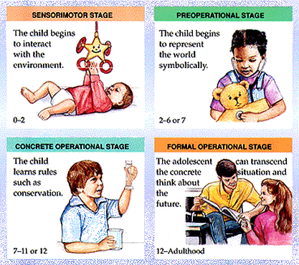
JEAN PIAGET'S 4 STAGE THEORY OF COGNATIVE and DEVELOPMENT
PREOPERATIONAL
At 2-6 or 7
At this stage they will relate to shapes, objects and symbols. Language, as they start to realise what words mean or even a sentences. Understand, that during this stage the child does not have the child lacks the cognitive ability for the kind of logic thinking as elder child or adults.
(McLeod, 2025.)
Cognitive development is the way of showing the quantities, stability, growth, pattern and change in the journey of the child's mind through preschool age and beyond. while they experience significant changes in the journey, we must recognize how important it is to see the child. The child development releases an interconnected flow, like a river of experiences instead of just isolated milestones. We know that a children have bonds towards their parents, however what extended family members, they sometimes show favoritism or perhaps look for comforting with one more than the other, this is the Childs mind developing as they start to use recognition and differential skills of the mind (First Discoverers, n.d.).
CONCRETE OPERATIONAL
At 7-11 or 12
They now are doing the opposite of the Preoperational stage. The cognitive level is higher; they now have logic of their thought and feelings in a realistic way.
(McLeod, 2025)
SENSORIMOTOR
At 0-2
This is where the child becomes aware of their
Senses and movements. For example, they
Notice another person's expressions such as
Smiles or cries, play with toys or things that bring them joy or comfort, and feel security in a warm hug. The experiences will show the child's brain processing sensory massages and connects them with actions and emotions.(McLeod, 2025)
FORMAL OPERATIONAL
At 12-Adult
Piaget's last stage this is the final area of adolescence to adult you can hold a conversation and where the mind is growing and preparing for adulthood, they start mature and prepare to become the young woman or man for the future.(McLeod, 2025)

Slide 5
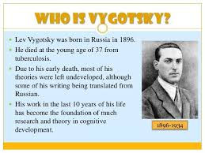
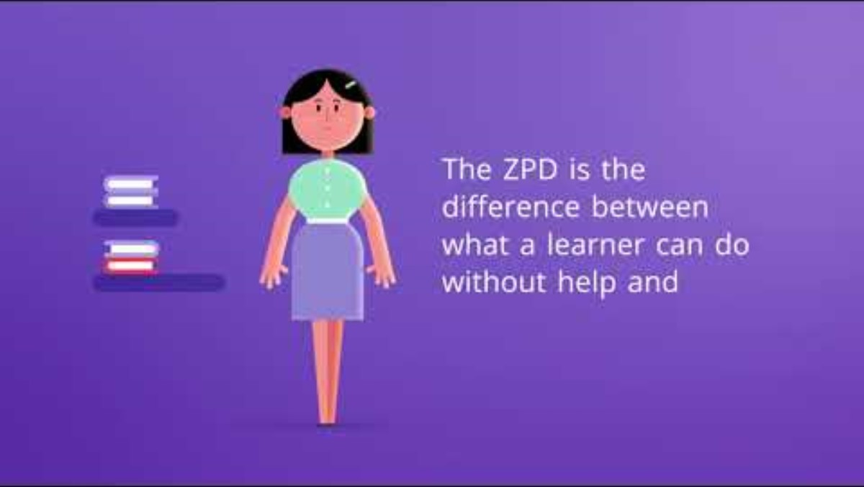
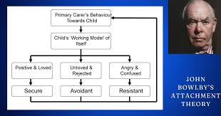
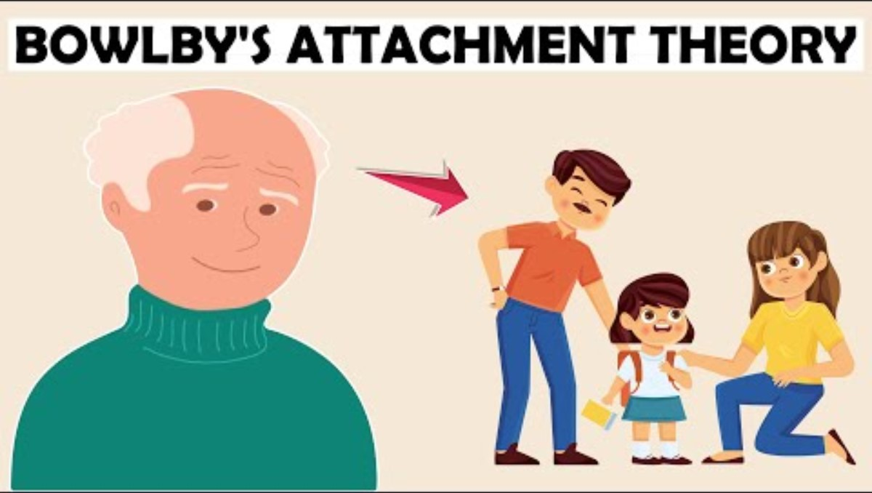
Vygotsky's Sociocultural Theory and Bowlby's Attachment Theory
Vygotsky (1978,cited in Chen,2025) argues that "cognition cannot be fully understood through individual efforts alone but requires an examination of social and cultural factors, including language, interaction, and behaviour. In essence, the outcomes of an individual’s cognitive development are shaped by their social relationships and interactions, which are gradually assimilated and internalized. These connections and interactions, embedded within the domain of social relationships, play a pivotal role in influencing the psychological development of children."
John Bowlby's had 4 stages to he's at Attachment Theory, He explains the child having proximity, which is a child's attachment to her mother both physical and emotional, most of us have seen when a child's mother leaves a room or is out of sight the child will cry and get upset until reunited, then they will cling to the mother tightly. Bowlby's believed that this help shape how children would grow and shape relationships, behaviour's. He did also study children in a laboratory paradigm, this was to research, investigation and gain knowledge for the attachment theory

Slide 6
Vygotsky's Siri is useful in health and social care because it highlights the importance of scaffolding, social interaction, and professional support in helping children like a mirror progress he provides practical strategies for practitioners to reduce anxiety encourage play and support speech development. However, the theory has limitations he places less emphasis on biological mature Asian, which also plays a role in delays, and it can be difficult to apply consistently in practise since every child's environment and support system are different. In amir's case the theory is valuable for guiding interventions, but it must be combined with awareness of her biological development an emotional needs to give a complete picture.
The Plan to help Amira.
Chosen theory: I have chosen Vygotsky's Sociocultural Theory of cognitive Development as it relevant to early childhood practice. He's theory implicates that children learn through social influence and cultural interaction. This is great for nursery settings where play with other children and learning with adult support are in place.
Propose practical strategies and interventions: I will support Amira with consistent routine hoping to reduce her anxiety when caregivers leave, helping her feel secure. Practitioners can scaffold her play by modelling activities, inviting her into small groups, and gradually building her confidence. Language rich play storytelling and guided conversations will encourage her speech while professional such as speech therapists and psychologists provide targeted support. Together, these strategies should help Amira overcome anxiety engage in play and develop communication skills
Explain the theory clearly: Vygotsky's theory Zone of Proximal (ZPD) where when practiced a child should achieve more with support than alone, this will help Amira progress with the correct guidance. I may need to put professionals in place, who will provide scaffolding to support her learning and language. This will show social interaction, and structured support can encourage Amira's development.
As a practitioner it must be considered that psychological development is shaped by both biological and environment influences. There for in Amira's case Nature refers to her biological maturation which is the natural growth of a child's brain and body this can cause defect in speech and social skills. For example, delays in speech may partly reflect her biological readiness. Nature refers to her environment, including the support she receives at nursery and at home her separation anxiety and caregivers leave shows how environmental factors can strongly affect her confidence play and communication. Together, nature and nature interact to shape her development while by a lot G sets the foundation her progress depends heavily on the quality of social interaction and emotional support she experiences
My future for Amira. First point of call will be.
Apply the theory to Amira's situation:As the practitioner, I notice that when Amira's caregivers leave, she displays high levels of Anxiety. I think this behaviour makes it difficult for her to engage in Group play, which reduces her opportunities for social interaction and learning. Because she is not comfortable in play she also lacks confidence in using speech which slows her overall development. Vygotsky's theory helps explain the chain reaction by showing that Amira is within her zone of proximal development (ZPD) she may be capable of progress but need consistent adult and peer support. Through scaffolding practitioners and professionals can guide her play, ease her anxiety and encourage her language use,helping her gradually build confidence and introduce new skills
SENCO: coordinates support for Amira's speech, play & anxiety.(DFE,2022, p6)
SEND: Extra help in nursery setting.
(GOV.UK, n.d)
IEP: tailored targets if SEND is not enough.
(National Autistic Society, n.d)
EHCP: formal plan if needs are complex and seem long-term

Slide 7
REFERENCES
Chen, B.C. (2025) ' Using Vygotsky's sociocultural theory to explore ethnic cultural representation in Taiwanese preschool children's play', Frontiers in Education, 10, 1569322. Available at https://doi.org/10.3389/feduc.2025.1569322 (Accessed: 18 November 2025).
Department for Education (2022). The role of the early years SENCO. London: GOV.UK. Available at: https://assets.publishing.service.gov.uk/media/622894808fa8f526d8531647/The_Role_of_the_Early_Years_SENCO.pdf (Accessed 23 November 2025).
First Discoverers(n.d) Cognitive development: The science of childcare. Available at:Cognitive development: The Science of Childcare (Accessed: 3 November 2025)
GOV.UK (n.d.). Children with special educational needs and disabilities (SEND): Extra help – EHC plans.Available at: https://www.gov.uk/children-with-special-educational-needs/extra-SEN-help (Accessed: 23 November 2025).
LinkedIn (2022) 8 Stages of Psychological Development by Erik Erikson Available at: Erikson’s 8 Stages of Psychosocial Development – Explained (Accessed: 19 November 2025)
McLeod, S. (2025), Piaget’s theory and stages of cognitive development: Simply Psychology. Available at: Piaget's Theory and Stages of Cognitive Development (Accessed: 05 November 2025)
National Autistic Society (n.d.). Individual education plans – what they are and how they help. Available at: https://www.autism.org.uk/advice-and-guidance/topics/education/extra-help-at-school/northern-ireland/individual-education-plans (Accessed: 23 November 2025).
Orenstein, G.A. and Lewis, L., 2022. Erikson's Stages of Psychosocial Development. In: StatPearls [Internet]. Treasure Island (FL): StatPearls Publishing; 2025 Jan-. Available from: https://www.ncbi.nlm.nih.gov/books/NBK556096/ (Accessed 21 November 2025).
YouTube (2025) Vygotsky in 60 seconds. @teachKloud Available at: https://youtu.be/e7k2Ix2eEKs?si=v4HdwhQvuJr8Zndg (Accessed: 18 November 2025
YouTube n.d BOWBY'S Attachment Theory Explained Psychology Exposed Available At: https://youtu.be/P-wh2AEhlOc?si=4wybDXGy5FueRYUM ( Accessed: 18 November 2025

