Slide 1
Ancestors, Death and Burial (HPAH5081/HPAH6081)
26/27
Module introduction

Slide 2
Outline
This module
Assessments
Studying death
The archaeology of death – concepts, ethics, sources

Slide 3
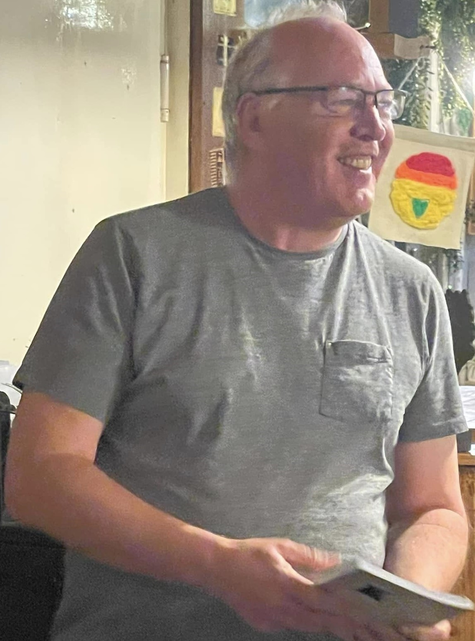
Lecturer Martin Locock
M.locock@uwtsd.ac.uk

Slide 4
The politics of archaeology and anthropology
Contemporary locations and recent history
Placenames, language, AD/CE
Current political debates: ethnicity, sustainability, gender, decolonisation
Authorised Heritage Discourse
Anthropology: observers and activists
Be aware of context in which work was done
Distinguish between data and commentary

Slide 5
The module
Block 1 28/9/26-23/10/26
This module explores how death is not a single event separating the living and the dead, but instead should be thought of a gradual social process.
How very different experiences of death are rooted in social and cultural worlds.
It engages with a variety of ethnographies and archaeological examples to illustrate the complex relationships between the living and the dead and how these are ritually negotiated.
Archaeological approaches to death and burial; the ancestors; commemoration
Death and burial in Bronze Age Cyprus
Death and burial in Mycenaean and Early Iron Age Greece
Death and burial in England, 600-1800CE

Slide 6
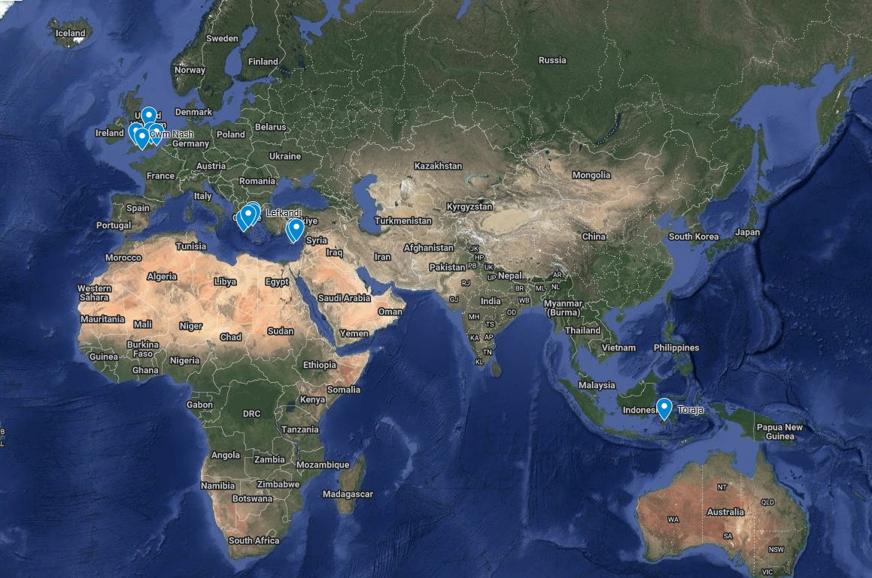

Slide 7
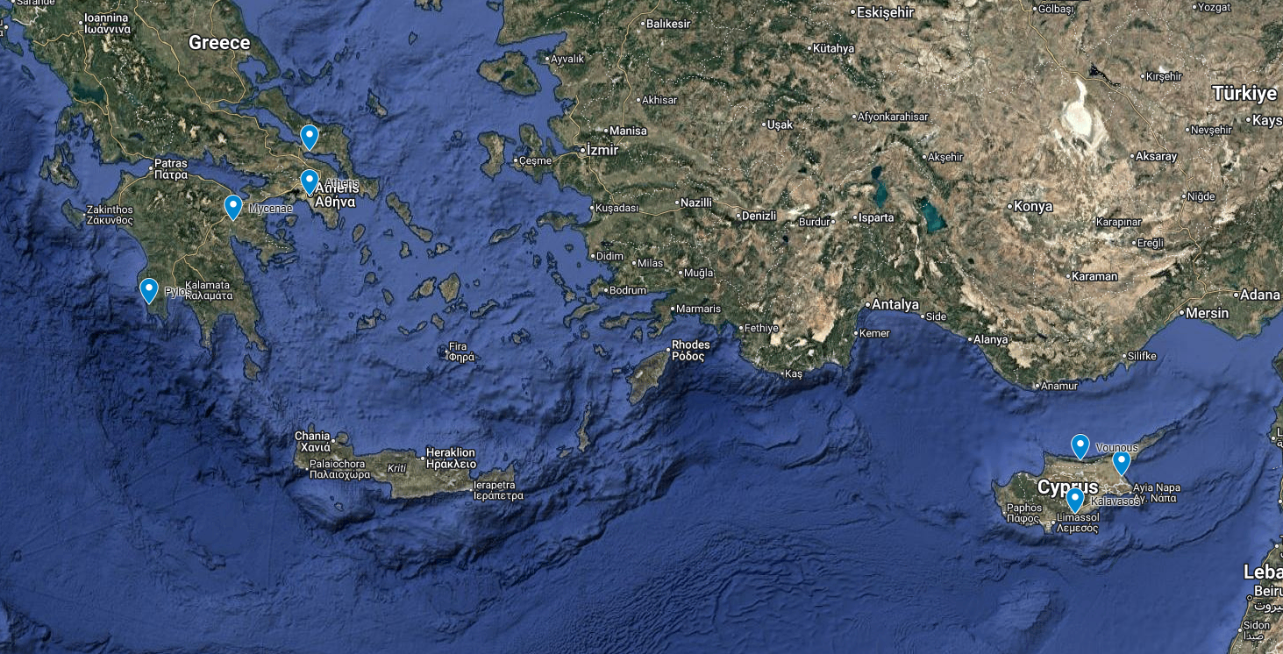

Slide 8
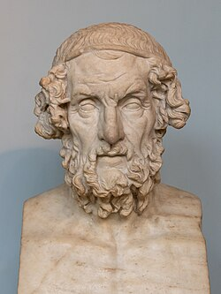
Iron Age
Bronze Age
Early Bronze Age Early Cypriot Early Helladic 2400BCE
Middle Bronze Age Middle Cypriot Mid Helladic 1900BCE
Late Bronze Age Late Cypriot I-IIIA Late Helladic 1700BCE
Late Bronze Age collapse 1177BCE
Early Iron Age Middle Protogeometric 1000BCE
“Greek Dark Age”
Late Protogeometric 950BCE Early Geometric
Sub-Protogeometric 900BCE
Middle Geometric Late Geometric
Archaic 800BCE
?Homer
Classical

Slide 9
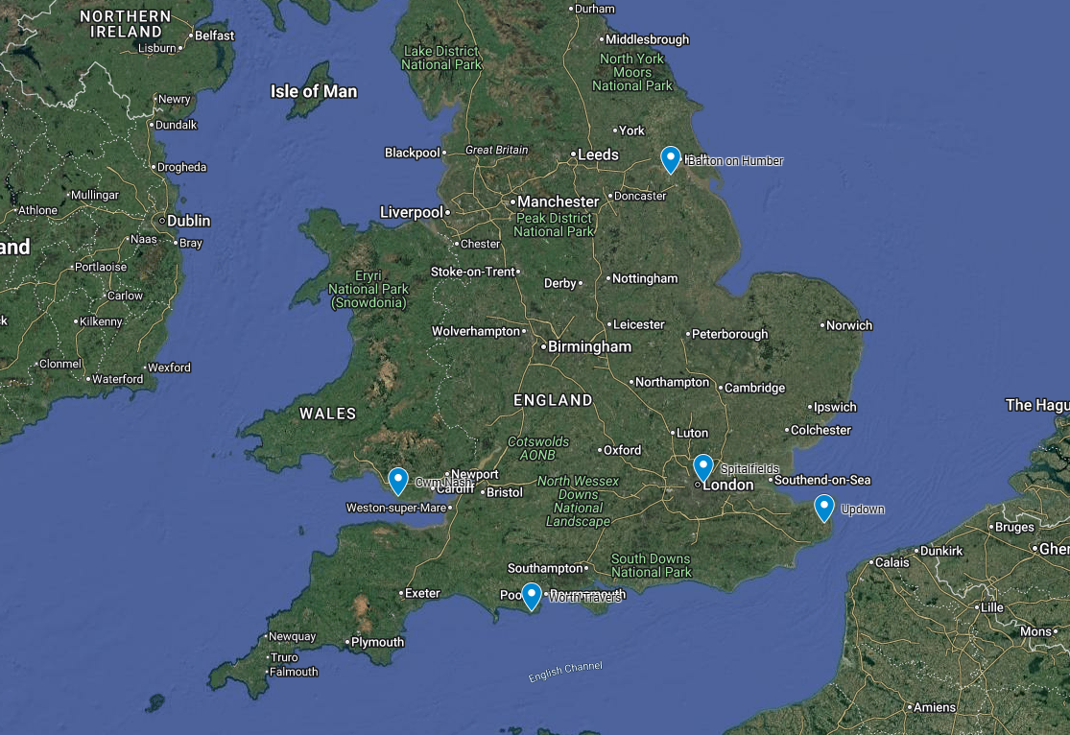

Slide 10
Assessments
1 Mini-lecture (20 minutes) based on article
2 Pinterest image board + self-reflection (1000 words or equivalent)
3 Gobbet (Iliad) or image analysis (1000 words)
Submission deadline: 23/10/26

Slide 11
1 mini-lecture
20 minutes
This is intended to be a mini lecture outlining the aims and objectives of the author(s), detailing their material or case study and how they used this to answer their research question.
You should critically reflect upon how effectively they have used this material to further our knowledge and understanding of burial practices and/or belief systems in the Bronze-Iron Age Aegean and Cyprus or in the Homeric context.
You will need to be able to answer questions as part of the presentation.

Slide 12
Presentations 19/10/26, 22/10/26, 23/10/26
19/10/26 (individual presenters only)
10:05 Mik Edmunds
10:30 Leon Griffiths
10:55 Cerys Lye
11:20 Olivia Hunt
11:45 Iwa Lewis
12:10 Lexin Jessop

Slide 13
Presentations 19/10/26, 21/10/26, 23/10/26
21/10/26
10.05 Sam Bennett
10.30 Tanwen Shaw
10.55 Soli Green
11.20 James Warne-Cleave
11.45 Kayla Bird
12.10 Kip Williams
12.35 Nicholas Drake

Slide 14
Presentations 19/10/26, 22/10/26, 23/10/26
23/10/26
10.05 Will Montague
10.30 Lucy Negus
10.55 Tobias Dinan
11.25 Flo Downing

Slide 15
Presentation 26/10/26
1000 Gwen Anthony (Teams)

Slide 16
Mini-lecture: tips
What were they trying to address?
What was the data-set?
How did they refer to previous work?
What does this tell us about burial practice?
For the presentation:
Rehearse timings
Don’t quote slabs –summarise
Use images to explain
What the author thinks / what you think (see video)

Slide 17
2 Pinterest board:
Analyse the archaeological evidence
for one of the following:
  ▪ Funerary rituals & beliefs
  ▪ Identity
  ▪ Status
  ▪ Wealth
  ▪ Commemoration
Provide a short analytical commentary for each
image, contextualising it in relation to academic
scholarship
Upload the document together with a short reflective
document (200 words) to contextualise your board.
You should also include references

Slide 18
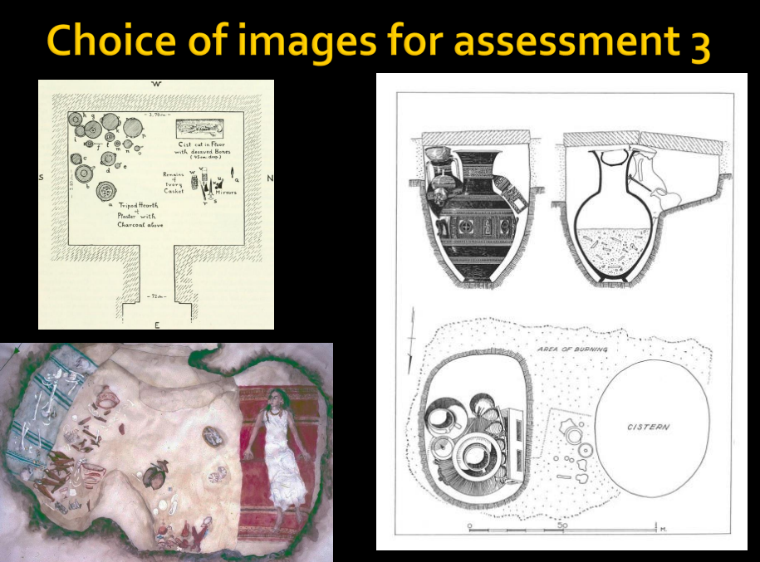
3: gobbet / image analysis
Either write a 1000-word gobbet on Homer’s Iliad 24.776-803
(translation by Murray, Loeb series, Harvard University Press)
Or
Analyse one of the provided images, highlighting what it
might tell us about funerary ritual, the treatment of dead, &
possibly about the associated belief system. You should
consider tomb/grave type, placement of the body/bodies,
associated grave goods, etc. Also consider the type of image,
how the burial is represented & how this affects your
understanding of the burial(s) (1000 words)

Slide 19
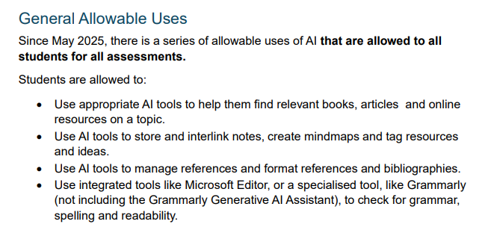
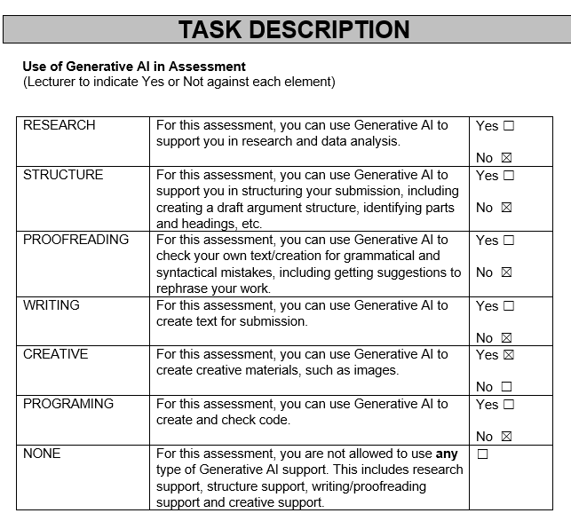
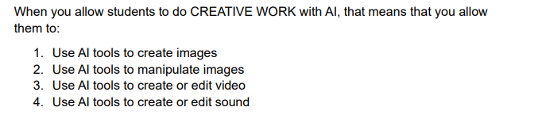
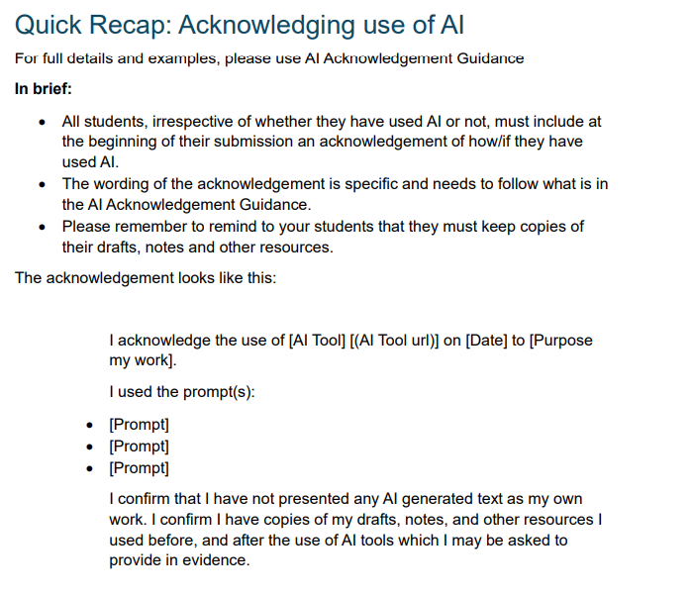
Use of generative AI

Slide 20
Programme - replaced – see next slide
M 28 9 26 | 1 | Introduction
Th 1 10 26 | 2 | Meeting the ancestors (Ucko, Swazey)
Fr 2 10 26 | 3 | Burial in England 600-1800CE
M 5 10 26 | 4 | EBA Cyprus
Th 8 10 26 | 5 | LBA Cyprus
Fr 9 10 26 | 6 | Mycenean Greece
M 12 10 26 | 7 | Pylos
Th 15 10 26 | 8 | Geometric Athens and the LBA collapse
F 16 10 26 | 9 | Lefkandi
M 19 10 26 | 10 | Presentations: mini-lectures (individual)
Th 22 10 26 | 11 | Presentations: mini-lectures
F 23 10 26 | 12 | Presentations: mini-lectures
M 26 10 26 |  | Presentation: mini-lecture
CJ05 Monday, Thursday, Friday, 10:00-13:00

Slide 21
Programme
M 28 9 26 | 1 | Archaeology of Death and Burial
W 30 9 26 | 2 | Meeting the ancestors
Fr 2 10 26 | 3 | Burial in England 600-1800CE
M 5 10 26 | 4 | EBA Cyprus
W 7 10 26 | 5 | LBA Cyprus
Fr 9 10 26 | 6 | Mycenean Greece
M 12 10 26 | 7 | Pylos
W 14 10 26 | 8 | Geometric Athens and the LBA collapse
F 16 10 26 | 9 | Lefkandi
M 19 10 26 | 10 | Presentations (individual)
W 21 10 26 | 11 | Presentations: mini-lectures
F 23 10 26 | 12 | Presentations: mini-lectures
Monday CJ6 10.00-13.00
Wednesday CJ2 10.00-13.00
Friday CJ1 10.00-13.00

Slide 22
Approaches to theory
Encountering a new term / concept
What does it mean?
  Context
  Dictionary/ encylopedia/ wikipedia
Where does it come from? (Who? When? Why?)
What is it opposed to/ distinct from?
Critiques and book reviews
Only use a term it if it helps!

Slide 23
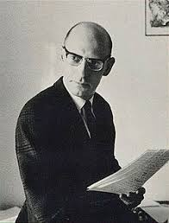
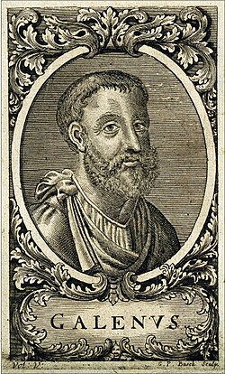
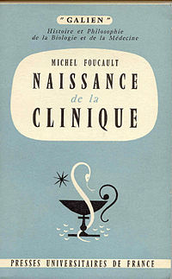
Michel Foucault ‘The archaeology of knowledge’
The Birth of the Clinic: An Archaeology of Medical Perception 1963
Medieval medicine- Galen
  Deference to Classical authority
Enlightenment medicine
  Empirical and observational
Foucault – power dynamic
Doctor as functionary
Doctor as authority
* Clinic = teaching hospital

Slide 24
Michel Foucault ‘The archaeology of knowledge’
Not about archaeology
History of ideas
Underlying or contradicting contemporary discourse and narrative

Slide 25
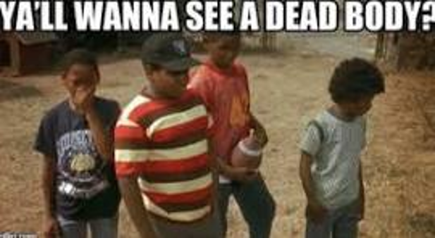

Slide 26
Studying death
Our experience of death
Emotional responses

Slide 27
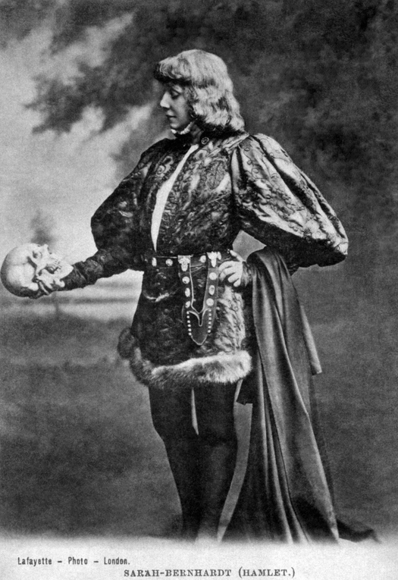
Hamlet Act V scene 1
BBC Television Shakespeare: Hamlet Prince of Denmark
https://learningonscreen.ac.uk/ondemand/index.php/clip/283925
'Clip from The BBC Television Shakespeare: Hamlet, Prince of Denmark', The BBC Television Shakespeare, Hamlet, Prince of Denmark, 21:20 25/05/1980, BBC2 England, 105 mins. 00:59:16-01:06:38. https://learningonscreen.ac.uk/ondemand/index.php/clip/283925?bcast=123962344 (Accessed 24 Jul 2026)

Slide 28
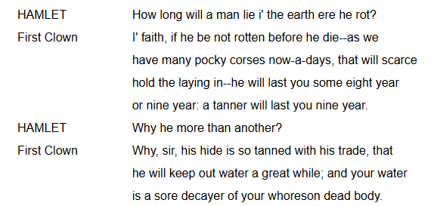
Attitude of gravedigger to bones (social exclusion)
Contrast between status in life and death
Discussion of decay
Physical features- smell
Burial of a suicide

Slide 29
Key themes
Kinship - biological and social relationships
Status
Age
Sex and gender
Ritual practice
Beliefs - eschatology
Memorialisation
Materialism and physicality
  Objects – votive, personal property, others
  Burial – coffin, shroud
  Physical evidence of ritual

Slide 30
Working with case studies
Jill Baker ‘Funeral Kit’ – norms and variation
Compare
Contrast
Analogies
Ethnographic parallels (Ucko)

Slide 31
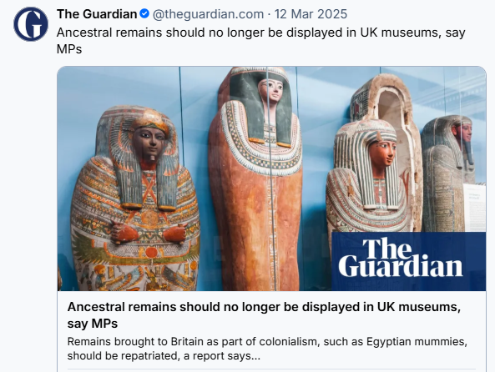
Ethics of study and display of human remains
Consent
Expectations
Modern attitudes
Permission from community representatives
Purpose of display
Religious sensitivities

Slide 32
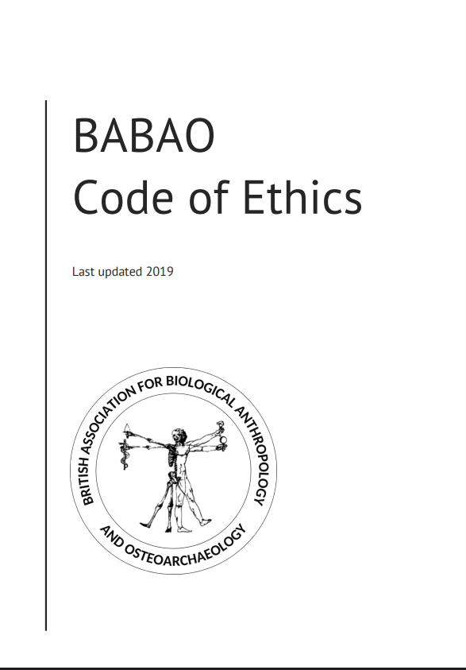

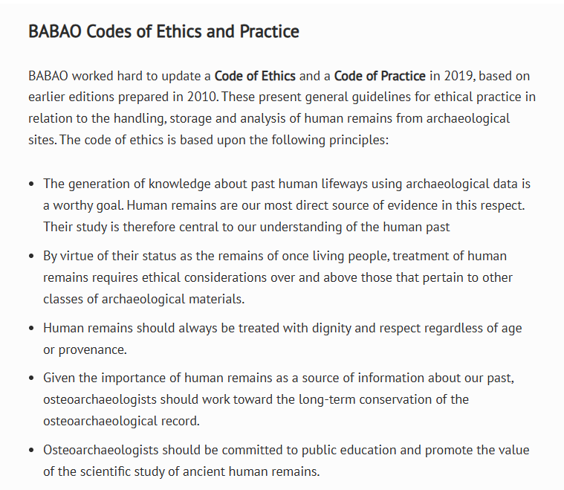
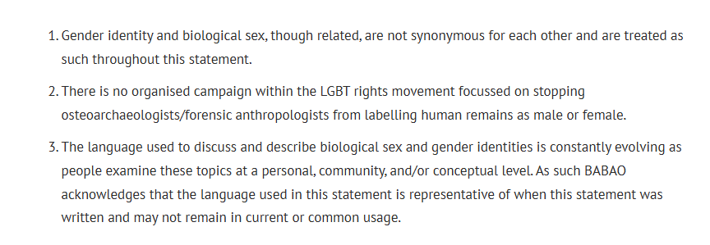
https://babao.org.uk/
https://babao.org.uk/babao-statement-on-sex-estimation/

Slide 33
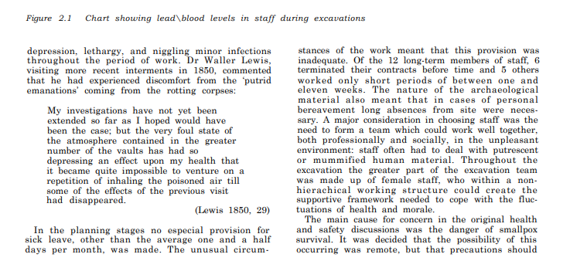
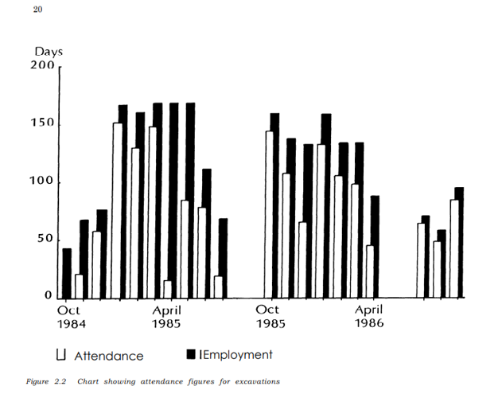
Effects on excavators
Reeve and Adams 1993 Christ Church, Spitalfields: investigations of the burial crypt 1984-1986 vol.1
https://archaeologydataservice.ac.uk/data-catalogue/resource/32b22854b4a3094e14751051e60192e5c7012f47821f4f9684ecc34a3ac86d10

Slide 34
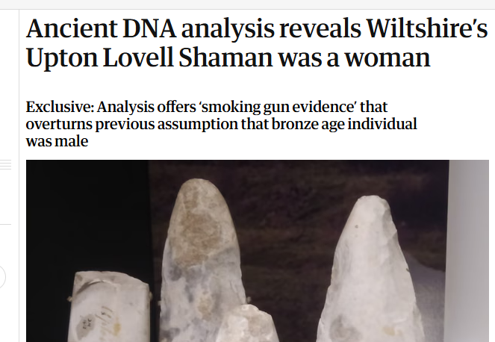
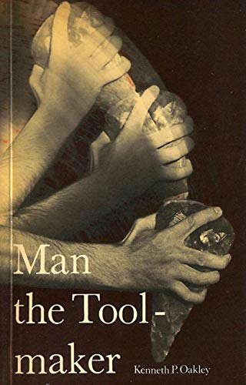
Gender and sex in archaeological interpretation
Cultural essentialism - men fight, women cook
Biological essentialism - male skeletons are taller
Gender roles vary across time/space
Gender is social and is performed
Divergence
https://www.theguardian.com/science/2026/jul/14/ancient-dna-analysis-reveals-upton-lovell-shaman-was-woman-wiltshire

Slide 35
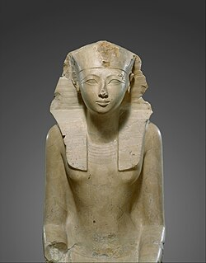
Hatshepsut (1505-1458 BCE)
Wife of Thutmose II
Regent for stepson Thutmose III
Co-ruler
Depicted as masculine
Reign later erased from monuments

Slide 36
Colin Renfrew
Awareness of Death and Mortality: The Archaeology of Immortality in the Ancient World
https://www.youtube.com/watch?v=aitzE63UEqw

Slide 37
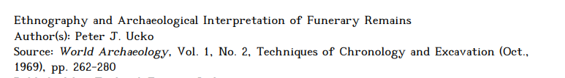
Peter Ucko

Slide 38
Value of ethnographic parallels in archaeology
Range of behaviours with material consequences
Beliefs about afterlife
Reasons for grave goods

Slide 39
Archaeology of Death and Burial

Slide 40
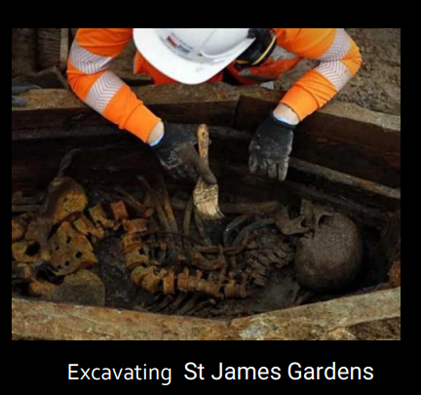
What do we examine & why?
Skeleton:
  ▪ Completeness & disposition in grave/tomb, etc.
  ▪ Biological Anthropology studies
Information surrounding funerary ritual:
  ▪ Burial arrangements
  ▪ Grave goods
  ▪ Relationships between burials

Slide 41
Rites of Passage
Van Gennep (1909) (reprinted in Robben (ed.) 2004)
Examined rituals performed to move individuals between social states:
  ▪ Key stages in life cycle
  ▪ Liminality
  ▪ Passing over threshold
  Main focus adulthood, marriage
Participants move through three stages:
  ▪ Separation – leave old status
  ▪ Marginalisation - time to transform
  ▪ Incorporation – return with new status

Slide 42

Rites of Passage: funerary rites
Funerary ritual: key stage is marginalisation
  ▪ Liminal state
  ▪ Mourners polluted through association with death (Mary Douglas 1966 Purity and Danger)
Ritual allows participants to move between states
  ▪ Deceased to afterlife, realm of ancestors etc.
  ▪ Living re-incorporated within society adopting new
  social roles

Slide 43
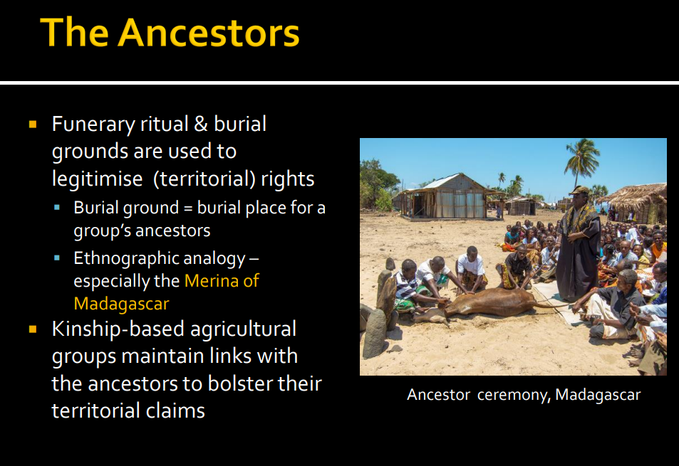

Slide 44
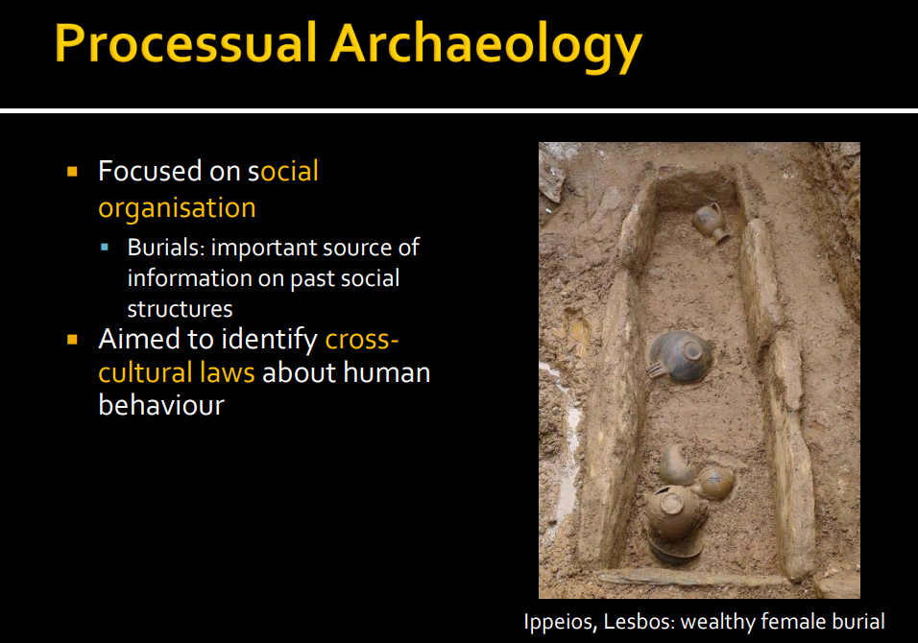

Slide 45
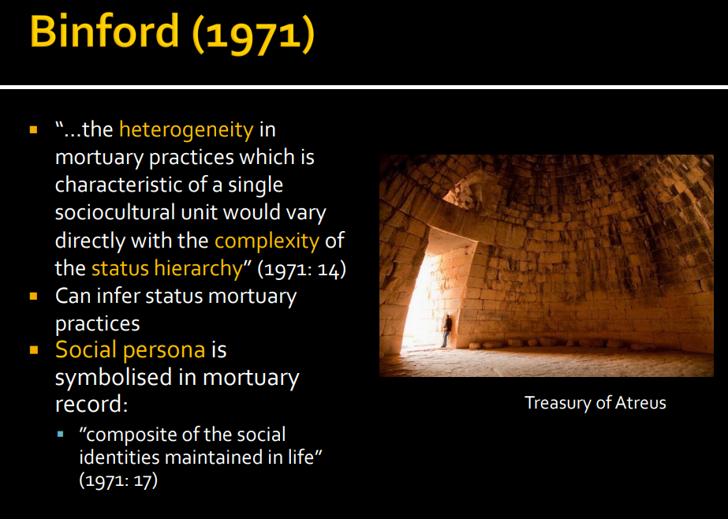
Binford, L. (1971)“Mortuary Practices: Their Study and Their Potential”, Memoirs of the Society for American Archaeology 25, 6-29

Slide 46
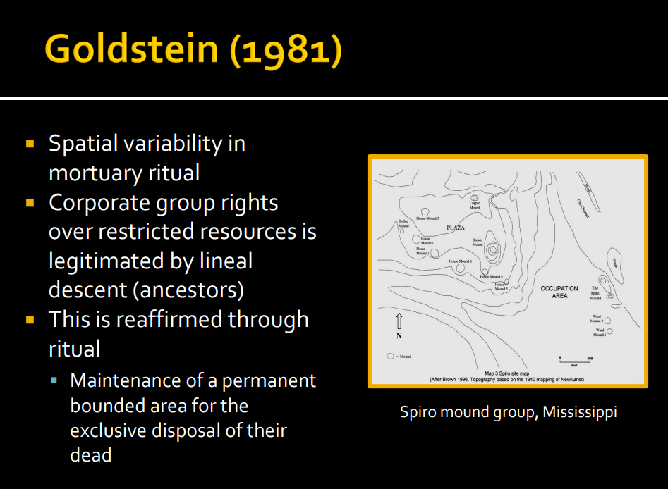
Goldstein, L. G. (1981). One-dimensional archaeology and multi-dimensional people: Spatial organization and mortuary analysis. In Chapman, R., Kinnes, I., and Randsborg, K. (eds.),The Archaeology of Death, Cambridge University Press, Cambridge, England, pp. 53–70.

Slide 47
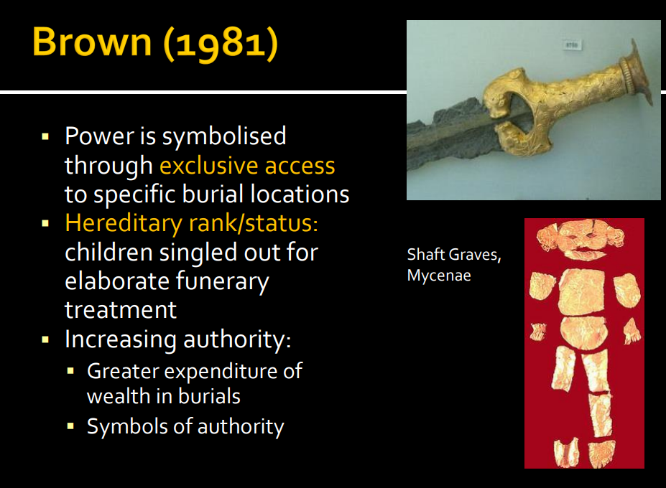
Brown, James A (1981) The search for rank in prehistoric burials. In Chapman, R., Kinnes, I., and Randsborg, K. (eds.),The Archaeology of Death, Cambridge University Press, Cambridge, England, 25-38.

Slide 48
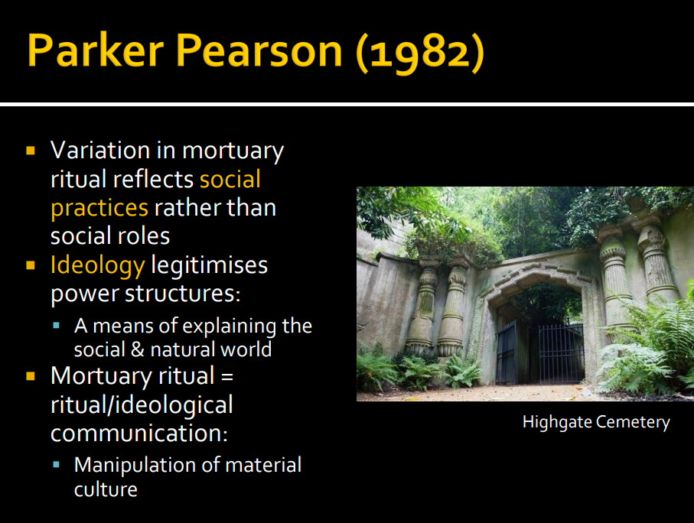
Parker Pearson, M. (1982) Mortuary practices, society and ideology: an ethnoarchaeological study. In I. Hodder (ed.) Symbolic and Structural Archaeology. Cambridge: Cambridge University Press, 99–113.

Slide 49
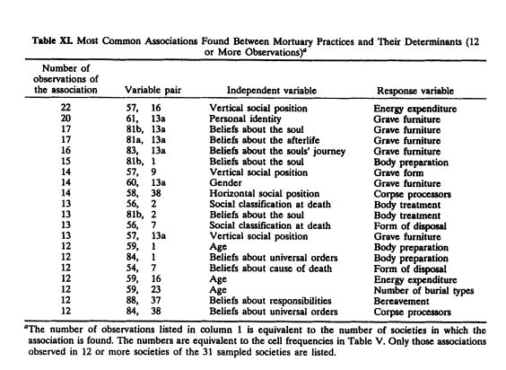
Christopher Carr (1995) “Mortuary Practices: Their Social, Philosophical-Religious, Circumstantial, and Physical Determinants”, Journal of Archaeological Method and Theory, Vol. 2, No. 2 (Jun., 1995), pp. 105-200
Significance of ideology in determining funerary practice
HRAF Human Relations Area Files – 31 cultures

Slide 50
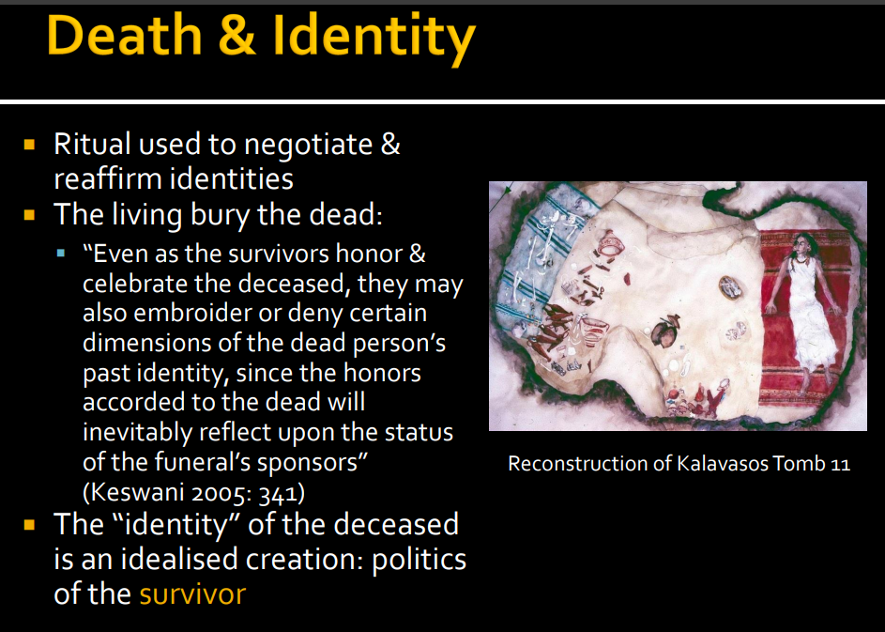

Slide 51
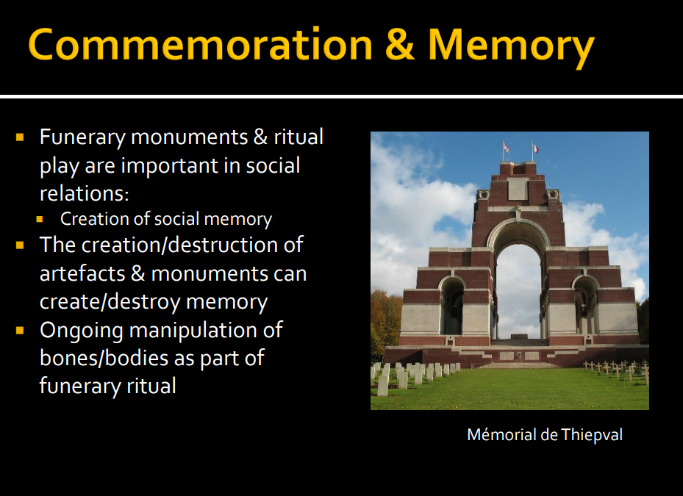

Slide 52
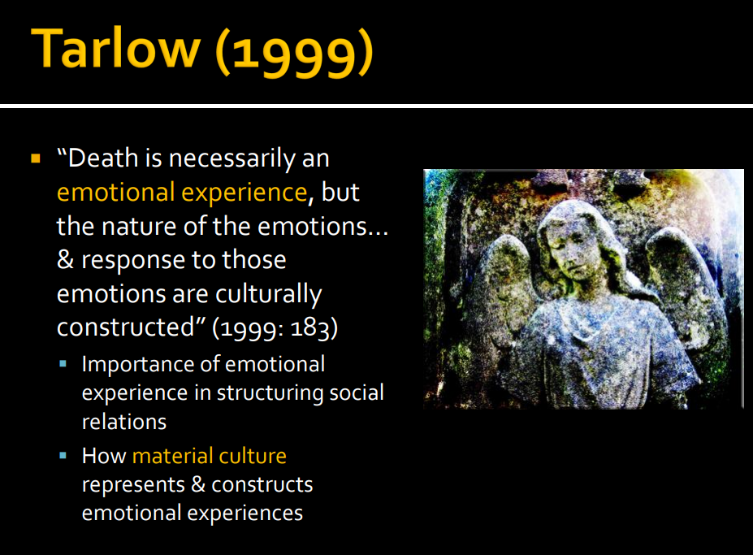
Tarlow, S 1999 Bereavement and commemoration : an archaeology of mortality

Slide 53
Divergent practices
Treatment of child based on parent’s status
Cultural variations – attitudes to display of wealth
Norms
Hybridity

Slide 54
Summary
Societies develop rituals reflecting social status and beliefs
Funeral practices provide process for change in status
Commemoration and secondary burial
Complexity about reading social status from burials

