Slide 1

﻿LCBB5010
Management Accounting for Managers
Week 5
Management control and corporate governance

Slide 2
Planning and Control Cycle
Formulating Long- and
Short-term Plans (Planning)
Begin
Comparing Actual
to Planned Performance (Controlling)
Implementing
the Plans
(Directing and Motivating)
Decision
Making
Measuring
Performance (Controlling)

Slide 3
Broadening and Extending The Basic Control Model
We have seen how various techniques, especially budgeting, are part of an organization’s planning and control system.
Here we extend the control system to include concepts of management control and performance management.
Also consider more informal aspects of organizational control.

Slide 4
A more complex view of organizations and accounting
In Chapter one, we distinguished between financial and management accounting.
In this chapter, we consider more complex perspectives on organizational accounting.
We analyse the corporate governance roles of management accounting.
We also return to the theme of business and professional ethics.

Slide 5
General models of management control and performance measurement
In a simple thermostat, system maintains a pre-specified temperature by switching a boiler on and off.
More sophisticated models include the use of feedforward control and double loop learning.
Feedforward control relies on a predictive model of processes so that errors can be anticipated and corrected for.
Double loop learning concerns the use of information to learn from past performance in order to change processes, change inputs or alter objectives.

Slide 6
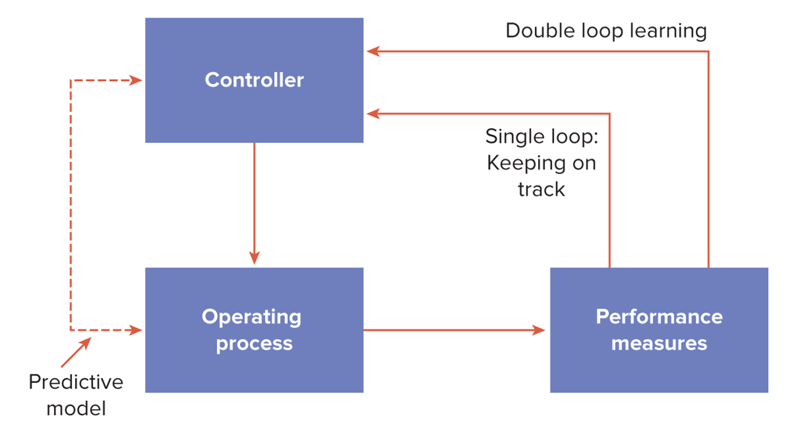
Feedback, Feedforward Control and Double Loop Learning

Slide 7
Performance Measurement System
In order to operationalize process control systems, we need to be more specific about objectives, motivation, culture and other organizational issues.
A key feature of a performance management framework is a performance measurement system.

Slide 8
Performance Measurement System
Consistent with the strategy and objectives of the organization.
A system of feedback and review to ensure that the information flows enable the organization to learn and adapt from its experience.
Comprehensive, including non-financial as well as financial indicators.

Slide 9
Performance Measurement System
Although comprehensive, the measurement system needs to be simple, clear and understandable, focusing on key performance indicators (KPIs).
It needs to be owned and supported throughout the organization and aligned with the rewards/penalties that managers and other employees receive for achieving performance targets.

Slide 10
The Levers of Control Model
‘Old style strategy’ – very rational, very analytical and top-down.
Implementation of strategy is either neglected or based on a hierarchical approach to control.
‘New style strategy’ is a more emergent process in a decentralized, learning /flexible firm strategy.
….characterized by employee empowerment and responding to customer needs.
Intended and emergent strategies tend to operate simultaneously with a need to balance both control and learning aspects.

Slide 11
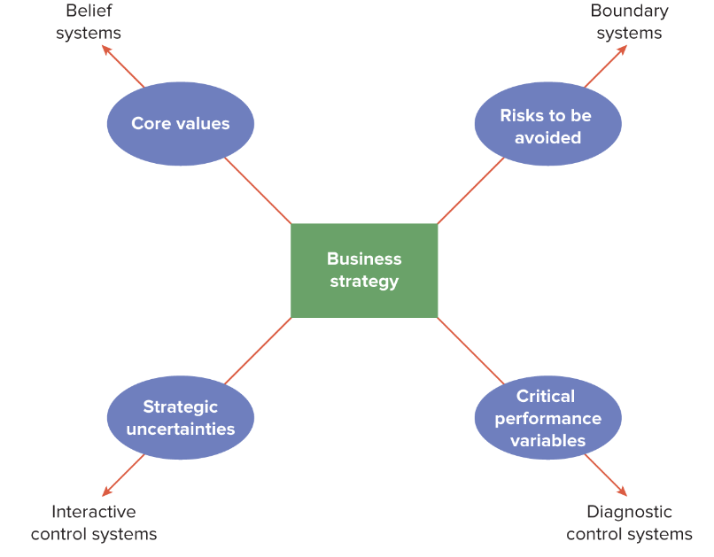
Levers of Control: Key Variables to be Analysed

Slide 12
Corporate Governance: A Financial Perspective
Recent evidence from the US, UK and elsewhere is that wealth has been destroyed by reckless, greedy and sometimes fraudulent behaviour by top executives.
Boundary between internal and external decision-making becomes more blurred.
So does earlier distinction between the roles of management and financial accounting.
Management accountants have a responsibility to ensure the integrity of financial data for reporting purposes.

Slide 13
Key performance indicators - KPI
What Are KPIs?
Key Performance Indicators (KPIs) measure progress toward key business objectives
Provide insight into performance and strategic direction

Slide 14
Key performance indicators - KPI
Financial KPIs – Core Concepts
Defined: Monetary metrics used to evaluate financial performance
Examples:
  Profitability: Gross margin, Net margin
  Liquidity: Current ratio
  Efficiency: Inventory turnover
  Valuation: Earnings per Share (EPS), Price-to-Earnings (P/E)
  Leverage: Debt-to-equity ratio

Slide 15
Key performance indicators - KPI
Non-Financial KPIs – Core Concepts
Defined: Metrics not expressed in monetary terms
Examples:
  Customer satisfaction
  Employee turnover rate
  Innovation rate
  Environmental impact (e.g., carbon emissions

Slide 16
Key performance indicators - KPI
Why Non-Financial KPIs Matter
Early indicators of performance
Help assess long-term strategic success
Critical for stakeholder engagement (e.g., ESG reporting)

Slide 17
Key performance indicators - KPI
Case Study – London Stock Exchange Group (LSEG)
Strategic Goal: Enable customer growth via data and infrastructure
Financial KPIs: Revenue from data & analytics, EBITDA growth
Non-Financial KPIs: System uptime, innovation output, customer base expansion

Slide 18
Key performance indicators - KPI
Case Study – BP plc
Strategic Pivot: Green transition to value-focused strategy
Financial KPIs: Shareholder returns, EBITDA from core operations
Non-Financial KPIs: Carbon reduction targets, investment in renewables

Slide 19
Key performance indicators - KPI
Aligning KPIs with Strategy
Map strategy to KPIs:
  Objective: Market Expansion
    Financial: Revenue growth
    Non-Financial: Customer acquisition rate

Slide 20
Regulatory Approaches to Corporate Governance
The suppliers of capital no longer trust their most immediate agents, the senior executives of large corporations.
In the US, the emphasis has been on increased judicial enforcement of financial reporting standards in the Sarbanes-Oxley Act (2002).
In the UK, a stronger role for non-executive directors has been proposed, the Higgs Report (2003).

Slide 21
Regulatory Approaches to Corporate Governance
Management accounting information can help non-executives to assess risk, check on strategy and monitor the behaviour of executive board members.
Key performance drivers should be informed by techniques such as balanced scorecard and strategic management accounting.

Slide 22
Balanced Scorecard Framework
Perspectives:
  Financial
  Customer
  Internal Processes
  Learning & Growth
Integrates financial and non-financial KPIs

Slide 23
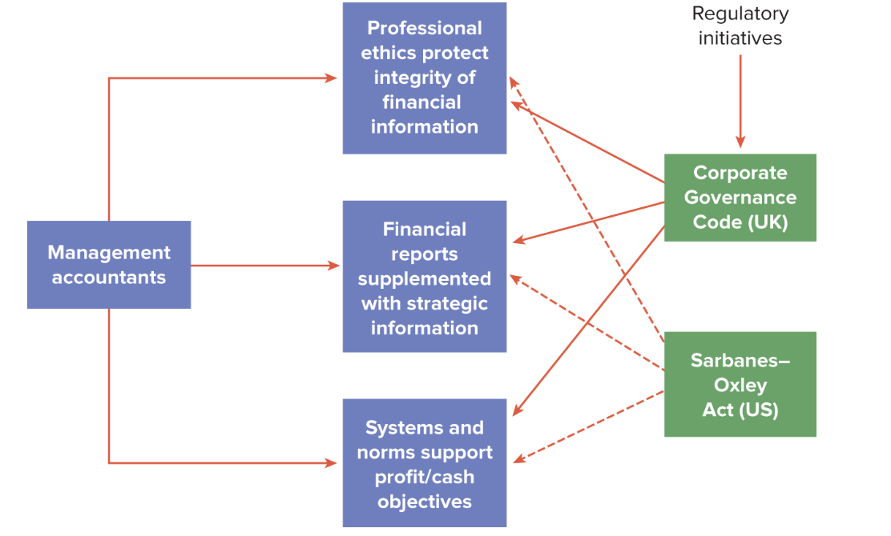
Management Accounting and Corporate Governance

Slide 24
Corporate Governance and Risk Management
Understand the nature of the risks facing the company.
Decide the extent and categories of risk which the company regards as acceptable for it to bear.
Consider the likelihood of the risks materializing.
Judge its ability to reduce the incidence and impact on the business of risks that do materialize.
Estimate the costs of operating particular controls relative to the benefit.

Slide 25
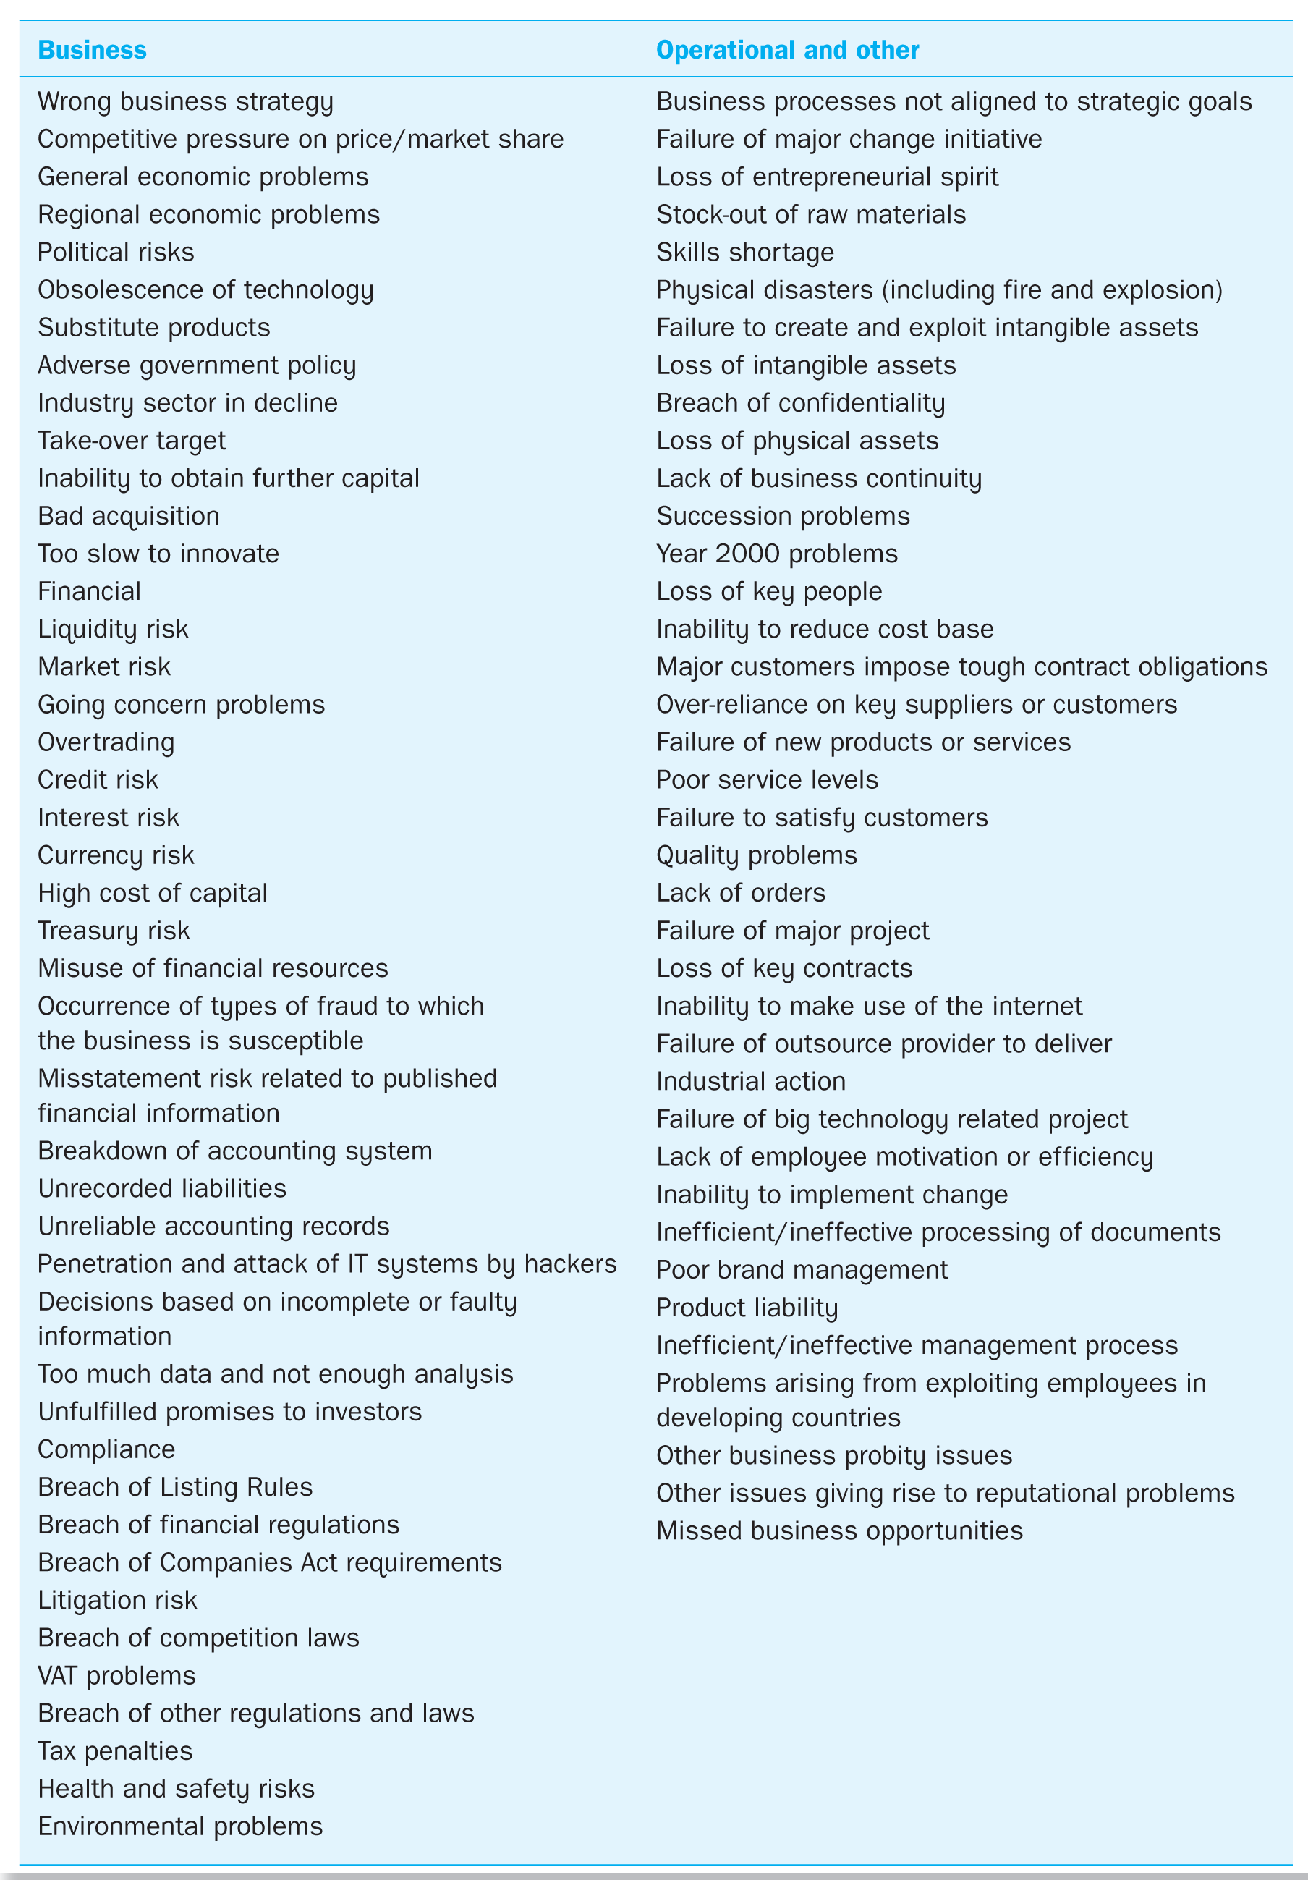
Examples of Risk

Slide 26
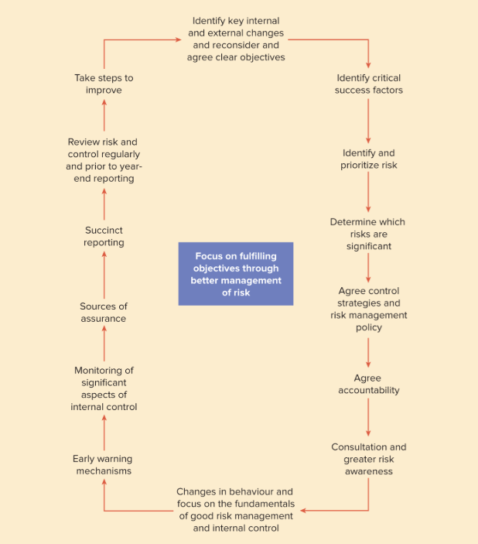
Risk Management: the Turnbull Model

Slide 27
Stakeholders, Business Ethics and Social Responsiveness
Corporate social responsiveness may be hampered by organizational performance management systems.
In profit-oriented organizations, the incentive system tends to reward economic rather than social performance.
Ethical problems arise because ethical goals that reflect corporate social responsibility may conflict with material goals of profit and staff bonuses.
Need a broader, stakeholder model of the organization.

Slide 28
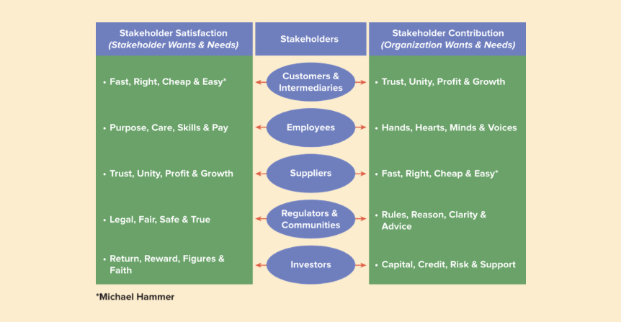
The Performance Prism/Stakeholder Model

Slide 29
Summary
We have reviewed several models of organizational control that aim to embed strategy and foster organizational learning.
We have discussed the importance of boundary systems and risk management.
Management accounting can provide key information for non-executive directors on issues such as the strategic direction of the firm.
We have introduced a number of broader issues related to organizational control and corporate social responsibility.
We have shown how attempts are being made to use management accounting practices to improve the accountability and service delivery in the public sector.

Slide 30
References
Rhode, S. and Garrison, N. (2019) Management Accounting. Sixth edition. London, England: McGraw Hill
KnowledgEquity – Support for CPA (2016) Understanding value and its relevance to management accounting. Available at: https://youtu.be/u1dim7U1VRs (Accessed: 8th Feb 2021)

