Slide 1



STRATEGIC HRM RECOMMENDATIONS FOR HEALTHCONNECT UK
Student Name: Anastasija Jevstafjeva
Student ID: 2512396
Module: Developing and Managing Individuals and Teams
Module code: LCLM5002_LON
Lecturers: Amer Kareem, Samson Oladejo
BA (Hons) Leadership and Management Skills for Workplace
1
Notes:
Good morning, everyone. My name is Anastasija Jevstafjeva, and I am the new HR Consultant for HealthConnect UK.
Today I will present my HR recommendations. They will help us attract, develop, motivate and keep our staff.

Slide 2

HEALTHCONNECT UK: OVERVIEW AND CHALLENGES
2
Who we are: a fast-growing UK digital healthcare organisation providing virtual consultations, remote patient monitoring and digital healthcare services.
Current workforce challenges
Recruitment
Hard to attract skilled healthcare and technology professionals
Turnover
More employees are leaving the organisation
Wellbeing
Stress and burnout concerns among staff
Digital skills
Skills shortages in digital healthcare technologies
Engagement
Lower employee engagement
Teamwork
Challenges managing multidisciplinary teams
Leadership
Gaps in leadership development
Board question: how can HRM help us attract, develop, motivate and retain staff while the organisation grows?
Notes:
HealthConnect UK is a fast-growing digital healthcare company. We provide virtual consultations, remote patient monitoring and digital health services across the UK.
Growth is good, but it has created people problems.
First, it is hard to recruit skilled healthcare and technology staff. Second, more employees are leaving. Third, many staff feel stressed and burnt out. We also have digital skills gaps, lower engagement, difficult teamwork between different professions, and not enough future leaders.
Today I will cover five areas: workforce planning, recruitment and selection, learning, performance, and reward and leadership.

Slide 3


WHY HRM MATTERS FOR HEALTHCONNECT UK
3
Workforce
Enough people with the right skills, in the right roles and shifts.
Experience
Fair treatment, safe workloads, development and supportive managers.
Service
Continuity, safe practice, good communication and a reliable patient experience.
Strategic HRM means aligning people practices with organisational goals, not running separate HR activities (Wright and McMahan, 1992).
For HealthConnect UK
Our virtual care depends on skilled, supported staff. HR practices improve results by building skills, motivation and opportunities to contribute (Jiang et al., 2012).
Evidence: Wright and McMahan (1992); Boselie, Dietz and Boon (2005); Jiang et al. (2012).
Notes:
Why is HR important for us?
Because our service depends on people. HR affects three things.
Workforce: we need enough people with the right skills, in the right roles and shifts.
Experience: staff need fair treatment, safe workloads and good managers.
Service: when staff are skilled and supported, patients get safe and reliable care.
Strategic HRM means our people practices must support the company's goals. HR is not a list of separate activities. This idea comes from Wright and McMahan.

Slide 4

START WITH WORKFORCE DIAGNOSIS
4
Capacity indicators
Vacancies • rota gaps • overtime • absence • turnover • time-to-fill
Capability indicators
Skills matrix by role • confirmed safe skills • digital confidence • using new skills at work
Experience indicators
Pulse survey • reasons for leaving • stay interviews • fairness • manager support
First 30 days: find our starting point
Collect
HR, rota, learning and service data
Group
By role, site, shift and staff group
Discuss
Check findings with staff and managers
Prioritise
Rank risks by impact on patients and how easy they are to fix
Use data to test ideas, not to confirm assumptions (CIPD, 2025).
Burnout check: 76% of UK organisations report stress-related absence, and heavy workload is the top cause (CIPD, 2023).
Notes:
Before we change anything, we must understand the real problem. We should use data, not guesses.
We look at three types of information.
Capacity: vacancies, overtime, absence and staff turnover.
Capability: which skills people have, and how confident they are with digital systems.
Experience: staff surveys, exit interviews and stay interviews.
In the first 30 days, we collect this data, check it with staff and managers, and decide which risks are the biggest for patients.

Slide 5





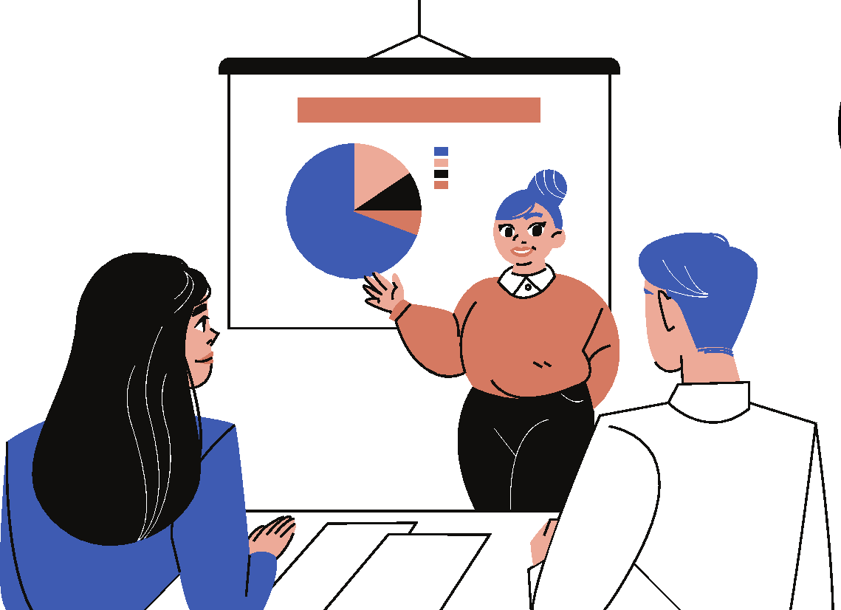
WORKFORCE PLANNING AND SKILLS GAP IDENTIFICATION
5
Forecast demand
Map supply
Identify gaps
Choose action
Review
Service volumes, shift patterns, role mix and planned change.
Skills, turnover, absence and internal talent.
Compare the skills we need with the skills we have.
Keep, train, recruit, redesign the role or work with a partner.
Monthly review with HR, service leads and finance.
Recruitment challenges for HealthConnect UK
Strong competition: 52% of employers say competition for well-qualified talent has increased (CIPD, 2026).
Many applicants, few suitable: 58% of employers saw more applications from unsuitable candidates (CIPD, 2026).
We compete with the NHS, which plans to recruit and retain many more staff and use more digital technology (NHS England, 2023).
Our biggest gap: digital healthcare skills, such as remote monitoring.
Notes:
Next is workforce planning. It has five steps.
One: forecast demand — how many staff and which roles we will need.
Two: map supply — the skills and people we already have.
Three: identify the gap between the two.
Four: choose an action — keep, train, recruit, redesign the role, or work with a partner.
Five: review every month with HR, service leaders and finance.
For HealthConnect UK, the biggest gap is digital healthcare skills. The CIPD reports strong competition for skilled staff, so we must plan early.

Slide 6

RECRUITMENT: CHOOSE CHANNELS TO FIT THE ROLE
6
Internal recruitment
Strength: quicker start and visible career growth.
Risk: leaves another vacancy.
Use for: development and succession.
External recruitment
Strength: new skills and a wider talent pool.
Risk: cost, delay and longer onboarding.
Use for: scarce or new skills.
Online recruitment
Strength: wide reach and fast applications.
Risk: many applicants who do not fit.
Use for: job adverts and talent pools.
Social media
Strength: visibility and targeted outreach.
Risk: can exclude some groups or allow bias.
Use for: awareness, always with a formal application route.
Recommendation: a mixed approach
Team leaders and future managers
Internal first: shows career growth and keeps knowledge in the organisation.
Digital Care Nurses and IT specialists
External + online + LinkedIn: these skills are scarce, so we need a wider pool.
All roles
Realistic job previews, accessible adverts and clearly stated essential criteria.
Track: time-to-fill, cost, candidate drop-off, shortlist diversity and retention at 6 and 12 months (CIPD, 2026).
Notes:
How should we recruit? Each method has strengths and risks.
Internal recruitment is quick, and it shows staff they can grow. But it leaves another empty job.
External recruitment brings new skills. But it costs more and takes longer.
Online recruitment reaches many people. But we may get many unsuitable applications.
Social media is good for visibility and finding specialists. But it can exclude some people, so we always need a formal application route.
My recommendation is a mix. We use internal recruitment for team leaders and future managers. For digital nurses and IT specialists, we use external, online and LinkedIn recruitment together. We will track time-to-fill, cost and retention after six and twelve months.

Slide 7

SELECTION: DIGITAL CARE NURSE EXAMPLE
7
Job level
Registered nurse level. Works remotely and makes escalation decisions about patients.
Job description
Monitors patients remotely, runs video consultations, escalates risks and keeps accurate records.
Person specification
Essential: nurse registration (NMC), clinical experience, clear communication, basic digital skills. Desirable: remote monitoring experience.
Fair, evidence-based selection process
Screen
Use the stated essential criteria only.
Assess
Structured interview + a fictional patient-monitoring task.
Agree scores
Trained panel, clear scoring criteria and written evidence.
Review
Check accessibility, fairness for all groups and candidate feedback.
Equal opportunity: reasonable adjustments, the same questions for everyone and transparent criteria; no assumptions based on personal characteristics.
Structured interviews are fairer and more accurate than informal interviews (Campion, Palmer and Campion, 1997).
Notes:
Here is a practical example: recruiting a Digital Care Nurse.
First, we set the job level, write a clear job description, and write a person specification. Essential skills are clinical experience, good communication and basic digital skills.
Then we use a structured interview. Every candidate gets the same questions and clear scoring. Campion and colleagues show that structured interviews are fairer and more accurate.
We also add a short task. The candidate looks at fictional patient monitoring data and explains what they would do.
For equal opportunity, we offer reasonable adjustments and judge people only on the job criteria.

Slide 8

LEARNING AND DEVELOPMENT: ONE EMPLOYEE'S NEEDS
8
Example: Sarah, a new Digital Care Nurse, has strong clinical experience but has never used our remote monitoring platform.
Diagnose
Manager compares role skills with observed practice. Gap: platform use and escalation.
Plan
Agreed objective: use the platform safely within 8 weeks.
Practise
Induction, shadowing a buddy, simulation and short online lessons.
Evaluate
At week 8, check safe platform use and correct escalation, not attendance alone.
Core learning priorities for all staff
Role-specific safety and safeguarding; digital systems; communication; handovers; inclusive service.
Sarah's development plan
Need: platform skills → Objective: safe use in 8 weeks → Activity: lessons, buddy, simulation → Support: weekly manager check-in → Review: week 8.
Training works best when practice, feedback and support at work reinforce learning (Salas et al., 2012).
Notes:
Now imagine we hire this nurse. Her name is Sarah. She has strong clinical experience, but she has never used our remote monitoring platform.
So her learning need is digital platform skills.
Her plan has four steps. Diagnose: her manager checks her skills against the role. Plan: they agree a clear goal. Practise: short online lessons, a buddy, and supervised practice. Evaluate: after eight weeks, the manager checks that she uses the platform safely and knows when to escalate a problem.
Salas and colleagues show that training works best with practice, feedback and support at work.

Slide 9

TALENT MANAGEMENT AND PERFORMANCE
9
Talent management
Career pathways, mentoring, transparent promotion criteria, internal moves and succession plans for critical roles.
Performance management
Monthly coaching, quarterly goal reviews and an annual development talk. Clear goals improve performance (Locke and Latham, 2002).
Balanced measures
Quality and safety, patient experience, teamwork, reliability and learning, not only speed or volume.
Avoid common pitfalls
One career path for everyone can exclude part-time or shift workers.
Individual targets can damage teamwork if rewards create competition.
Annual-only reviews delay feedback; regular coaching needs manager time and training.
Staff are more likely to stay when they feel supported by the organisation (Eisenberger et al., 1986; Hom et al., 2017).
Notes:
For talent management, we offer clear career paths, mentoring and succession plans for key roles.
For performance, we recommend monthly coaching, not only one review a year.
Goal-setting theory says clear goals improve performance. But individual targets can damage teamwork. In healthcare, teamwork is very important. So we measure quality, safety, patient experience and teamwork — not only speed.
Research by Eisenberger shows that when staff feel supported, they are more likely to stay.

Slide 10

REWARD, MOTIVATION AND LEADERSHIP
10
Reward systems
Fair, transparent pay and benefits; consistent criteria; recognise contribution without rewarding unsafe shortcuts.
Employee motivation
Connect work to purpose; support autonomy, competence and belonging; give timely, specific recognition (Deci and Ryan, 2000).
Leadership styles
Transformational (coaching) style for learning and improvement; clear, directive style for urgent safety decisions (Bass and Riggio, 2006).
Different staff groups, different rewards
Clinical staff
Often compare us with NHS pay and benefits. Value flexible shifts, wellbeing support and professional development.
Technology staff
Compare us with the tech job market. Value competitive salary, remote work and fast career growth.
Critical comparison: we can use both. Money helps attract and keep staff, but alone it does not fix workload, fairness or poor supervision. Non-financial rewards build engagement, but never replace fair pay or safe staffing.
Notes:
Pay must be fair and clear. But money alone does not fix heavy workloads or poor management.
Different staff groups also need different rewards. Clinical staff often compare us with NHS pay and value flexible shifts and wellbeing support. Technology staff often compare us with the tech market and value pay and career growth. So we can use both approaches.
Self-determination theory, from Deci and Ryan, says people are motivated by autonomy, competence and belonging. So we give staff some control, training, and quick recognition.
For leadership, we use two styles. A coaching style for learning and improvement. A clear, directive style for urgent safety decisions.

Slide 11

IMPLEMENTATION, EVALUATION AND CONCLUSION
11
0–30 days
Collect baseline workforce and skills data.
31–90 days
Pilot structured recruitment and individual learning plans.
3–6 months
Train managers; start coaching and stay interviews.
6–12 months
Evaluate results; expand what works.
Monitor
Vacancy rate • time-to-fill • retention at 6/12 months • absence • internal fill rate • confirmed safe skills • staff pulse survey • patient/service quality
Board decisions requested
Expected benefits
Lower staff turnover
Faster hiring for scarce roles
Less stress and burnout
Stronger digital skills
Safer, better patient care
1. Sponsor a monthly workforce review.
2. Adopt structured and fair recruitment.
3. Protect role-based learning time.
4. Require a balanced people-and-service dashboard.
Notes:
Here is the plan.
In the first 30 days, we collect workforce and skills data.
From day 31 to 90, we test structured recruitment and individual learning plans.
From three to six months, we train managers and start coaching and stay interviews.
From six to twelve months, we check the results and expand what works.
We will measure vacancy rate, time-to-fill, retention, absence and patient quality.
I ask the Board for four decisions: a monthly workforce review, structured and fair recruitment, protected learning time, and a people-and-service dashboard.
The expected benefits are lower turnover, faster hiring, less burnout and better patient care.

Slide 12
REFERENCES
12
Bass, B.M. and Riggio, R.E. (2006) Transformational leadership. 2nd edn. Mahwah, NJ: Lawrence Erlbaum Associates.
Boselie, P., Dietz, G. and Boon, C. (2005) ‘Commonalities and contradictions in HRM and performance research’, Human Resource Management Journal, 15(3), pp. 67–94.
Campion, M.A., Palmer, D.K. and Campion, J.E. (1997) ‘A review of structure in the selection interview’, Personnel Psychology, 50(3), pp. 655–702.
CIPD (2023) Health and wellbeing at work. London: CIPD. Available at: https://www.cipd.org/globalassets/media/knowledge/knowledge-hub/reports/2023-pdfs/8436-health-and-wellbeing-report-2023.pdf (Accessed: 21 October 2026).
CIPD (2025) Strategic human resource management. Available at: https://www.cipd.org/uk/knowledge/factsheets/strategic-hrm-factsheet/ (Accessed: 19 October 2026).
CIPD (2026) Resourcing and talent planning report 2026. London: CIPD. Available at: https://www.cipd.org/uk/knowledge/reports/resourcing-surveys/ (Accessed: 21 October 2026).
Deci, E.L. and Ryan, R.M. (2000) ‘The “what” and “why” of goal pursuits: human needs and the self-determination of behavior’, Psychological Inquiry, 11(4), pp. 227–268.
Eisenberger, R. et al. (1986) ‘Perceived organizational support’, Journal of Applied Psychology, 71(3), pp. 500–507.
Hom, P.W. et al. (2017) ‘One hundred years of employee turnover theory and research’, Journal of Applied Psychology, 102(3), pp. 530–545.
Jiang, K. et al. (2012) ‘How does human resource management influence organizational outcomes?’, Academy of Management Journal, 55(6), pp. 1264–1294.
Locke, E.A. and Latham, G.P. (2002) ‘Building a practically useful theory of goal setting and task motivation’, American Psychologist, 57(9), pp. 705–717.
NHS England (2023) NHS Long Term Workforce Plan. Available at: https://www.england.nhs.uk/long-read/nhs-long-term-workforce-plan-2/ (Accessed: 21 October 2026).
Salas, E. et al. (2012) ‘The science of training and development in organizations’, Psychological Science in the Public Interest, 13(2), pp. 74–101.
Wright, P.M. and McMahan, G.C. (1992) ‘Theoretical perspectives for strategic human resource management’, Journal of Management, 18(2), pp. 295–320.
Notes:
These are my sources, in Harvard style.
Thank you for listening. I am happy to answer your questions.

