Slide 1
What is Applied Drama?
HPAD4001 Introduction to Applied Drama

Slide 2
When did ‘Applied Drama’ become a ‘thing’?
Applied drama is a relatively new term that started getting used in the 1990’s to refer to a growing body of work that refers to drama forms outside of the more traditional setting where one might usually think they belong.

Slide 3

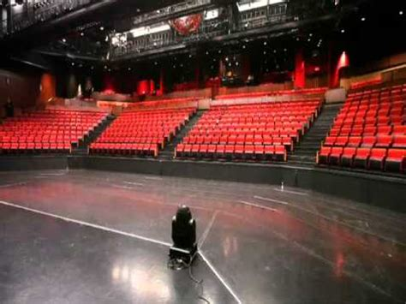
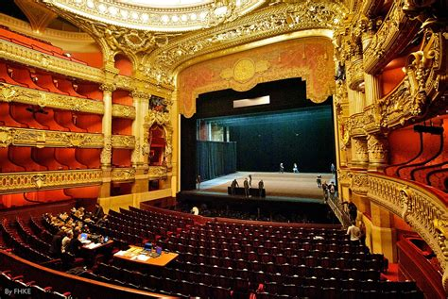
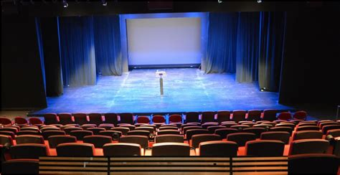
What do I mean by traditional settings?
Notes:
theatres where the paying public buy their tickets to attend a performance, largely for entertainment purposes

Slide 4
Well…
Applied Drama CAN happen in these places, BUT it is more likely to happen in UNEXPECTED places and spaces

Slide 5
What is the result of this?
It is not just for those who can afford to attend
Or those who are likely to attend because of their socio-economic background
It is open to all - inclusive

Slide 6
It also means that people who would normally think that drama or the creative arts was ‘not for them’ are invited to access and participate in creative and dramatic processes.

Slide 7
Intentional
To improve the lives of the individuals and communities that take part
3 Key Aspects

Slide 8
1. Time and Space
Real time, real people & real spaces
BUT defies the boundaries of time, people and space/place
A duality of time, space and being
Look up ‘Metaxis’ (Boal)

Slide 9
2. Collaboration
Drama requires us to collaborate with others
It requires more than one person
Integral element of communication with another or others
Communication requires connection
Connection is essential for human beings

Slide 10
3. Expressive Art Form
It enables those who participate to express thoughts, feelings ideas, fears and hopes.
Applied Drama can use fiction, metaphor or real stories
Powerful way to have voices heard
A political and democratic act

Slide 11
What does Applied Drama look like?

Slide 12

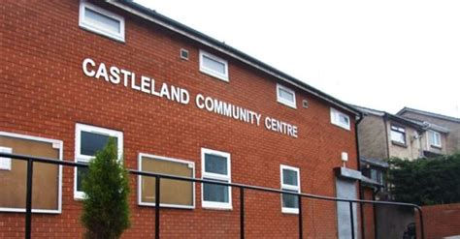

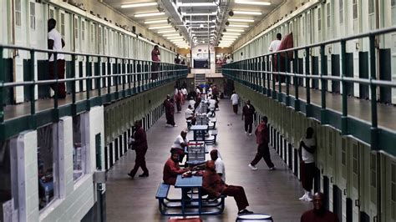
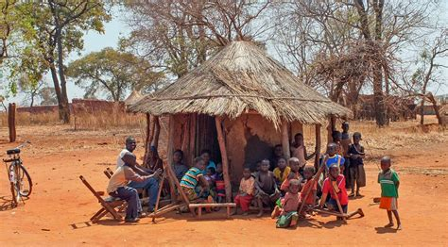


Slide 13
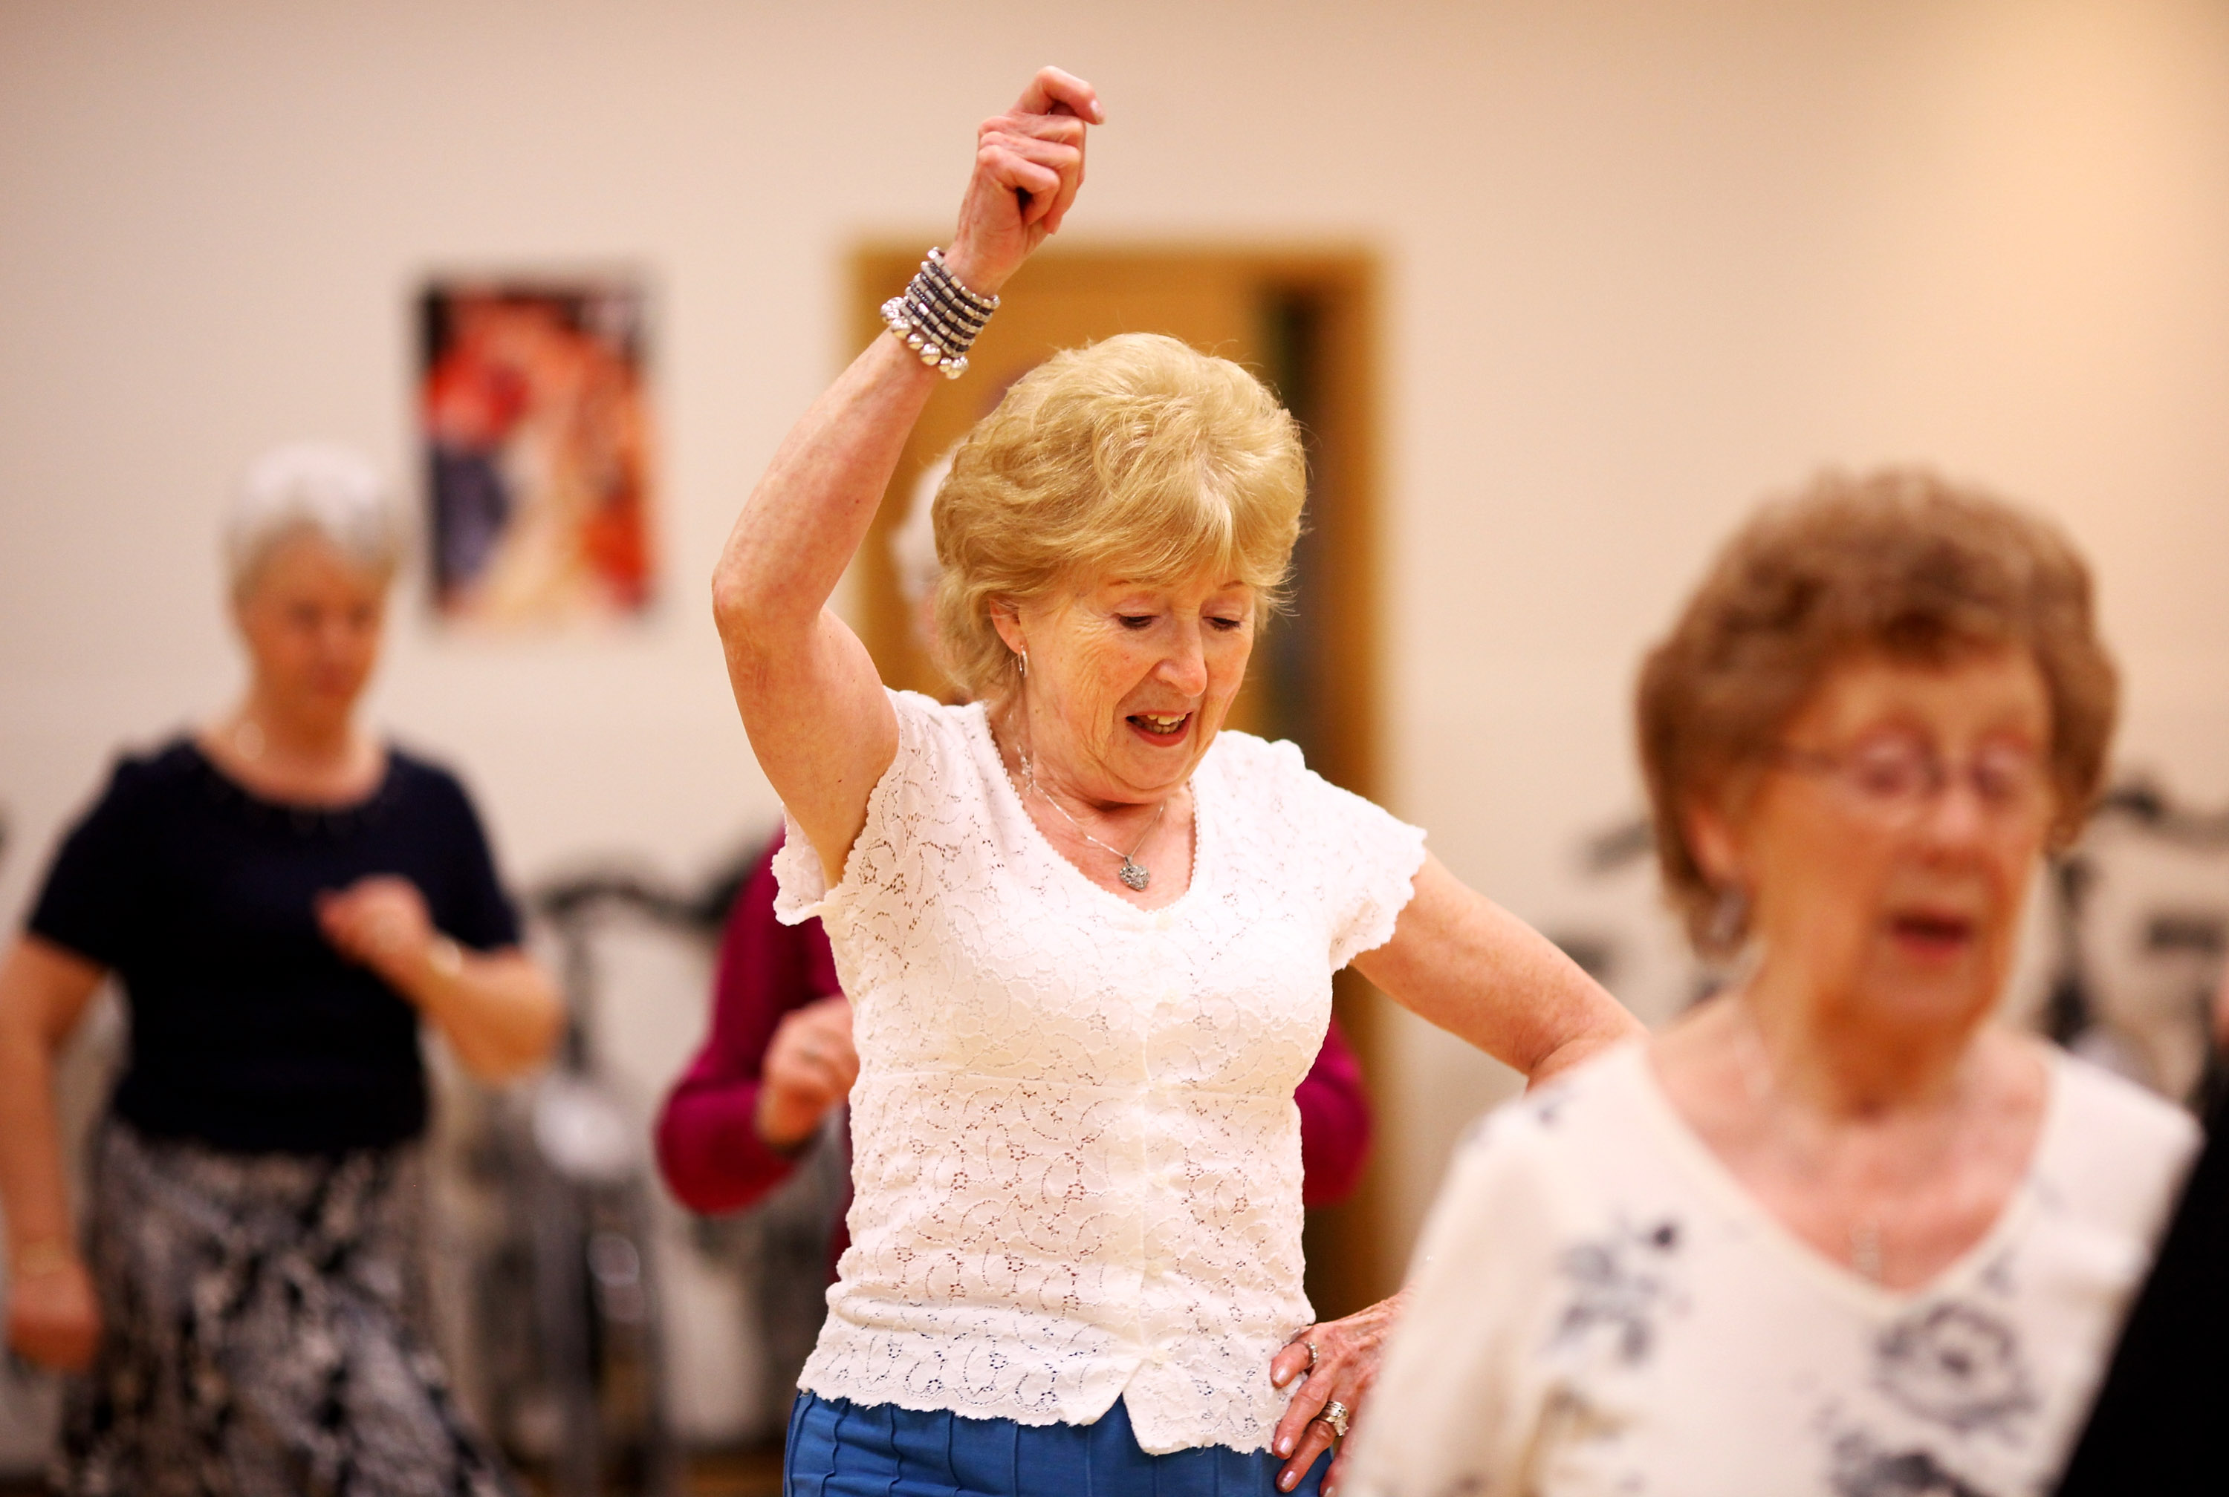

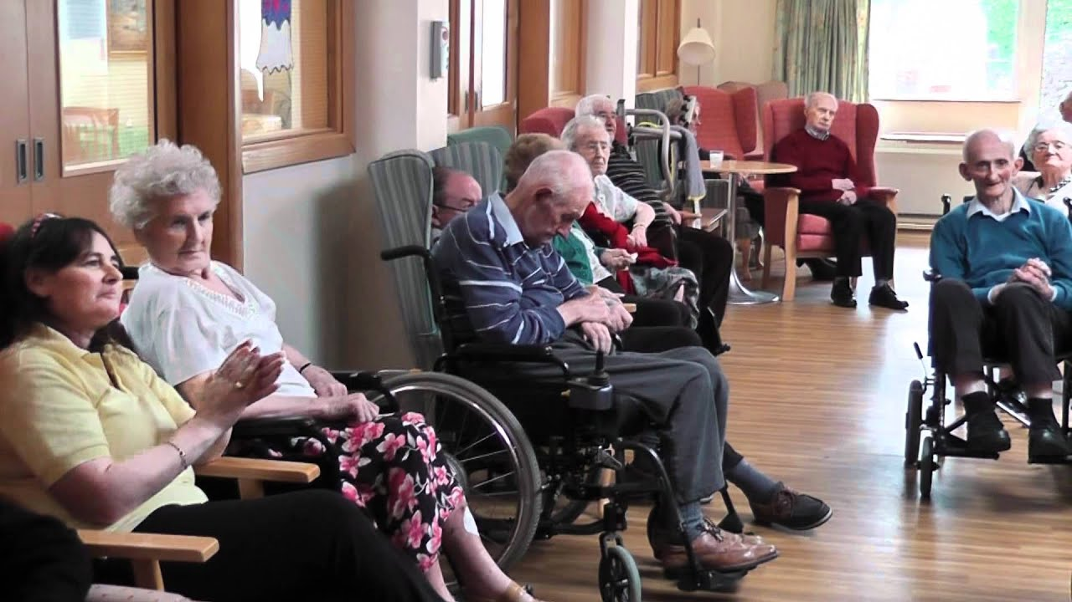
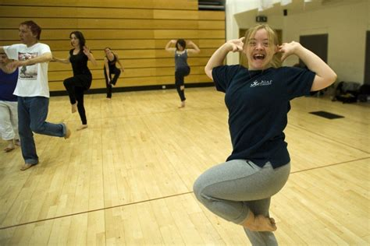



Notes:
This widening of access to drama and drama processes can take a variety of forms, not just that of traditional audience, but as active participants in the process of exploring, making, reflecting, witnessing and engaging with drama.

Slide 14
Drama or Theatre?

Slide 15
Think about?
Your own experiences of applied drama?
Any moments where you could say drama or theatre changed your life for the better?
What spaces and places or communities are you interested in working in?

